Slide 1
How regular exercise helps your organisation to PAWgress
Casper Dreef, GÉANT
Room B
Thursday 16th June

Slide 2
Why PAW?
It’s a soft CLAW!
Our objectives
ISO27001
Security baseline
Crisis management plan
Organisation wide exercise
Notes:
the outcomes was that we want to get a better overall understanding of crisis management among staff.
crisis management process, roles & responsibilities – also known as the Crisis Management Organisation-, a communication plan and training exercises.

Slide 3
Where to start?
CLAW scenario
2 infoshares: CMP and exercise
Create teams, appoint Coordinators
Publish background story and supporting documents
Notes:
Create teams - a cross-section of the organization

Slide 4
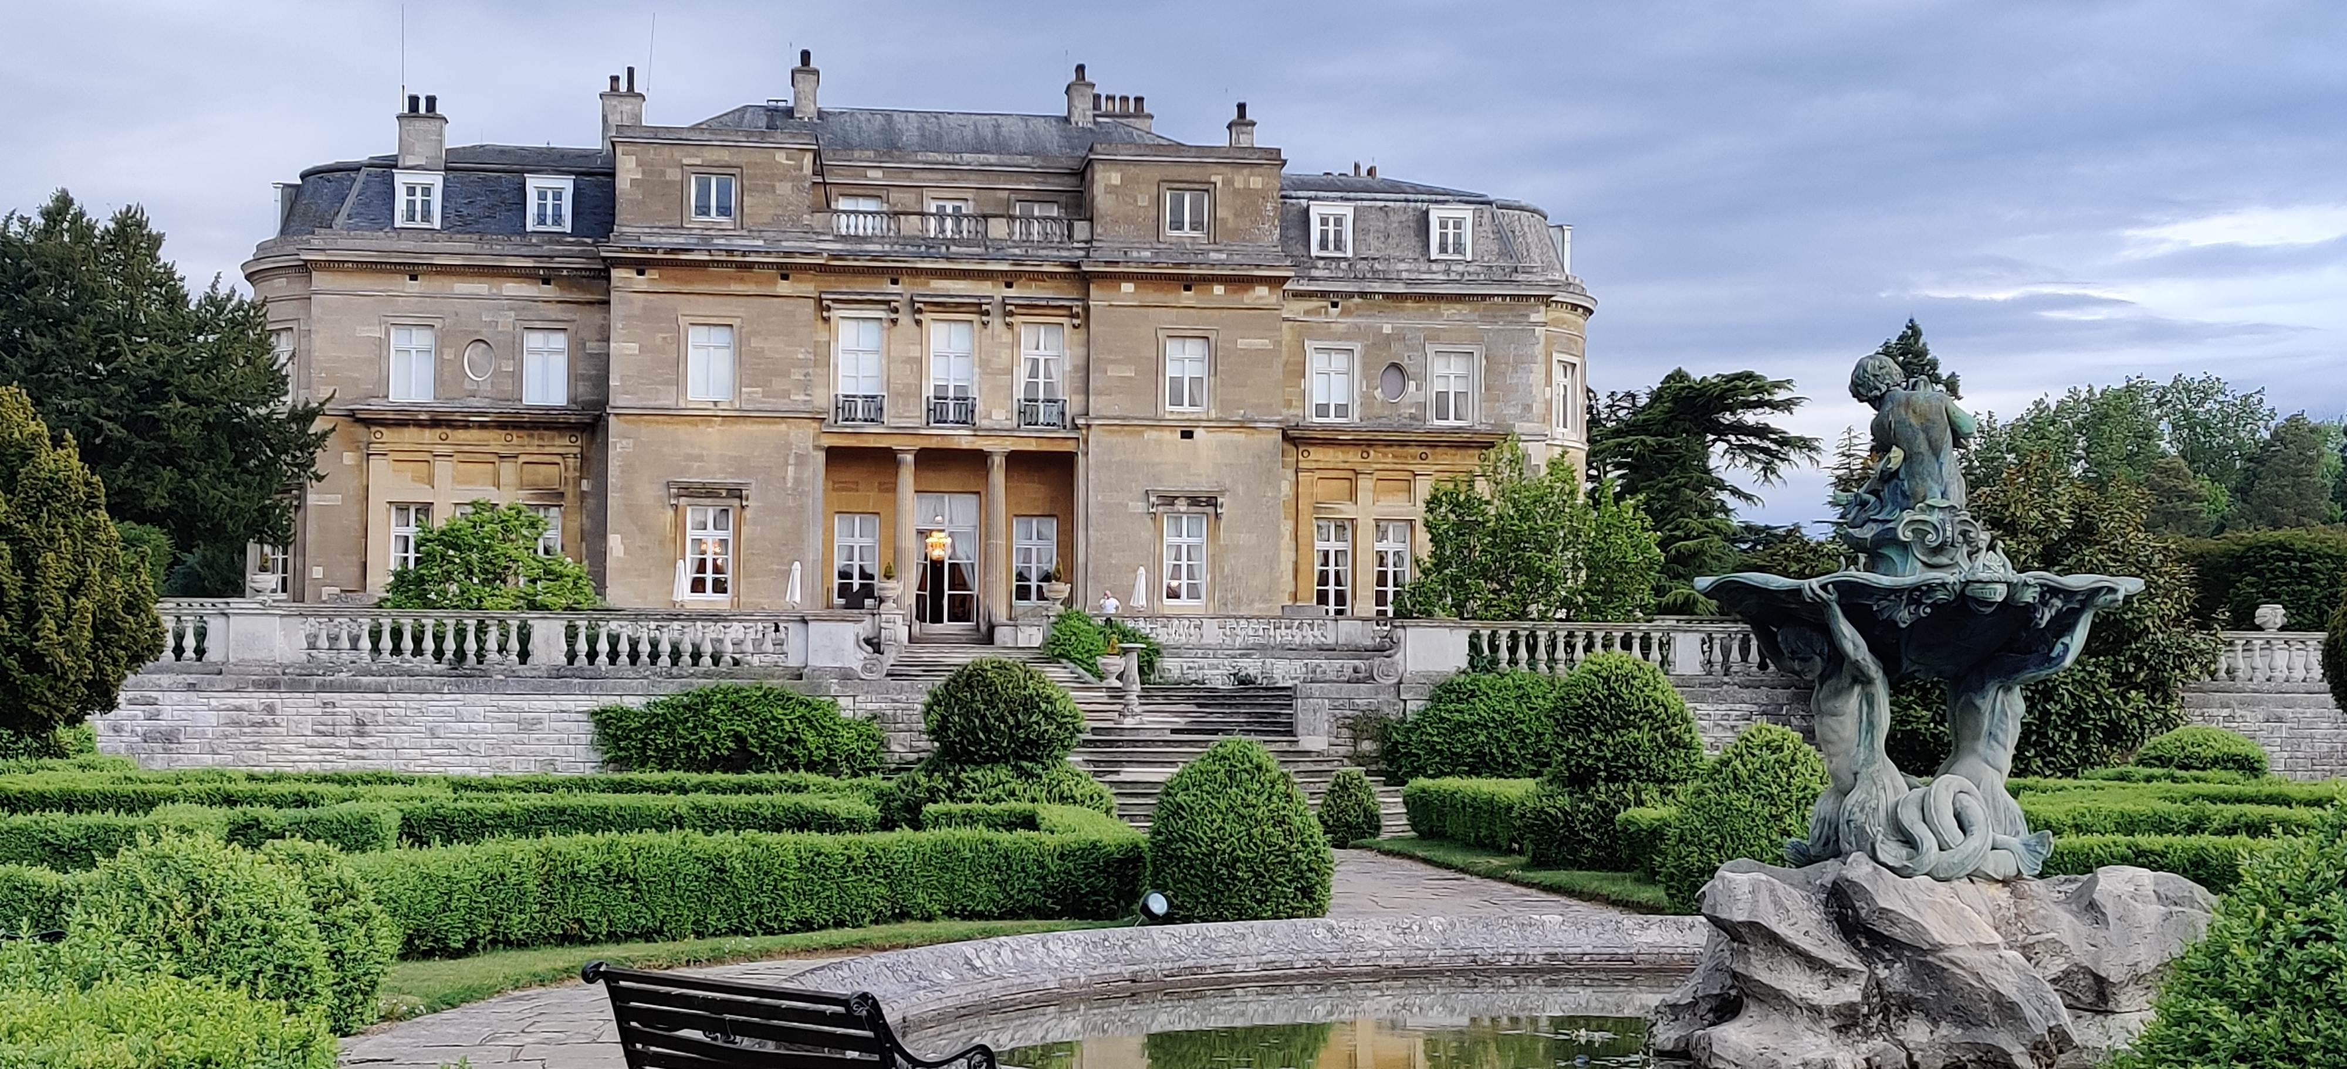
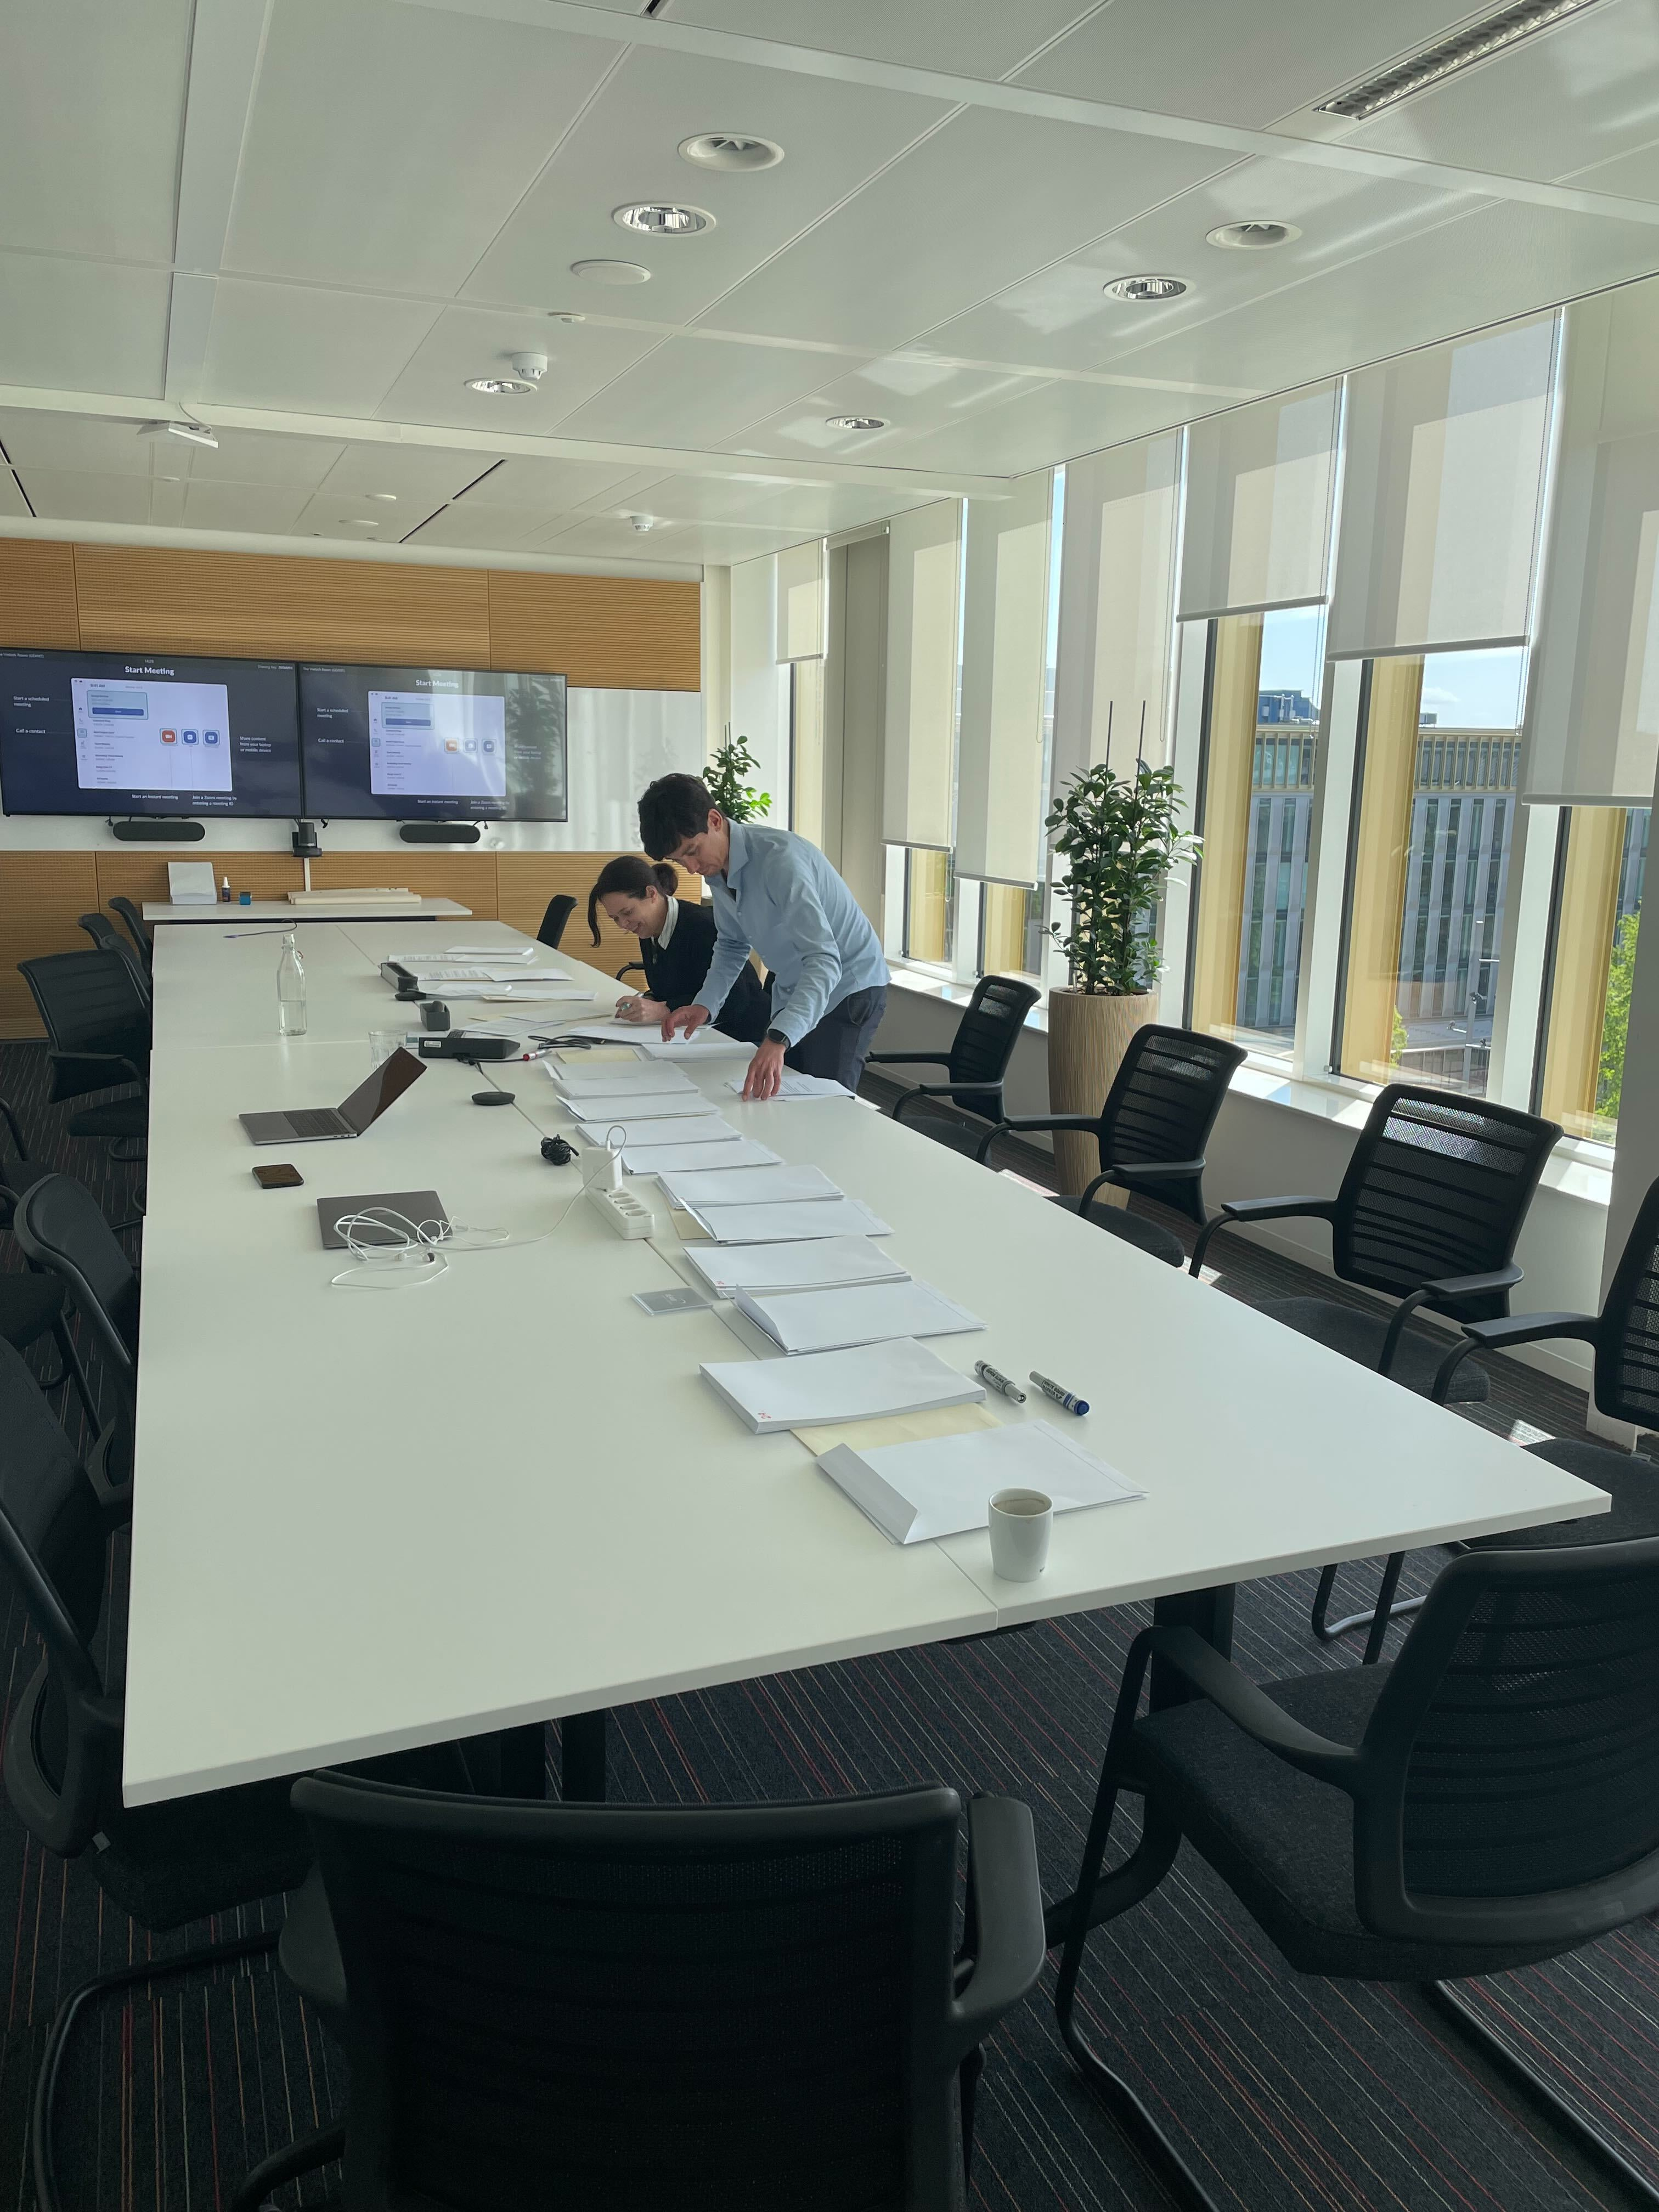
Challenges
Get ALL staff involved
Venue
Connectivity
Solution → paper-based
Notes:
tweaked the scenario to make it more relatable to staff
appoint an observer. This way someone with a less technical background could still contribute to the team.

Slide 5
The scenario
Notes:
- new information, communication from fictional characters in the exercise that could help the team with the task at hand, a task description, and an answer form
non-playing members – disruptions – call sheets
15 envelopes - supporting materials - call sheets for coordinators

Slide 6
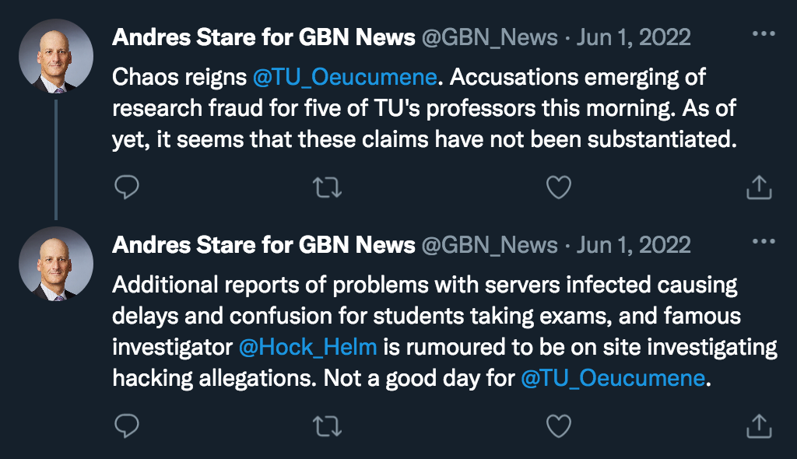
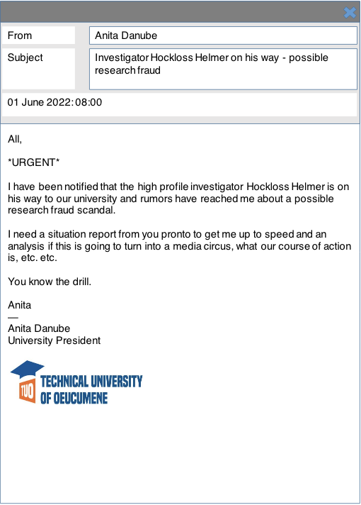
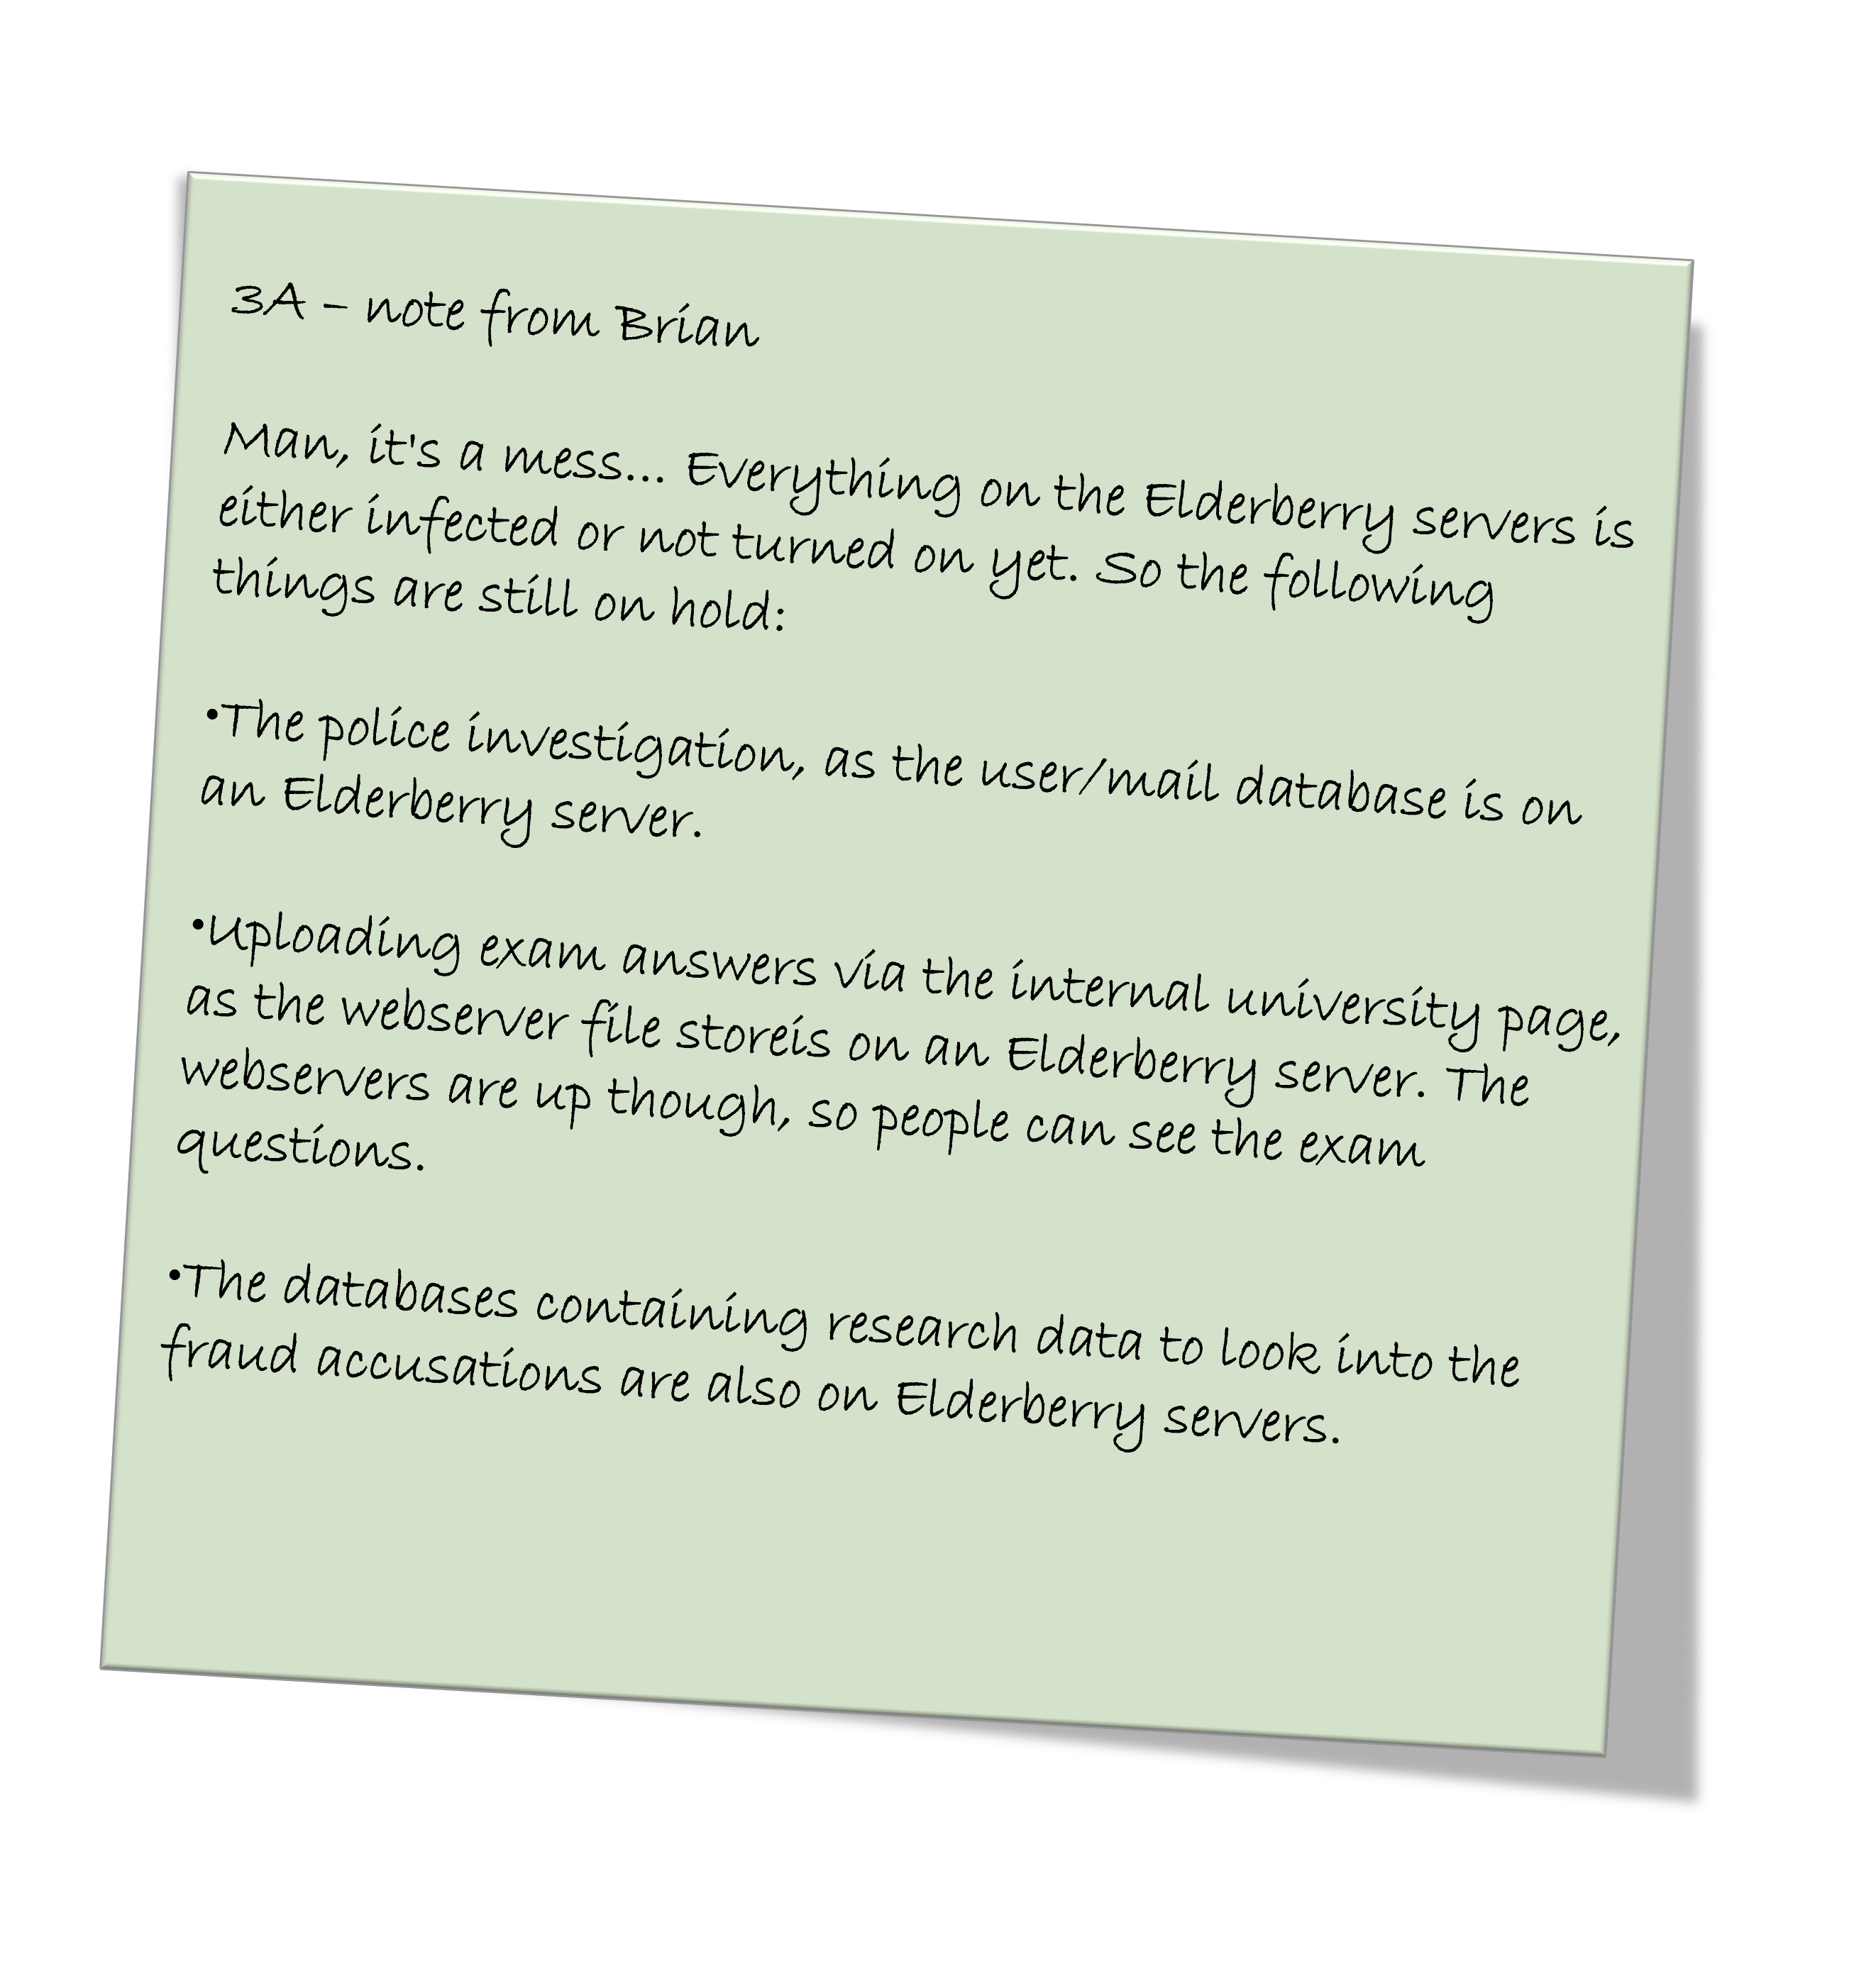
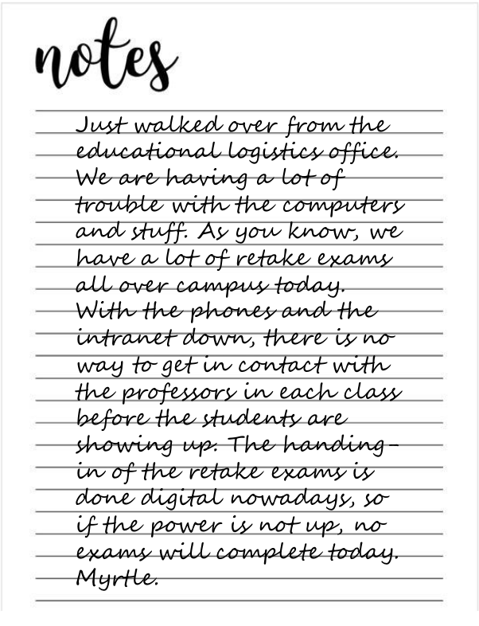
Redesign CLAW
Notes:
Original script was plain text

Slide 7
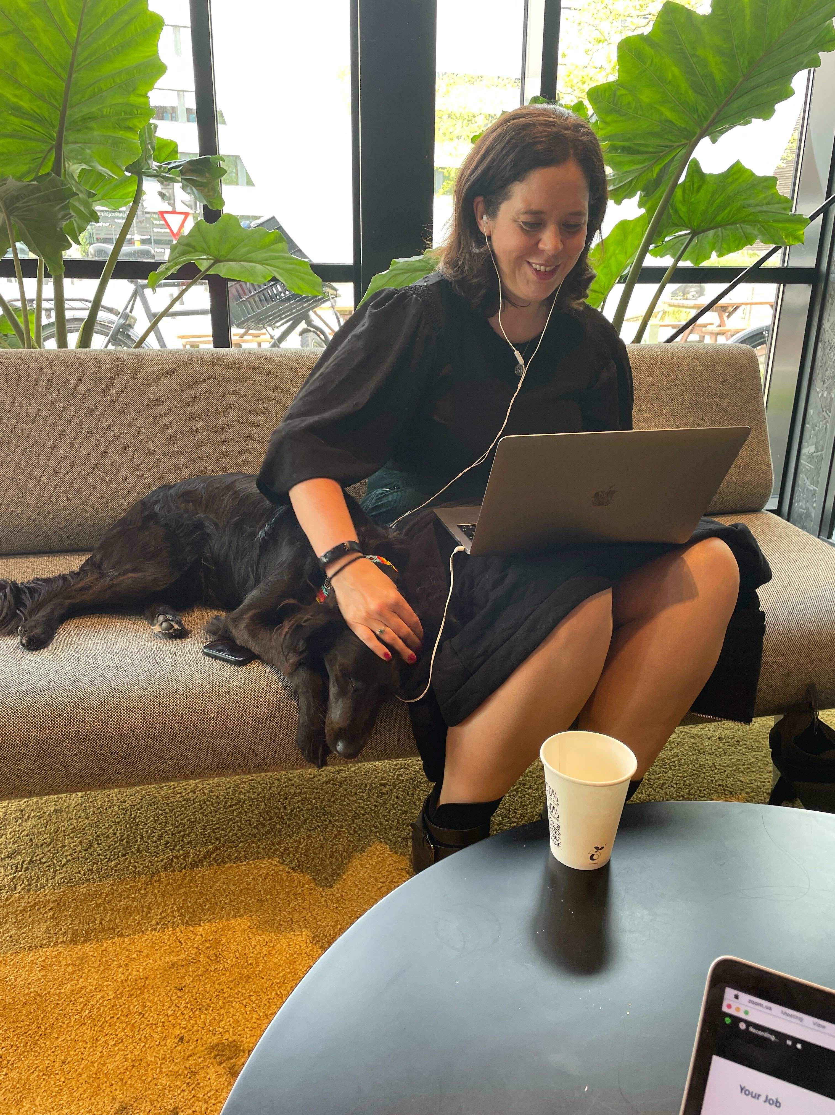
Staff prep
2 staff infoshares
Wiki page
Coordinators training
Slack channels
Notes:
Crisis Management Plan. This was to explain staff why we have one and what’s in it.
PAW – history of Guilder and the university of Oecumene
- the recordings of the infoshares,
- the background information of Guilder and the University,
some additional preparation materials, such as
- policies and process documents of the University
- technical documents
other documents to support the storyline. Think about a briefing document from the police and an internal memo about a previous incident that happened at the University
Assign roles + phone numbers

Slide 8
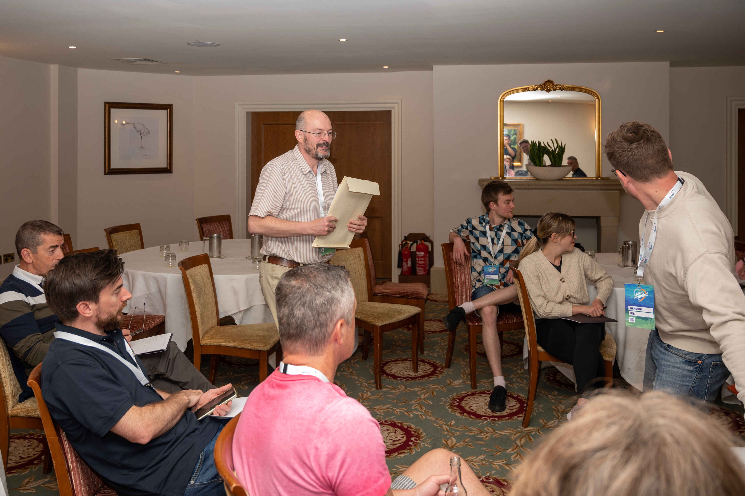
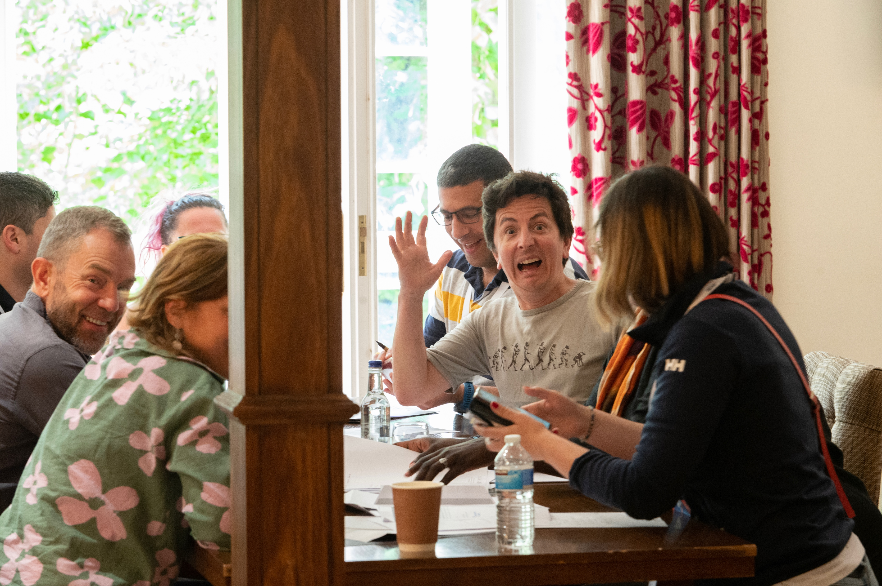
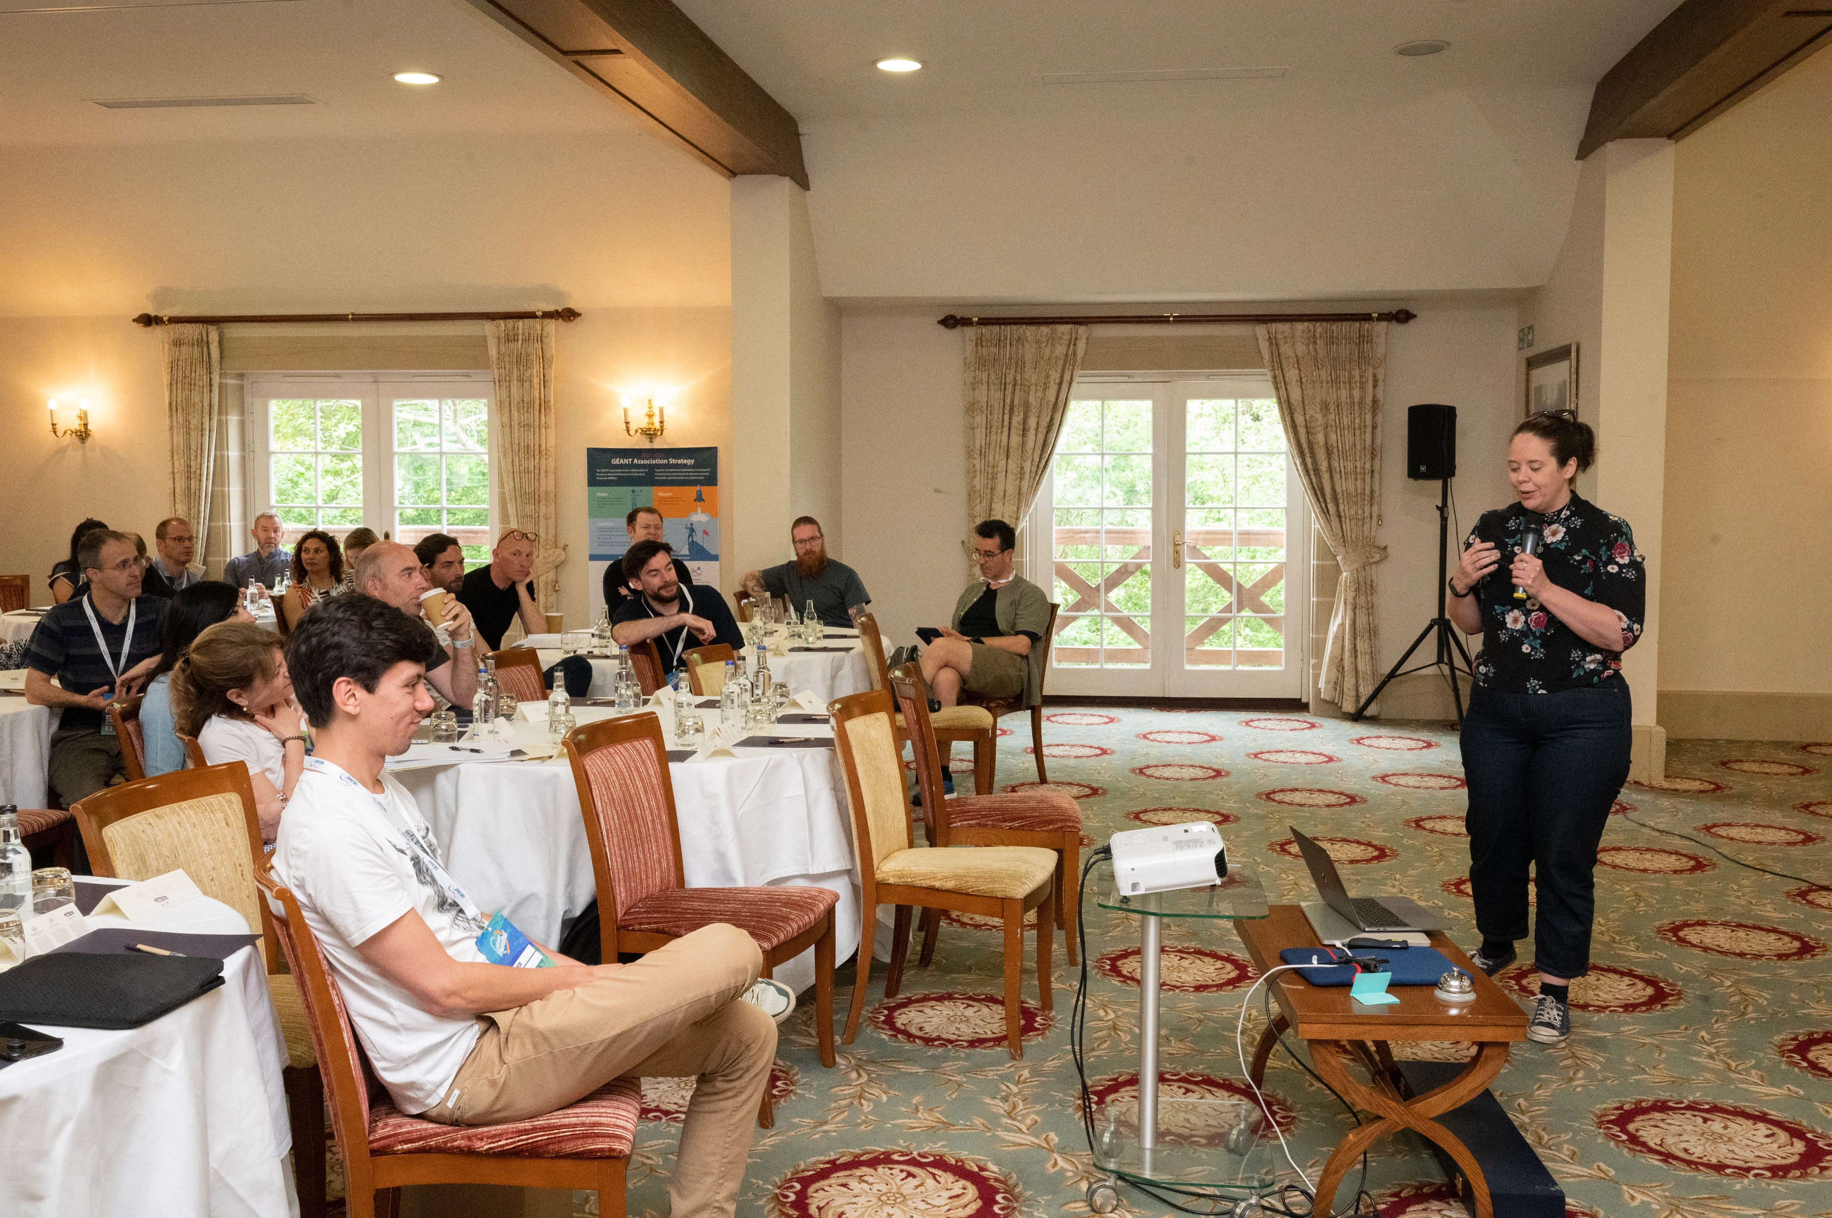
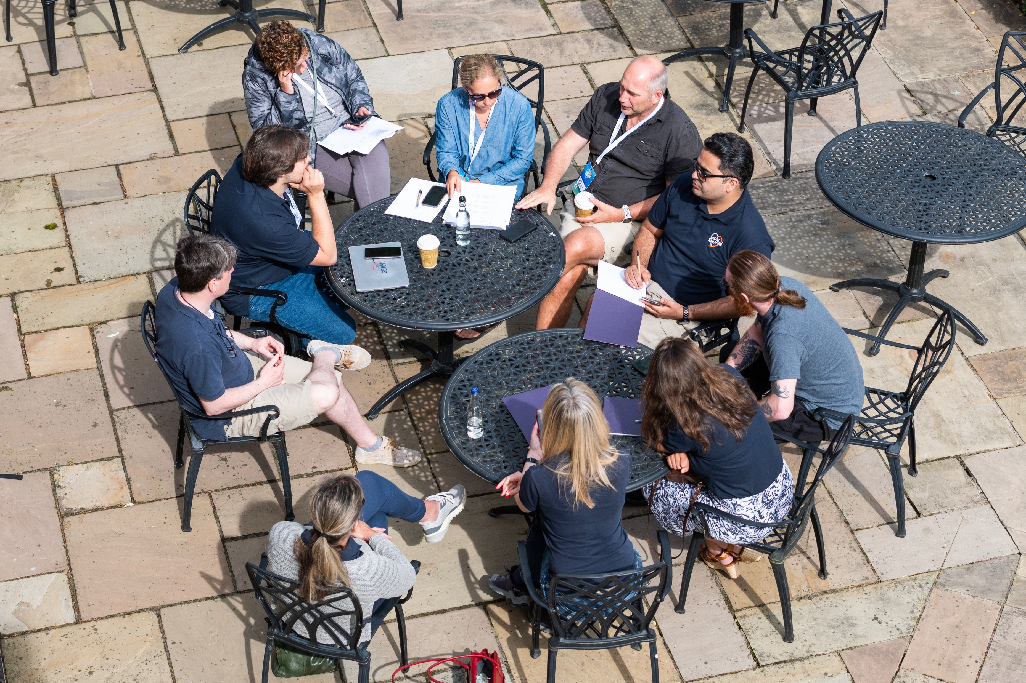
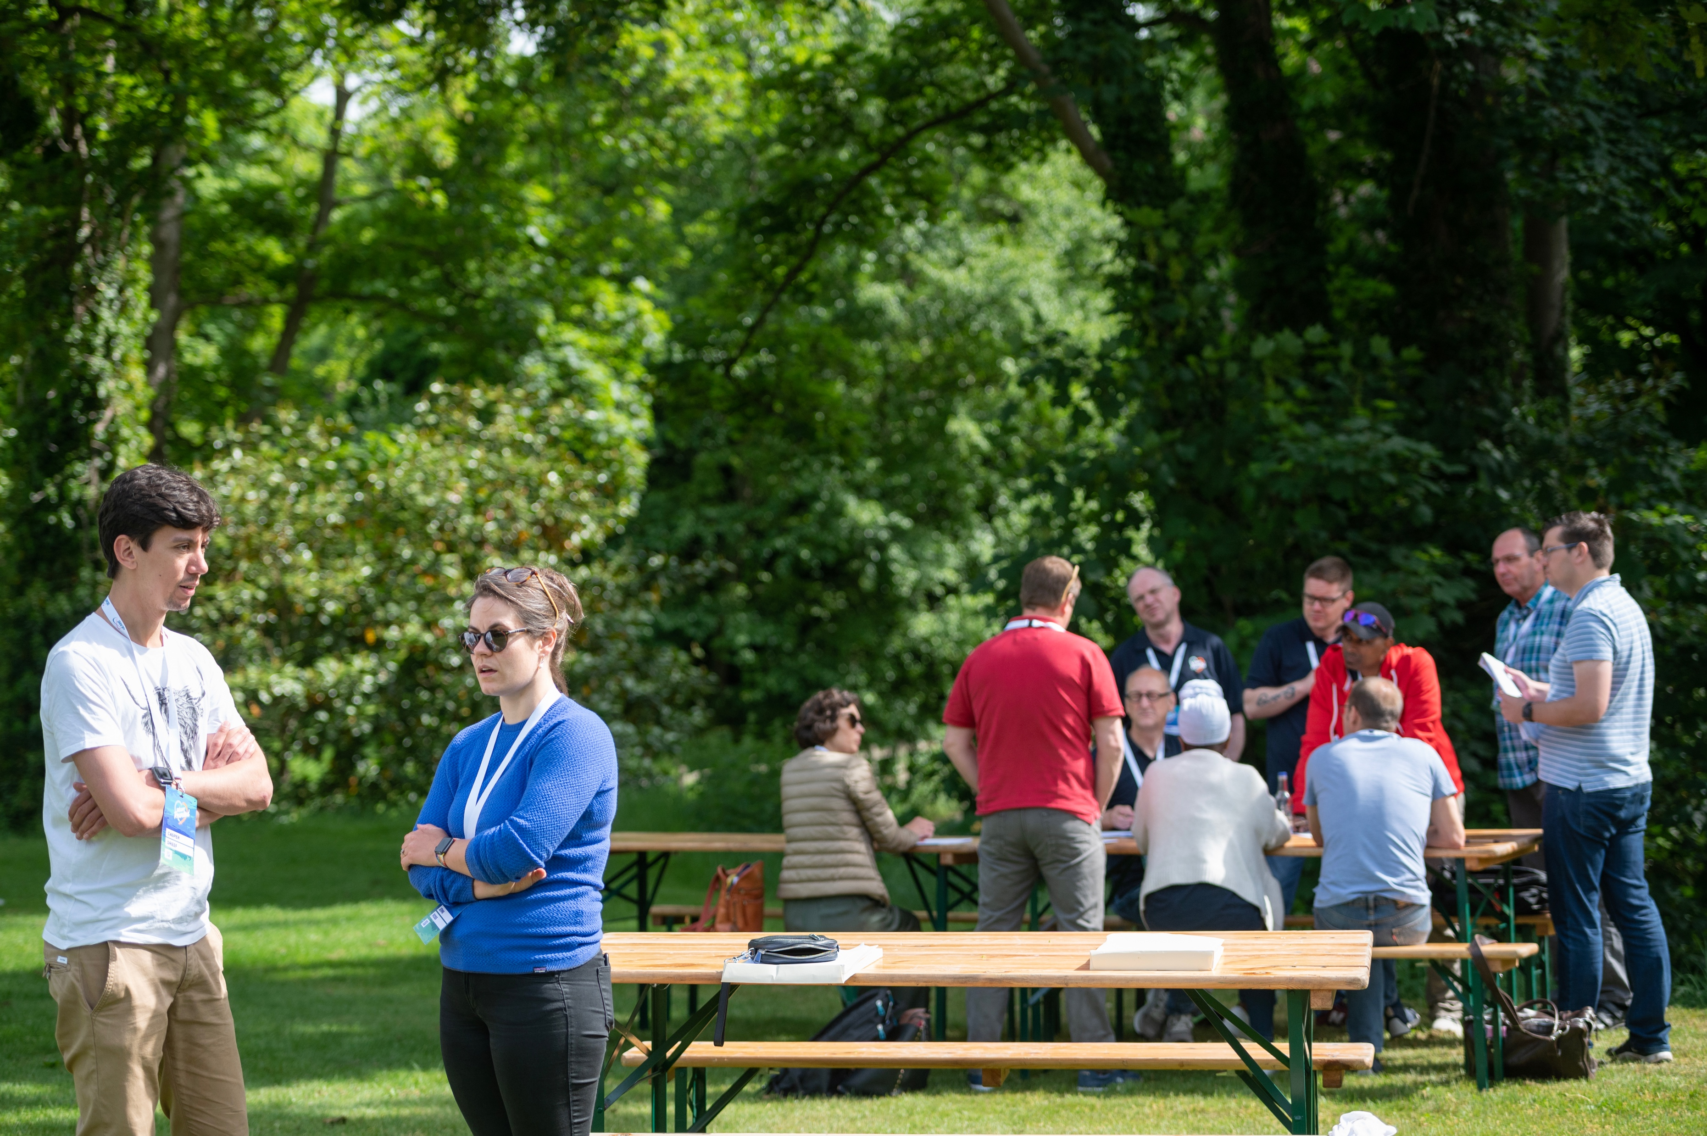
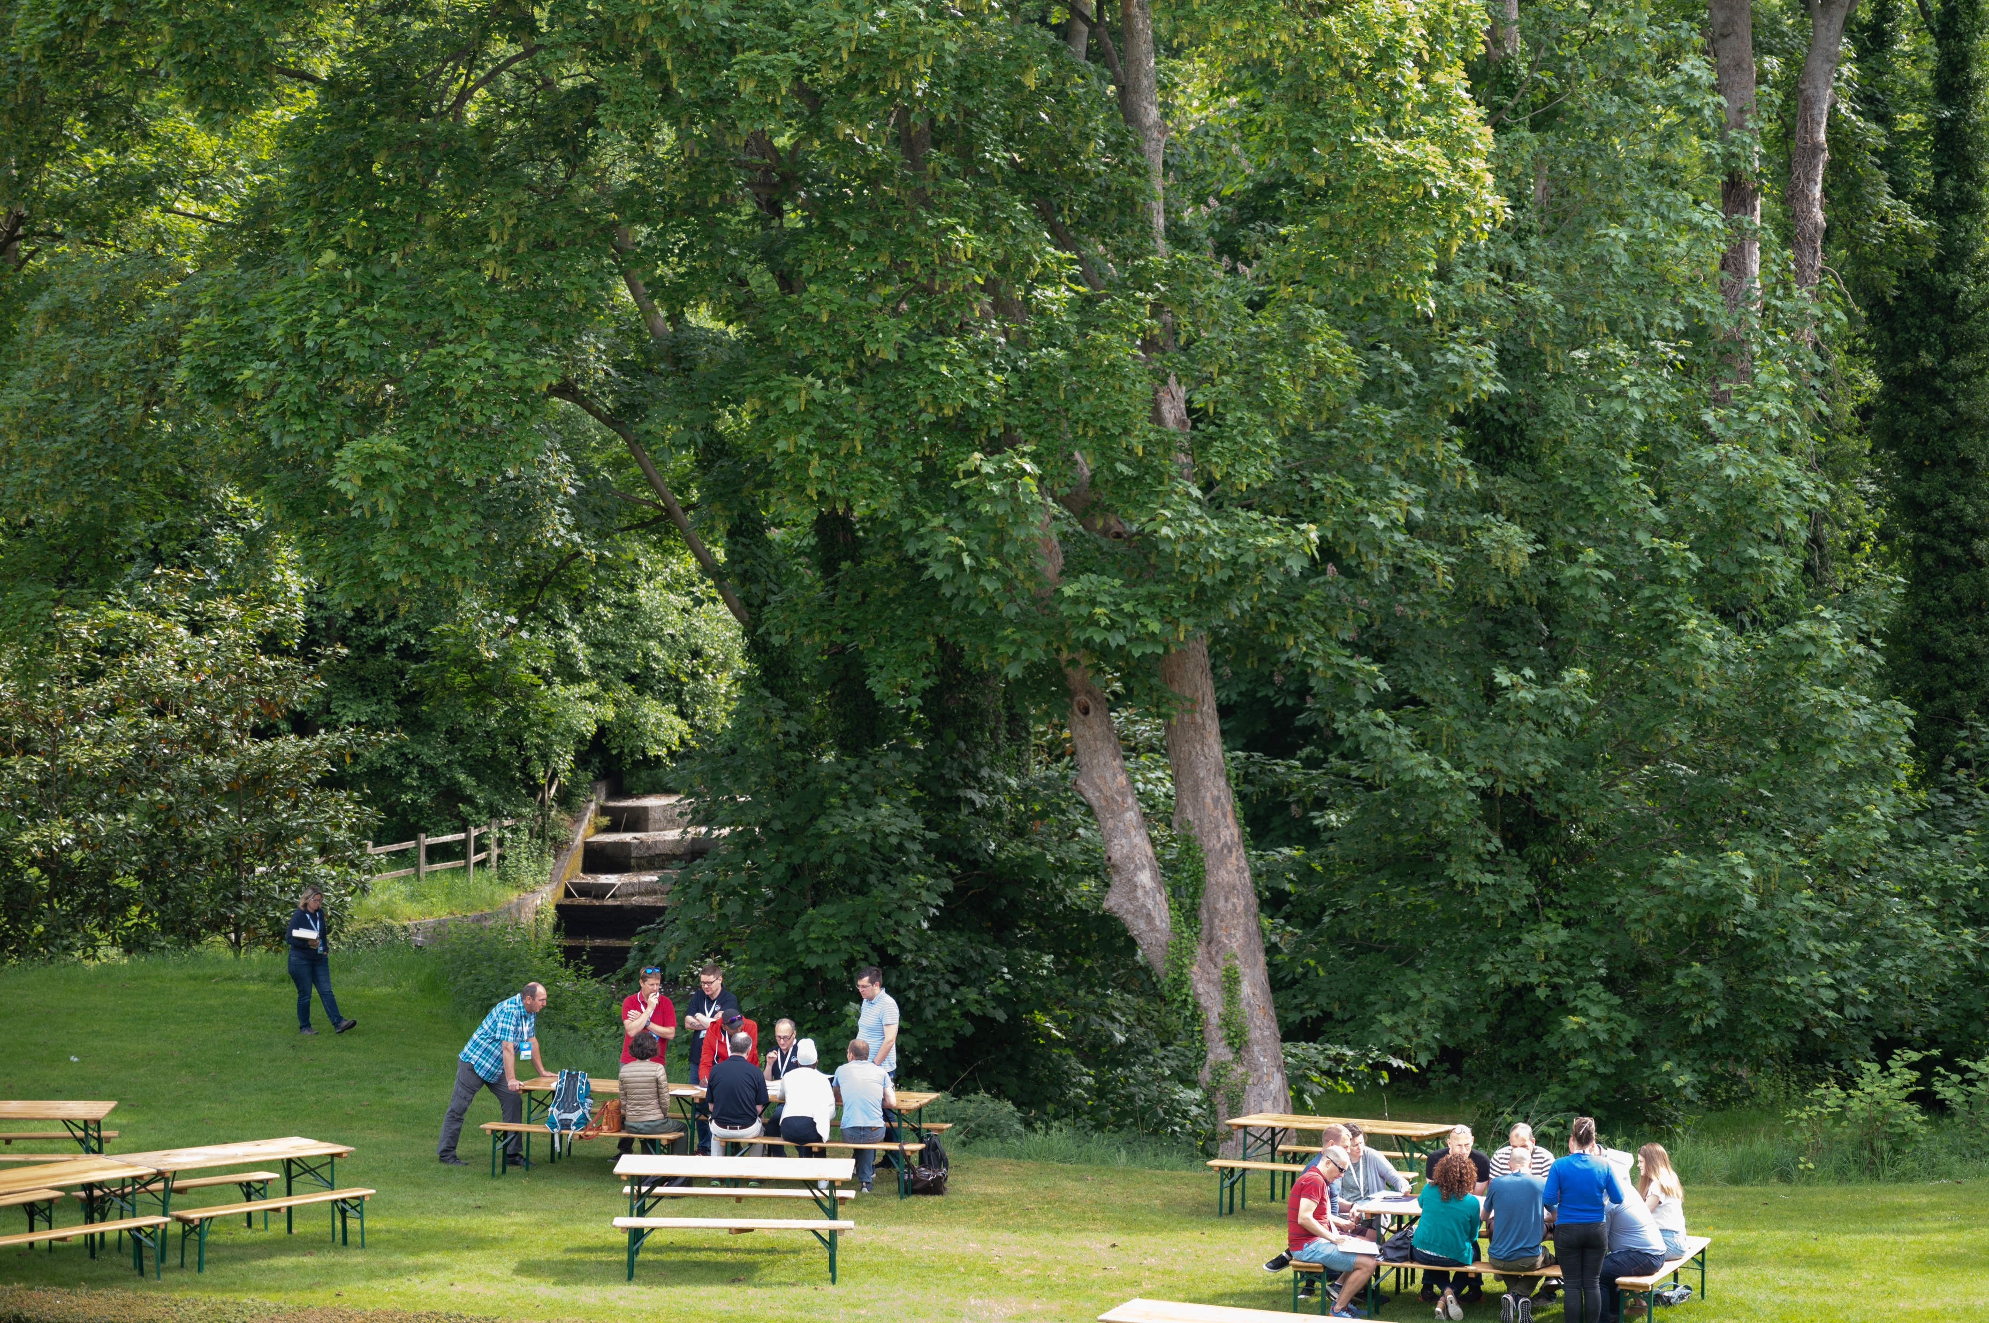
Running the exercise
Notes:
Quick refresher
Airconditioned room – outside – sunshine
Catch up with coordinators
Starting to feel the pressure

Slide 9
Outcomes
Feedback from staff
Stressful
Collaboration
Different approaches
Green and orange, no red
“More fun than expected”
Training
Prioritisation
Legal
Notes:
3 outcomes – Good, Medium, Bad

Slide 10
casper.dreef@geant.org

