Slide 1

How the world’s largest student mobility programme is going digital
TNC, 15 June 2022
Notes:
Thank you for having me,
While I'm delighted to be here with you today I have a small confession to make: this talk is not about new disruptive technology
Instead it is about how networks, trust and smart applications help bring people together, a little bit like it happens here in TCN

Slide 2

Notes:
Bringing people together is a bit part of the work we do at the European University Foundation, which is the largest university of its kind in Europe, and also the most influential.
The EUF has a dual focus: in one hand it strives to accelrate the modernation of HE in Europe.
and On the other it‘s deeply commited to the betterment of student mobility. >

Slide 3
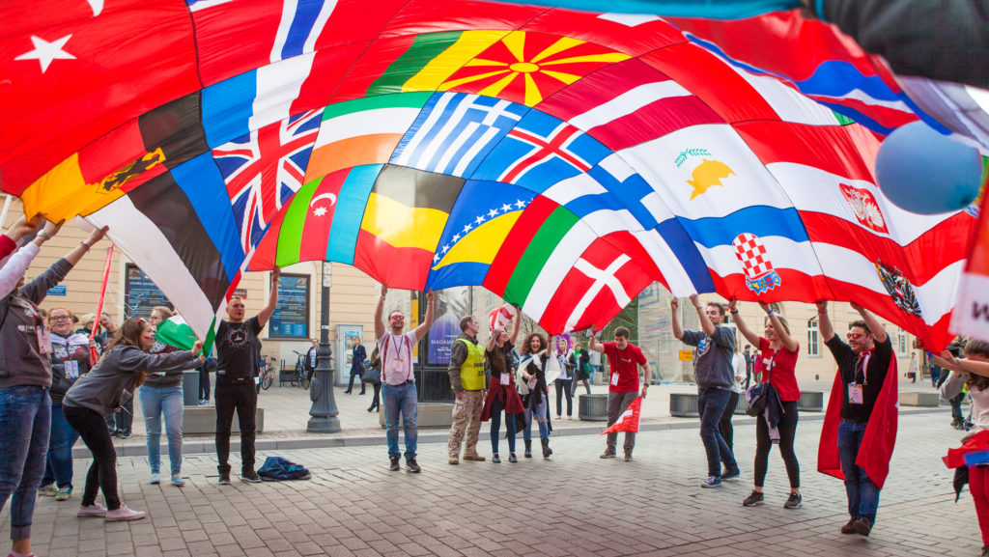
Notes:
fun fact: this stuff is not new - cross border students and scholars have had some kind of special status since almost 900 years.
The first to put the issue on the agenda, as we would say nowdays, was Emperor Barbarossa
the Privilegium Scholasticum.confered the rights of freedom of movement for the purpose of studying!
and for many centuries academic mobility was linked to the socialisation of political, economic and intellectual elites
fast forward to the renaissence and Erasmus of Rotterdam is one of the most famous example of a roving scholar, aka the prince of Humanists. some of your will know about his body of work and influence, but what you might not know is that he studied and taught in England, France, Italy, Belgium and Switzerland
Whihc is why it's very appropariate that Europe's student mobility flaghsip progamme is named after him

Slide 4

Erasmus+
Launched in 1987
1 million mobilities reached in 2002
9 million mobilities in 2017
10 million mobilities more planned for 2021-2027 aim
Europe + 153 partner countries
Notes:
Erasmus nowdays encompasses virtuall all education systems, but my focus today is on HE, which remains the largest and most mature
.... With nearly 30bn budget for a 7 year period

Slide 5
“How unexpected encounters had lasting effects. About the person they became by going outside their comfort zone. It was about finding creative solutions for unexpected problems. Failing. Working out misunderstandings. Starting again. Becoming more self-confident, but also open and caring. Making new human connections. These are life-changing experiences.”
In https://www.eaie.org/blog/words-matter-virtual-mobility.html
Notes:
Why is does this matter?
colleague from Antwerp
This impact is also profound within the university systems themselves
put together impact students + universities
big picture: this is really about putting the european ideal into practice, fostering mutual understanding and appreciation - not least so that when we disagree with each other we can do things diferently than in centuries prior

Slide 6
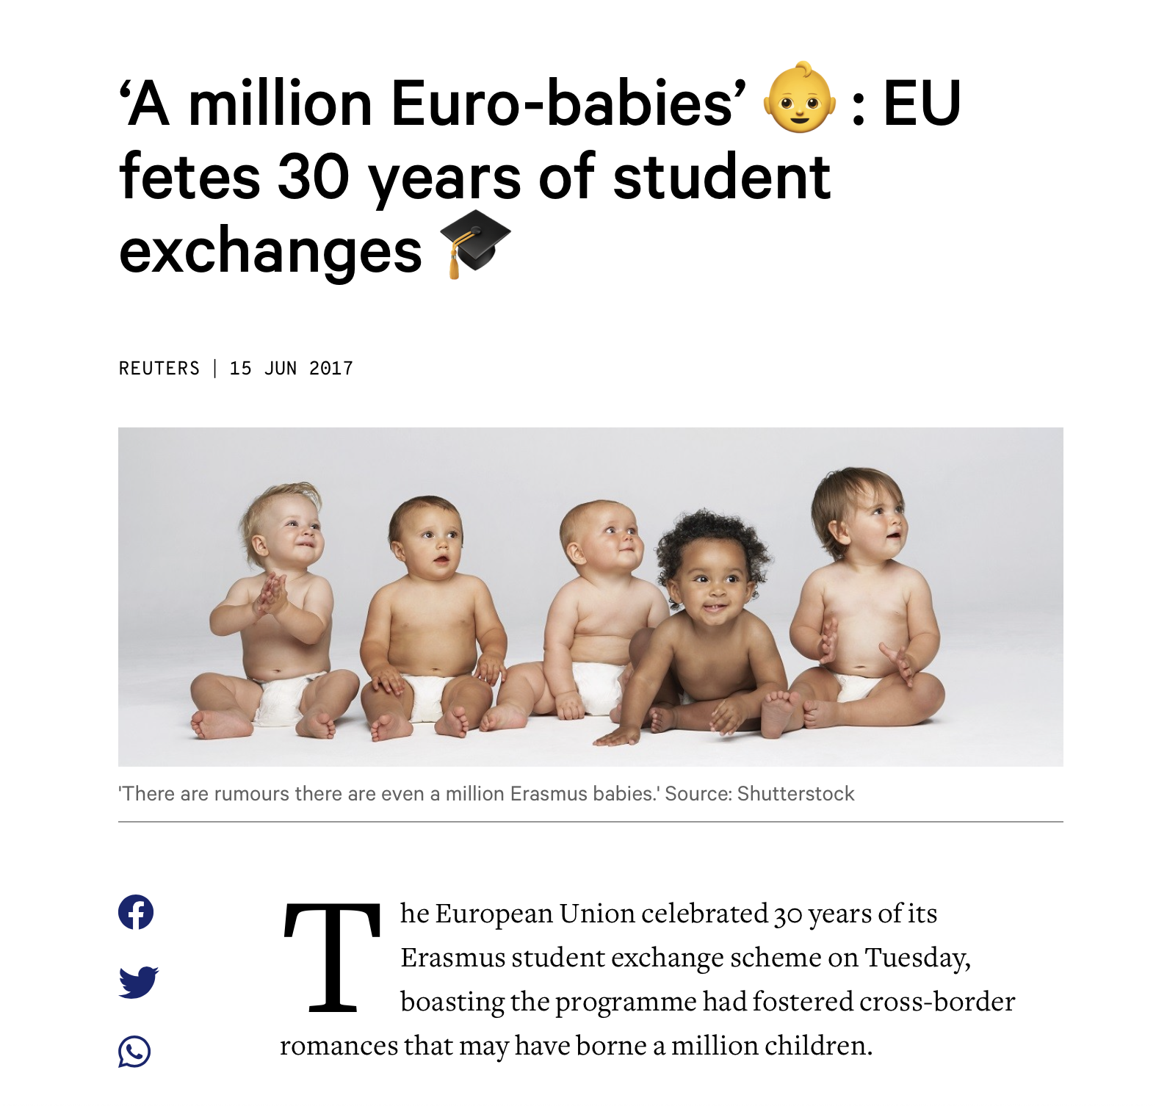
Notes:
And on its free time from promoting peace and understanding Erasmus also has other tricks up it sleeve, like giving a helping hand to Eiurope's declining demography! :)
side note, this is how you win a bet about being able to squeeze a photo of cute babies in a TNC keynote.... ;)
So, there are lots of wonderful things about Erasmus, but there are also a few problems, if I’m being completely honest

Slide 7

Unknown International Relations Officer, circa 2013
Notes:
Allow me to illustrate https://www.youtube.com/watch?v=1fh7kjAbdx4
But the parody does resonate
And we actually have the data to prove it

Slide 8
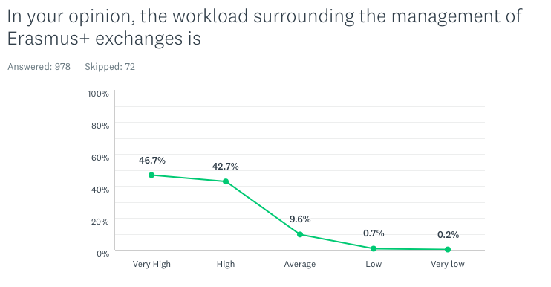
Notes:
In 2015, we asked 1000 IROs the following question...
And gues what? less than 1% felt workload it was “low or very low”
(as is to be expected when the administrative backbone of such a programme is not significantly changed in 3 decades)

Slide 9

  Digital transformation was made into a EUF strategic priority
  Reimagine student experience of mobility
  Free IROs from (pointless) mechanical work
  Compliance (e.g. GDPR)
Notes:
same year the EUF Council of Rectors said enough is enough
And they challenged the network to do some problem-solving... strategic priority

Slide 10
Erasmus single points of entry
Access to information, events and checklists
Interoperability
EWP
universities
App
students
And electronic services for mobility
Electronic exchange of information
Notes:
So we got to went ahead
And designed a operating system for mobility
With a clear single point of entry for unis and students
EWP = interesting

Slide 11
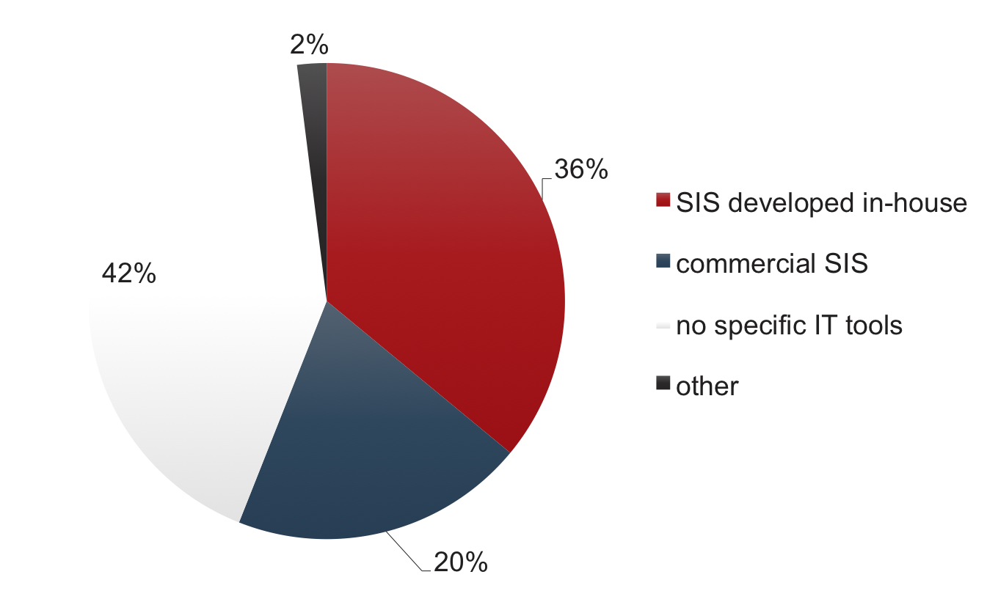
Mapping of IT infrastructure among ECHE holders
EWP Survey (n=1050)
Notes:
Very importantly
This OS was inclusive by design
Very good data on system fragmentation

Slide 12

University 1
⬇
University 2
⬇
EWP
⬇
Notes:
EWP is the red thread you see in the picture allowing systems to talk to one another
A middle layer, if you will

Slide 13
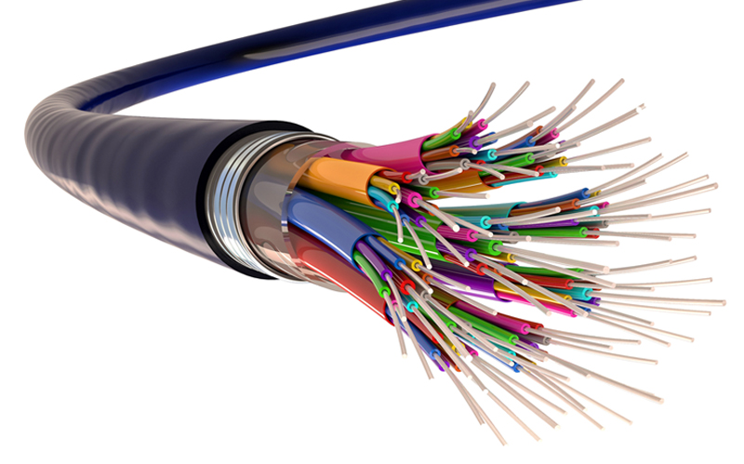
Information about HEI
Information about courses
Inter-institutional agreements
Nominations
Learning Agreements
Transcript of Records
Separate API according to the type of information being exchanged
Notes:
if you were to cut that phone line open this is what you would fine
a buffet of APIs
with a consistent format and semmantic
whose specification evolves as required
and that support each key step that is in focus of our work
also making it future-proof from a structural viewpoint

Slide 14

If your IT tools are too old or non-existent…
Notes:
but if you recall the pie chart
you might have noticed that there is also a very large % of HEIs who simply lack the appropriate systems
for proper electronic data exchange

Slide 15

It’s ok. We’ve built some for you.
To make sure no universities are left behind!
Notes:
ID 96890442 © Danil Chepko | Dreamstime.com
so we went one step further and built free to use applications

Slide 16

ESCI (EWP) roadmap
Set forth by the European Commission
Sets out electronic data exchange as a requirement
Making machine readable data the default
Roadmap to paperless mobility:
  2022 – Inter-Institutional Agreements and Learning Agreements
  2023 – Nominations and Transcript of records
Notes:
This work was received with such entusiasm that in 2019
EC made it a flagship called ESCI
most important thing:
1- set electronic data exchange as a mandatory requirement
2 - and provides a roadmap which allows universities to transition in concert

Slide 17
EWP today
2572 universities connected
96% of all European HEIs doing Erasmus mobilities for studies
Notes:
Thiis is how far we have already come...
Very proud that Europe is the most advanced academic data ecossystem in the world

Slide 18

But there’s one last piece to this puzzle: the
European Student Identifier

Slide 19

Enabling consistent recognition of users across different student information systems.
ESI it’s already deployed by more than 2100 IdPs.
Using eduGAIN as a secure transport layer. Students and IROs don’t have to know it or interact with it.
Notes:
We joined forces with GEANT and other key stakeholders to develop and publish the ESI specification
in fact today I‘m also here to thank you for the fantastic cooperation and the fantastic support we received from so many NRENS

Slide 20



A digital ecosystem for student mobility
launched in 2017
re-launched in 2021
launched in 2018
launched in 2020
Notes:
(If you wanna hear more about how MyAcademicID became one of the cornerstones for this „mobility operating system“… don't miss the MyAcademicID session today at 4pm!)
what is important for you to know is that this ecossystem is already rocking the status quo
Tasks that used to take thousands or hours of manual work are gradually being automatised in universities across europe
Do you remember the video clip from 2002 ago?
Well, since a few months the majority of european students can finally apply to go abroad in Erasmus from their mobile phone, taking into consideration parameters live living costs, feedback from other exchange students and much more. Until the end of 2022 we will also start bring accomodation offers to their fingertips

Slide 21
With many new potential use cases
Placements mobility
Blended mobility
Staff mobility
European University Alliances
Enabling student services
Mobility Tool reporting
Grade conversion
Grant management
Other educational sectors
Erasmus+ partner countries
Notes:
And if this sounds like a good start to you…
be aware it‘s just the beggining...these are just some of the new use cases and potencial areas for expansio for this work!
so, looking a ahead

Slide 22
Challenges & opportunities
Strategic autonomy
Notes:
autonomy and data sovereigny
is a huge topic- and a huge opportunity for all of you
Long story short, many public universities currently rely on the diligence and good will of commercial providers to a remarkable extent, and some would say some balance needs to be restored in such a relationship
In countries such as Poland universities had to band togehter to take matters into their own hands
So much like EUF and GEANT have teamed up to spectacular effect
There‘s a potencial for you to do the same with the universitiess in your countries and consider how their needs can be best adressed

Slide 23
Challenges & opportunities
From Europe to the world
Notes:
, in the very beggining I mentioned that there are more than 150 countries that also are partnrers in Erasmus
and it won‘t be long until we will need to share this kind of infrastructure to our friends from around the world
We are already doing a interoperability pilot with 23 unis in 7 Asian countries - student mobility very much is a global phenomena.
so I finish how I started: technology can indeed bring our students and universities closer together, making the world a genuinly better place along the way. - who else but this fantastic community is better placed, expertise wise, to bring about such a change of paradigm than thisi fantastic community?
thank you

Slide 24
Call for action!
ESI: let’s finish what we started
Notes:
We have already achieved a lot but the job is not done yet
Once you get back home from TNC
please help us show everyone that is not in this room...
... what the eduGAIN community is capable off
Policy and decision makers in the audience will understand that with identification and aauthentication are being very high in the EU agenda…. competition for the role currently fulfilled by NRENs could prove fierce,
and student mobility is something of a killer application for your infrastructure that you can and should use to your advantage

Slide 25
Thank you for your attention!
João Bacelar
Executive manager
European University Foundation

