Slide 1
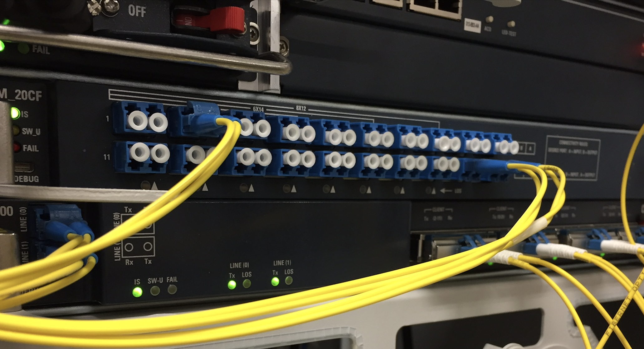
Inter-NREN Intent-Driven Optical Networking
Rob Smets, TNC2022-Trieste

Slide 2
Introduction – Parting with the Limiting OTN Layer Stack
Inter (N)REN Building services using infrastructure resources from others, and allowing others to use SURFs resources.
Intent Driven Translating and unlocking the resources of the optical equipment into a more diverse set of services, only limited by physics and deployment rules set by SURF.
Goals to achieve
Business-case
independence
Interoperability and flexibility
Reduce network
resource footprint

Slide 3
Service and optical-transport become more disjunct. This fuels the need for more diverse and cross-domain optical services
Transport
& service
infrastructure
SURFnet 6
(2006)
SURFnet 7
(2012)
Transport & service
infrastructure
Transport
infrastructure
Service
infrastructure
SURFnet 8
(2018)
Service
Infrastructure
#2
Transport
infrastructure
Service
Infrastructure
#1
Beyond SURFnet 8
Service
Infrastructure
#3

Slide 4
Optical line system and transport functionality is changing
SURF’s transport capacity requirements doubles every 5 years, while available transponder capacity doubles every 2.5 years.
    One wave will be sufficient to transport any required capacity on a link.
Driving need for more flexible OLS equipment to support
    DCI-like, Metro ROADM like, and Long haul / submarine transport
    Cross-domain
And a need for a generic way of creating new optical services
    Spectrum services instead of alien waves.
    Bi-directional and uni-directional services
    Classic and quantum services

Slide 5
OLS Business case limitations v.s. hardware capabilities
Vendors base the functionality and features of their NMS on business-cases
  for the majority of network operators and service providers
  on what a few big NO’s and SP’s dictate
  to win a contract
  in support of standardisation and IPR
Validation of services both by vendor and SURF
Full resource availability on day-0 of deployment.
Limitations on the way low-level functionality of the hardware is controlled:
  Media access rules to protect the integrity of the system and services
  Deployment rules when these restrict to only supported business cases

Slide 6
Spectrum service to GEANT on ASD-HB is a good example:
Spectrum Service Attach Points (SAP)
7x
Alien Wavelength
Service Attach Points
WSS
WSS
ILA
WSS
WSS
Most NMS only allow for the creation of individual trails NOT a spectrum service.
  For example, a 800GHz spectrum service would be:
    ONE time a trail of 800GHz -> power non-uniformity: over or under-powered
    EIGHT times a trail of 100GHz -> hosting NREN must provision and maintain these
Alien Wavelength and Spectrum Service Attach Points do not correspond.
  Physical connection to the guest NREN is on the WSS port.
  NMS does not allow multiple AWs to be provisioned on a Spectrum SAP

Slide 7
Automation & Orchestration platforms translate business and deployment rules. They prevent media access violations
At the essence, A&O platforms, compute which resources to claim and release and validate proper deployment and operation of resources.
What is the most appropriate resource?
  Trail {port A, port B, center frequency, bandwidth, launch power, route}
    Alien wave model or at best spectrum model.
    High abstraction
    Builds on exisiting OTN layer model and must corresponds to approved SAPs
  Cross-Connect {port A, port B, slice of 12.5GHz spectrum, mode, power/loss/gain}
    Network slice model
    Low abstraction
    Very generic, can be applied to any component, can be applied for any service

Slide 8
“Cross-Connect and Power Resource Model”
Optical Device, Element, or Component
(EDFA, WSS, filter, fiber, pad, circulator)
Commissioned Port based resources
Subscription UUID
Adjacent UUID
Port properties (connector type)
Ingress and egress allowed power density ranges per 12.5GHz slice
Service Attachment Point parameters
Operational mode and parameters
Measurement modes and parameters
UUID of authorized controlling user
XC deployment
Subscription UUID
Port A
Port D
12.5GHz slice ID
Loss = 0.5
A
B
XC resource collection
Port x
Port y
12.5GHz slices
Losses
Target powers
XC deployment
Subscription UUID
Port D
Port A
12.5GHz slice ID
Loss = 40.0
Service Resource Consumption
Subscription UUID
Ingress and egress demanded and measured power density per 12.5GHz slice.
UUID’s for each service per Service Attachment Point and per 12.5GHz slice
Sink or source
Alarms
C
D

Slide 9
Building the network topology
Device 2
Device 3
Device 1
A
B
TP 3
TP 2
A
B
SAP
Service Access Point (SAP)
A
B
C
D
C
D
SAP
C
D
TP 1
Device 4
Topology Link definition
Subscription UUID
Subscription UUID port D
Subscription UUID port A
A
B
C
D
SAP

Slide 10
Alien Spectrum becomes a set of 12.5GHz cross-connects
INGRESS
WSS
191.3125THz, port 1
191.3250THz, port 1
PREAMP
EDFA
Guest B workflows
196.1500THz, port 1
Slice resource control
Guest A services
Validation
191.3125THz
port 0
191.3125THz
port 1
191.3125THz
port 0,
191.3125THz, port 2
191.3250THz, port 2
191.3250THz
port 0
191.3250THz
port 1
191.3250THz
port 0
196.1500THz, port 2
SURF workflows
Guest B workflows
Commissioning
Resource control
SURF services
Validation
Slice resource control
Guest A services
Validation
196.1500THz
port 0
196.1500THz
port 1
196.1500THz
port 0
191.3125THz, port 20
191.3250THz, port 20
196.1500THz, port 20
Orchestrator
(master)
191.3125THz, port 1
Guest
APIs
191.3250THz, port 1
196.1500THz, port 1
Orchestrator
(slave)
191.3125THz
port 0
191.3125THz
port 1
191.3125THz
port 0
191.3125THz, port 2
191.3250THz, port 2
191.3250THz
port 0
191.3250THz
port 1
191.3250THz
port 0
Network
Controller
196.1500THz, port 2
Photonic
Technology
Domain
196.1500THz
port 0
196.1500THz
port 1
196.1500THz
port 0
Optical Equipment
191.3125THz, port 20
BOOSTER
EDFA
191.3250THz, port 20
EGRESS
WSS
196.1500THz, port 20

Slide 11
Workflows, Validators and Streaming Telemetry.
Workflows:
  Create and maintain topology, fill the resource matrices and enable power measurement functionality (commissioning)
  Validation of the topology
  Distribute resources across guests
  Create and maintain services in a hierarchical fashion:
    For SURF: create a spectrum service.
    For Guests: API on guest orchestrator to create alien wave services / request resources / check power levels.
Path computation funtionality with spectral resolving and power validating capabilities.
Validators to compute expected power levels and raise alarms where mismatch exists, for home services and for guest services.

Slide 12
Summary - Create cross-domain services using intent driven allocation of resources
A resource based optical networking paradigm provides maximum freedom and capabilities to both NREN home and guest users.
  Not restricted to pre-approved services
  Only limited by physics
  Lean resources and equipment footprint
  Use same optical infrastructure in support of future services
Very limited requirements must be imposed on the equipment
  Low level XC functionality with local power level control loops allowed.
  Power level measurement functionality.
Fits SURF’s A&O platform, philosophy, and concepts.

Slide 13
Thank you
Rob Smets
E-mail: rob.smets@surf.nl
www.surf.nl
Social media: https://www.linkedin.com/
in/rob-smets-99ba8219/
Driving innovation together

