Slide 1
Ahoy Communities! Building trust for research and collaboration.
Maarten Kremers, SURF
Hannah Short, CERN
TNC22
Trieste, Italy 15th June 2022

Slide 2
Incubator
Enabling Communities
T&I Services
Identity Feds
r/e-infras
EOSC
eGov
Operational Support

Slide 3
Enabling Communities

Slide 4
T&I eScience Global Engagement
The 'eScience Global Engagement' of EnCo in the GEANT project is there to support those developments in the policy and best practice areas that would benefit the community at large, and do that by means of supporting the work in the existing forums such as WISE, FIM4R, IGTF, REFEDS, AARC-community, and the research and e-Infra communities directly

Slide 5
T&I Enabling Communities
INTEROPERABILITY
TRUST
SECURITY

Slide 6
REFEDS
IGTF
AARC
EnCo
FIM4R
WISE

Slide 7
T&I Enabling Communities
Interoperability, sustainability, integration and compatibility: Authentication and Authorisation for Research and Collaboration (AARC) – a set of turn-key AAI solutions bringing research collaborations closer together.

Slide 8
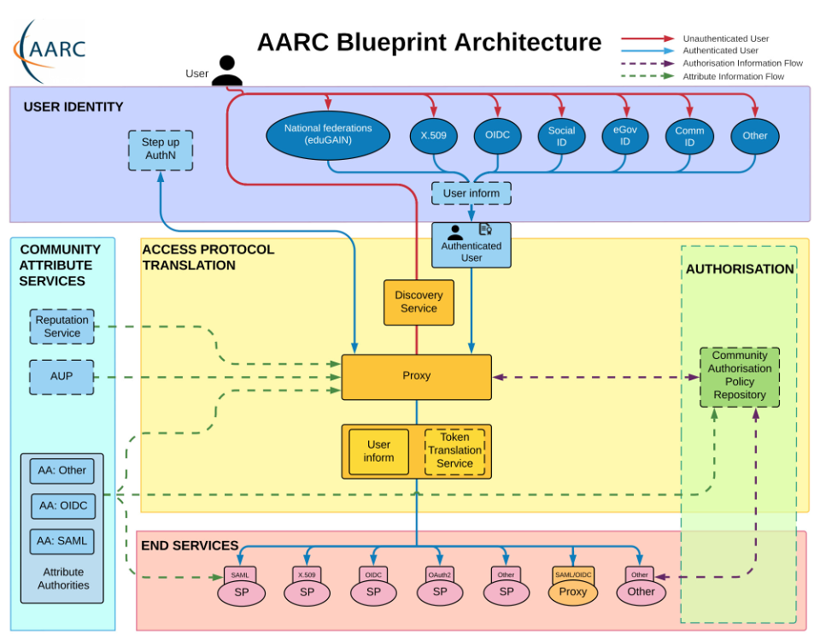
T&I Enabling Communities
The AARC Blueprint Architecture (BPA)
is a set of software building blocks that can be used to implement federated access management solutions for international research collaborations.

Slide 9
T&I Enabling Communities
Harmonising rules for a common infrastructure: The Policy Development Kit (PDK) Harmonising the rules that organisations apply to identity management is essential for achieving an integrated AAI framework.

Slide 10
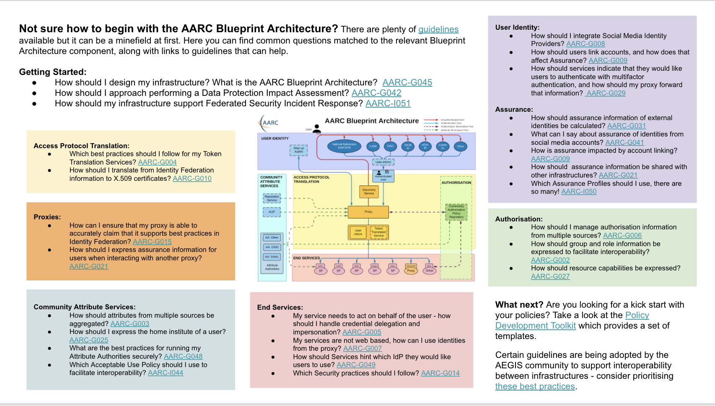
T&I Enabling Communities
Linking Guidelines, BPA and PDK
https://aarc-project.eu/architecture/
https://edu.nl/h3dm4

Slide 11
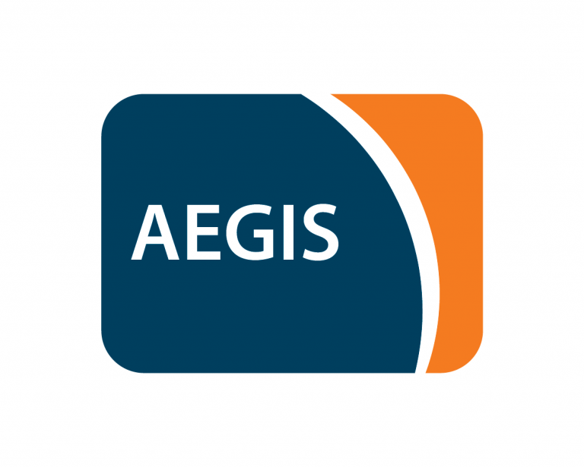
AEGIS
The AARC Engagement Group for Infrastructures (AEGIS) brings together global representatives from AAI operators in research infrastructures and e-infrastructures, which are implementing authentication and authorisation services that support federated access, to discuss adoption of policy and technical best practices that facilitate interoperability across e-infrastructures ands research infrastructures.
Facilitated by EnCo

Slide 12
T&I Enabling Communities
REFEDS (the Research and Education FEDerations group) is to be the voice that articulates the mutual needs of research and education identity federations worldwide.

Slide 13
T&I Enabling Communities

Slide 14
T&I Enabling Communities
REFEDS Assurance Profile (v1.0)
Consisting of three individual specifications:
REFEDS Assurance Framework (RAF), ver 1.0, published 2018
REFEDS Single Factor Authentication Profile (SFA), ver 1.0, 2018
REFEDS Multi Factor Authentication Profile (MFA), ver 1.0, 2017
Component-based approach
Two identity assurance profiles: Espresso (high assurance) and Cappuccino (moderate assurance)
v2.0 in progress

Slide 15
T&I Enabling Communities
Full paper published
https://doi.org/10.22323/1.378.0029
Notes:
Making Identity Assurance and Authentication Strength Work for Federated Infrastructures
Level of Assurance (LoA) frameworks: To assess and communicate the quality of identities being used and authentications being performed
Sophisticated LoA frameworks like NIST 800-63-3, Kantara IAF 1420 or eIDAS regulation are often considered too complex to be used in R&E scenarios
the REFEDS Assurance Suite has been developed, a more lightweight approach
To select an appropriate assurance level, Service Providers need to weigh risks and potential harms in relation to the kind of service they offer.
However, the management of risks is often implicitly assumed and little or no guidance to determine the appropriate assurance level is given
The paper provide guidance and best practices based on example scenarios for both Service Provider as well as for Identity Provider operators on how to implement REFEDS assurance components.

Slide 16
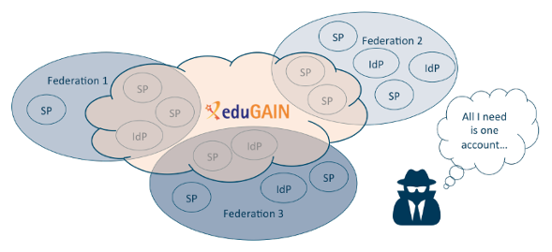
T&I Enabling Communities
Contributions to SIRTFI v2
Source and more information: https://refeds.org/wp-content/uploads/2016/02/Why_Sirtfi.pdf
Notes:
REFEDS SIRTFI
Operational Security
Incident Response (Confidentiality and collaboration)
Traceability (Logs)
Participants Responsibilities (AUP)

Slide 17
T&I Enabling Communities
Contributions to the eduGAIN security incident Handbook

Slide 18
T&I Enabling Communities
The Interoperable Global Trust Federation (IGTF) is a body to establish common policies and guidelines that help establish interoperable, global trust relations between providers of e-Infrastructures and e-Research, identity providers, and other qualified relying parties.

Slide 19
T&I Enabling Communities
AA Operations Security Guideline 2022 (AARC-G071)
https://www.eugridpma.org/guidelines/aaops/
Notes:
These guidelines describe the minimum requirements and recommendations for the secure operation of attribute authorities and similar services that make statements about an entity based on well-defined attributes.
These guidelines may help to establish trust between communities, operators of attribute authorities and issuers, and Relying Parties, infrastructures, and Service Providers

Slide 20
T&I Enabling Communities
The Wise Information Security for Collaborating e-Infrastructures (WISE) community enhances best practice in information security for IT infrastructures for research.
SCI (Security for Collaboration among Infrastructures) Workgroup focusses on best practices, trust and policy standards for collaboration with the aim of managing cross-infrastructure security risks

Slide 21
T&I Enabling Communities
SCI Trust Framework
Enable interoperation of collaborating Infrastructures in managing cross-infrastructure operational security risks.
Builds trust between Infrastructures by adopting policy standards for collaboration especially in cases where identical security policy documents cannot be shared.
Self Assessment Tool
Guidance Doc

Slide 22
T&I Enabling Communities
Self Assessment Tool
Guidance Doc

Slide 23
T&I Enabling Communities
Revision PDK in progress based on feedback and experience
Service Operations Security
Data Protection / Privacy
Notes:
Development of AARC PDK by WISE SCI-WG
Involve the widest experience from many Infrastructures and policy groups
Policy templates are useful to new Infrastructures and help build trust and interoperability (compliant with SCI Trust Framework)
WISE SCI will collect feedback from Infrastructures
And use this if/when a new version of a template is required

Slide 24
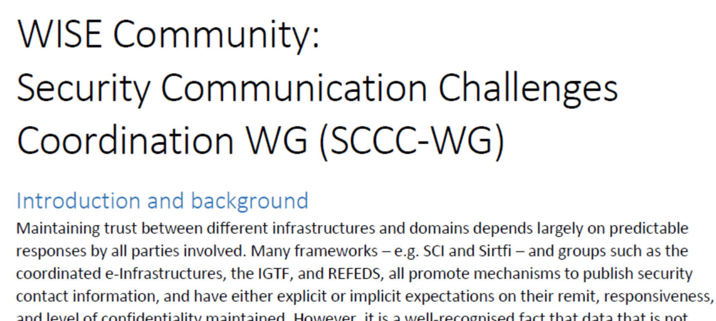
T&I Enabling Communities
Contributions by EnCo

Slide 25
T&I Enabling Communities
FIM4R (Federated Identity Management for Research) is a collection of research communities and infrastructures with a shared interest in enabling Federated Identity Management for their research cyber infrastructures. In order to achieve this, FIM4R develops requirements bearing on technical architecture, federated identity management, and operational policies needed to achieve a harmonious integration between research cyber infrastructures and R&E Federations.

Slide 26
T&I Enabling Communities
Support by EnCo
https://fim4r.org/2021/06/23/fim4r-assurance-workshop/

Slide 27
Engage!
https://fim4r.org
https://refeds.org
https://wise-community.org
https://www.igtf.net
https://aarc-community.org
Contact us: policy@aarc-community.org

Slide 28
Thank you
Any questions?
maarten.kremers@surf.nl hannah.short@cern.ch
As part of the GÉANT 2020 Framework Partnership Agreement (FPA), the project receives funding from the European Union's Horizon 2020 research and innovation programme under Grant Agreement No. 856726 (GN4-3).​​​

