Slide 1
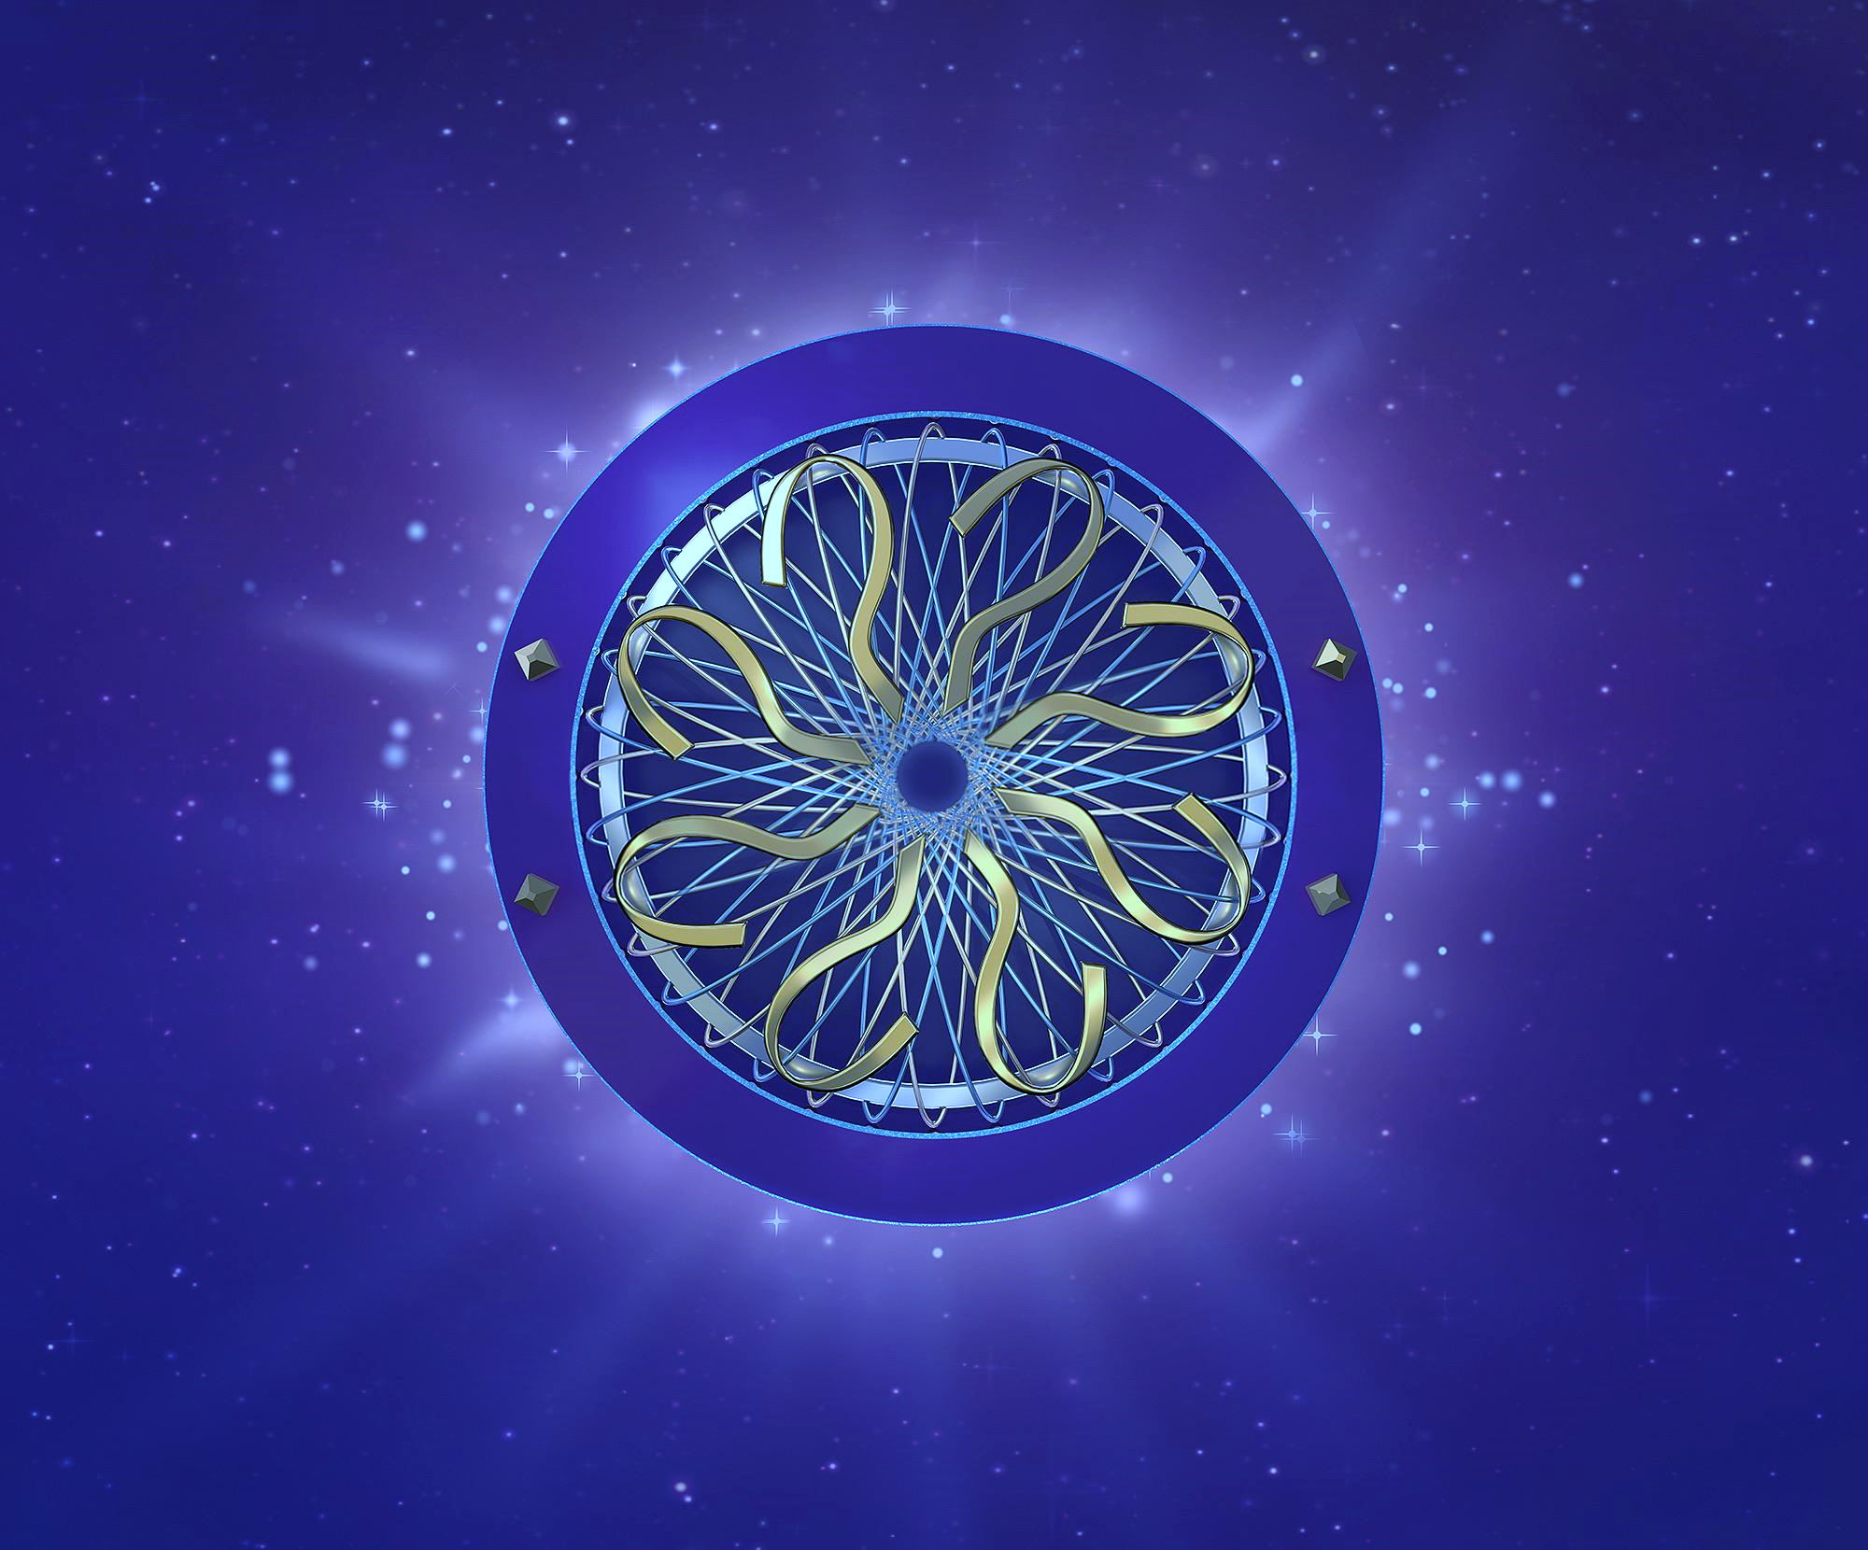
WHO WANTS TO JOIN THE
WHO WANTS TO JOIN THE
GREN MAP

Slide 2
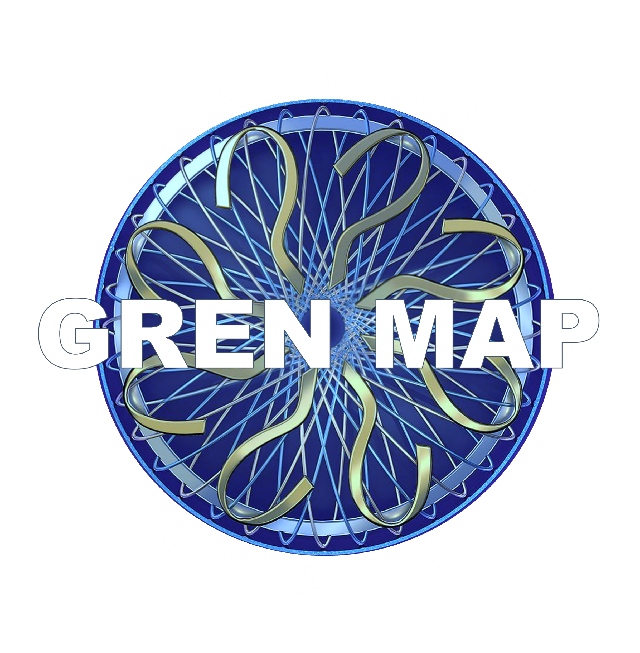
APPLAUSE
What is the GREN Map?
A: A plot device from Harry Potter
B: A route from Trieste to Lake Gren
C: A distributed map of the Global Research & Education Network
D: An artifact at the Trieste Musuem

Slide 3
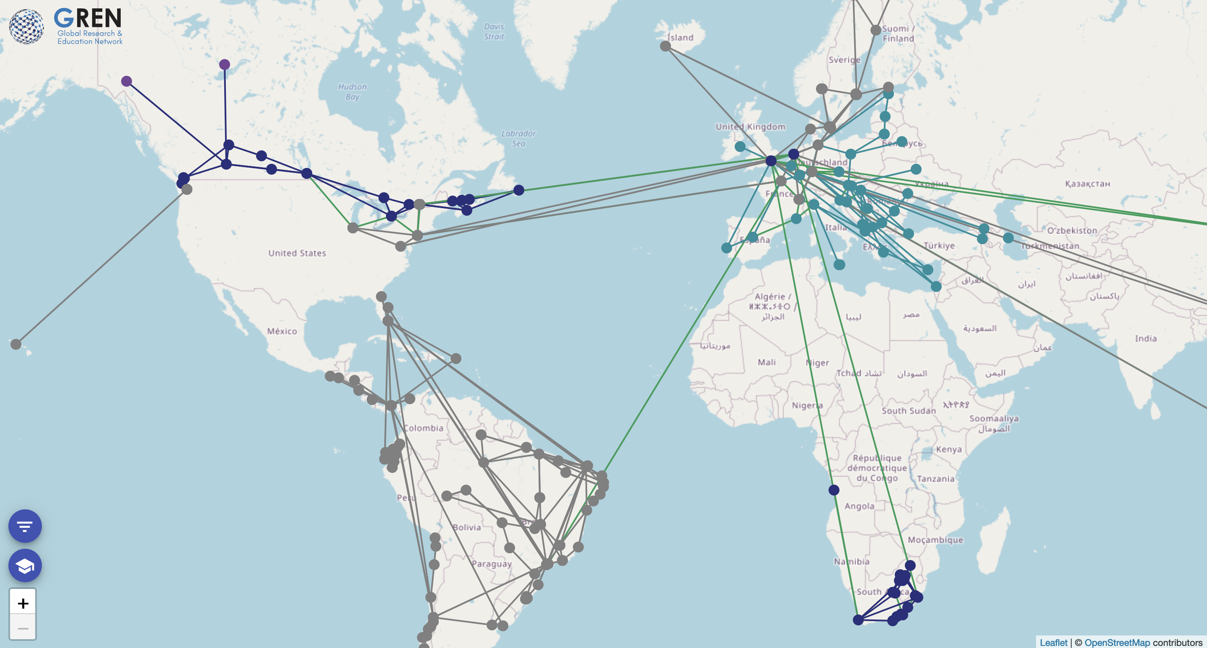
GREN Map Picture placeholder – wide view

Slide 4
APPLAUSE
Who would use the GREN Map?
A: Funders, Institutions & GREN Partners
B: Gamers
C: World Travelers
D: Geography Professors

Slide 5
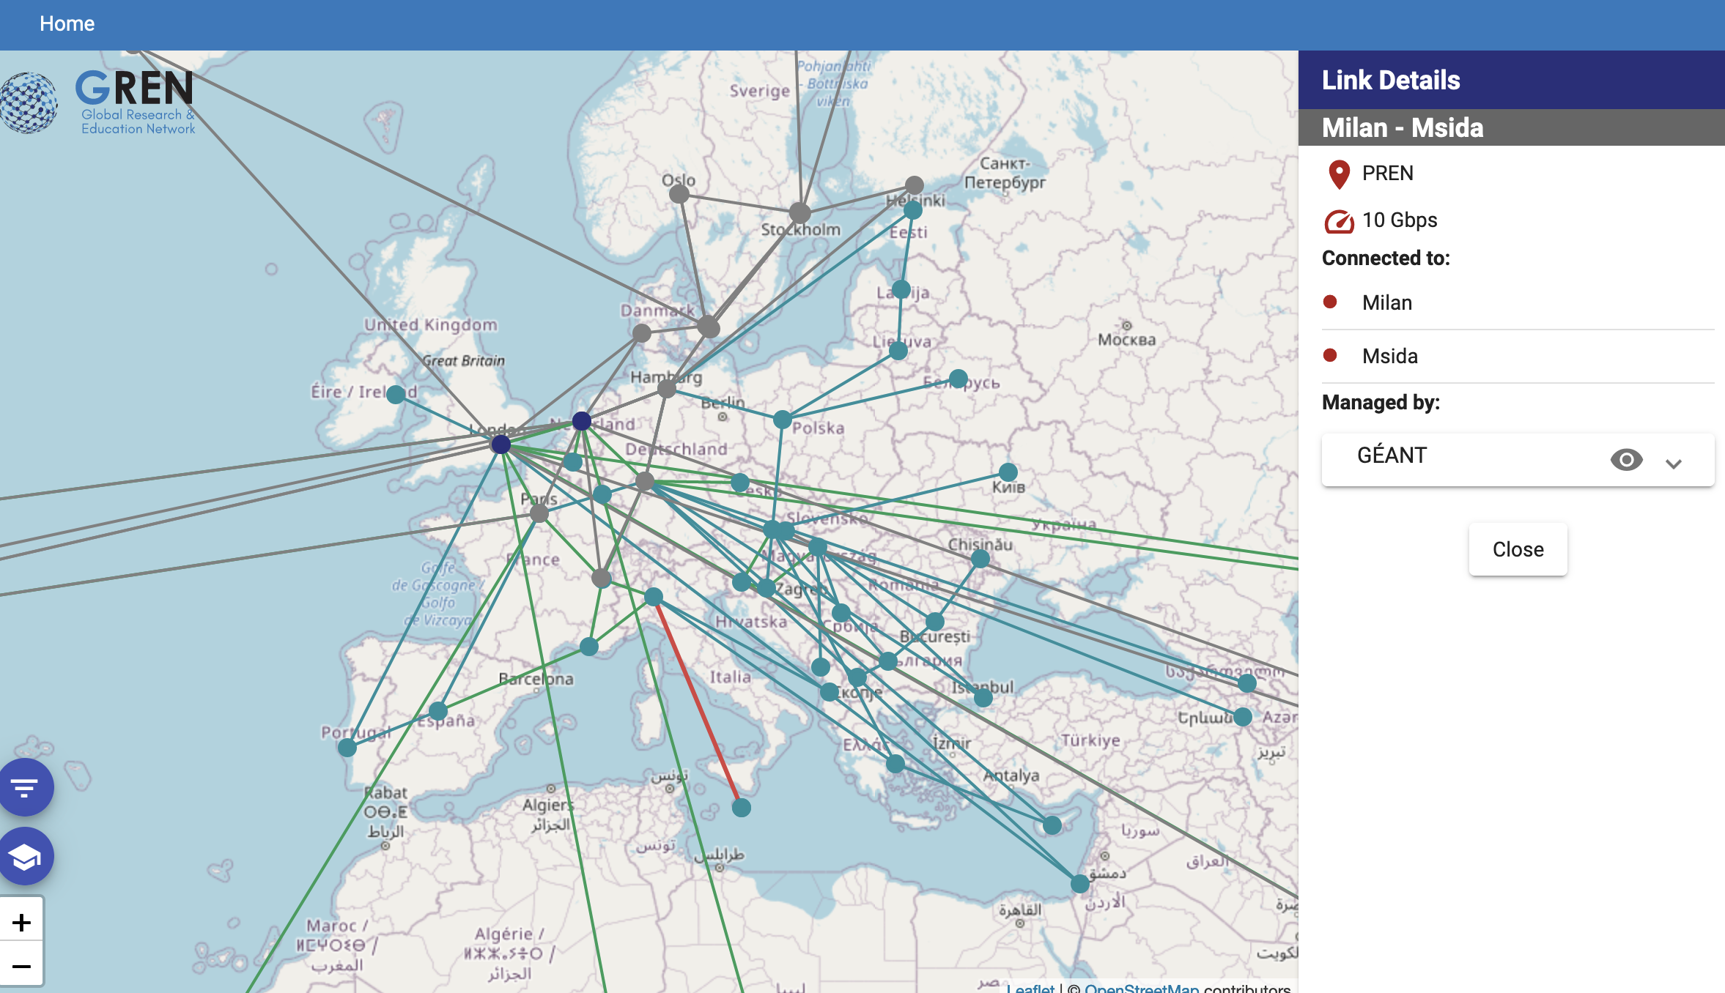
GREN Map Picture placeholder – close view

Slide 6
APPLAUSE
Why do we need a GREN Map?
A: Many current maps are static
B: To stop R&E traffic getting lost en route to destination
C: Every regional map reinvents the wheel
D: To collect and show the entire detailed GREN in one view, right down to individual institutions

Slide 7
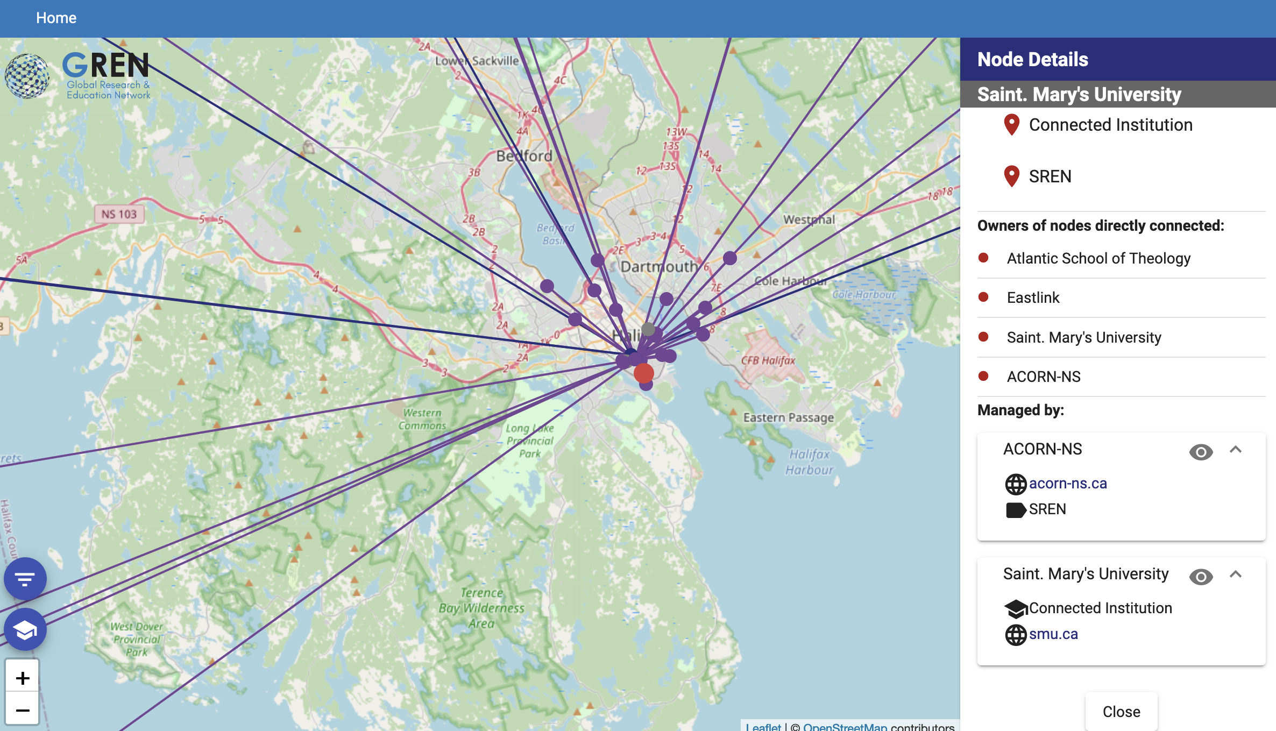
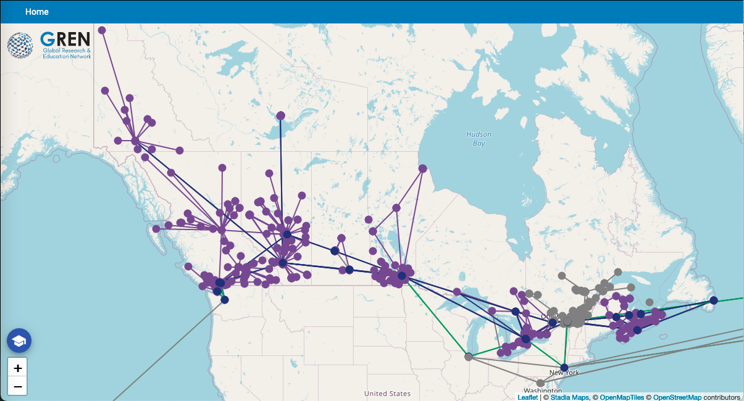
GREN Map Picture placeholder – institution view

Slide 8
What are the barriers to participation in the GREN Map?
A: It's a lot of trouble to prepare the data
B: We might lose control of our own data
C: We already have a map
D: Worries about security and privacy

Slide 9
GREN
PREN
NREN
NREN
NREN
SREN
SREN
SREN
SREN
SREN
Data
Data
Data
Data
Data
Data
Data
Data

Slide 10
APPLAUSE
When will the GREN Map be ready?
A: A copy is under your seat
B: Preparing for full v.1 launch
C: It should be ready in 2063
D: It launched six years ago; why aren’t you using it?

Slide 11
GREN Map Picture placeholder – GitLab page screenshot

Slide 12
APPLAUSE
How do we get involved in the GREN Map?
A: Contact me!
B: Provide direct development support
C: Share your data
D: Join the Working Group

Slide 13
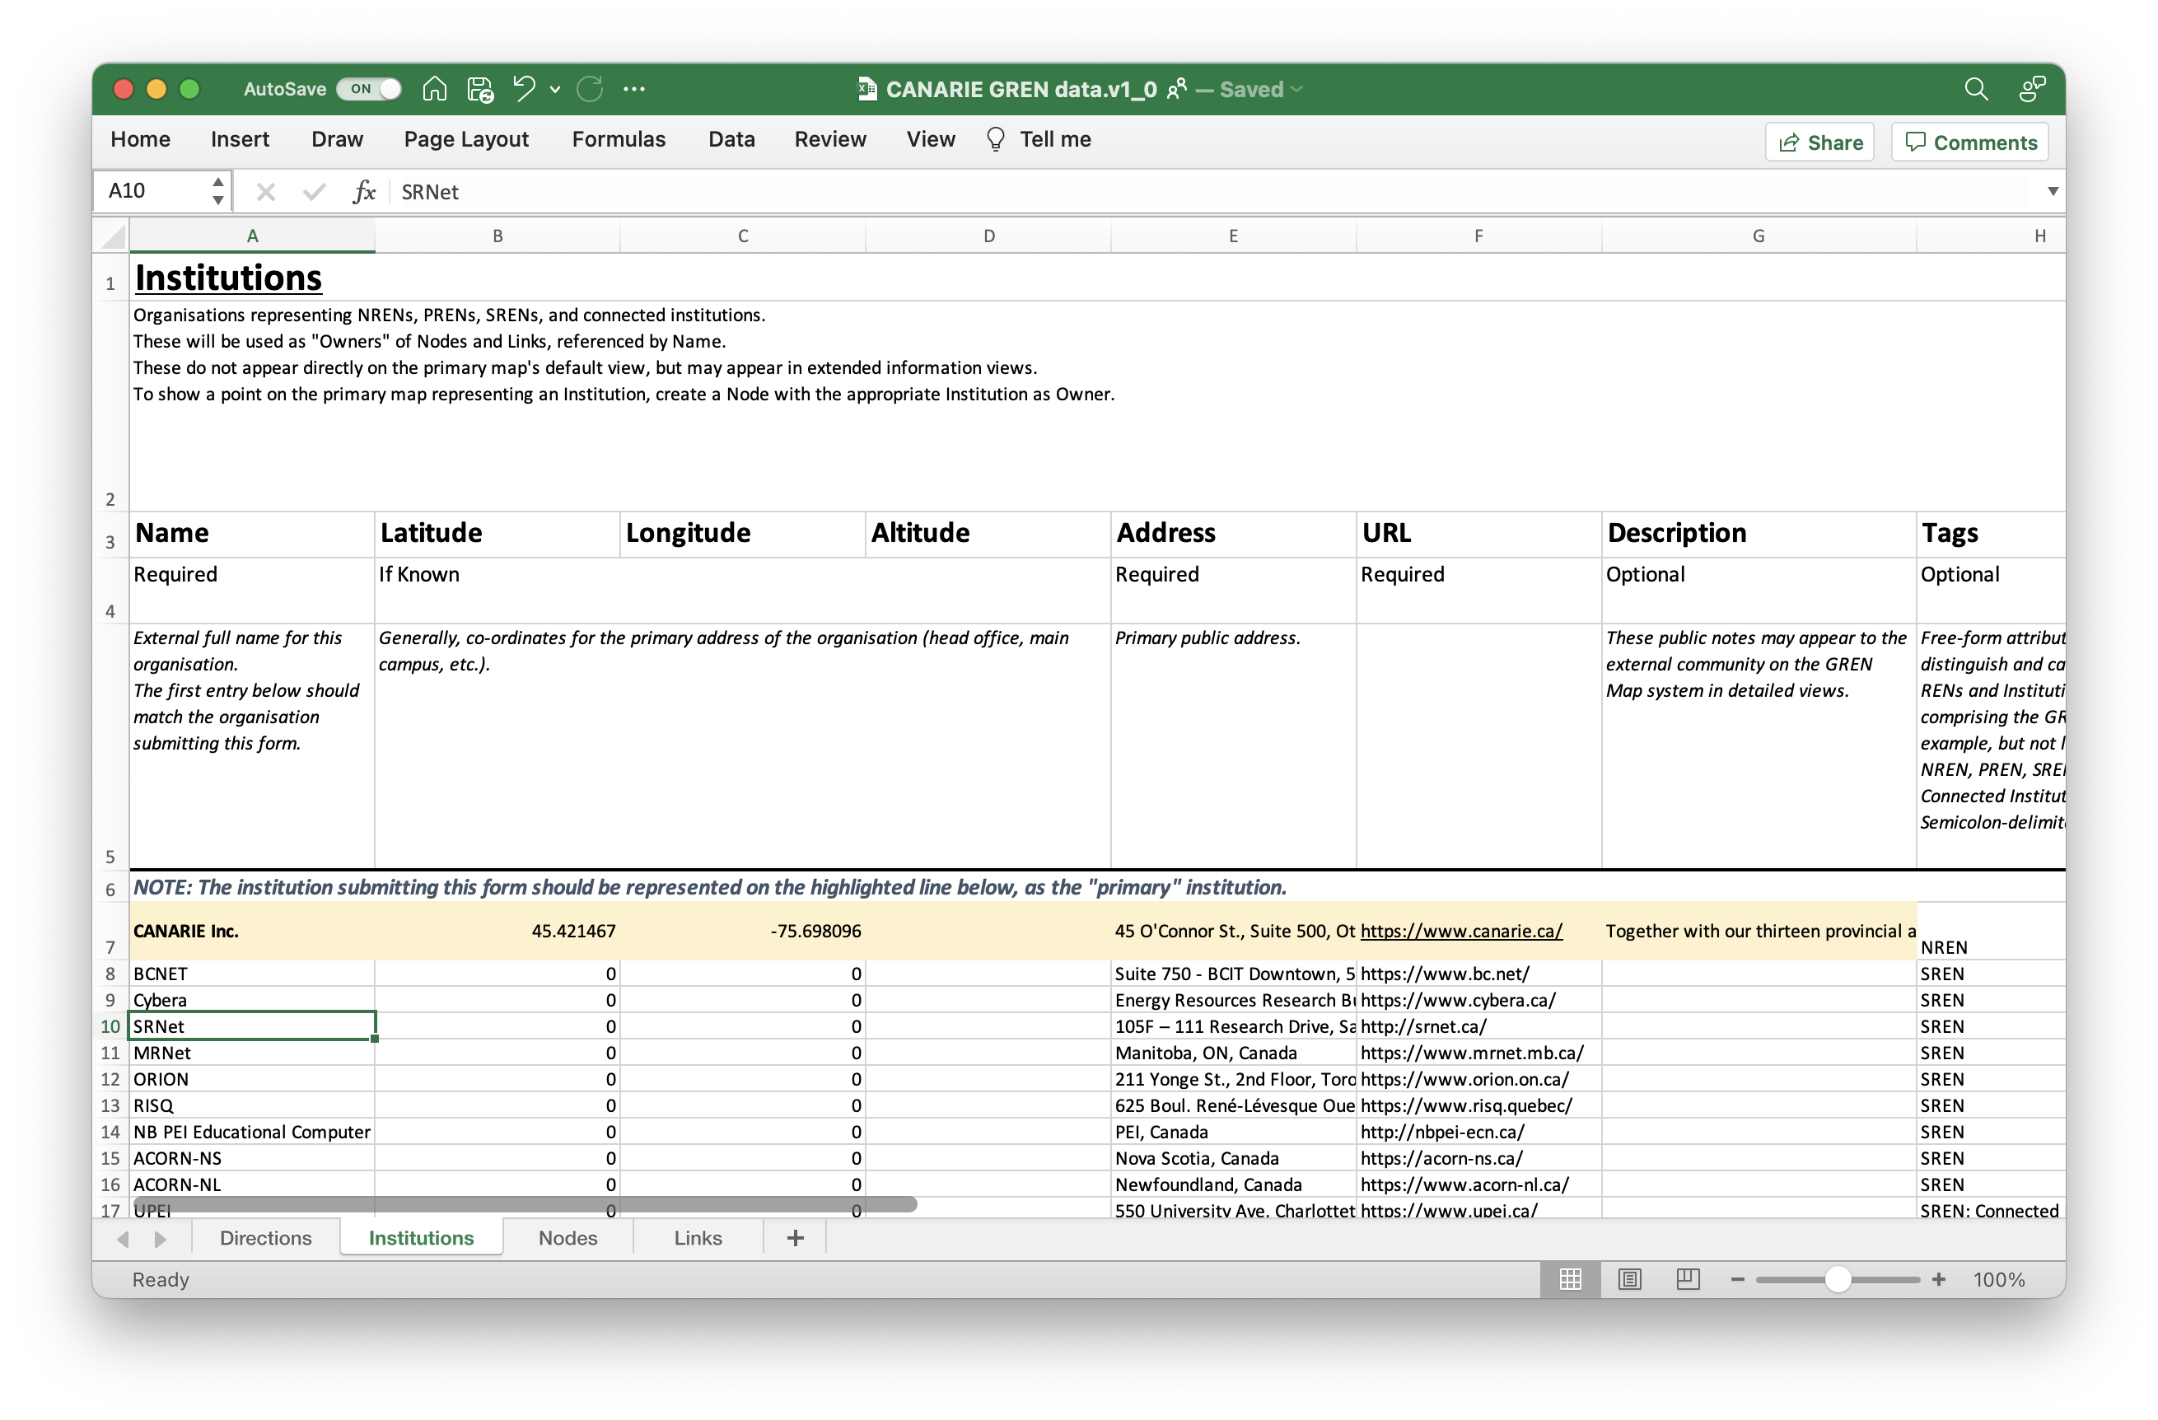
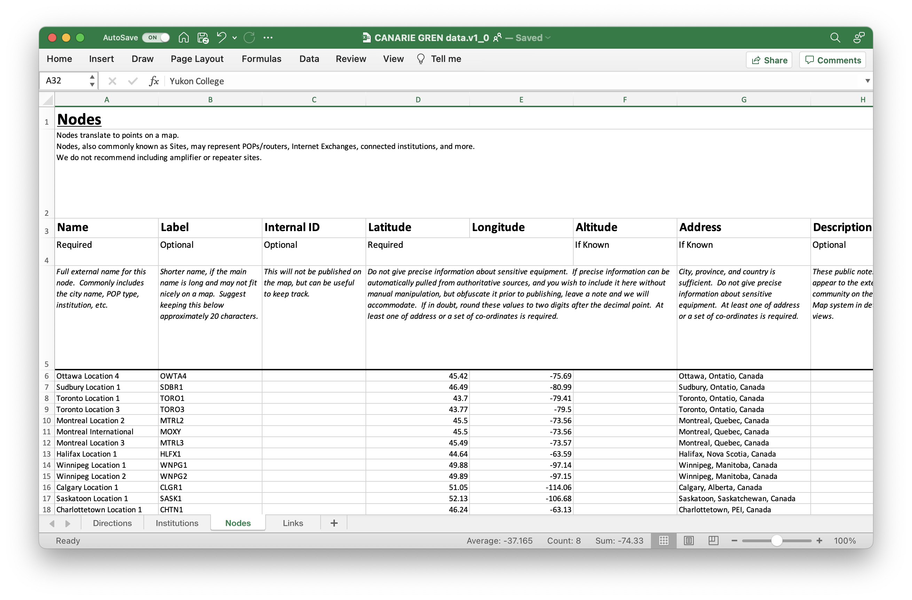
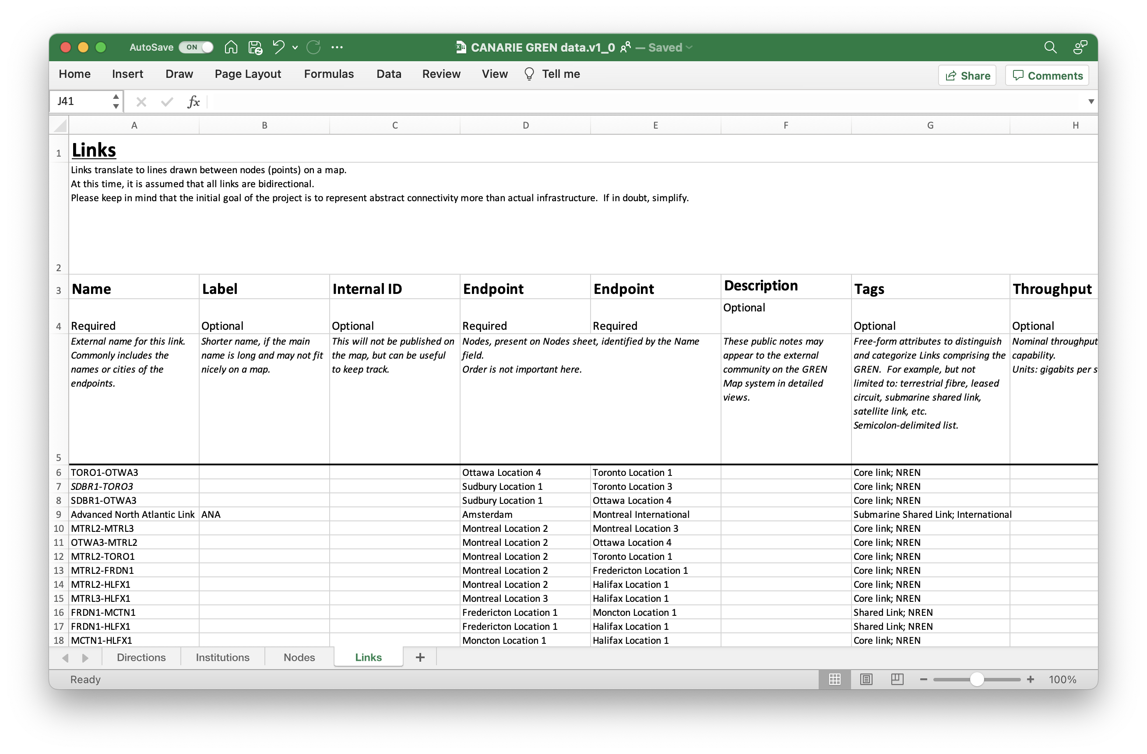
Institutions & Networks
That’s you!
Dots!
Nodes
Lines!
Links
Name
HQ Lat/Long
URL
Name
Lat/Long
Name
Node endpoints

Slide 14
Thanks for playing!
For more info, contact: ryan.davies@canarie.ca

