Slide 2
Agenda
Why Programming the Data Plane
Who and Where
What and some outcomes.
Knowledge collected

Slide 3
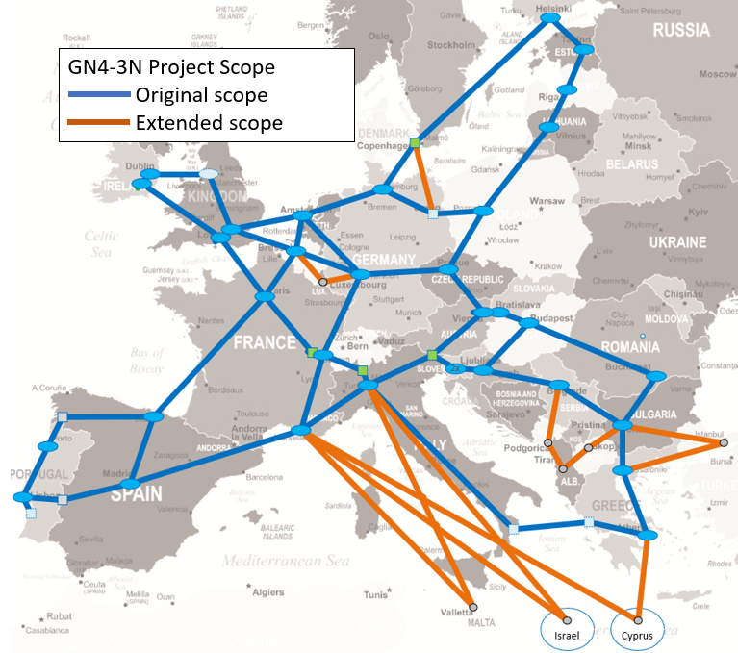
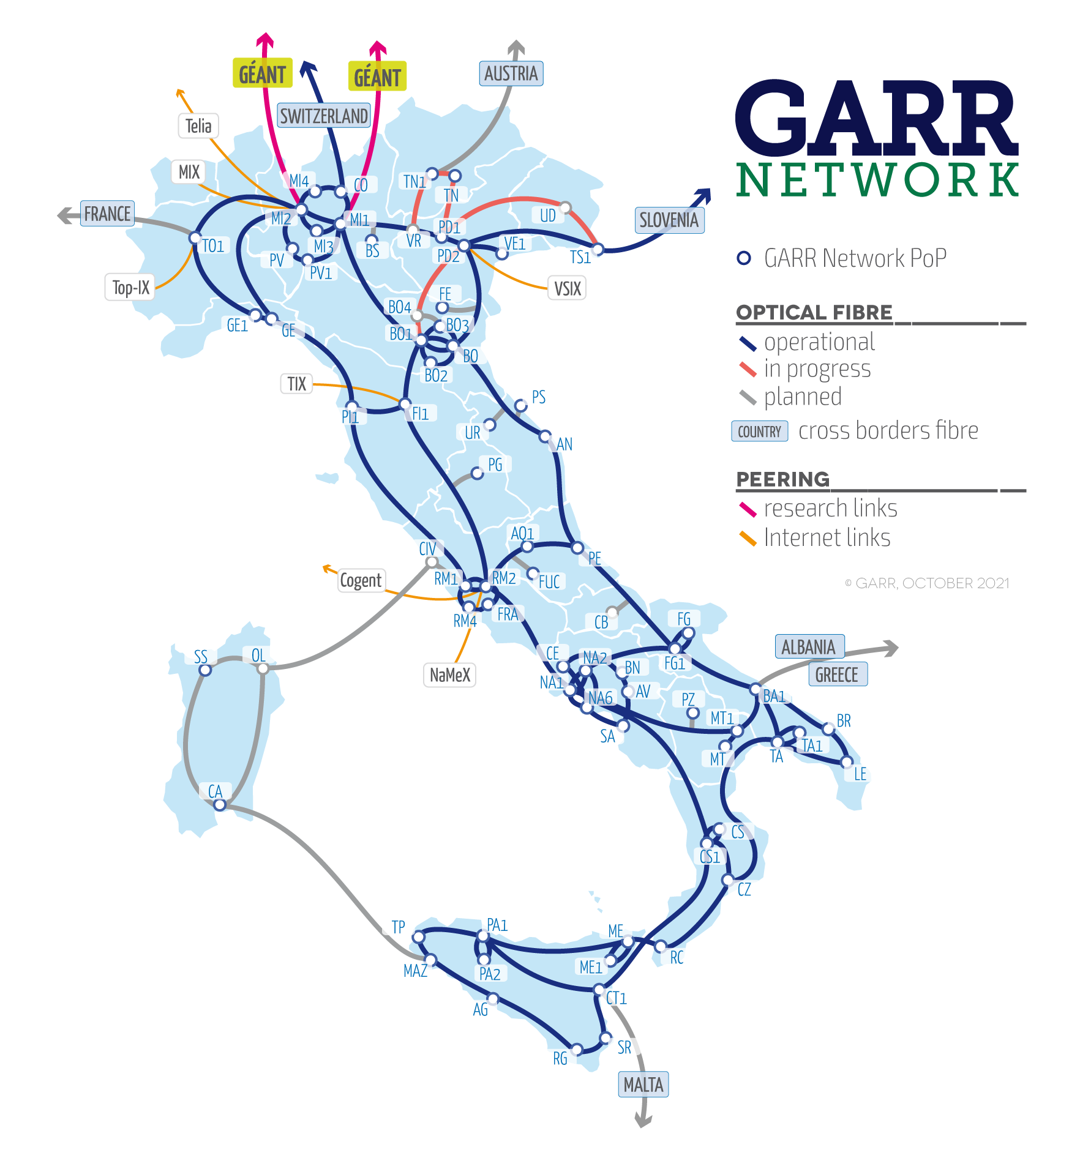
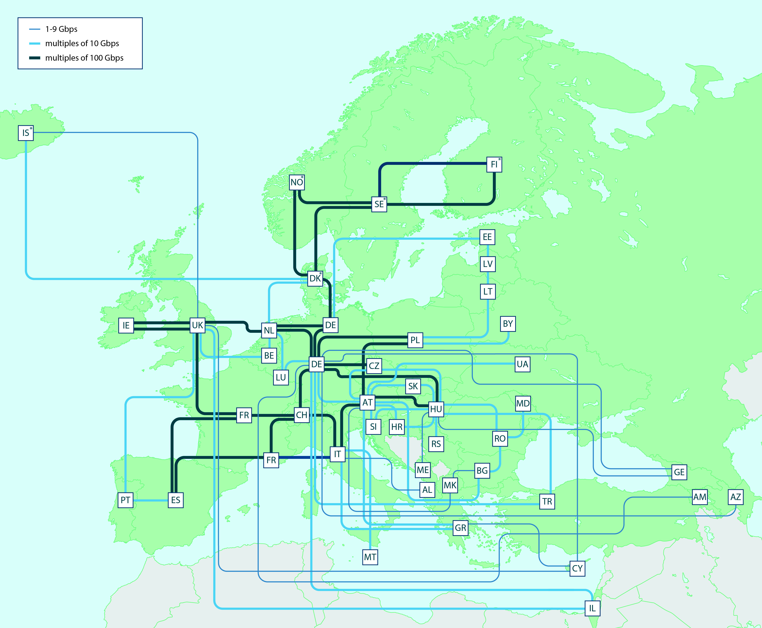
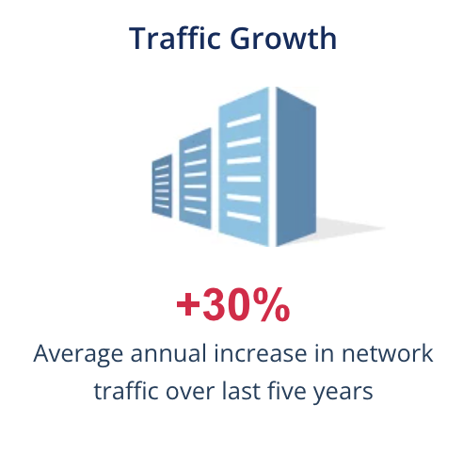
GÉANT fibre Topology
2019
2022 new dark fibre

Slide 4
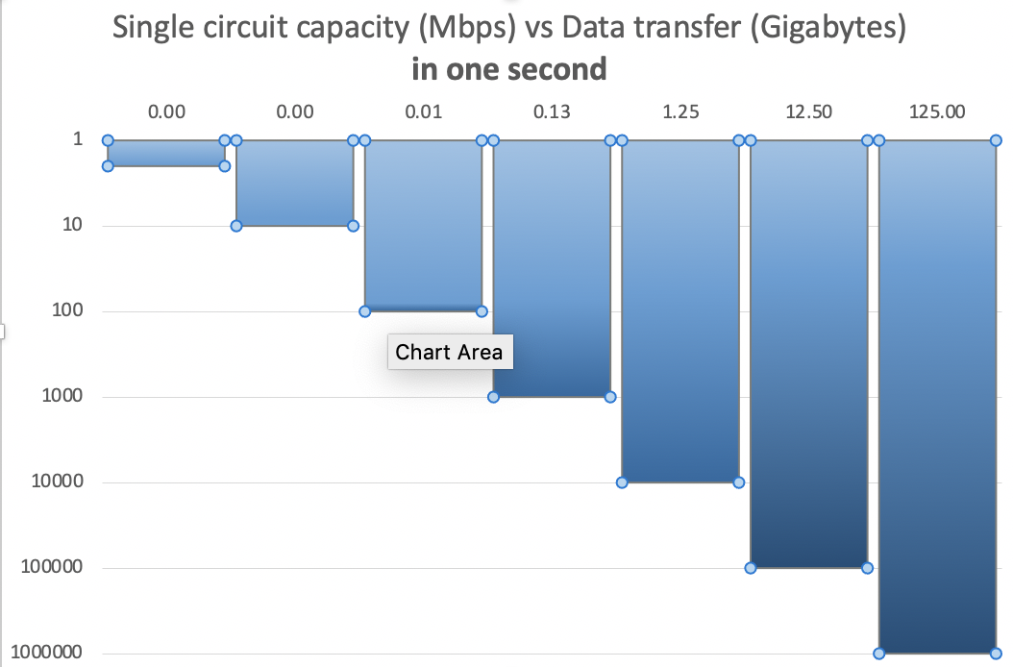
Why this effort ?
Networks’ growth (in capacity and size) “may” need innovative tools for control and monitoring
Contribute to the evolution toward Automated, Programmable, Agile, and Personalized networks
Consider security and real time applications challenges @ 1Tbps
Integration of WAN, LAN, Clouds, Edge in softwarized ”platforms”
New Knowledge on how networks behave at these new “depths”
1000 Gb per second = 125 GB per second

Slide 5
The opportuniuty : innovation in Programming the network stack
(Open) User SW
SDN
Software
Defined Networking
Disaggregating control and switching
~ 2009
e.g. Protocol Independent Switch Architecture
~ 2016
Data Plane
Programming
~ 2019
~ 2022

Slide 6
Programming the data plane
Applying "non switching" logic to all/selected packets
Altering the structure of all/selected packets with "in-house" logic
Improve and personalize monitoring beyond streaming telemetry
fast-feed data plane ”new” information to control plane
Elements became available :
Programming Protocol-Independent Packet Processors : High level, C-like, coding language for controlling packet forwarding planes in networking devices
New silicon (Tofino), FPGA, all P4 enabled at line speed

Slide 7
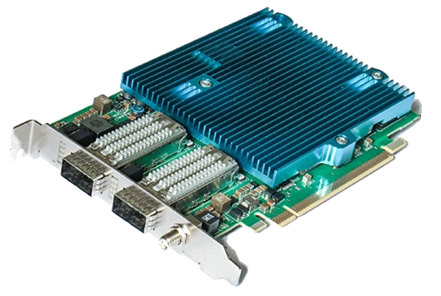
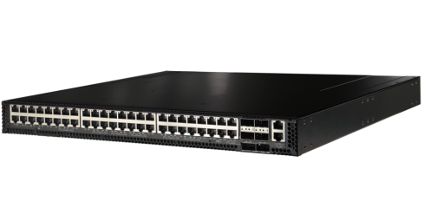
P4 code developed for these platforms (on GitHuB)
BMv2 virtual
P4 software switch
BMv2 Behavioural Model v2 – emulation of Tofino
Uses Mininet
FPGA P4 compiler developed by Cesnet up to 2x100 Gbps
Tofino 1 Asic engineered for data plane programming by Barefoot (now Intel), specific SDE
DPDK (Data Plane Development Kit) kernel software acceleration, 2 P4 to DPDK compilers ( T4P4S and P4C-DPDK)
Netcope NFB-100G2
Edgecore Wedge100BF-32X
P4 on DPDK "off-the-shelf” PC HW

Slide 8
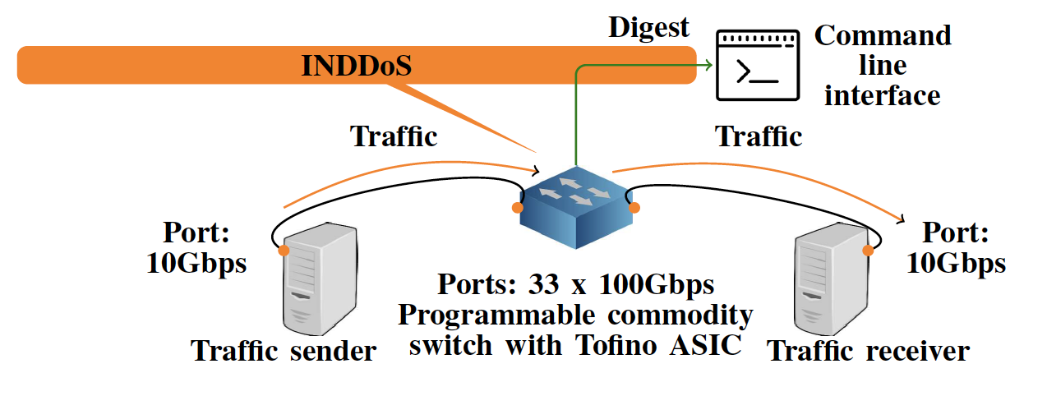
First Use case: DDoS detection in the data plane
A P4 program:
Threshold based identification. Developed an algorithm (BACON) (based on count min-sketch, Bitmap) to minimize memory occupancy, preserving identification precision of attackers and targets for further decision on mitigation by an external controller.

Slide 9
DDoS : lessons learned
Developing the P4 program in the virtual environment facilitates prototyping, implementing in hardware requires careful tuning
Efficient identification, threshold based, in the data plane at line-rate works well, within scale ranges
Algorithms require many/all processing stages in the Tofino ASIC. The P4 program has to be limited in complexity to preserve line-rate processing and preserve staged for switching logic
Central processing and memory resources are only partially used
Processing time increases packet delay slightly (about 100 ns)

Slide 10
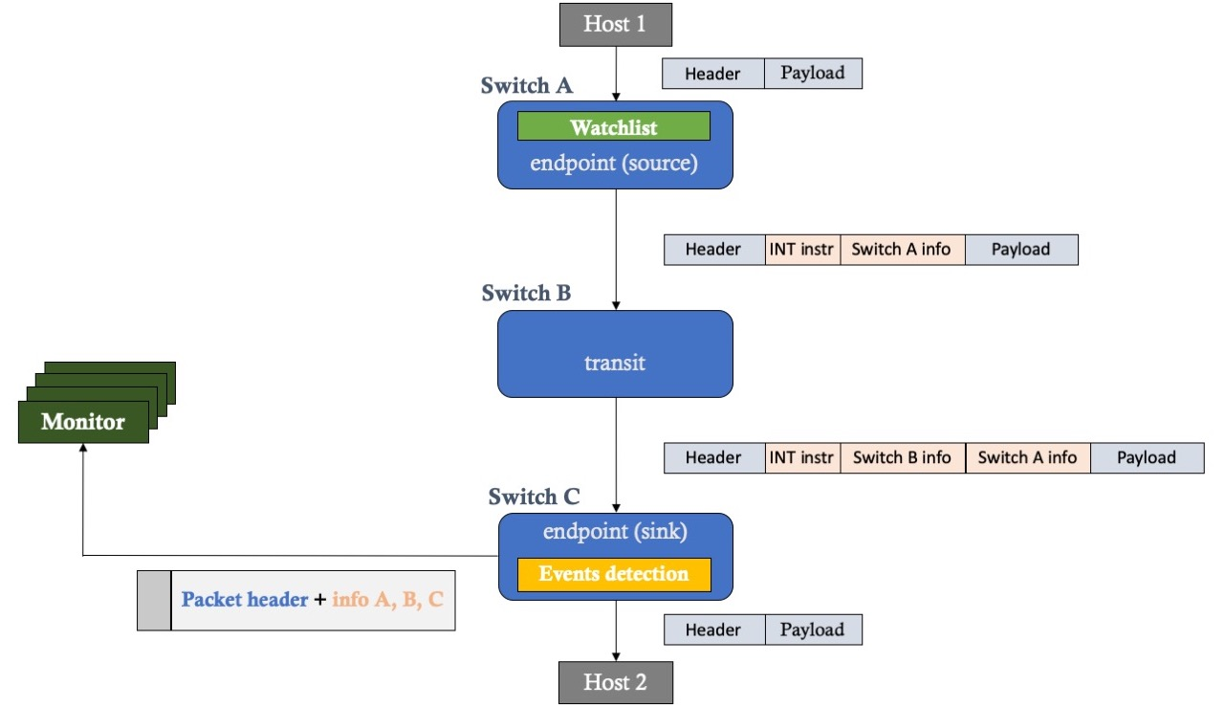
Second Use case: In-Band Network Telemetry (INT)
INT alters structure of selected packets, in the fly, to store and transport information in-band, in real time
INT functions
INT source node adds a small INT header to every chosen packet containing e.g. Switch IDs, Interfaces IDs, Timestamps, Link and queue utilization
INT transit nodes add specific local
The last INT sink node extracts, may analyze and and sends informstion to a a collector
INT source
INT Collector
INT transit
INT sink

Slide 11
INT test set-up (FBK to Cesnet)
PSNC (Back-end)
FBK
Server
UDP+INT
UDP
- - - ∘∘
Non-INT router
Wedge
Server1
INT-analytics
- - - ∘∘
GÉANT NRENs
networks
UDP+INT
User app
int-platforms/tofino
Non-INT router
INT data
Traffic
mirror
Server
INT-collector
INT data
Non-INT router
FPGA card
- - - ∘∘
UDP+INT
int-platform-fpga
INT report
INT data
INT data
NIC card
int-platform-fpga
(collector)
CESNET
Grafana

Slide 12
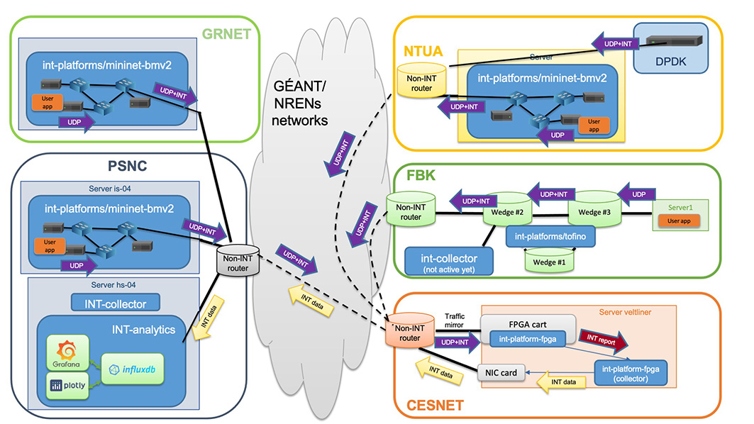
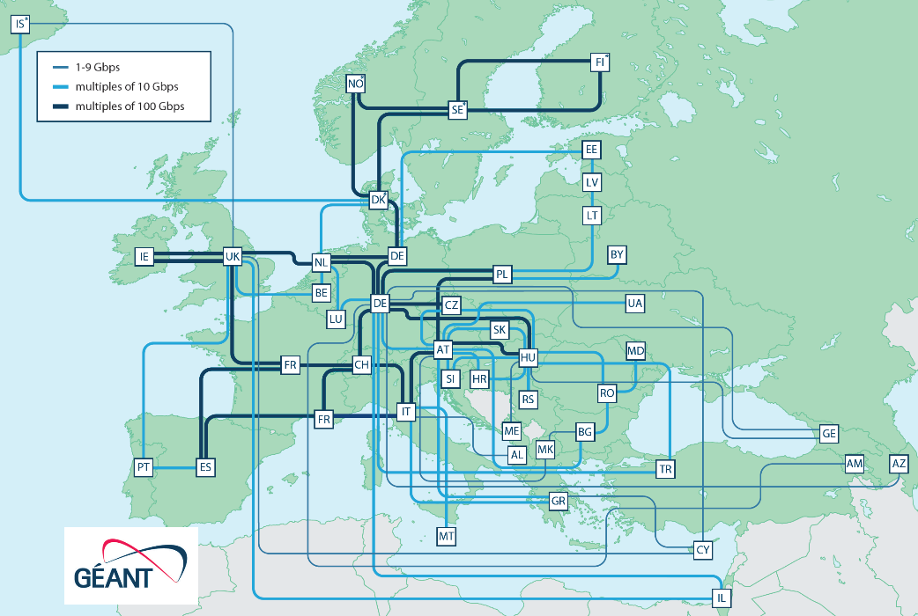
Our INT testbed over production NREN networks
GREECE
GREECE
POLAND
ITALY
4 switch platforms
UDP packets flow in NRENs networks
Collected INT data in CESNET is sent to PSNC for collection and presentation.
CZECH REPUBLIC
Packet carries timestamps, sequence number in INT headers between Source (all) and Sink node (CESNET)
UDP packets generated at constant rate ~1k to 300k pps

Slide 13
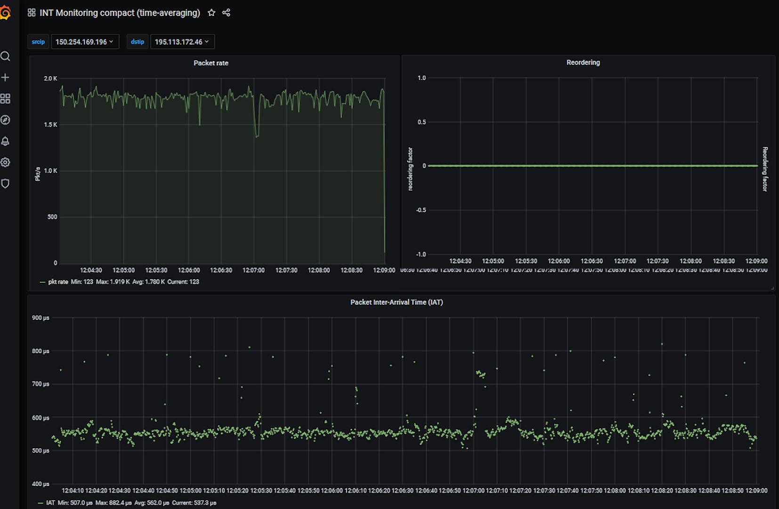
5 minutes of the INT tags in a single UDP flow PSNC to CESNET
5 minutes (~540K points)
Packet rate (1.8K pps)
Flow of about 1 Mbps
Reordering (and loss) (none)
100 𝞵s
Packet inter-arrival time (550 𝞵s average -1 packet is ~2 𝞵s on 1 Gb LAN)

Slide 14
Testing NRENs’ networks effect on a flow – first results
Measure at the source a flow inter packet gap (IPG) as the time between subsequent pairs of packets (function of capacity/packets per second)
Measure at sink for the same flow the IPG between same pairs
Subtract source IPG from sink IPG to remove variation due to the source
If the networks behve “well”, it should preserve the flow characteristics and the IPG at the source and at the ned should be almost identical
Note:
Timestamp are set in HW (ns precision) at swith ingress
No packet losses/reordering have been noticed
Collector-InFluxDB communication and performace sub-optimal still

Slide 15
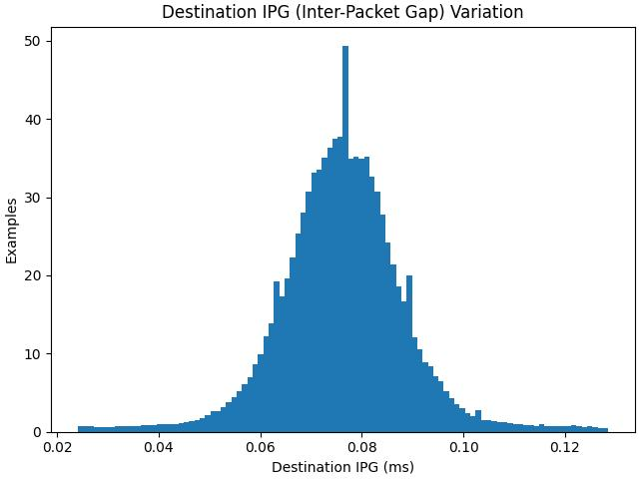
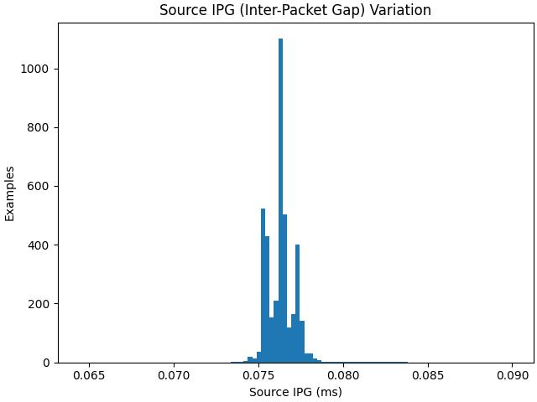
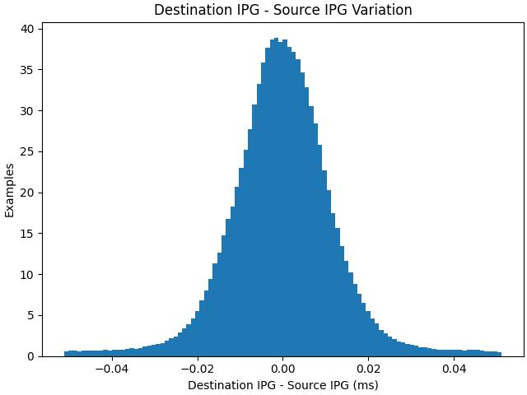
Testing NRENs’ networks effect on a flow
2Mbps (user), 120 sec, payload 20B, expected IPG 76.29 µs, 13108 pkts/s
destination
source
20 𝞵s
20 𝞵s
Network effect
20 𝞵s

Slide 16
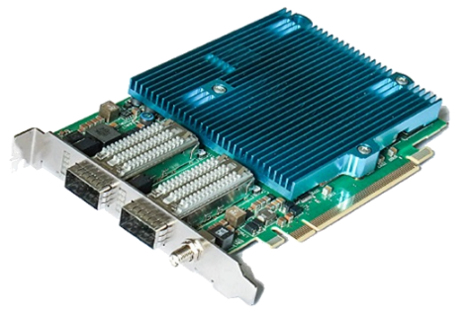
Platforms for INT : Lessons Learned
BMv2/mininet: good to set-up initial P4 program development (performance/jitter ceiling)
Tofino switches: feature-rich for P4, limited central memory, non standard timestamping
FPGA card: very flexible HW, large memory
P4 compiler quality: vital
Specific HW insight is required
INT-DPDK :
Promising performance up to few Gbps
Needs careful selection of Network Interface Cards, (timestamping, etc…)
P4 to DPDK compiler quality may vary
Bmv2 virtual
P4 software switch
P4 on DPDK implementation

Slide 17
Challenges, engineering and sustainabiity
Expertise on a tight integration of HW and software. Almost all participants left to private environment since the start of the effort
Fast software updates in each platform requiring P4 program re-validation
Not sufficient standardization on timestamp format, HW implementation and propotocol (e.g. PTP) support
A strong backend is also needed for data collection, storage, presentation. Essential for scalability

Slide 18
The steps to set-up INT from scratch
Choose INT data and Header position
INT headers contain source and destination timestamp, sequence number, placed between UDP and payload
Coding using P4
HW programming, limited cycles and memory, lack of complex arithmetic operations, lower flexibility in the use of registers
Collector for INT data
Tuned InfluxDB (up to 300K INT data/s multiple threads)
Visualization
Grafana, Plotly , added IPDV computation in data plane
Analyze
"Knowledge" under development
Time synchronization to be tuned to sufficient precision (few microseconds, ns), need also node internal clock stability
Notes:
Some arithmetics operation and

Slide 19
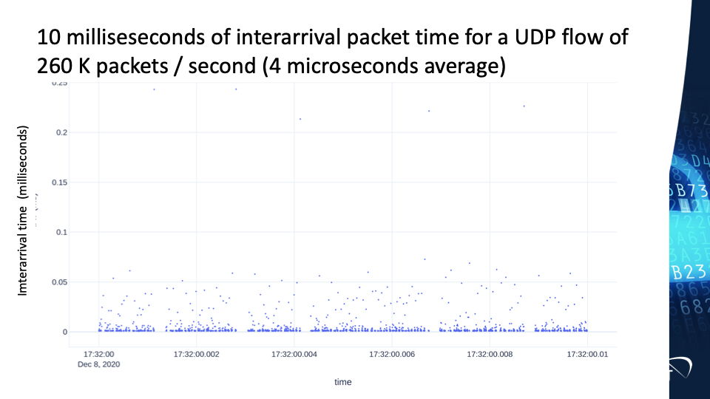
10 ms of inter-arrival packet time, 1 UDP flow of 260 K pps (~3.3 𝞵s average) FBK to CESNET (1 packet is ~2 𝞵s @ 1 Gb LAN)

Slide 20
Data “velocity” in In-Band Network Telemetry
Assuming that every packet is monitored :
Flow rate | Only 64B packets (+20B interpacket gap) | Only 1518B packets (+20B interpacket gap) | Only 9018B packets (+20B interpacket gap)
100Mbps | 149K reports/s | 8.13K reports/s | 1.38K reports/s
1Gbps | 1.49M reports/s | 81.3K reports/s | 13.8K reports/s
10Gbps | 14.9M reports/s | 813K reports/s | 138K reports/s
100Gbps | 149M reports/s | 8.13M reports/s | 1.38M reports/s
Means OK for "our" INT testbed
Performance has also to scale by the number of simultaneously monitored connections
INT reports require near real-time data processing or batch processing:
Generate events (anomalies)
Calculate aggregated statistics
Provide visualisation

Slide 21
Ways to improve INT scalability (if higher-rate, more than one flow)
Control Plane level
Data Plane level
INT exporting
INT collection
INT preprocessing
INT storaging
INT visualisation
INT analytics
Control Plane or Application systems
P4 language
Data filtering
Kafka Streaming cluster
eXpress Data Path
Key events finding
Data Plane Development Kit
ElasticSearch cluster
Data aggregation
extended Berkeley Packet Filter
InfluxDB Enterprise cluster
Time resolution
Spark cluster
Remote Direct Memory Access
Data Plane
level
More generality and flexibility, bigger server clusters
Many limitations, hardware special requirements
Control Plane
level

Slide 22
Final considerations
NRENs’ networks handle well flows at sub-second scale or lower
Data Plane Programming) (using P4) is not business-as-usual, requires specific, scarce expertise (fastly changing, mixing ICT, network and data)
The request for specific HW does not facilitate wide implementation yet
INT offers an agile tool for high frequency monitoring, supporting new control plane mechanisms and debugging in real time. INT can be used by both providers and independently by end-users
Monitoring network at second, or lower, scale provides complex results , and transient effects are evident also at milliseconds range

Slide 23
Data “velocity” in In-Band Network Telemetry
Assuming that every packet is monitored :
Flow rate | Only 64B packets (+20B interpacket gap) | Only 1518B packets (+20B interpacket gap) | Only 9018B packets (+20B interpacket gap)
100Mbps | 149K reports/s | 8.13K reports/s | 1.38K reports/s
1Gbps | 1.49M reports/s | 81.3K reports/s | 13.8K reports/s
10Gbps | 14.9M reports/s | 813K reports/s | 138K reports/s
100Gbps | 149M reports/s | 8.13M reports/s | 1.38M reports/s
Means OK for "our" INT testbed
Performance has also to scale by the number of simultaneously monitored connections
INT reports require near real-time data processing or batch processing:
Generate events (anomalies)
Calculate aggregated statistics
Provide visualisation

Slide 24
Ways to improve INT scalability (if higher-rate, more than one flow)
Control Plane level
Data Plane level
INT exporting
INT collection
INT preprocessing
INT storaging
INT visualisation
INT analytics
Control Plane or Application systems
P4 language
Data filtering
Kafka Streaming cluster
eXpress Data Path
Key events finding
Data Plane Development Kit
ElasticSearch cluster
Data aggregation
extended Berkeley Packet Filter
InfluxDB Enterprise cluster
Time resolution
Spark cluster
Remote Direct Memory Access
Data Plane
level
More generality and flexibility, bigger server clusters
Many limitations, hardware special requirements
Control Plane
level

Slide 25
Acknowledgements
The effort reported has received essential contributions from many GÉANT participants and specifically:
Damu Ding (Italy), Federico Pederzolli (Italy), Pavel Benacek (Czech Republic),
Tim Chown (Jisc UK), Ivana Golub (PSNC Poland),
Xavier Jeannin (RENATER France)
Thanks !

Slide 26
More information on GÉANT Data Plane Programmability activity
Data Plane Programming / INT GEANT web page https://wiki.geant.org/display/NETDEV/INT Includes all documents produced and a pointer to GitHub INT P4 code
Mailing list: https://lists.geant.org/sympa/subscribe/int-discuss,
White Paper INT Tests in NREN networks – DPP WP6 T1 white paper https://www.geant.org/Resources/Documents/GN4-3_White-Paper_In-Band-Network-Telemetry.pdf
DDoS Paper: "In-Network Volumetric DDoS Victim Identification Using Programmable Commodity Switches", F. Pederzolli, M. Campanella and D. Siracusa, in IEEE Transactions on Network and Service Management, Vol. 18, Issue: 2, June 2021, page: 1191-1202, DOI: 10.1109/TNSM.2021.3073597 and at https://arxiv.org/abs/2104.06277
The GÉANT First (and second )Telemetry and Big Data Workshop https://wiki.geant.org/display/PUB/Telemetry+and+Big+Data+Workshop https://events.geant.org/event/1104/

Slide 27
Non GEANT References
The Programmable Data Plane Reading List : https://programmabledataplane.review/
Oliver Michel, Roberto Bifulco, Gábor Rétvári, Stefan Schmid, "The Programmable Data Plane: Abstractions, Architectures, Algorithms, and Applications", ACM Computing Surveys, Volume 54, Issue 4, May 2021, Article No.: 82, pp 1–36, https://doi.org/10.1145/3447868 10.36227/techrxiv.12894677.v1 https://www.univie.ac.at/ct/stefan/csur21.pdf
"A Survey on Data Plane Programming with P4: Fundamentals, Advances, and Applied Research", Frederik Hauser, Marco Häberle, Daniel Merling, Steffen Lindner, Vladimir Gurevich, Florian Zeiger, Reinhard Frank, and Michael Menth (50 pages).26 Jan 2021, to be published in" Communications Surveys & Tutorials (COMST) journal --https://arxiv.org/pdf/2101.10632.pdf
Kaur, Sukhveer & Saluja, Krishan & Aggarwal, Naveen. (2021). "A review on P4-Programmable data planes: Architecture, research efforts, and future directions". Computer Communications. 170. 10.1016/j.comcom.2021.01.027.
IOAM: https://datatracker.ietf.org/wg/ioam/about/

