Slide 1
Propelling Australia’s Digital Life Science Research with Collaborative Research Infrastructure
Jim Basney Principal Research Scientist - CILogon
John Scullen
Head, Projects & Managed Services - Australian Access Federation

Slide 2
Background

Slide 3
Context: R&E in Australia
High penetration of enterprise solutions like Okta and Azure AD
Largely addressed on-campus and cloud IDM challenges
Don’t handle federation (as we know it). >1 IdP = 🤯
Increasing need to include non-AAF research partners
government agencies
hospitals
smaller medical research institutes
commercial providers

Slide 4
Context: R&E in Australia
Growing recognition of the need for improved security:
more robust identity assurance
authentication assurance (multi-factor authentication)
signaling assurance levels between federation participants
coordinated intelligence and incident response

Slide 5
Australian BioCommons (think ELIXIR for Australia)
Mission: Enhancing Australia’s digital life science research through world class collaborative distributed infrastructure
30,000 life science researchers in Australia
Approach
Repurpose as much existing work as possible
Compatibility with international counterparts
Get the right experts together and work out what to do from there
Partner with existing providers to operate infrastructure

Slide 6
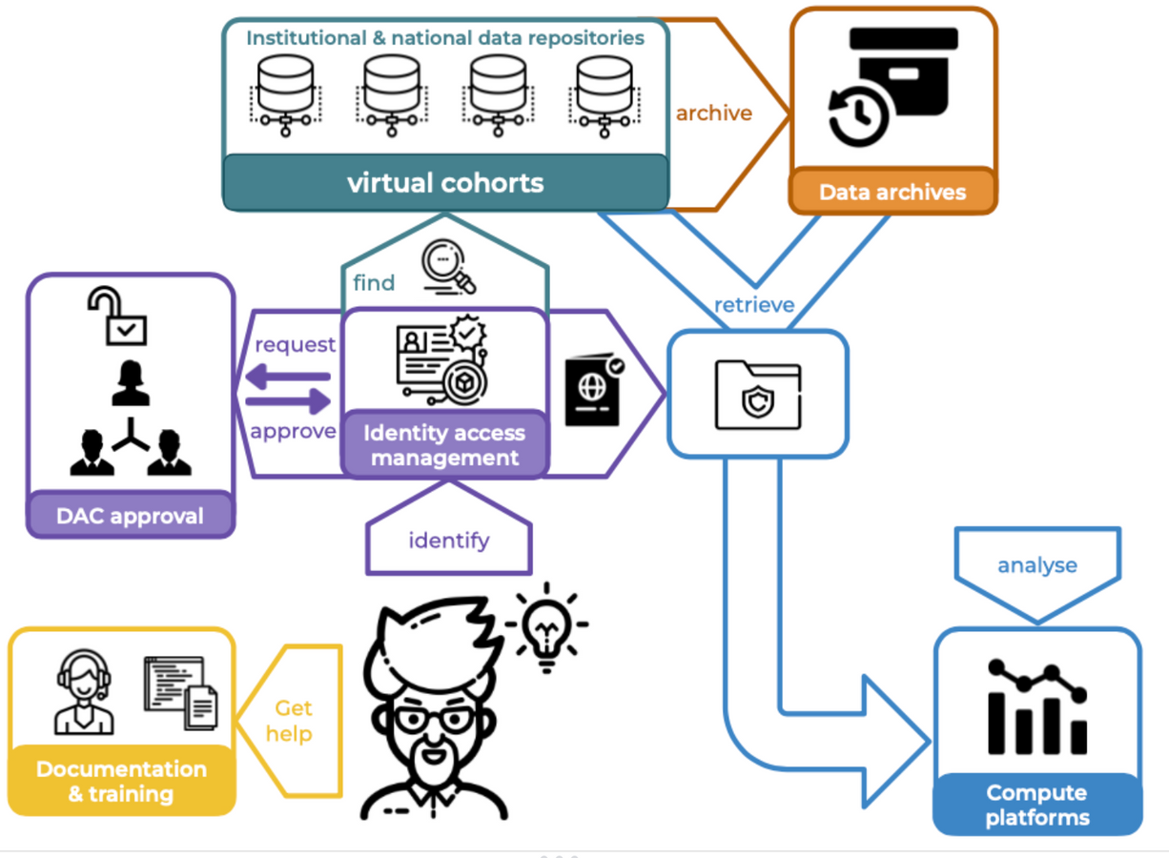
Pilot: Human Genomes Platform Project
Work Packages
Virtual cohorts
Streamline the Data Access Committee (DAC) process
Federated identity and access management
Data and metadata archiving
Documentation and training

Slide 7
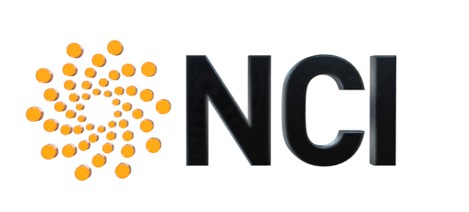
HGPP Partners
Notes:
Includes the largest players in human genome research in Australia

Slide 8
Challenges
No F2F interaction
Diverse collaboration networks
most not AAF customers.
Diverse technologies
OIDC, SAML
Web, command line, sensors and instruments
Need to build workflows between different service providers
No common rules or shared expectations re: trust and identity

Slide 9
Challenges (continued)
Sensitive data (human genomics)
catalyst for REFEDS Assurance Framework
Unfamiliar solution components – Gen3, Terra, REMS, Beacon, CTRL, GA4GH Passports
Difficult to coordinate Data Access Committees (DAC) approvals
membership from multiple organisations
relies on email trails for approval
requests for further information add latency
process is opaque to the requestor and DAC members
Notes:
CTRL (sample donor consent management)

Slide 10
Solution Building Blocks
Start with AARC: https://aarc-project.eu
AARC Policy Development Kit
AARC Blueprint Architecture
do-it-yourself (DIY)
eduTEAMS
CILogon
REFEDS Assurance Framework (RAF)¹
REFEDS MFA Profile
¹ https://refeds.org/assurance

Slide 11
Opportunities
Growing recognition of AARC Blueprint Architecture for research communities and the role of tools like CILogon
Growing awareness and acceptance of CILogon as a capable solution
Reseller arrangement with CILogon
AAF working to secure government funding to establish ongoing T&I capability

Slide 12
Process
Requirements
review background material
interview subject matter experts
validate and classify
Identify Requirements
Record new / updated reqs
Select priorities for prototyping
Test / review
Implement / pilot
Prototype
Production solution
Production

Slide 13
CILogon

Slide 14
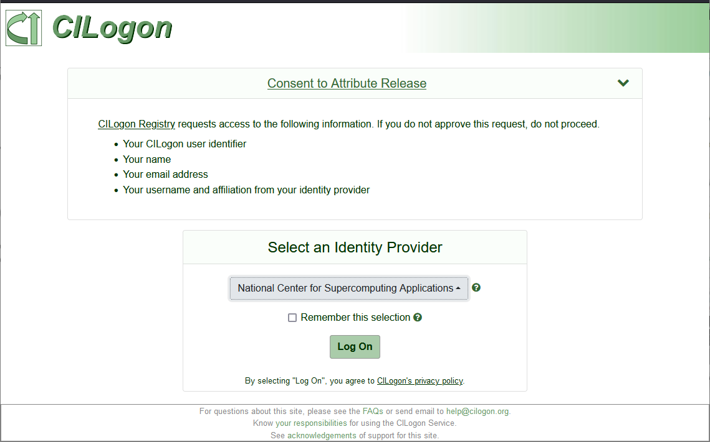
Introduction to CILogon
Federated identity management enables researchers to use their home organization identities to access research applications
17,500+ active users
450+ organizations globally

Slide 15
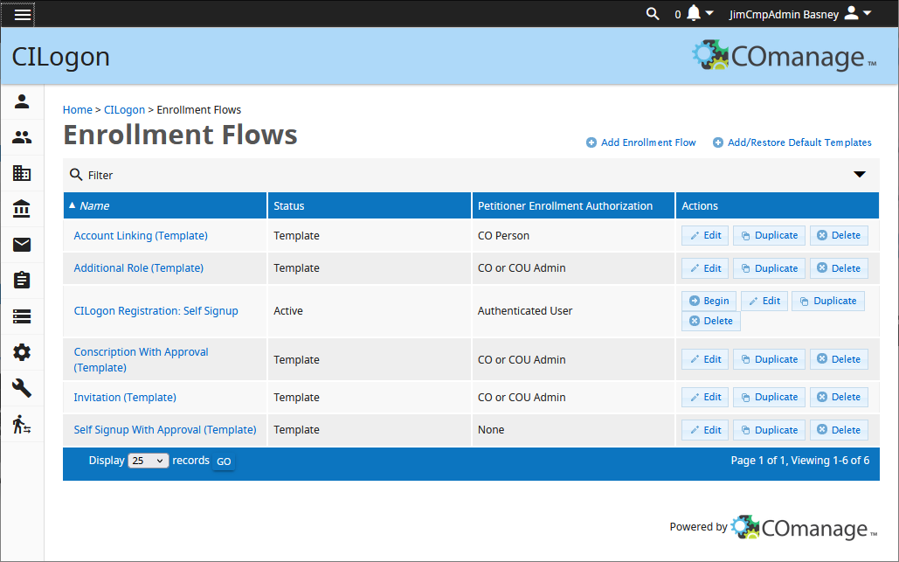
Introduction to CILogon (cont)
CILogon enables researchers to log on to cyberinfrastructure (CI) by providing coherent identity and access management for research collaborations
via hosted cloud IAM services
according to the AARC Blueprint Architecture

Slide 16
CILogon Platform
Science App
X.509 CA
HSM
Science App
OIDC Provider
COmanage
Identities
Tokens
SSH Keys
Groups
Attributes
Apps
Grouper
Advanced AuthZ
Supporting access to science applications:
HPC clusters
Jupyter notebooks
Globus
REST APIs
etc.
Identity providers from:
Home organisations (SAML / Azure AD)
external sources (Google, Microsoft, ORCID, Github)
Science App
SAML IdP
Science App
SciTokens
Science App
LDAP
User Registry
AAF IdP
SAML SP
eduGAIN IdP
Google IdP
OIDC SP
ORCID IdP
OAuth SP
GitHub IdP
Notes:
[ ] convert image to separate objects

Slide 17
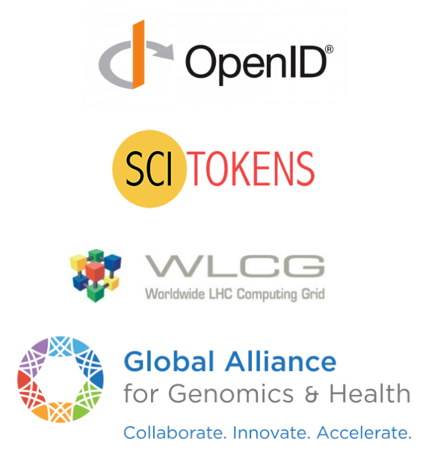
JSON Web Tokens for Science
containing user attributes and group memberships from the research community (via COmanage) and from the researcher's home institution via AAF / InCommon (eg. SCiMMA)
containing authorization scope values determined by per client/subscriber policy (eg. LIGO)
support for wlcg.groups and storage.*|compute.* scopes (eg. Fermilab)
support for Affiliation And Role, Accepted Terms And Policies, ResearcherStatus, ControlledAccessGrants, and LinkedIdentities (eg. Australian BioCommons)

Slide 19
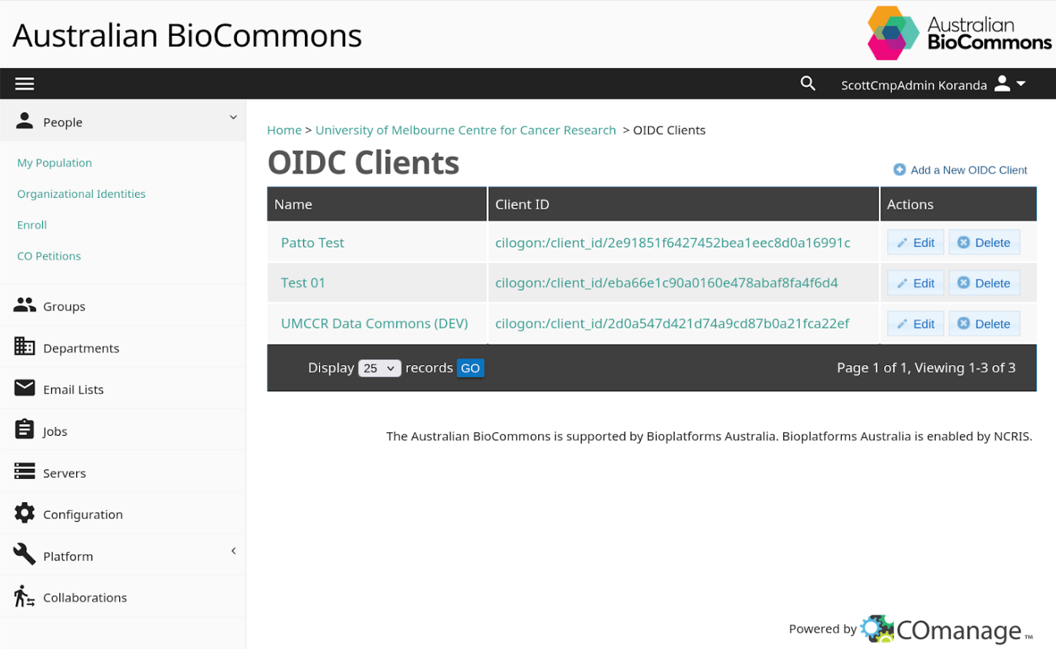

Slide 20
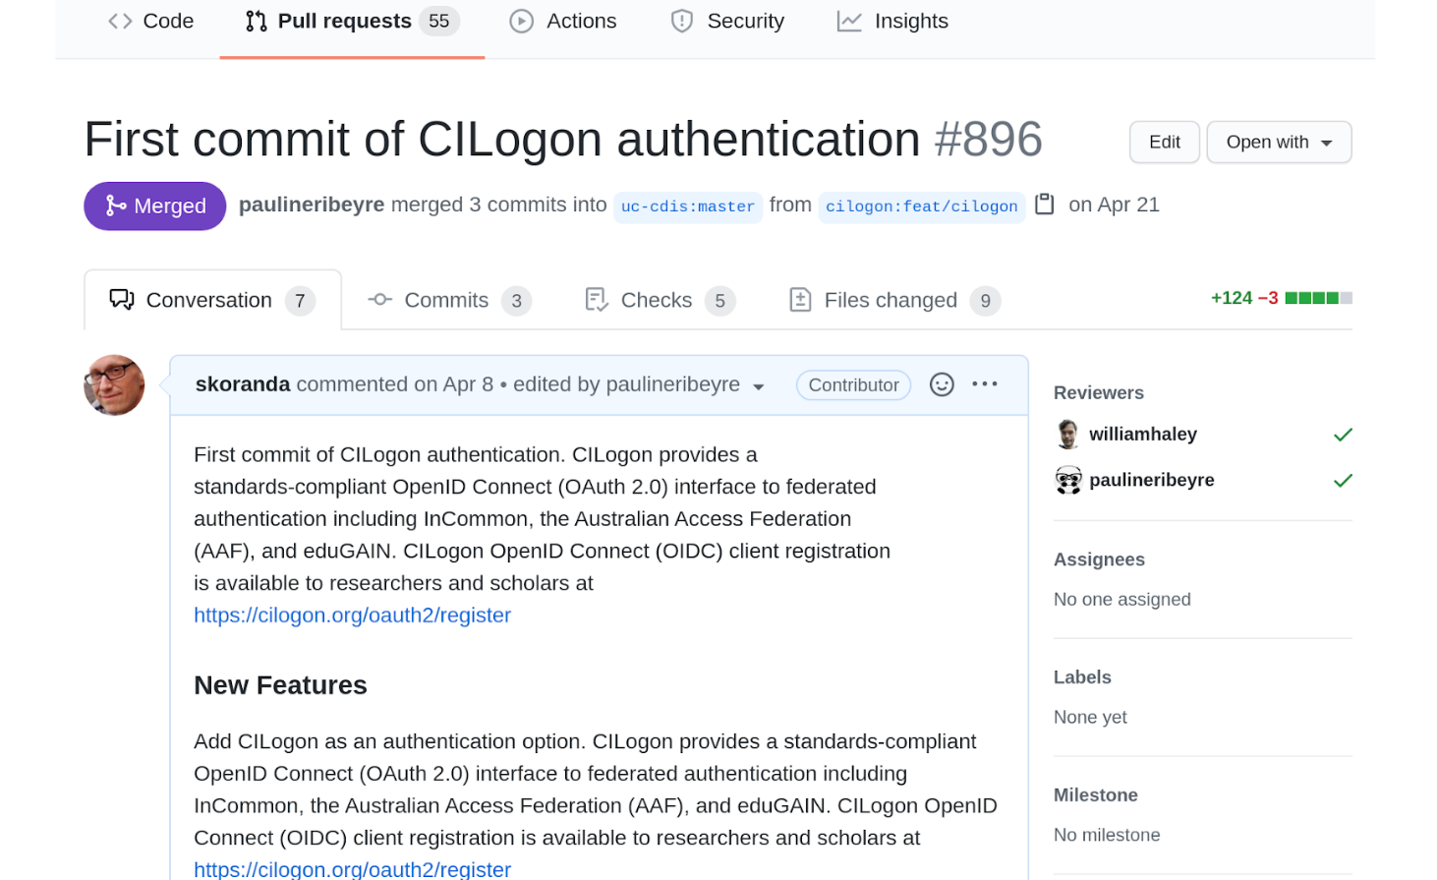

Slide 21
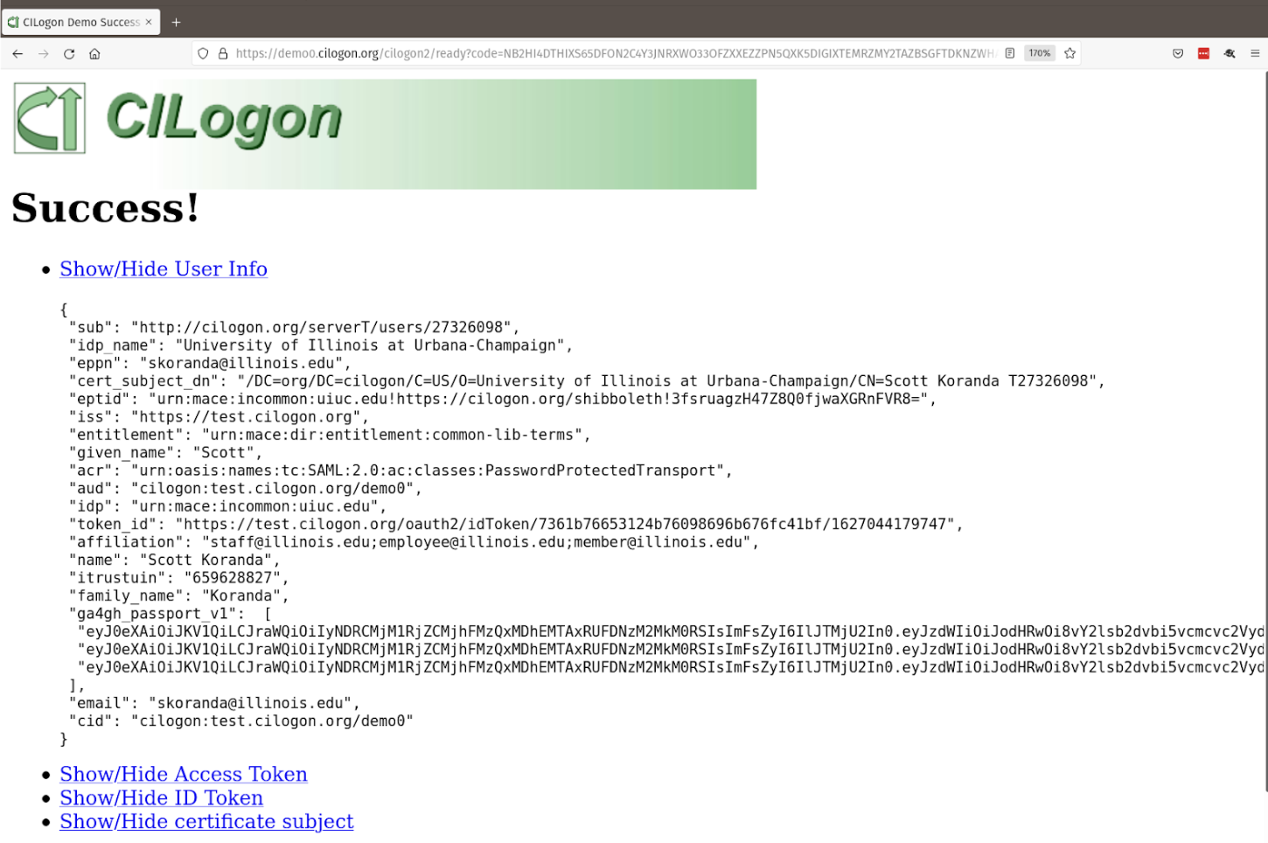

Slide 22
Demo: Thursday 12:45 - 13:15
Affiliation and Role
eduGAIN IdP
COmanage
ID
Linked Identities
Web Browser
ID
CILogon Provider
AC
Researcher Status
Researcher
AC
AC
AT
P
BioCommons Passport Visa Issuer
ID
SAML Identity Assertion
Data Provider
Controlled Access Grants
AC
OAuth Authorization Code
Data Sets
AT
OAuth Access Token
P
GA4GH Passport

Slide 23
Reseller Model
AAF acts as local reseller and provides local support
Infrastructure hosted in Australia

Slide 24
Roles
Research communities
Manage community membership lifecycle
Membership adds, moves and changes
Connecting services to the collaboration
AAF
Business analysis (process mapping for communities)
Policy guidance
Technical implementation and configuration
Tier 1 and 2 support
Advise CILogon about new feature priorities
CILogon
Infrastructure maintenance
New feature development
Tier 3 support

Slide 25
Deployments
BioCommons
https://biocommons.org.au
CADRE
Sensitive social science data
https://cadre5safes.org.au
Human Genomics
Life Science
Humanities
Cardiovascular Disease Research
Language Data Commons of Australia (LDaCA)
Indigenous and other language collections
https://www.ldaca.edu.au

Slide 26
Lessons

Slide 27
Lesson 1
Getting the first community established is the hardest part
Abstract and hard to understand
Demonstrators make it real
Working examples make for a more compelling case

Slide 28
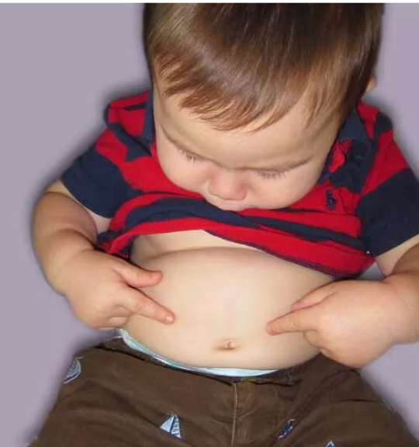
Lesson 2
Seeing how people interact with a basic prototype is more informative than endless navel-gazing
Don’t waste time theorising about aspects that may turn out to be relatively unimportant
The waterfall model doesn’t work well in research oriented projects.
The research world has a much higher tolerance for uncertainty, ambiguity and experimentation than central IT environments. Leverage this to explore new technologies and techniques.

Slide 29
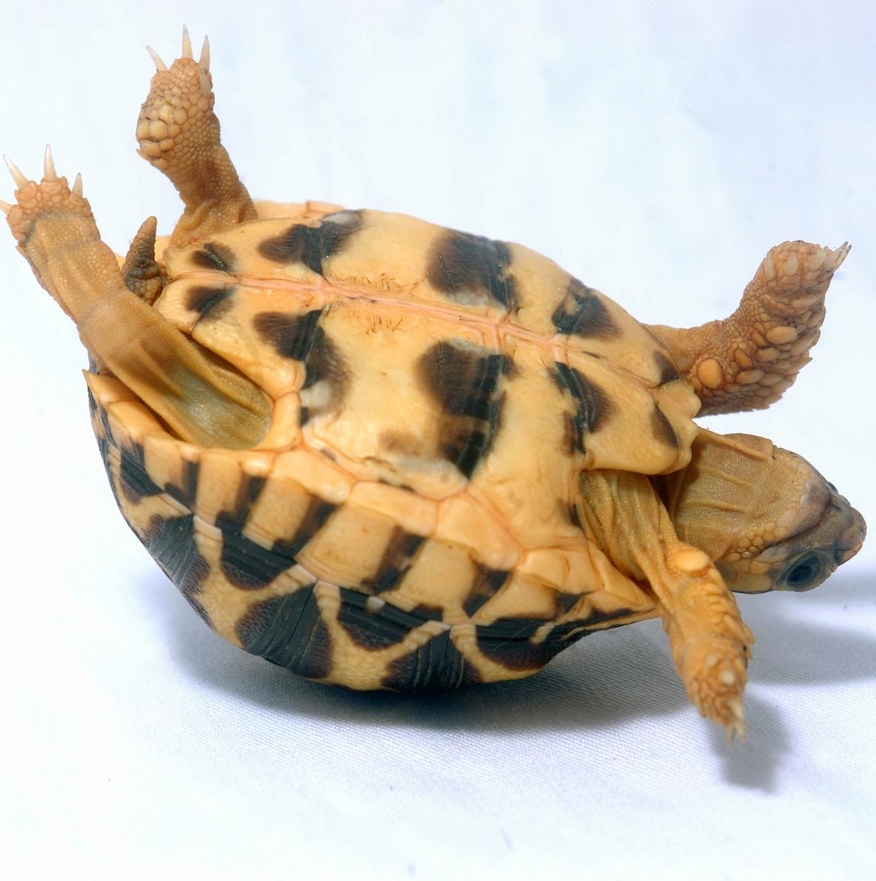
Lesson 3
Researchers need as much (more) help with the policy aspects as they do with technology
Data protection & privacy, security incident response, and membership management lifecycle are often not even on the radar.
Difficult to retrofit policy afterwards

Slide 30
Lesson 4
Patterns transfer readily to other contexts / disciplines
Cancer research to cardiovascular disease
Transfer of ideas between life science and humanities communities

Slide 31
Lesson 5
Attributes and assertions vs access tokens… why not both?

Slide 32
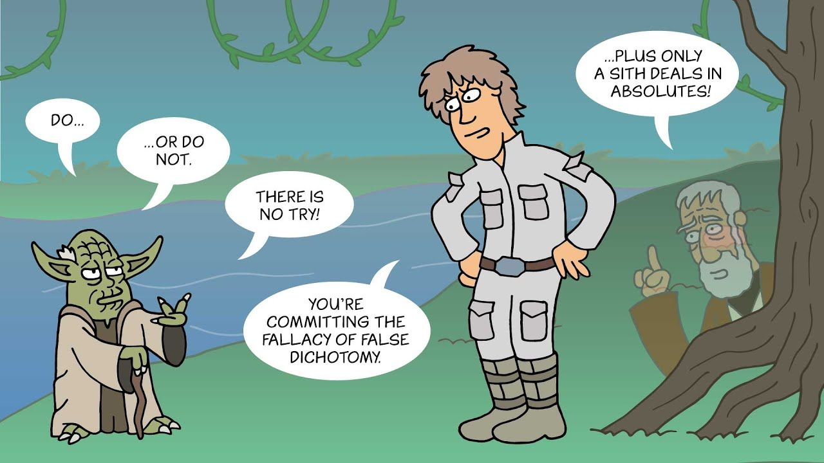

Slide 33
Next Steps

Slide 34
From here…
Confirm top priorities from each partner organisation
Start building MVP
Draft policies aligned with AARC Policy Development Kit and socialise
Finalise reseller agreement details

