Slide 1
Building a Realistic Orchestration Validation Environment for netwoRks (ROVER)
Chris Cummings
Network Automation Software Engineer
Nick Buraglio
Planning and Architecture
Energy Sciences Network (ESnet)
Lawrence Berkeley National Laboratory
TNC22
June-2022

Slide 2
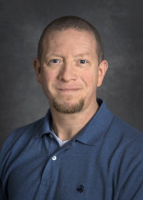
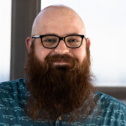
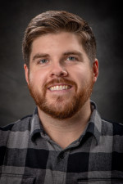
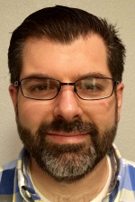
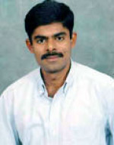
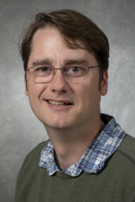
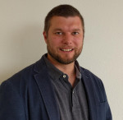
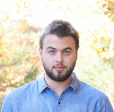
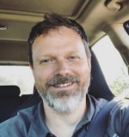
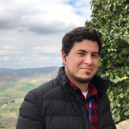
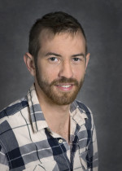
The ROVER Team
Team Members, from Left to Right:
Nick Buraglio, Chris Cummings, Luke Baker, Scott Richmond, George Robb, Dhivakaran (Dhiva) Muruganantham, Marc Koerner, Derek Howard, Sam Oehlert, Eric Smith, Garrett Stewart, Brendan White (Not pictured)

Slide 3
The Problem
Testing of orchestration software before deploying to production in a full featured environment is difficult, but required for full awareness
Lab with physical elements is very constrained for resources (too many people, not enough equipment)
Physical equipment lab (qLAB) configuration and orientation does not resemble production
qLAB may be in a state of transition from one project to the next
Resetting qLAB to a known state is currently not easily accomplished

Slide 4
ROVER: Origins
"Wow, it would be nice to do automated tests on our full orchestration stack!"
Tested various platforms such as Eve-NG, found them not well suited for consistent but ephemeral topologies with associated services**
Learned about containerlab by talking to Roman Dodin (creator)
Internal development and orchestration teams acknowledged need for this tooling, brought Planning and Architecture Group (PAG) into project
PAG brought in to build an overall plan and to take ROVER from concept to initial release

Slide 5
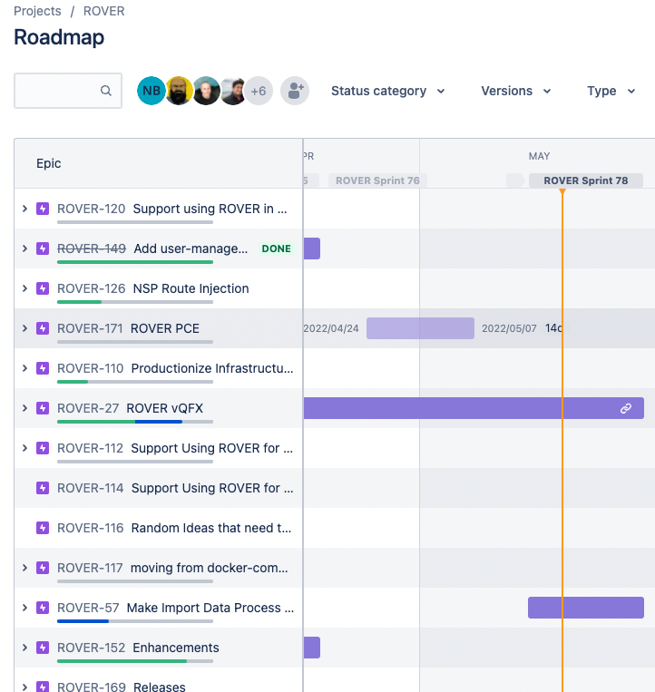
ROVER: Origins
Structured like a software project
Clear and achievable deliverables
Driven by needs and requirements gathered beforehand
No scope creep

Slide 6
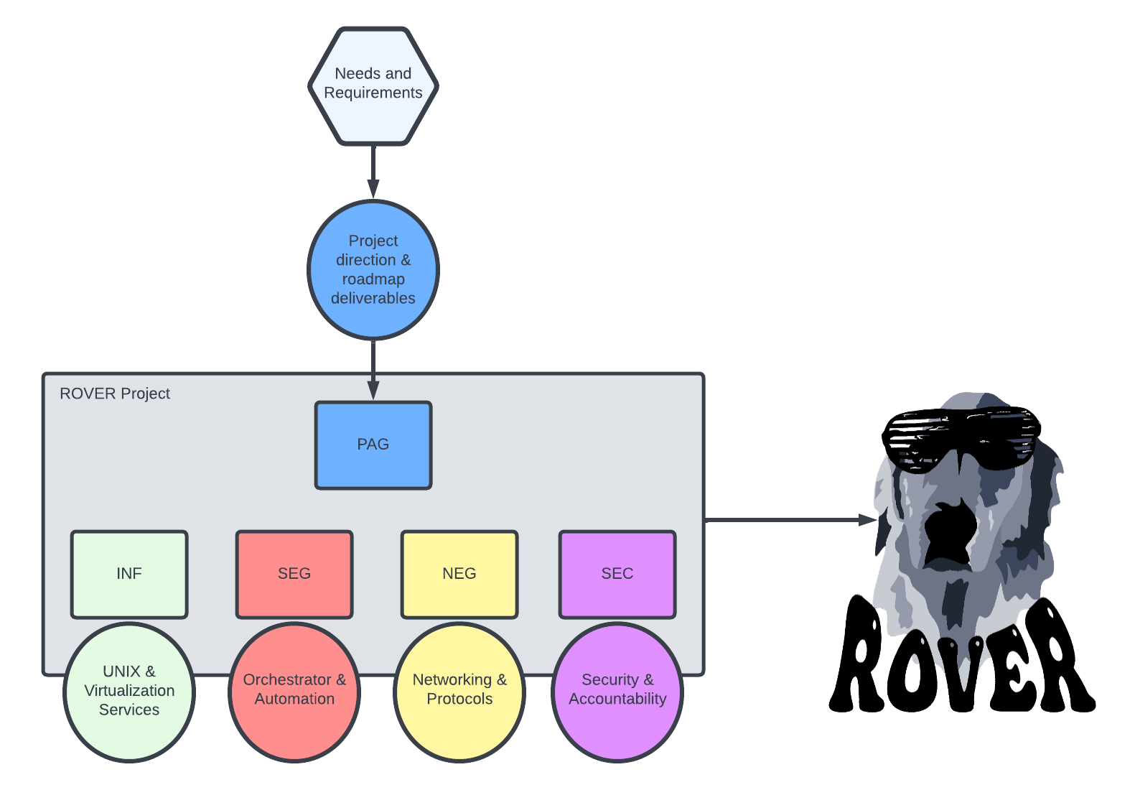
ROVER: Origins
Notes:
Undertaking was approached very much like a software project
Team was formed comprised of subject matter experts in each discipline

Slide 7
Deliverables
Develop a repeatable, supportable test env for VRF migrations
MUST—A Network topology based off production configs
MUST—Contain OCD software to run orchestrated workflows
MUST—Support for swapping out versions of OCD software to test latest changes
Stretch Goals—Support dataplane capabilities
  Ping across links
  BGP, IS-IS, etc.

Slide 8
Categories of Users
👨🏾‍💻 Software Developers
👩🏻‍💻 Network Engineers
👩🏽‍🏫 Trainers demonstrating our orchestration tooling
👨🏻‍🎓 Users of OCD software who need to learn the tools
💻 CI/CD Pipelines
Notes:
Handoff to Chris

Slide 9
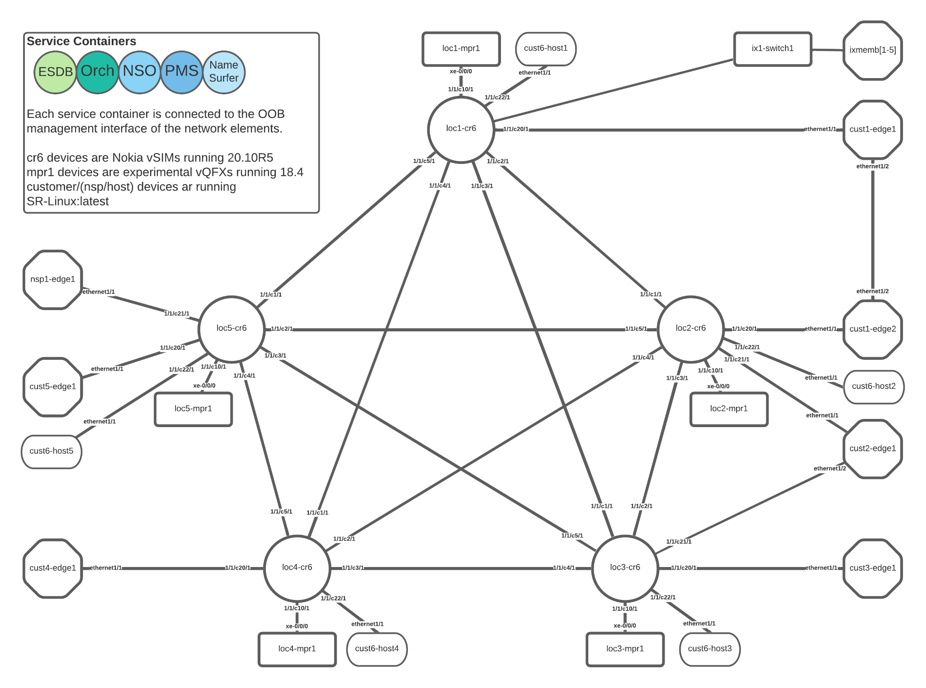
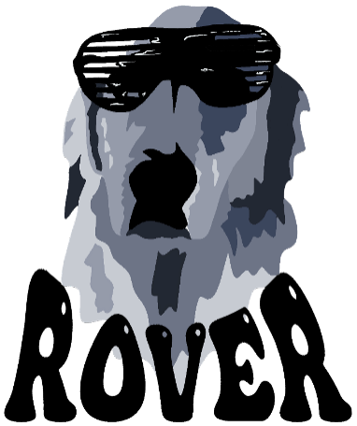
Topology

Slide 10
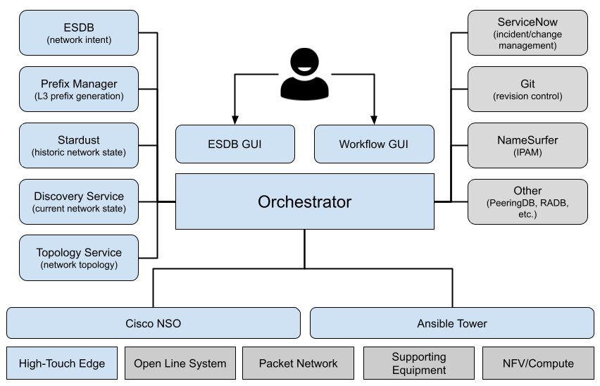
ESnet6 Provisioning Stack

Slide 11
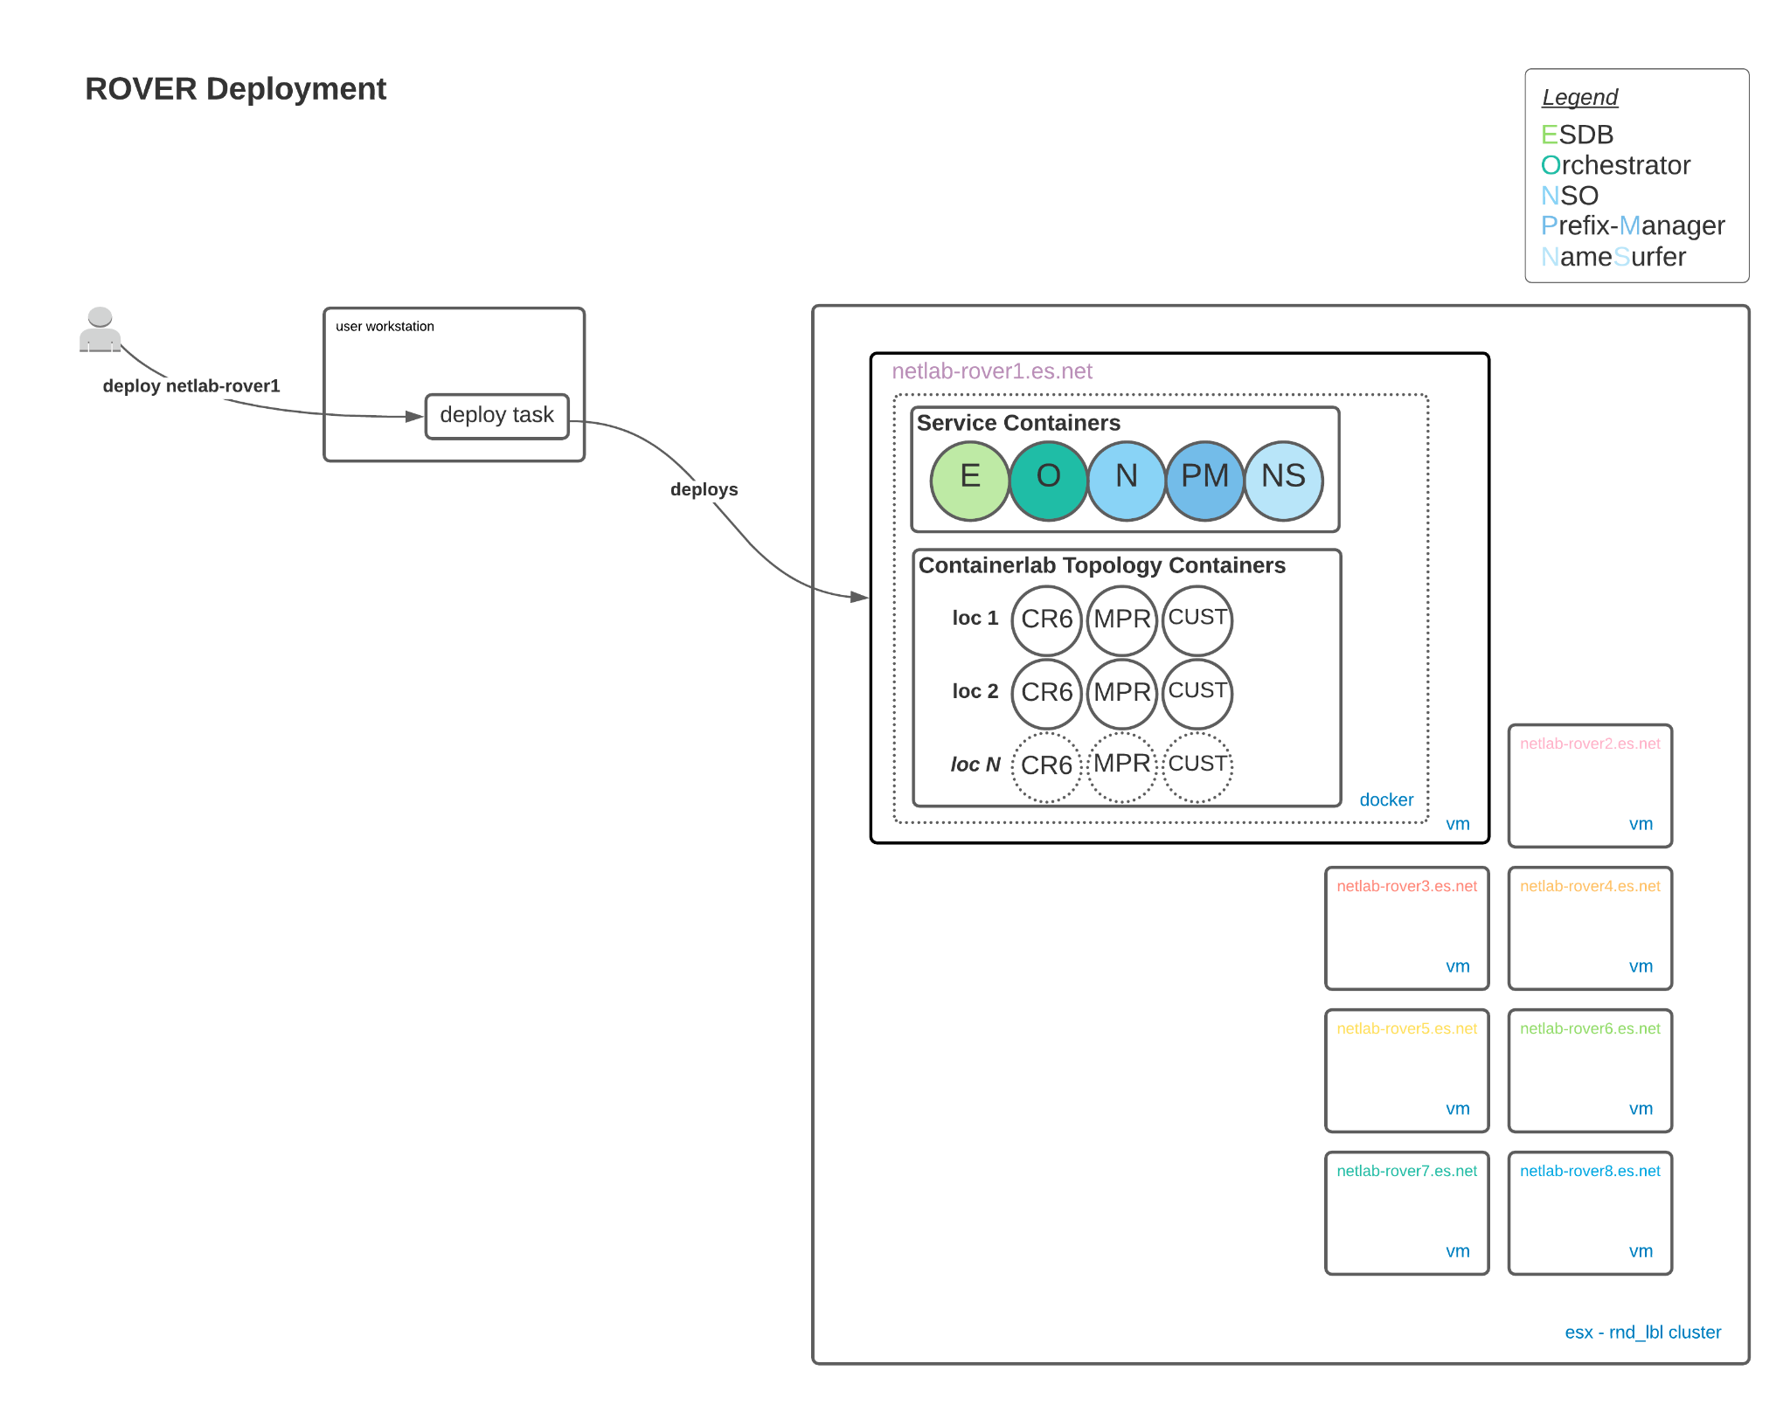
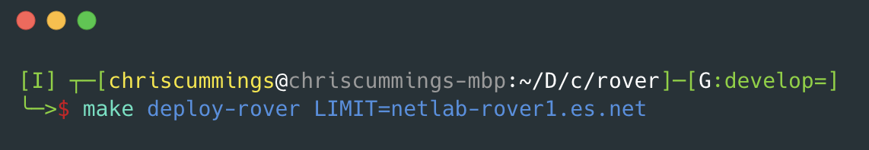
Deployment

Slide 12
Demonstration
Walkthrough of a Backbone Link Deployment Workflow
Walkthrough of BGP Peer Deployment Workflow

Slide 13
Questions?

