Slide 1
Towards a federated anycast infrastructure
A case study with DNS
Leandro M. Bertholdo
University of Twente
16/Jun/2022

Slide 2




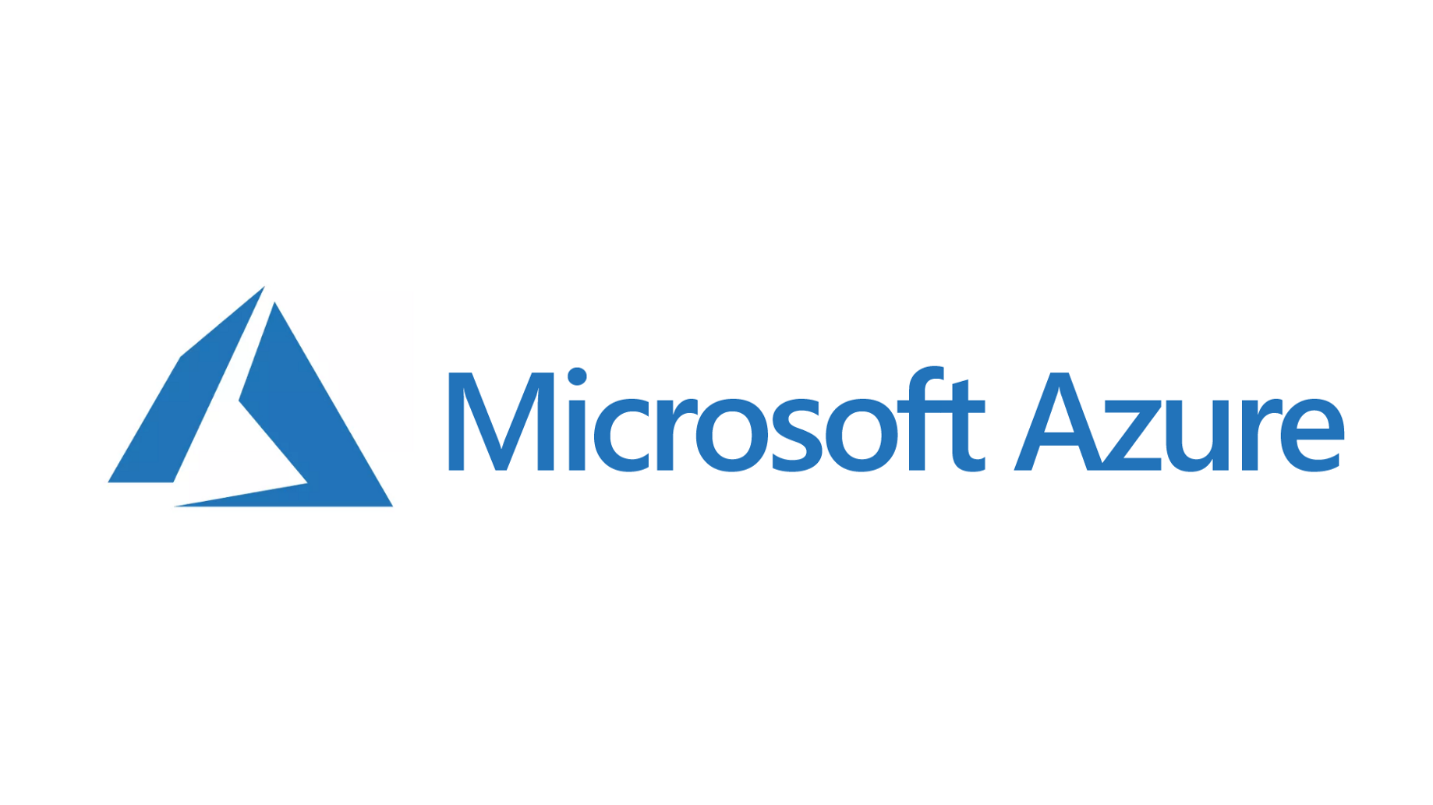

Where do you use anycast in your daily life?

Slide 3
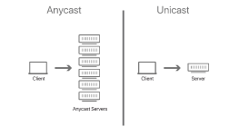
What is Anycast for?
Improve load balance
Diminish response times
Increase resilience against DDoS
It is used by DNS root-servers since the end of the 90's

Slide 4
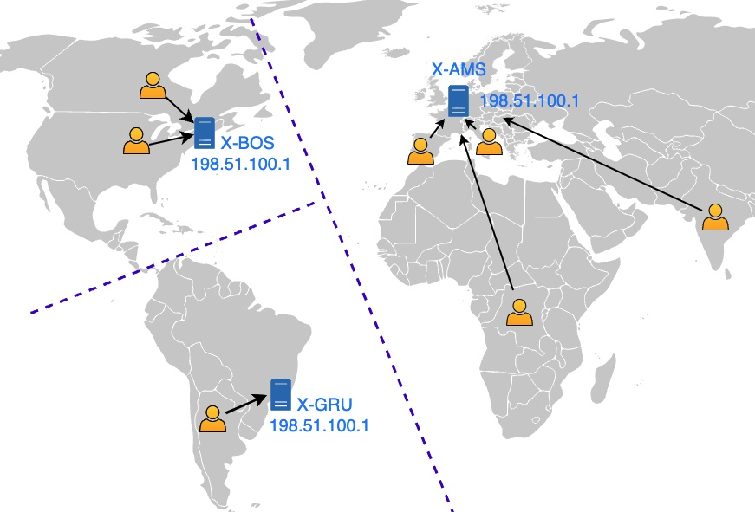
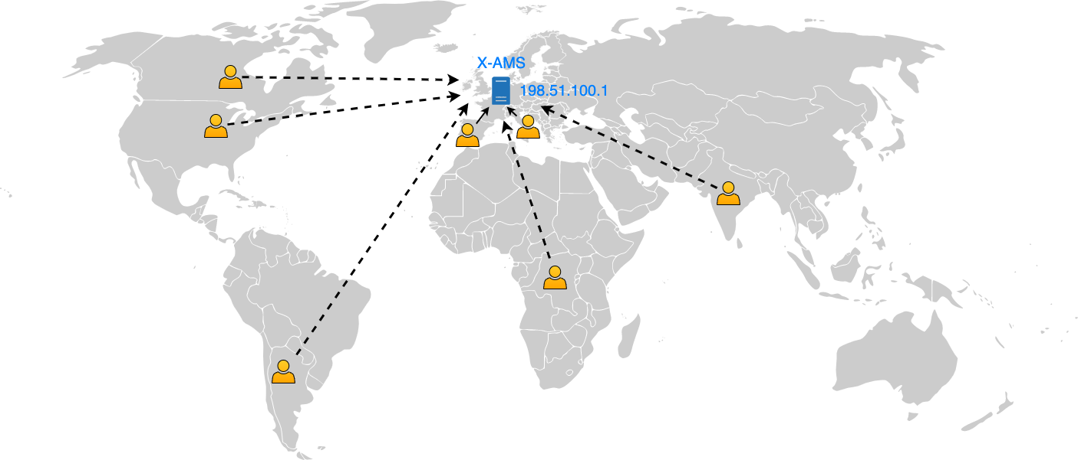
How Anycast works
Unicast Service
Anycast Service

Slide 5
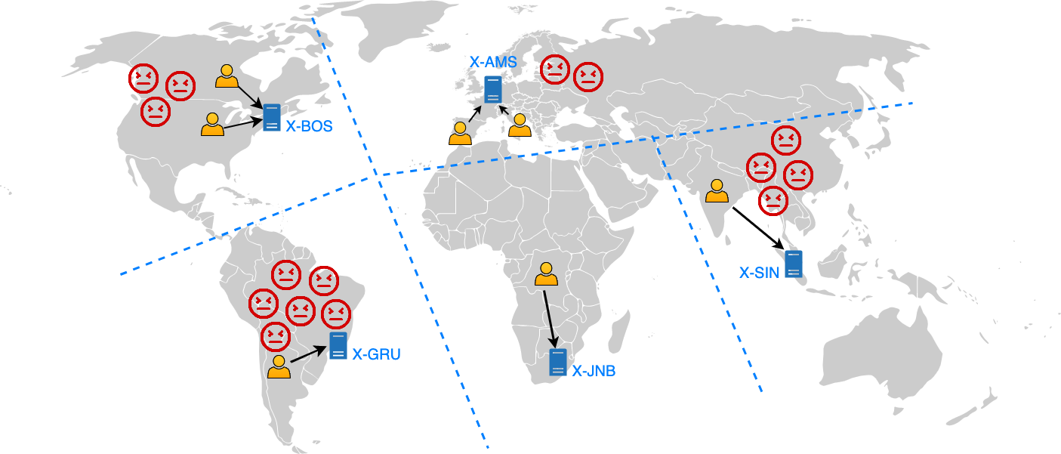

The more anycast sites the better resilience !

Slide 6
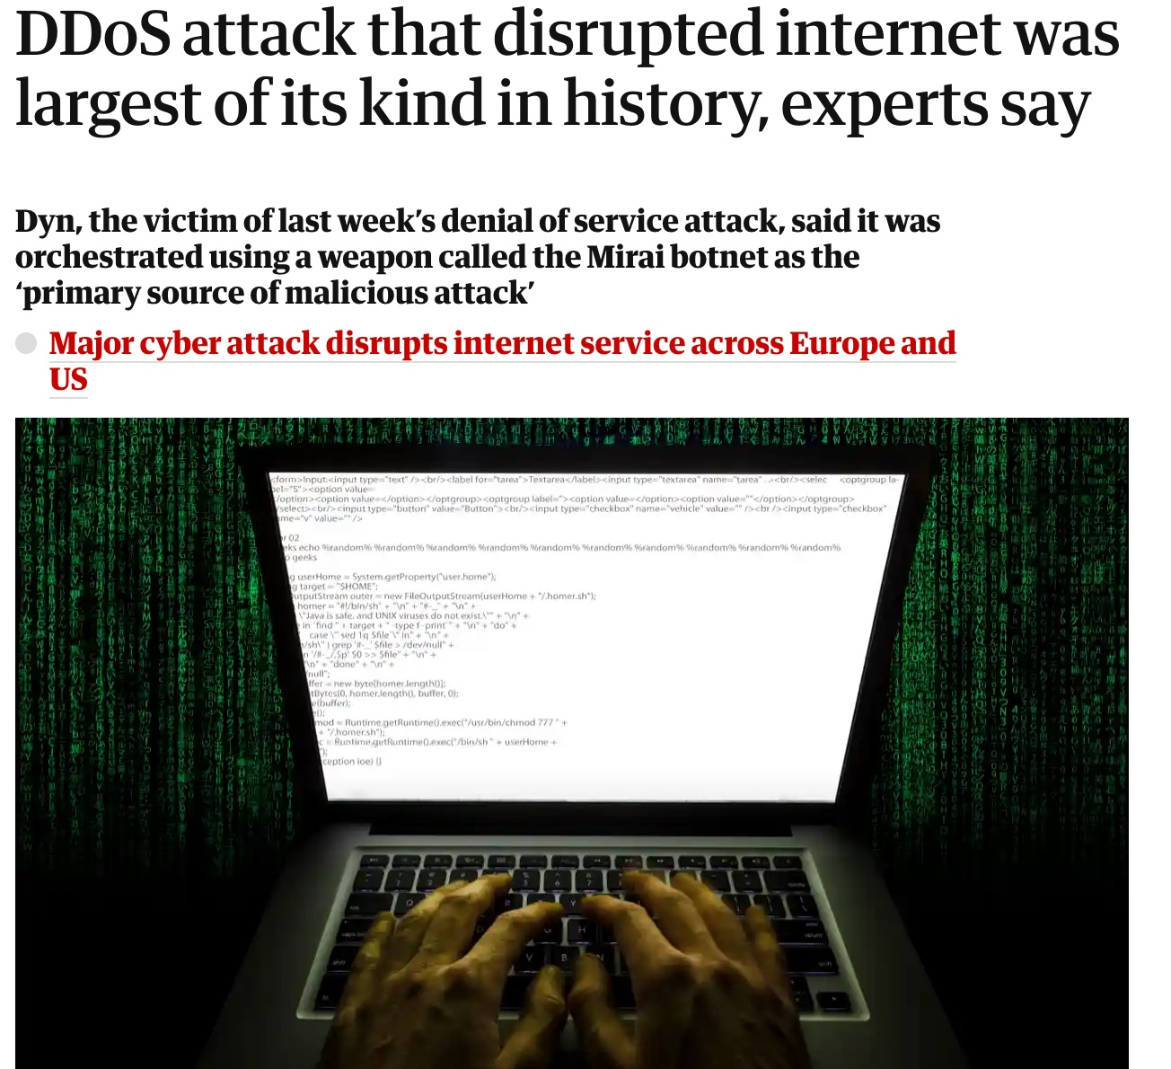
DNS case study:
Why should DNS be a concern in NRENs?
DNS is critical
DNS are used in amplification attacks
  30.000-40.000 DNS resolvers inside academia can be misused to attack others [1].
  90% of DNS servers do NOT use rate-limit best practice [2].
Source: theguardian.com

Slide 7
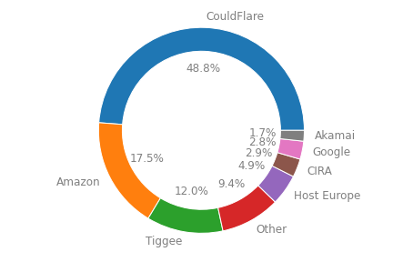
DNS case study:
Where are universities hosting their DNS ?
University Name Servers (NS) analyzed --> 15,218
University with anycasted name server (NS) --> 20 %

Slide 8
How about the risks?
DNS does not seem a priority in universities
Universities are hiring commercial DNS provider
They are heavily concentrated [3]
To concentrate all NS in one is bad (DynDNS and OVH cases).
Privacy and Logs concerns

Slide 9

Opportunities for a federated anycast network
Universities are looking for bigger resilience
  Commercial hosting should not be the only option
Several NRENs have regional anycast
  Some using not global routable prefixes
Economy of scale helps
  DNS operation can be laborious.
DNS (resolver/server) logs are valueable to security team
  To stop malware, locate bootnets, …
NRENs have tradition in collaboration
  Universities hosted NS from each other in the past
  NRENs already built Federated Authentication / Eduroam !

Slide 10
Is a federated academic anycast network possible?
What do you think?
YES !

Slide 11

What is required to build an anycast network?
Infrastructure (R1)
  Connectivity
  Datacenters
Management (R2)
  People
  Basic anycast maintenance
Address space (R3)
  IP space (>/24)
  Autonomous system (AS)
Anti-DDoS protection (R4)

Slide 12
What is required to build an anycast Federation?
Infrastructure (R1)
  Connectivity
  Datacenters
Management (R2)
  People
  Basic anycast maintenance
Address space (R3)
  IP space (>/24)
  Autonomous system (AS)
Anti-DDoS protection (R4)
Infrastructure Coordination (R1)
  Health of the sites
  Anycast “pool”
Management (R2)
  Keep global anycast routing
  Catchment management
Address space (R3)
  Unique or multiple prefixes and ASes
    Some NRENs could just add more power to its own infrastructure
Anti-DDoS resilience (R4)
  Service goes beyond NREN umbrella

Slide 13
Other requirements for an anycast federation
(Step-2)
Anycast can be used for other services (eg. DNS resolvers, CDNs)
  Several NRENs have regional anycast for them
Extra requirements
  Custom site allocation per service/NREN (R5)
  Anycast optimization per AS/prefix (R6)
  Easy operation for university/NRENs administrators (R7)

Slide 14
Challenges to build an Academic Federated Anycast Network
Support several prefixes/ASes over same infrastructure. (R1 / R3)
Provide independent anycast site selection. (R2 / R3 / R5)
Provide a graphical interface for operation (eg. BGP tuner). (R2 / R6 / R7)
Share security mechanisms (eg. DDoSDB)
Increase the anycast resilience against DDoS (eg. Anygility) (R4)
Provide mechanism to reduce DNS abuse (best practices)

Slide 15
Opportunities – Where to begin
Build a DNS anycast service
Federated infrastructure
  Share infrastructure (more sites, bigger resilience)
  Share knowledge (easy to follow best practices and new standards)
  Attacks will be stopped near source (IoT)
  Prepare to support other services than just DNS
New toolboxs are publicly available to manage (and defend) anycast networks
  Tangled, Anygility, BGP Tuner, Verfploter, DDoSDB.

Slide 16
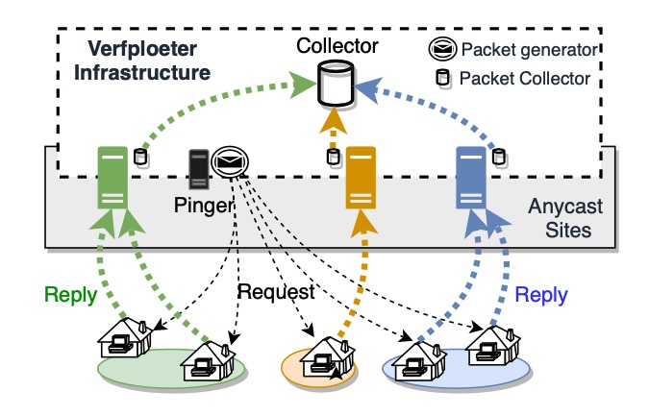
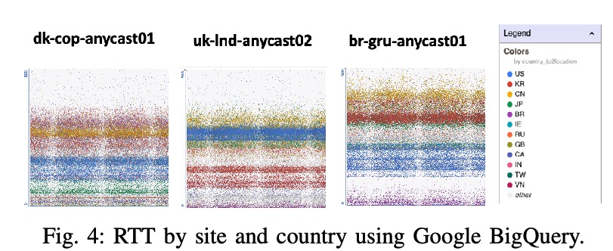
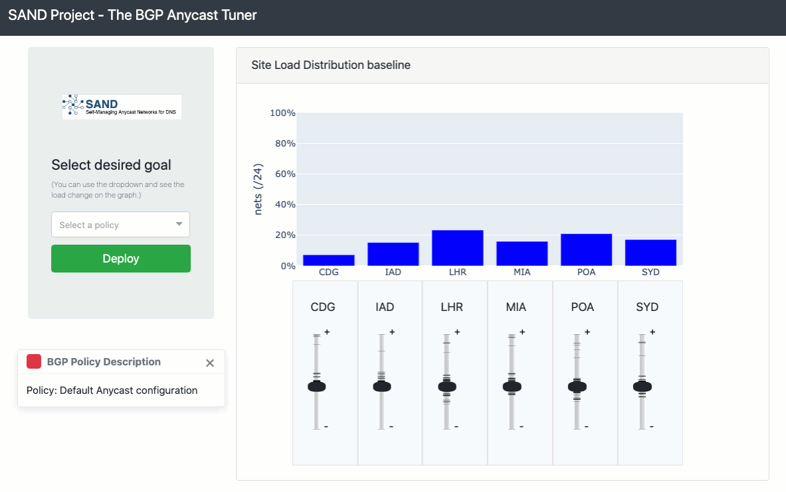
Some tools we built

Slide 17

More possibilities
Once the anycast federation is in place, it can be expanded:
  Authentication infrastructure
  Certification Authorities
  Content delivery
  Sharing scrubbing infrastructure

Slide 18
References
R. Yazdani, A. Hilton, J. van der Ham, R. van Rijswijk-Deij, C. Deccio, A. Sperotto, and M. Jonker, “Mirrors in the Sky: On the Potential of Clouds in Reflection and Amplification DDoS”.
O. van der Toorn, J. Krupp, M. Jonker, R. van Rijswijk-Deij, C. Rossow, and A. Sperotto, “Anyway: Measuring the amplification ddos potential of domains”, 2021.
G. C. M. Moura, S. Castro, W. Hardaker, M. Wullink, and C. Hesselman, “Clouding up the internet: How centralized is dns traffic becoming?”
Bertholdo, Leandro M., et al. ”BGP anycast tuner: Intuitive route management for anycast services." 2020 16th International Conference on Network and Service Management (CNSM). IEEE, 2020.
Bertholdo, Leandro M., et al. "Tangled: A cooperative anycast testbed." 2021 IFIP/IEEE International Symposium on Integrated Network Management (IM). IEEE, 2021.
Rizvi, A. S. M., Bertholdo, L., Ceron, J., & Heidemann, J. (2022, August). Anycast Agility: Network Playbooks to Fight DDoS. In Proceedings of the 31st USENIX Security Symposium, page to appear. USENIX.

Slide 19

Leandro M. Bertholdo <l.m.bertholdo@utwente.nl>

Slide 20
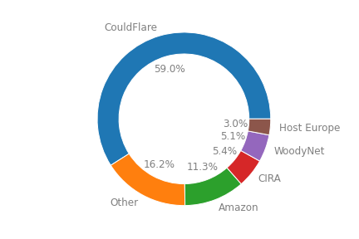
Where Universities are hosting their DNS ?
Globally
University Name Servers (NS) analysed --> 15218
University with anycasted name server (NS) --> 20 %
Connected at Geant

