Slide 1
NSF CC*: Q-Factor Real-time transfer optimization using programmable data planes
Jeronimo Bezerra, FIU, PI
Dr. Wenji Wu, ESnet, Co-PI
Dr. Julio Ibarra, FIU, Co-PI
NSF Program Director: Dr. Deep Medhi

Slide 2
Outline
Motivation
Goals
Why now?
Leveraging In-band Network Telemetry
Deploying a Distributed Management Plane
Building the Q-Factor Telemetry Agent
Science Drivers
Engaging the Community
Team
TNC22|| June 16th, 2022 || Q-Factor: Enabling host tuning using In-band Network Telemetry

Slide 3
Motivation [1/4]
Host tuning is necessary for any new OS installation
Complex and time-consuming (HW, OS, SW, RTT, TCP vs. UDP)
Maxing out tuning parameters waste host’s resources
No single tuning configuration fits all configurations of HW and SW
Over time, context might change (new HW, higher/lower RTT)
What if tuning could be done dynamically based on HW, OS, SW, RTT, and transport?
TNC22|| June 16th, 2022 || Q-Factor: Enabling host tuning using In-band Network Telemetry

Slide 4
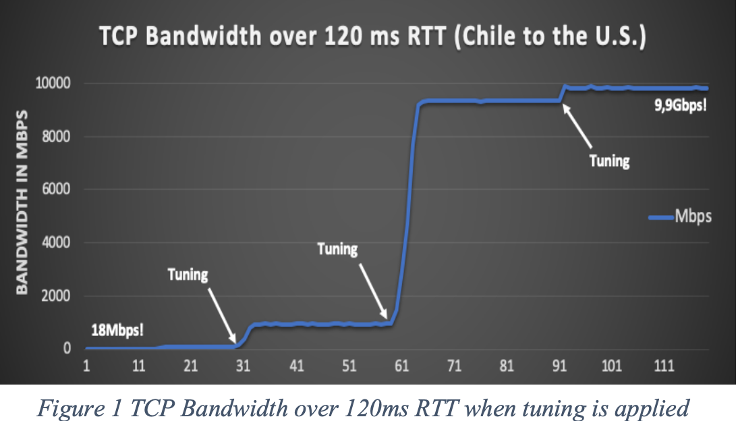
Motivation [2/4] – The importance of proper tuning
TNC22|| June 16th, 2022 || Q-Factor: Enabling host tuning using In-band Network Telemetry

Slide 5
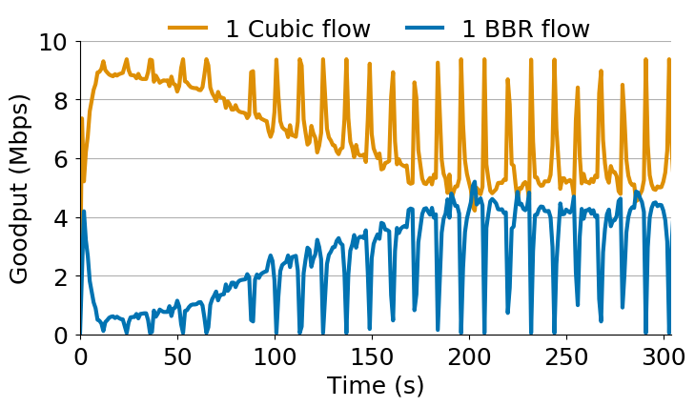
Motivation [3/4] - TCP Congestion Control 101
Ideally TCP would send packets at a fair share of network capacity. But the TCP sender has no idea what “available network capacity” means
As a result, TCP algorithms probe the network by slowly increasing their sending rate
Usual indication of a “that’s too fast” condition is packet drops (no ACK arrives)
This is a key behavior in different congestion control algorithms
In fact, TCP only infers congestion
A packet is dropped when a forwarding device’s buffer/queue is full or close to full.
TNC22|| June 16th, 2022 || Q-Factor: Enabling host tuning using In-band Network Telemetry

Slide 6
Motivation [4/4] - How to detect if queues are forming?
Several possible solutions:
ICMP Source Quench Redux
ICMP generates a congestion notification (and tells which TCP flow)
Unreliable (often filtered out) and reactive
Explicit Congestion Notification
Sparse signal (single bit)
Both hosts need to be aware, IP-level marking needs modification at the end hosts
Use newer (i.e., delay-based) congestion control (BBR 2.0)
…
Still, congestion control only infers network state
What if the network forwarding devices could share the buffer utilization?
TNC22|| June 16th, 2022 || Q-Factor: Enabling host tuning using In-band Network Telemetry

Slide 7
Q-Factor’s Goals
Offload tuning from IT operators
Dynamically tune hosts based on
Leveraging new telemetry technologies
Telemetry agents on the hosts doing the tuning or making suggestions to operators
Hardware capabilities
OS configuration
+RTT
+network conditions
P4/In-band Network Telemetry
Programmable NICs
Linux eBPF & XDP
NSF Award #: 2018754
Collaboration between Florida International University (FIU) and Energy Sciences Network (ESnet)
TNC22|| June 16th, 2022 || Q-Factor: Enabling host tuning using In-band Network Telemetry

Slide 8
Why now? What has enabled Q-Factor?
Challenge:
Queue occupancy leads to packet drops and jitter, and it varies per packet received
Currently, host protocols infer queue/buffer occupancy
Network devices export queue occupancy values in summaries
What has changed?
Development of the P4 In-band Network Telemetry (INT) application in 2016
Launch of the Barefoot/Intel Tofino ASIC in 2016
Launch of the first programmable NICs in 2016/2017
Launch of the first Tofino white boxes in 2018
TNC22|| June 16th, 2022 || Q-Factor: Enabling host tuning using In-band Network Telemetry

Slide 9
Leveraging In-band Network Telemetry [1/3]
INT is a P4 application that records network telemetry information in the packet while the packet traverses a path between two points in the network
As telemetry is exported directly from the Data Plane, the Control Plane is not affected:
Translating: you can track/monitor/evaluate EVERY single packet at line rate and real time.
Examples of telemetry information added:
Timestamp, ingress port, egress port, queue buffer utilization, sequence #, and many others
TNC22|| June 16th, 2022 || Q-Factor: Enabling host tuning using In-band Network Telemetry

Slide 10
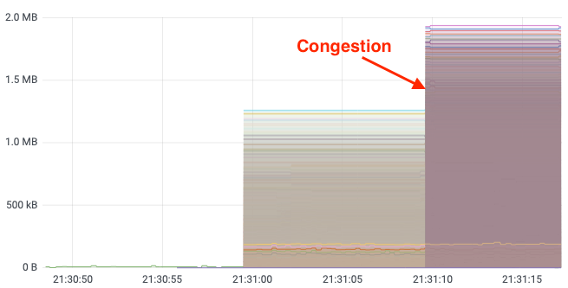
Leveraging INT – Mitigating Buffer/Queue Utilization
Ideal Buffering:
1-10’s KBs of queueing
Not noticeable by users or applications
Congestion:
1000-10000’s KBs of queueing
Dramatically noticeable by users or applications via increased delay and packet drops (retransmissions).
TNC22|| June 16th, 2022 || Q-Factor: Enabling host tuning using In-band Network Telemetry

Slide 11
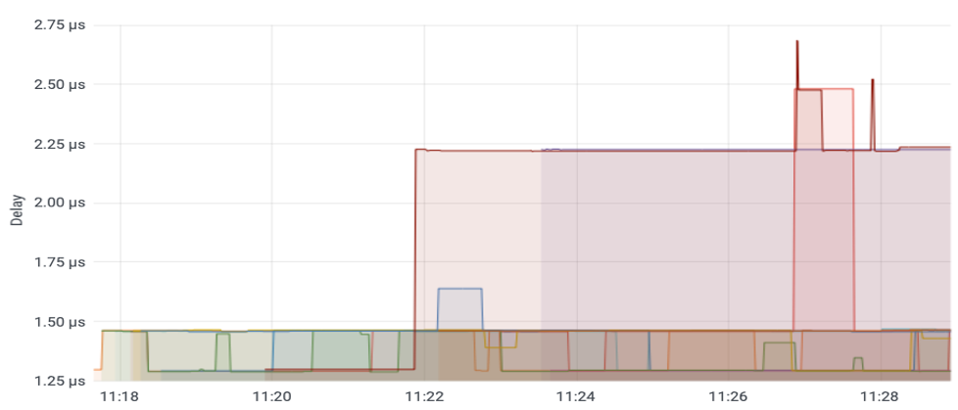
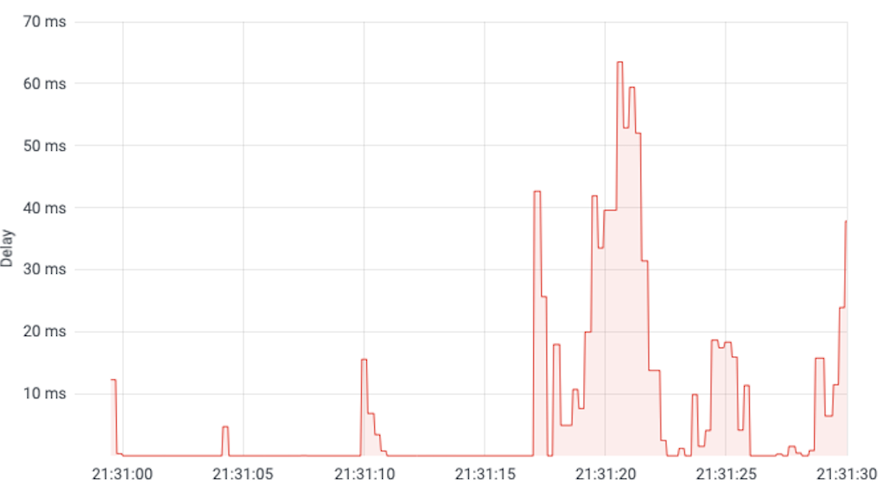
Leveraging INT – Observing Hop Delay & Jitter
Sources of jitter
Ideal Hop Delay:
1-10’s Microsecond's delay
Barely noticeable by users or applications in 10+ ms RTT environments
Hop Delay during a burst:
1000-10000’s Microsecond's delay
Dramatically noticeable by users or applications for all environments
TNC22|| June 16th, 2022 || Q-Factor: Enabling host tuning using In-band Network Telemetry

Slide 12
P4/INT enables network operators to have even deeper visibility
Fast mitigation of sources of jitter and packet drops
However, P4/INT focus ONLY on network operators
Users remain unaware of what is happening when their applications “struggle”
Users still have to infer the network state
TNC22|| June 16th, 2022 || Q-Factor: Enabling host tuning using In-band Network Telemetry

Slide 13
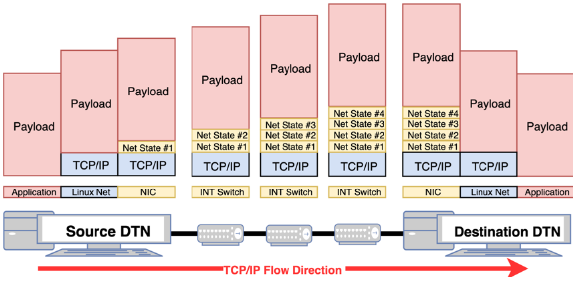
Q-Factor: Deploying a Distributed Management Plane
What if we extended the Management Plane to the hosts?
What if hosts could access telemetry metadata and find out the network state instead of just inferring it? Would that be useful?
How will Q-Factor do it?
TNC22|| June 16th, 2022 || Q-Factor: Enabling host tuning using In-band Network Telemetry

Slide 14
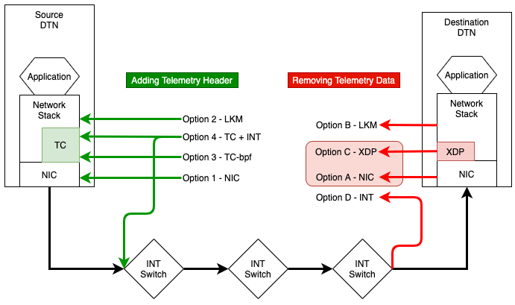
How will Q-Factor operate? [1/2]
Q-Factor will extend the hosts’ capabilities by:
Adding support for INT to hosts
Supporting a Telemetry Agent to tune the host
INT at hosts will operate via two approaches:
If a programmable NIC is available, INT will be done at the NIC
Otherwise, eBPF/XDP/TC will be used before the Linux TCP/IP stack for performance
Hosts’ applications will NOT need to be changed:
Q-Factor will operate before the Linux TCP/IP stack
Completely hidden from the upper layers
TNC22|| June 16th, 2022 || Q-Factor: Enabling host tuning using In-band Network Telemetry

Slide 15
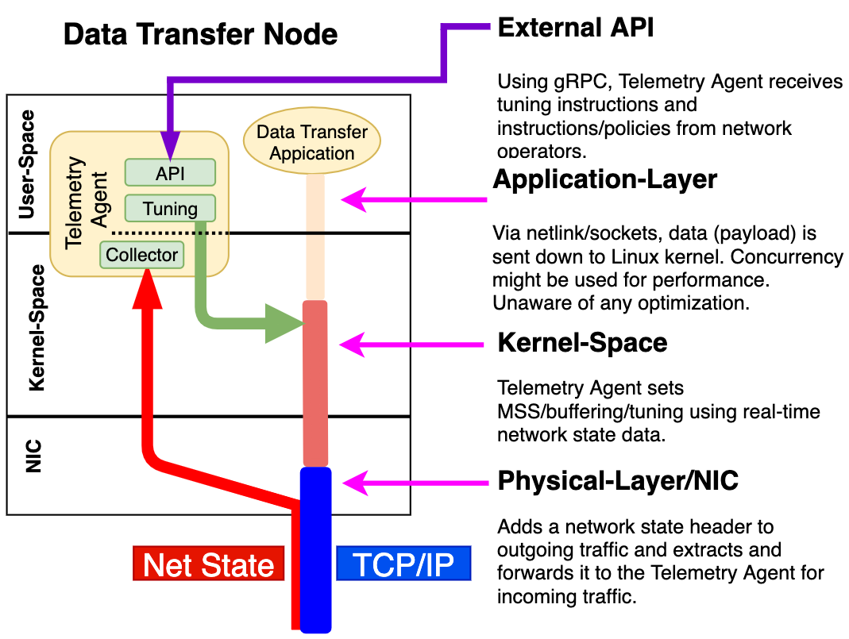
How will Q-Factor operate? [2/2]
Q-Factor’s Telemetry Agent will tune the hosts:
Hosts will be pre-tuned based on best practices (buffers, BIOS, NIC, MTU, etc.)
Hosts will be dynamically tuned based on INT metadata
Operators will have control over tuning:
Learning mode just with tuning recommendations
Active mode dynamically applying the tuning recommendations
TNC22|| June 16th, 2022 || Q-Factor: Enabling host tuning using In-band Network Telemetry

Slide 16
Building the Q-Factor Telemetry Agent
Q-Factor’s major contribution:
Consume telemetry metadata to tune hosts
Tune hosts based on best practices and hardware configuration
Save memory by setting buffers to the proper size by using the active data transfers’ highest RTT
Processing INT’s queue occupancy and hop delay to mitigate bottlenecks
Even if you don’t have INT in your network, Q-Factor will offload the tuning activities from operators!
Dynamic tuning will focus on:
Adjusting Linux kernel’s buffers (for instance, controlling TCP window) via Sysctl
Setting TCP pacing for a steady data transfer based on network state:
If there is only 24Gbps available in the end-to-end path, why try to increase the data rate above the available limit and face drops?
Setting the TCP congestion control algorithm based on network state and hosts’ capabilities
TNC22|| June 16th, 2022 || Q-Factor: Enabling host tuning using In-band Network Telemetry

Slide 17
Tuning Examples
* TBD after evaluations
Apply tuning when:
Under-provisioned tuning parameters (TCP congestion, write buffers)
Data transfers’ highest RTT > 50* ms
Up: INT reports buffers < 1MB* and hop delay < 20* microseconds
Down: INT reports buffers > 2MB* and hop delay > 100* microseconds
Don’t apply tuning when:
Data transfers’ highest RTT < 10* ms (DC, campus, metro network)
Host’s bandwidth already at max capacity
Host’s CPU operating at max capacity
Host’s Swap is used

Slide 18
Q-Factor: Where are we now?
Q-Factor is an NSF CC* Integration project planned for 2 years
Q-Factor is a little behind due to struggles with recruitment and the pandemic
Milestones achieved:
Extracting INT telemetry using eBPF/XDP and Netronome NICs at the destination at 40Gbps!
Q-Factor Telemetry Agent’s Tuning module is ready for static host tuning.
Next steps:
Developing observation-based learning techniques to consume queue occupancy and hop delay to mitigate bottlenecks
Apply tuned accordingly to the observation-based learning techniques
Leveraging Machine Learning to detect complex anomalies.
Github: https://github.com/q-factor-project/
TNC22|| June 16th, 2022 || Q-Factor: Enabling host tuning using In-band Network Telemetry

Slide 19
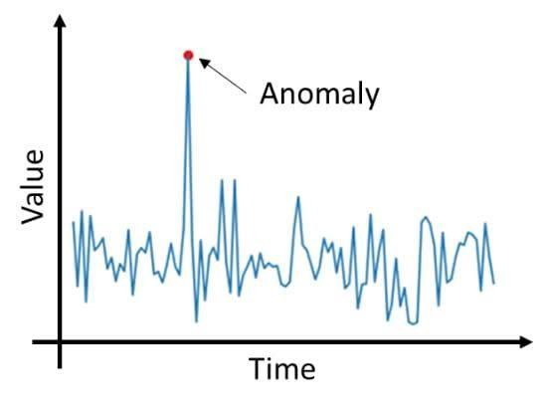
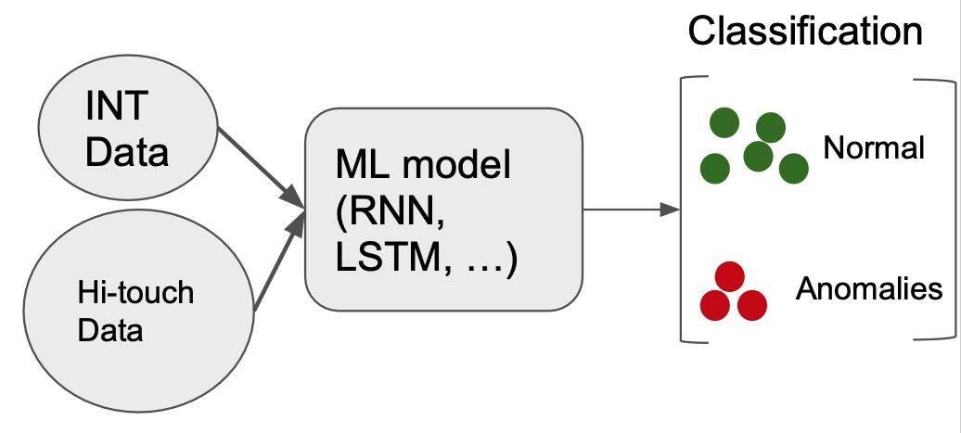
Plus: ML-based Anomaly Detection using In Network Telemetry Data
Anomalies are events that deviate significantly from “normal” network traffic.
Types of anomalies:
Security threats: DDoS attacks
Performance issues
Micro-congestion, link over-utilization, heavy flows, overloaded hosts, packet loss
Current telemetry solutions (sFlow, NetFlow) send only a small sample of data for analysis for maintaining low overhead.
Establishing a normal profile and detecting time critical events becomes hard or impossible.
INT data provides detailed in-network information in real time.
Normal profile can be established using Machine Learning models trained on INT data enhanced with Esnet Hi-touch data.
TNC22|| June 16th, 2022 || Q-Factor: Enabling host tuning using In-band Network Telemetry

Slide 20
Engaging the community
Q-Factor still has a long road ahead (1.4 years)
We are open for suggestions and collaborations
Once Q-Factor is ready for production, it will be deployed at AmLight:
What use case would you like to see evaluated?
Which direction should Q-Factor take next?
Are you interested in participating in our discussions?
Join us at https://q-factor-project.slack.com
TNC22|| June 16th, 2022 || Q-Factor: Enabling host tuning using In-band Network Telemetry

Slide 21
NSF CC*: Q-Factor Real-time transfer optimization using programmable data planes https://www.nsf.gov/awardsearch/showAward?AWD_ID=2018754 https://www.q-factor.io
Thank you! Questions?
Jeronimo Bezerra <jbezerra@fiu.edu>
Dr. Julio Ibarra <julio@fiu.edu>
Dr. Wenji Wu <wenji@es.net>

Slide 22
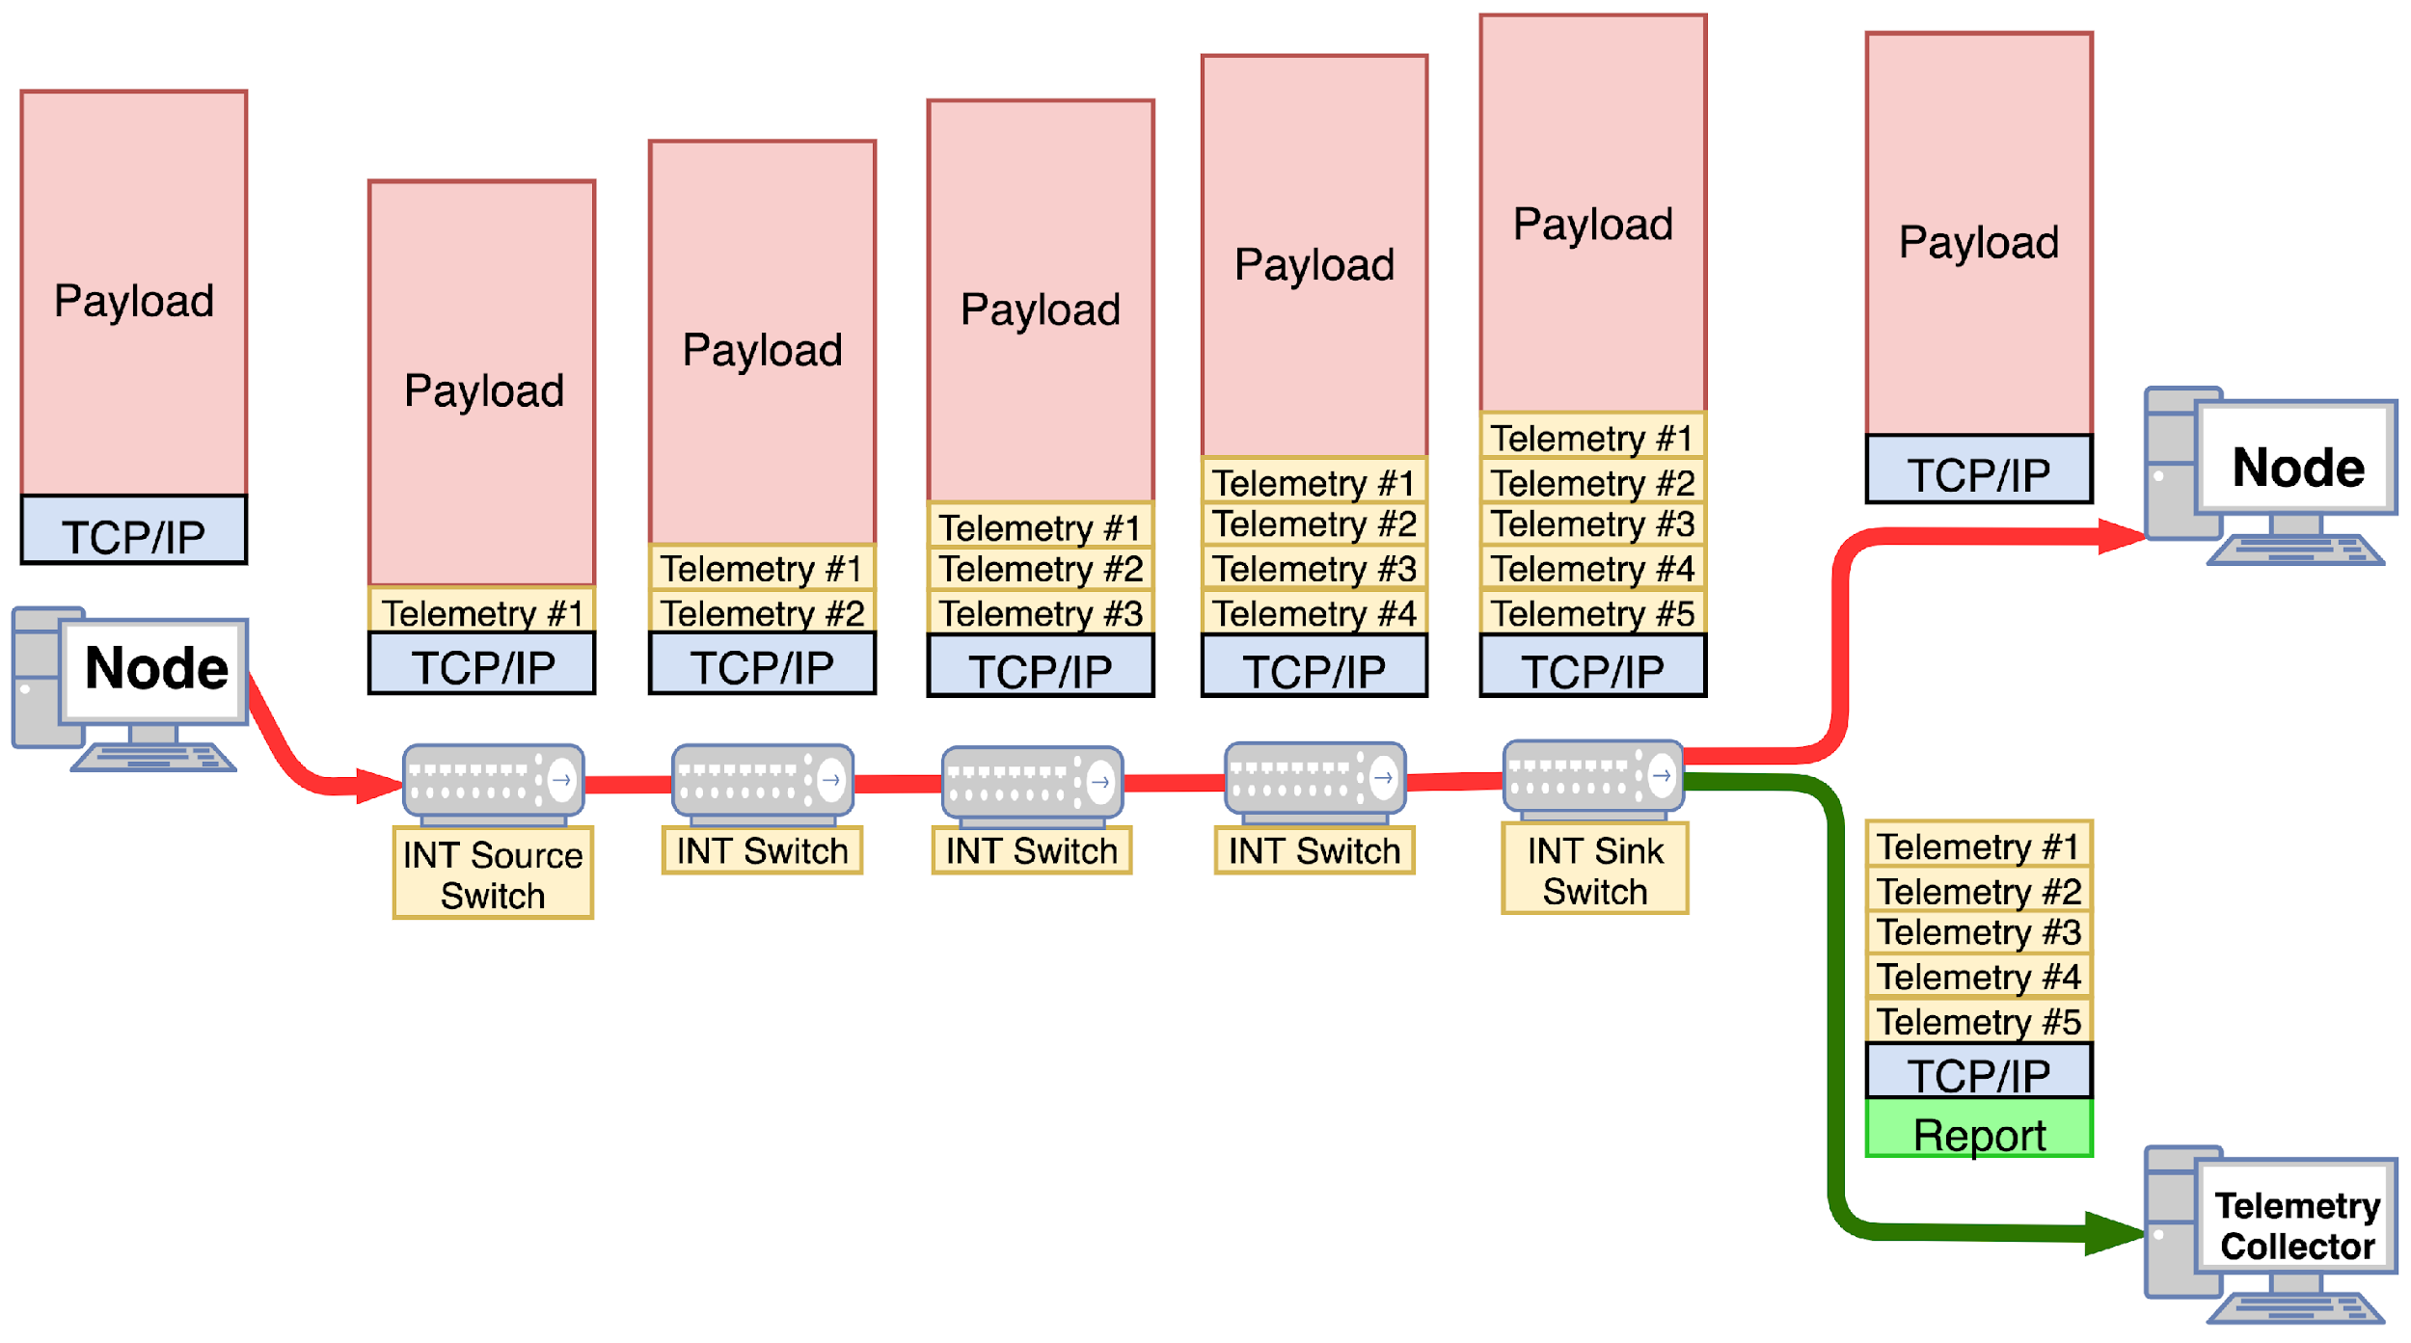
Leveraging In-band Network Telemetry [2/3]
1 – User sends a TCP or UDP packet unaware of INT
2 – First switch (INT Source Switch) pushes an INT header + metadata
3 – Every INT switch pushes its metadata. Non-INT switches just ignore INT content
4 – Last switch (INT Sink Switch) extracts the telemetry and forwards original packet to destination
5 – Last switch (INT Sink Switch) forwards the 1:1 telemetry report to the Telemetry Collector
TNC22|| June 16th, 2022 || Q-Factor: Enabling host tuning using In-band Network Telemetry

