Slide 1
20 years of perfSONAR to bring you 5.0
Antoine Delvaux ・ PSNC / GÉANT Project ・ antoine.delvaux@man.poznan.pl
TNC22

Slide 2
Performance
Service-Oriented
Network monitoring
ARchitecture

Slide 3
Inception
There is some debate
When was perfSONAR created?

Slide 4
First ideas
2000

Slide 5
First meeting
OGF
Network
Measurement
Working
Group
2001

Slide 6
First practice groups
Performance
Enhancement
Response
Team
2002

Slide 7
First collaborative workshop
2004

Slide 8
First partnership
2004
2005

Slide 9
First joint presentation
2005
TERENA Conference
(Poznan)

Slide 10
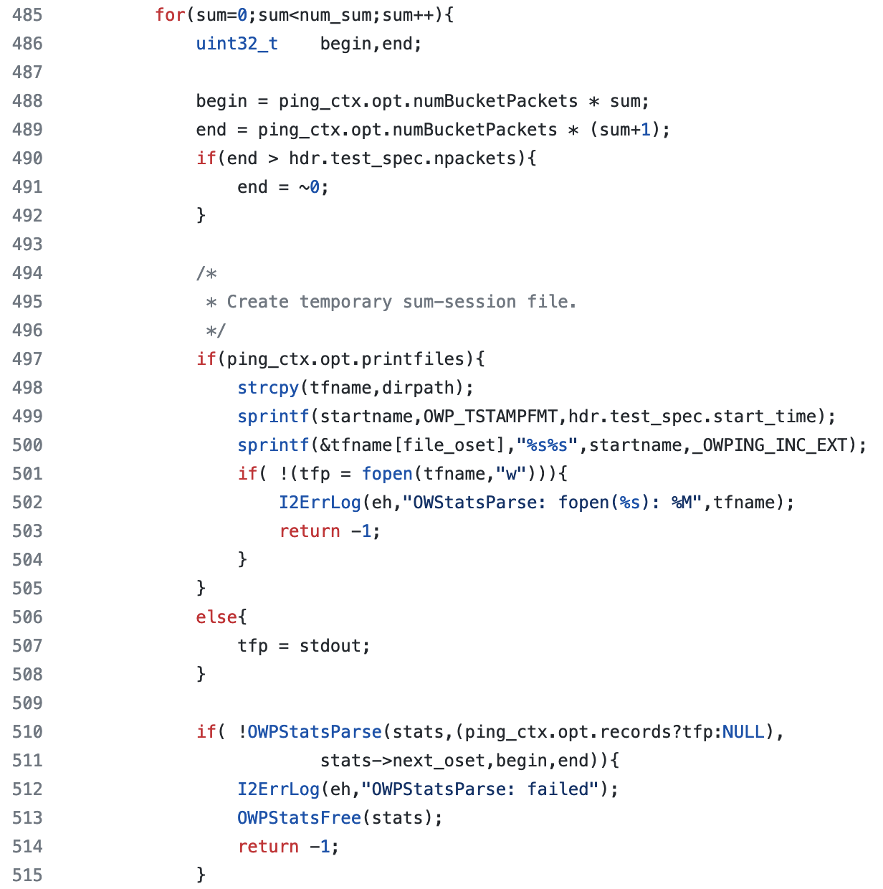
First line of code
2005

Slide 11
First release
2006
v1.0

Slide 12
First fork
2008
pS MDM

Slide 13
First 1000 deployments
2013
(1000 public instances)

Slide 14
First Debian packages
2015

Slide 15
First 4.0
2017
(pScheduler)

Slide 16
All that …
And more…

Slide 17
… to bring you 5.0
Already 5 years since 4.0
And multiple things going on development wise

Slide 18
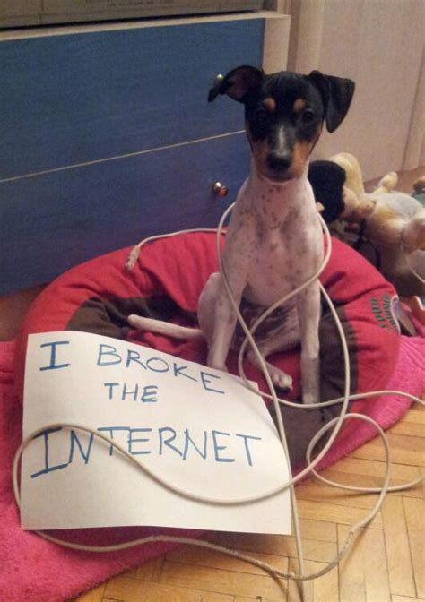
Looking closer at network problems
Current pS usage
perfSONAR data
Loss
Latency
Throughput
Route traces
Application response time
…
Correlate with other data sources
Interface counters
Flow data
Optical layer
…

Slide 19
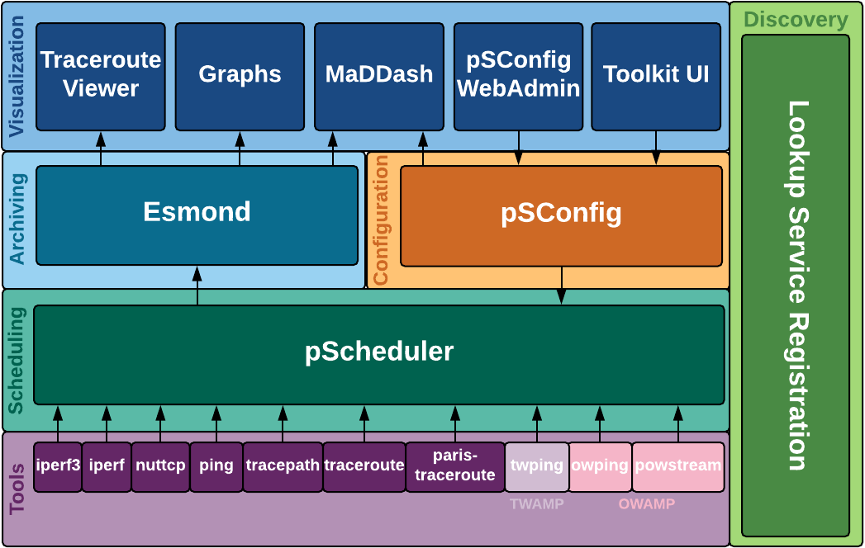
Changing the archive (backend)
The archive
Storing
Metadata
Data
Using
Esmond

Slide 20
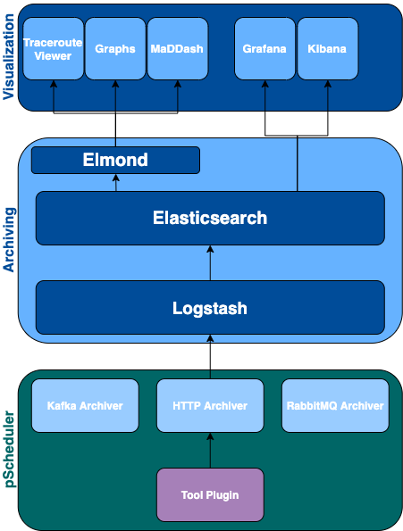
Changing the archive
The archive
Storing
Metadata
Data
Using
Esmond
Opensearch

Slide 21
Changing the archive
Opening up
New integrations
New possibilities
Backward compatible
Elmond
Same Esmond API
Elasticsearch API
Grafana

Slide 22
Help us test it!
Beta release available
https://www.perfsonar.net/releasenotes-2022-05-31-5-0-0b1.html
Testing
https://docs.perfsonar.net/release_candidates/5.0.0/install_rcs.html
Feedback
https://lists.internet2.edu/sympa/info/perfsonar-user

Slide 23
perfSONAR is a partnership
https://www.perfsonar.net/collab_about.html

Slide 24
And something important…
with collaboration…

Slide 25
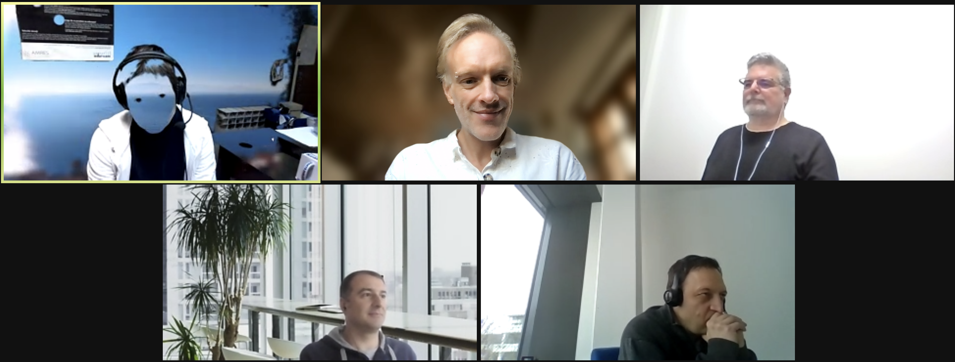
Is to have a team…

Slide 26
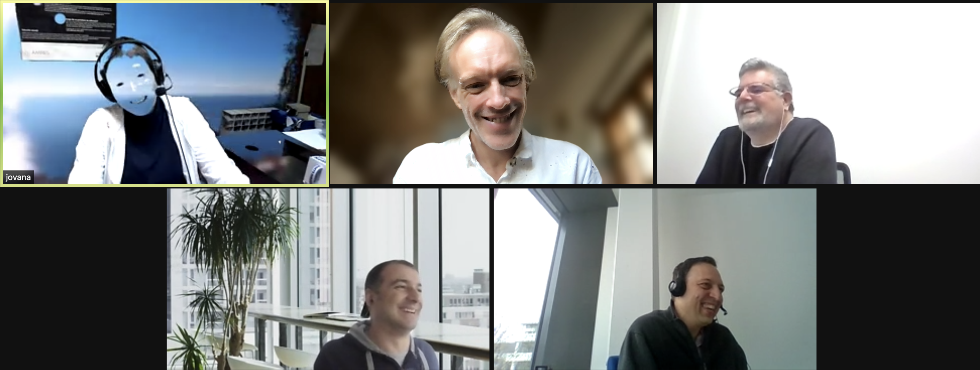
that is having fun while working!

