Slide 1
Are NRENs ready for digital education?
Gyöngyi Horváth (GÉANT)
TNC22, Trieste, Italy
16 June 2022

Slide 2
Why the question?

Slide 3
European Commission
Digital Education Action Plan (2021-2027)
offers a long-term strategic vision for high-quality, inclusive and accessible European digital education
addresses the challenges and opportunities of the COVID-19 pandemic, which has led to the unprecedented use of technology for education and training purposes
seeks stronger cooperation at the EU level on digital education and underscores the importance of working together across sectors to bring education into the digital age
presents opportunities, including improved quality and quantity of teaching concerning digital technologies, support for the digitalisation of teaching methods and pedagogies and the provision of infrastructure required for inclusive and resilient remote learning

Slide 4
UNESCO Strategic Development Goal 4: Quality education
“Ensure inclusive and equitable quality education and promote lifelong learning opportunities for all.”
Notes:
The Education 2030 agenda was adopted in 2015 to ‘ensure inclusive and equitable quality education and promote lifelong learning opportunities for all’ by 2030 with a series of targets set out to realize this. Before COVID-19, the world was already off-track to meet the targets and because of the pandemic some of the gains already made in education were lost. Education was severely disrupted worldwide with the most vulnerable learners affected worst. However, the crisis also saw global partnerships strengthened or newly forged in order to rethink the way forward for education and realize the Education 2030 goals.
In 2015 world leaders signed up to the Education 2030 Sustainable Development Agenda, a structured pathway to making education accessible to all and the foundation for sustainable development and peace.
UNESCO coordinates the international community to achieve the education goals of Sustainable Development Goal 4 through partnerships, policy guidance, capacity development, monitoring and advocacy with the Education 2030 Framework for Action as roadmap.

Slide 5
Current landscape
NRENs educational services
Trends & opportunities
TF-EDU
Community facilitation & representation
GÉANT and ERASMUS+
MyAcademicID
Notes:
ERASMUS + supporting identity
Offering a service supporting digitalization of ERASMUS+ - the aim is for students to apply for their mobility period using federated access. Therefore using their institutional credentials.
Reref to Licia’s presentation on Wednesday afternoon.

Slide 6
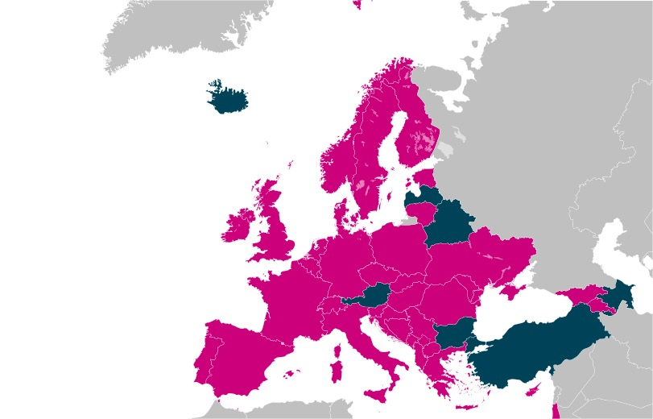
GÉANT NRENs educational services

Slide 7
Educational services
Digital Learning Environment
Student
Management
Systems
Online, blended and remote delivery of education
Providing e-Content
Video
Conferencing
For education
T&I for
education
Open badges, digital credentialling
Inhouse built tools by your NREN for digital learning
Educational
Data mining and Analytics
Learning
Analytics
Digital assessment and testing
Anti-plagiarism

Slide 8
NRENs provide educational services 2019-2020-2021-2022

Slide 9
Trends
Significant increase in uptake:
T&I for education
Videoconference for education
Digital Learning environment
E-Content
Moderate increase in uptake:
Open badges, digital credentialing

Slide 10
Country | Digital Learning Environments | e-Content | Online or blended education | Digital assessment | Open badges, digital credentialing | Learning Analytics | Student Manag. System | T&I for education | Educational data mining | Videoconferencing for education | Support Offshore students | In-house built tools
Albania
Armenia
Austria
Azerbaijan
Belarus
Belgium
Croatia
Cyprus
Czech Republic
Denmark
Estonia
Finland
France
Georgia
Germany
Greece
Hungary
Iceland
Ireland
Israel
Italy
Kosovo
Kyrgysztan
Lithuania
Luxembourg
Macedonia (FYR)
Moldova
Montenegro
Netherlands
Norway
Poland
Portugal
Serbia
Slovakia
Slovenia
Spain
Sweden
Switzerland
Tajikistan
Turkey
Ukraine
United Kingdom
Service level growing
Project level growing
Inititative level growing
Service level stable
Phasing out

Slide 11
Human resources in NRENs education activities

Slide 12
NREN educational services 2019 - 2020 – 2021 - 2022

Slide 13
Interest for collaboration areas

Slide 14
Effects on NRENs
Infrastructure is not enough anymore
ICT is part of education and research strategy
→NRENs need to be part of the strategic debate
→Influence choices by presenting technological opportunities & solutions
→Explore with institutions (students, faculty and staff) what they need & adapt thereto
New technical spaces to fill: AI, data, etc.
New ways of collaborating with members and other stakeholders (co-create)

Slide 15
Collaboration
TF-EDU
Case for NRENs
International policy makers
University management & association of universities
Ministries & governments
Notes:
‘To raise the profile, engagement and influence of (N)RENs and our communities, nationally and globally, in the area of education in alignment with the UNESCO Sustainable Development Goals’

Slide 16
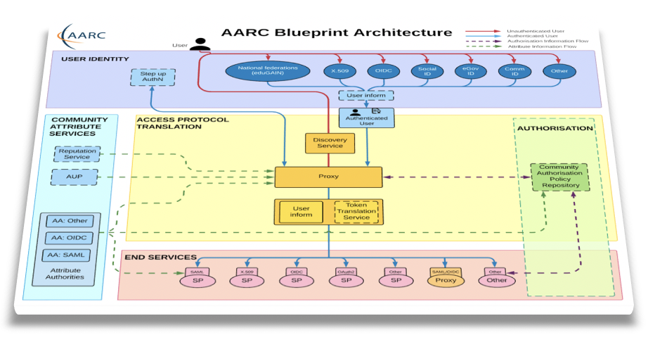
Making tools available for the NREN community
Coordinate development
Joint procurement
Public values
Supporting virtual teams and sharing resources
Offering a validation service based on “studentness”
TRUST
IDENTITY
ACCESS
16
Notes:
Joint procurement: OCRE

Slide 17
Increased NREN activities for educational tools & services

Slide 18
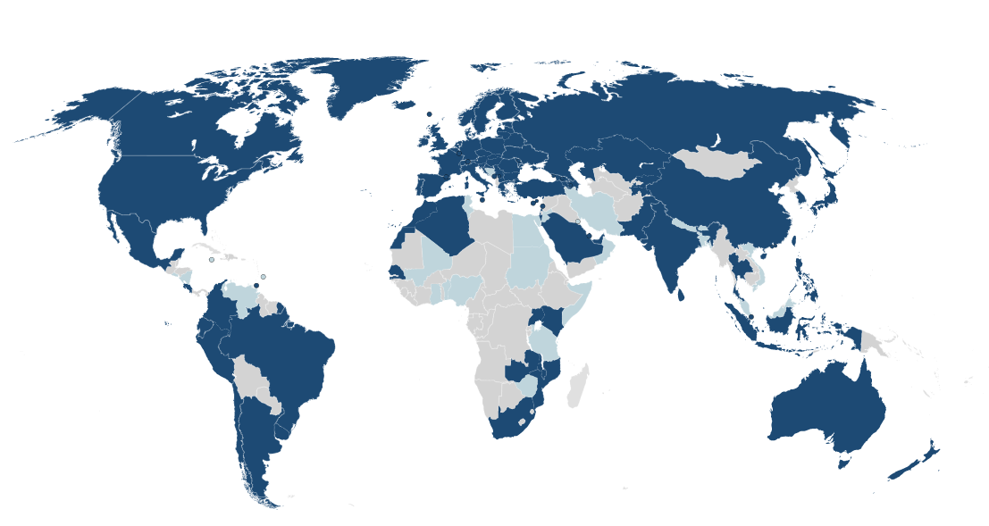
Federated services
Student mobility / eduID / lifelong learning
Interoperability for European Student card
Federated educational resources
T&I services: eduGAIN, MyAcademicID
Microcredentialling
eduroam
Notes:
T&I services: eduGAIN, MyAcademicID

Slide 19
Open badges, digital credentialing and e-Content

Slide 20
Data handling
Interoperability
Mobility
Standardization
Policy on microcredentials
Lifelong learning
Standards for description of microcredentials
Quality assurance
Infrastructure
Exchange of educational data
EduBagdes: digital certificates
Identity that can be used across institutions (eduID)

Slide 21
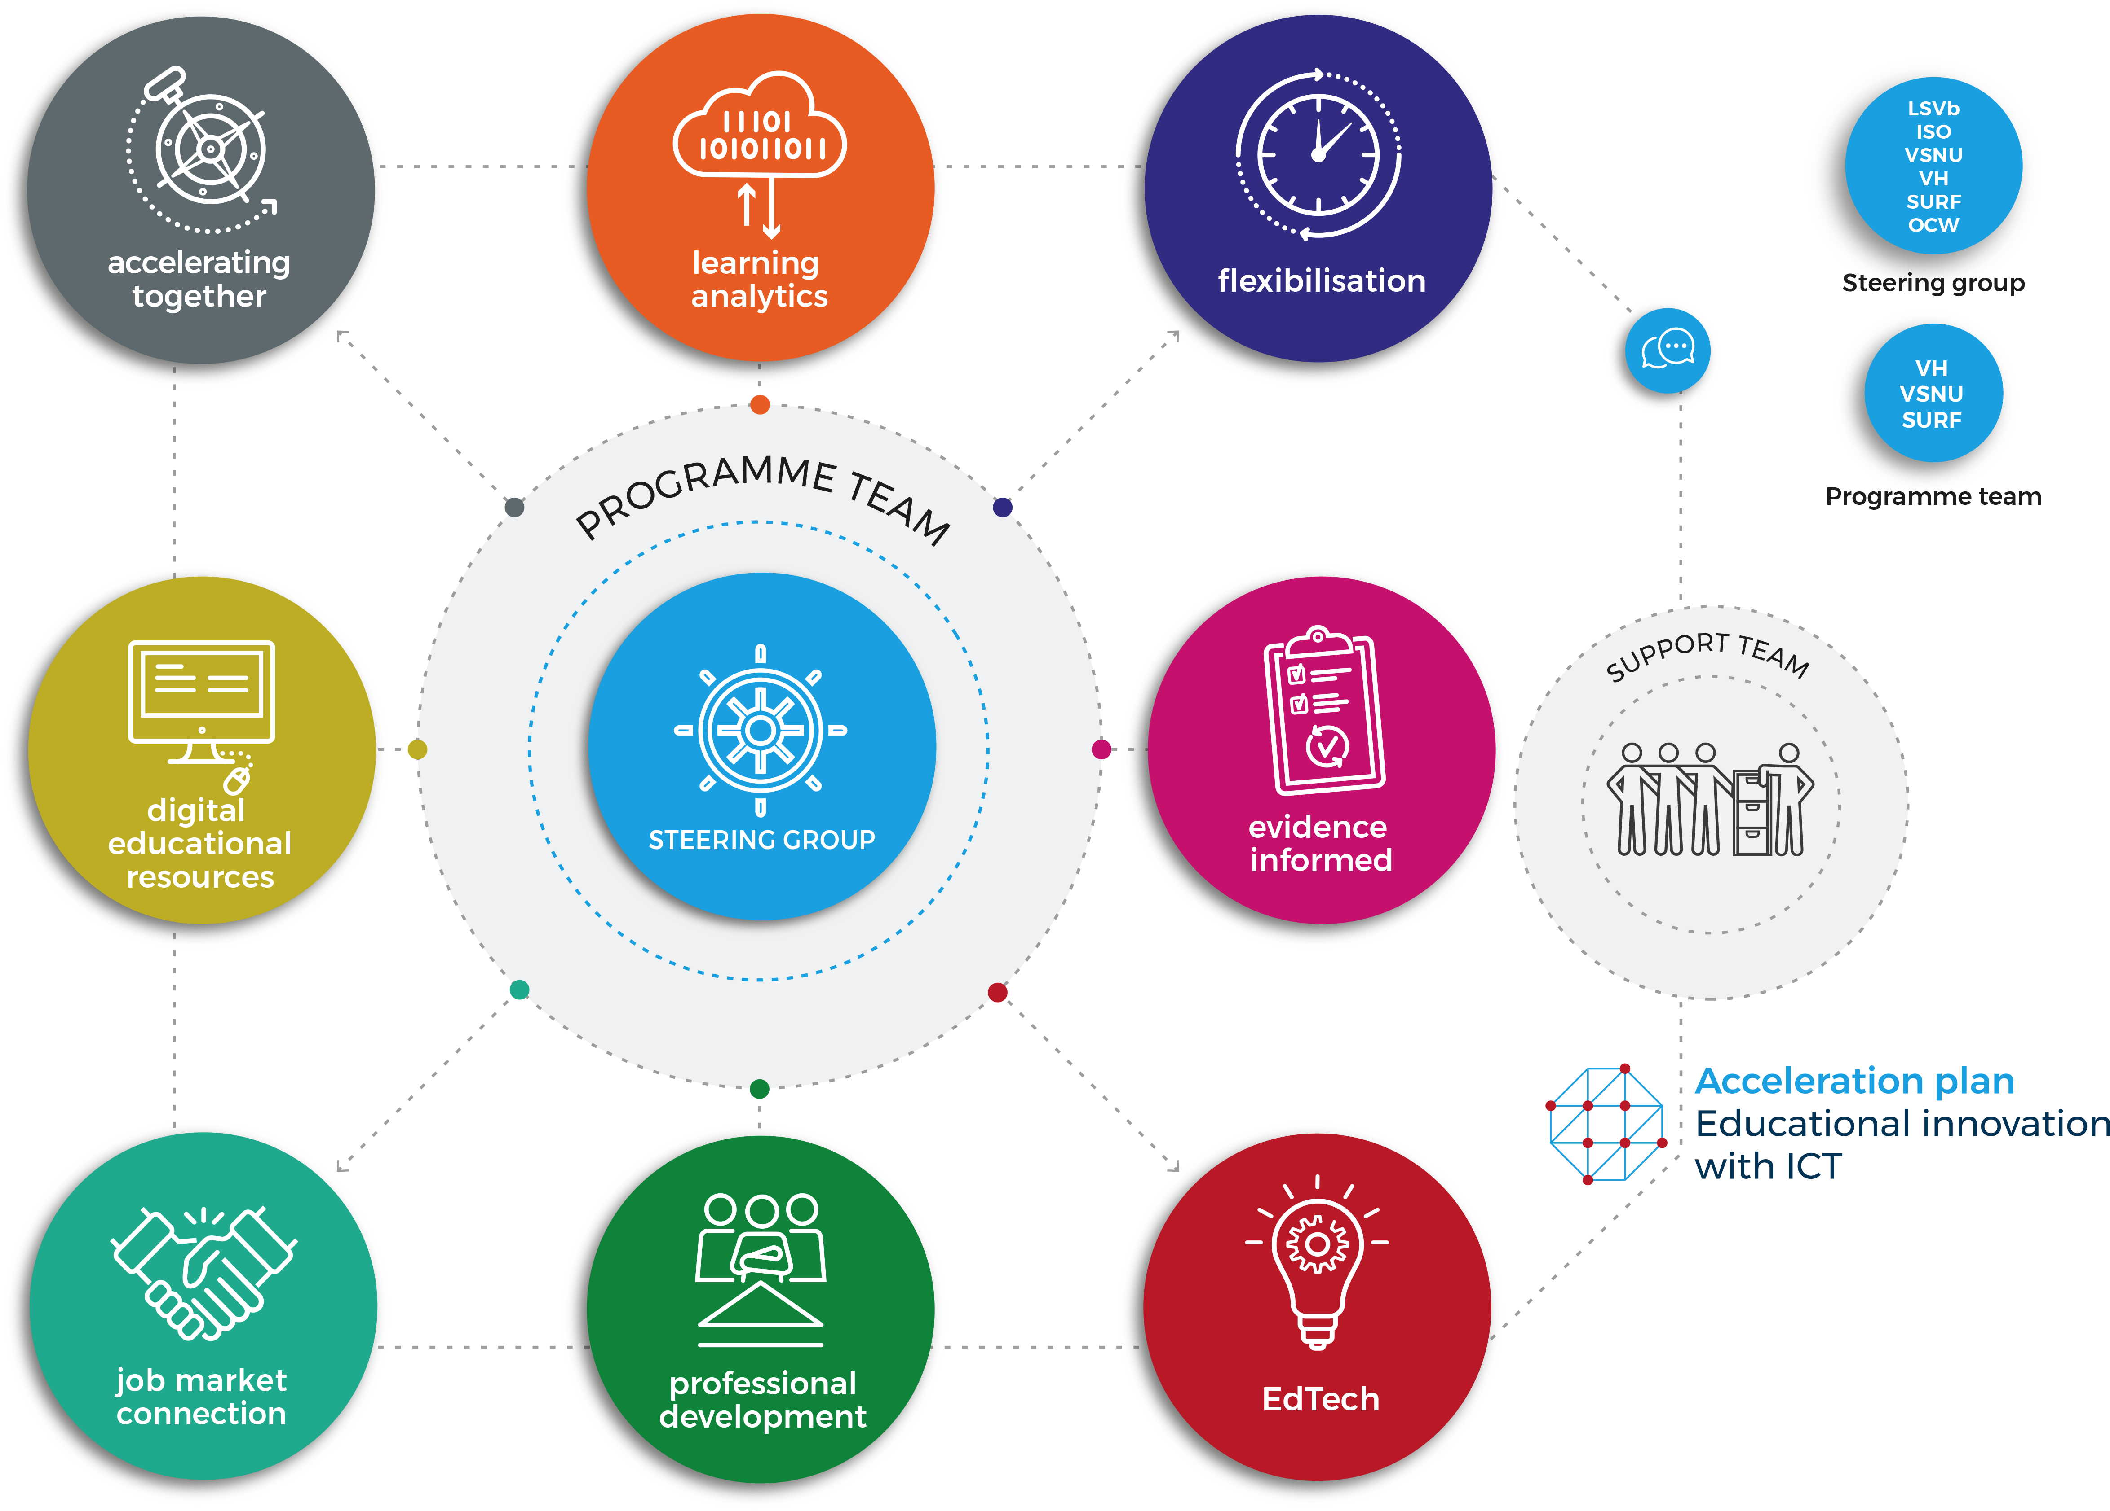
Acceleration: Example for the Dutch NREN: SURF
Notes:
three ambitions:
1. Improving the connection to the labour market
2. Stimulating the flexibility of education
3. Smarter and better learning with technology
4 year program 2019-2022
Main objectives:
1. Improve job market connection
2. Facilitate mobility
3. Provide & use open educational resources
4. Improve quality through data driven & evidence informed interventions

Slide 22
Challenges
Country situation
NRENs’ mandate varies
Business models
Legal situation
Resources
Interoperability
Individual / national developments – interoperability, standardization
Procurement
Transferability

Slide 23
Why to act more?
ICT is part of education and research strategy
NRENs need to be part of the strategic debate
Influence choices by presenting technological opportunities and solutions
Explore with institutions (students, faculty and staff) what they need & adapt thereto
New technical spaces to fill: AI, data…etc
New was of collaborating with members and other stakeholders
Why NREN collaboration?
We have the knowledge
We have trust and build on that
Together, we also have capability
Notes:
The knowledge to scale international services.
We have demonstrated that by collaborating we can achive more things: eduGAIN, eduroam, TCS, network
Together we can scale up.

Slide 24
gyongyi.horvath@geant.org

