Slide 1
MANRS and R&E Networks
TNC 2022
Warrick Mitchell
June 2022

Slide 2
What is MANRS?
Creation of a MANRS Research and Education Networks Programme
Can you help?
© AARNet Pty Ltd | 2

Slide 3
What is MANRS?
Mutually Agreed Norms for Routing Security (MANRS) is a global initiative, supported by the Internet Society, that provides crucial fixes and tools to help reduce the most common routing threats.
Without MANRS, a malicious or not malicious service provider / entity can advertise your IP address space, and hijack your traffic.
Right now, you are all vulnerable to this, and in fact we have seen this occur.
In order to protect yourselves, you need to work with us to complete the following four simple actions.
Filtering Prevent propagation of incorrect routing information
Anti-spoofing Prevent traffic with spoofed source IP addresses
Coordination Facilitate global operational communication and coordination between network operators
Global Validation Facilitate validation of routing information on a global scale
Mandatory
Optional
Mandatory
Mandatory

Slide 4
Filtering
Private ASNs should not exist in either the global routing table or the global R&E table.
The others look to be where a RIR and customer of the RIR have failed keep in contact and possibly there is a billing dispute to be resolved.
Notes:
Imagine if there was a ROA created for 130.229.0.0/18 with an ORIGIN AS of 2837
But again, if we followed the letter of the MANRS these would be considered BOGON ASN’s which should be filtered.

Slide 5
Filtering
It’s ok we won’t make the same mistake with IPv6…
Ummm… people still are.
Notes:
Imagine if there was a ROA created for 130.229.0.0/18 with an ORIGIN AS of 2837
But again, if we followed the letter of the MANRS these would be considered BOGON ASN’s which should be filtered.

Slide 6
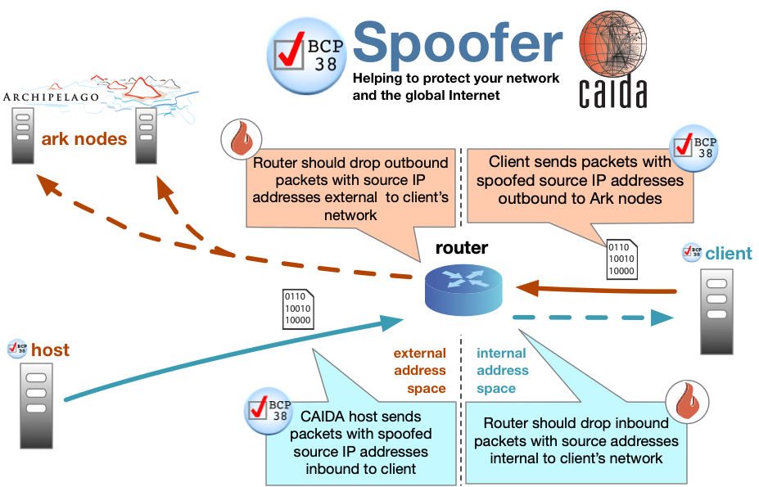
Anti-Spoofing
Do you have uRPF checks enabled on your network at all points (including your own office connections, customers etc?)
Have you tried running the CAIDA anti-spoofing tool to test yourself? https://www.caida.org/projects/spoofer/
Notes:
Imagine if there was a ROA created for 130.229.0.0/18 with an ORIGIN AS of 2837
But again, if we followed the letter of the MANRS these would be considered BOGON ASN’s which should be filtered.

Slide 7
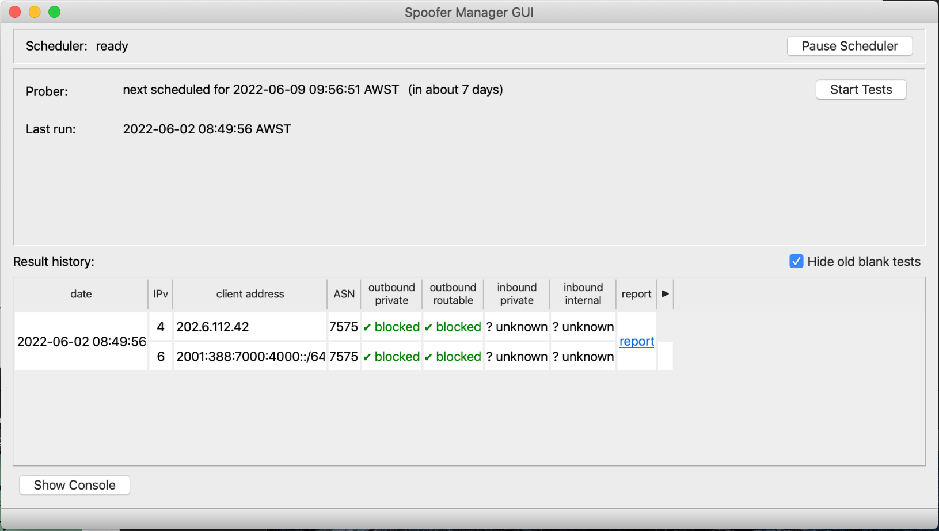
Anti-Spoofing
Notes:
Imagine if there was a ROA created for 130.229.0.0/18 with an ORIGIN AS of 2837
But again, if we followed the letter of the MANRS these would be considered BOGON ASN’s which should be filtered.

Slide 8
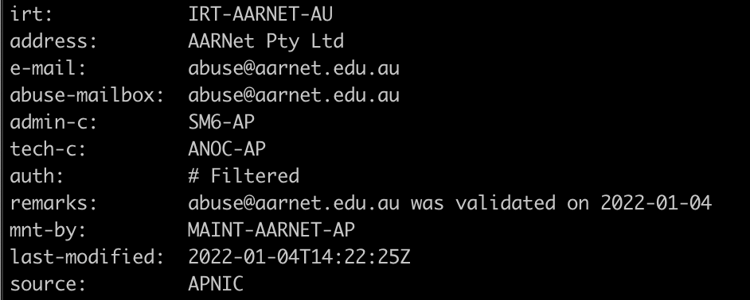
Co-ordination
Everyone should be checking that they have a IRT (Incident Response Team) or at least up to date contact details for their network allocations so when a fault occurs others can reach you to resolve an issue etc.
You need to reach out to APNIC, ARIN, RIPE NCC, LACNIC & AFRNIC to do this.
Notes:
Imagine if there was a ROA created for 130.229.0.0/18 with an ORIGIN AS of 2837
But again, if we followed the letter of the MANRS these would be considered BOGON ASN’s which should be filtered.

Slide 9
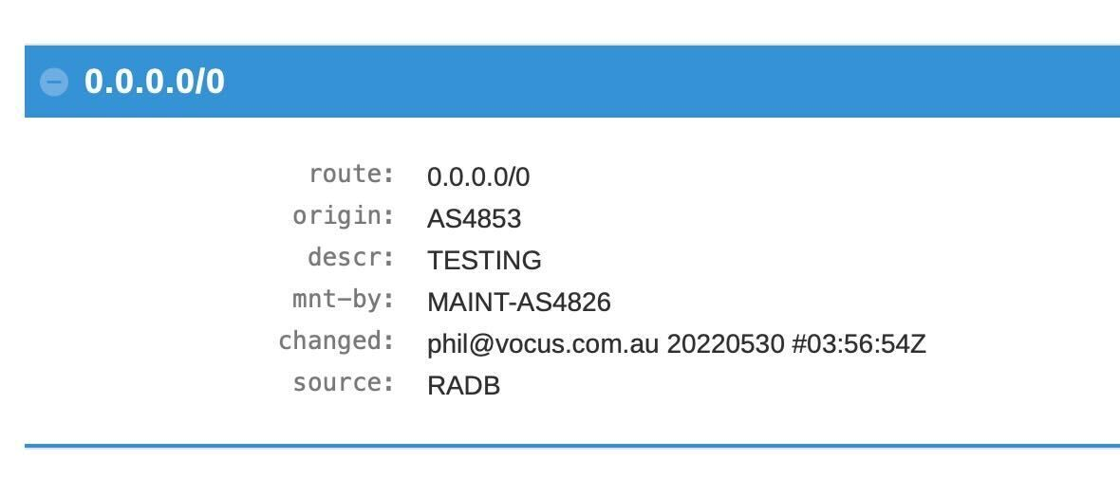
Validation
Do you have a route object in your RIR or RADB?
Is it correct?
Do you filter / check your RADB results?
* Note: The above was a test and has been removed, but it is possible to put bad things in RADB.
Notes:
Imagine if there was a ROA created for 130.229.0.0/18 with an ORIGIN AS of 2837
But again, if we followed the letter of the MANRS these would be considered BOGON ASN’s which should be filtered.

Slide 10
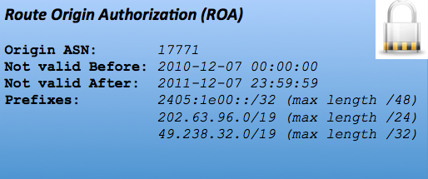
Validation
Have you created ROA’s for your IPv4 and IPv6 networks, to help people understand your “intent” i.e. who you want to originate it and what length of advertisement?
If you have historical records, we understand there may be constraints, but hopefully we can help make this happen!
Notes:
Imagine if there was a ROA created for 130.229.0.0/18 with an ORIGIN AS of 2837
But again, if we followed the letter of the MANRS these would be considered BOGON ASN’s which should be filtered.

Slide 11
How many people are participating in MANRS?
MANRS is a collaborative initiative of Internet operators
The MANRS Participants are the Internet operators that meet the requirements of the 4 MANRS programmes:
Network Operators – 682 participants – 78 of these are R&E Networks and Universities
IXPs – 98 participants
CDN/Cloud Providers – 18 participants
Vendors – 5 participants
MANRS Partners are organisations recognised by the MANRS Community as supporting MANRS through promotion, training, resourcing and/or in other ways

Slide 12
Can Research and Educations Networks be MANRS compliant?
The challenges arise when some REN’s try to comply with the “Filtering” and “Global Validation” actions.
There are currently 120 research and education networks in the world today, with over 25,000 universities behind these networks.
Unlike the traditional commodity internet providers, REN’s have been working collaboratively to provide mutual backup paths, which makes filtering of routes/as-path granularity challenging and now makes some REN’s no longer MANRS compliant as they haven’t created or updated a IRR policy record to indicate to the world they may see the backed up party routes via their network.
The allocation of IPv4 and IPv6 addressing to the REN’s and downstream universities, can and commonly are from historical address space, meaning that the resource holders can not easily create “Route Object Authorisation” (ROA’s) records as the Regional Internet Registry may require REN’s/universities to sign up with them and pay more money for their allocations that have been previously free from cost. There may also be legal impediments as well to be considered.

Slide 13
AARNet’s current MANRS compliance
Source: https://observatory.manrs.org (Note: you need to be a member of MANRS to see this for your network)

Slide 14
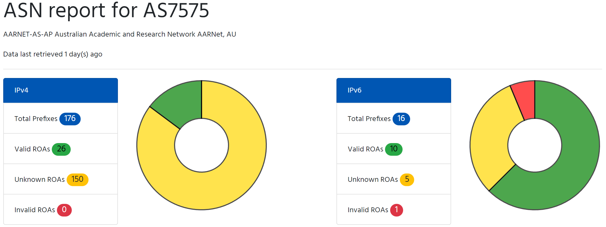
AARNet’s Current ROA Status
Source: https://roa-stats.manrs.org (Note: You don’t need to be a member of MANRS to use this tool)

Slide 15
Creation of the MANRS Research and Education Networks Programme
The MANRS Steering Committee has nominally accepted a proposal for the creation of a Research and Education Network Programme as of the 8th of December 2021.
The aims:
Proactively encourage all research and education networks to reach MANRS compliance (both Internet Facing and R&E Network facing)
Contribute towards improved techniques and tools to support this goal
Publicise MANRS globally and encourage universal participation

Slide 16
Creation of the MANRS Research and Education Networks Programme
Technical advantages:
Early adopters - we experiment with new technologies and push the capabilities of existing technologies in order to meet the needs of research and education.
Mutual backup – in various places around the world, NRENs advertise each other’s customer networks in order to provide greater diversity and resilience. The NREN community is developing an updated implementation of Best Current Practice BCP38 to support this collaborative scenario, which can then be shared more broadly.
Historical address space - universities typically have address space which was allocated early – NRENs are able to help facilitate the registration of ROAs for much of this historical space.
NRENs run Research networks - we’re generally willing and able to implement innovations to improve internet architecture and performance, by sharing data and providing a platform for network research – eg. RIPE Atlas probes, RouteViews participation

Slide 17
Creation of the MANRS Research and Education Networks Programme
What are some of the items the programme may investigate?
BGP Route Selection Policy (ROA, the RIR data, then RADB? Or other options)
R&E Peering Agreement best practices
BGP Communities - how to use this with a focus on R&E networking
ASPA (Autonomous system provider authorisation)
BGPSec (an alternative to AS Path Verification)

Slide 18
Creation of the MANRS Research and Education Networks Programme
What are some of the items the programme may investigate?
Can we filter customer routes via a “ROA” sub table? Rather than creating of prefix lists?
Generalized TTL Security Mechanism (GTSM), RFC 5802
TCP-AO
RPKI: ROV implementation
Advertise and use Max prefix on eBGP sessions
RFC 9003 (Extended BGP Administrative Shutdown Communication)

Slide 19
We need volunteers for each region, will you help?
© AARNet Pty Ltd | 19

Slide 20
Thank you

