Slide 1
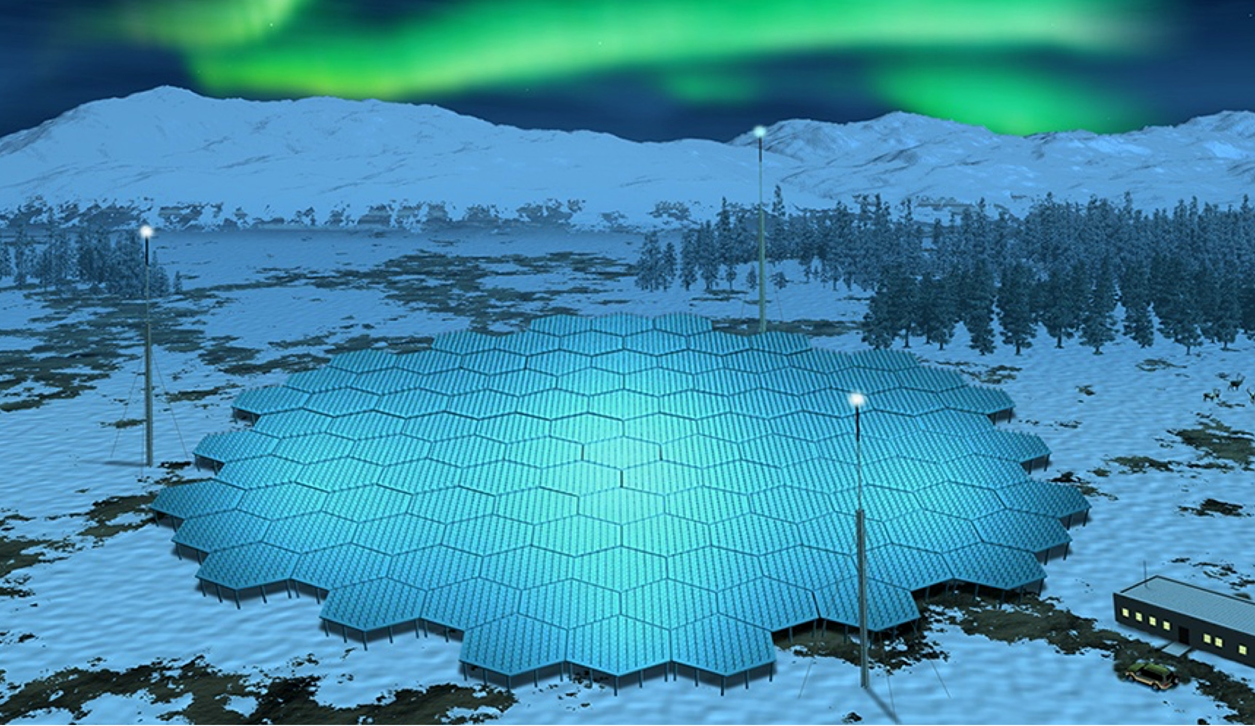




TERABIT TO THE TUNDRA
Notes:
Big science
EISCAT – science and instrument
The challenge of geography
Fiber networks
Background and evolution
Terabit model
Packet network
Optical network design and testing
Sites and equipment
NREN role; close collaboration with science is essential. A joint effort, not a provider costumer experience
integrating network in instrument

Slide 2
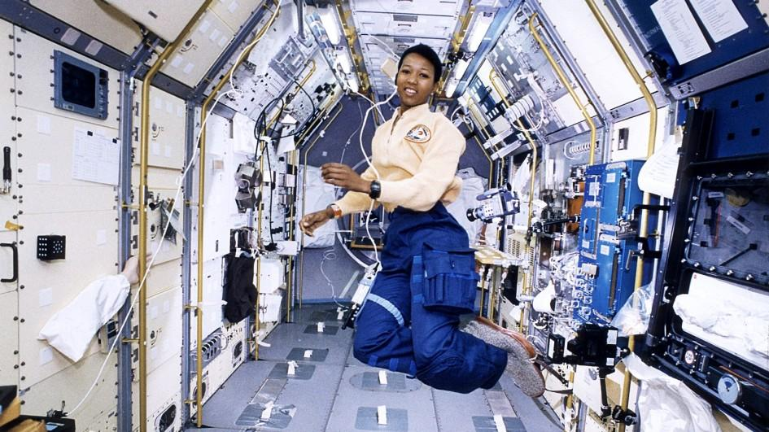
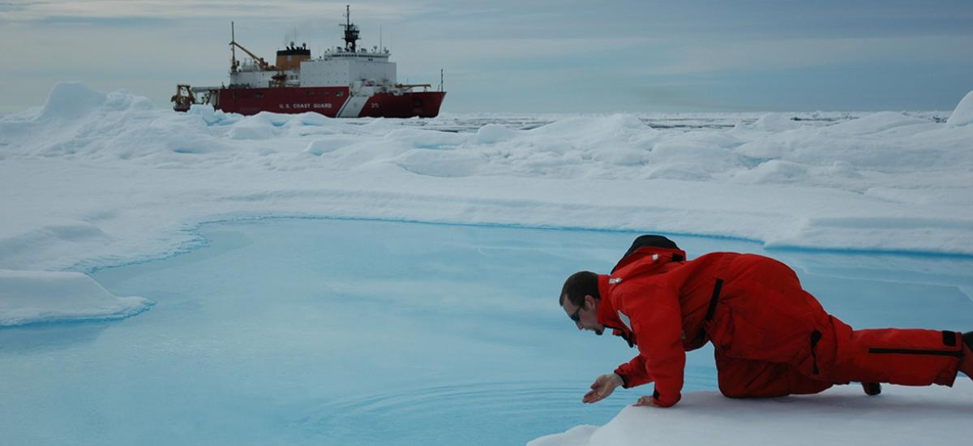


Anyone, anywhere, any time.
    Research is completely unconstrained by the physical location of instruments, computational resources, or data

Slide 3
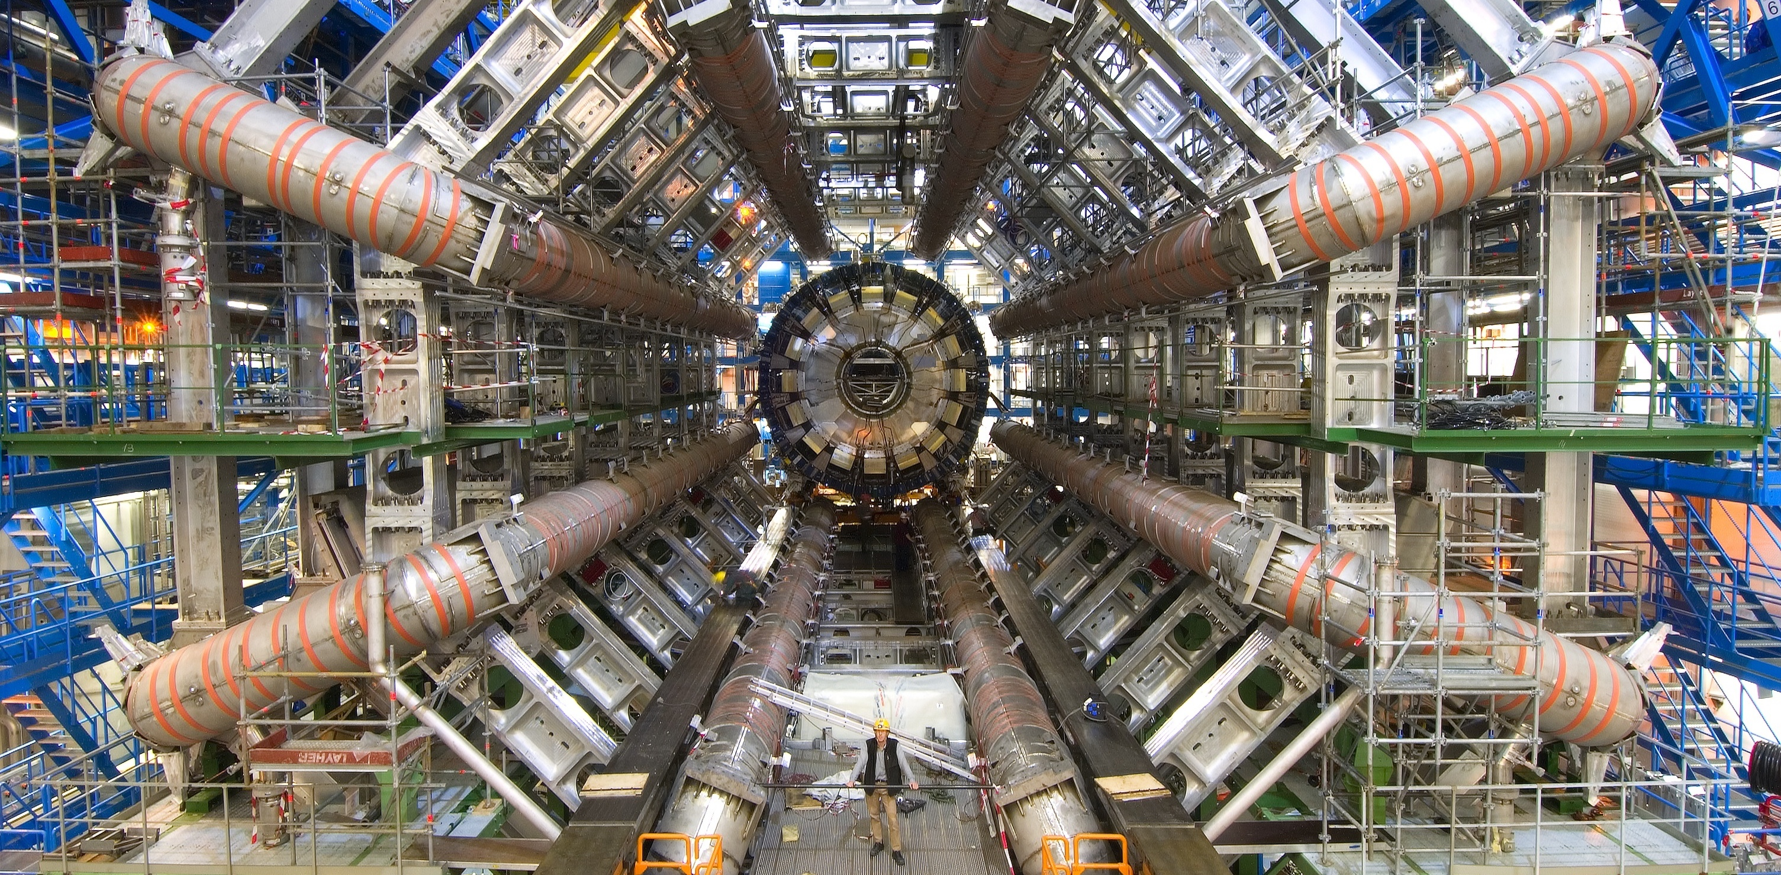
Big Science

Slide 4
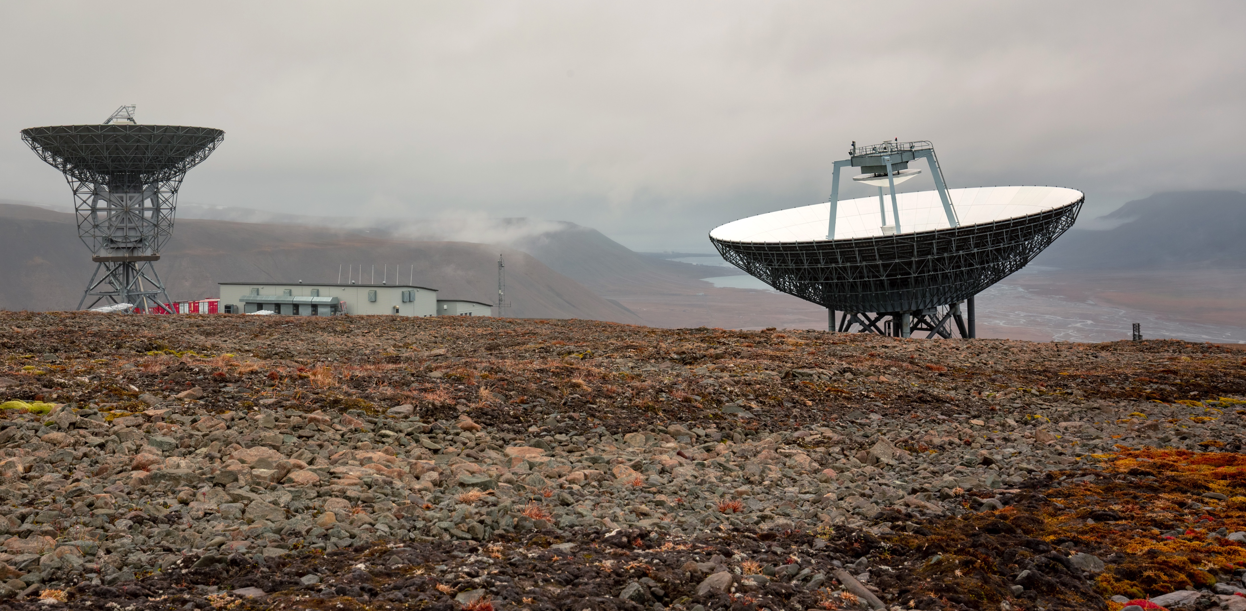
EISCAT

Slide 5
How is earths atmosphere coupled to space?

Slide 6
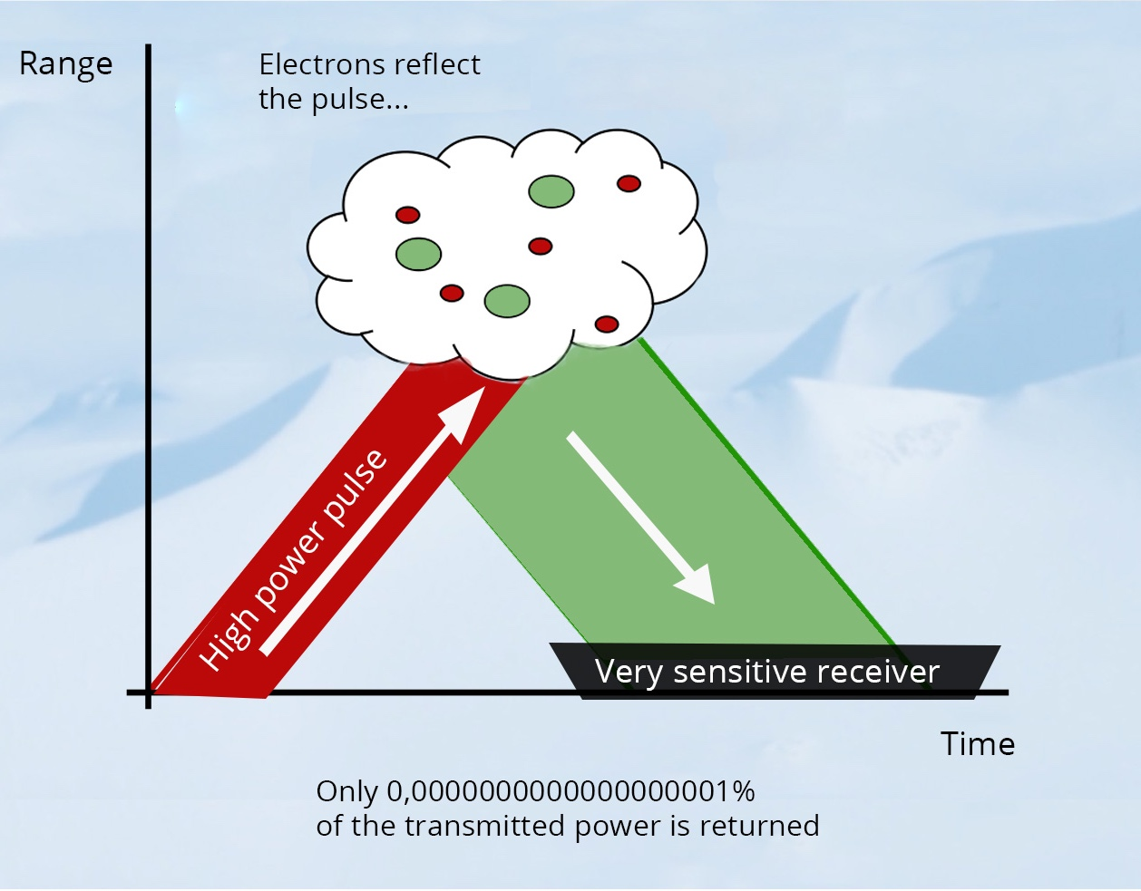
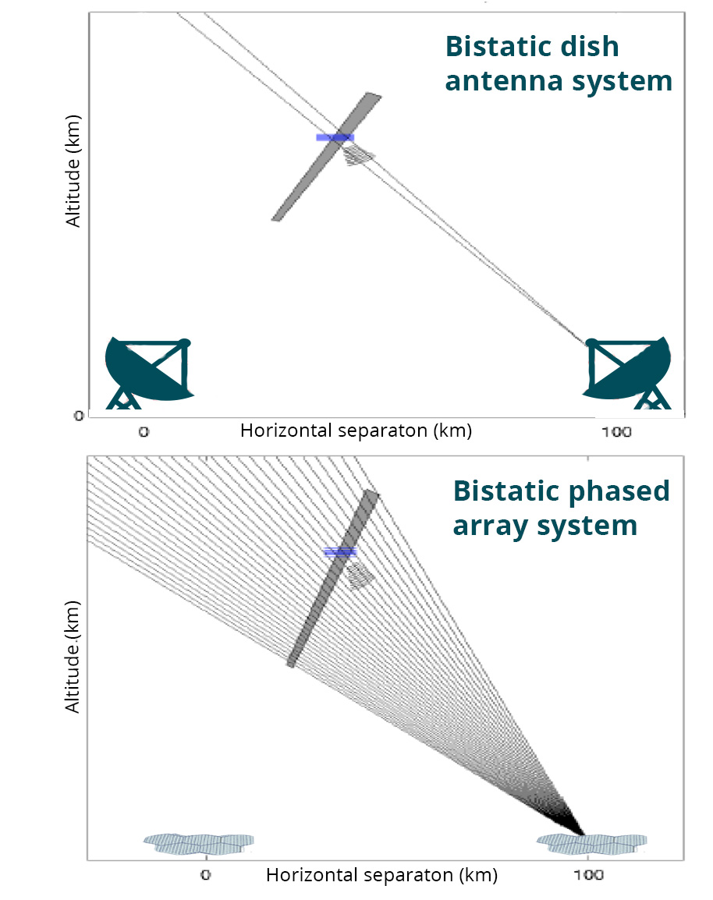
Incoherent scatter radar

Slide 7
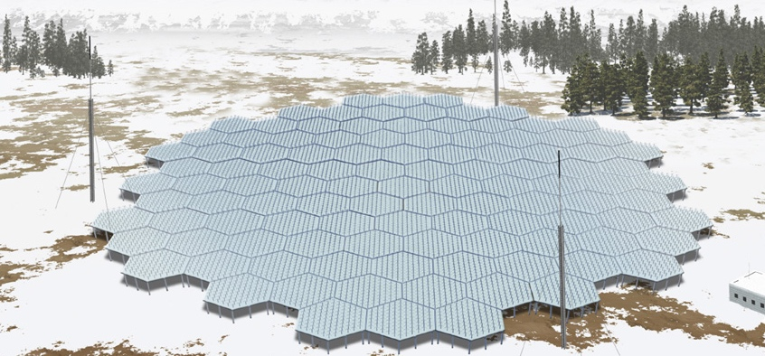
EISCAT-3D
Notes:
Multi-static phased array radars
Advanced digital processing
Beam Steering & volumetric imaging
Continuous observations, high flexibility

Slide 8
Applications
Ionosphere studies
Space weather studies, forecasting
Space debris tracking
Auroral observation
Meteor studies
Planetary imaging
Many applications in collaboration with other instruments, satellites, etc.
Notes:
Multi-static phased array radars
Advanced digital processing
Beam Steering & volumetric imaging
Continuous observations, high flexibility

Slide 9
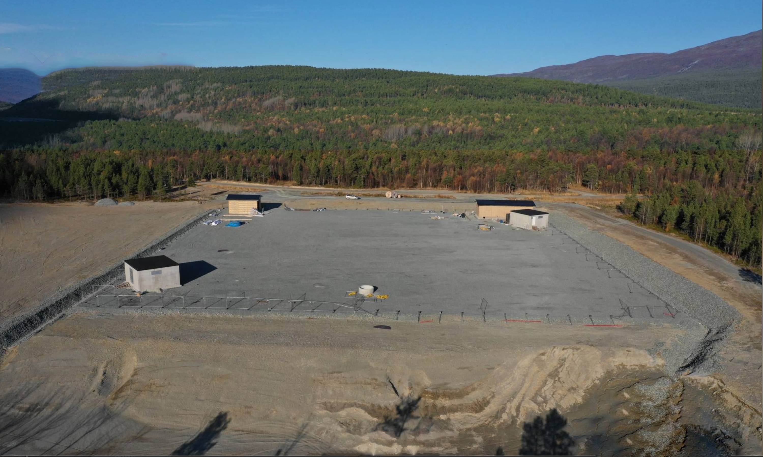
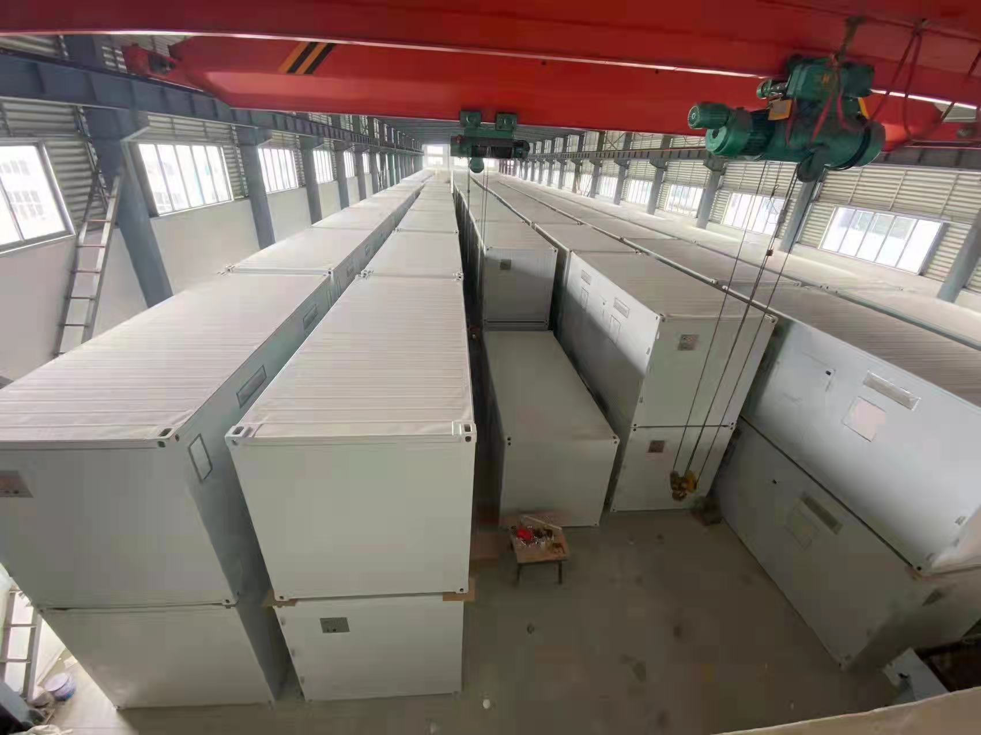
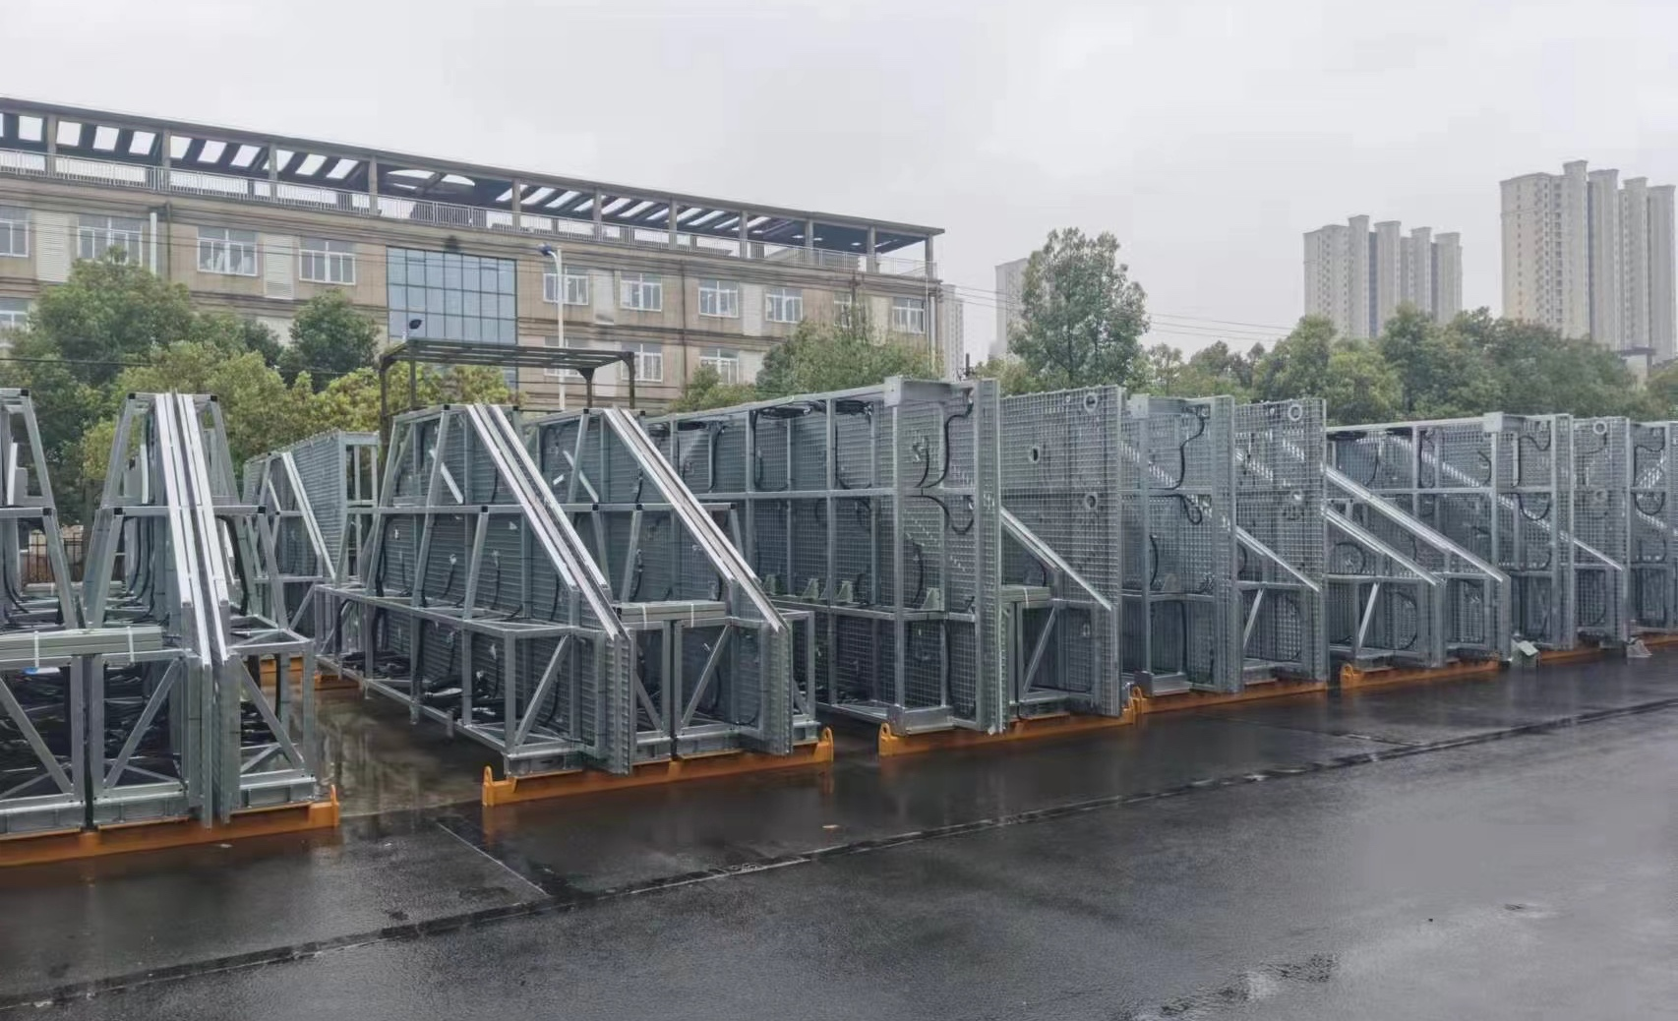
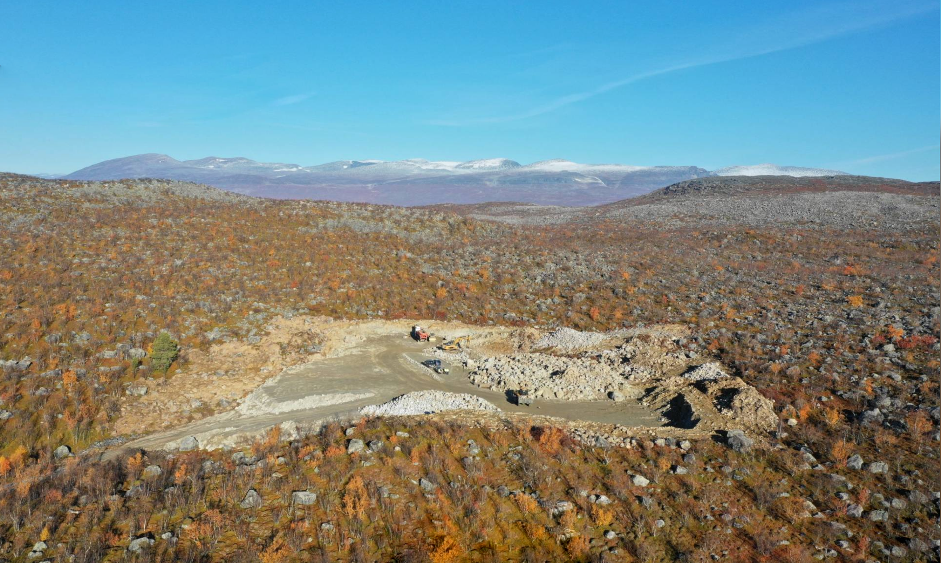
EISCAT-3D Site
Images: EISCAT Scientific Association

Slide 10
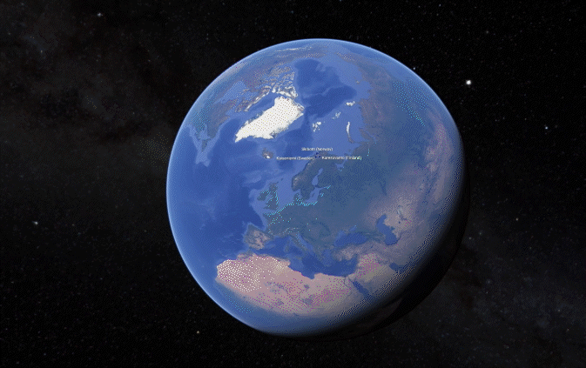
Networking

Slide 11
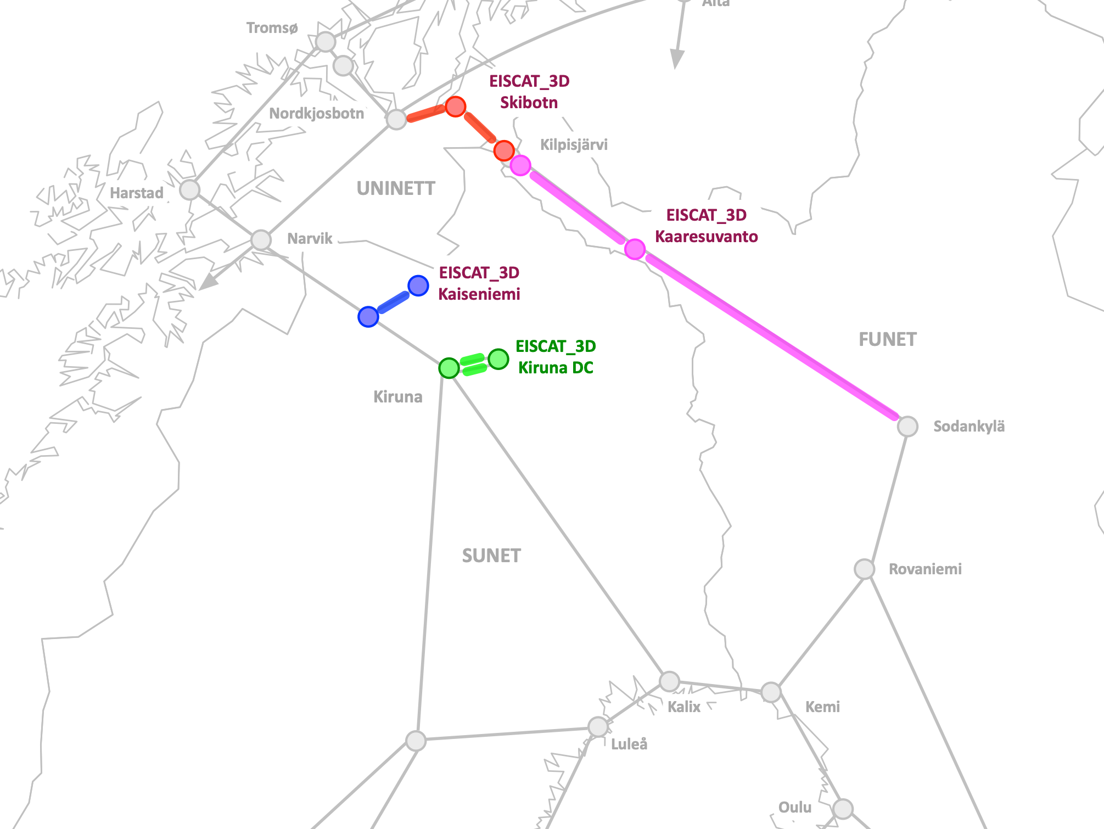
EISCAT_3D and fiber networks in the arctic region
Joint project between EISCAT, NORDUnet and the Nordic NRENs in Finland (Funet), Norway (SIKT) and Sweden (SUNET)
  Including the authors, a lot of our colleagues have involved in planning and implementation stages
Three antenna sites with 2 optional locations in Norway and Sweden
  Skibotn, Norway, transmitter and receiver site
  Kaiseniemi, Sweden, receiver site
  Kaaresuvanto, Finland, receiver site
Separate data center location somewhere within the region
  Later Kiruna, Sweden was chosen
None of the antenna sites had fibers available
  Required building new local loops and building or leasing fibers for the missing long-haul routes
Fiber ring to avoid extensive service breaks
  Difficult to fix issues in winter times due to harsh weather
  Reuse existing fiber topologies where available
  Flexibility to serve multiple potential data center locations
New long-haul fiber
and local loop
in Norway
Leased long-haul fiber
and new local loop
in Finland
EISCAT_3D
Skibotn
SIKT
EISCAT_3D
Kaaresuvanto
EISCAT_3D
Kaiseniemi
EISCAT_3D
Kiruna
data center
Funet
New local loop
in Sweden
Fiber ring
1 750 km
Upgrade local loop
for data center
in Sweden
SUNET

Slide 12
Network architecture – the beginning
Network planning started in 2015 together with the NRENs and EISCAT
  Original EISCAT_3D architecture based on computing at the sites
  Bandwidth requirements up to 53 Gbps per site after local process computing
Services to be offered with IP/MPLS networks
  Traditional design with router-to-router connections at the border locations
  Router connectivity to each antenna site
  Extensive use of backbone links which need to be upgraded as well
NRENs were using optical line systems from 2000s
  Designed for 10G with dispersion compensation but 100G possible
  Fixed-grid and on some spans very limited spectrum available
  Vendor lock-in with capacity licencing

Slide 13
Network architecture – open optical line systems
During the project existing optical systems started to reach end-of-life
  Need for new optical line systems to replace the older systems
SUNET began with their renewal in 2016
  Very high OSNR with hybrid EDFA/Raman amplification
  Gridless spectrum
  Open line system with licensing-free spectrum
Later other NRENs decided to follow the model
  Economical and technical limitations were practically gone
Huge development with transponders driven by cloud giants
  Disaggregated DCIs, up to 600+G line interfaces
  Significant cost reduction

Slide 14
Network architecture – “Terabit to the Tundra” model
First proposals to change the original IP/MPLS model
  Separate Ethernet ring between the sites and the data center with domain-specific waves
    No need to upgrade backbone IP routers and links
  End-to-end Ethernet connectivity to the data center with alienwaves across the borders
    Even less waves needed
    Possibility for optical protection
But terabit-era was closing, could we refresh the model altogether?
  Data received directly from the receivers to a single computing location would give big benefits for analysing stage
  Receivers have Ethernet interfaces and could be transported
  Increases transmission costs but decreases operational and equipment costs on sites
EISCAT_3D project scientists were interested about the idea
  TCO estimates were calculated based on existing DCIs available
  And eventually it was accepted and chosen

Slide 15
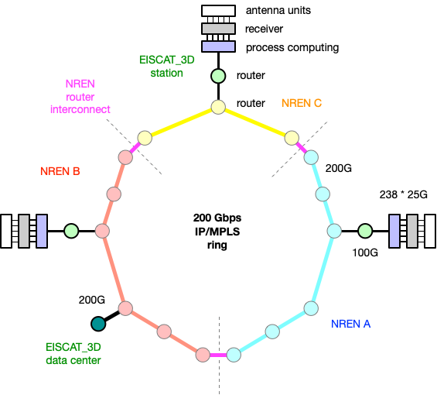
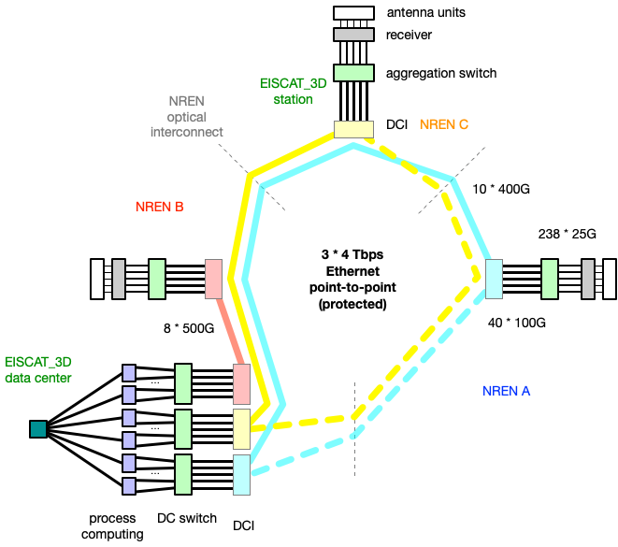
Network architecture – evolution towards terabit
2015
2022

Slide 16
Network architecture – “Terabit to the Tundra” challenges
“Terabit to the Tundra” model challenges
  Receivers in EISCAT_3D can generate up to 4 Tbps data rates from each site
    Need for serious amount of transmission capacity and spectrum
  Commitment from the NRENs to provide THz level spectrum for the project
Operation in multi-layer and -domain environments
  Optical line systems are operated independently by NRENs
  Transport and optical protection are operated jointly by involved NRENs
  Packet network is operated by EISCAT
Monitoring in multi-layer and -domain environments
  Transport and packet layer metric collection by Streaming Telemetry and/or SNMP
  Feed metric data to common time-series database and dashboard frontend
  Later to extend to cover the line systems as well?

Slide 17
Network architecture – packet network
Will be planned, acquired and managed by EISCAT
Antenna sites
  Receiver is transmitting up to 2 x 16 Gbps data streams through 2 x 25 GbE interfaces
  Switches will aggregate 6 x 16 Gbps data streams into a 100 GbE transport interface
Kiruna data center
  Two options, not decided yet:
  Via switching layer (100 GbE only) to steer traffic to the computing nodes
  Directly from the transport to the computing nodes
Most probably no need for deep buffering
  Continuous data rate, no transforms from higher to lower speeds

Slide 18
Network engineering – optical network design
Transparent optical interconnects between the networks
  ROADM-to-ROADM interconnects to pass signals
  Services logically terminated at the border
Signal power equalisation between the domains
  Signals are always online via both optically protected routes
  Automatic or manual equalisation?
Transponders and add-drops
  Tx side filters to keep high launch OSNR in colorless add-drop
  Receive power level optimised with amplifiers
Conservative spectrum planning for the services
  100 GHz per 400G CP-16QAM (~ 70 Gbaud) : 1 THz per 4 Tbps
  Could be 87,5 GHz or 75 GHz if performance is good enough: 0.75 THz per 4 Tbps

Slide 19
Network engineering – capacity and reach
All line systems designed to provide high OSNR
Total OSNR estimated as the ring is not yet online
  Performance tested with similar transponders over different routes
  Primary routes relatively short: enough margins
  Secondary routes (up to 1300 km): lower margins but should be in safe side
Either 400G or 500G waves are used
  400G: Skibotn - Kiruna (primary 450 km, secondary 1 300 km)
  400G: Kaaresuvanto - Kiruna (primary 600 km, secondary 1 150 km)
  500G: Kaiseniemi - Kiruna (125 km)

Slide 20
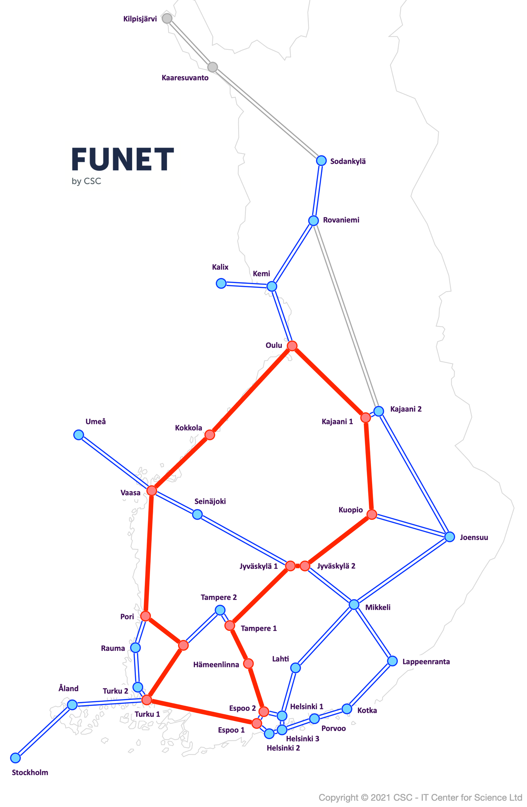
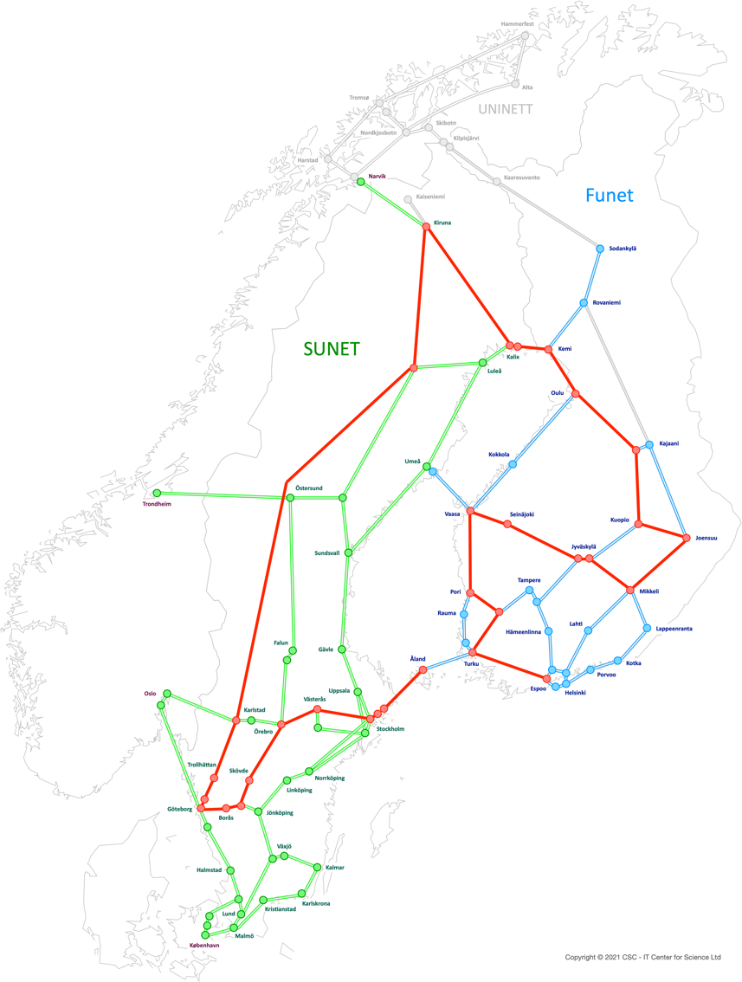
Network engineering – testing line system performance
Nordic NRENs have performed intra-domain and multi-domain tests to evaluate optical line systems’ performance
  All tests done close to the specified equipment limits
  Will give better estimates about the achievable reach
Short term (hours or days) stability
  500G CP-32QAM (69 Gbaud) @ 125 HGz channel, over 500 km
  400G CP-16QAM (69 Gbaud) @ 125 GHz channel, over 2 500 km
  2 x 200G CP-QPSK (69 Gbaud) @ 150 GHz channel, over 7 000 km
  2 x 200G CP-QPSK (69 Gbaud) @ 100+100 GHz channels, over 10 000 km
  300G CP-8QAM (69 Gbaud) @ 125 GHz channel, over 4500 km
Long-term (weeks) stability
  2 x 400G CP-16/32QAM hybrid (67 Gbaud) @ 150 GHz channel,
  over 1 900 km
Funet
2 * 400G
1900+ km
4+ weeks
Funet+SUNET
2 * 200G
10 000+ km
few hours

Slide 21
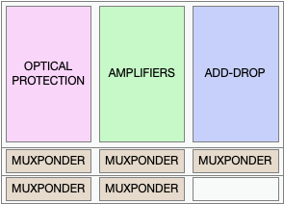
Building the system – equipment
Transport and protection models were designed by NRENs
  Only mandatory requirements
  TCO over 10 year period used to differentiate alternatives
  Return-to-factory support and own spares to drive costs down
  Separate network management system to enable joint operation
Three separate 4 Tbps point-to-point systems
  Total capacity 12 Tbps
4 Tbps point-to-point system configuration (ADVA)
  OLS platform: optical protection, amplification and add-drop
  DCI platform: muxponders (max. 2 * 600G per module)
  40 * 100GbE LR4 client interfaces towards the packet network
DCI based transport is very compact and energy efficient
  2 RUs for 4 Tbps
  Less than 3 kW (typical) power consumption per 4 Tbps link
Transport node in
EISCAT_3D sites
OLS
DCI

Slide 22
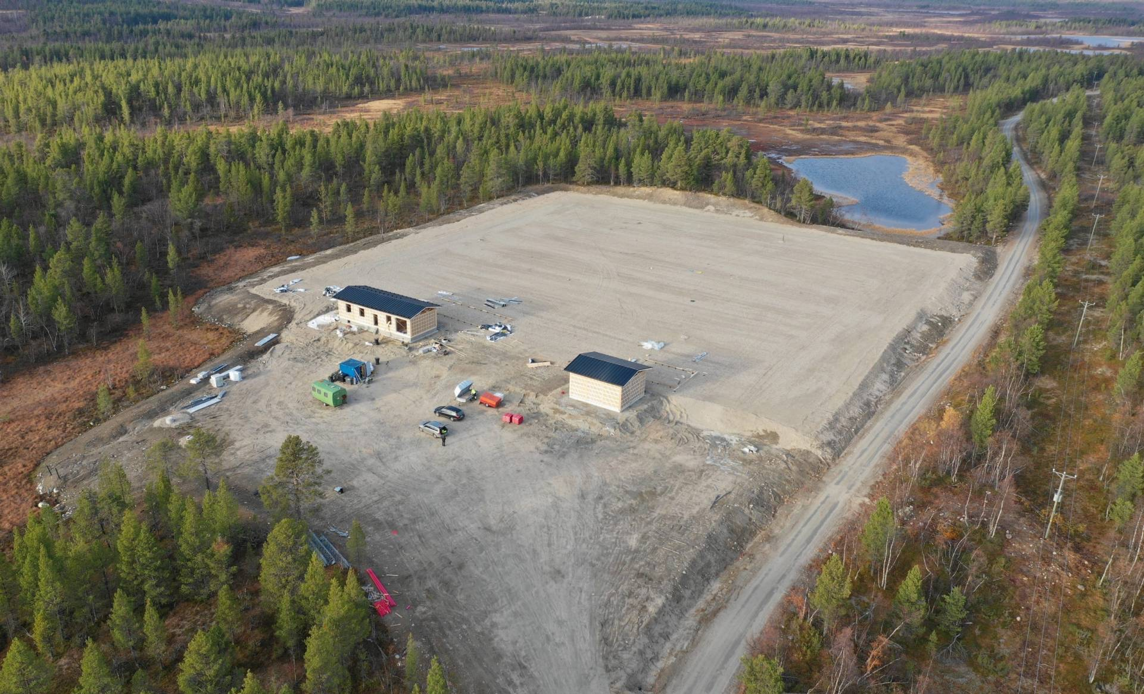
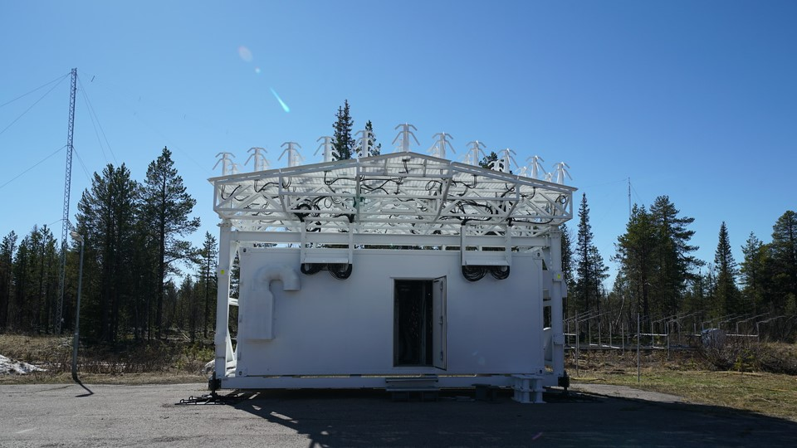
Building the system – site status
Instruments has been already tested in the test subarray
Serial production of antenna fields has been finalised
Instrument production ongoing and should be ready end of 2023
Equipment installations and commissioning
  Optical line system extensions and transport: before end of Q4/2022
  Transport tests: Q1/2023
  Packet layer : 2023
  Antenna fields: Norway autumn 2022, Finland/Sweden spring/summer 2023
  Instruments: Norway winter 2022, Finland/Sweden summer 2023
First measurements planned
  Norway: early 2023
  Full system: end of 2023
EISCAT_3D site in Kaaresuvanto, Finland
(late 2021)
EISCAT_3D Kiruna test subarray
Images: EISCAT Scientific Association

Slide 23

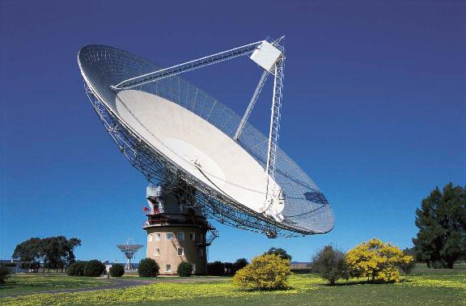
Rethinking Networking for Research Instruments
Integration of Instrument, NREN, and Data Centre networks
  “It’s not just transport anymore”
  The network is part of EISCAT_3D
  Helping create a more powerful instrument
  Enabled by (improved) technology
New options w/ DCI optical equipment
  Tunable & High capacity, small form factor, lower cost
Modern Data Centre and Compute Facilities
  Hosting, Facility Management, Containerized Computing
  Large-scale Science Storage Facilities
  … integrated with instruments

Slide 24
The Role of the NREN
Delivering the impossible
  Terabit connectivity at 70’N
Enabling Partnership for Science
  Based on science workflows and the data lifecycle
  Joint Process, NRENs included from early phases
  Engaging the entire spectrum of e-Infrastructures
  Helping scientists understand the possibilities
Much more than a provider / customer relation
  Terabit to the Tundra is a close collaboration to find the fit between research objectives and technology options
  Taking the long view, building consensus over years
  Transforming both the instrument and the network in the process

Slide 25
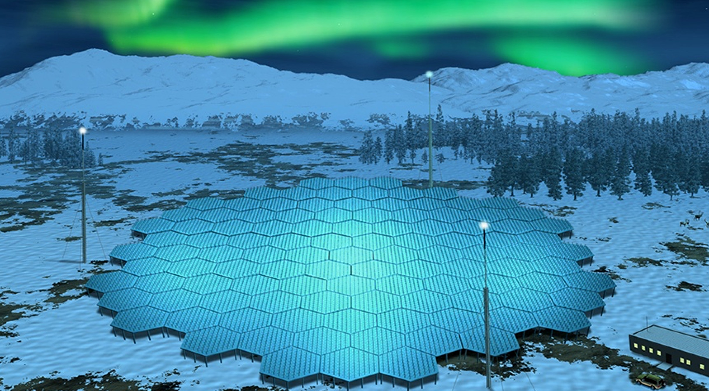
Thank You!
Notes:
Big science
EISCAT – science and instrument
The challenge of geography
Fiber networks
Background and evolution
Terabit model
Packet network
Optical network design and testing
Sites and equipment
NREN role; close collaboration with science is essential. A joint effort, not a provider costumer experience
integrating network in instrument

