Slide 1
Exploring our planet through SMART cables
Chris Atherton
Senior Research Engagement Officer
17/6/22
TNC22, Trieste

Slide 2
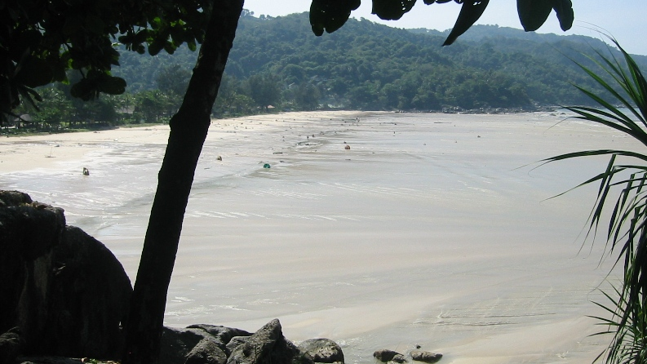
Notes:
26th December 2004 at close to 8 am in the morning an earthquake struck Indonesia.
Eye witnesses reported a sucking sound and the tide moving way out off shore.
If you are ever by the sea and experience this, run to the top floor of the highest building or get to high ground.
What struck next was the Indian ocean Tsunami of 2004.

Slide 3
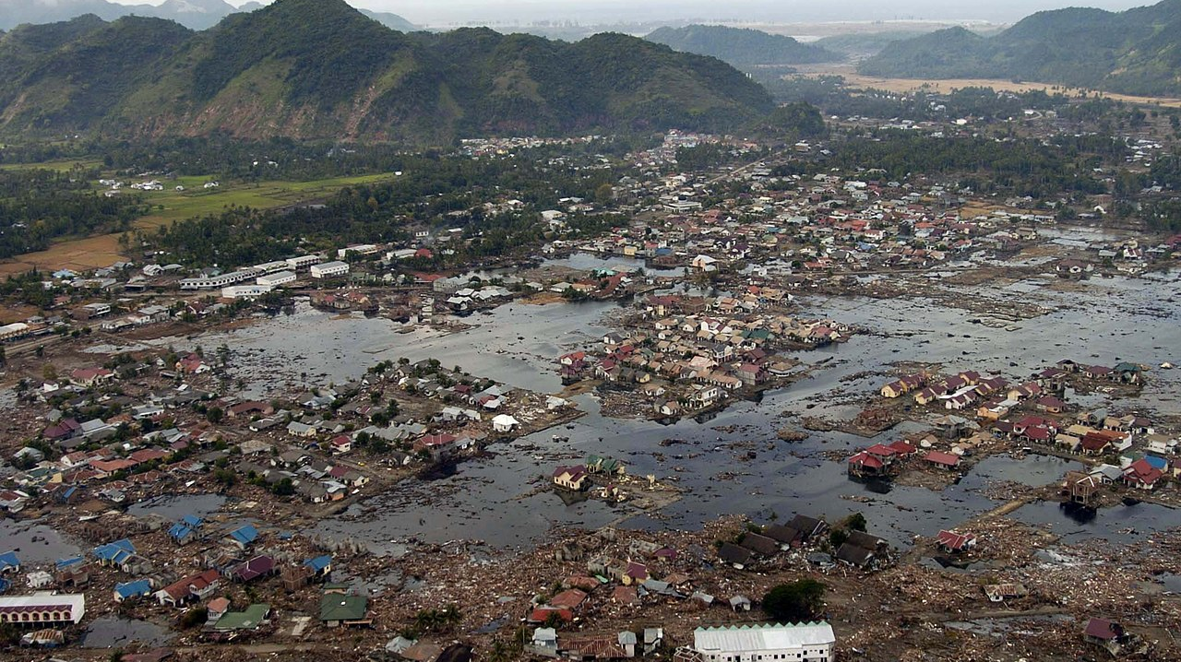
By U.S. Navy photo by Photographer&#039;s Mate 2nd Class Philip A. McDaniel - This image was released by the United States Navy with the ID 050102-N-9593M-040 (next), Public Domain, https://commons.wikimedia.org/w/index.php?curid=8241767
Notes:
250,000 people died in total across the whole of the Indian Ocean, 170,000 from Indonesia.
1.8 million people in total were made homeless as a result of the disaster.
In response, in 2005, a UN group started building an integrated Tsunami warning system across all countries affected.
Indonesia had a Tsunami warning system at the time but it didn’t have the variety of sensors or the ability to transfer all data in real time. It just couldn’t react quickly enough to get a message out to people.
Indonesia installed their new Tsunami early Warning system made up of various land and ocean based sensors from 2005. A Tsunami monitoring buoy system, composed of 22 buoys was installed in 2006 and it was completed in 2007.
The full Tsunami warning system being fully operational by 2011.

Slide 4
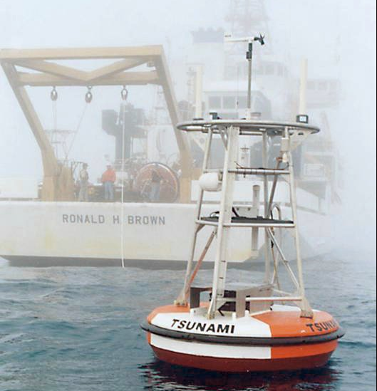
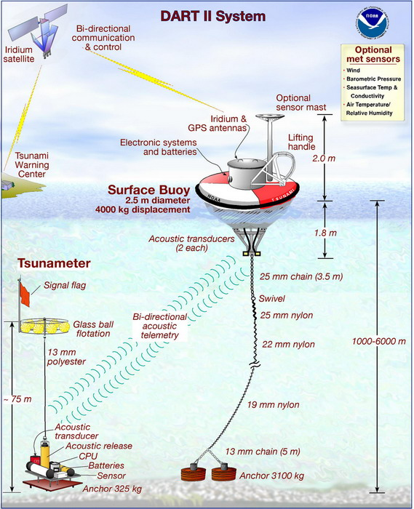
By NOAA - http://www.magazine.noaa.gov/stories/images/dart_tsunamicover.jpg, Public Domain, https://commons.wikimedia.org/w/index.php?curid=24516204
Notes:
Their buoy system which monitors deep ocean pressure was similar to the Deep Ocean Assessment and reporting (DART) system developed by the US, in fact a number of buoys were donated by the US.
The sensors are anchored on the sea floor and send an acoustic signal (using MFSK - https://www.ndbc.noaa.gov/dart/dart_ii_description_6_4_05.pdf section 3.5.2.1) to a surface buoy which then relays the data via satellite back to the Tsunami warning centre. In the case of Indonesia, they don’t use the Iridium system but their own national owned satellite system in geo stationary orbit.
The total system (buoys and land bases sensors) cost $142 million to install, with an estimated $2.3 million spent every year to maintain just the buoys alone. This was 50% of the annual maintenance budget.

Slide 5
How Tsunamis are monitored and reported
Up-Stream
Measurement, Analysis, Decision
Down-Stream
Awareness, Preparedness, Reaction
Sensor Systems
Seismometer
cGPS
Tide Gauge
Bouy System
Others
Warning Centre
Processing
Simulation
Decision-Support
Warning Message
Local Administration
Dissemination
Local Communities
Earth Quake / Event
Time
Lauterjung, J., Letz, H. (Eds.) (2017): 10 Years Indonesian Tsunami Early Warning System: Experiences, Lessons Learned and Outlook, Potsdam: GFZ German Research Centre for Geosciences, 68 p. DOI: http://doi.org/10.2312/GFZ.7.1.2017.001
Notes:
How it works – From the moment of the event, various sensors pick up an earthquake, change in the height of the land, significant change in tide height, or change in pressure from the ocean bottom.
That info is then passed to the warning centre where it is automatically triaged, and a decision is made by the centre about the classification of the event (i.e. if it’s a serious alert, a warning should be issued, or an advisory should it be a small Tsunami.
It’s then disseminated by text message or warning signals
The Tsunami centre has to provide a warning within 5 minutes of an earthquake.
https://balittanah.litbang.pertanian.go.id/ind/dokumentasi/prosiding/post%20tsunami/1harjadi.pdf

Slide 6
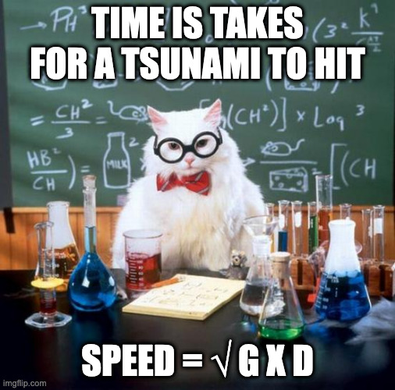
1000 meters water depth
= 713 Km/s
4000 meters water depth
= 198 m/s
g = 9.81
d = Depth of water
Notes:
g = acceleration of gravity at Earth’s surface

Slide 7
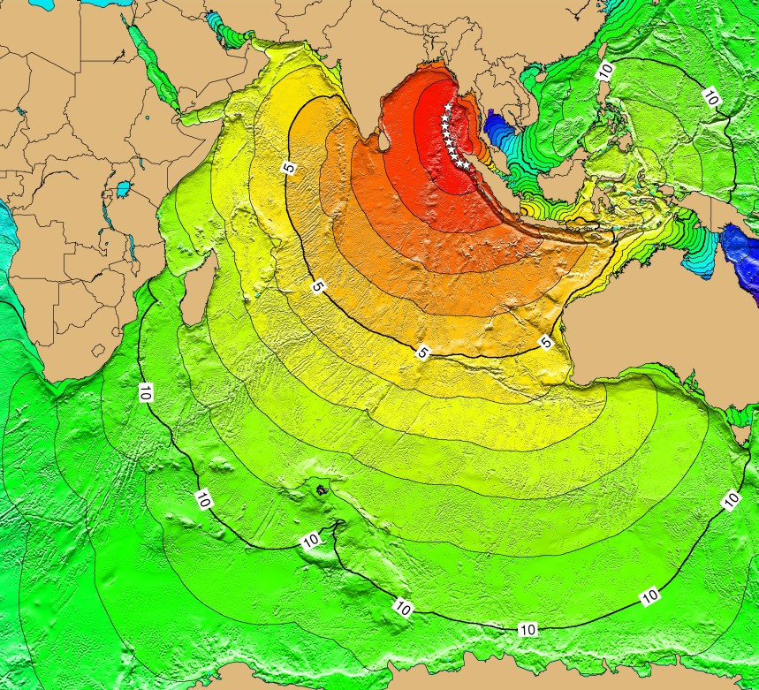
Tsunami travel speed map
Map contours: 1-hour intervals:
Red: 1-4 hour arrival times
Yellow: 5-6 hour arrival times
Green: 7-14 hour arrival times
Blue: 15-21 hour arrival times
https://www.ngdc.noaa.gov/hazard/tsu_travel_time_events.shtml
Notes:
https://www.ngdc.noaa.gov/hazard/tsu_travel_time_events.shtml
Ocean Tsunami buoys most effective near the coat. Also in the area where fishing takes place. The Tsunami buoys are then often used as moorings for fishing vessels which can and often does damage them.
The buoy monitoring system cost 50% of the total tsunami warning system annual maintenance budget.
Due to vandalism the Indonesian deep ocean warning buoys fell out of use between 2013 and 2018. The system was turned off as it was unable to be maintained and buoys renewed.
2 Tsunami’s hit Indonesia in 2018. They issued the alerts based on the tidal gauges and seismometers but they missed the severity of the Tsunami’s due to the lack of ocean buoys.

Slide 8
Where are Ocean Tsunami Buoys most effective?
NOAA National Data Buoy Centre: NOAA/NDBC | Esri , GEBCO, IHO-IOC GEBCO, NGS | …
Notes:
Tsunami buoys most effective near the coast. Also in the area where fishing takes place. These buoys are then often used as mooring buoys by fishermen.
Indonesia’s deep ocean tsunami warning buoys fell out of use between 2013 and 2017. With all 22 vandalised, it was too expensive to repair or replace the buoys, and the system was turned off.
Example of damage Tsunami buoys experience: https://www.researchgate.net/profile/Chung-Chu-Teng-2/publication/224119726_Buoy_vandalism_experienced_by_NOAA_National_Data_Buoy_Center/links/00b7d533ef6b390eb2000000/Buoy-vandalism-experienced-by-NOAA-National-Data-Buoy-Center.pdf?origin=publication_detail

Slide 9
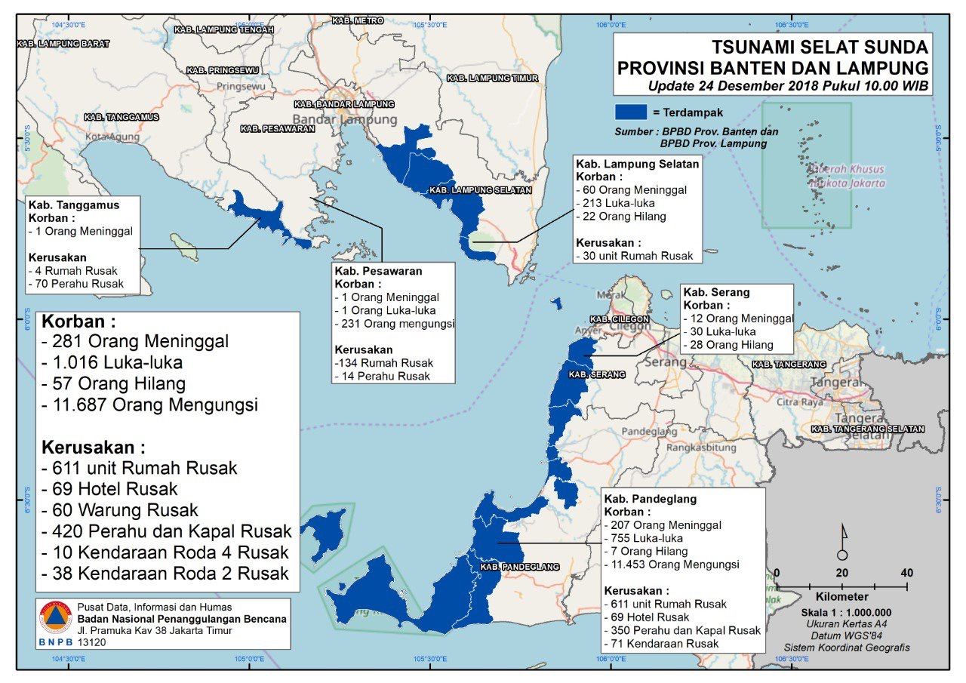
2 x tsunami strikes in 2018
Warning sent but it wasn’t accurate as the tsunami was triggered by a volcano landslide. The installed tidal gauges weren’t able to distinguish the tsunami from the high tide and the deep water buoys weren’t monitoring.
By Indonesian National Board for Disaster Management (BNPB) - https://twitter.com/sutopo_pn/status/1077092955389812736, Public Domain, https://commons.wikimedia.org/w/index.php?curid=75301355

Slide 10
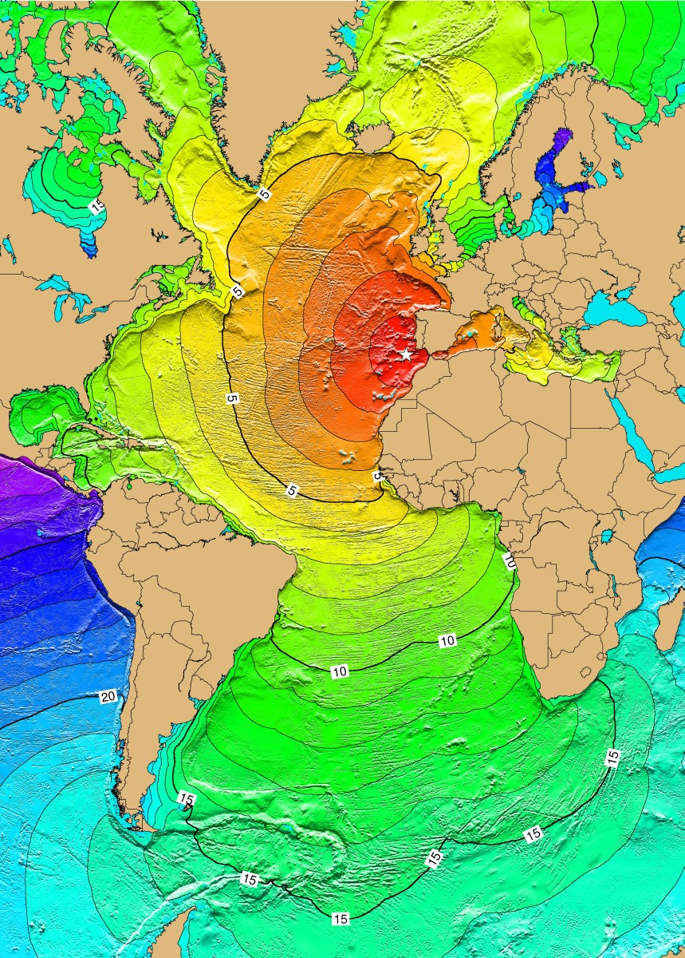
Tsunami’s in Europe
Map contours: 1-hour intervals:
Red: 1-4 hour arrival times
Yellow: 5-6 hour arrival times
Green: 7-14 hour arrival times
Blue: 15-21 hour arrival times
https://www.ngdc.noaa.gov/hazard/tsu_travel_time_events.shtml
Notes:
https://www.ngdc.noaa.gov/hazard/tsu_travel_time_events.shtml
Tsunami’s also a risk in Europe.
November 1755 a Tsunami hit Lisbon, Portugal after an earthquake in the Atlantic (this is travel time map based on the estimated location). The tsunami also hit the Azores and Madeira.
It may be a long time ago but for example, an estimated 100M wave hit Indonesia in 1674.

Slide 11
Another societal challenge from lack of deep ocean observations
Photo by Rob Curran on Unsplash
Notes:
It’s not just tsunamis and earthquakes which are a challenge to monitor in the deep ocean.
There are other societal challenges which humanity faces.

Slide 12
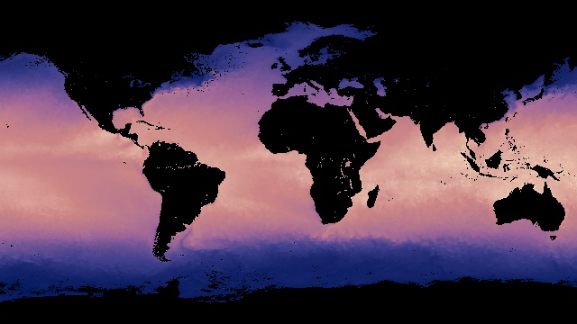
Global Deep Ocean Temperature
Credit: Imagery processed by the NASA Earth Observations (NEO) team in collaboration with Gene Feldman and Norman Kuring, NASA OceanColor Group.
Notes:
Another data point we need from the deep ocean is ocean and sea bottom temperature.
This data is used in climate change models.
Deep ocean water makes up 90% of the volume of the oceans
The general circulation model which is also used for weather prediction is more influenced by deep ocean temperature compared with topology.
Ocean-atmospheric interaction heavily influences climate and weather models
Water temperature is mainly acquired by satellite observation of the surface (as per this image). But like Tsunami monitoring it requires buoys and sea bottom sensors to be installed. The information is retrieved every few months, swapping hard drives out.
The other method is from special sites which pull ocean bottom water up to the surface for measurement.
There is a lack of global ocean bottom sensors in the deep ocean. This is due to the difficulty in installing, retrieving and long term observation availability and consistency of sensors.
https://neo.gsfc.nasa.gov/view.php?datasetId=MYD28M

Slide 13
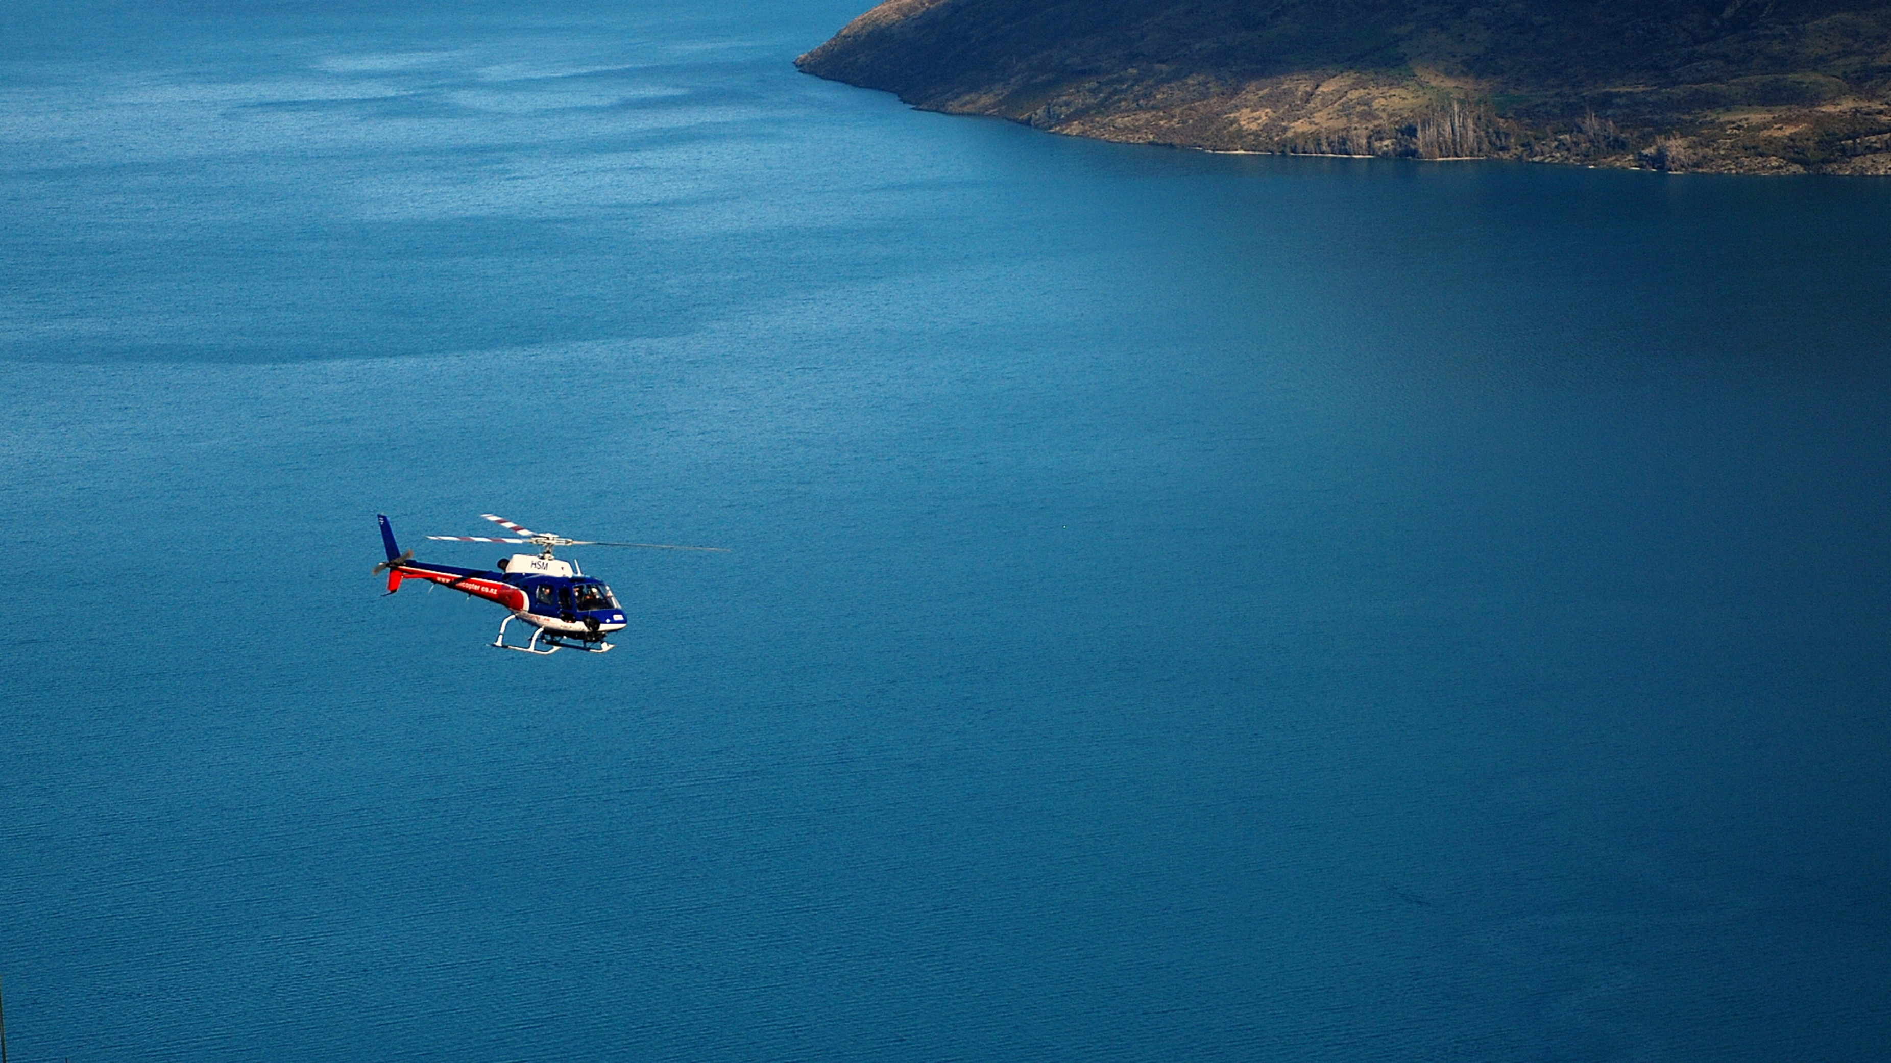
We need more data!
Long term data sets for:
Climate modelling
Weather forecasting
AI and all that
Photo by Snowscat on Unsplash
Notes:
To get a true helicopter view of what’s going on across our planet we need more data from the deep ocean

Slide 14
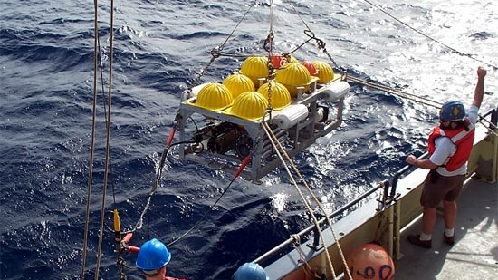
What about dedicated infrastructure?
By John Whitehead - Ocean Instruments, Public Domain, https://commons.wikimedia.org/w/index.php?curid=15663716

Slide 15
Expensive to install

Slide 16
Expensive to maintain

Slide 17
Who pays?
Photo by Ibrahim Boran on Unsplash
Notes:
Photo by Ibrahim Boran on Unsplash

Slide 18
Who is responsible?
Photo by Frederic Köberl on Unsplash
Notes:
For the infrastructure, for the storage, publication, distribution and ownership of the data?
Photo by Frederic Köberl on Unsplash

Slide 19
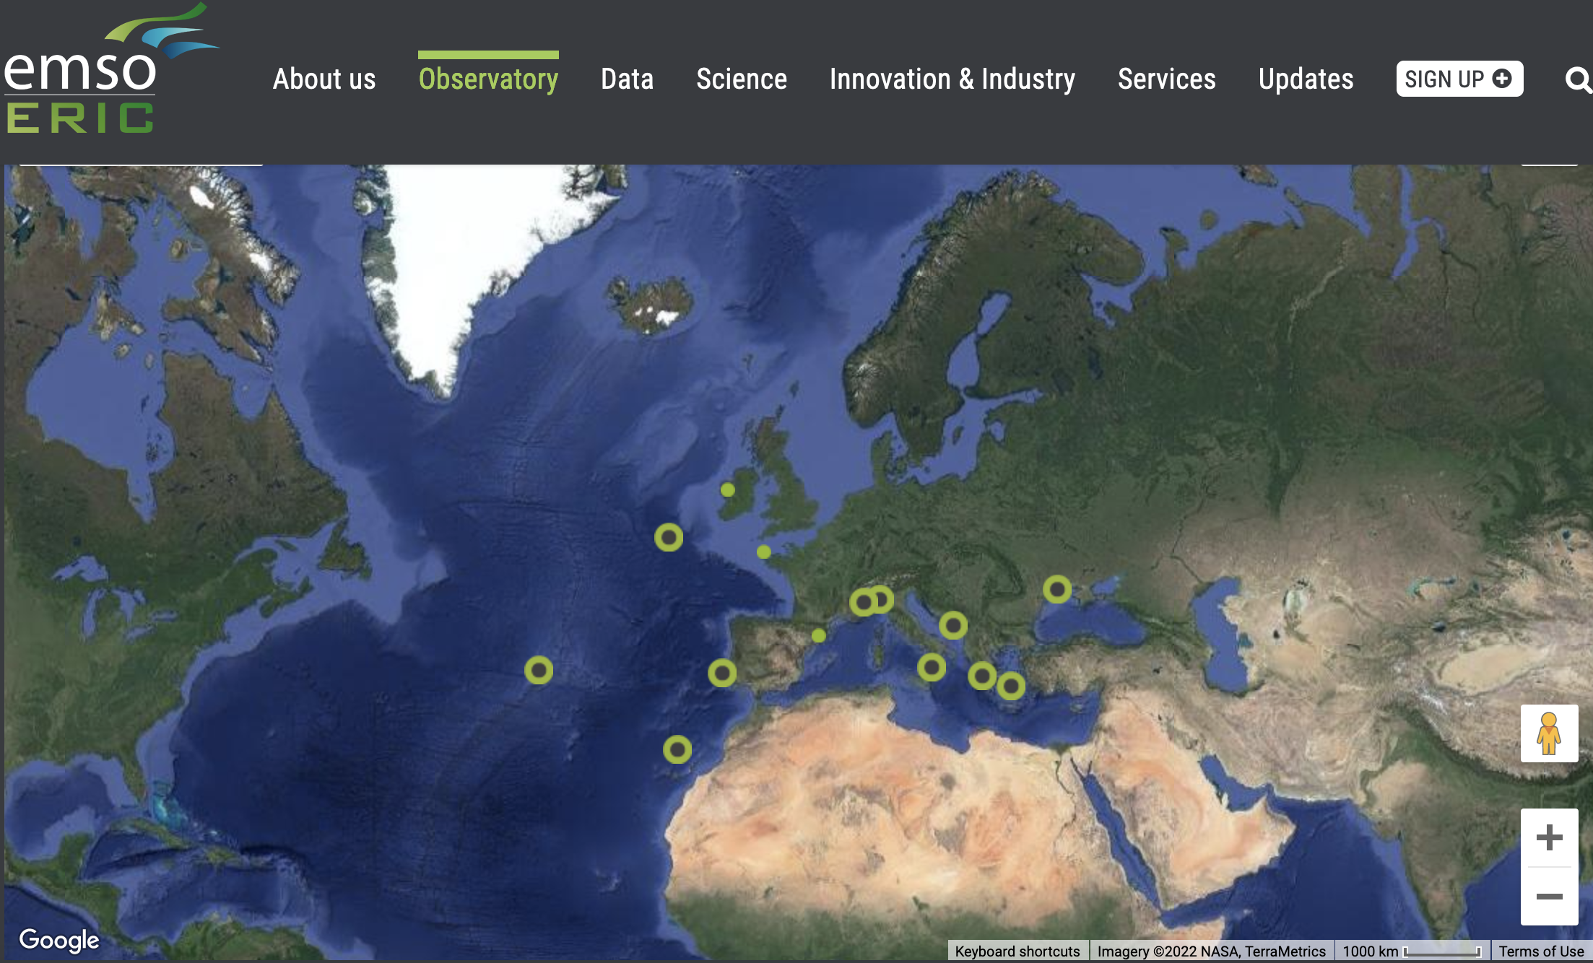
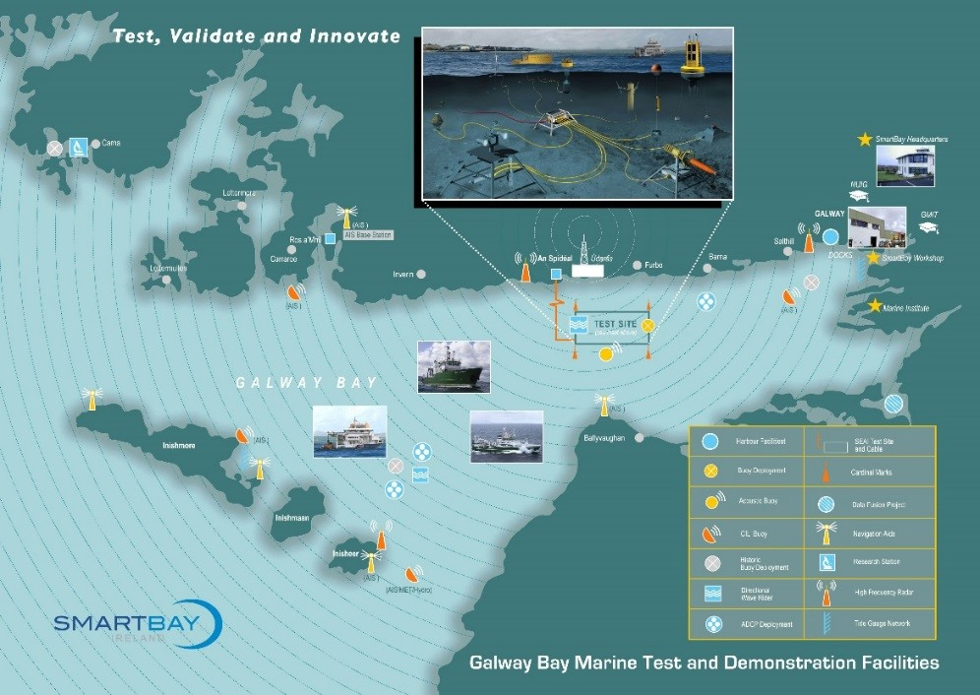
There have been dedicated cables and infrastructure installed!
Notes:
The dedicated infrastructure is still needed! The scientific data products from these pieces of infrastructure are essential.
Various dedicated infrastructures have been installed such as:
2006 VENUS
2009 NEPTUNE
And there is the European Marine Seafloor Observatory which has a number of sites around Europe, such as SMARTBAY in Galway, Ireland.

Slide 20
What about Space?
Photo by NASA on Unsplash
Notes:
Yes, you can monitor the ocean from space but the temperature is limited to the surface. For tsunami warning you could use GNSS signals reflected from the ocean then received by low earth orbiting satellites. But this would require:
1000’s of satellites in LEO
Dedicated sensors installed on each of those space craft
Doesn’t really address all the science needs as it would be limited to monitoring sea surface height.
Also, who owns the sensors, maintains the systems, stores the data, makes it available for research?

Slide 21
This isn’t just a theoretical problem
Notes:
The societal challenges about deep ocean tsunami detection and ocean bottom temperature isn’t just a theoretical problem. The UN has been looking at this for a while.
A group of people thought what if there was already infrastructure in the deep ocean that was powered, maintained, crossed the planet and was already economically viable.

Slide 22
Credit: www.submarinecablemap.com
Notes:
What about submarine telecommunications cables?

Slide 23
Science Monitoring And Reliable Telecommunications
Notes:
This led to the creation of the Joint Task Force under the auspices of the UN to look at how to piggy back sensors off the back of the power and telecommunications infrastructure that already existed.

Slide 24
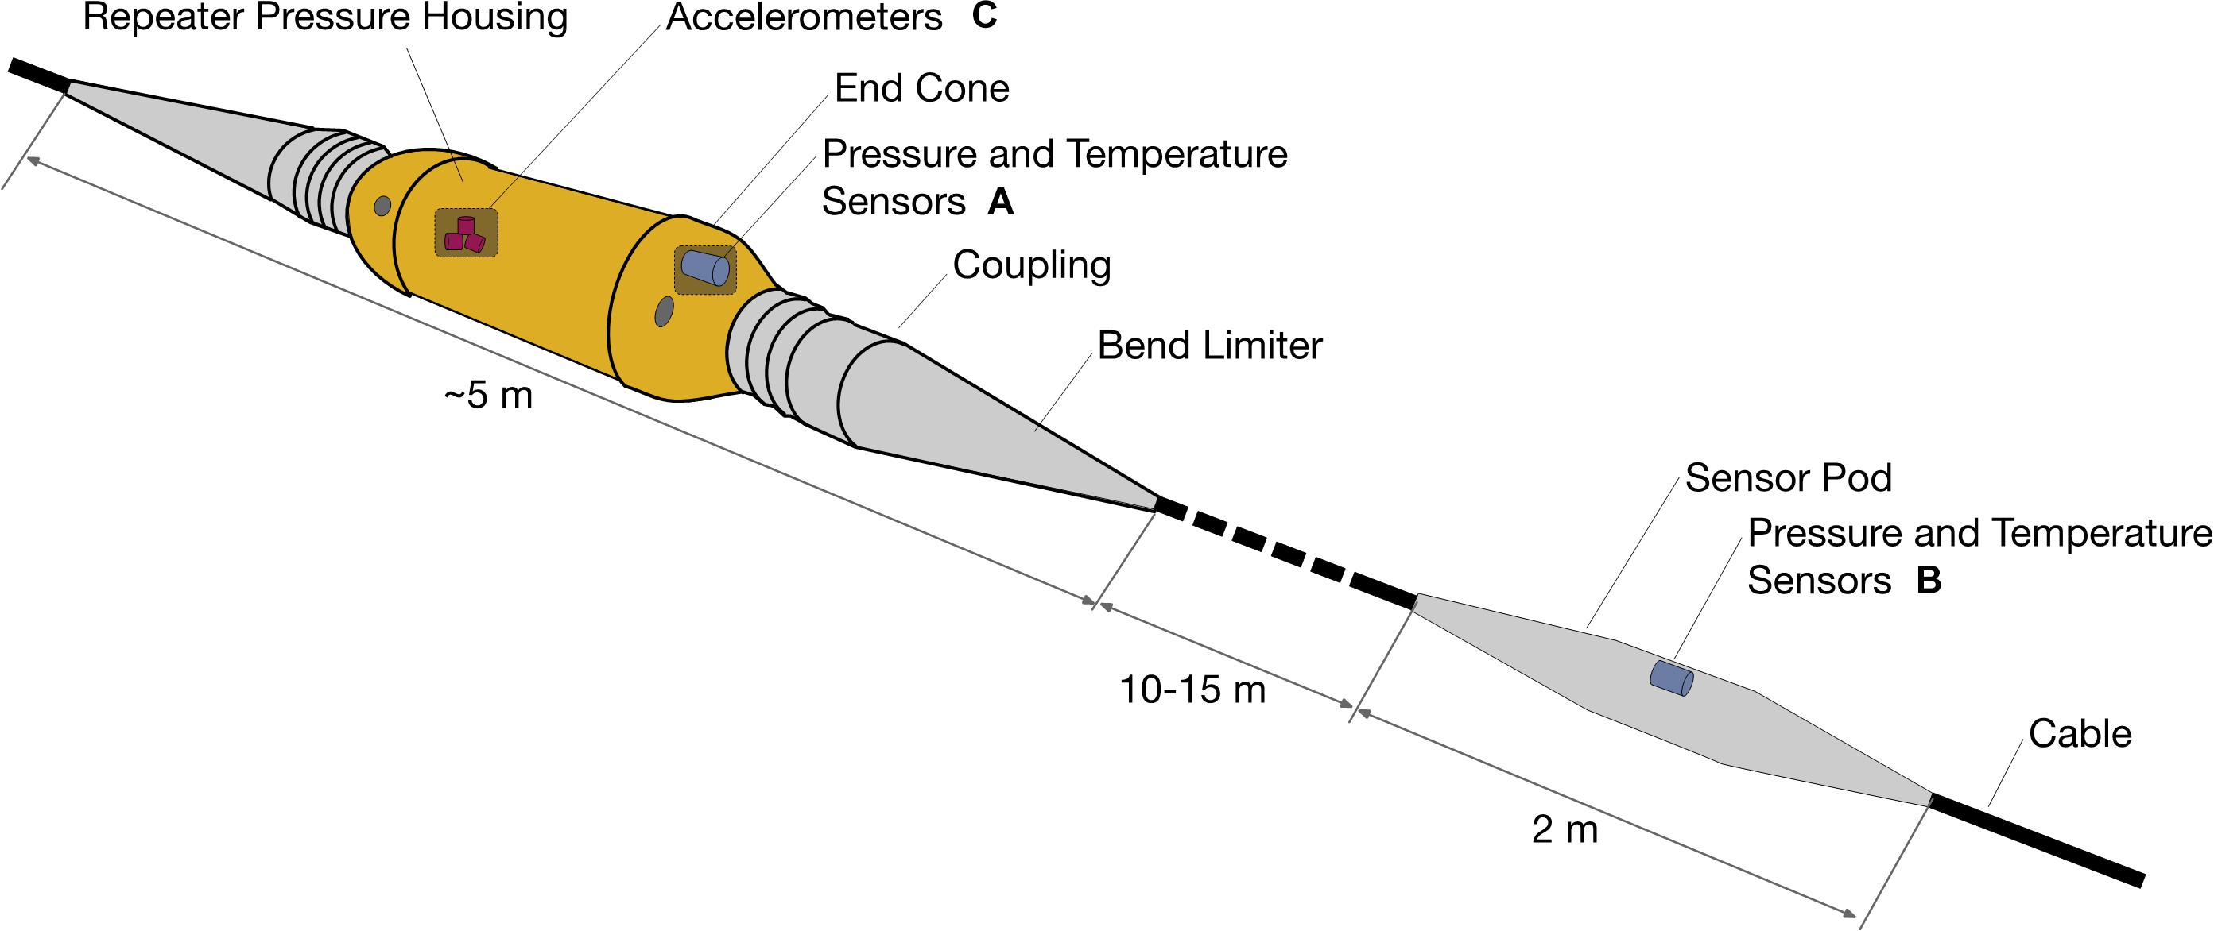
SMART Cable concept
Howe et al., (2019, August 2). Smart cables for observing the Global Ocean: Science and implementation. SMART Cables for Observing the Global Ocean: Science and Implementation. Retrieved June 10, 2022, from https://www.frontiersin.org/articles/10.3389/fmars.2019.00424/full
Notes:
https://www.frontiersin.org/articles/10.3389/fmars.2019.00424/full
JTF wants to install temperature, pressure and seismic sensors on the repeater units on a cable system for future newly deployed cables.
Some manufacturers are reticent. The cables have to operate for 20+ years and they don’t want to introduce any risk or systems which don’t have a proven design life.

Slide 25
Is there another way?
Photo by Beth Macdonald on Unsplash
Notes:
There are other technologies which could achieve a lot of the sensing capabilities without needing to disrupt or replace the cables. These methods could compliment the SMART cable concept!
DAS
SOP
SOP OTDR

Slide 26
With thanks to Prof Martin Landrø, NTNU
Notes:
Interrogator sends a “laser” down a fibre optic cable. The reflections of the laser against the fibre, a concept called Rayleigh backscattering (the same concept which explains why the sky is blue and turns red at sub set) get sent back to the interrogator unit, turning each point the light wave hits the fibre into a sensing point. Collectively it turns the cable into effectively a giant microphone.
DAS works to the first junction box but due to the way the interrogator works, the usable distance is limited to about 200kmm. After that there is too much noise to properly discern what it is that is making the signal.

Slide 27
What can DAS detect?
Wales
Storms
Ships
Earthquakes
And more
With thanks to Prof Martin Landrø, NTNU
Notes:
Das can be used to detect many things
Wales and other sea life
Earthquakes
Vessels
Storms
Suspensions in the cable
Some research suggests that you can also detect ocean bottom temperature

Slide 28
With thanks to Prof Martin Landrø, NTNU

Slide 29
With thanks to Prof Martin Landrø, NTNU

Slide 30
GeoLab
The first permanent infrastructure dedicated to Science embedded into a commercial Subsea Telecom System
Funchal, Madeira
Seismology, volcanology, marine ecology, and oceanic conditions are key to understanding the future of our planet.
EllaLink GeoLab initiative aims to provide the scientific community with real-time, accurate and relevant data on seabed conditions along the EllaLink cable route.
EllaLink is the first telecoms submarine cable to integrate SMART cable concepts.
Notes:
What is it:
The EllaLink cable that is being deployed across the Atlantic, between Portugal and Brazil, has opened up an opportunity to integrate a scientific component into a commercial submarine cable system. GeoLab was created as a partnership between EllaLink, ANACOM, EMACOM, FCT and GÉANT to provide an infrastructure for the benefit of the global scientific community.
This infrastructure consists of a spare fibre pair built into the Funchal branch of the EllaLink cable, which stretches out for 75km, south east from the coast of Madeira, into the Atlantic Ocean. Along with the fibre, it is intended to provide space, power, air-conditioning, data storage and internet connectivity to researchers using the facility.

Slide 31
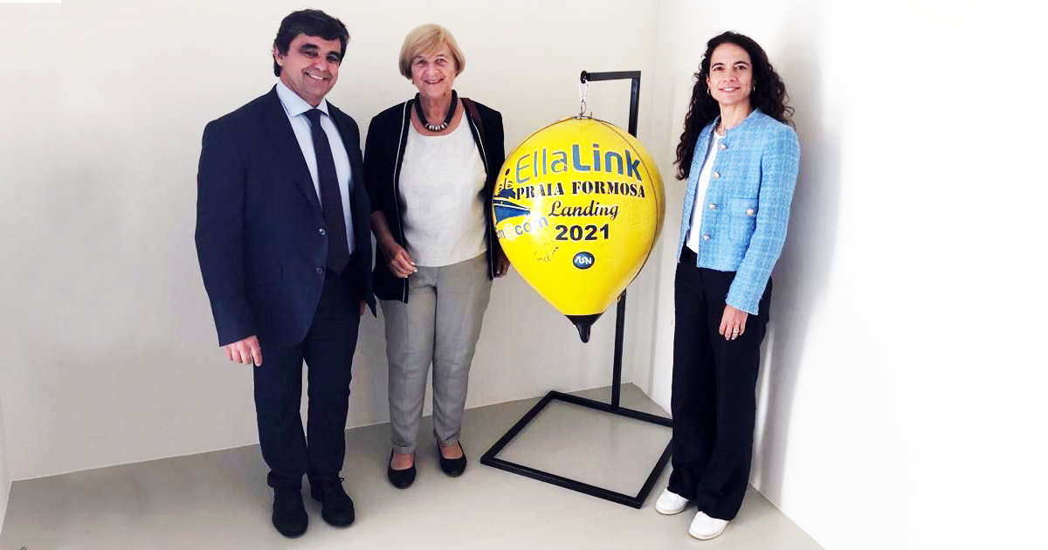
GeoLAB and DAS
Photo by FCT|FCCN
Notes:
On the 23rd of May FCT|FCCN (the Portuguese NREN) signed the agreement with EMACOM, the cable landing station operator in Madeira to guarantee use of the unlit fibre optic cable for scientific research.
We’ve already had one research project, GEO-INSPIRE, confirmed to use GeoLab.

Slide 32
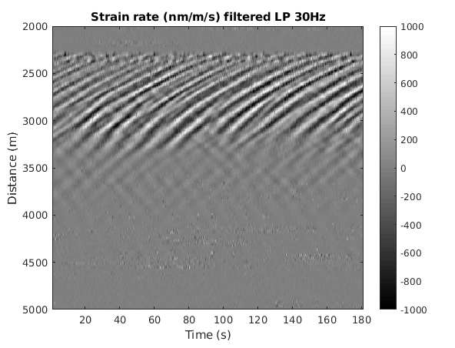
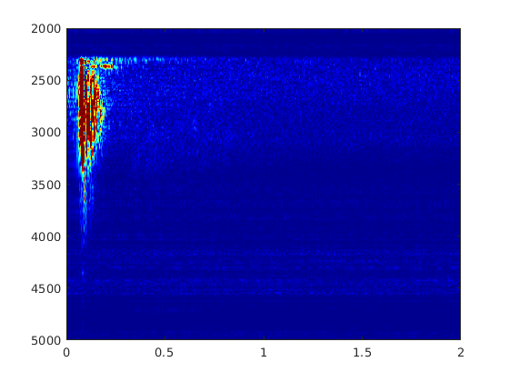
Some initial results with a DAS at GeoLab
Frequency (Hz)
Distance (m)
Left: Strain rate recorded at the entrance of the fibre in the water (2.25km) filtered with a low-pass filter at 30Hz. The shallow water ends after around 4.5km of cable. Right: Frequency content of strain rate signal along the fibre.
Atherton et al., (2021, June 16). Subsea telecoms cables: A driver for scientific research. Retrieved June 10, 2022, from https://about.geant.org/wp-content/uploads/2021/12/Geolab_white_paper.pdf
Notes:
We’ve even run a proof of concept to show that the DAS can work on the cable. This was performed as part of the installation of the cable and you can see here the waves in the benthic zone (the bit between the water and the sea floor) over time moving out away from the cable landing station.

Slide 33
Dedicated cable required?
Photo by Sharon McCutcheon on Unsplash
Notes:
In the past a DAS has required a dedicated fibre but there is some initial findings from research performed earlier this year on the southern cross cable system in the Pacific suggest that you can combine a DAS signal on a live telecoms cable as an alien wave.
It would increase the signal to noise ratio but from what I’ve heard it is not detrimental to the telecoms traffic on the cable. However, the research hasn’t been published yet so we can’t say for sure.
There is also another technique which is much closer to home and was first published about in 2018.

Slide 34
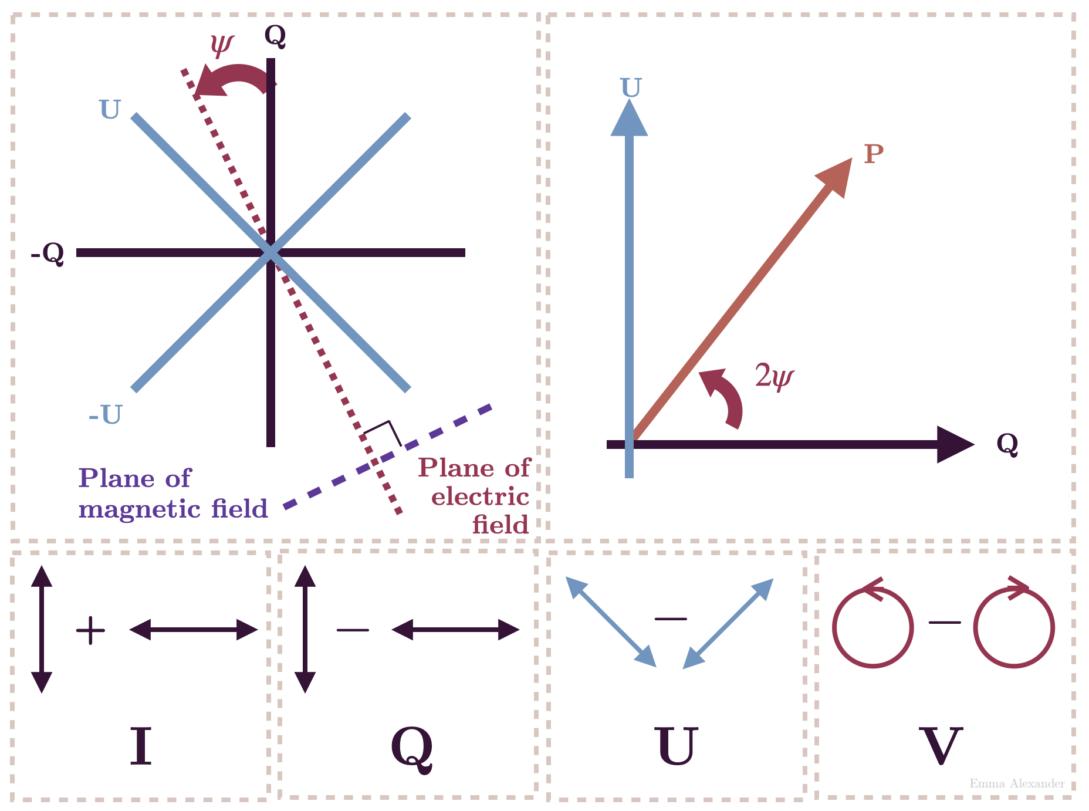
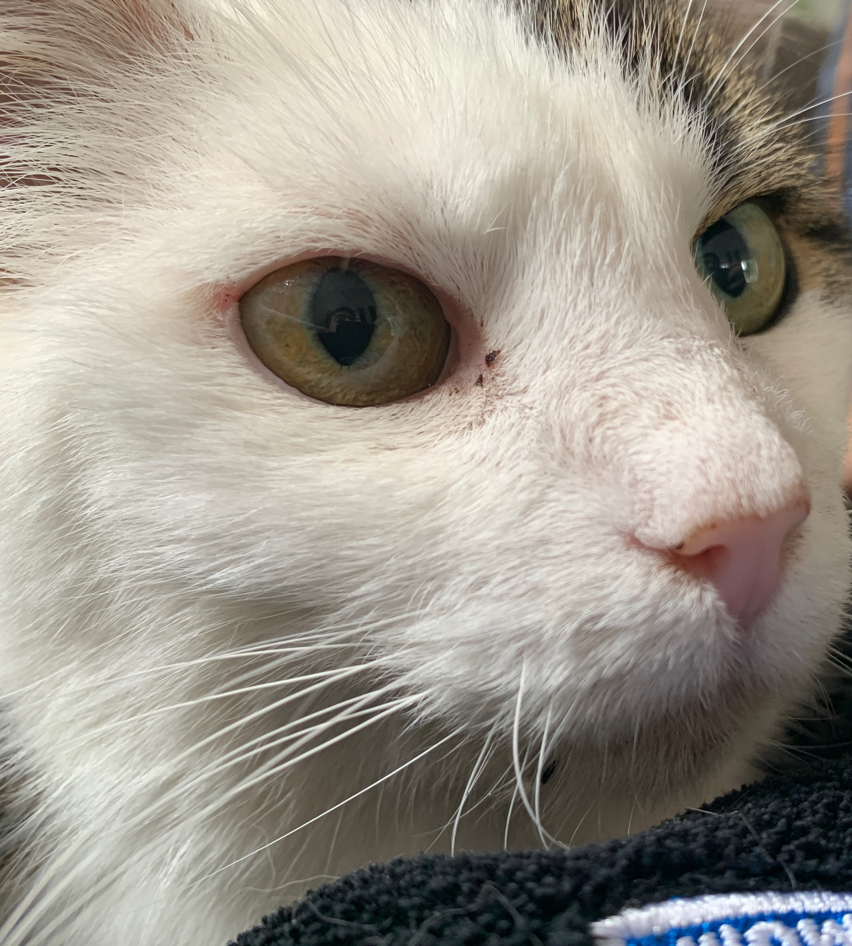
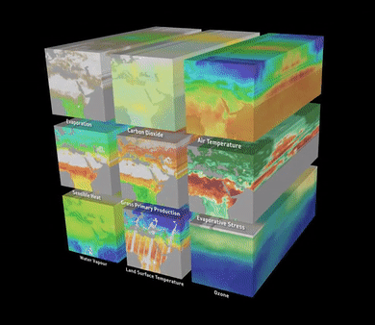
The other technique – State of Polarisation (SoP)
Fibre optic Submarine telecom cable
Stokes Parameter
Stokes Parameter
DWDM
Optical
Transponder
DWDM
Optical
Transponder
Carrier phase and polarization can be recovered from the DSP outputs.
Normal telecoms traffic
Stokes Parameter By Emma Alexander - [1], CC BY 4.0, https://commons.wikimedia.org/w/index.php?curid=116390426
Notes:
State of Polarisation
SOP works by using the error correction signal from the DWDM optical transponders to infer disturbances on a fibre optic cable.
It’s a relatively new technique to be applied to submarine telecoms cables. Paper was first written in 2018. Google has been leading the way with its own research, publishing a paper in 2020.
This is the key point. It uses data from the optical transponders to make detections. Some NRENs have access and own those line cards. We have access to that data. But we throw it away.
Due to advanced modulation the use of coherent optics means that the carrier phase and polarization can be recovered from the DSP outputs in transport systems. This provides direct paths to estimate cable stress/strain caused by vibrations. This technique is known as State of Polarization measurement. Mecozzi, et al. proposed that this technique could be used on existing submarine optical cables with the signal extracted from a standard coherent telecom receiver.
Vibrations of the polarization of received light can be caused by a number of events, such as Earthquakes. Earthquakes emit both compressional (P wave) and shear elastic (S) waves. P waves travel faster within the Earth and have smaller amplitudes. S waves are slower but stronger. Identification of P and S waves on seismic records are critical to earthquake detection and localization using traditional seismic sensors.
SoP measurements are integrated along the entire cable. For this reason, the P and S waves from earthquakes do not produce sharp arrivals as distinct as on traditional seismometers. The identification of P and S waves is further complicated by the fact that the along-cable sensitivity of SOP may vary along the cable, due to differences in cable type (e.g., single armoured vs. double armoured), fiber stress state (e.g., curved vs straight), and coupling to the seafloor. The travel time calculations may not have a unique distance. Zhan et al. assumed that the fibre section closest to the earthquakes contributed the biggest signals, but the assumption has not been tested rigorously due to lack of long-term datasets.
DWDM
Mecozzi, et al. "Polarization sensing using submarine optical cables," Optica 8, 788-795 (2021)
Zhan, Zhongwen, et al. "Optical polarization–based seismic and water wave sensing on transoceanic cables." Science 371.6532 (2021): 931-936

Slide 35
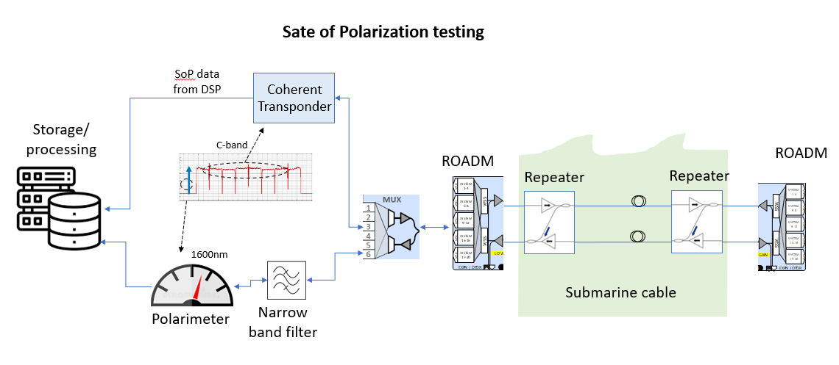
SOP OTDR
Notes:
State of Polarization (SOP) Optical Time Domain Reflectometry (OTDR) sensing in submarine optical communication systems allows one to monitor the health of the submarine cable while simultaneously monitoring physical phenomena around the cable. The method transmits periodic optical pulses along the cable and utilizes in-built high loss loopbacks (HLLBs) to obtain reflections of these pulses at every repeater. The reflections are typically created by narrow-band Fiber Bragg Grating (FBG) based mirrors in submarine repeaters.
Reflected signals from the repeater FBGs are filtered to eliminate out of band noise and then converted to their corresponding Stokes parameters for further analysis. Signals passing through the HLLB experience higher transmission losses owing to the loopback architecture and operate at lower signal to noise ratio. Since Stokes’ parameters are insensitive to polarization mixing, frequency offset and laser phase noise, they form an excellent choice of monitoring parameters in such severe conditions. Using these Stokes’ parameters from multiple instances in time, one can create a Stokes’ parameter based time series for every repeater in the cable and monitor the time series for any anomalies.
Since a unique SoP time series data set can be constructed for every repeater, any phenomena affecting a certain segment of the cable will not affect the time-series created from other segments of the cable. Therefore, using SOP based OTDR and simple manipulations of the time series data one can also localize the anomalous event along the cable. The method can be extended and implemented on multiple submarine cables to create a two-dimensional array of sensors to detect various physical phenomena in the world’s oceans.
Pierre Mertz “Seismic Event Detection and Localization Using Submarine Optical Cables”, OFC W1A.3, Infinera Corporation

Slide 36
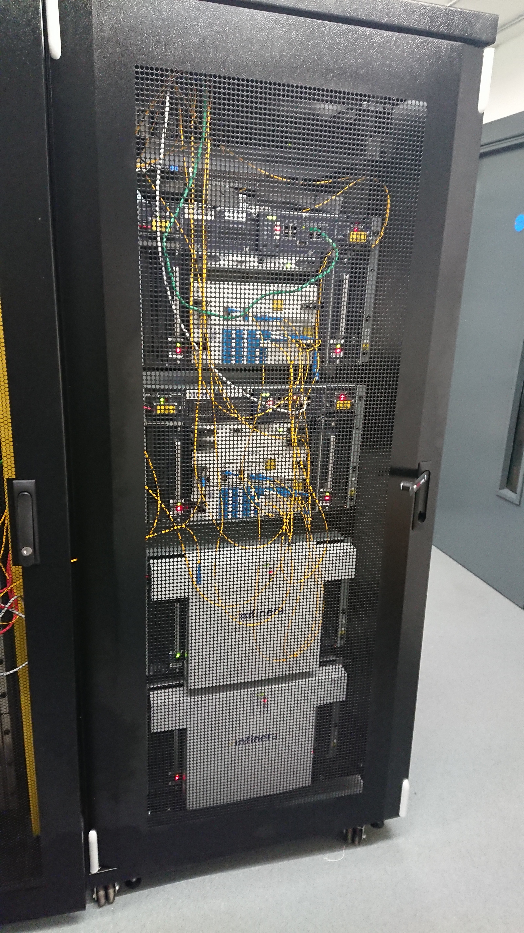
SOP and DAS – New services we can offer to researchers?
Our Equipment
Our Services
Notes:
It’s with SOP and DAS where NRENs have the means to help address those societal challenges I mentioned earlier. Not just for Tsunamis and deep ocean temperature, but more.
Can SOP and DAS signal injection be a new set of services for our community?
After all, it is our equipment which would be used to extract SOP data and our services to inject DAS signals like we do with other alien waves.

Slide 37
SUBMERSE Project
Notes:
A consortium of 24 organisations including GÉANT submitted an EC research project proposal in April to investigate integrating DAS, SOP and SOP OTDR techniques, then integrating the different infrastructures involved, maximising on each others strengths. The aim is not to create a new parallel research infrastructure but to integrate and compliment existing infrastructures together.
Not for the NRENs or GÉANT to do research into earthquakes, tsunami’s and the likes, but to provide the infrastructure and services necessary for researchers to do their work, in the most easy, scalable and streamlined way possible.

Slide 38
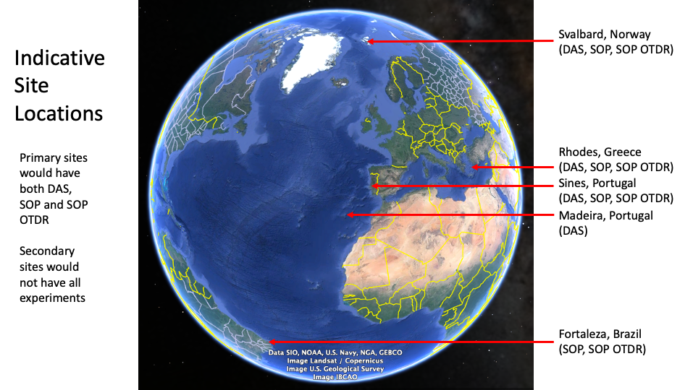
Notes:
The SUBMERSE project aims to prepare for and deploy a standardised research instrument in a number of geographically diverse locations to create a sustainable, pan European, DAS and SoP continuous acquisition and dissemination system for European research infrastructures, as well as allowing for the acquisition of the generated data by multiple users simultaneously. This would be achieved through several experiments, testing different types of cable designs, technologies and configurations of a standardised design at a continental scale.
We find out in September 2022 if we get the funding!

Slide 39
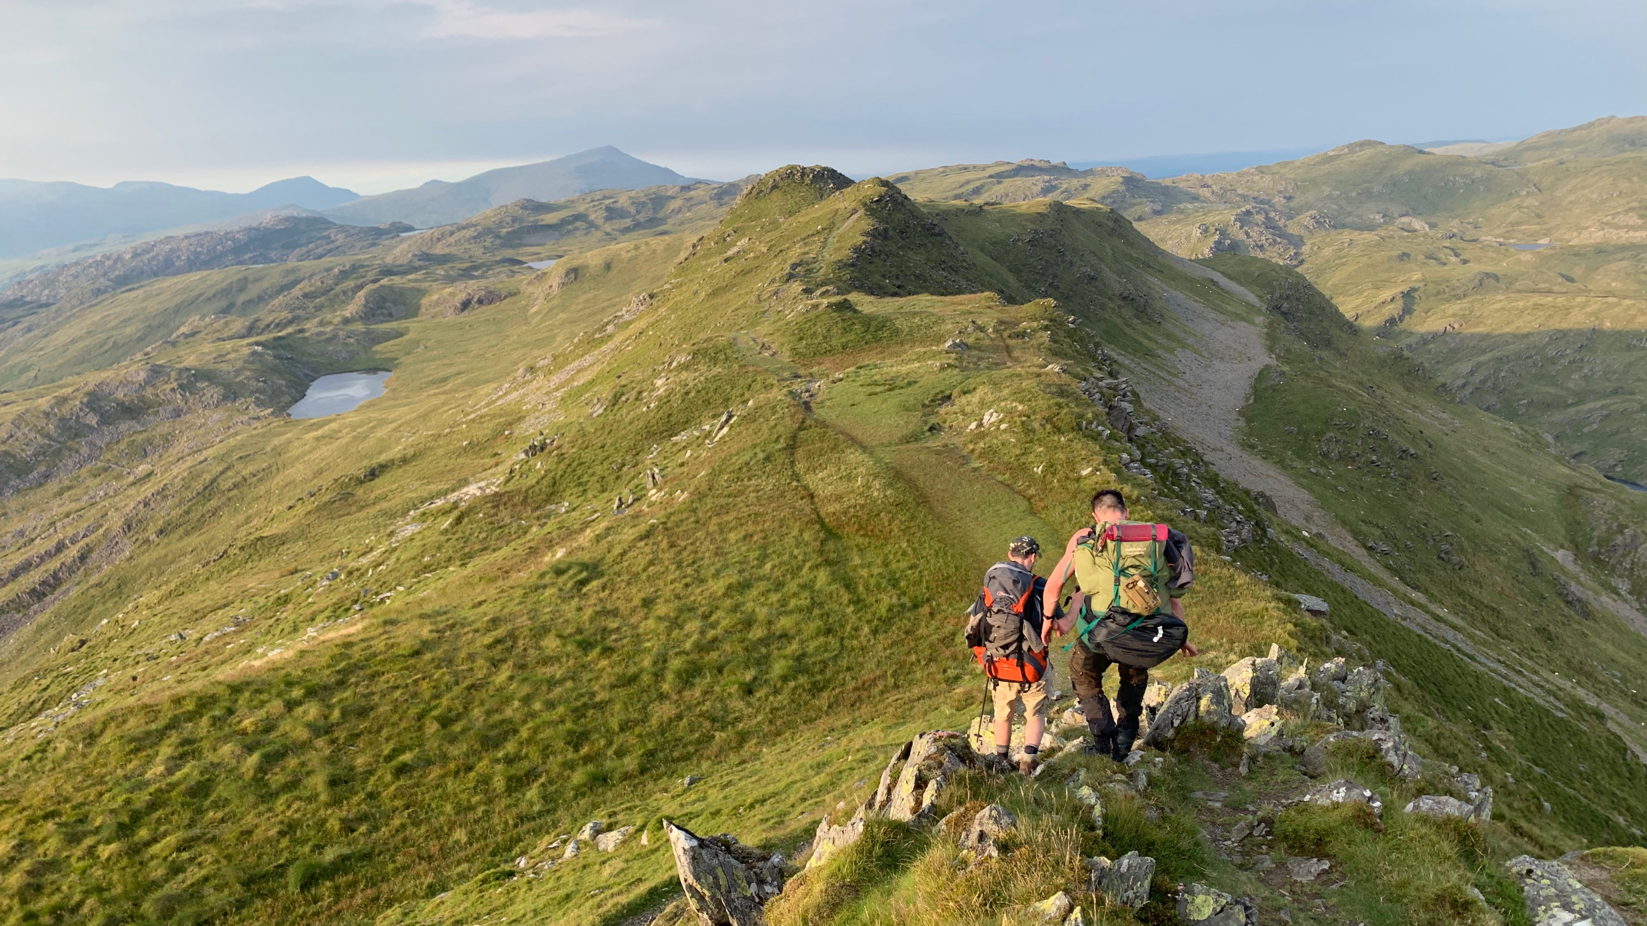
My challenge to you
Chris Atherton 2019
Notes:
How can we as a community show innovation and value with the infrastructure we have available to us?
In a world where traditional networking is becoming less and less prominent, how do we as a community show innovation and value with the infrastructure we have available?
What else could we use? What other by-products of our network and services could add value to our society and the global scientific community?

Slide 40
Chris.Atherton@geant.org

