Slide 1
Share a single GPU to multiple VMs through GPU virtualization
C. Pisa¹, D. Passalacqua¹, A. Colla¹, A. Barchiesi¹, F. Galeazzi¹, M. Di Fazio¹, M. Lorini¹, F. Lombardo¹, E. Petagna¹, S. Rabellino², I. Colonnelli², M. Aldinucci², S. Donetti²
¹ Consortium GARR, Italy ² University of Turin, Italy
Trieste, June 14th 2022
TNC22
Notes:
Good afternoon, I'm Claudio Pisa, and I work at GARR at the Distributed Computing and Storage Department, and I am here presenting a joint work with the University of Turin

Slide 2
GARR Cloud Services
Federated GARR Cloud Platform (IaaS)
GARR Container Platform (CaaS)
Deployment as a Service (DaaS)
GARR Workplace (SaaS)
Notes:
GARR provides Cloud Services that span from the Infrastructure as a Service to the Software as a Service space, targeting the research and education community and using open source tools such as OpenStack and Kubernetes.

Slide 3
11500 cores
16.3 PB
333 TFlop
SSD
... 11 rack/CSD-modules
Notes:
The federated GARR Cloud infrastructure includes several data-centres in Italy, interconnected through the high-speed GARR network, for a total of 11500 cores, 90 PB RAM, 16 PB of storage and additional 333 TFLOPS from Graphical Processing Units.

Slide 4
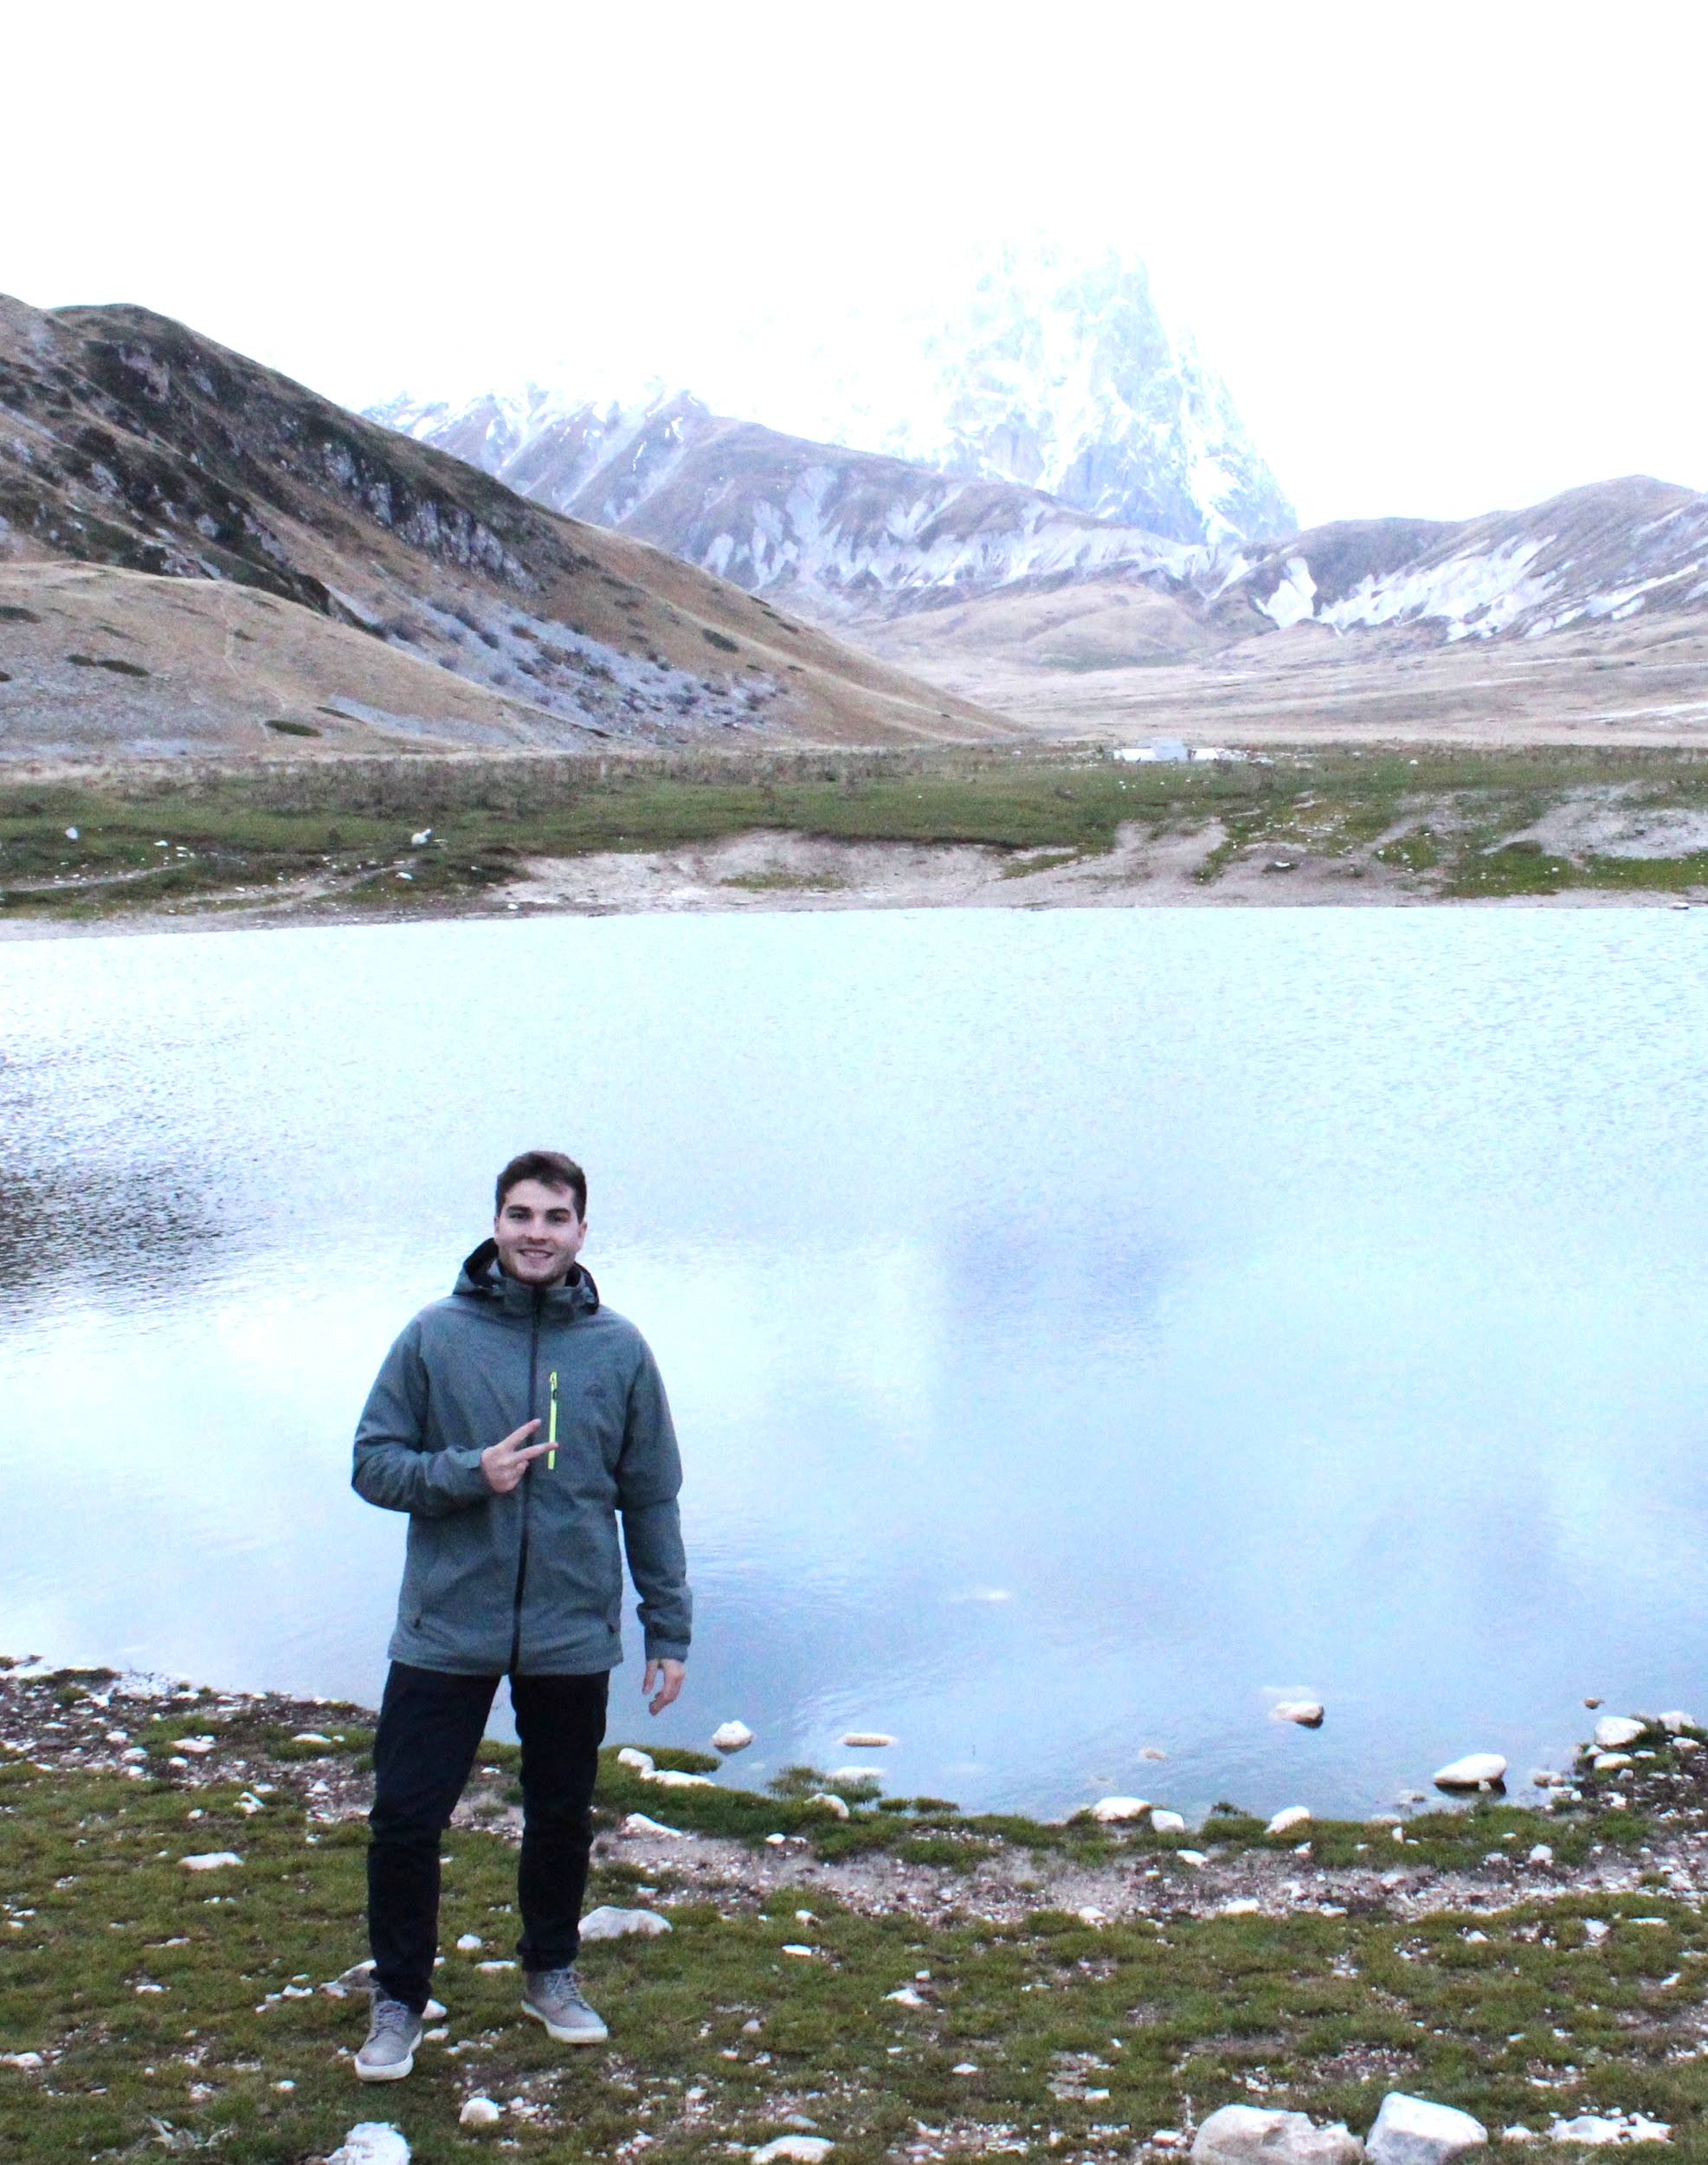
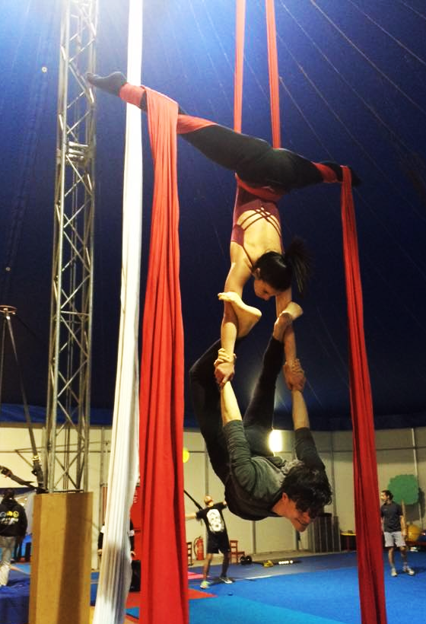
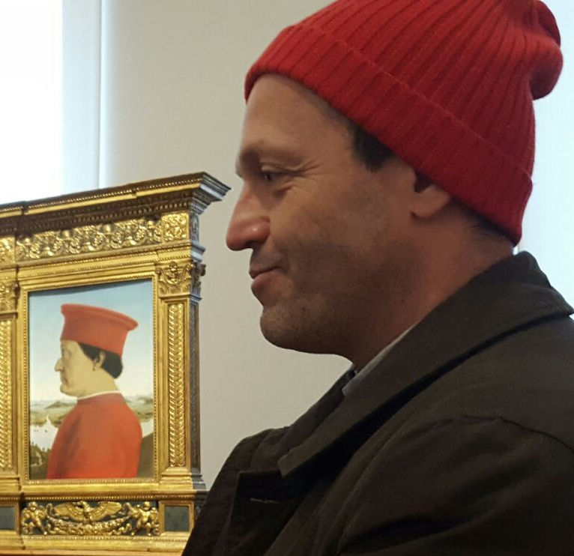
team CSD in real life
Notes:
And this is our team! (5 seconds)

Slide 5
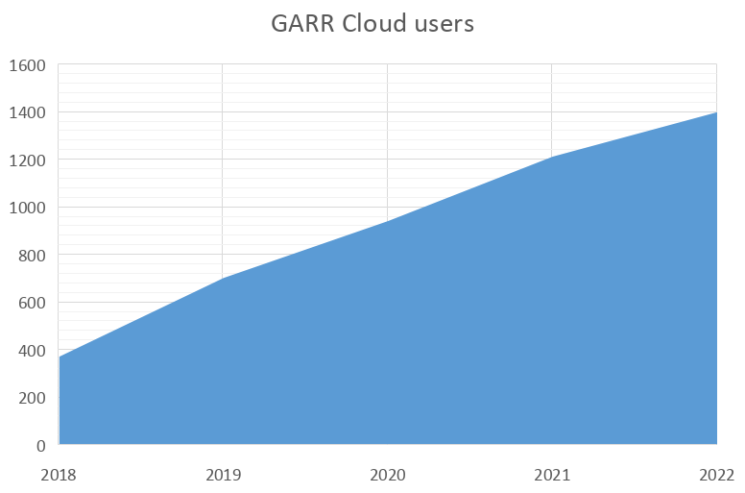
Users vs GPU workloads
Increasing number of users
Increasing popularity of GPU workloads
GPU hardware scarcity
GPU virtualization!
Notes:
In the latest years we are experiencing a growth of our user base and an increasing demand for Graphical Processing Units, that is GPUs, for their research activities, which are for example big data processing or neural networks training. However, not all the available GPU cores are used at the same time by researchers, which spend quite some time developing and optimizing their code. This allows for the virtualization of GPUs

Slide 6
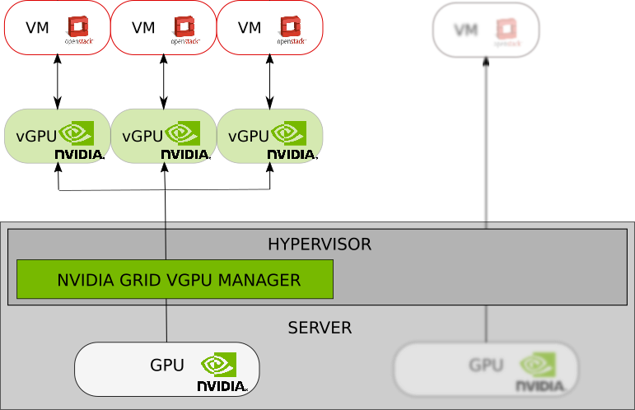
Making GPUs available to users
virtualization
passthrough
Notes:
In our setup, we currently have Tesla v100 GPUs. We can make available these GPUs to OpenStack virtual machines by the means of two methods: one is GPU passthrough and the other one is GPU virtualization.
With GPU passthrough the entire physical GPU can be made available to the virtual machines, while with GPU virtualization we can split a physical GPU into virtual GPUs, each having a fraction of the GPU resources.
The focus of this talk will be on GPU virtualization.

Slide 7
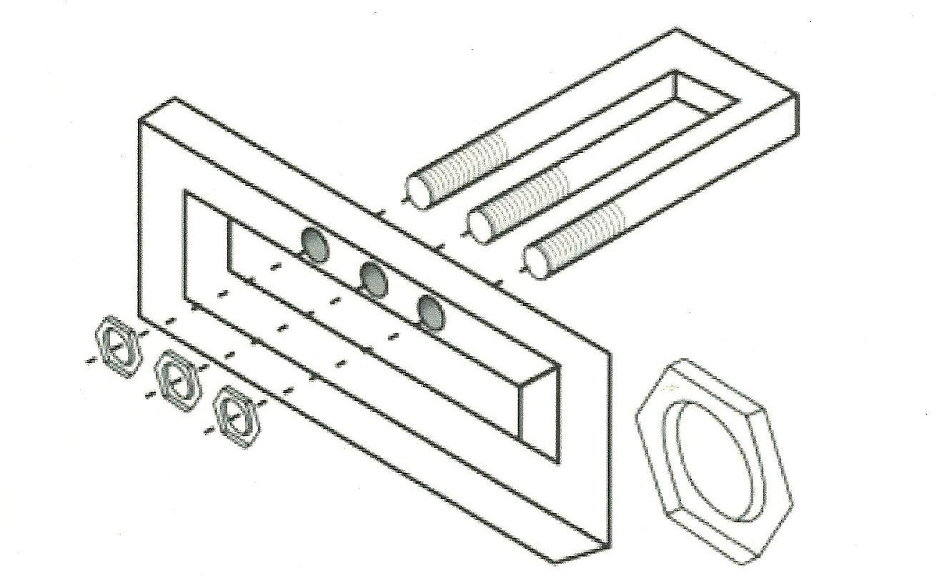
GPU virtualization can be challenging
Slicing GPUs can be non-trivial
e.g. For NVIDIA V100 GPUs, several steps need to be taken and several technical issues need to be tackled
Notes:
Virtualizing GPUs can be a non-trivial task. Along the way we had to tackle several technical issues.
—
https://www.flickr.com/photos/hugo90/4455412652

Slide 8
GPU virtualization in OpenStack
Get Nvidia GRID license and install license manager
Download and install drivers on the hypervisor servers
Configure OpenStack nova
Choose one of the supported vGPU types, depending on your use case
Add configuration to nova-compute.conf
https://docs.nvidia.com/grid/13.0/grid-vgpu-user-guide/index.html#installing-configuring-grid-vgpu
Notes:
To virtualize our GPUs we had at first to get a license from Nvidia,then we installed a license manager in our network and installed the appropriate drivers on the OpenStack hypervisors.
Then we choose one of the supported virtual GPU types, which correspond to different use cases.
Finally, we configured the OpenStack nova service accordingly.
————————————————————————————————————————————
First, we check the supported devices and choose one of them.
Then add this line to the nova-compute.conf (enable_vgpu_types = a supported device)
Restart nova-compute service
https://docs.nvidia.com/grid/13.0/grid-vgpu-user-guide/index.html#installing-configuring-grid-vgpu

Slide 9
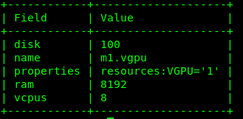
GPU virtualization in OpenStack
Create a new flavor
Create a new image including GPU drivers
Now users can create vGPU powered Virtual Machines!
Nice but… there is an increasing demand from our users for GPU powered Kubernetes workloads
Notes:
Then we created a specific OpenStack flavor for virtual GPUs. And, as all new GPU enabled virtual machines have to be authorized by the Nvidia license manager during the GPU driver installation, we created a virtual machine image to simplify the process for our users.
After these steps, users can indeed create virtual GPU powered virtual machines by selecting the right image and flavor.
This is very nice, but… we have also a demand for GPUs from our Kubernetes users, not only OpenStack.
—————————————————————————————————————
In order to properly use the vGPU, a newly created VM should be authorized from the license server. So, after the VM has been created, we need to install the proper drivers on it. To simplify the task to our users, we created an ad-hoc image, that contains the drivers and a simple bash script for their installation.
So the users can use the vGPU simply selecting the appropriate image and flavor.
35’’
At first boot installs drivers on vm (using nvidia script)
Aggiungere qualche informazione in piu' sul tipo di customizzazione: quali pacchetti installiamo, cosa altro modifichiamo. La lista, se breve, o un puntatore ad esempio a una pagina web del nostro sito/

Slide 10
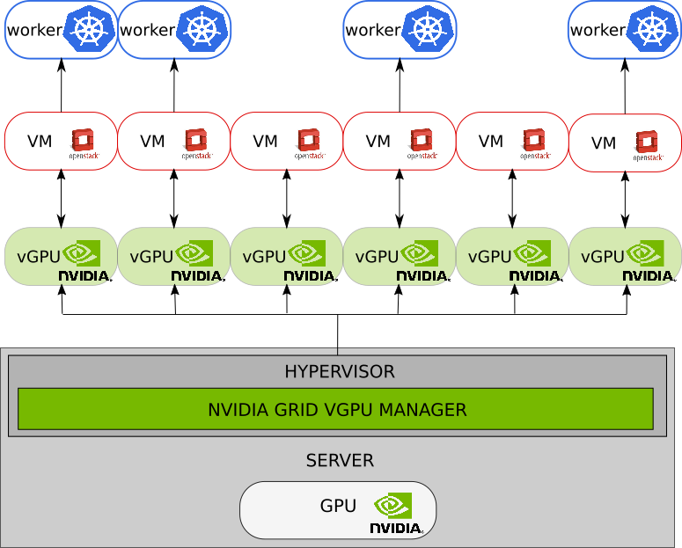
Enable GPU powered Kubernetes workloads
Create GPU powered Kubernetes workers using the vGPU OpenStack flavor created previously*
Enable Nvidia device plugin on Kubernetes Workers*
Enable Kubernetes API PodTolerationRestriction admission controller and “flag” GPU enabled Kubernetes worker nodes*
Now users can create vGPU powered Kubernetes workloads!
* These operations can be performed automatically through Juju
Notes:
To enable graphical processing resources in Kubernetes, we created Kubernetes workers in OpenStack using the virtual GPU flavor created previously. Then in the Kubernetes cluster we enabled the Nvidia device plugin and enabled a specific admission controller so that only specific namespaces and pods are allowed to use the graphical processing resources.
In this way, users can create graphical processing workloads also in Kubernetes!
——————————————
Bozza di discorso: By using Juju we deployed on Openstack 16 VMs of type "m1.gpu", which then became Kubernetes worker nodes. Juju helped us configure the NVIDIA device plugin, which allows user to run GPU enabled containers, and the PodTolerationRestriction admission controller feature of Kubernetes which, in combination with the taint of the GPU worker nodes, limits the ability of users to run gpu enabled containers and gives the kubernetes administrator the 'power' to enable and disable users to schedule gpu pods at the namespace level.
40’’
Enable Kubernetes API PodTolerationRestriction admission controller and “flag” GPU enabled Kubernetes worker nodes
so that only namespaces and pods with the correct flags are allowed to use vGPU enabled workers

Slide 11
But…
Issue: Linux devices associated with virtual GPUs are not persistent across reboots
Solution:
save the list of devices during operation
restore them at boot time
Our scripts available at https://github.com/ConsortiumGARR/gpu_mdev_scripts
vGPU
devices
Notes:
But we hit a snag: whenever a user creates a virtual machine with a virtual GPU, an associated Linux device file is created on the hypervisor.
However, these Linux device files do not survive reboots.
To tackle this issue we have created and published a set of system scripts which save and restore this information.
—————————
Whenever we create a vGPU OpenStack instance on physical server a new mdev is created; mdev mechanism is transient (and dynamic) by nature.
If the physical server is rebooted (no matter why) we lose all the mdevs.
OpenStack will try to reboot all the instances but it will fail because of missing mdevs associated to vGPUs.
A way to save and restore vGPU mdevs is needed…
How our (actual) fix works:
1 we use mdevctl utility
2 some bash scripts that save/restore mdevs associated to vGPUs
3 Systemd Units (and timers) to periodically save the mdevs and restore them at reboot
45’’

Slide 12
Wrap-up
We have increased the availability of GPU resources for our users by leveraging virtualization
GPUs are scarce compared to the demand from users
Several use cases don’t need all the resources of a physical GPU
=> More Happy Users!
Future work:
Benchmark vGPU vs GPU Passthrough
Improve automatic deployment of new GPU servers
Improve GPU reservation and accounting
Integrate A30/A100 GPU hardware
Mix different vGPU types (/2, /4, /8)
Notes:
To wrap it up, we have increased the availability of graphical processing resources for our users by using virtualization. This is because graphical processing resources are scarce compared to the demand from users, and also not all users need all the resources all the time.
As future work, we plan to assess the performance of the virtualization solution, then to improve the automatic deployment of GPU servers, improve the reservation and accounting procedures, integrate new types of GPU hardware, and see if we can mix different virtual GPU types and sizes
————————————
For A100, no need for license manager
L'abbiamo fatto perche' ne avevamo poche e in molti casi (compilazione, tuning, testing su piccola scala, scarsa scalabilita'/parallelizzabilita' di alcuni workload) non serve avere un mostro da 5k CUDA cores.
Nostra esperienza so far: piu' utenti smanazzano e sono contenti (e' vero?)
Altre idee per il futuro:
- visto che avremo A100, come cambia tutto il discorso? Un filo piu' semplice perche' non avremo license server.
- e' possibile mischiare GPU affettate in 8 con GPU affettate in 4 con GPU non affettate? Come le gestisci in OpenStack? E in Kubernetes? Puoi offrire questa scelta, o devi creare ambienti omogenei distinti?

Slide 13
Thank You
Write us at csd-support@garr.it
or meet us at TNC 22:
Wednesday at 9:00: “A Community Cloud for the Italian Research community... And more!”
Thursday at 18:00: Community Cloud Operators BoF
GARR booth
Trieste, June 14th 2022
TNC22
Notes:
That’s all. If you have any question or comment please write us to csd-support@garr.it or meet us on Wednesday or Thursday or find us at the GARR Booth. Thank you

