Slide 1
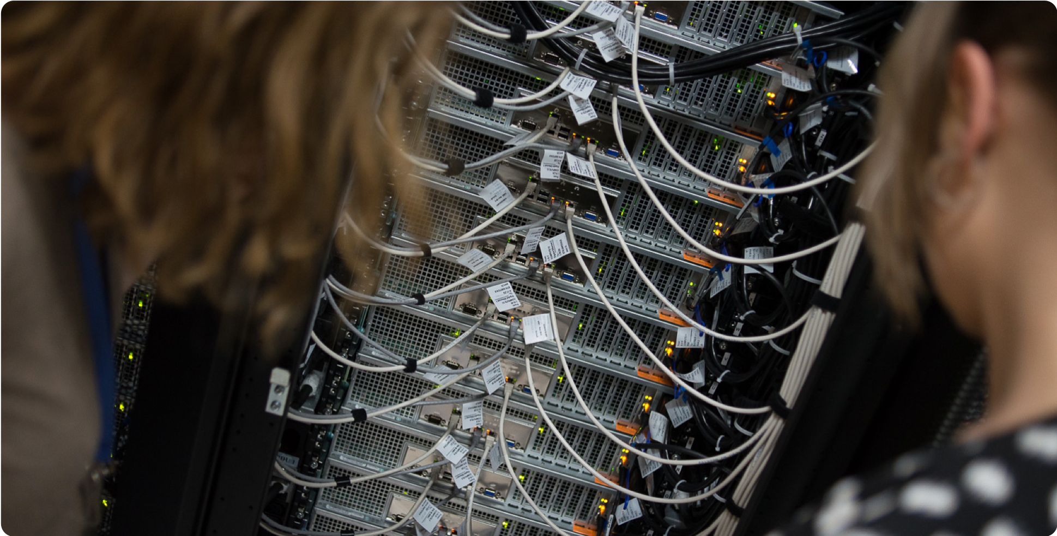
NFV for R&E
TNC 2022, Triëste
Eyle Brinkhuis, SURF Nils Vogels, SURF
Notes:
External developments – SURF's vision
Digitalisation makes it possible to do things today that yesterday, we still believed to be impossible. Digitalisation provides new services, new players and new rules.
1

Slide 2
In this talk
What is NFV?
What is SURFs use case for NFV?
What did not work for SURF?
What do we use?
Demonstration

Slide 3
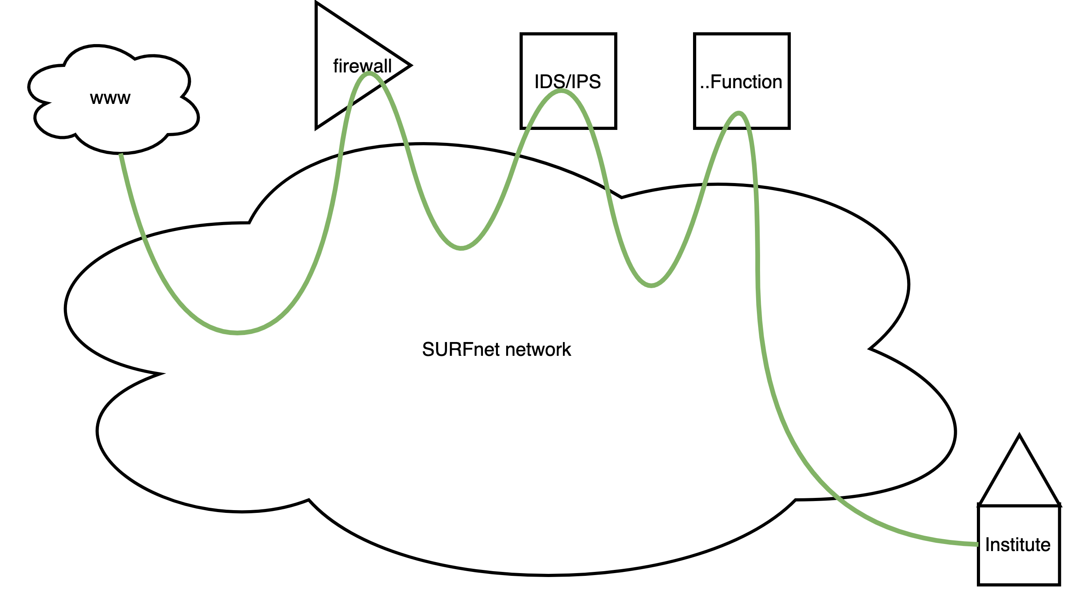
NFV in short
Common-off-the-shelf hardware
Run what you want
Pay As You Grow
Automated deployment and run
Service function chaining

Slide 4
But.. COTS is not meant for that
Huge pages
Preferred I/O
SmartNICs
Kernel bypass to userspace
dpdk.org
ebpf.io
fd.io

Slide 5
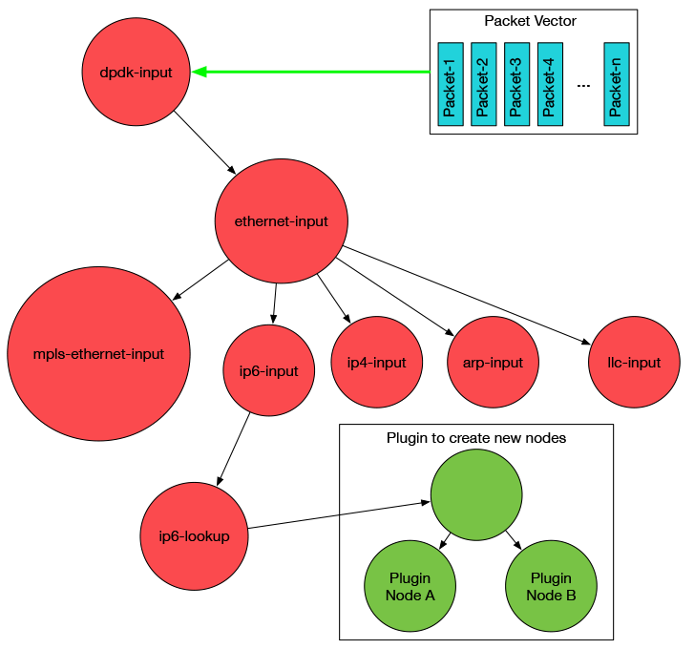
FD.io Vector Packet Processor
Fastest software dataplane in the world
L2-L4 features
Support for:
Containers
VMs
Tun/Tap, AF_Packet, Netmap
RDMA
And a lot more
https://fd.io/gettingstarted/technology/

Slide 6
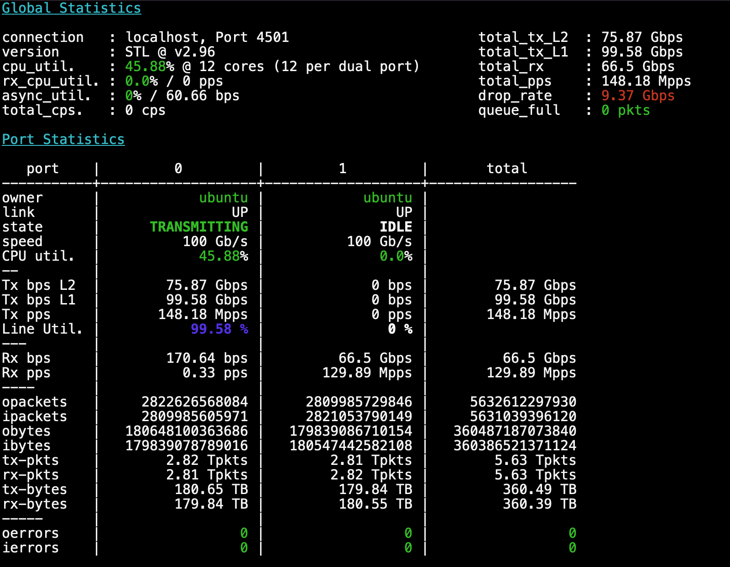
Performance
64Byte
~ 130 Mpps throughput

Slide 7
SURF’s goal for NFV:
Provide additional networkservices for connected institutes
Firewalling
Routing
EduVPN
On-demand
Pay as you grow
High throughput – low latency
”Give me a fully licensed 1Gbit UTM capable firewall with such-and-such
ruleset in Amsterdam between 9:00AM and 4:00PM on September 22nd"

Slide 8
Proof of concepts
Juniper Contrail
Not the right fit
Better for datacenters
Vanilla Openstack with VPP dataplane
Openstack is complex (!)
No QinQ success story
openstack.org

Slide 9
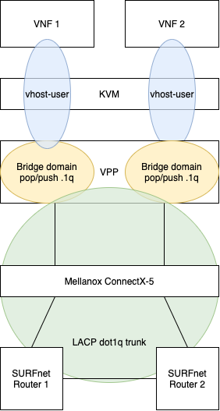
What do we need for NFV at SURF?
Virtualization engine
Shared storage
Something to piece it all together
High speed dataplane

Slide 10
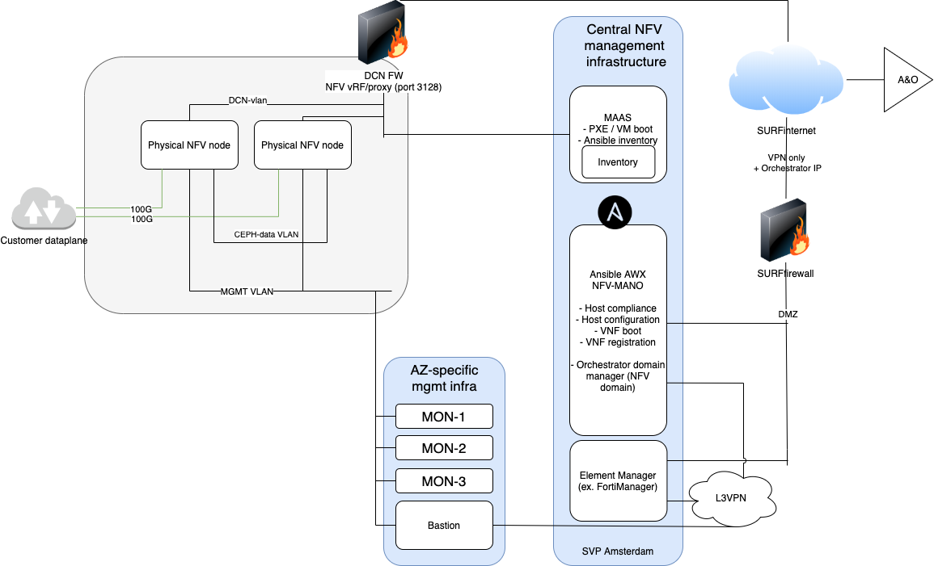
Deployment

Slide 11
Demonstration

Slide 12
Questions
Eyle Brinkhuis
Eyle.Brinkhuis@surf.nl
Nils Vogels Nils.Vogels@surf.nl

Slide 13
Samen aanjagen van vernieuwing
Notes:
De tekst zonder aanhalingstekens en zonder vraagteken. We willen hier graag ook nog de lijn plaatsen aan de rechterkant, maar dan in het wit.

