Slide 1
Race against time – leveraging anomaly detection
TNC22
AARNet Cyber Security
James Ng (General Manager – Security Operations)
AARNet Public
Notes:
Introductions (AARNet and James Ng/General Manager Security Operations)
Topic of the day – focus on adversary driven innovation leveraging anomaly threat detection
Thanks/recognition to Charles Sterner (CISO) in absentia
Quick overview of AARNet and how we fit into providing a SOC service to the HE&R sector including timeline of our SOC journey
Timeline of our SOC journey
Share our approach to SOC (in particular our use of anomaly threat detection using UEBA)
Share a case study
How this compares to the traditional approach to SOC (touching on static and dynamic correlation)

Slide 2
Who is AARNet?
Pioneered the internet in Australia in 1989
Not-for profit company
Licensed telecommunications carrier
Owned by 38 universities and CSIRO
Serves more than 2 million people
Proudly Australian owned and operated
AARNet Public
Notes:
AARNet summary on a slide – Australian wide NREN

Slide 3
Australian R&E Community
Schools TAFEs
Research organisations
Universities
Health
Galleries, Libraries, Archives and Museums
Scientific instruments
AARNet Public
Notes:
R&E – Research and Education

Slide 4
Our Network
National scope, global reach
AARNet Public
Notes:
National NREN and network interconnected with our global partners and subsea cable system co-investments.
Consolidated view at a national level but connect and collaborate internationally.

Slide 5
The team
A day in the life
AARNet Public
Notes:
A day in the life of the AARNet SOC
Zero days
Customers
Incidents/IR
On-Call
Covid
Reporting

Slide 6
The team
A day in the life
AARNet Public
Notes:
But we’re human (reference to anger management/axe throwing!)

Slide 7
The journey
March 2019
AARNet Board Approved SOC Business Case
May – June 2019
SIEM RFQ and Proof of Concept (POC)
September 2020
Production / Go-Live SOC Service
LogRhythm and Exabeam
Available outside of Pilot Universities
2022
SIEM Re-evaluation
Increased Retention
IT Ops Logs
XSOAR (Playbooks)
2019
2020
2021
2022
2018
Needs analysis
University discussions
Business case preparation
Jan 2020
Pilot with 4 Universities
2021
MISP (Threat Intelligence Sharing)
XSOAR (Case Management)
On-Call Automation
Spike Analysis
AARNet Public
Notes:
Timeline slide

Slide 8
Anomalous Detection – a new kind of SOC
AARNet Public

Slide 9
A New Kind of SOC
Knowledge
Wisdom
Observation
Listening to Our Adversaries
It’s not a machine vs a machine; It’s a human vs a human
Environment
Known Process
Measured
Signal
Model
Residual Noise
+
-
Modelled Behaviour
Machines (business processes) do normal, humans (adversaries) do abnormal
Knowing what’s normal makes the abnormal obvious
AARNet Public
Notes:
Not just running off signatures. How much can we learn about an environment that we can then apply ‘wisdom’ to it. Determine what ‘normal’ looks like. From there we make observations.
Can sort through the noise to focus on things we can care about. Machines don’t do random. Adversaries tell us what we are after.

Slide 10
A New Kind of SOC
Adversaries
Asset
User
Asset
User
AARNet Public
Notes:
Asset/User data and looking at the unique relationships.

Slide 11
A New Kind of SOC
Asset
User
Monitored Behaviours
Expert Assigned Score
Dynamic ML Driven Adjustment
Sum Risk Score
Remote logon
+20
.7
14
DATAFEEDS
102
126
90
98
49
65
25
35
81
16
11
4
Application
User
System
Network
AARNet Public

Slide 12
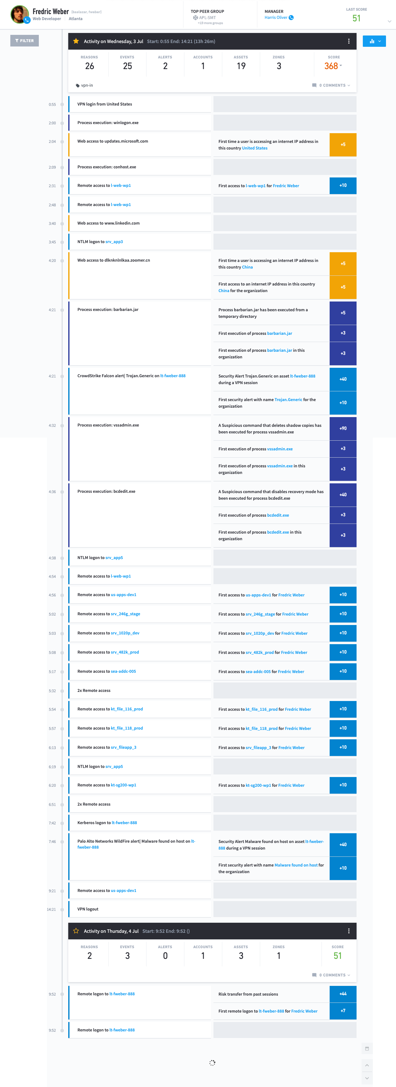
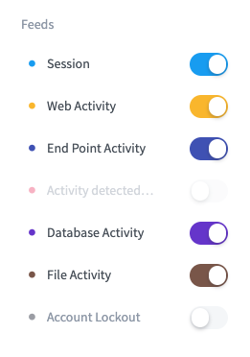
A New Kind of SOC
AARNet Public
Notes:
Standard lab environment. Raw log data on the left and then the right is the areas of interest (abnormal). Interesting and not interesting to an analyst. After the sum total as a model.

Slide 13
Case Study – RYUK Ransomware
AARNet Public
Notes:
Look all good on slides but let’s look a real life example
At a university institution, RYUK ransomware that was multi-staged and suspect initially compromised non privileged account (student) to access teaching infrastructure (lecture theatre machine) to laterally move to corporate assets

Slide 14
Background
Responding to threats with no security data
Original point of infection was not logging data to the SOC
AARNet Public

Slide 15
Background
Responding to threats with no security data
Original point of infection was not logging data to the SOC
Anti-virus software did not flag a malware infection on any infected system
AARNet Public

Slide 16
Background
Responding to threats with no security data
Original point of infection was not logging data to the SOC
Anti-virus software did not flag a malware infection on any infected system
Firewall/IPS did not flag any suspicious traffic
AARNet Public
Notes:
North/south firewall did not trigger on any suspicious traffic.
Security toolsets on the boxes did not trigger. Relying on normal or known bag signatures we would have missed this entirely.

Slide 17
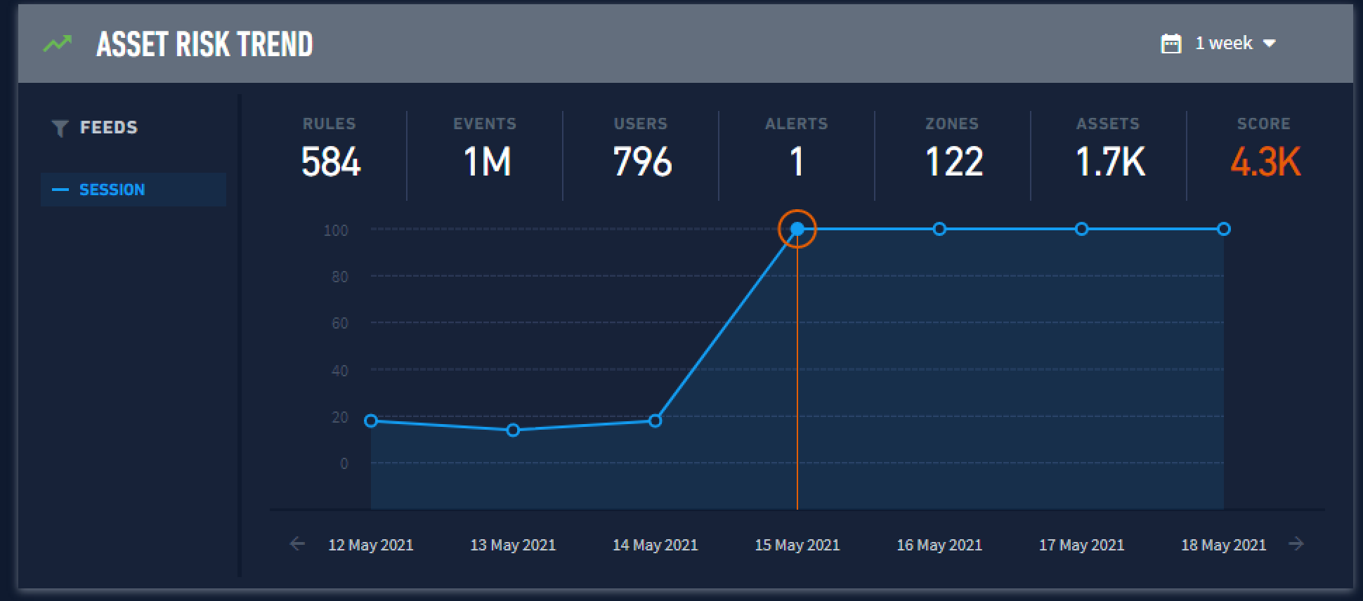
What?
AARNet Public
Notes:
One of their critical servers. Avg score of 20 leading to the attack to 4300+

Slide 18
How?
C2 Callback
Initial POI Detected
Lateral Movement
AARNet Public
Notes:
POI = Point of Infection
C2 = Command and Control
Just normal windows logs but the fact that the adversary was doing abnormal activity it stood out

Slide 19
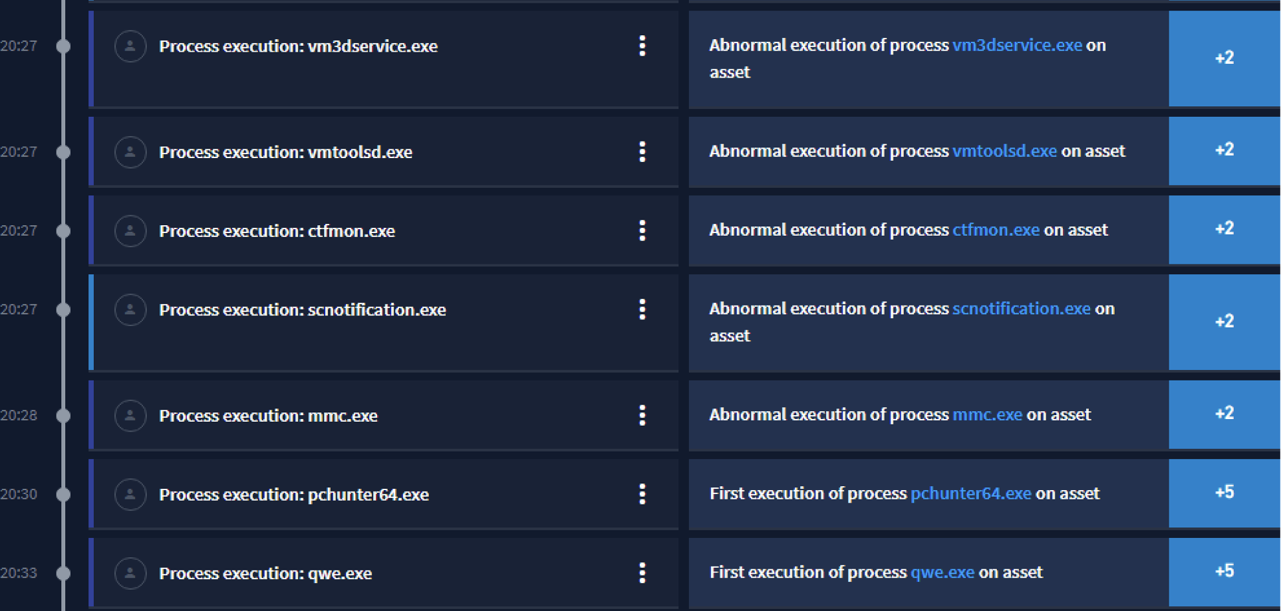
So What?
Not only do we know what compromised looks like, we can proactively stop these processes from running
The adversary has now told us exactly how they compromise a target, with their exact toolkit
We learned this from only understanding “normal”
AARNet Public
Notes:
Adversary told us how they compromised the target by stitching together the story to identify highly suspicious activity.
Can get ahead an look at identifying the blast radius and blocking future attempts of this toolkit (as we know it is malicious).

Slide 20
NREN community sharing
Threat informed protection
AARNet Public

Slide 21
Integrated SOC Approach – is the ‘old’ SOC dead?
AARNet Public

Slide 22
So is Old SOC Dead?
The traditional approach
Building use cases where it makes sense
AARNet Public
Notes:
No it isn’t but we are going to do static use cases where it makes sense.
Static detection becomes contextual enrichment – to aid the analyst make a determination if it is malicious or not. Prior example/case study if we had threat intelligence to enrich.

Slide 23
So is Old SOC Dead?
The traditional approach
Dynamic
Static
AARNet Public
Notes:
Example how it works. Dynamic detection execution (don’t know if malicious or not). Static detection (known bad). Make a simple decision for the analyst.

Slide 24
Prevent, Detect, Respond
Old + New = Innovation
SOC
SOC
7
East - West
8
Exfiltration
6
Lateral Movement
Exploit Infiltration
1
Malware Download
3
2
Vulnerability Exploitation
4
Malware Installation
5
Command and Control
AARNet Public
Notes:
Cyber kill chain and Mitre – . We need to be right all the time, but so does the bad guy. These are “opportunities” for us to the detect

Slide 25
Prevent, Detect, Respond
Managed
Unmanaged
Old + New = Innovation
SOC
SOC
7
East - West
8
Exfiltration
6
Lateral Movement
Exploit Infiltration
1
Malware Download
3
2
Vulnerability Exploitation
4
Malware Installation
5
Command and Control
AARNet Public
Notes:
Unmanaged = things we would get from the firewall or security technologies (good using static)
Managed = data we get from the system or endpoint logs (good using dynamic)
How much insight to we have for each stage of prevent, detect and respond stages

Slide 26
Prevent, Detect, Respond
Old + New = Innovation
SOC
7
East - West
8
Exfiltration
6
Lateral Movement
Exploit Infiltration
1
Malware Download
3
2
Vulnerability Exploitation
4
Malware Installation
5
Command and Control
AARNet Public

Slide 27
One Team
Together and global
1
Exploit Infiltration
6
Lateral Movement
4
Malware Installation
2
Vulnerability Exploitation
7
East - West
5
Command and Control
3
Malware Download
8
Exfiltration
Static Use Cases
Static / Advanced
Use Cases
Advanced
Use Cases
(Easily Shareable)
(Dedicated Capability)
(Internal Capability)
AARNet Public
Notes:
We combine to get the ‘best’ of both UEBA/anomaly detection and traditional SOC, noting overlap.
One team globally = we focused what we are doing internally (dynamic use cases as this environment specific) but should be collaborating together where it make sense (static use cases and known bad are really good for collaboration).

Slide 28
Building on our vision
Multi-layer defence at scale
Production
Development
Planned
Analysis
Identify
Protect
Detect
Respond
Recover
Security Operations Centre
Extended Detection and Response (XDR)
IRAP Secure Internet Gateway
Enterprise Firewall Service
Continuous Security Validation
DDoS Protection
Sophistication
Cyber Security for Schools
DNS Firewall
Cyber Security Professional Services
Tabletop Exercises
AARNet Public
Notes:
We talked a lot about ML and but we see multiple ways to improve our prevent, detect, respond enrichment capabilities within the SOC.

Slide 29
Questions?
AARNet Public

