Slide 1
TNC 101
Getting the most from your TNC experience
Casper Dreef and Rosanna Norman
Trieste, Italy
Tuesday 14th June 2022
Notes:
C: Hi everyone. Benvenuti a TNC22 e benvenuti nella bella Trieste. My name is Casper Dreef and I am a Project Support Officer in the T&I Ops team at GÉANT. And today I am joined on stage by my colleague Rosanna Norman. Rosanna, I am so happy that we can have TNC22 in person again, aren’t you? By the way, how is your Italian?
R: …Buongiorno a tutti e benvenuti a Trieste. Che piacere vedervi tutti qui! Not bad eh? Casper? (PS: I am Italian ;-))
When was your first TNC and how did you like it?
C: Trondheim in 2018. My only job was to explore all the exciting stuff going on in the R&E community. Actually, that is not much different that this year’s motto: Navigate the unexplored!
R: It looks like we are TNC Twins. My first TNC was TNC18 where I was responsible for the event comms and this is still my role at TNC22! So it looks like I might be doing a good job then.

Slide 2
About GÉANT
Notes:
Raise hands if you’ve heard of GÉANT and its activities

Slide 3

The GÉANT Association is the collaboration of European National Research and Education Networks (NRENs).
Together, we deliver an information ecosystem of infrastructures and services to advance research, education, and innovation on a global scale.
Notes:
Casper

Slide 4


Vision
To collaborate to deliver the infrastructures and services that enable the R&E community to excel.
Notes:
C: As many of you know – the world faces a multitude of challenges – societal, environmental and equality, to name a few.
To tackle these challenges, collaborative effort between scientists, researchers and educators is invaluable
For this, R&E networks are the glue that enable such collaboration to happen, be it nationally or globally.
Hence our mission:

Slide 5

Mission
To empower R&E with an open, innovative, and trusted information ecosystem.
Notes:
C:

Slide 6

Ambition
To address and anticipate the needs of the R&E community by offering sustainable, open, innovative and trusted infrastructures and services.
To be a trusted and preferred-choice partner to the benefit of the European R&E community.
To collaborate and share knowledge to enable NRENs to improve their performance, both individually and collectively.
Notes:
Rose
We are committed to the R&E community and aim to be the partner of choice. If NREN improve their performance, it will be beneficial to society at large.

Slide 7








The GÉANT Association is driven by
Eight Strategic Goals
Network
We are the trusted partner for pan-European and global advanced R&E networking.
Security
We provide a safe and secure information ecosystem for researchers, educators, and students.
Innovation
We continually evolve key infrastructures, innovate, and develop new services in order to fulfil the needs of the R&E community in a sustainable way.
Community
We are acknowledged worldwide as a leader for developing and supporting R&E networking communities, and global REN development.
European Union
We are seen by the EU as an indispensable partner for their vision.
Stakeholders
We forge relationships with other
e-infrastructure providers, research infrastructures (RIs), and other stakeholders, to benefit the R&E community.
Governance
We have a governance structure that is agile and benefits from the diversity of our membership.
Funding
We will ensure financial sustainability to benefit our members.
Notes:
Rose
I won’t go over all of them , but let me just pick at least three: Network Innovation and Community

Slide 8
About TNC
Notes:
Rose

Slide 9
What is TNC?
The GÉANT community's flagship conference.
TNC22 is our the 37th annual event.
Bringing together decision makers, networking and collaboration specialists, and identity and access management experts from all major European networking and research organisations, universities, worldwide sister institutions, as well as industry representatives.
Regular attendance of over 700 participants from all across the world.
Notes:
Rose
Technical Workshop 1989 in Trieste
Statistics – approx. 700 registrations , 63 countries, organisations? Steffie / Laure to provide final figures.
Number of presentations and speakers: 126 speakers, 4 keynotes, 5 plenaries, 20 parallel sessions, 11 demonstrations

Slide 10
WHAT’S ON THE PROGRAMME?
POSTERS
BOOTH
LIGHTNING TALKS
HALLWAY CHATS
KEYNOTES
PRESENTATIONS
SOCIAL EVENTS
DEMOS
Notes:
C: What’s on this year’s programme?
This year the PC selected 4 keynote speakers: Filippo Giorgi – who will kick off this conference later this morning - , Monique Morrow, João Bacelar and Gihan Kamel.
Lightning talks – 2 rounds of lightning-fast presentations where the speakers need to get to the point in just 5 minutes. Also, this year we have no less than 8 speakers from the Future Talent Programme presenting.
Tracks – Over the next three days there will be 20 tracks with topics varying from security to the network, cloud to T&I. Unfortunately, you can’t be in two places at the same time. So, choose wisely.
Posters are in the exhibition Hall. During the breaks the submitters will be happy to answer all your question about the projects and services presented. And talking about the breaks, during each break there will be demonstrations down the dedicated demonstration area. Go and check that out!
You may have also noticed the TNC22 Partners Exhibition where you will also find GÉANT’s booth
As you can see, lots of things going on this week. But where can you find the programme?

Slide 11

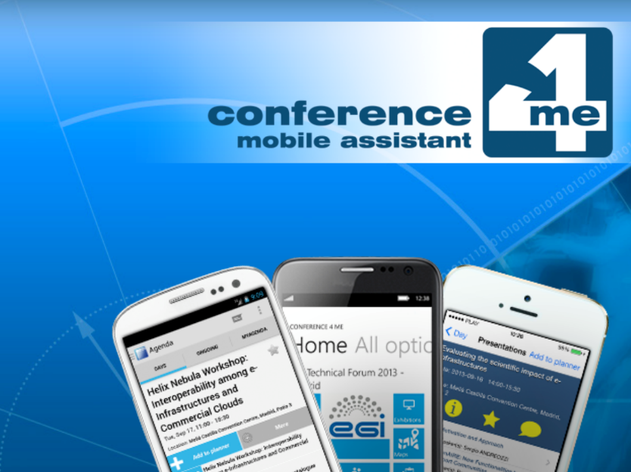
Finding the Programme
Notes:
Casper.
You will find the programme on the TNC22 website or you can download the conference4me app from your app store. In the app you can find all the session and what room they will take place. You can even add sessions to your agenda and will get a notification before your favorite session starts. This app was developed by PSNC.

Slide 12
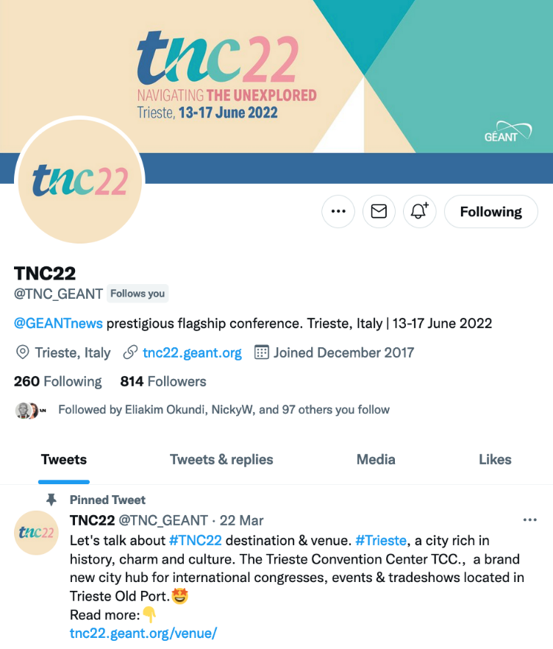
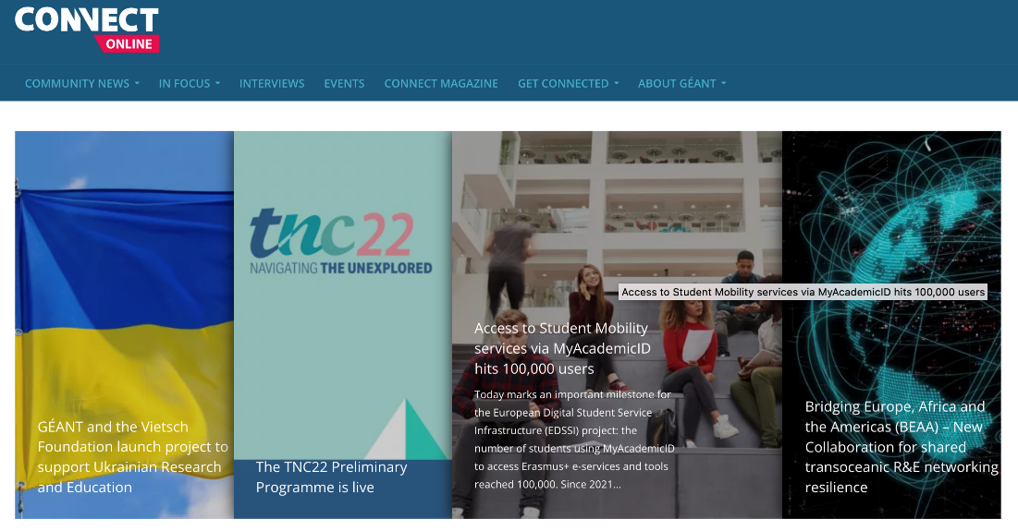
Keep Up-to-Date
Notes:
Rose:

Slide 13
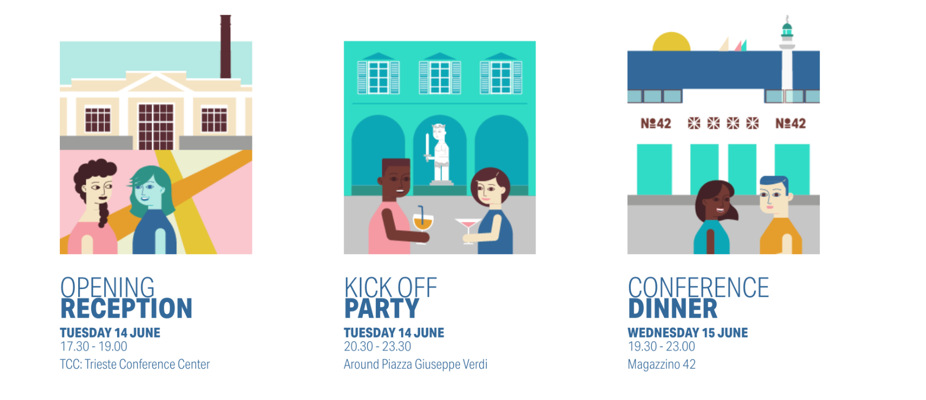
Come Socialise
Notes:
Rose

Slide 14
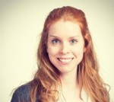
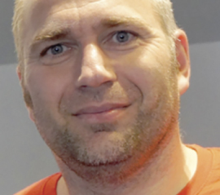
Code of Conduct
Participants at TNC22 enjoy an environment of respectful and encouraging behaviour, so that everyone feels welcome, comfortable and equal.
If you feel that you have been subjected to behaviour that is contrary to such an environment, or if you have any other concerns, please contact our conference organiser – Steffie Bosman or our CITO - Klaas Wierenga. They will discuss and help resolve your concerns in the strictest of confidence.
Read here more about our Code of Conduct:
https://tnc22.geant.org/code-of-conduct/.
Notes:
Bullet 1 - Rose
Bullet 2 – Casper
Bullet 3 - Casper

Slide 15
After TNC…
Give us feedback (via the App)
Join a mailing list: https://lists.geant.org/
Join a Task Force or Special Interest Group
Plan to present next year: presentation, lightning talk, poster, demonstration
Talk to us!
Notes:
Together
C - Conference app – after each session
C - Mailing list – ask presenter and session chairs
C - Community Programme – more information GÉANT website: community.geant.org
R - Present next year – stay tuned for TNC23. Follow the announcements about call for proposal. Mailing list in the email send to you at the end of the conference
R - Talk to us -> schedule with GÉANT’s specialists can be found at the booth and online

Slide 16
Notes:
Now it’s time for you to navigate the unexplored. We hope you will create your own happy memories of your first TNC! See you at the reception here at TNC and on the dance floor tonight! We will both be there, for sure! Right Casper?

