Slide 1
Network Development in the GÉANT Project
Maria Isabel Gandia Carriedo, CSUC/RedIRIS
Ivana Golub, PSNC
TNC23
June 5-9, Tirana, Albania
Public (PU)

Slide 2
Agenda
Environment
Network Development
Production Services
NETDEV Incubator

Slide 3
The GÉANT Project Structure
WP1
Project Management
WP2
Marcomms, Events and Policy Engagement
WP3
User and Stakeholder Engagement
WP4
Above-the-Net- Services
WP5
Trust & Identity Services Evolution and Delivery
NETDEV
WP6
Network Development
WP7
Network Core Infrastructure and Core Service Evolution and Operations
WP8
Security
WP9
Operations Support
Task 1: Project Governance, Management & Coordination
Task 1: Communications and Design
Task 1: Partner Relations
Task 1: User-Facing Service Delivery Chain
Task 1: Operations and Enhancement of eduroam
Task 1: Technology
Task 1: Network Engineering and Implementation
Task 1: Security Management
Task 1: Operations Centre including CERT
Task 2: Finance
Task 2: Services Marketing
Task 2: Supporting International User Groups
Task 2: Vendor-Facing Service Delivery Chain
Task 2: Operations and Enhancement of eduGAIN
Task 2: Platform
Task 2: Network Infrastructure and Services Evolution
Task 2: Human Factor
Task 2: Software Governance and Support
Task 3: ICT
Task 3: Events
Task 3: External Relationships
Task 3: Infrastructure Cloud Procurement
Task 3: AAI Core platform and eduTEAMS Services
Task 3: Monitoring
Task 3: Network Management, Automation and Orchestration
Task 3: Security Products and Services
Task 3: Service Management
Task 4: PLM
​​​​​​​Task 4: Policy Engagement
Task 4: Community Programme
Task 4: Above Net Services Strategic Planning
Task 4: InAcademia
​​​​​​​Task 4: Academy
​​​​​​​Task 4: Packet Layer Renewal
Task 4: Research; Security for High-Speed Networks
Task 4: GÉANT Software Development and Operations
Task 5: Human Capital Development
Task 5: Above Net Services Developments
Task 5: T&I Incubator
​​​​​​​Task 6: Procurement & Supplier Management
Task 6: T&I Enabling Communities
WP Leaders: Ivana Golub (PSNC), Pavle Vuletić (UoB/AMRES)
WP6 budget: > 3,1 mil EUR
31 R&E organisations from 25 countries
85 team members
https://wiki.geant.org/display/netdev
​​​​​​​​​​​​​​Task 7: Distributed Identities

Slide 4
Paul can we have an agenda slide?
Network Development
Optical Time and Frequency Networks - OTFN
Quantum Technologies - QT
Router for Academia, Research and Education - RARE
GÉANT P4 Lab - GP4L
TechLab

Slide 5
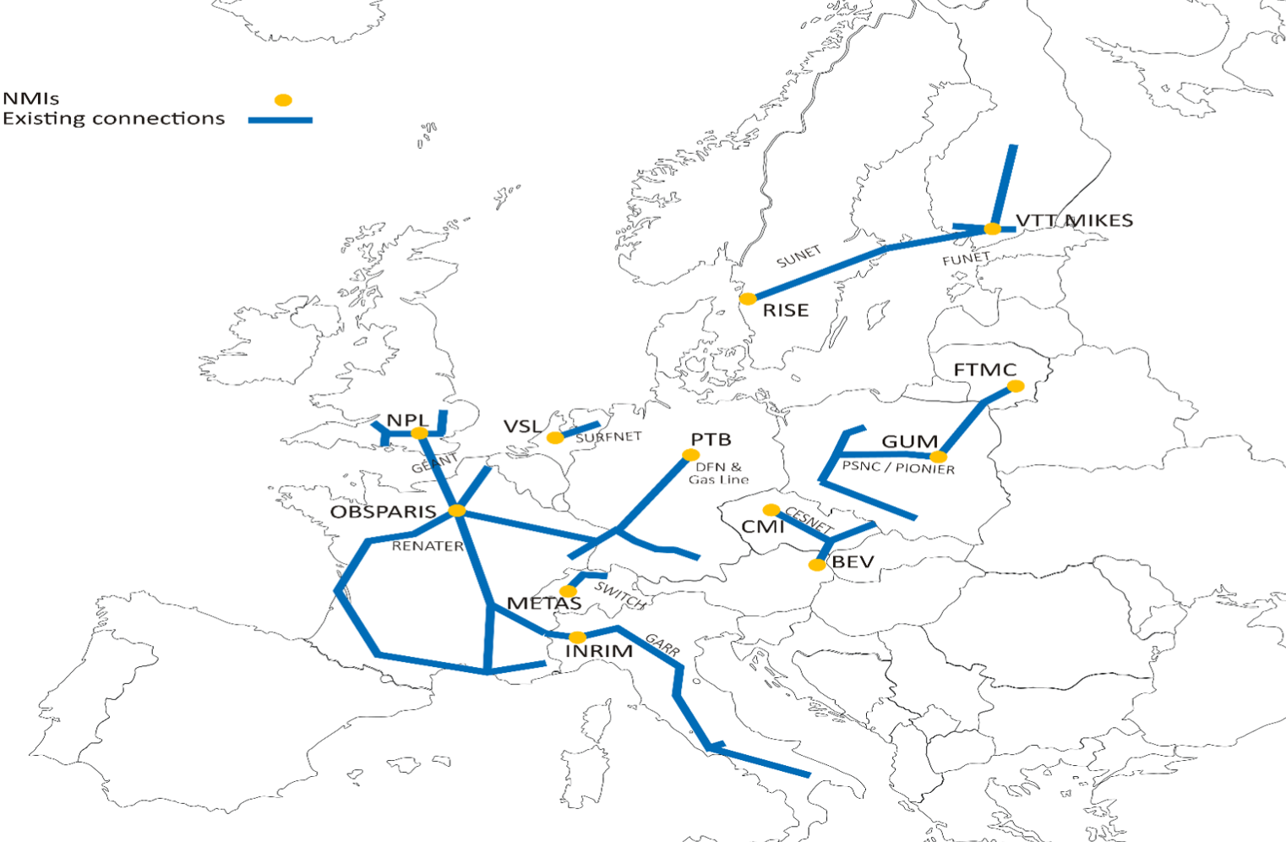
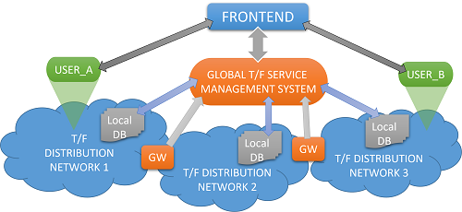
Optical Time and Frequency Networks - OTFN
Exploring approaches for Time and Frequency (T&F) Services in NREN Networks:
T&F service and infrastructure study - considering CLONETS-DS results
T&F Gateway - national signal sources and cross-border transfer
Monitoring and calibration solutions
https://wiki.geant.org/display/NETDEV/OTFN

Slide 6
Quantum Technologies
Exploring Quantum Technologies (QT) for NREN Use cases
Quantum / QKD services in NRENs
Supporting NRENs in their QT deployments
QT training material in the Network eAcademy
Discussion forums:
Open Quantum Group Meeting
quantum-discuss@lists.geant.org
QT wiki
Infoshare “Quantum Solutions”: 21 June 2023, 1-3pm CEST
https://wiki.geant.org/display/NETDEV/QT

Slide 7
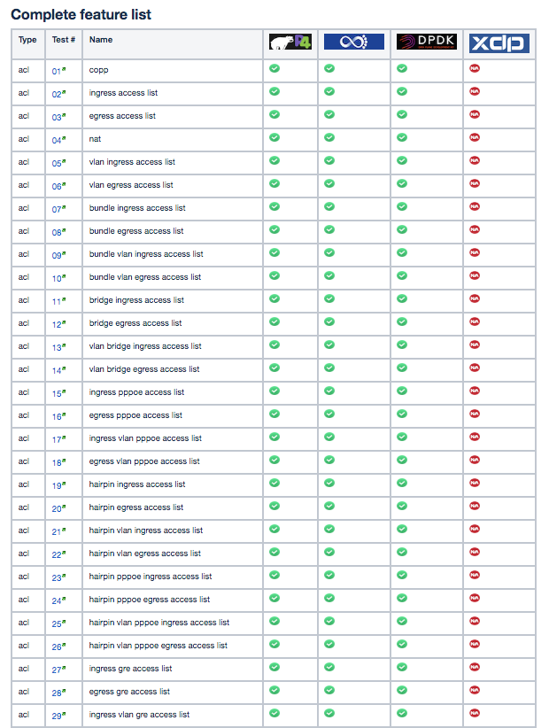
RARE - Router for Academia, Research and Education
An open source router OS for R&E use cases
Supports six data planes:
based on UNIX socket
Libpcap
DPDK
BMv2 (P4)
INTEL TOFINO ASIC (P4)
XDP, eXpress Data Path
RARE features (not limited to):
Interior Routing Protocol
Dataplane forwarding
External Routing Protocol
Link local protocol
Network management
RARE
rare-users@lists.geant.org
rare-dev@lists.geant.org
rare@lists.geant.org

Slide 8
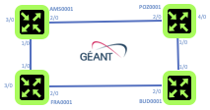
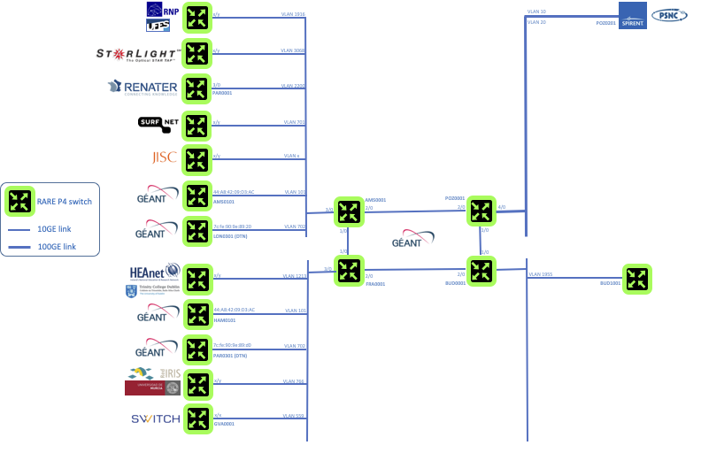
GP4L - GÉANT P4Lab
P4 switch-based lab infrastructure interconnected through the GÉANT network
4 switches in Europe: AMS, POZ, FRA, BUD
Initially aimed to validate the RARE/FreeRtr open source routing stack software
With growing interest, offering experimental dataplane programming facilities to researchers to perform geographically distributed network experiments:
With the usage of RARE/FreeRtr NOS
Using a clean slate environment (i.e use exclusively GP4L without RARE/FreeRtr dataplane & control plane)
https://wiki.geant.org/display/GP4L

Slide 9
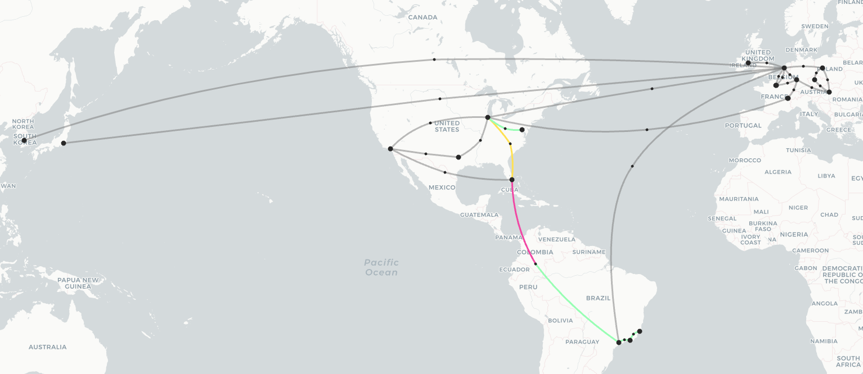
Global P4L May 2023
Over 20 locations worldwide
Strong collaboration with the GNA-G DIS GNA-G Data Intensive Sciences Working Group

Slide 10
TechLab is an initiative to facilitate access to information on research network infrastructures and services that can be made available to work on modern and innovative solutions.
Brings together specialists and researchers to share knowledge and experience and promote work results
Offers shared resources and services for advanced testing, piloting and research.
Promotes test infrastructures whose owners are open for collaboration
Increases the visibility of test infrastructures and there developed solutions
GP4Lab
NMaaS
perfSONAR in NMaaS
SPA/E-Line in NMaaS
SPA Inventory2 in NMaaS
WiFiMon in NMaaS
https://wiki.geant.org/display/NETDEV/TechLab

Slide 11
Paul can we have an agenda slide?
Production Services
Network Management as a Service - NMaaS
Service Provider Architecture Platform - SPA
and (SPA) Inventory
perfSONAR
Performance Management Platform - PMP
WiFiMon
TimeMap
Argus
Network eAcademy

Slide 12
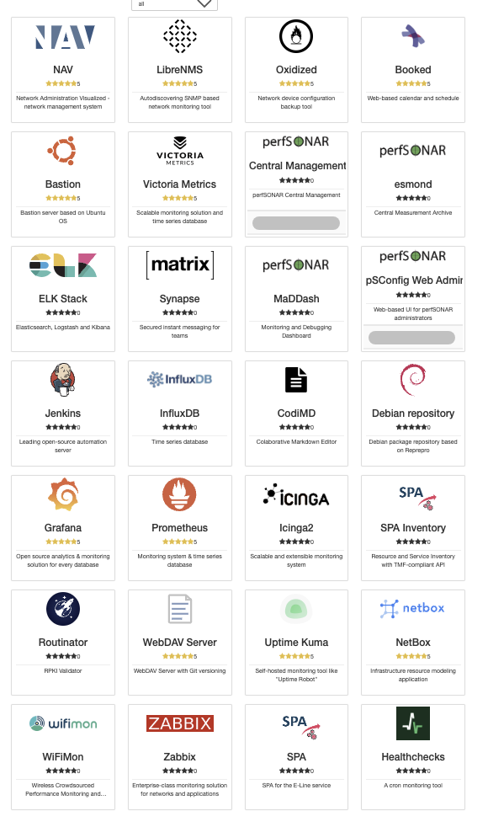
NMaaS - Network Management as a Service
A portfolio of network management applications run as dedicated, cloud-based per-user instance
nmaas.eu
nmaas@lists.geant.org
28 applications available, easy to add new tools
Use cases:
Network/Equipment Management for Small/Medium size networks/ institutions
Project-owned equipment
NMaaS Virtual Lab - NEW!
How to use NMaaS?
Managed service
Production NMaaS instance: https://nmaas.eu
Sandbox instance: https://nmaas.geant.org
Self-hosted
On your own NMaaS instance: https://docs.nmaas.eu/install-guide
On a local machine: https://docs.nmaas.eu/local-vm

Slide 13
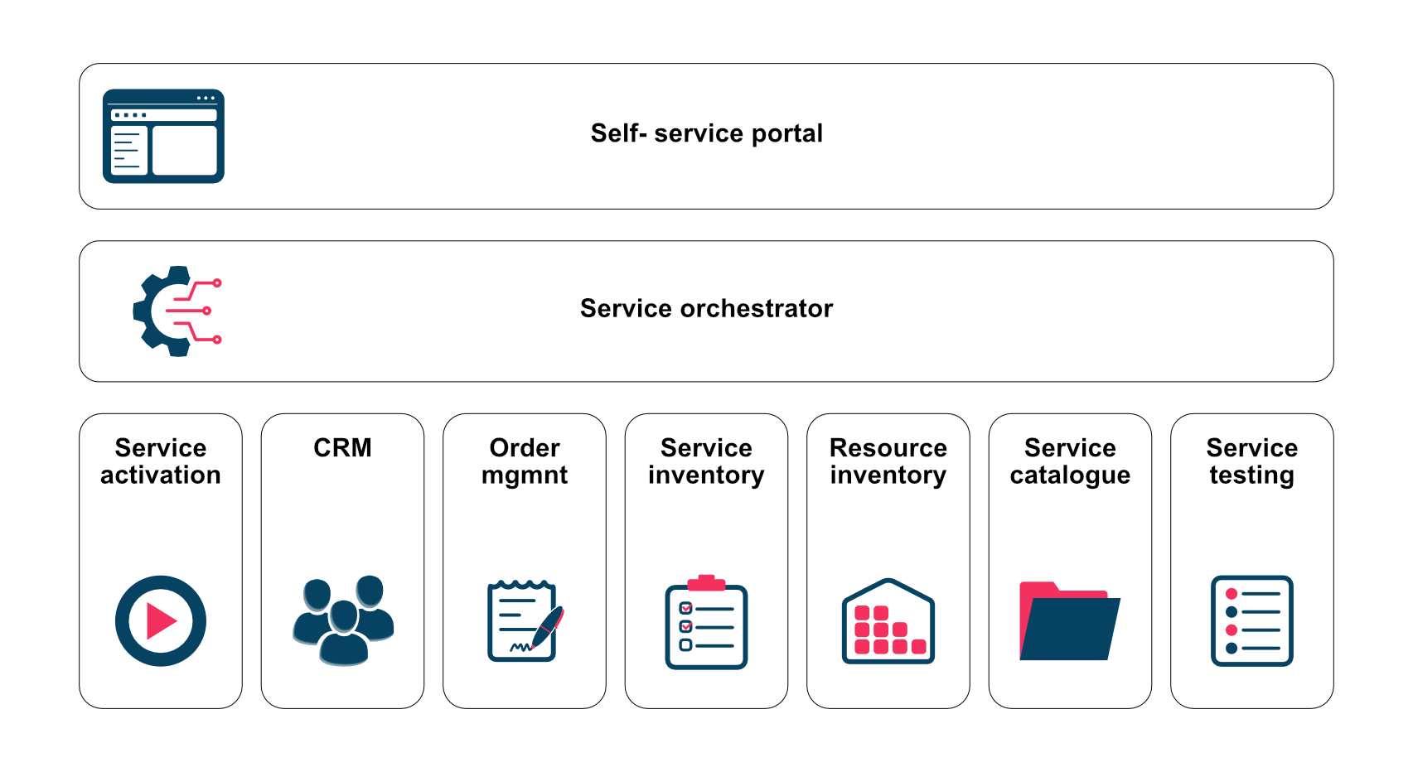
Support the service lifecycle of all network services
Common information model
Design a LEGO® type of service architecture
Orchestration (workflows)
Reusable components
Use automation wherever possible
TMF Frameworx compliant
Used for the GÉANT Connection Service (GCS)
Test service instance available in NMaaS
spa@lists.geant.org
https://wiki.geant.org/display/NETDEV/SPA

Slide 14
Inventory
Resource Inventory and Service Inventory implemented as a stand-alone application
Storage for the information about resources and service instances
One of the key components of SPA
The Source of Truth for automation
Inventory version 3
Use of NoSQL (MongoDB) database
Data model can be easily updated/ extended and validated
In testing in PSNC/PIONIER

Slide 15
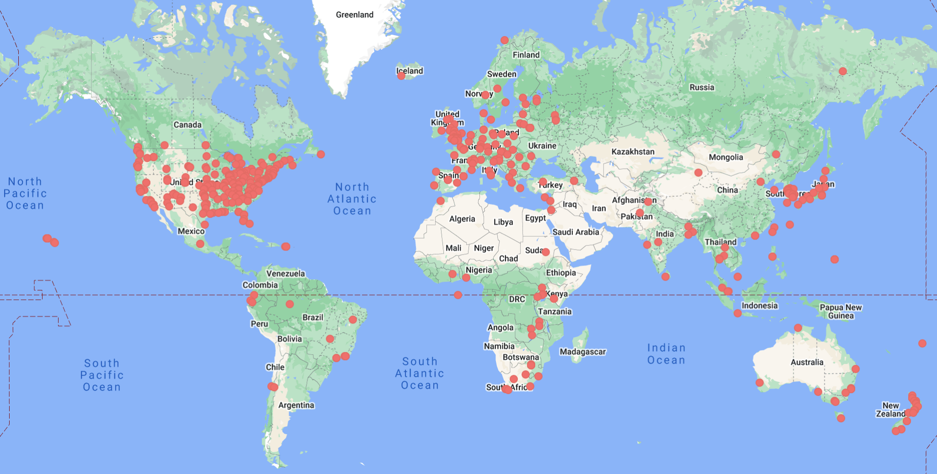
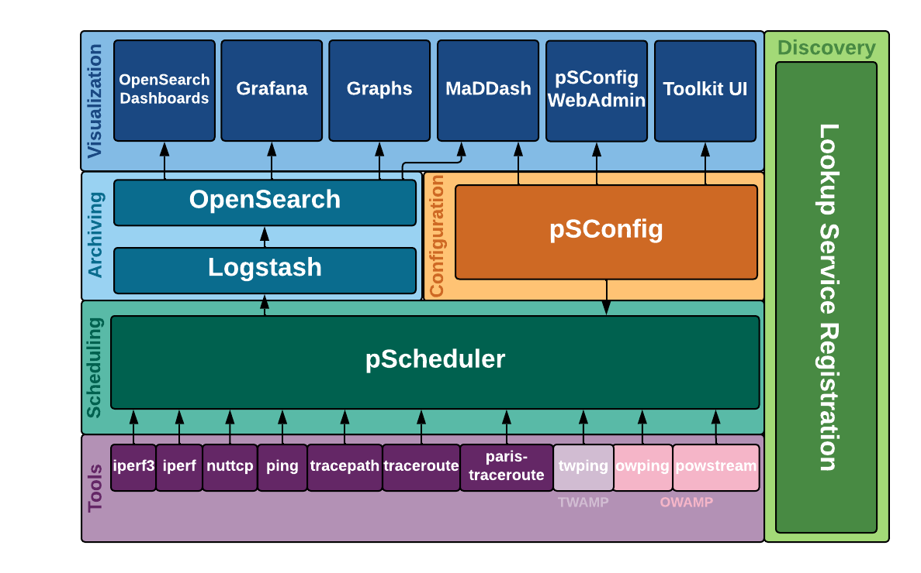
perfSONAR
https://www.perfsonar.net/
Open-source, modular, flexible architecture for IPv4 and IPv6 active network measurement and monitoring
perfSONAR 5.0 released April 17th, 2023
Greater visualization and analysis capabilities
New pScheduler test plugins to support WiFi BSSID, 802.1X authentication, DHCP response time and more
Over 2000 registered hosts in more than 1000 organisations around the world
Supported on Ubuntu 20
More OSs to follow in early summer (EL8, EL9, Ubuntu 22, Debian 11)

Slide 16
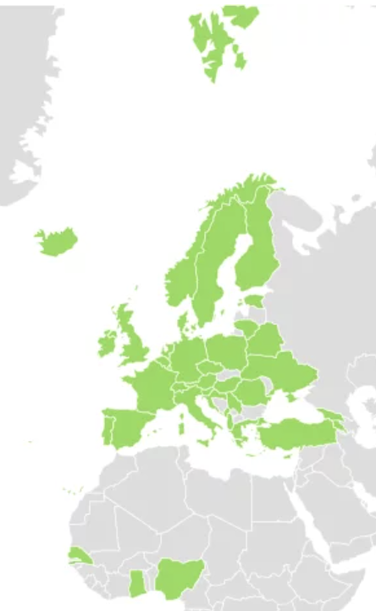
Performance Measurement Platform - PMP
Exploring the performance of the GÉANT backbone while experiencing perfSONAR on small nodes
Low-cost hardware nodes with pre-installed perfSONAR software and deployed in GÉANT collaborating organisations in Europe and Africa.
Central components including a central Measurement Archive (MA) and a Dashboard.
Measurement points in the GÉANT backbone network
PMP data analysis for new service report using AI/ML
In green: Countries with the PMP service coverage in Europe
Dashboard: https://pmp-central.geant.org/maddash-webui/
Contact: perfsonar-smallnodes@lists.geant.org

Slide 17
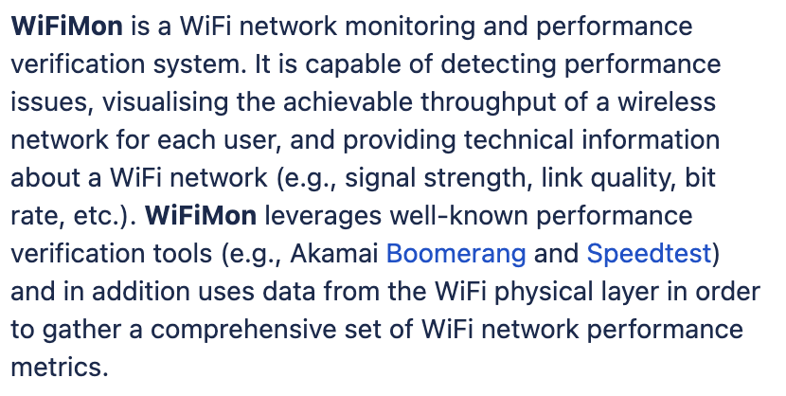
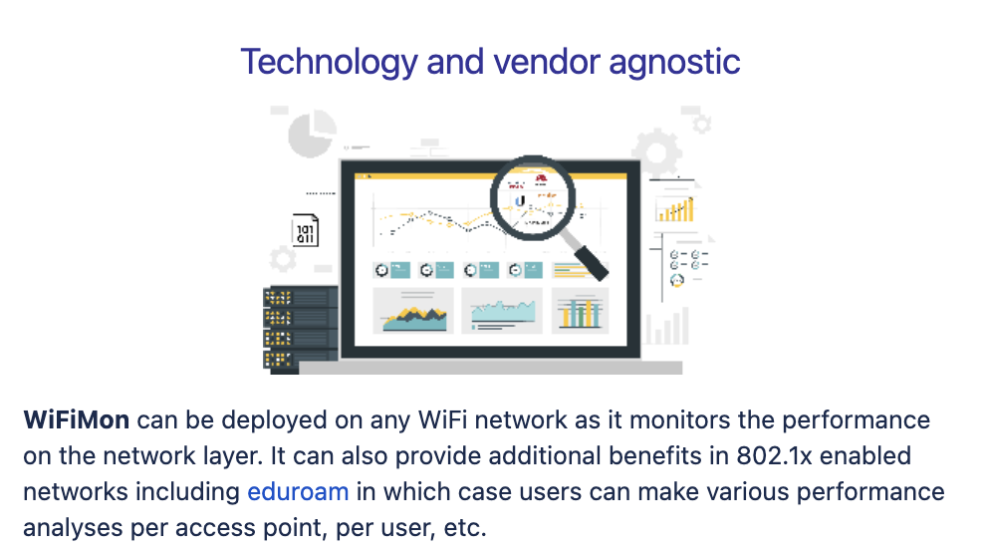
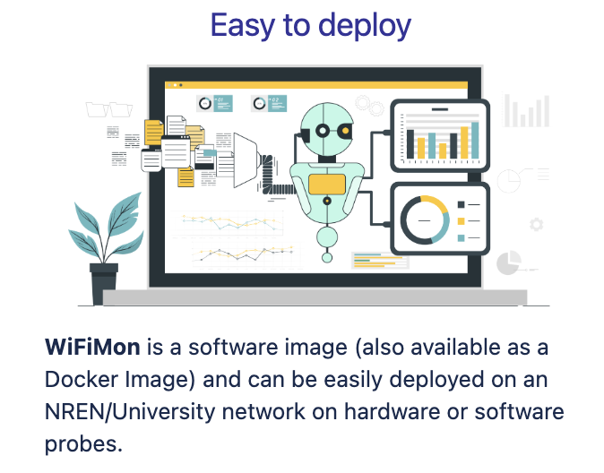
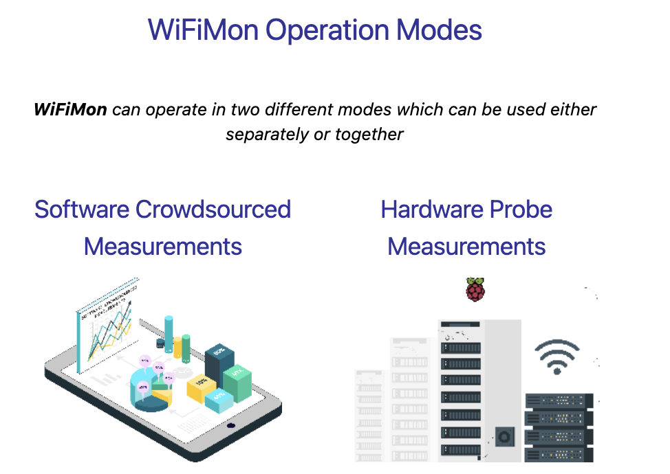
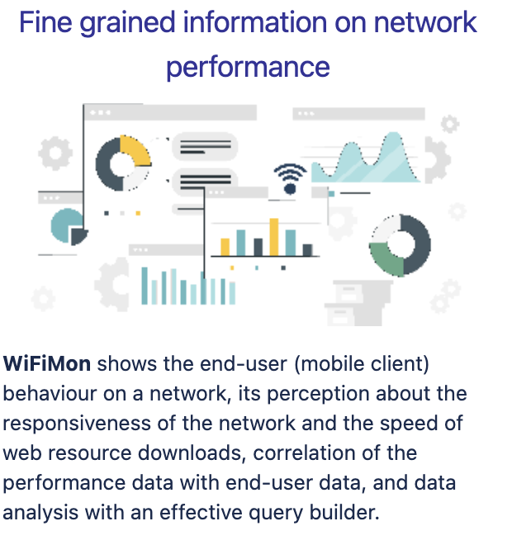
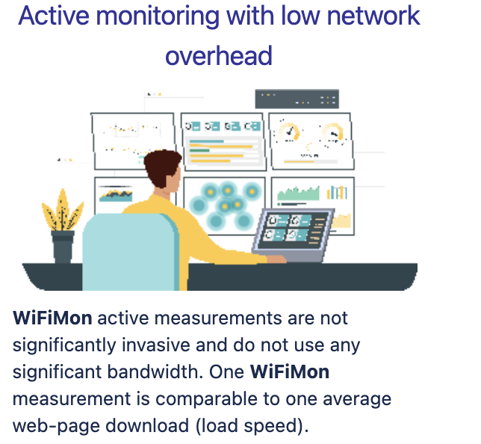
WiFiMon
A WiFi network monitoring and performance verification system
WiFiMon

Slide 18
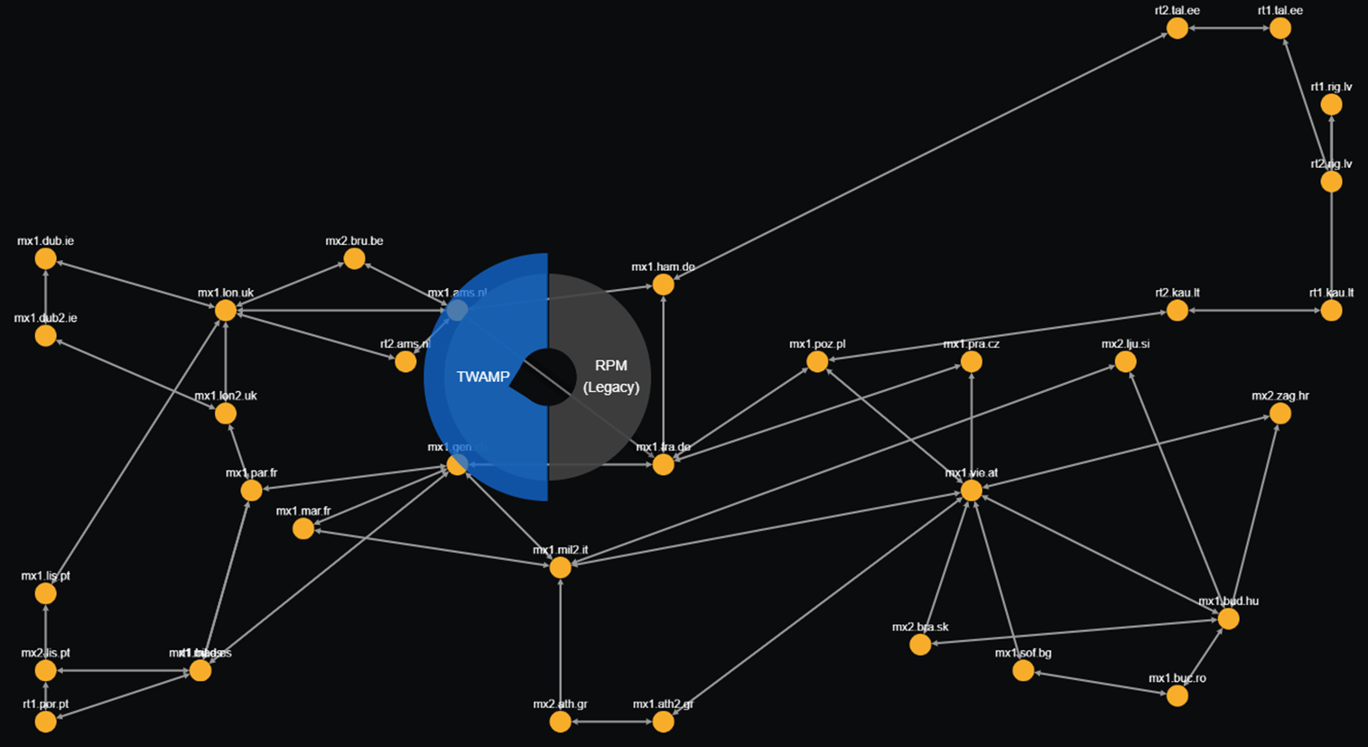
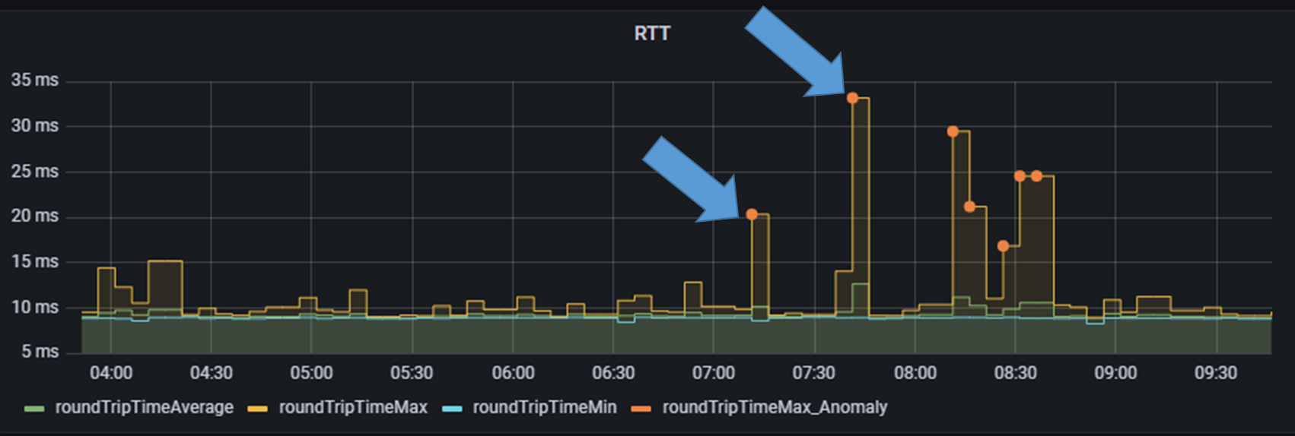
TimeMap
Per-segment latency and jitter monitoring tool
Based on TWAMP (RFC 5357)
Easy and quick modular installation
Initial AI-based anomaly detection implemented
Deployed in the GÉANT backbone network
Documentation
TimeMap
Code and documentation
TimeMap page

Slide 19
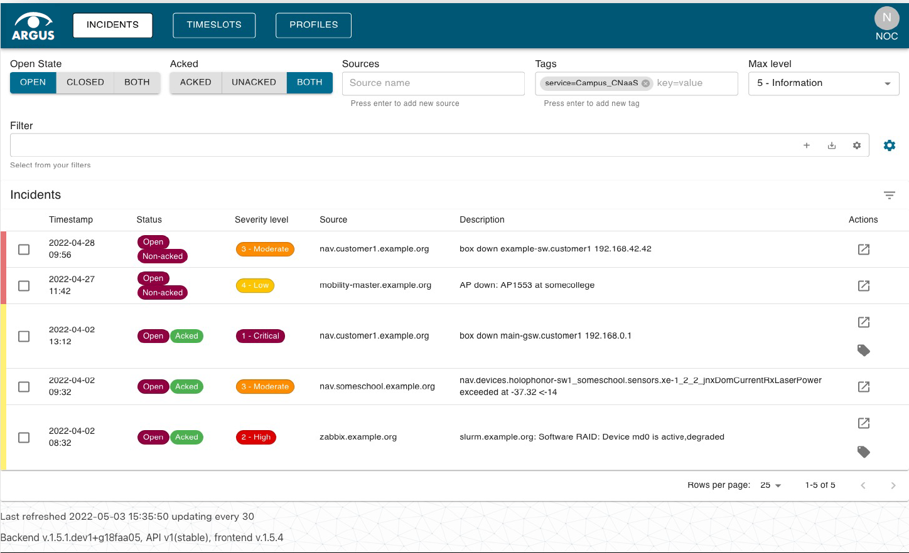
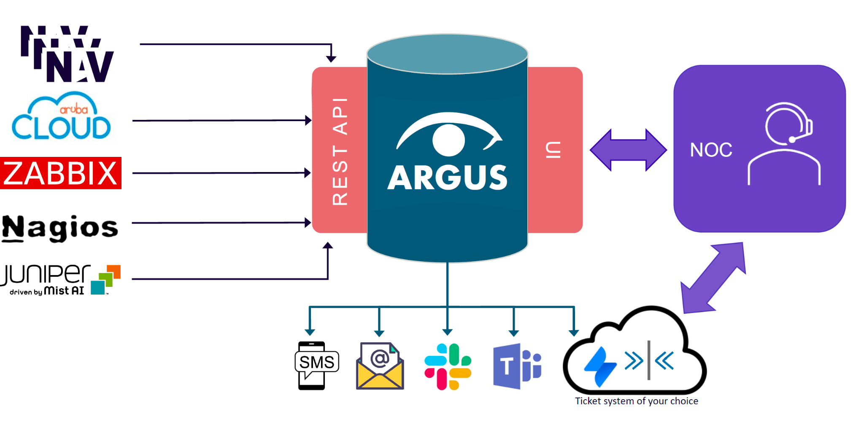
An alarm aggregation and correlation tool
A single unified dashboard and notification system for aggregated incidents from all monitoring applications
Based on the CNaaS use case
In production in Sikt and SUNET
A production service since Sept 2022
https://wiki.geant.org/display/netdev/argus

Slide 20
Network eAcademy
Network eAcademy
Powered by:
OAV Training
Terminology
OAV public wiki
CNaaS (use case)
Quantum Training
Architecture /Mapping
DTN (use case)
Maturity Model
Notes:
So, we are producing different resources around automation, grouped under the Network Automation eAcademy umbrella, that includes a training programme, a common terminology document, a reference functional architecture based on the TM Forum Open Digital Architecture, the study of use cases like Campus Network management as a Service and an OAV Maturity Model.

Slide 21
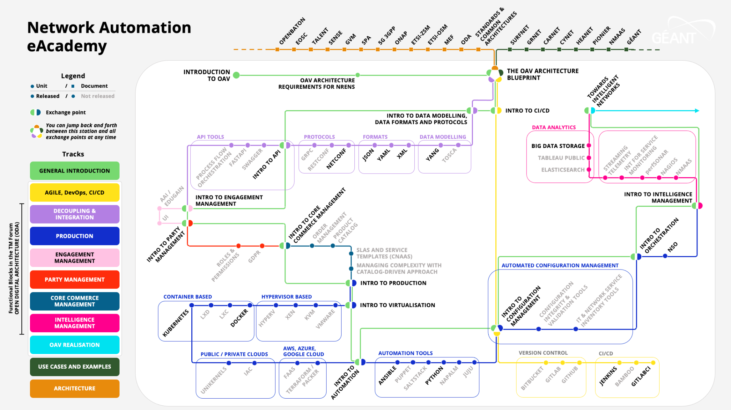
CC BY-NC-SA license
eduGAIN access (or social media)
https://wiki.geant.org/display/NETDEV/OAV+Training+Portal
Notes:
To make it easier to follow, we created an interactive metro map with the help of the Marcomms team in GÉANT, where each knowledege block is a line. So, you can follow the general introductory line, or more in-depth units, differenciated by colours and also following the functional blocks in ODA. There are round stations, that correspond to Moodle courses in the GÉANT Learning and Development platform, with presentations, videos with subtitles and quizzes, and square stations, that are links to documents and external resources.

Slide 22
Paul can we have an agenda slide?
NETDEV Incubator

Slide 23
NETDEV Incubator
A mechanism to include new work during the project
Simple proposal procedure following simple rules
A proposed project MUST be:
Relevant to the NETDEV project (GN5-1 WP6)
SMART: Specific, Measurable, Achievable, Resource- and Time-bound
With evident interest for the results from the community
https://wiki.geant.org/display/NETDEV/NETDEV+Incubator

Slide 24
More Information
NMaaS
Argus
TimeMap
Future events
21 June, Quantum Solutions, online
Contact details
netdev@lists.geant.org
https://wiki.geant.org/display/NETDEV/
WiFiMon
Performance Measurement Platform
perfSONAR
Inventory
Service Provider Architecture
Optical Time and Frequency Networks
RARE
GP4L
Network eAcademy
Quantum Technologies
TechLab
NETDEV Incubator

Slide 25
Thank You!
netdev@lists.geant.org

