Slide 1
Sciebo RDS
Reducing friction of FAIR data handling for researchers
Juri Hößelbarth, Richard Freitag
Underground A
6/6/2023

Slide 2
Who we are
Juri Hößelbarth
Software Developer @ University of Münster
Leading Task 4.2 @ CS3MESH4EOSC
hoesselbarth@uni-muenster.de
Richard Freitag
Project Manager for Sunet Drive
freitag@sunet.se

Slide 3
Glossary
EFSS: Enterprise Sync – and Share System
example: OwnCloud, Nextcloud
(Research Data) Repository: A publishing and/or archiving platform for (research) data
example: Zenodo, OSF, Figshare, …

Slide 4
Background
University of Münster
Major German University (44.585 students in 2022/23)
Runs the Sciebo Sync‘n‘Share service
Sciebo
OC10 based, federated Sync‘n‘Share
ca. 230.000 users across 40 universities
30GB per student, 500GB per employee,
30-2.000GB for project boxes
ca. 3,9 PB of total storage
Sunet – Swedish University Computer Network
Founded in the 1980s as a research project
for Swedish computer scientists
National and international data communication services
8400 km nationwide fiber, 750 000 users and
110 connected organisations.
SunetDrive
NC26 based, federated Sync‘n‘Share
Ca. 2000 users across 54 universities
2 PB available, ca. 170TB used, 0.5TB per day
(* The population of NRW is 16M vs. 10M in Sweden)
4

Slide 5
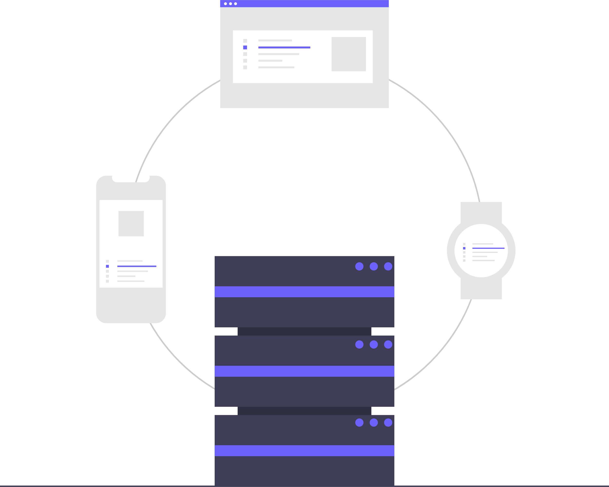
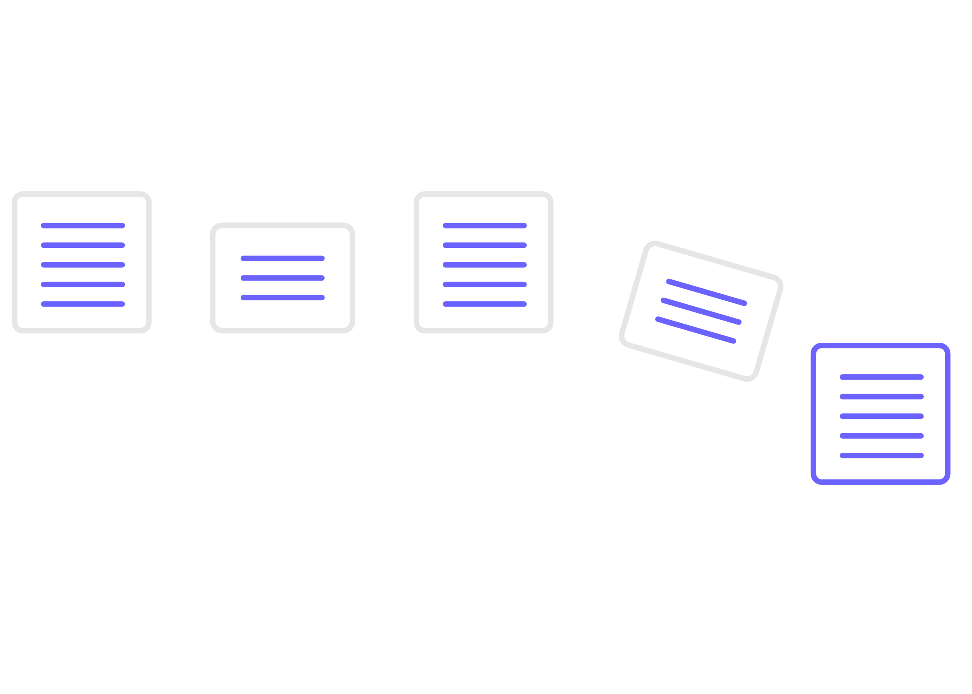
What we have
File Storage

Slide 6
What we want
FAIR Data
File Storage

Slide 7
Demo: Publishing from Sciebo (ownCloud)

Slide 8
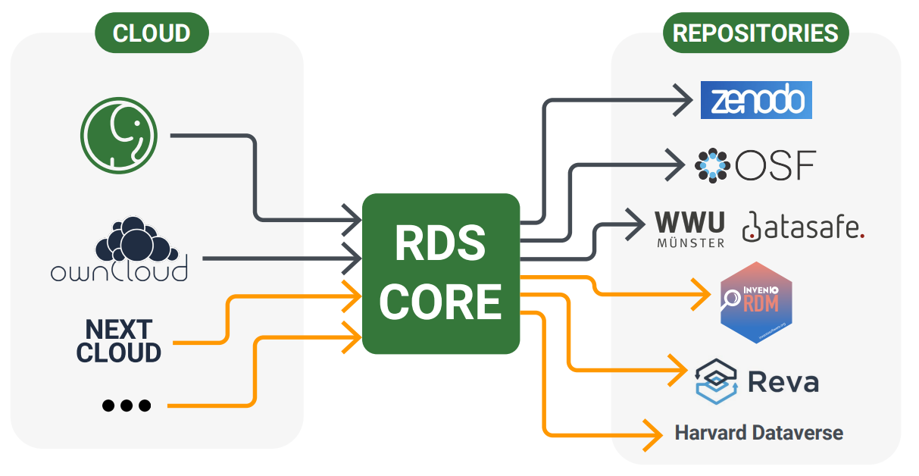
Sciebo RDS
Part of the
application catalogue
Compatibility layer between a host (EFSS) and research data repositories
Provides metadata annotation via describo, metadata stored as RO-Crate
Integration via native EFSS plugin system
Plugin acts as a wrapper around standalone RDS web app
Utilizing basic EFSS functionality like filepickers and oauth for user management
Each storage provider / repository is implemented as it‘s own microservice
Currently in „public alpha“
FigShare
iRods
Easily extendable for your EFSS by writing a native wrapper plugin
Easily extendable for your data repository by writing a microservices that maps to your API

Slide 9
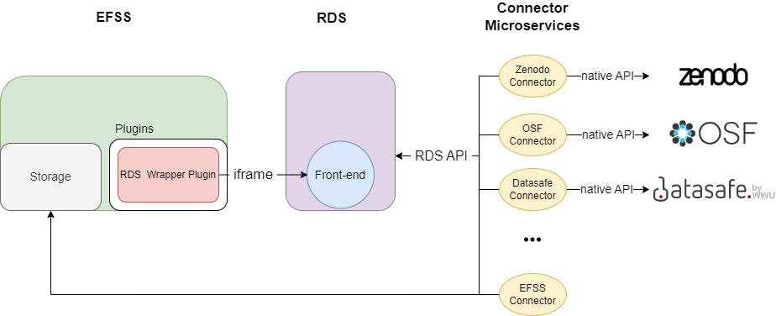
Schema
New EFSS?
New repository?

Slide 10
Development
Core Components developed at the University of Münster
RDS Core
Owncloud plugin
Connectors for Zenodo, OpenScienceFramework and WWU Datasafe
Adaption and extensions by Partners like Sunet, SND and SURF
Nextcloud port for the Owncloud plugin (Sunet)
Doris connector (SND)
Figshare, Harvard Dataverse and iRods connectors (SURF)
Everything openly available on Github
Sciebo RDS is Open Source – why not develop your own connector?! :-)

Slide 11
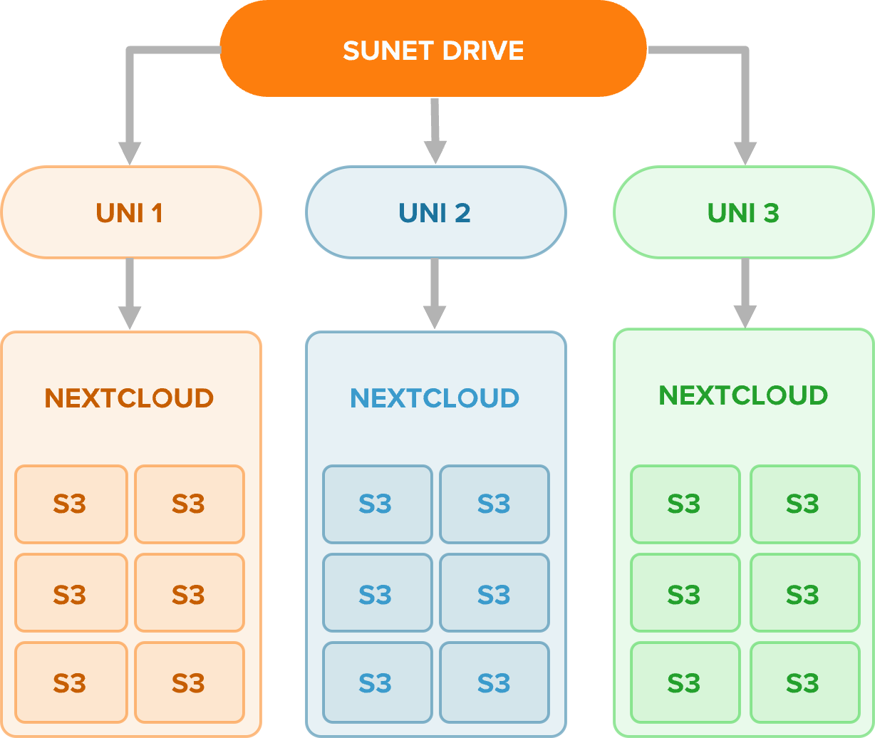
Sunet Drive
Federated file sharing
Co-management of nodes
Part of ScienceMesh
S3-bucket storage
Share data between nodes
Access ownership separation
Lifecycle managed buckets
Follow your data as a researcher

Slide 12
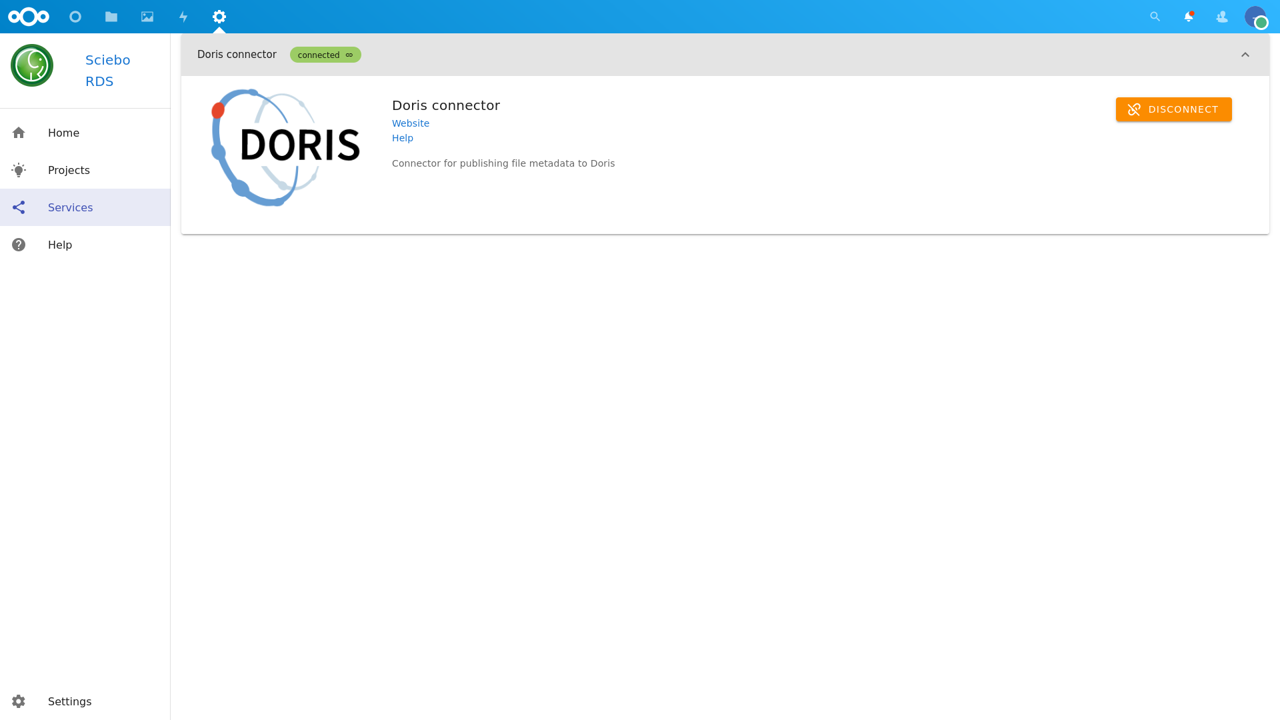
Porting Sciebo RDS to Nextcloud (Sunet Drive)
Sunet – RDS Infrastructure
WWU streamlined infrastructure setup
Prepare deployment using Sunet infrastructure
RDS App for Nextcloud
Initially only minor changes necessary
Nextcloud updates required further customizations
SND/Doris Connector
Define architecture and design within the context of both Doris and Sunet Drive
Specify integration into storage architecture (S3), ideally avoiding a dependency on Nextcloud
Deploy app to be used by reference users
Most components still require some development effort, but we are getting there!

Slide 13
Demo: Publishing from Sunet Drive (Nextcloud)

Slide 14
RDS - Planning and Rollout for Sunet Drive
Component | Description | Status | Planning
Sunet RDS App and Infrastructure | Sunet self-hosted RDS infrastructure | Test/Release Candidate | Test: Q2 - 2023 Production: Q2/Q3 - 2023
Sciebo-Connectors | Connectors developed by Sciebo development team | Test/Release Candidate | Test: Q2 - 2023 Production: Q2/Q3 - 2023
SURF-Connectors | Figshare, iRods, Harvard Dataverse | Under Develoment | Dependent on external development
SND-Connector | Connector for Doris | (Early) Development | Dependent on external development

Slide 15
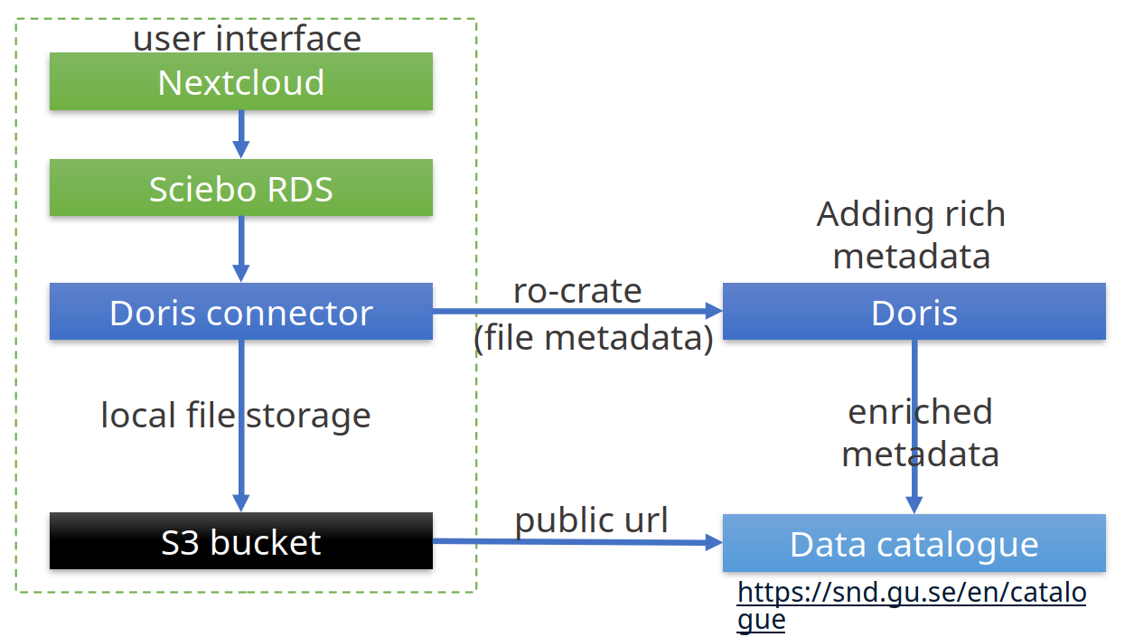
Swedish National Dataservice (SND)
DORIS
Status: (Early) Development)
Metadata management system
Cross discipline
Heavy use of controlled vocabularies
More information about sharing data via DORIS https://snd.gu.se/en/describe-and-share-data

Slide 16
Get in touch
www.research-data-services.org
gitter.im/Sciebo-RDS
github.com/Sciebo-RDS
sciebo.rds@uni-muenster.de
drive@sunet.se
Juri Hößelbarth
hoesselbarth@uni-muenster.de
Richard Freitag
freitag@sunet.se
Lennart Hofeditz
lennart.hofeditz@uni-potsdam.de

Slide 17
Thank you
Any questions?
hoesselbarth@uni-muenster.de
freitag@sunet.se

