Slide 1
eduroam - scaling K12 deployments in the US
Mike Zawacki - Internet2
Sara Jeanes - Internet2
Underground B
Thursday June 6, 2023

Slide 2
Agenda
Overview of the eduroam Support Organization (eSO) Program
Programmatic considerations
Technical considerations
What’s next?

Slide 3
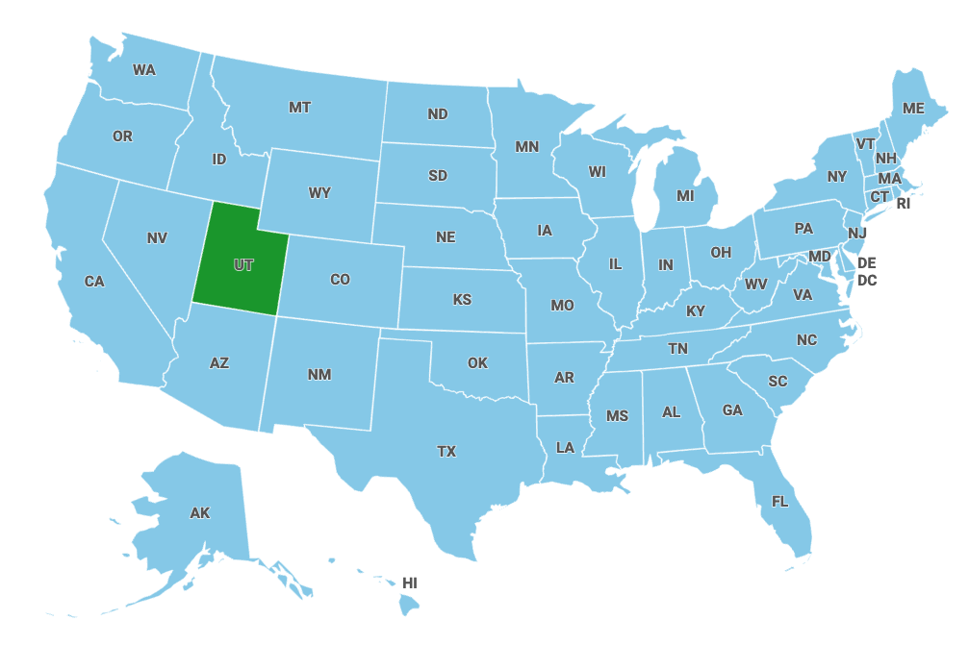
Overview of the eduroam Support Organization Program
How it started… (2019)

Slide 4
Overview of the eduroam Support Organization Program
2018: Utah Education and Telehealth Network (UETN) deploys eduroam at a handful of K12 schools, other non-HE locations around the state
2019: UETN approaches Internet2 about doing statewide deployments of K12. The eduroam Support Organization (eSO) pilot is launched
2020: Internet2 realizes a few things about eduroam and K12
Drives ubiquity, benefits the whole eduroam community
High crossover between populations of K12s and smaller higher eds
Participation of one segment increases value for the other
Internet2 can’t scale to all of K12 in all 50 states (+3 territories) -
We need partners, and all K12 participation needs to flow through that partnership
2020: The eSO program pilot begins, call for proposals goes out for a new cohort

Slide 5
Overview of the eduroam Support Organization Program
State-wide deployment of unlimited eduroam identity providers for K-12, museums, and libraries with SPs (“Hotspots”) anywhere.
Regional/state network, state department of education, or other organization serving K12s and other educational entities in a state or region
eSO signs one agreement, pays single fee for all K-12s, libraries, and museums in its state
Can add SP-Only “hotspots” in their state/region without cost
Takes on portions of service delivery
First level eduroam support to their constituents
Assist constituents in provisioning eduroam
Manages any contracting or invoicing of its constituents
Only one eduroam Support Organization per state

Slide 6
Overview of the eduroam Support Organization Program
2021: ConnectEd Nebraska, The Sun Corridor Network join the eSO program. Successful year is had by all! Program adjusted, On-Ramp added
“Try before you buy”
Allows On-Ramper to set up processes and relationships needed to succeed as a full eSO
2022: First On-Rampers - Link Oregon, Connecticut Education Network (CEN)
2023: Link Oregon becomes full eSO (CEN is pending). Two new state networks join as On-Rampers (announcement pending)

Slide 7
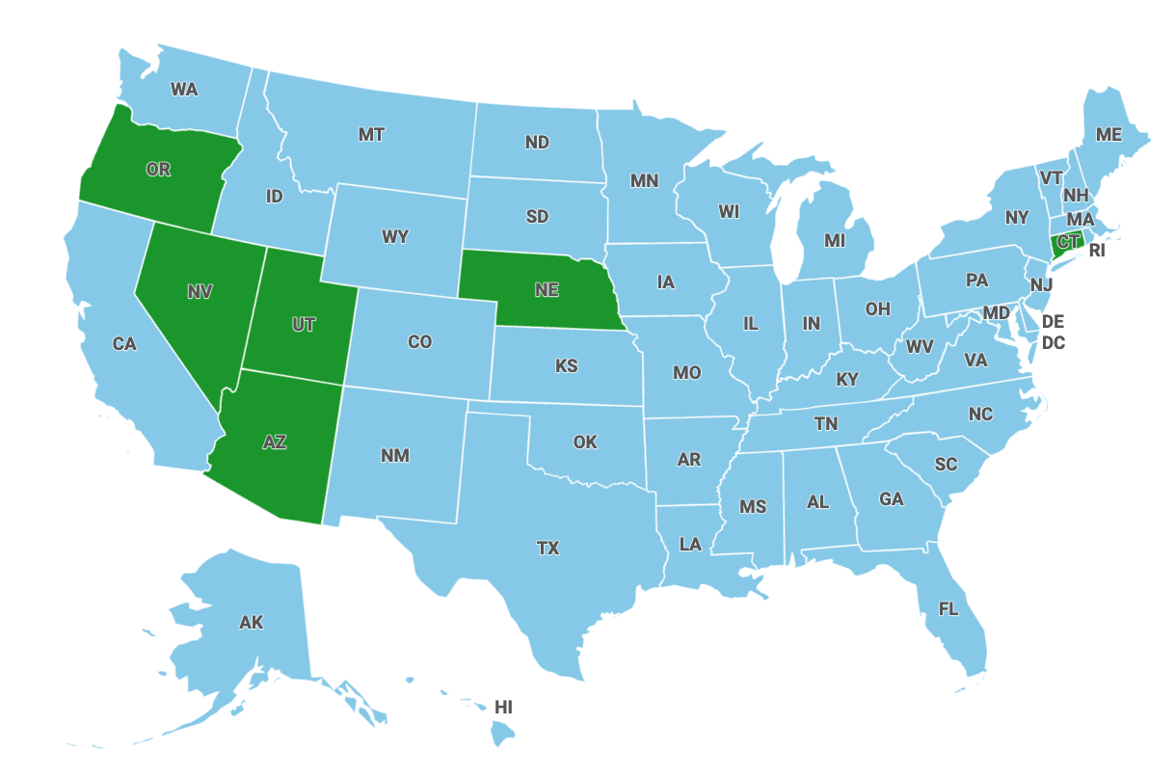
Overview of the eduroam Support Organization Program
How it’s going… (2023)
+1 more state!
(announcement pending…)

Slide 8
Overview of the eduroam Support Organization Program
Important numbers from the 2022 cohort
Growth in K12 deployments:
280 K12 constituents active in 2022
Total eSO deployed/sponsored hotspots:
63 hotspot constituents active in 2022
eduroam Support Organization student devices connected:
16,616 student devices connected to eduroam hotspots outside their districts in 2022
Actual student authentications much higher - only external authentications are visible
Guests supported by eduroam Support Organization constituents:
212,433 visiting devices connected through eduroam Support Organizations in 2022

Slide 9
Programmatic considerations - make it scale
Under the current model Internet2 does not serve K12s directly
K12 inquiries are directed to their eSO
In states with no eSO, directed to their state/Regional network
eduroam team has been more active in US K12 community, presenting at conferences
Existing K12s are grandfathered in
Need to ensure a uniform approach to support and service delivery
Annual training offered to eSO staff and constituents
Empower the community, reduce need for technical escalation
Regular coordination calls with eSO staff
Monthly updates with eduroam US community

Slide 10
Programmatic considerations - make it scale
Every eSO is different
Different funding models, what sorts of organizations they serve
Size, maturity of eSO
Composition of eSO (one organization? Many organizations working together?)
Model of support (e.g. central operations center or consortium of school district staff)
Program needs to accommodate a variety of organizational models, approaches to support
We’ve encouraged eSO community to work collaboratively, share experiences and resources
Legal agreements
Best practices
Troubleshooting
Engagement with local, regional, and national ISPs (more on that later…)

Slide 11
Programmatic challenges and opportunities -
Adoption within student populations has been slow.
Concerns around student privacy/safety regulations and risks to funding
Frequent approach is to enable eduroam only on school issued, managed devices
Citing existing student deployments helps!
Develop logo locked info/marketing materials for eSOs
Many eSOs have limited/no staff for developing materials
Avoids duplication of effort by eSOs, Internet2
Getting designs pre-approved by GÉANT saves time (and reduces work for GÉANT!)
Ensures consistent branding, messaging

Slide 12
Programmatic challenges and opportunities -
Need to continue to grow repository of technical documentation
Creating info resources, collecting and curating existing documentation
eSOs are big on self service for their communities
Benefits eduroam community at large
Creating contracting, fee structure for working with commercial Internet Service Providers (ISP)
Encourage broader availability of eduroam in public spaces
Help eSOs to more productively engage with the network providers in their states/regions
Good contracting and business models keep eduroam sustainable
Public SPs/hotspots and potential for deployment in residential areas

Slide 13
Technical considerations - keep it running
Changes to the management interface
Create a “middle layer” management interface for eSO admins
Gives eSO admin the ability to view, change configurations for only their constituents
New style of reports needed - one for the eSO themselves and a roll-up report of all their constituent organizations
eSO administrators tend to find (and create) corner cases
Unique needs, unique scale
eSOs will be drivers for possible infrastructure changes
Changes to RADIUS infrastructure model
Automation of map data, other service aspects

Slide 14
Technical considerations - keep it running
The eduroam US infrastructure has kept pace, even during unusual bursts of traffic (so far)
Real world example: ConnectEd Nebraska turned up eduroam for a major educational conference, enabled 120,000+ authentications in one day with no impact
123k authentication requests

Slide 15
Technical challenges and opportunities -
Deployment of SPs/hotspots in residential areas via ISP partnerships
Legal, privacy considerations must be addressed
Method to automate entry of service locations to keep work scalable
Encourage efforts like the eduroam2go project
Community sourced effort to repurpose network gear and open source software into “plug and play” SPs
Could be a model for community outside of the eSOs
Metro or regional RADIUS proxies
ISPs could serves as metro level RADIUS aggregator for their customers
eSOs might stand up regional proxies to speed authentications, reduce load on national proxies
User onboarding can be a challenge
CAT adoption picking up speed with eSO populations, but still slow

Slide 16
What’s next?
Continue to grow the program, encourage adoption by more states
Look for ways to enable participation by state networks with smaller staff
Consider ways work more closely with community colleges, technical colleges, other Higher Education institutions with high adjacency to K12s
Student teachers, K12 students taking advanced placement classes, K12 faculty taking continuing education courses at community colleges, others
Develop automation for the administrative interface to accommodate residential and public deployments of SPs/hotspots by commercial ISPs. Address privacy concerns
Investigate community development of user onboarding, guest user services
US eduroam Advisory Committee has developed requirements for both
More informational and promotional resources for the eSO (and eduroam US!) community

Slide 17
Thank you
Any questions?
mzawacki@internet2.edu
sjeanes@internet2.edu

Slide 18
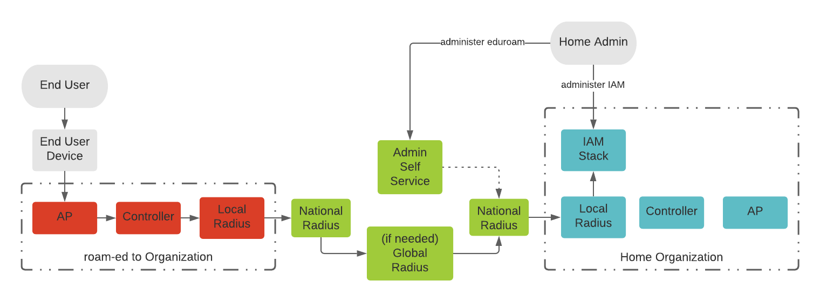
Technical considerations - keep it running
eduroam Support Organization Admin

