Slide 1
geteduroam
Paul Dekkers
Tirana
June 6, 2023

Slide 2
geteduroam Goals
Help users to easily and securely connect to eduroam*
Simple, single, unified Apps for all end-users and institutions, improving usability and security
Server software to issue client certificates / pseudo-accounts
* And other networks, like OpenRoaming™️ as eduroam user, or govroam

Slide 3
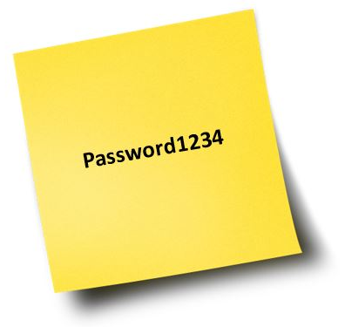
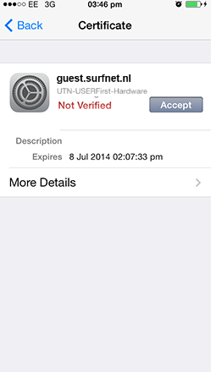
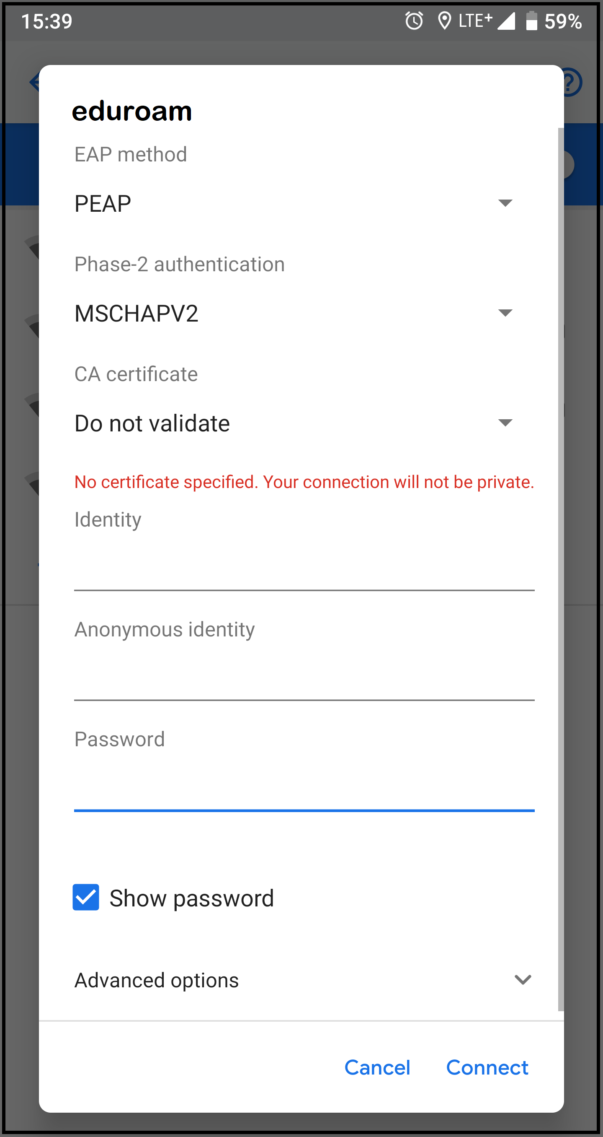
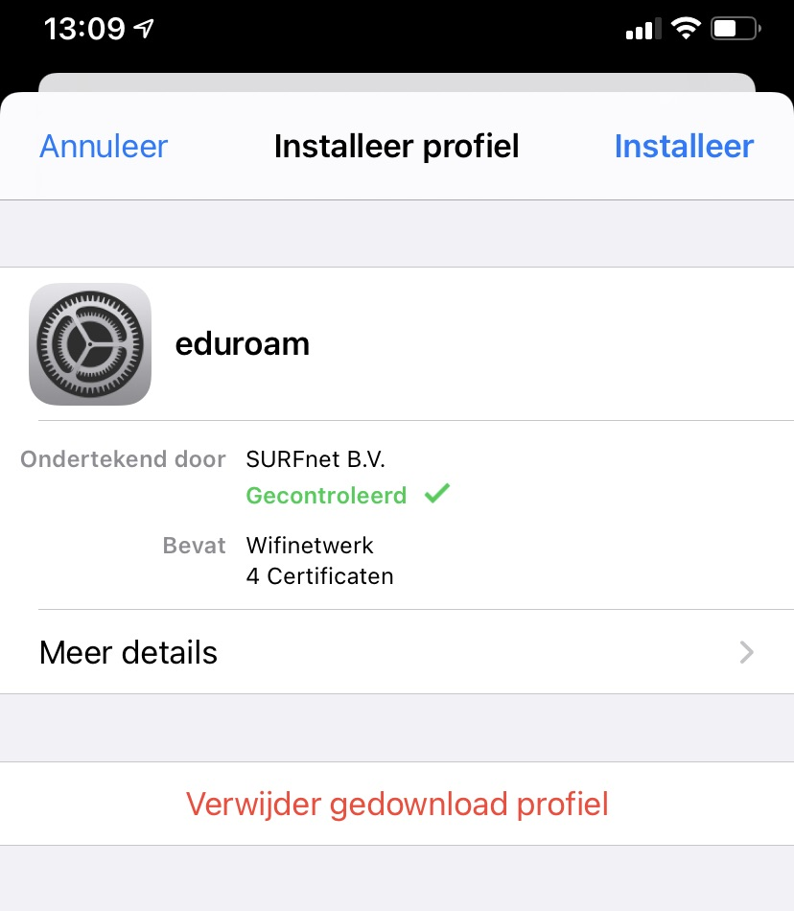
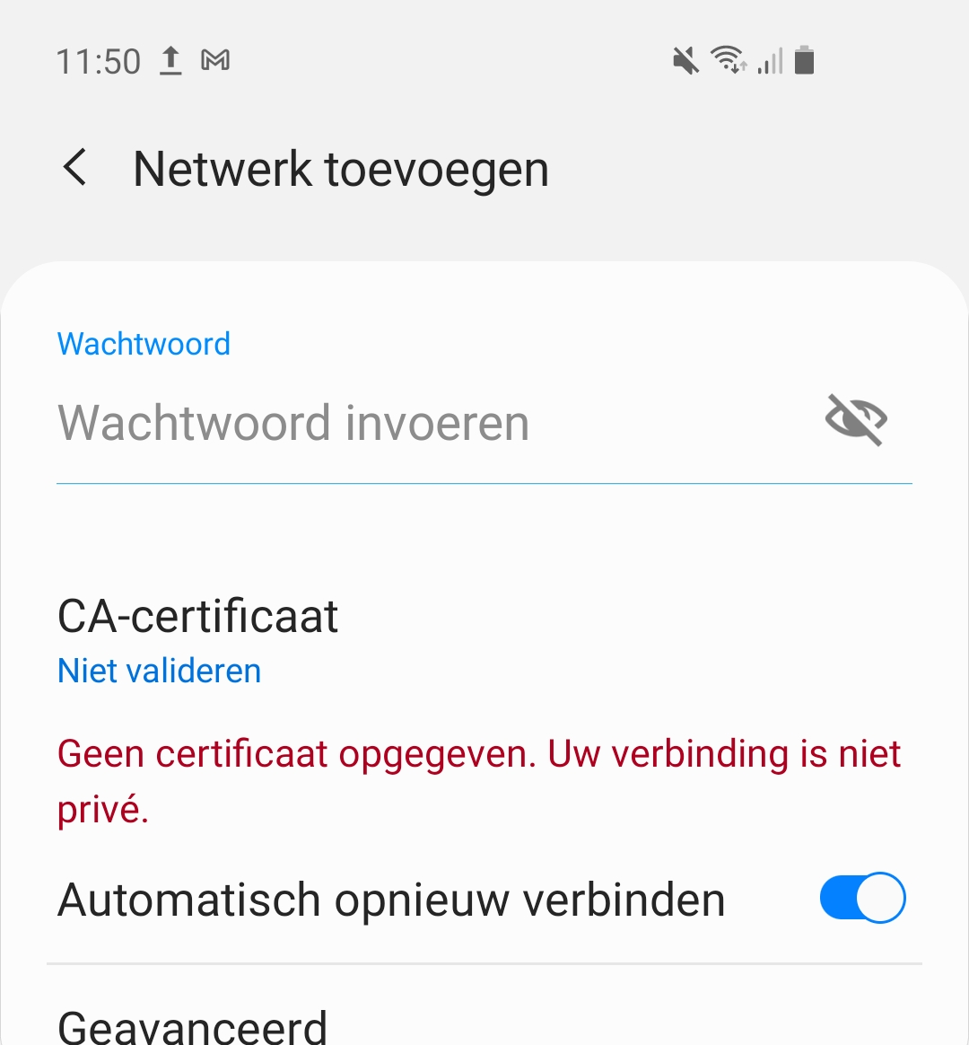
manually configuring eduroam* is not 2023
Need mutual authentication
Properly set username, realm, EAP-type, … error prone
Want to go passwordless
Can’t manually add Passpoint networks
…
* or any other Enterprise Wi-Fi

Slide 4
The geteduroam project
Interesting, challenging and relevant
Pandemic
People working on it, internal and external changes
Changing landscape (ie. Android policy changes)
eduroam is huge, diverse, it’s hard to please everyone
Diversity in IdP settings (cause of bad App reviews…)
Try to consider the need/desires of everyone
Regions, NROs, institutions
Do very very careful testing
To be bug-free
Usability testing
A lot of communication

Slide 5
Role of geteduroam Commons Conservancy board
geteduroam established as Commons Conservancy project
Open governance model, shared legal infra
Similar community projects, such as eduVPN, SimpleSAMLphp, FileSender, IdentityPython
Allows anyone to contribute, donate
Funding so far
NORDUnet
GÉANT
SURF
Stichting govroam NL
… you? ;-)
Fund and coordinate development, maintenance and roadmap of Apps, software

Slide 6
The geteduroam project, technical aspects
Relies on eduroam CAT portal for institution profiles, discovery
Creating Apps is really challenging
Android is a very very very diverse ecosystem
API deprecations causing a vacuum, example: Android 10
Bugs, example: iOS 15
Limited APIs, example: ChromeOS, macOS
Development and maintenance takes a LOT of time
New apps under development for 1.5y, still needs a lot of testing
Announcement of geteduroam Apps to community came 2y before publication, still some people were surprised
Creating software is one, supporting it is another

Slide 7
(Hosted) Pseudo accounts
The geteduroam clients configure mutual authentication, so even username/passwords are secure when configured via the Apps
But client-certificates offer the best security
Issue client-certificates as ‘pseudo accounts’ derived from (web, federated) authentication
Anything! eduGAIN, Shibboleth, SimpleSAMLphp, ADFS, Azure AD, Google Workspaces, …
MFA
Auth process familiar to end-users
Client certificates have a limited lifespan; clients warn users
High success-rate in authentications

Slide 8
(Hosted) Pseudo accounts
Single purpose profiles/certificates: just eduroam
Passwordless, no password change policies
However: need reauthentication/reissue
Authorization is local, even if NRO or eduroam provides hosted geteduroam IdP (APs or local RADIUS can assign VLANs)
Even on eg. affiliation: i3diflzrhn1xu4o5@student.institution.geteduroam.nl
Security settings don’t allow to be non-traceable

Slide 9
geteduroam components

Slide 10
geteduroam components and maintenance contracts

Slide 11
geteduroam regional IdP authentication servers
Like a global CDN, authentication close to the user
Example: EU user visiting South-Africa, fast local authentication
… then we found out about non-blocking issues with dynamic peer discovery

Slide 12
Some numbers
255 eduroam + 63 govroam organizations published in discovery
72 NL + 22 International via eduroam OT
38510 distinct users (mid may)
113647 pseudo accounts (renewals, multiple devices)
~300k authentications daily
Several standalone deployments, institutions, NROs, something in ~16% of countries 🇳🇱 🇨🇭 🇫🇮 🇪🇸 🇿🇦 🇩🇪 🇭🇺 🇱🇺 🇬🇷 🇫🇷 🇩🇰 🇸🇪 🇳🇴 🇯🇵 🇲🇾 🇮🇹 🇨🇦 Malaysia has 126 institutions with pseudo-accounts!

Slide 13
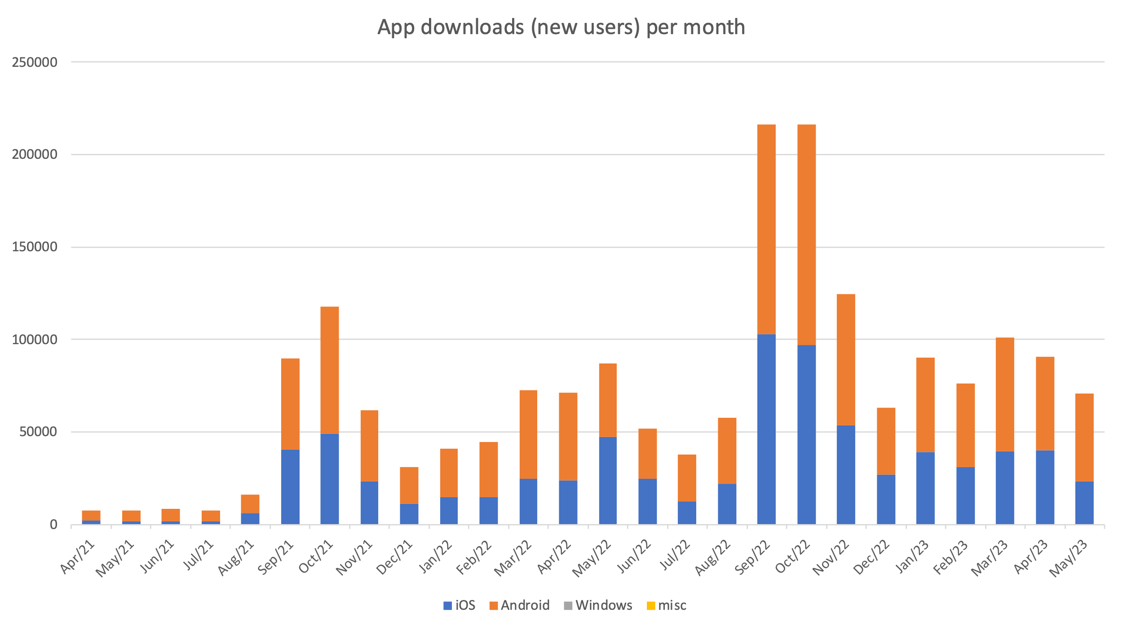
Start of academic year

Slide 14
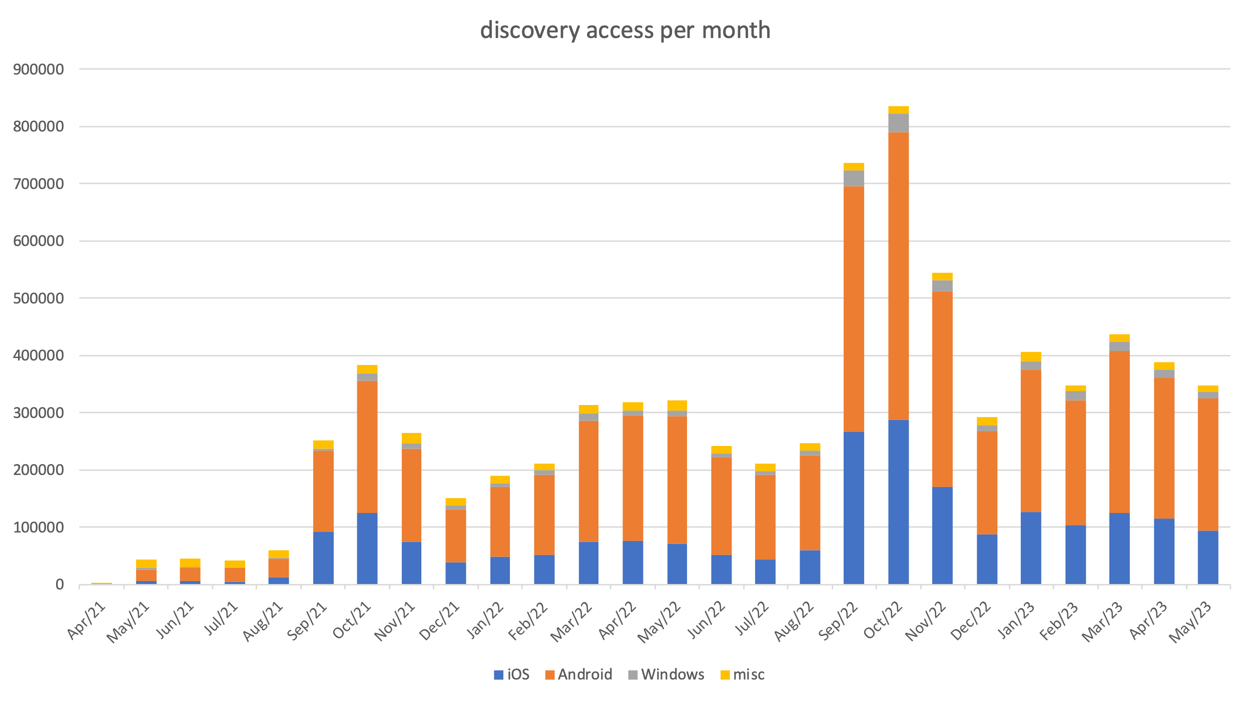

Slide 15
Measurement of success
Not performing telemetry or anything privacy intrusive
Institutions claim the burden on the helpdesk is reduced, fewer configuration mistakes
Pseudo-accounts get a near 100% authentication success-rate
“I believe that geteduroam reduces the number of support calls, both during onboarding and in incidents. One indication of this is the rapid adoption of geteduroam by our helpdesk colleagues, which was not the case with previous installers. I have no evidence to suggest that we are setting the bar too high with geteduroam or that it would result in a shift to mobile data. In summary, I have a very positive impression, and the fact that you have incorporated privacy by design also contributes to this.” – C. Houthuijs, Vonk

Slide 16
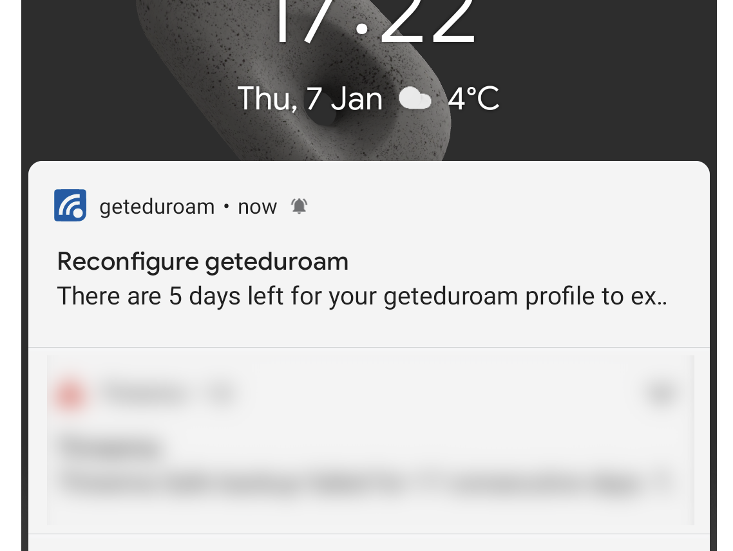
App workflow
Mobile browser for web/pseudo-accounts

Slide 17
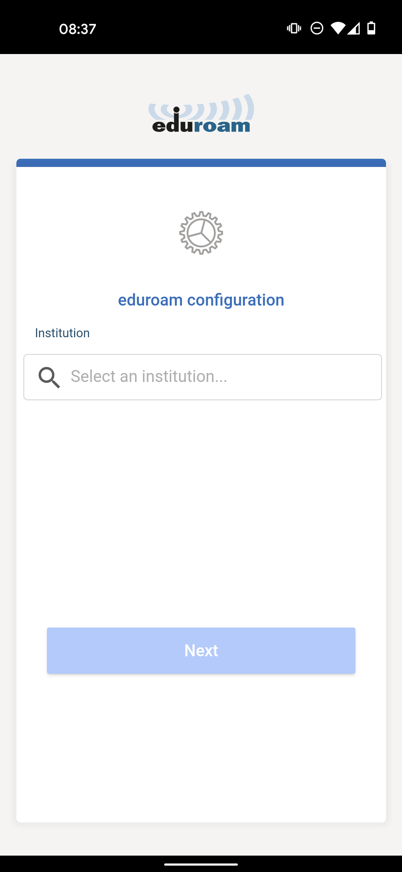
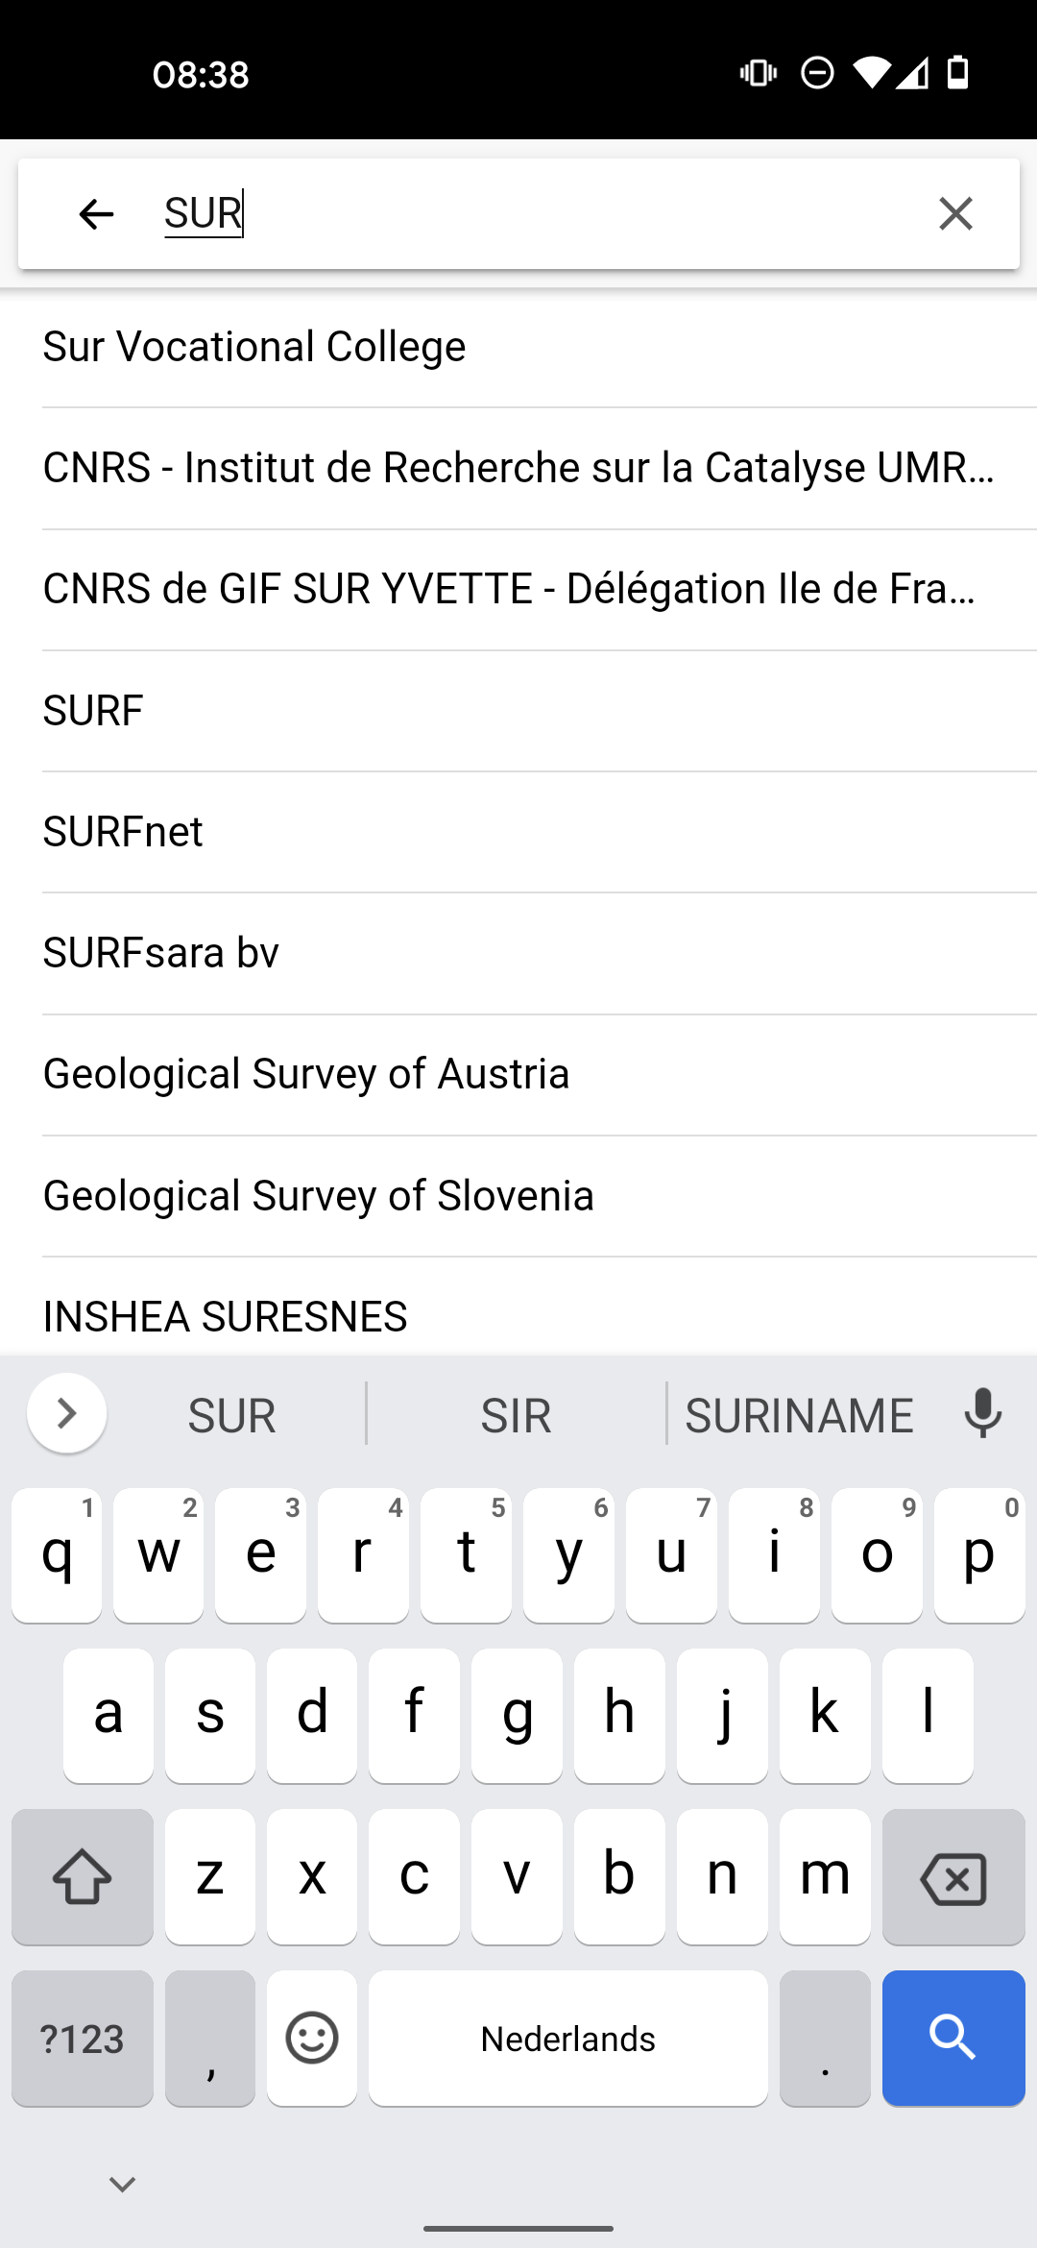
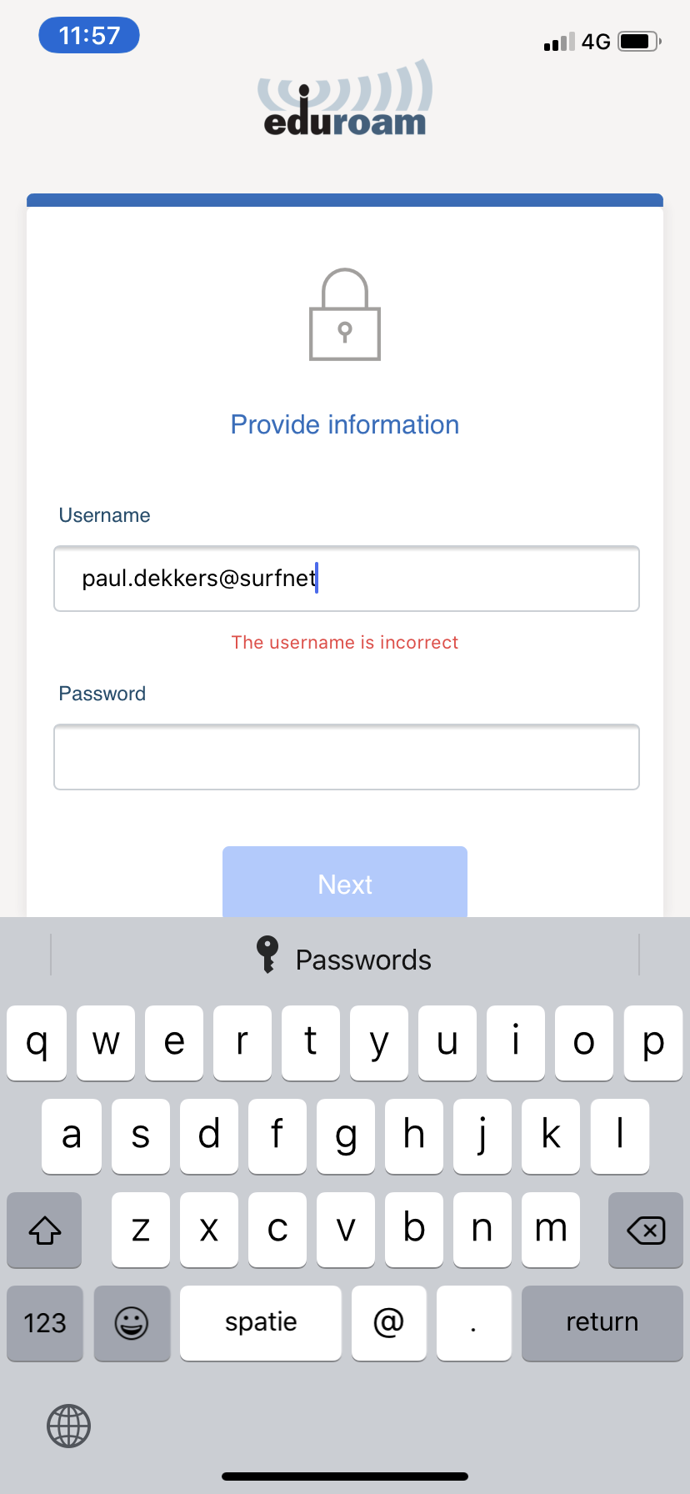
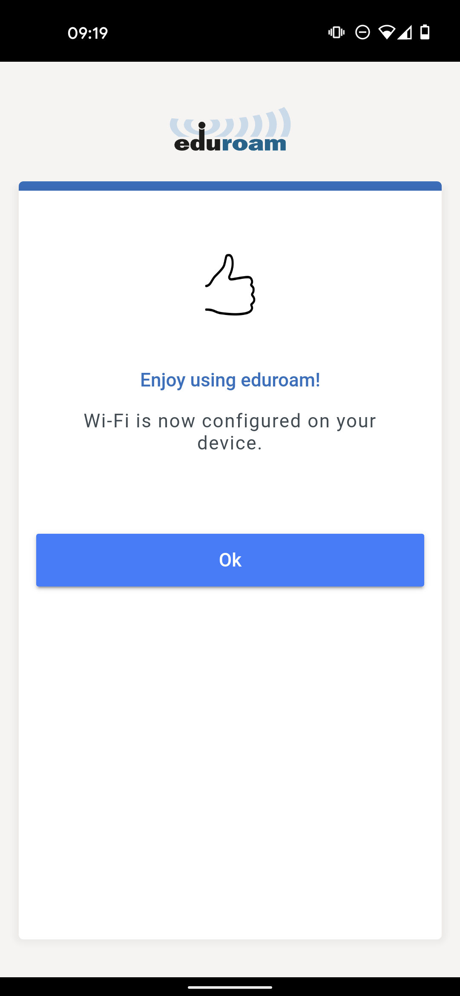
App workflow, regular accounts
Input validation

Slide 18
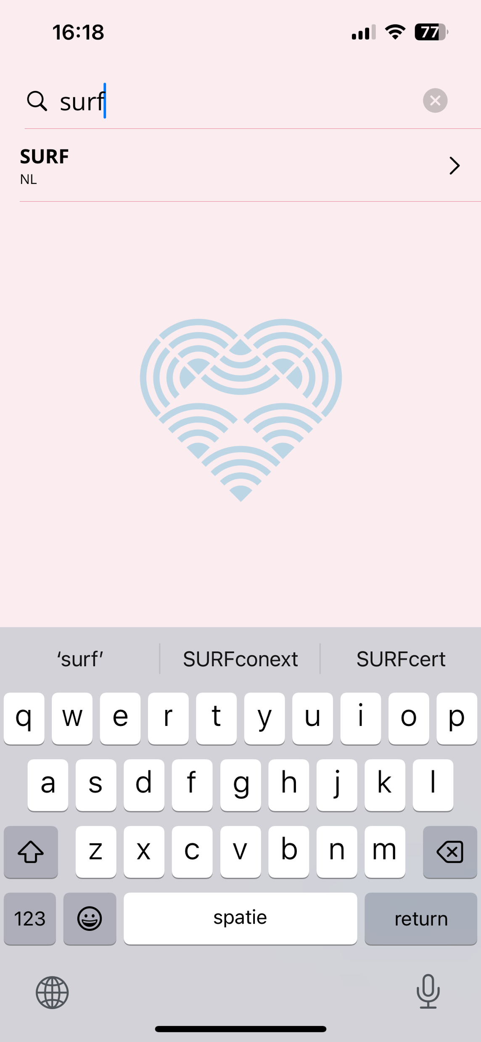
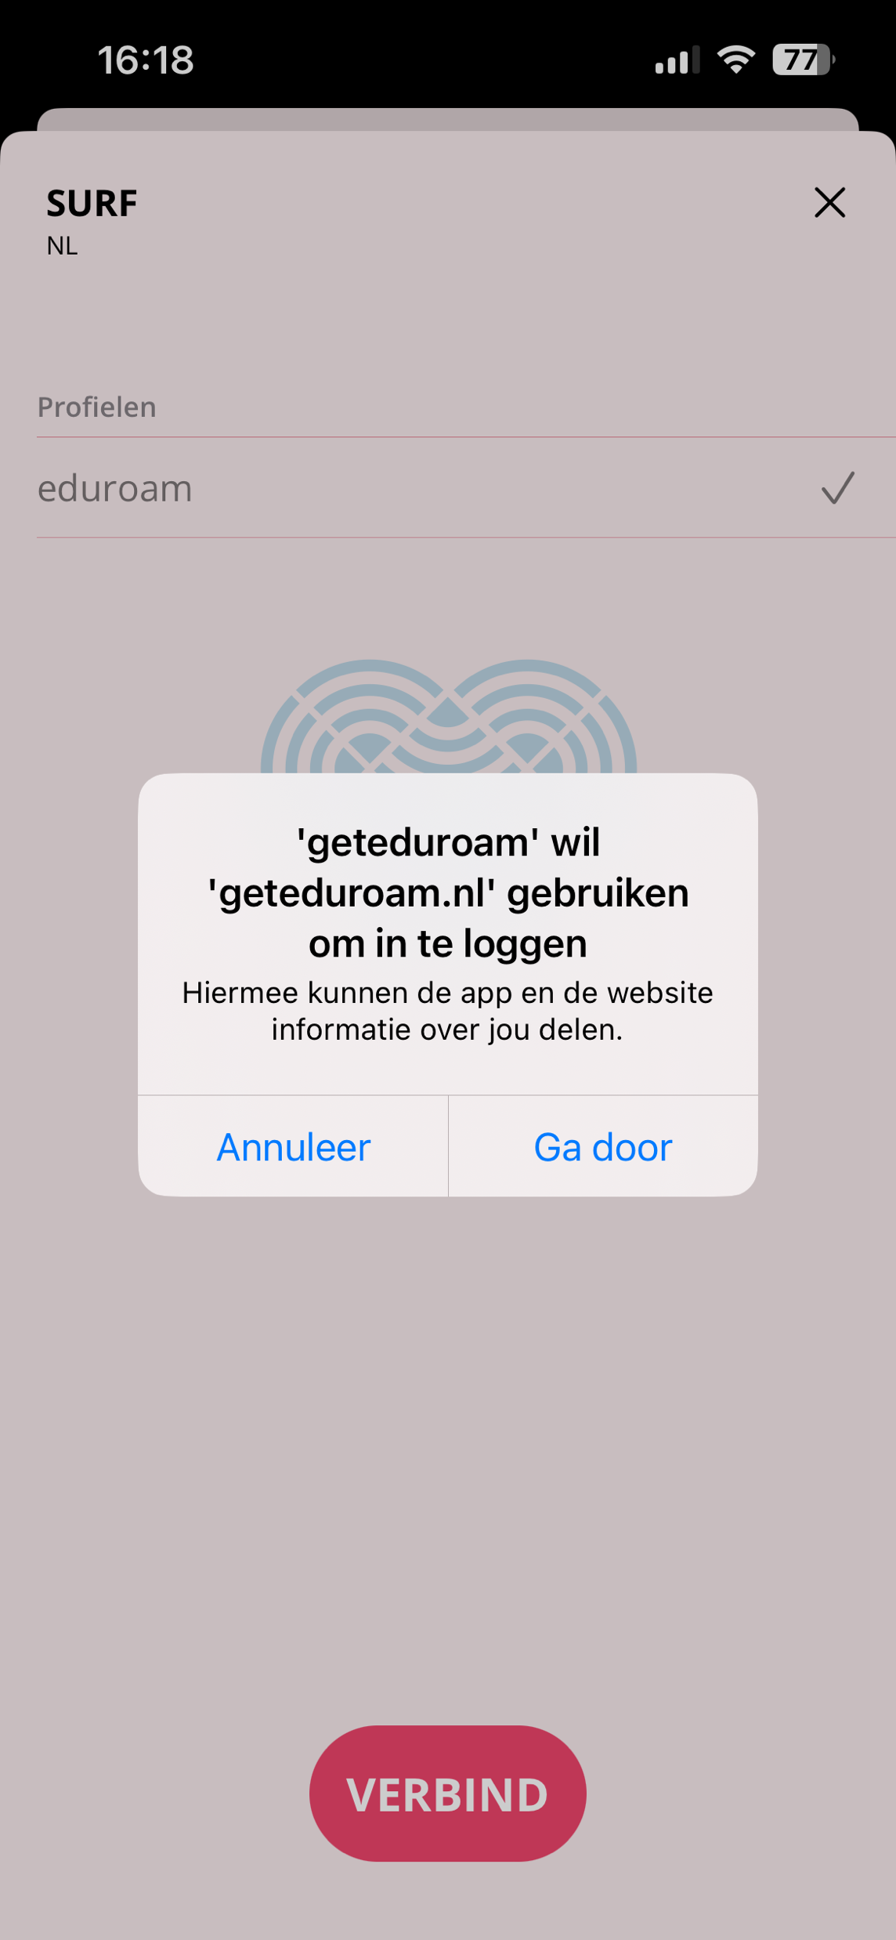
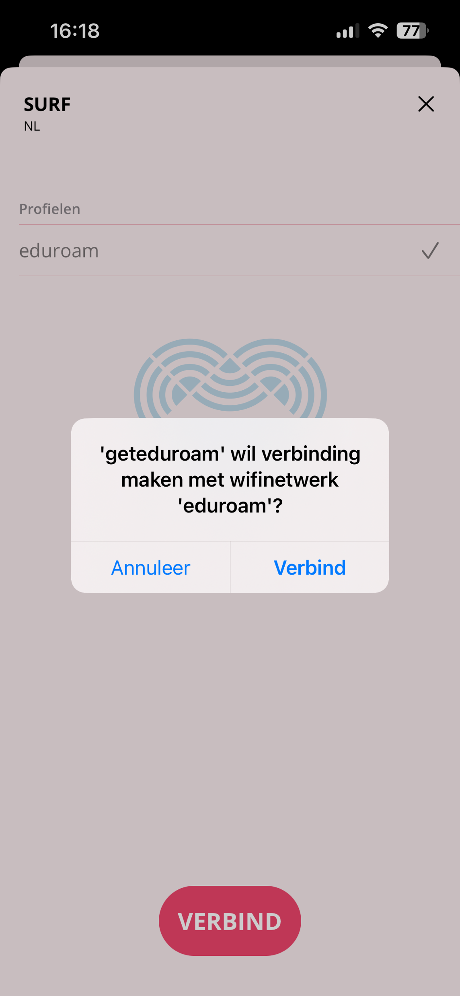
new App (Test) versions, iOS & macOS
Dark mode

Slide 19
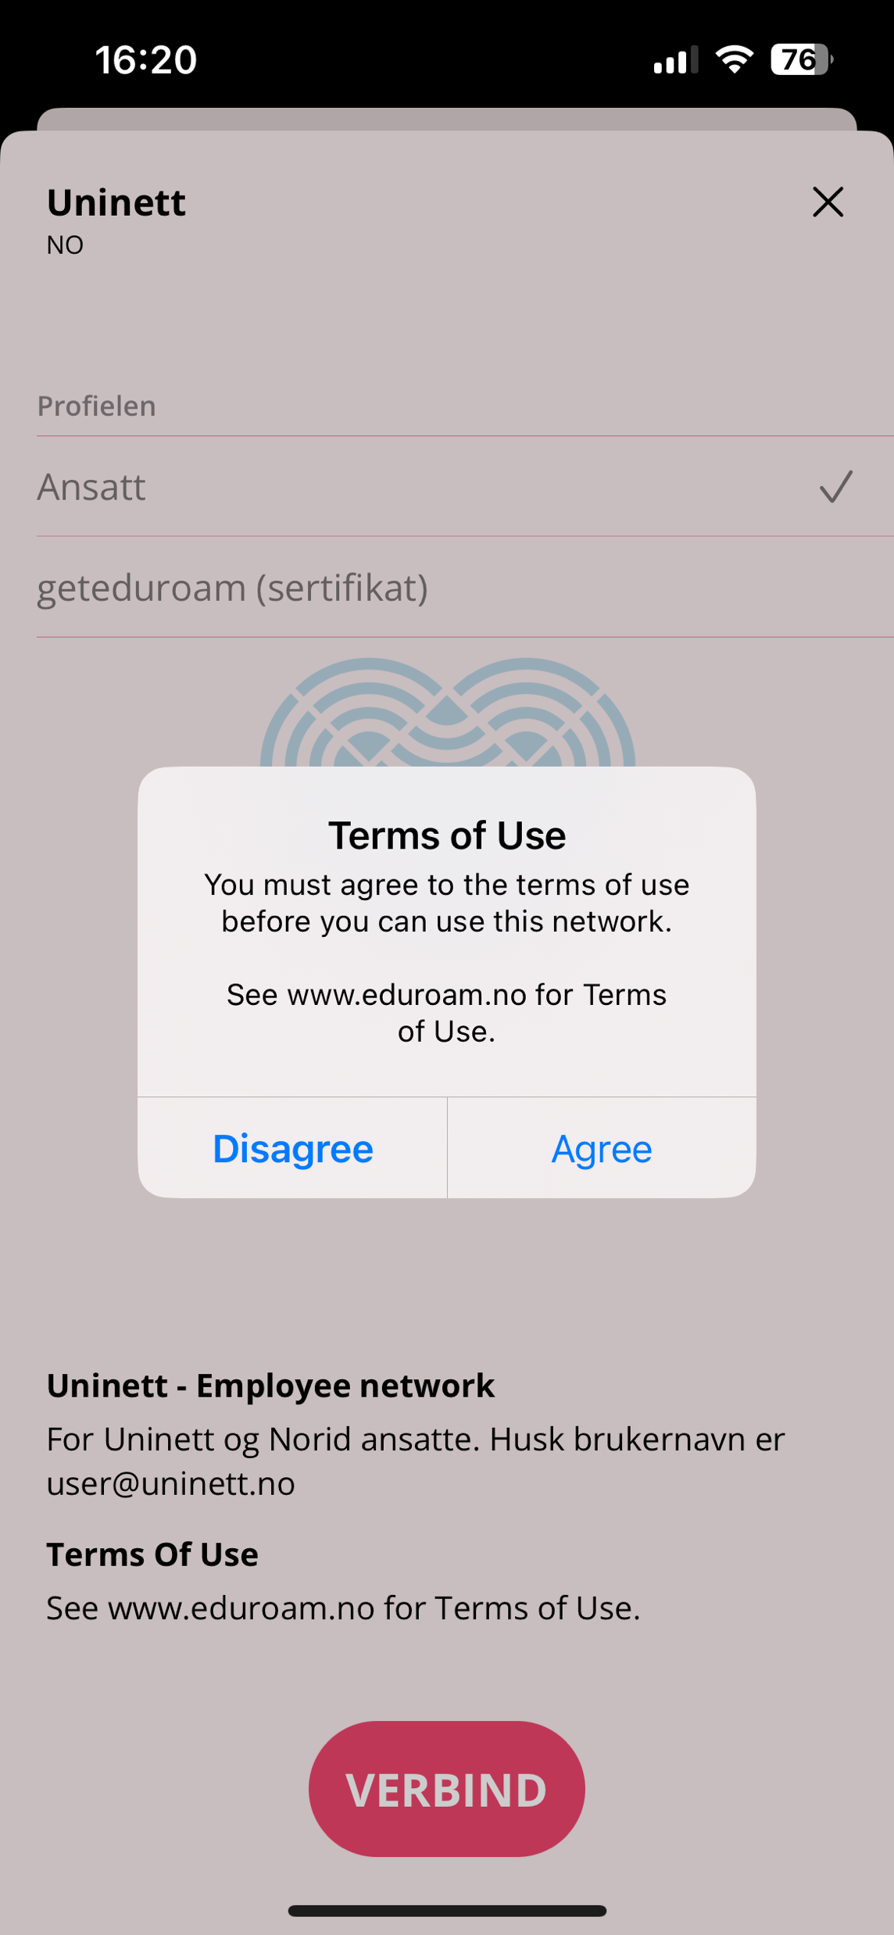
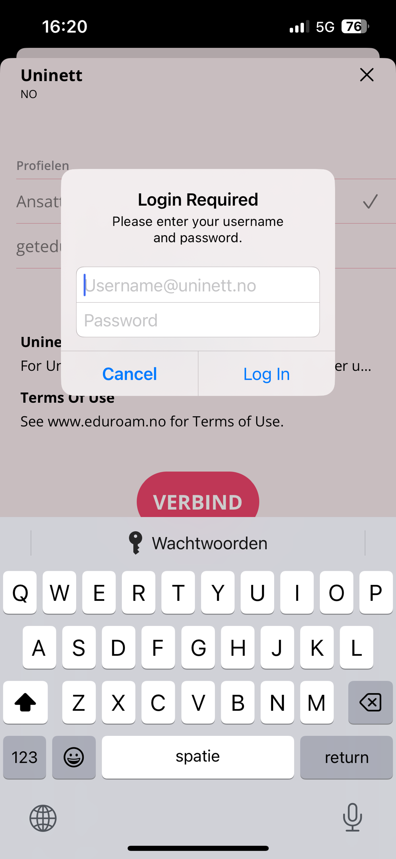
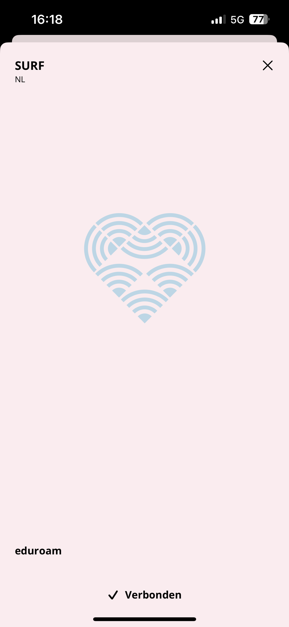
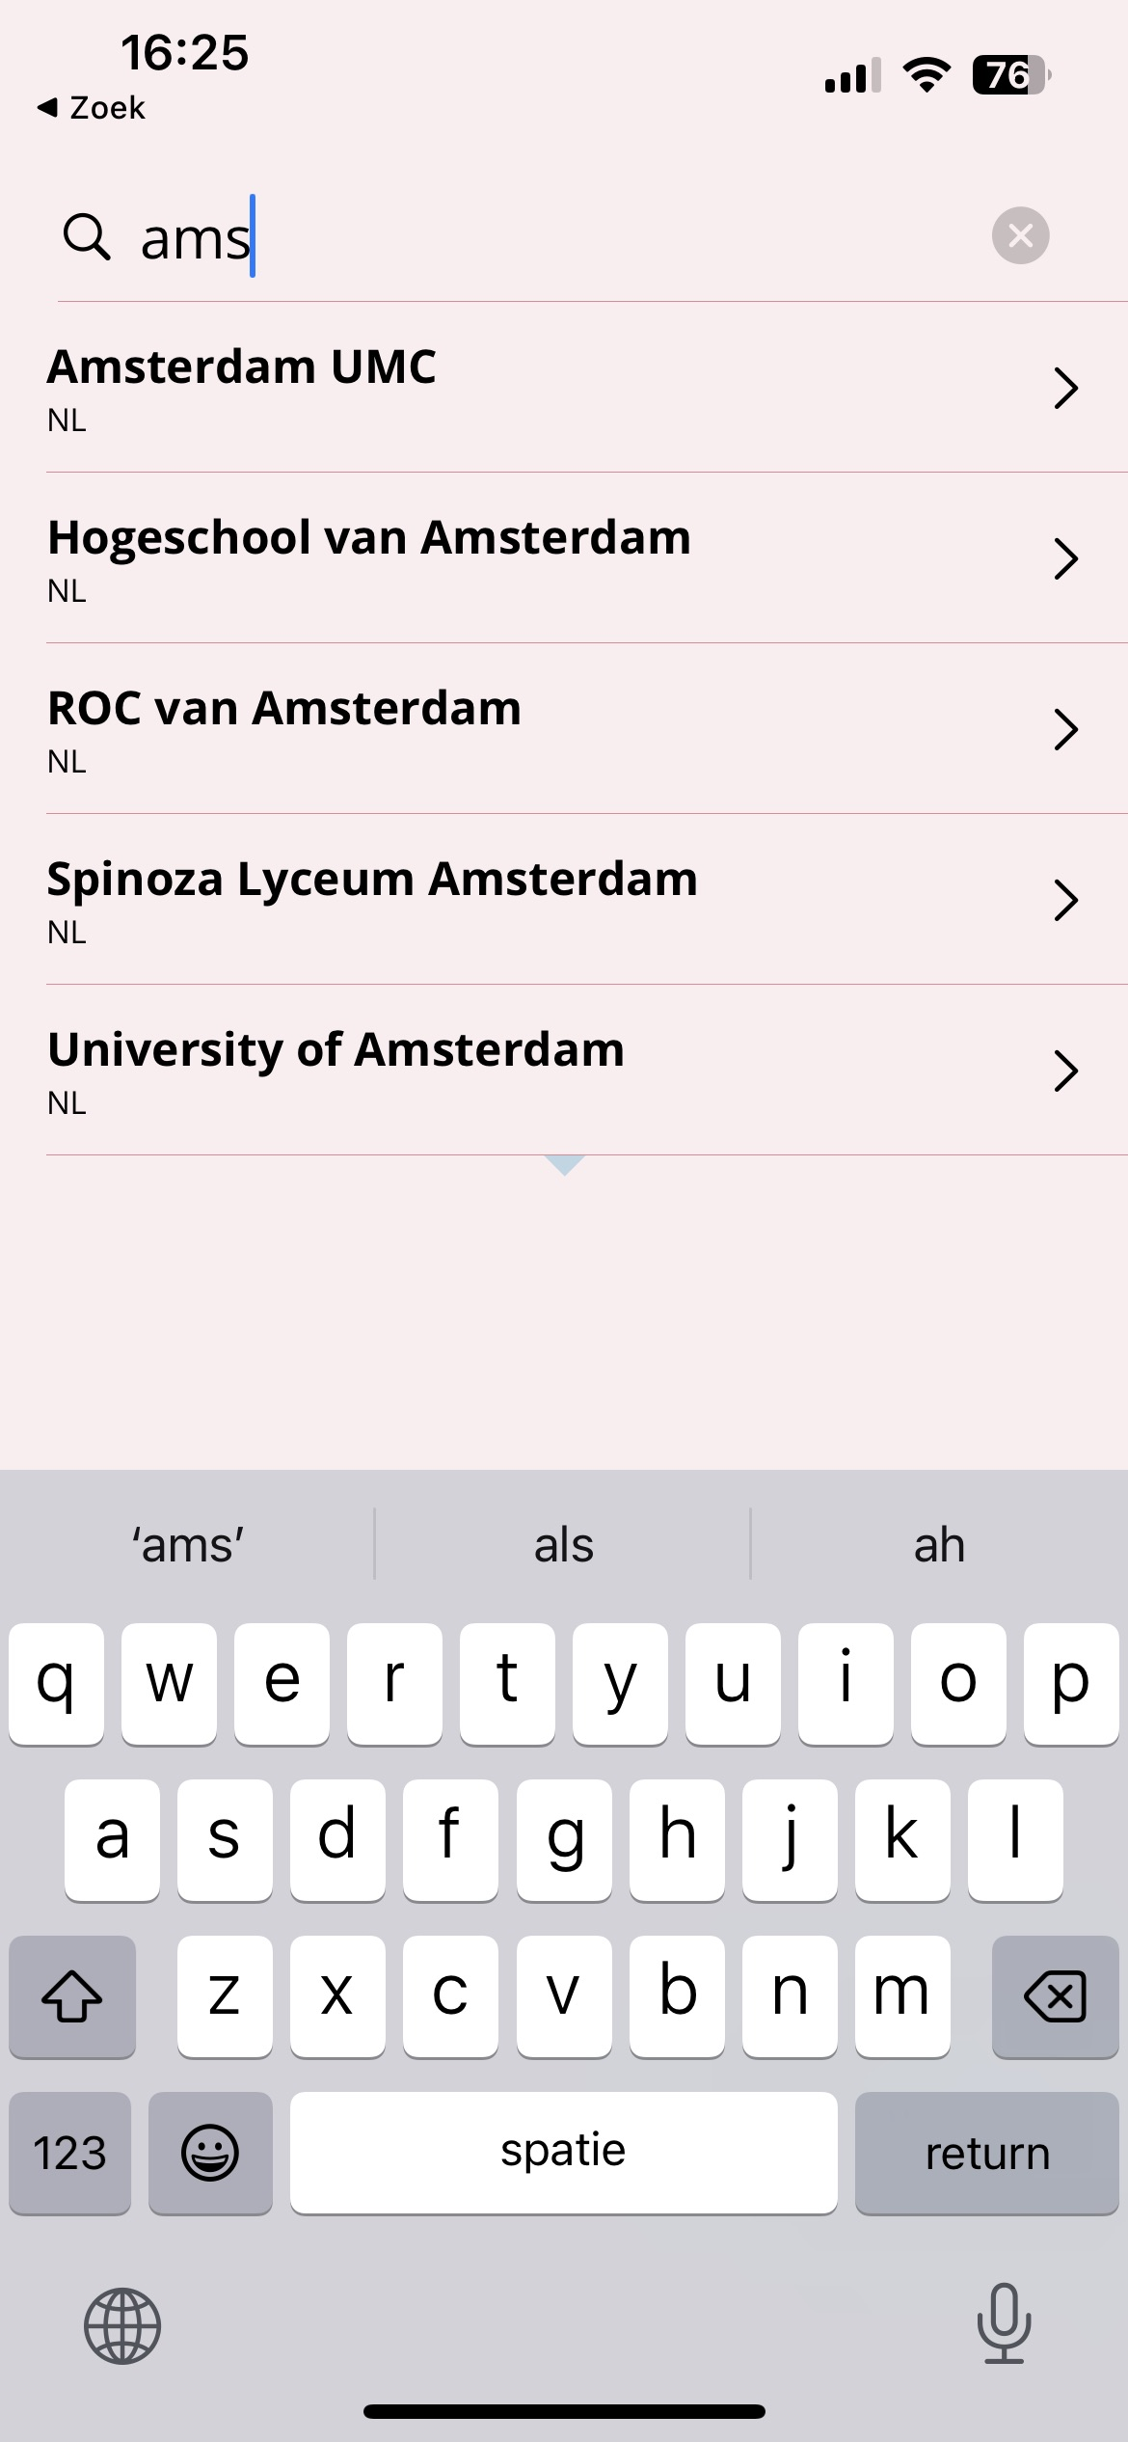
new App (Test) versions, iOS & macOS
discovery
ToS
Passwords

Slide 20
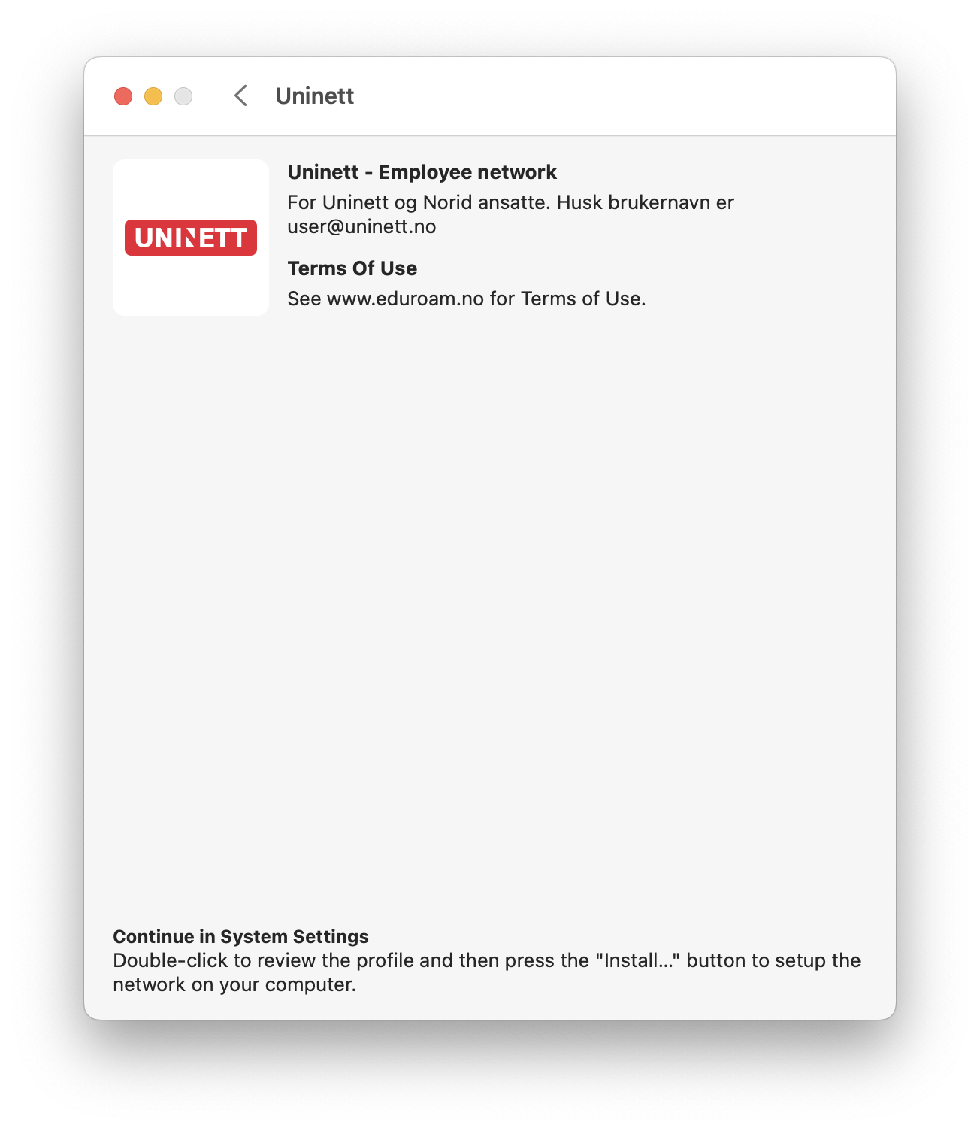
new App (Test) versions, iOS & macOS

Slide 21
new App (Test) versions, iOS & macOS

Slide 22
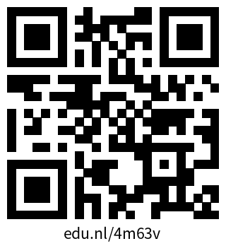
One More Thing: new App (Test) versions, iOS & macOS
iOS & macOS TestFlight
Feedback? testflight@eduroam.org

Slide 23
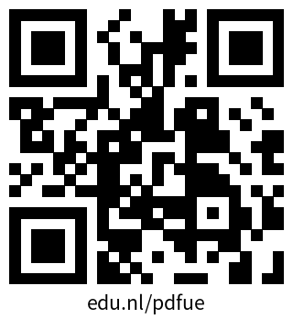
Linux client, Incubator project
Linux CLI
Feedback? feedback@eduroam.org

Slide 24
Admin portal

Slide 25
Future
Continous, sustainable development and maintenance for
Apps
Android
iOS
macOS
Linux
Windows
Server-side, features, ease installation
CA portal
Admin portal
Documentation
Hosted service, integration
Investigate support/demand for
managed devices, eg. via SCEP
new platforms (ChromeOS)
…

Slide 26
Thank you
Any questions?
www.geteduroam.app
Paul.Dekkers@surf.nl

