Slide 1

jjjjjjjjjjjjjjjjjjjjjjjjjjjjjjjjjjjjjjjjjjjjjjjjjjjjjjjjjjjjjjjjjjjjjjjjjjjjjjjjjjjjjjjjjjjjjjjjjjjjjjjjjjjjjjjjjjjjjjjjjjjjjjjjjjjjjjjjjjjjjjjjjjjjjjjjjjjjjjjjjjjjjjjjjjjjj
Operations efficiency across IP and optical layers
Bruno De Troch
Alberto Bellato

Slide 2
Agenda
IP/Optical convergence history
IP Routing versus Optical Transport
Coherent pluggables
Platform choices
Management and Operations
Business Aspects
Putting it all together

Slide 3


Simplify networks
Reduce equipment
Save space
Reduce power
Drive down cost
The promise of
IP-Optical network
convergence
The benefits are compelling and so the journey began…
3
© 2023 Nokia

Slide 4

IP-optical convergence
Over a decade in the making
Data Plane
Packet-optical platforms
Router line cards w/integrated transponder
SFF pluggable DCOs in routers
Control Plane
Are we
there yet?
G-MPLS, GMPLS-UNI, ASON…
Management Plane
Converged IP+O management
‘SDN’
Cross-domain management & control
2000 2020 2025
4
© 2023 Nokia

Slide 5
Agenda
IP/Optical convergence history
IP Routing versus Optical Transport
Coherent pluggables
Platform choices
Management and Operations
Business Aspects
Putting it all together

Slide 6
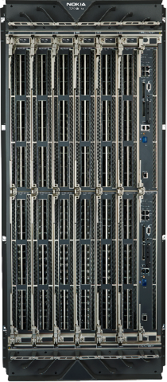

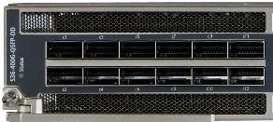
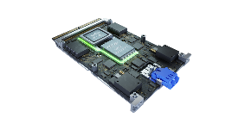
IP Routing versus Optical Transport
Different goals, different focus, different solutions
IP Routing
Scale node capacity
Maximize port density
Optical Transport
Scale link capacity
Maximize fiber throughput/reach
Approaching Shannon’s limit
7750 SR-14s
12 cards per 24RU
QSFP-DD 800G
36 ports per card
PSE-6s
800G over 2000+ km

Slide 7



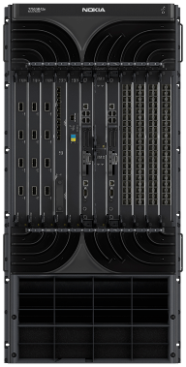
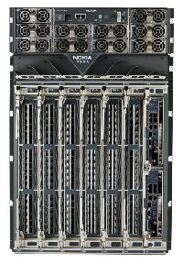
Evolution of router capacity and resource footprint
Moore’s Law of increasing routing silicon and system integration
Silicon
integration
FP3
40nm
FP4
16 nm
FP5
7 nm
400G SR
(2012)
(2018)
(2022)
~25 mW
per Gbps
3x capacity
-75% power
Power
per bit
System
integration
8x capacity
27x density
~100 mW
per Gbps
What about the pluggables?
57.6Tb HD in 16RU
2160x 10G QSFP28
720x 100G QSFP-DD
144x 400G QSFP-DD
172.8T HD in 16RU
1152x 100G QSFP-DD
288x 400G QSFP-DD
144x 800G QSFP-DD
Capacity and
port density
7.2T HD in 22RU
360x 10G SFP+
36x 100G CFP2

Slide 8

800GE Routing: Technology enablers
800G transceivers
Routing silicon
QSFP-DD
formfactor
112G SerDes signaling
800GAUI
112Gbps SerDes
800GAUI
NPU
Fabric IO
100G wavelengths
800GE (coherent) line cards
Switch fabric
25–30W per cage
air flow
SFM
800G QSFP-DD
pluggables
Line
card
PCB
Unimpeded airflow from front to back
SFM
112G SerDes
SFM
air flow
SFM
heat sink

Slide 9
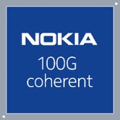



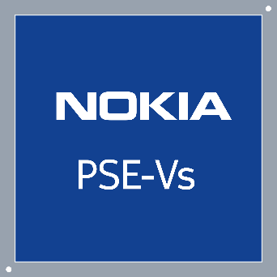

Evolution of Coherent Optics
Capacity, Power, Reach
First single-λ
100G
First
2-ch 500G
First shaped
PCS
Continuous baud rate
SD-FEC
100G
PSE
PSE-2
PSE-3
PSE-V
PSE-6
Super-
Coherent
33Gbaud/100G
Longhaul
33Gbaud/200G
Metro
45Gbaud/250G
200G Longhaul
67Gbaud/600G
400G Regional
90Gbaud
400G Anywhere
130Gbaud/1.2T
800G Longhaul
up to 53% savings
Gen 5
Gen 6
94%
reduction six generations
800G
800G
PSE-6s at 800G/wave
up to 40% less
than prior generation
3x reach
Costly regens
Doubling of optics, space, and power
800G
400G wavelength #1
800G
PSE-6s at 800G/wave
400G wavelength #2
500 1000 1500 2000
500 1000 1500 2000
Reach (km)
Reach (km)
Total network power consumption
normalized Watts per Gb/s
Number coherent interfaces
Normalized to equivalent network capacity

Slide 10
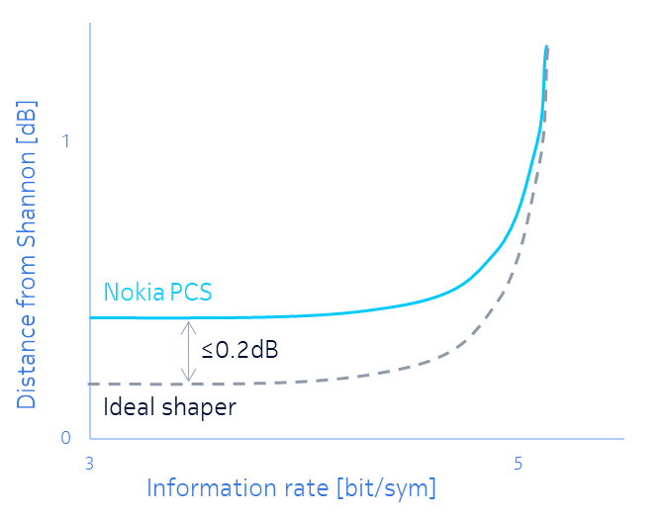

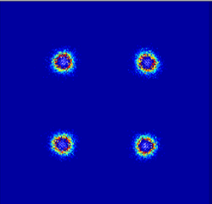
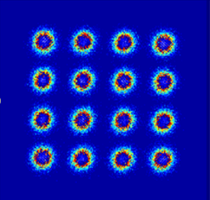
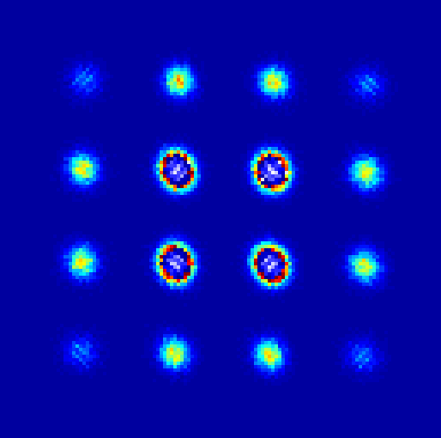

Evolution of Coherent Optics
Modulation format evolution / Data converters / Technology challenges
DAC
DSP
DAC
More complex modulation
Prob. Const Shaping (PCS)
DAC
DAC
QPSK
Higher bitrate
16QAM
Improved perf
PCS
Transmitter/Receiver
[E/O comp + CMOS(DAC+DSP)]
10011
DAC
Sampling rate
Equivalent bandwidth
ADC
Digital
Analog
Analog
Digital
160GBd
200GSps
140GBd
180GSps
higher sampling rate
95GBd
120GSps
Lower CMOS geometry
Enable higher Baudrate
Larger bandwidth
Spectral efficiency is plateauing: Focus on higher Baudrate to increase reach (constant client) and power reduction
Need to choose the appropriately CMOS node for a given Baudrate
… otherwise, performance is limited

Slide 11




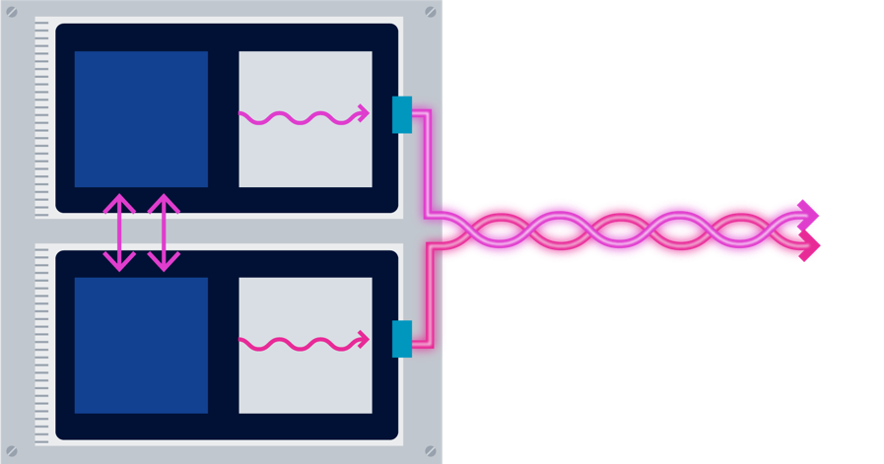
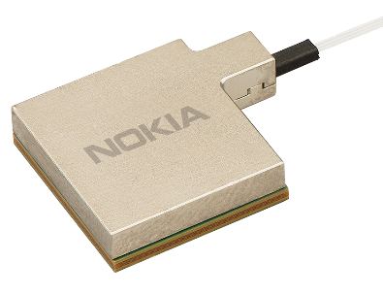
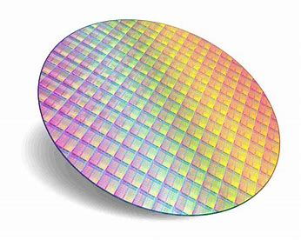
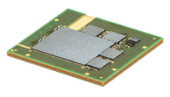

Enabling Coherent Photonic Service Engines
A Fully Vertically-Integrated Approach
Coherent modem algorithms
Probabilistic
Constellation Shaping
Continuously Tunable Baud Rate
Advanced
Analytics
5nm DSP
130Gbaud 1.2Tb/s
Multi-Chip Module Integrated opto-electronic co-design and packaging optimized for performance
Silicon photonics
Client
Optics
CMOS manufacturing
Advanced flip-chip BGA packaging
High-performance optics
Line
Optics
130GBaud optics
CDM and ICR

Slide 12





IP-Optical view of applications
Know the destination
Access and
metro DCI
Metro/regional aggregation
Metro/regional
edge/core
Long haul and
subsea
Point-to-point
traffic and fiber
Hub and spoke traffic
over fiber rings (typically)
Mesh traffic over interconnected fiber links
Mesh traffic over long spans and multi-degree nodes
Increasing reach & complexity
Drives IP-O technology & solution requirements
12
© 2023 Nokia

Slide 13
Agenda
IP/Optical convergence history
IP Routing versus Optical Transport
Coherent pluggables
Platform choices
Management and Operations
Business Aspects
Putting it all together

Slide 14


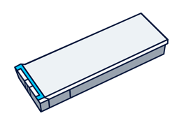
Technology: coherent optics
Full speed ahead!
The challenges:
Capacity
Form factor
Reach
Power
Interoperability
SFF pluggable coherent optics go mainstream
400G QSFP-DD ZR/ZR+ (-10dBm)
400G QSFP-DD ZR+ (0dBm)
800G QSFP-DD ZR/ZR+
25km unamplified
120km with pluggable OLS
450km with ILA
80km unamplified
120km with pluggable OLS
650km with ILA
Est 27-30W
10km unamplified
120km with ILA
Available now
Emerging
2H24
Sweet spot: 400G
Access, metro DCI & metro/regional applications
14
© 2023 Nokia

Slide 15



Maximize scale and performance from metro to long-haul
Flexible support for wide range of clients and wavelength speeds
Maximize 800GE bandwidth efficiency
Single 2.4Tb/s linecard supports up to 3 x 800GE
3x the capacity/linecard of current 800G solutions
Metro, DCI and IX interconnection
Long-haul 800GE transport
800G transport over long-haul distances (2000km+)
3x the reach of 7nm/90-100Gbaud solutions
Single-wavelength 800GE long-haul transport without regens
Flexible and efficient multi-service transport
Support wide range and mix of clients
Up to 24x100GE/OTU4, 6x400GE or 3x800GE
Efficient and flexible transport from metro to long-haul

Slide 16
Agenda
IP/Optical convergence history
IP Routing versus Optical Transport
Coherent pluggables
Platform choices
Management and Operations
Business Aspects
Putting it all together

Slide 17



Technology: platforms & integration
Some curves to navigate
Line Systems
Routers / Transponders
In-line amplification
Fiber/DWDM mux
(Open) ROADMs
Coherent optics support
Power & cooling
Optics integration
Requirements for both optical platforms & routers
17
© 2023 Nokia

Slide 18

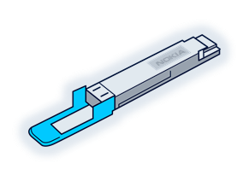


Hop-by-hop routing versus reconfigurable add-drop multiplexors
Forwarding IP transit traffic at the most economical layer
Total Power: 100 Watts/400GE
High
IP fabric
(Layers 1-3)
60W
36W
4W
96% less power by forwarding IP traffic at the optical layer
Cost/bit
Power/bit
Latency
Electrical-Optical
(400ZR+ DCO)
4W
Optical line system
(FOADM or ROADM)
Low
400G IP transit hop
400G IP express

Slide 19
Agenda
IP/Optical convergence history
IP Routing versus Optical Transport
Coherent pluggables
Platform choices
Management and Operations
Business Aspects
Putting it all together

Slide 20





Technology: management & operations
An uphill climb
Reach and
complexity
Path compute
Optical add/drop
Dynamic gain equalization
Active power management
Modulation
Channel plan
Power ramp
Link up/down
Optical add/drop
Dynamic gain equalization
Active power management
Modulation
Channel plan
Power ramp
Link up/down
Active power management
Modulation
Channel plan
Power ramp
Link up/down
Channel plan
Power ramp
Link up/down
Link up/down
Access
(400ZR)
Metro DCI
(P2P 400ZR)
Metro DCI
(P2P 400ZR+)
Metro/Regional Agg’n
(2D ROADMs)
Metro/regional (ROADMs)
IP team
IP-optical co-ordination required
Optical team
IP-optical coordination
20
© 2023 Nokia

Slide 21











IP-Optical Management Architecture
End-End coordinated cross-domain management
IP
team
Optical team
Cross Domain Coordinator
T-API
T-API
IP management
Intent Based Prov.
Edge
Port
Discovery
Open
Terminal
Control
WaveSuite
IP + Optical Fault Management
Optical M&C
Resource
Controller
Planner
Network Operation Center
400G
Multihaul
400G
Multihaul
ROADM-enabled
Optical Line System
400G ZR+
400G ZR+
IP Layer
Optical Layer
IP Layer

Slide 22
Agenda
IP/Optical convergence history
IP Routing versus Optical Transport
Coherent pluggables
Platform choices
Management and Operations
Business Aspects
Putting it all together

Slide 23

Business aspects
Before even starting the trip
Organization
Commercial objectives
Are IP and optical transport teams under common management?
Which team takes the project lead?
Are the business objectives well understood?
Is the business case for the project compelling?
23
© 2023 Nokia

Slide 24
Agenda
IP/Optical convergence history
IP Routing versus Optical Transport
Coherent pluggables
Platform choices
Management and Operations
Business Aspects
Putting it all together

Slide 25
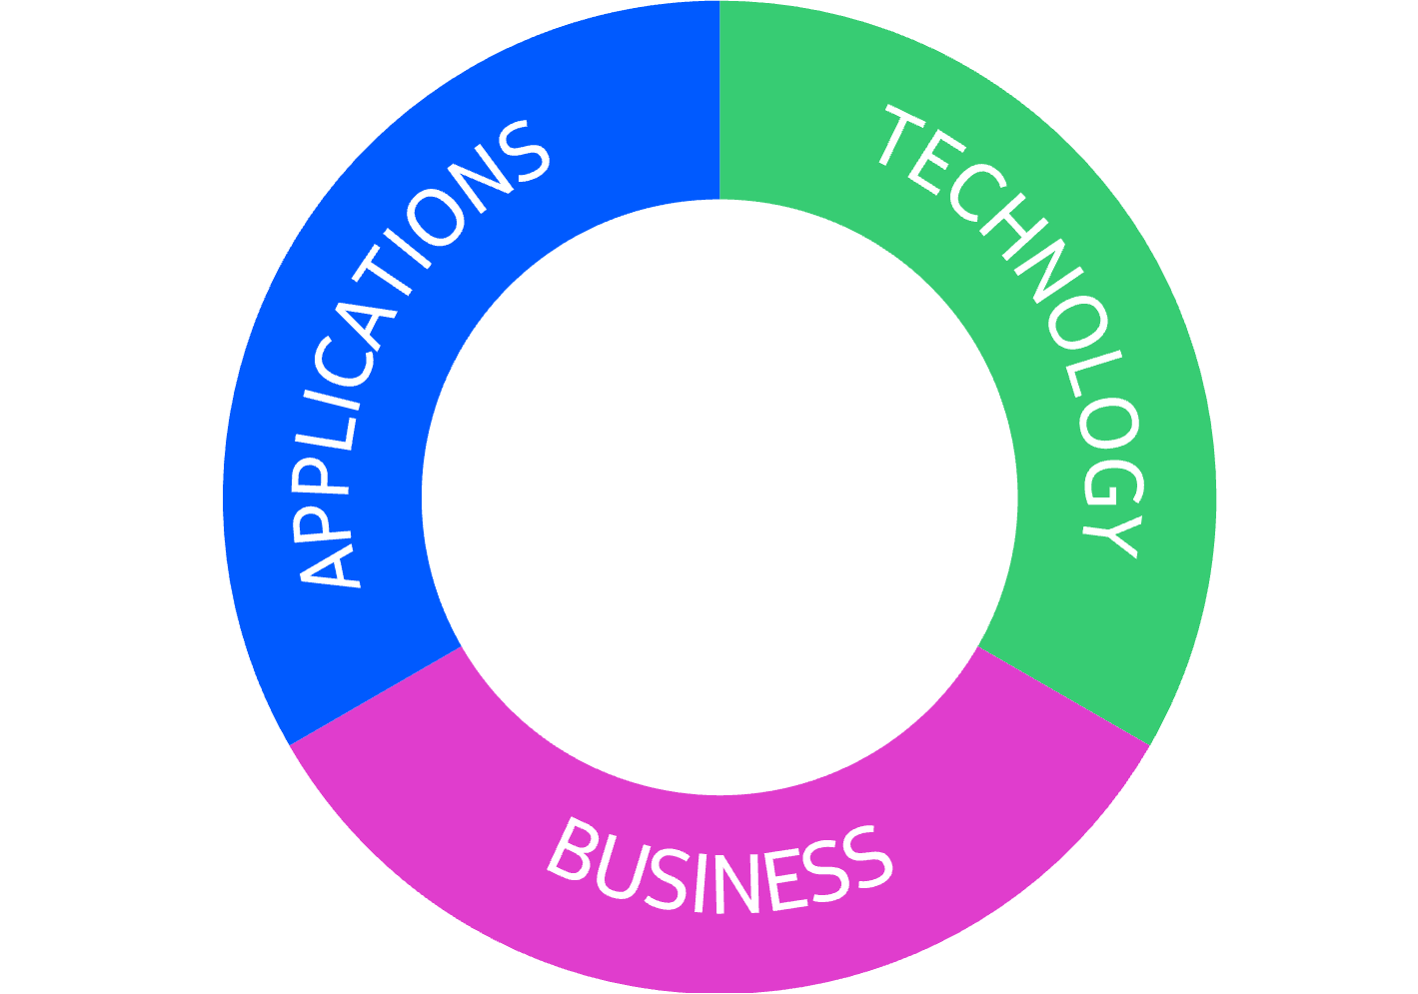
IP-Optical convergence
Putting it all together
Business
Applications
Technology
P2P access/
metro DCI
Pluggable DCOs
Platforms
Management & operations
Organization
Commercial
objectives
Metro/regional aggregation
Metro/regional edge/core
Long haul /
subsea
3 keys to success
25
© 2023 Nokia

Slide 26
Are we
there yet?
Lots of progress,
but still a lot of
road ahead!
26
© 2023 Nokia

