Slide 1
Simulations in Education and Research
A Public Values Perspective
John Ford Walker, SURF
TNC 2023
June 7, 2023

Slide 2
Intro + Image
Simulations in Education and Research: A Public Values Perspective
John Ford Walker, SURF | TNC 2023, Tirana
23 May, 2023

Slide 3
Mission and Vision
Mission
Vision
SURF makes reliable and innovative IT facilities possible, with which Dutch education and research can excel.
SURF stimulates the formation of ecosystems in which members and their stakeholders collaborate, innovate and share knowledge on the basis of shared values and agreements.

Slide 4
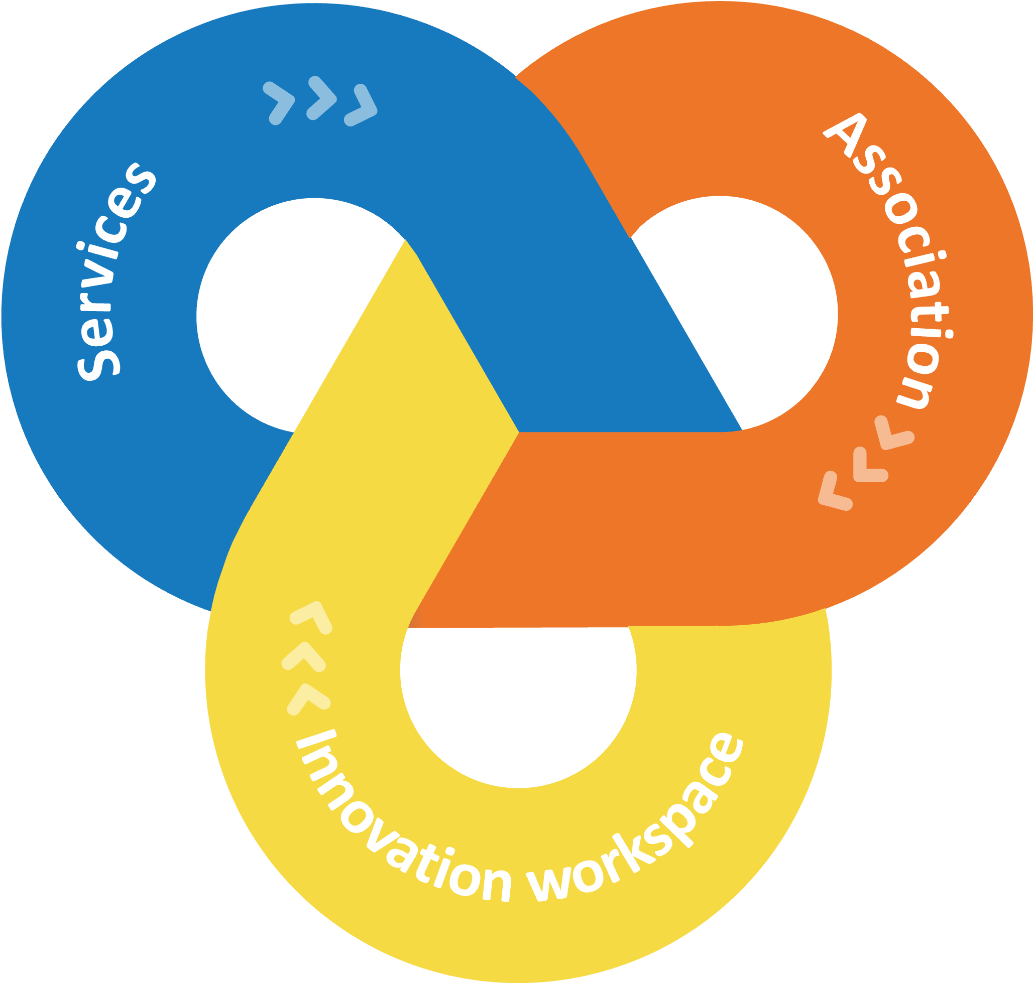
Three Parts of SURF
SURF's three roles that reinforce each other to grow together.

Slide 5
Your Presenter
John Walker
Emerging Technology Advisor
John.Walker@SURF.nl
Responsible XR
Education & Research

Slide 6
Three Parts: One Project
Public Values in Education and Research
XR Case Examples 1 & 2
Responsible XR

Slide 7
The Process
Internal/External Reviews
Towards a common understanding. Reviews by Case example researchers.
Public Values
Desk research / interviews / Workshopping and weighing values
Responsible XR
Understanding and applying public values at a new level
XR Tour
Meeting with members and interviewing for case examples
Writing and Development
Reading, writing on XR in education and research
Publishing
In September

Slide 8
Chapter orange
Who here has been in ‘Virtual Reality’?

Slide 9
Chapter orange
What is eXtended Reality?

Slide 10
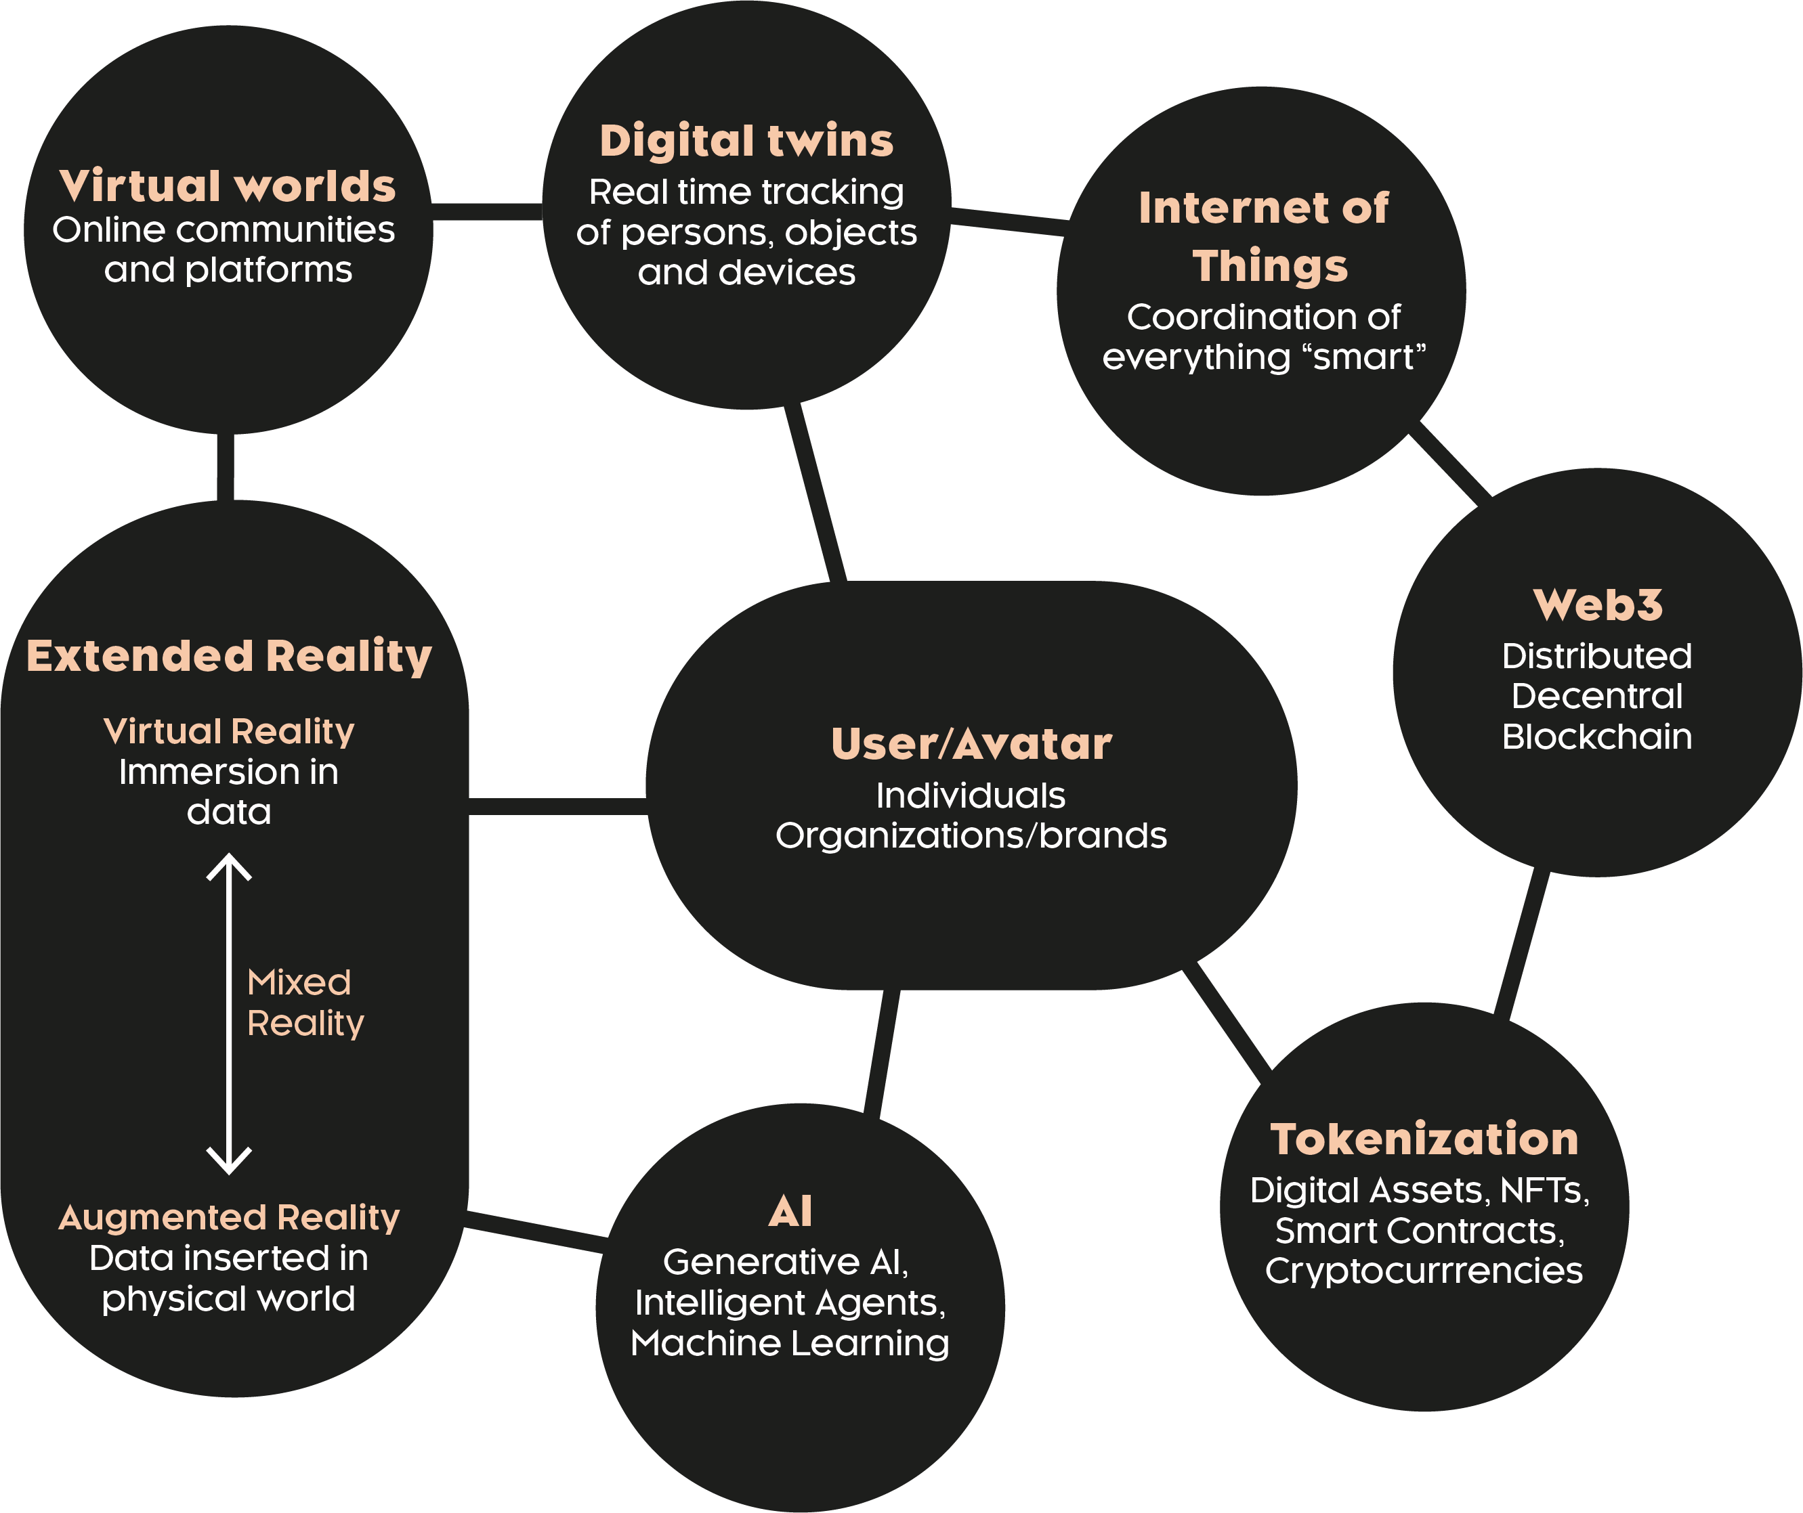
Chapter orange
Is it the Metaverse?
Is it virtual worlds?
Is it in my phone?
Is it a culture?
What layer are we talking about when we say Metaverse?
What is eXtended Reality?

Slide 11
Chapter yellow
What is the connection to Public Values?

Slide 12
Chapter green
XR & Public Values: Connections
A perspective from public values could be taken to:
Explore how considerations could be made from the technology to a public value.
&
How XR technologies can be considered as mediating/shaping both:
The public value considered and
The learning experience described in the case examples.
Notes:
XR technologies have capabilities that extend to affecting different emotional states, bringing people together and influencing social behaviour (Nikiel, 2020).
Taking seriously the role of technologies in education means recognizing technologies as having impact on our ways of living and norms. XR Technologies are no different but are unique in their increasingly disruptive capabilities.
The simulated environments that are generated by these devices are not to be taken lightly, as they are able to induce intense emotions, physical reactions and collect data on almost every movement made by the user.

Slide 13
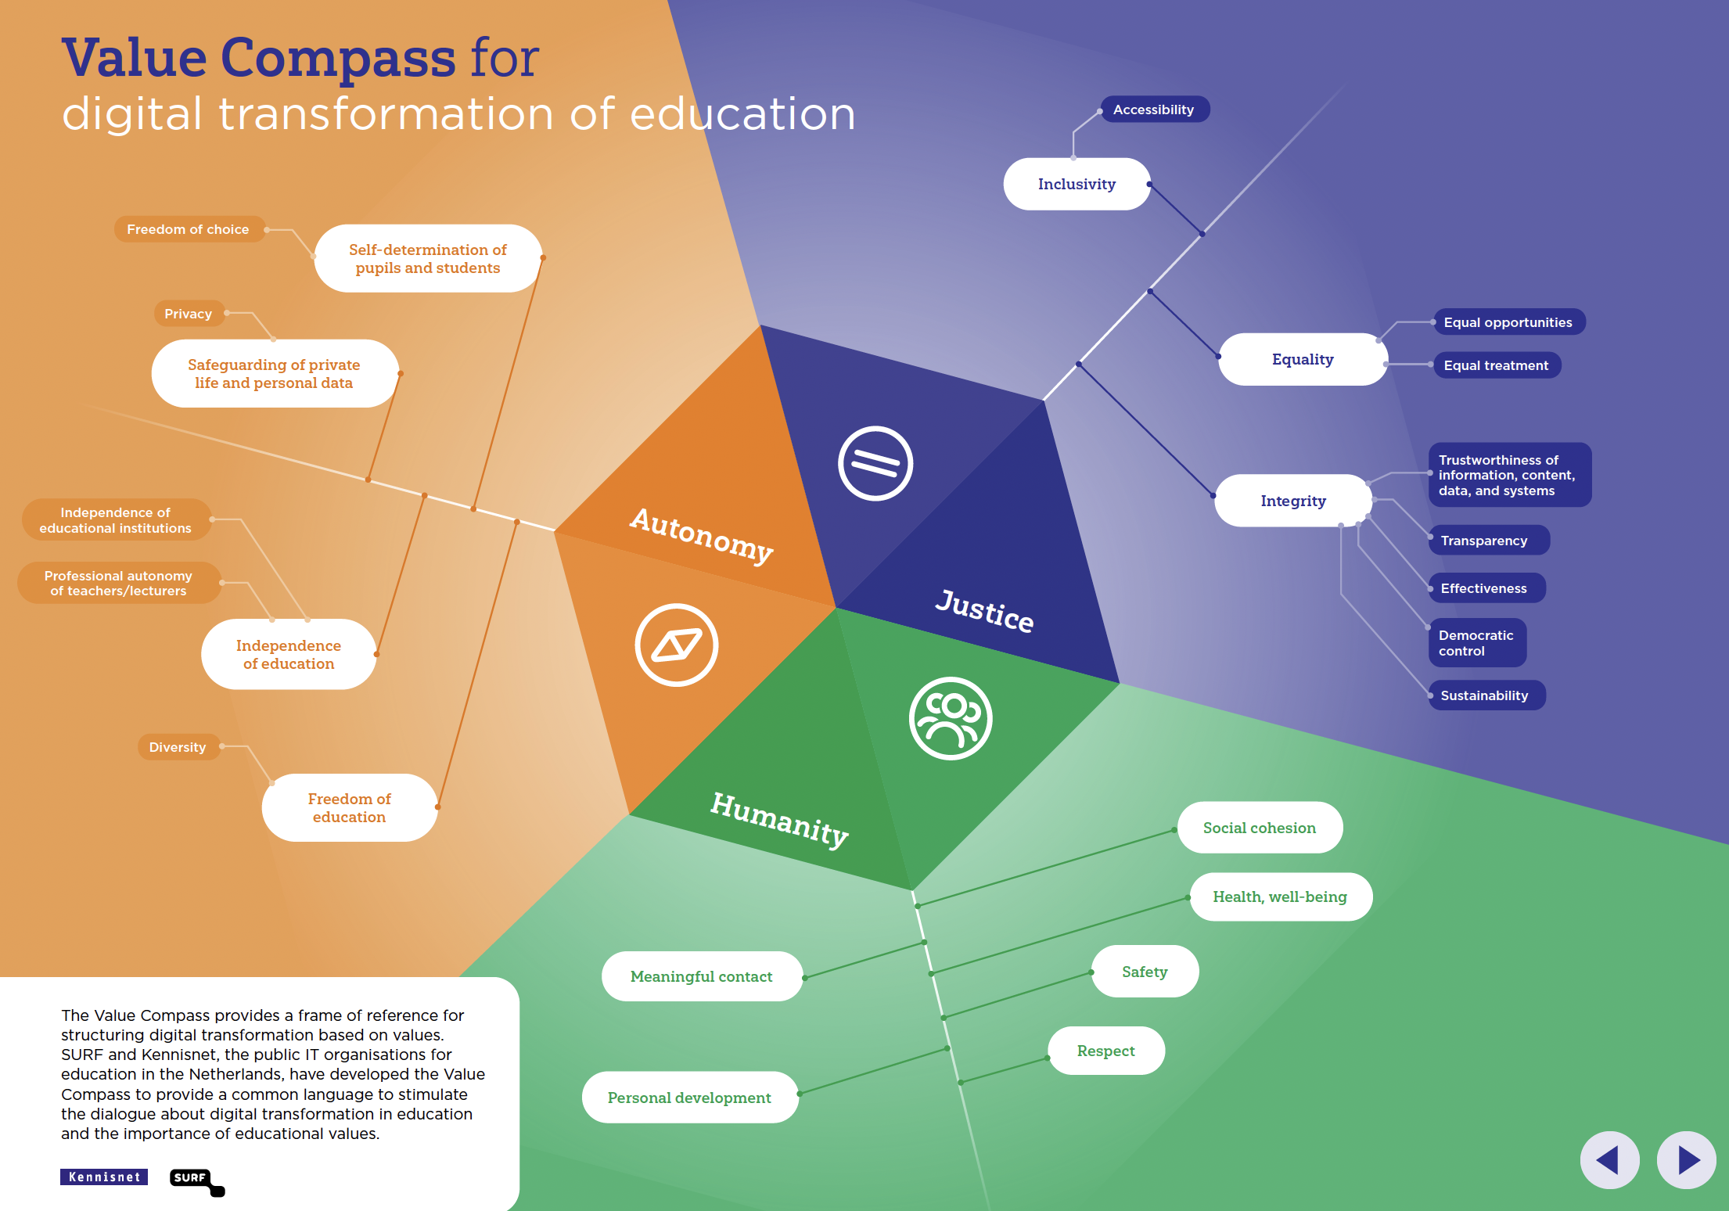
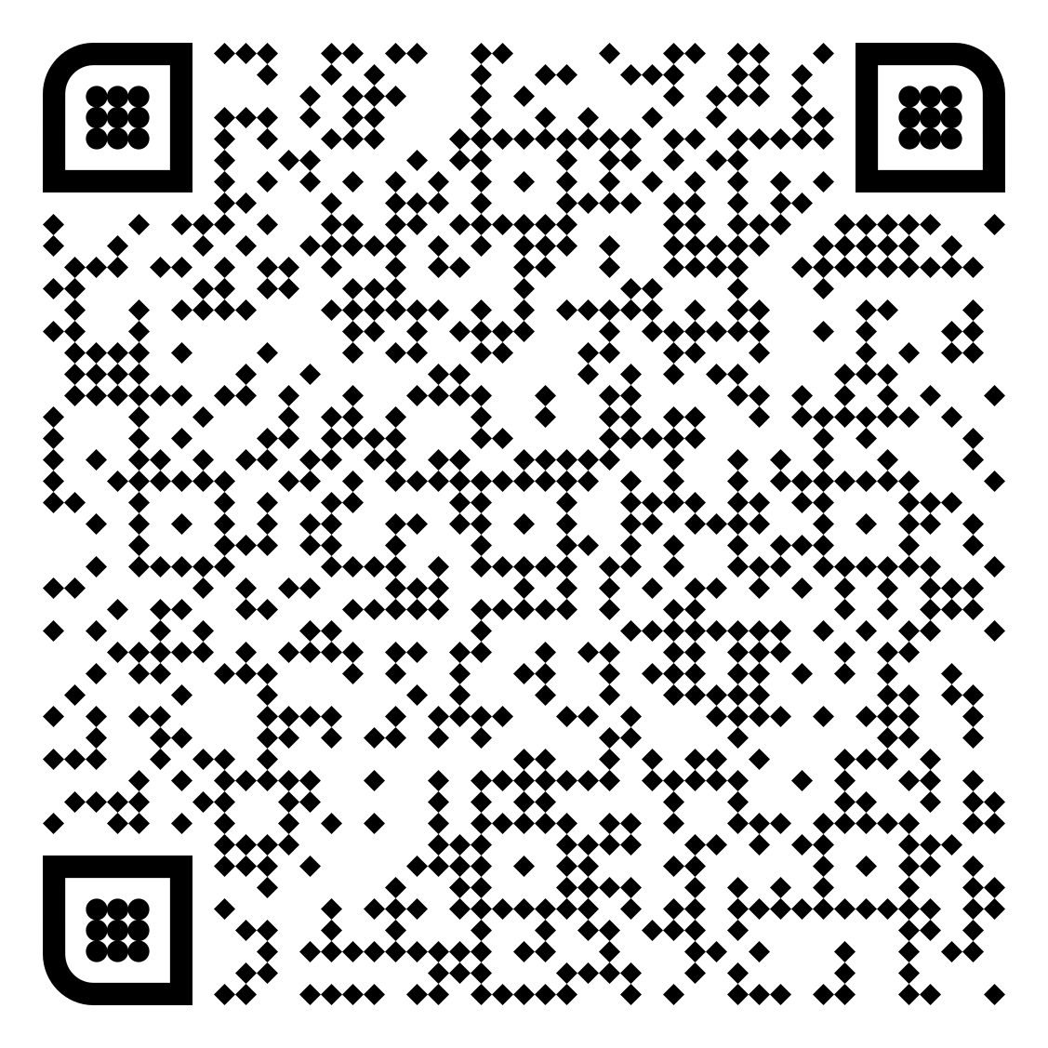
Chapter green
Download the Value Compass Here
Notes:
Supporting and framing

Slide 14
Chapter blue
Asking --- Questions

Slide 15
Chapter blue
Asking [More Critical] Questions
→ Means recognising that we are responsible for shaping better simulations that will in turn shape us.

Slide 16
Chapter blue
Case Example 1
Case Example 1
Case Example 2
Discussion Paper

Slide 17
Case Example: VR Training in Labs
A VR organic chemistry labs experiment for laboratories in the Netherlands used to cope with both training students on new lab equipment, their feelings of preparedness in the lab and give virtual access to it during closure times during COVID 19 lockdowns.
Learn about the lab layout, its tools and what to expect before going into the real thing could be extremely helpful for new students.
Platform for a variety of scenarios found in labs and with varying educational methodologies including challenge-based learning. The introduction of virtual labs with VR is a new experimental step for these institutions.
Notes:
Photo from: https://commons.wikimedia.org/wiki/File:MARUM-Lab-01-HiRes.jpg

Slide 18
Column 1x + Image 2x
Personal Development (Humanity)
Defining
Education should encourage self-development by incentivizing expression of the learners’ character and their relation to the world (Bok et al., 2021).
Questions
What process or training do we as an institution see as appropriate with VR technology? How can we facilitate that training better in VR than in person?
What features of the real world should be not added to the virtual one for the betterment of experience or focus?
Which opportunities open to students who choose to use VR-based training that are not available to in-person trainings?
How might implementing XR technologies change the personal development goals of our students or staff?

Slide 19
Column 1x + Image 2x
Inclusivity (Justice)
Defining
The value of inclusivity is found by keeping education open to all learners (Bok et al., 2021).
Questions
Are our simulated laboratories and accompanied trainings developed with pedagogy in mind? If yes, what are those pedagogies?
Are we the owner of our own digital twin/simulated laboratory?
What risks in data governance do we need to consider if the VR-based laboratory collects personal data on our learners?
Who can’t be included in a VR-based laboratory? Who is missing from the conversation or trainings?

Slide 20
Column 1x + Image 2x
Self-determination Of Pupils And Students (Autonomy)
Defining
In the context of public values, students should have the right to choose the type of education that suits them through self-determination (Bok, et al., 2021).
Questions
What current challenges does VR-based laboratories resolve for students and are there other technologies that could be viable instead?
Can VR-based increase the safety and privacy of certain students that in-person laboratories cannot?
Does the VR-based training in virtual labs enhance the experience current learning goals or pedagogy?

Slide 21
Chapter orange
Case Example 2:
Case Example 1
Case Example 2
Discussion Paper

Slide 22
Case Example: VR Presentation Training
These simulations offer learners an audience that is always available and easy to organize with. Continual use of these simulations has been researched thoroughly to ascertain the benefits of presenting in a virtual world.
VR simulations offer not only an existing audience, but also one that can give feedback based on eye tracking, motion tracking, speech rate and more (Ginkel, 2019).
Virtual VR presentations are still difficult to integrate into a more traditional educational space and therefore require their own lab or workshop.
Notes:
Photo from: https://commons.wikimedia.org/wiki/File:MARUM-Lab-01-HiRes.jpg

Slide 23
Column 1x + Image 2x
Meaningful Contact (Humanity)
Defining
Meaningful Contact can be interpreted as an important and meaningful connection between students and teaching staff (Pijpers & Bomas, 2020, pg. 19).
Questions
How does the headset or wearables impact the communication between instructor and learner? Is the instructor inside the virtual world?
What new behaviours form in VR-based presentations? Are there habits from the headset?
Does a trainer or instructor need to be present at all VR-based trainings?

Slide 24
Column 1x + Image 2x
Equal Opportunities (Justice)
Defining
Equal opportunity may be concerned with educational institutions offering equal opportunity to all students, without disadvantaging or excluding specific groups (Bok et al., 2021).
Questions
Can agreements be made to share simulations between institutions?
What kind of opportunities do students see in the future with virtual reality for presenting?
Are our simulated presentation trainings developed with pedagogy in mind? If yes, what are those pedagogies?

Slide 25
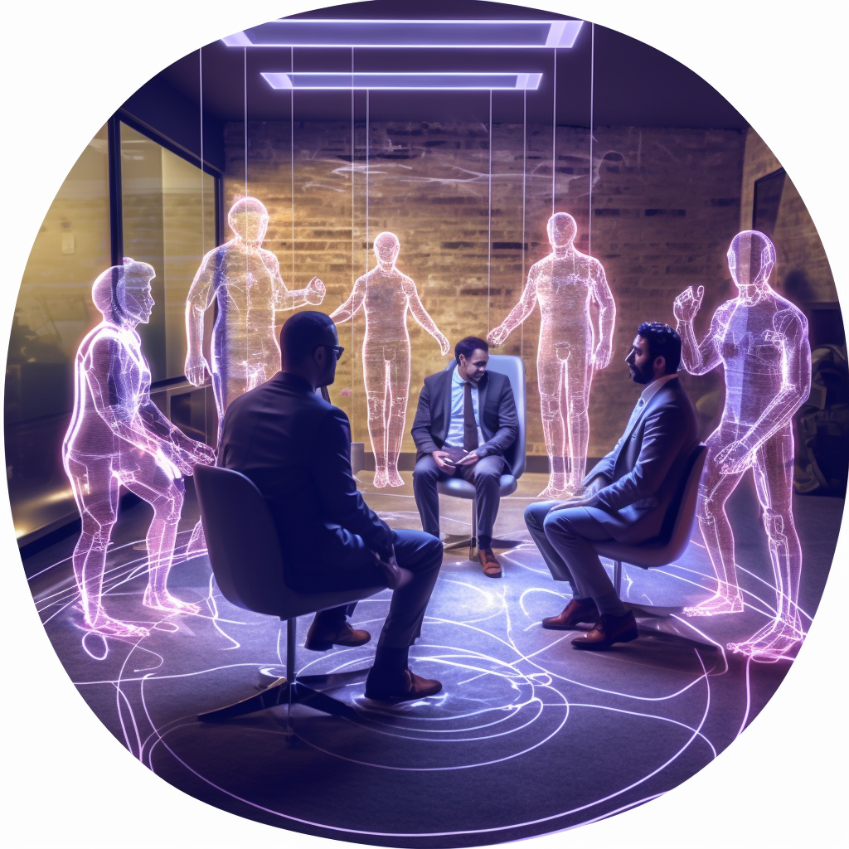
Column 1x + Image 2x
Safeguarding Of Private Life And Personal Data (Autonomy)
Defining
One component of autonomy in education is the ability to safeguard personal life and personal data; where learners and educators know their privacy is ensured when they use digital resources of their institution (Bok et al., 2021).
Questions
What data is necessary for proper feedback? How is this communicated to a learner?
If taken away from an institution, will the cameras of the headsets record the spaces of the learner? Who will have access to that data?
What current challenges does VR-based labs resolve for students and are there other technologies that could be viable instead?

Slide 26
Three Key Takeaways so far…
Learning in VR has impact
Public Values can re-frame technical talks
Responsible XR has motivation
On learner behavior, emotion, and sense of confidence.
More critical inquiries that both educators and researchers should consider when incorporating these emerging technologies into their respective contexts.
There is a need for creating more shared understanding around the implementation of XR technologies with responsible design and application

Slide 27
Chapter orange
Responsible XR
Case Example 1
Case Example 2
Discussion Paper

Slide 28
Responsible XR
Respecting that technologies shape our daily interactions and relations to our world is one step past seeing tools as just a means to some end; a neutral tool to achieve human goals (Vallor, 2022).
Responsibility as a practice
Creating space for things like
Critical reflection
Consequence scanning
Horizon building
We can create more understanding surrounding both practical and theoretical issues of new and emerging technologies in these fields without sacrificing attention to moral dilemmas and social values.

Slide 29
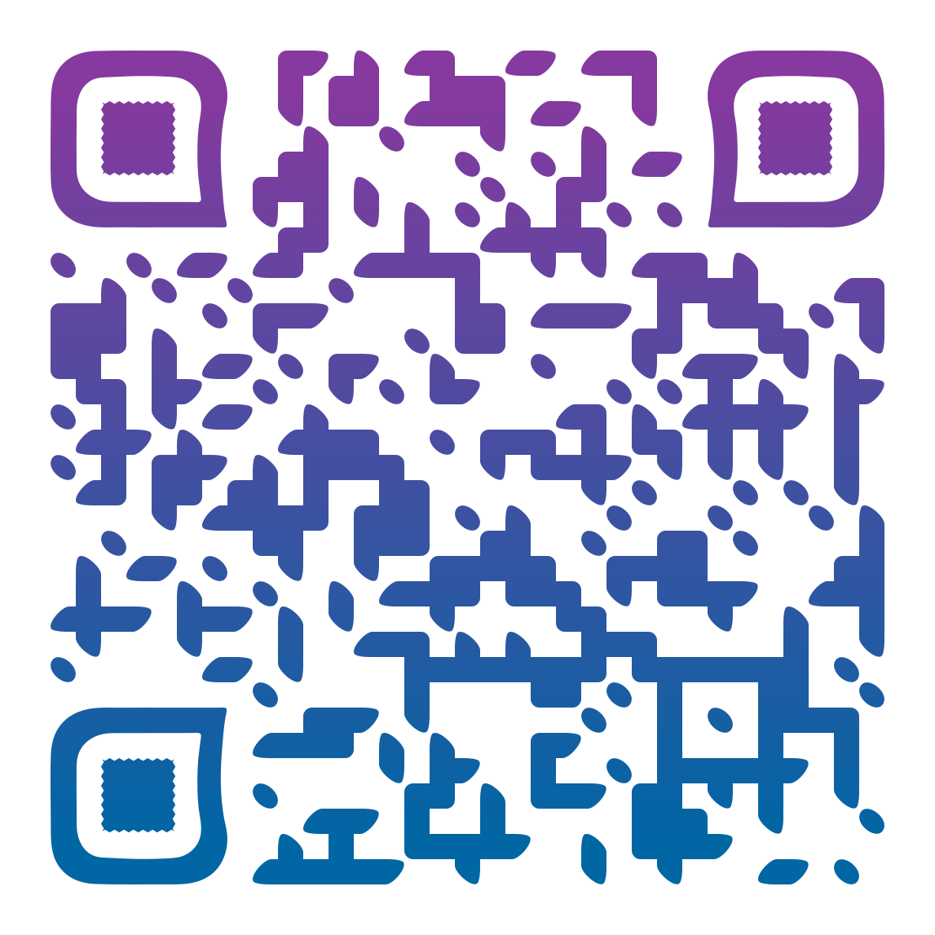
Closing slide
Thank you for your attention!
Utrecht, NL
John.Walker@SURF.NL
Or connect with me on
LinkedIn to learn more!

