Slide 1
Bridging the gap
From society without internet to techo-natives
Tina Marković, Barbara Pinculić
Tirana
7.6.2023.

Slide 2
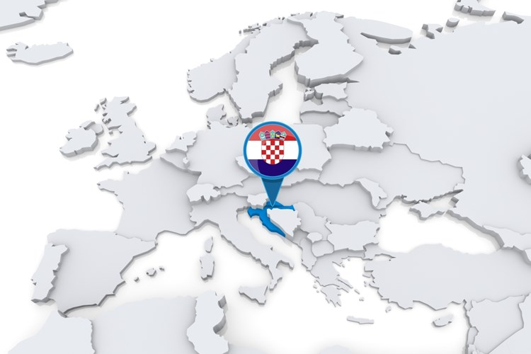
Croatia
1991. Independency
2013. EU
population of 3 871 833
56.542 km2
low density population 68,47/km2
1244 islands

Slide 3
1# Fun fact

Slide 4
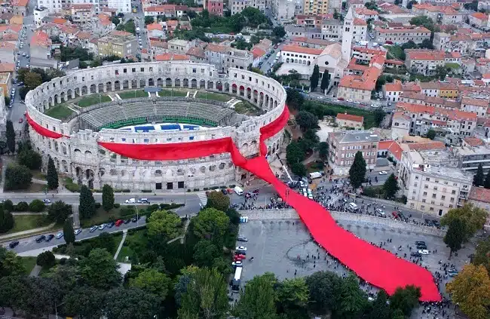
2# Fun fact

Slide 5
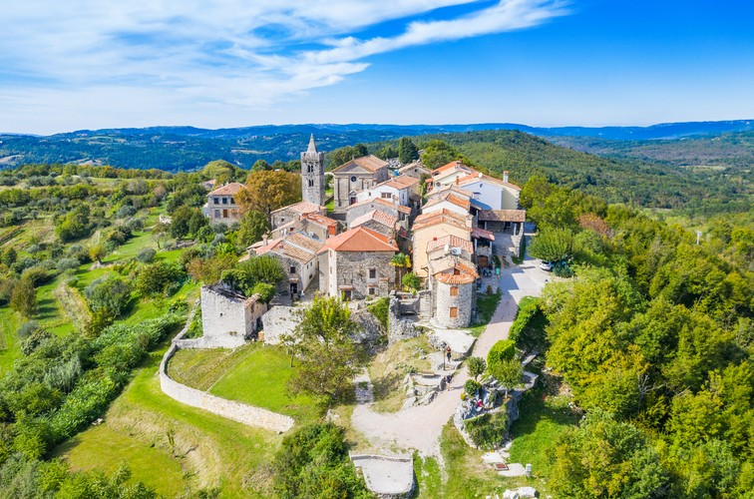
3# Fun fact

Slide 6
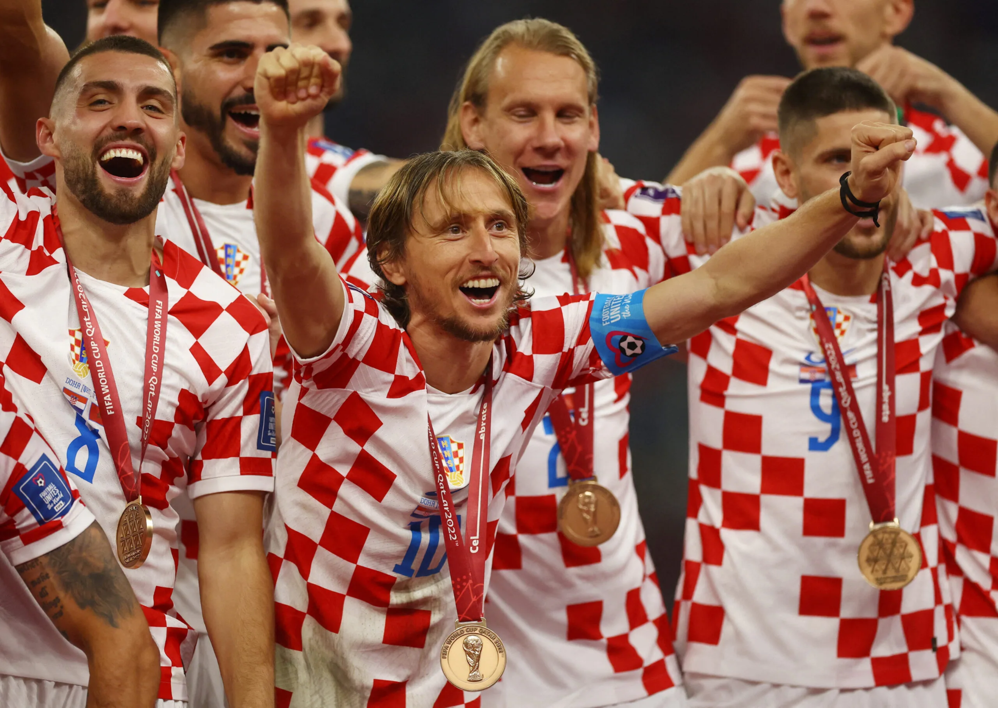
What are the Croatians most proud of?

Slide 7
About us…

Slide 8
About us…
Croatian Academic and Research Network
Connectivity
E-services
Security
User support
200 + employees
Public institution
Budget: 85 000 000 EUR
EU funding 70%
Government 30%
70+ services

Slide 9
Users
Primary and Secondary Schools
Institutions of Higher Education
Scientific and Research Institutes
End users:
50 000 + teachers, 500 000 pupils
20 000 staff, 200 000 students

Slide 10
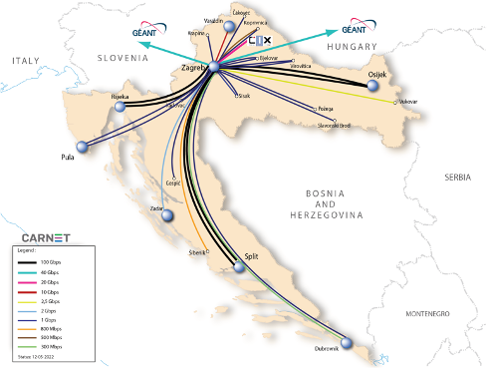
Connecting 5144 locations

Slide 11
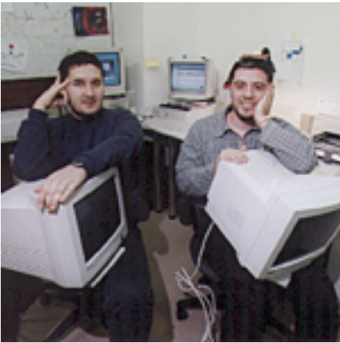
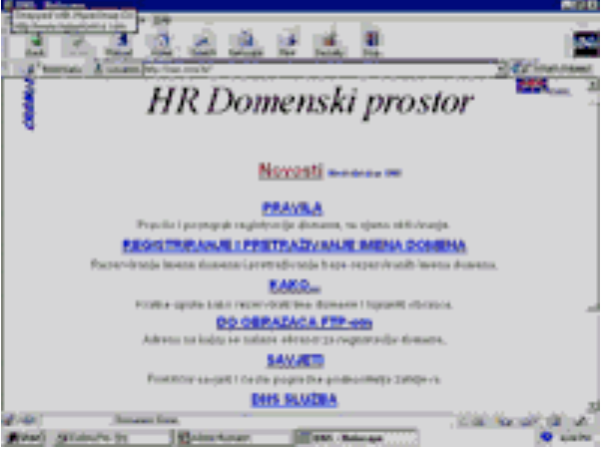
CARNET in 90’s and early 2000’s
Young and agile organization
Serving universities and research institutes
Services:
connectivity
courses
videoconferences
security

Slide 12
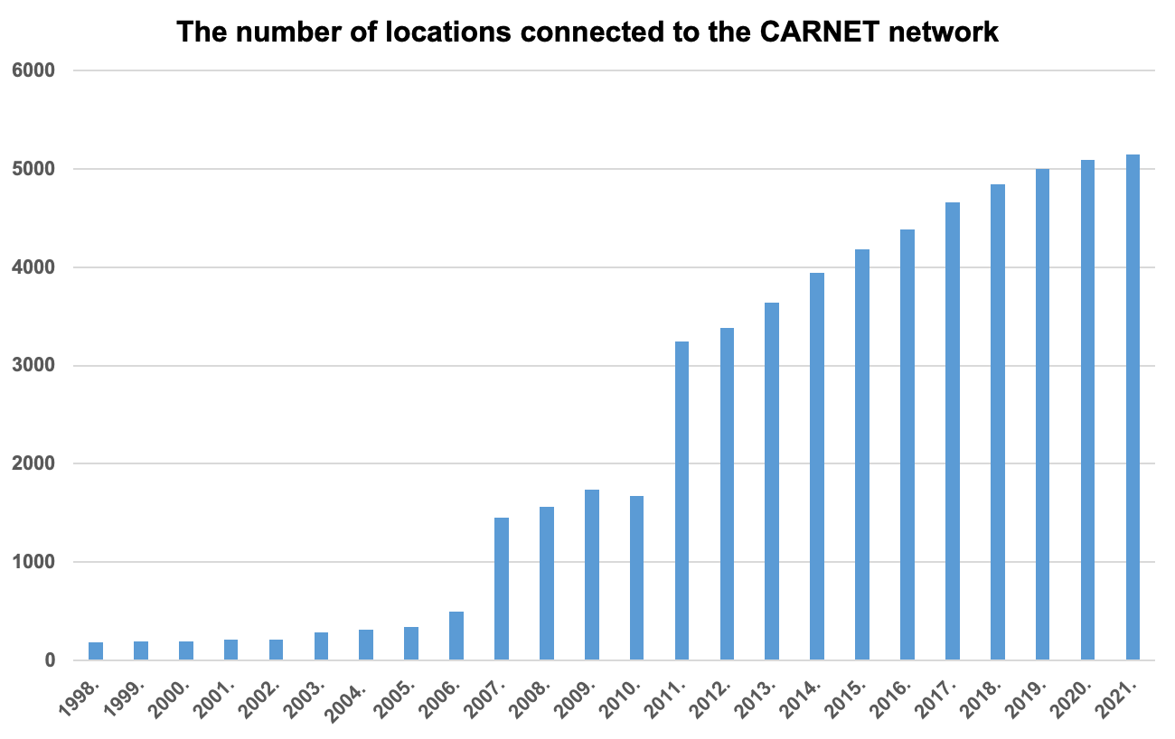
CARNET in the late 2000’s
Intense growth:
Users - schools becoming users
Services
Employees

Slide 13
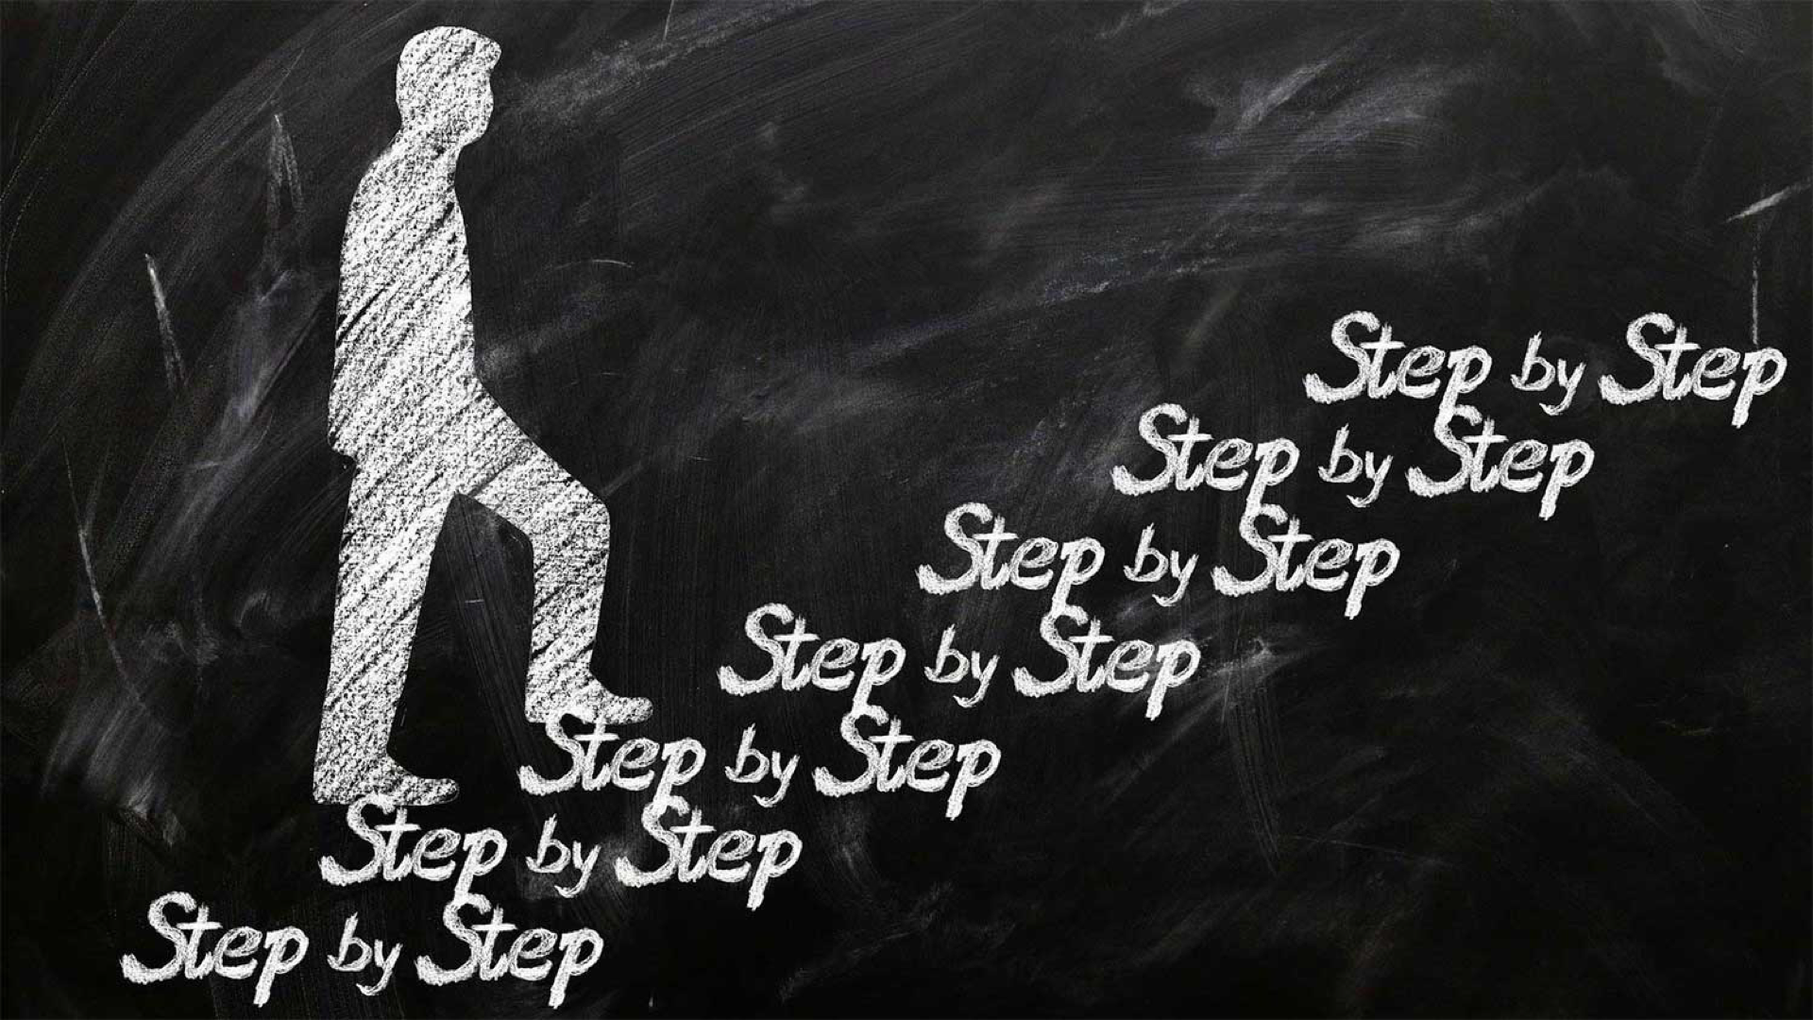

Slide 14
In the beginning…
2006.

Slide 15
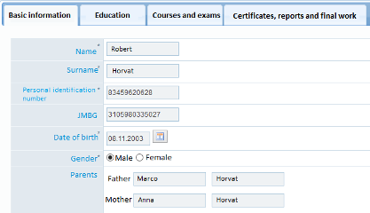
Central e-Registry
2006.

Slide 16
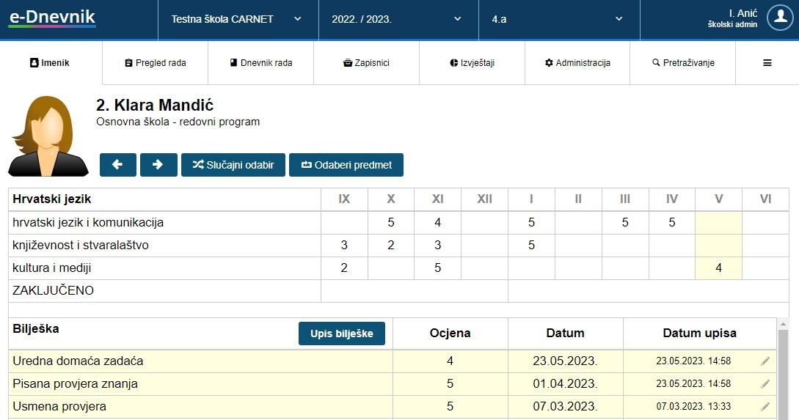
e-Classbook
2011.

Slide 17
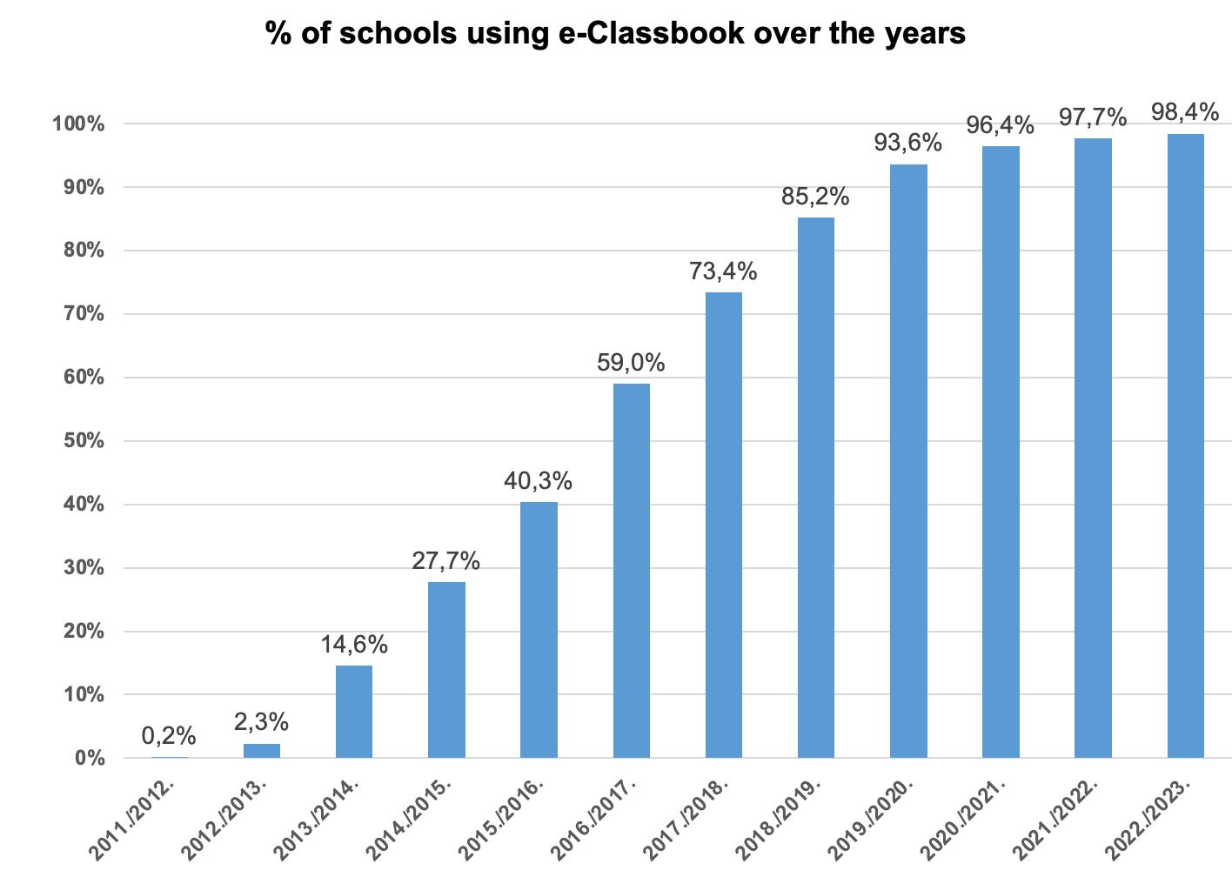

Slide 18
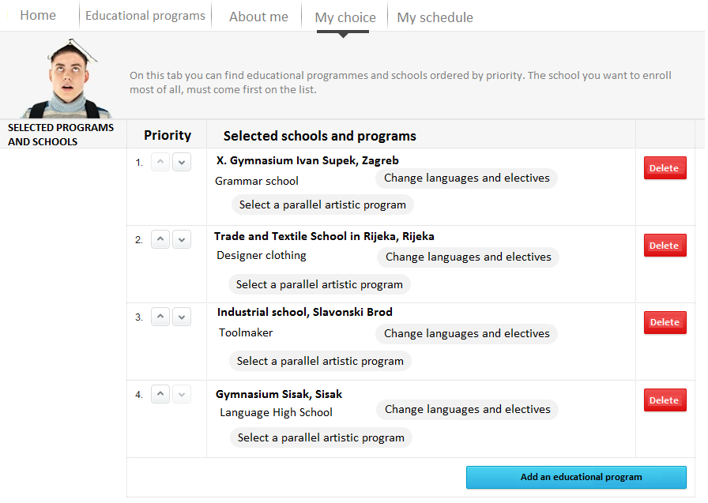
e-Enrolment in secondary schools
2013.

Slide 19
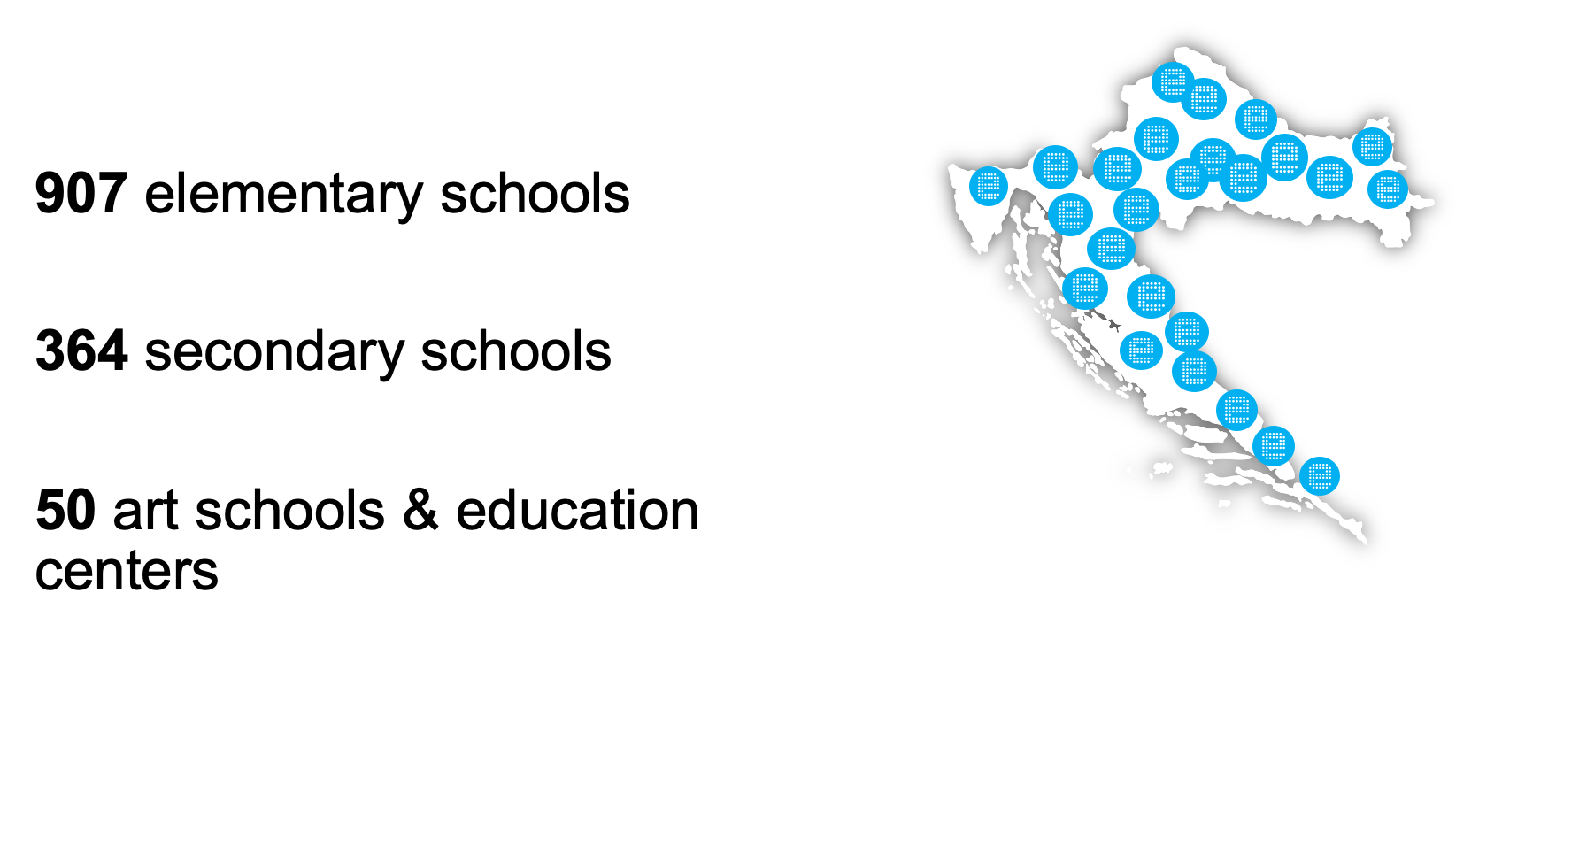
e-Schools programme: Development of the System of Digitally Mature Schools
2015.- 2023.

Slide 20
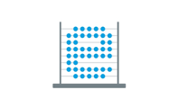
Infrastructure e-services e-content Education & Support Research
e-Schools
Total budget: 217 million euros

Slide 21
Digital maturity of schools - framework
 | Digitally unaware | Digital beginners | Digitally competent | Digitally advanced | Digitally mature
Leadership, planning and management
ICT in learning and teaching
Development of digital competence
ICT culture
ICT infrastructure

Slide 22
What is next…..
e-Universities
e-Enrollment
new services for schools
from kindergarten to adult education

Slide 23
Thank you
Any questions?
tina.markovic@carnet.hr
barbara.pinculic@carnet.hr

