Slide 1
Secure Zones for Sunet Drive
MFA secured file access in federated file sharing environments
Leif Johansson, Richard Freitag (presenter)
Micke Nordin, Michiel de Jong
Underground B
7/6/2023

Slide 2
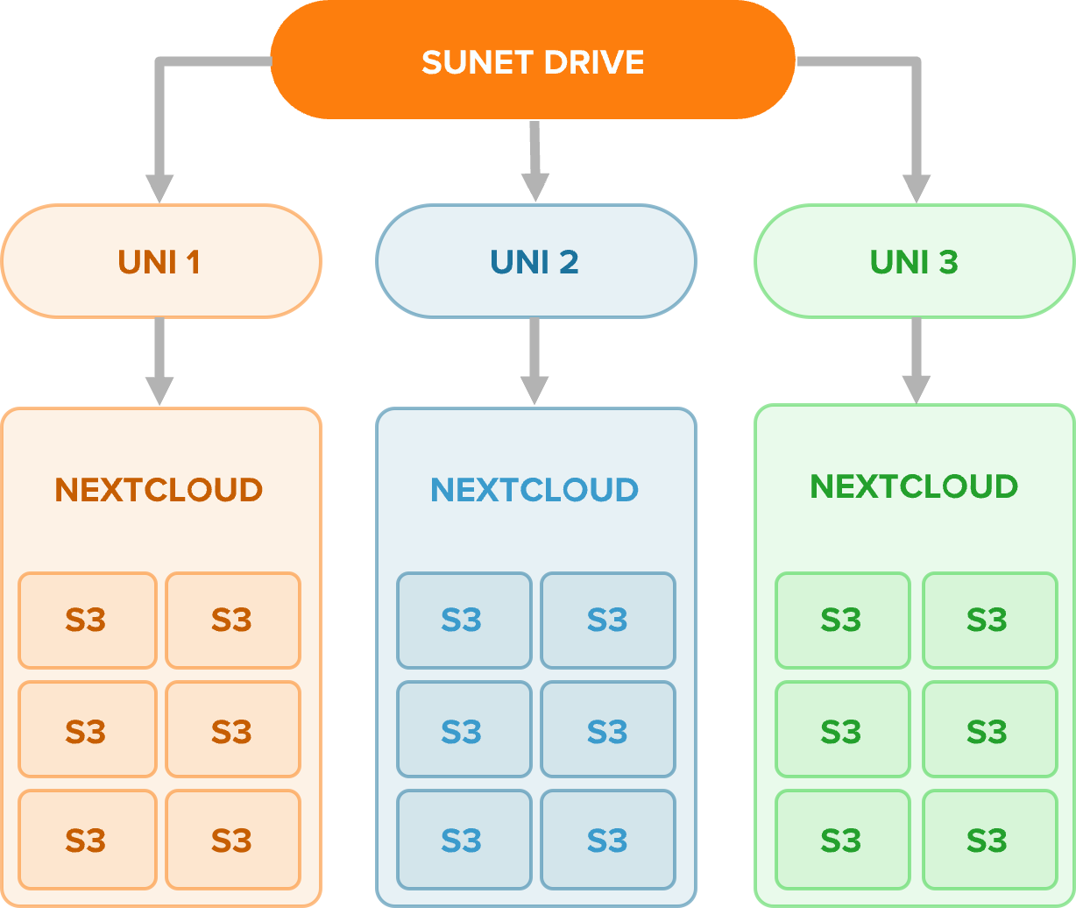
Sunet Drive
Federated file sharing
Co-management of nodes
Part of ScienceMesh
S3-bucket storage
Share data between nodes
Access ownership separation
Lifecycle managed buckets

Slide 3
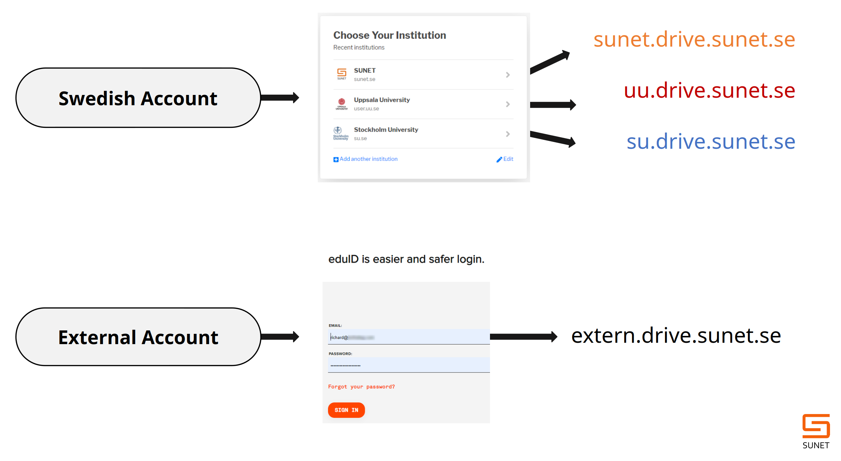
Identity Management

Slide 4
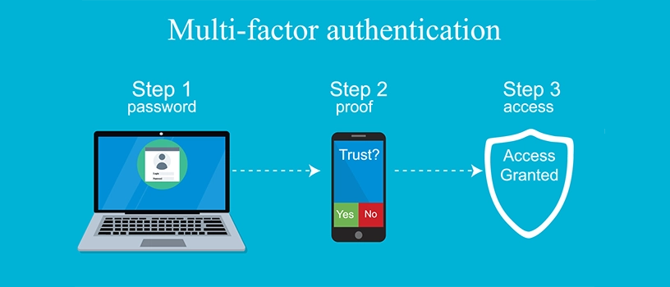

Slide 5
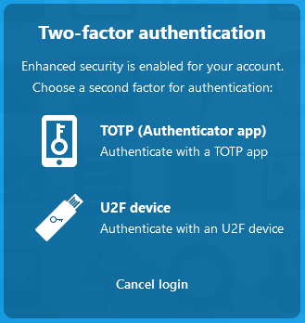
What is MFA?
Multifactor Authentication
Security technology that requires multiple methods of authentication from independent categories of credentials
Examples: SMS, TOTP (Authenticator app), WebAuthn (Yubikey)

Slide 6
MFA – Why is it complex?
Multiple technologies
SMS
TOTP (Authenticator app)
U2F Device (Yubikey)
Other (Mail, proprietary)
Who implements MFA?
Identity provider
Service provider
Both (?)
Requires administration
Lost or stolen devices
Remove/Reenable MFA
Identity providers
Must implement MFA individually
Different technologies for different IdPs
Service providers
Can enforce same MFA technology for all
Could turn Two-factor into Three-factor if IdP has added factor

Slide 7
MFA-Zones - Requirements
MUST support both MFA and non-MFA logins
MUST have control over MFA- and non-MFA-areas
MUST prevent other sharing for MFA-only areas
SHOULD be easy to administrate
SHOULD be easy to use

Slide 8
MFA-Zones
Share with confidence
Enforce MFA for all users with access to file or folder
Step-up authentication only if necessary

Slide 9
Implementation
MFA info comes in as SAML attribute
Passes through Global Site Selector Leader / Follower
Received in user_saml app
Stored in a session variable
Picked up by a Workflow Engine Rule
Hidden tags mark folders as MFA Zones
Extra drawer dialog tab in GUI to set/unset this tag

Slide 10
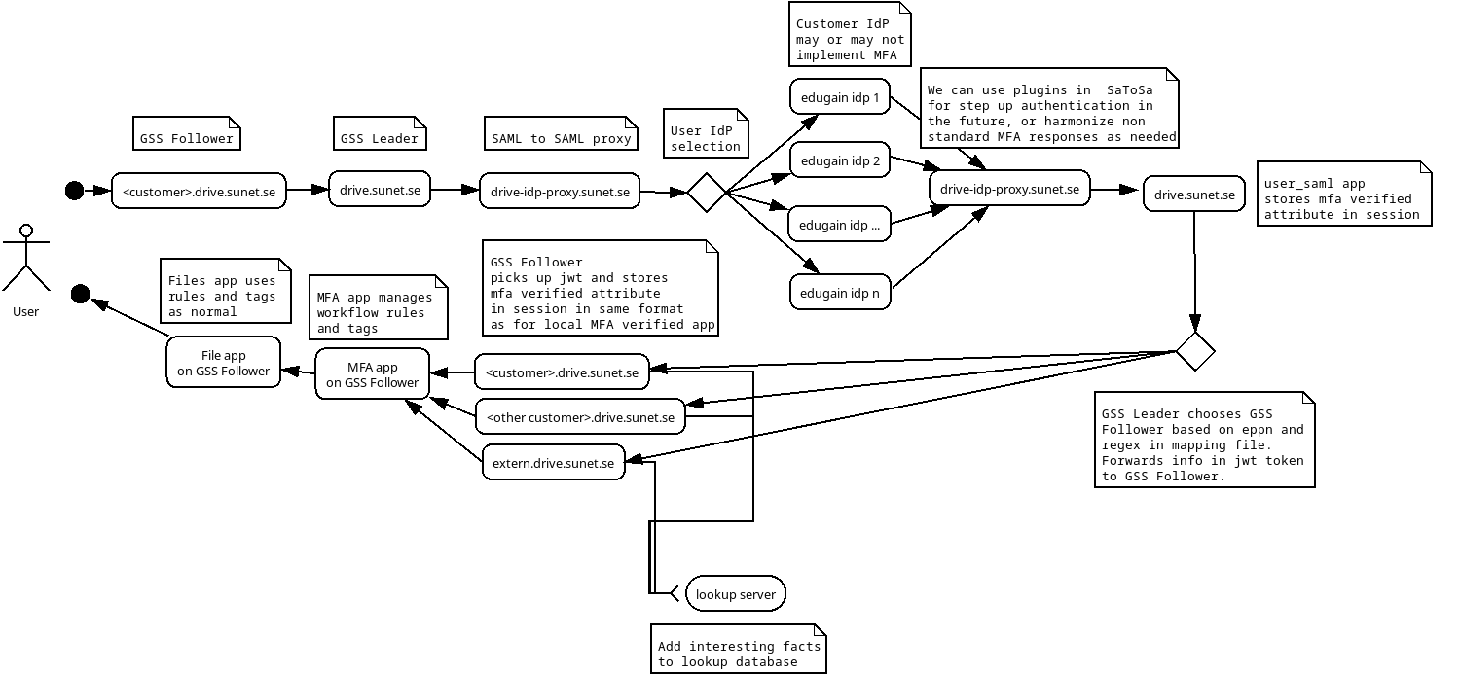
Implementation

Slide 11
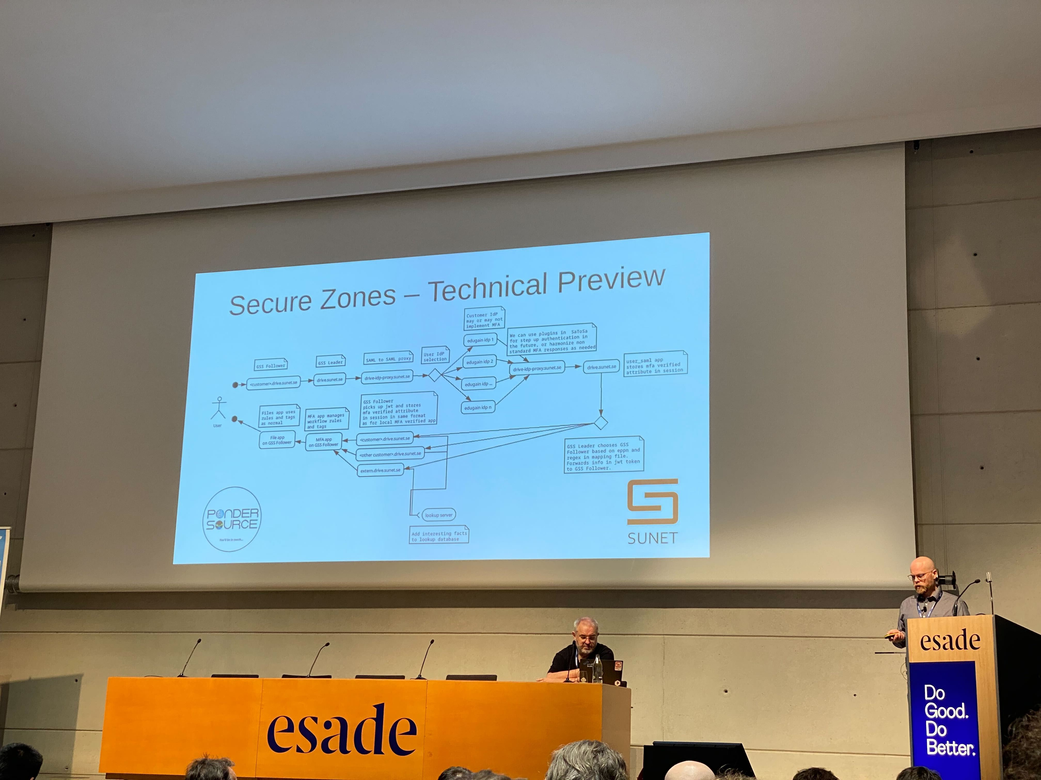
Secure Zones - Status
Project in 6 steps:
Show a boolean flag from user_saml app in Nextcloud ✓
Create a Deny-All zone in Nextcloud ✓
Show boolean flag from gss client as well as from local passwordless + MFA ✓
In Files app, make MFA-only zone accessible if flag is set ✓
GUI for creating and viewing MFA-only zones ✓
Security Audit ⏱

Slide 12
Thank you
Any questions?
freitag@sunet.se
leifj@sunet.se

