Slide 1
Connecting the stars
Chile, the astronomical capital 2025
Albert Astudillo Barraza Sergio Cofré Morales
Tirana, Albany.
7th of June, 2023.

Slide 2
Agenda
REUNA in numbers
Chile, astronomical capital 2025
REUNA’s Backbone
Chajnantor PoP
Patagonia Project
International Connectivity

Slide 3
48 Organizations
Non Profit
+80%
in Chile are part of REUNA and we want to integrate the entire R&E Ecosystem
+11.000 Km
REUNA is a non profit corporation
+30 Years
Research in Chile is carried out by institutions connected to REUNA
of network infraestructure
Promoting the digital development of Chile
3

Slide 4
We are advancing towards a great digital platform with national coverage
An Enabling Infrastructure for Research and Education
REUNA Network
Presence in 14 regions
Backbone Network Infrastructure with a backup services or links
24x7 NOC in house
PATAGONIA Network
Reaching Coyhaique
Next step Punta Arenas
In the future connecting Antarctica
4

Slide 6
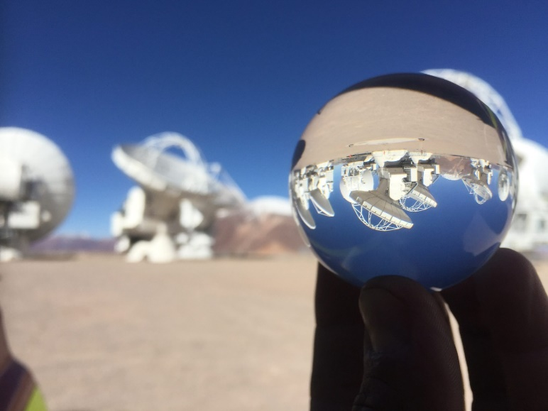
Chile, the astronomical capital 2025
Chile has privileged conditions for astronomical observation: clear skies, few cloudy days a year and high mountains.
The next instruments to be installed are the Giant Magellan telescope and the Extremely Large Telescope.
They are installed in remote locations.
These instruments generate a large amount of data which needs to be transported for processing.
It is estimated that by the year 2025 Chile will concentrate more than 70% of the observation capacity installed worldwide.
Credits: Juan Carlos Rojas (ESO/NAOJ/NRAO)

Slide 7
Rich collaboration with the astronomical community through REUNA history
2005
AURA becomes the first non-university organization member of REUNA
2012
ALMA and REUNA signed MoU for the managing of the network
2020
AAP and REUNA signed MoU to collaborate in the implementation of network infrastructure to deliver services to projects located on the Chajnantor plateau
2010
EVALSO Project Infrastructure was build together with ESO to deliver network services from Antofagasta – Santiago to ESO/ALMA/REUNA/RedCLARA
2018
Vera Rubin Observatory connects to REUNA to send its traffic to USA using a link between La Serena – Santiago of 100 Gbps
2022
ESO becomes a member of REUNA
Notes:
.

Slide 8
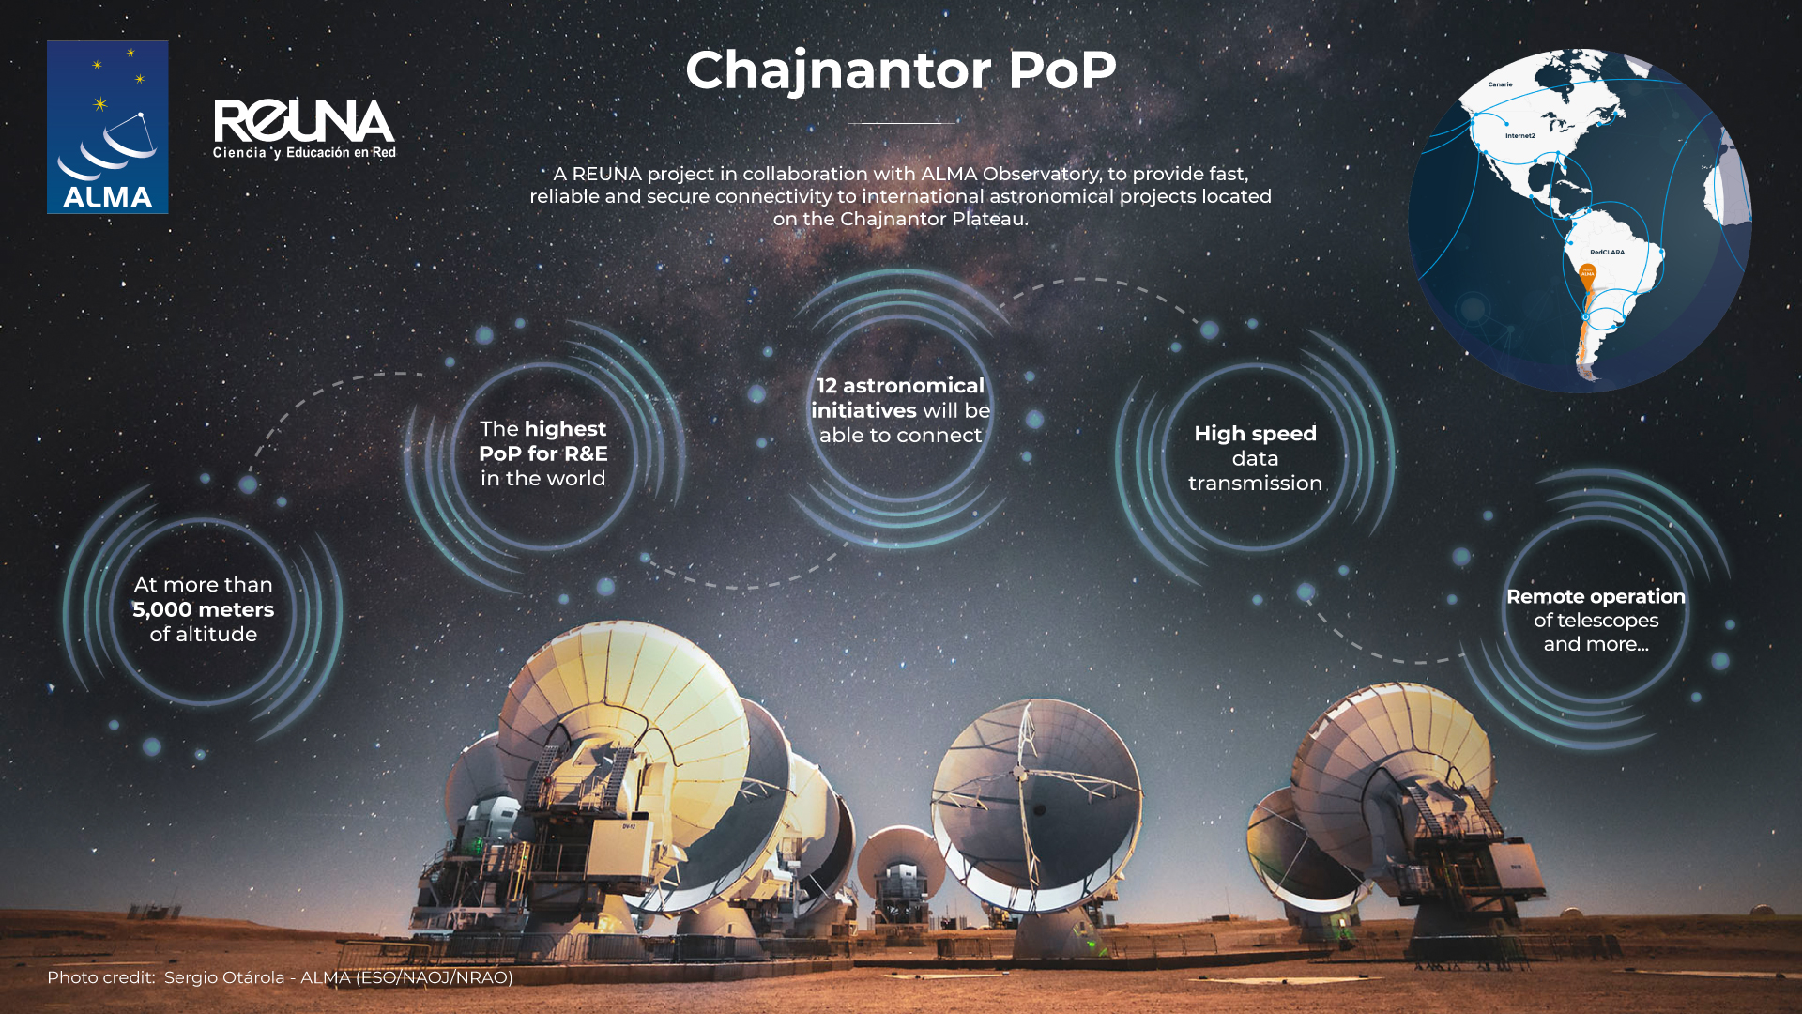

Slide 9
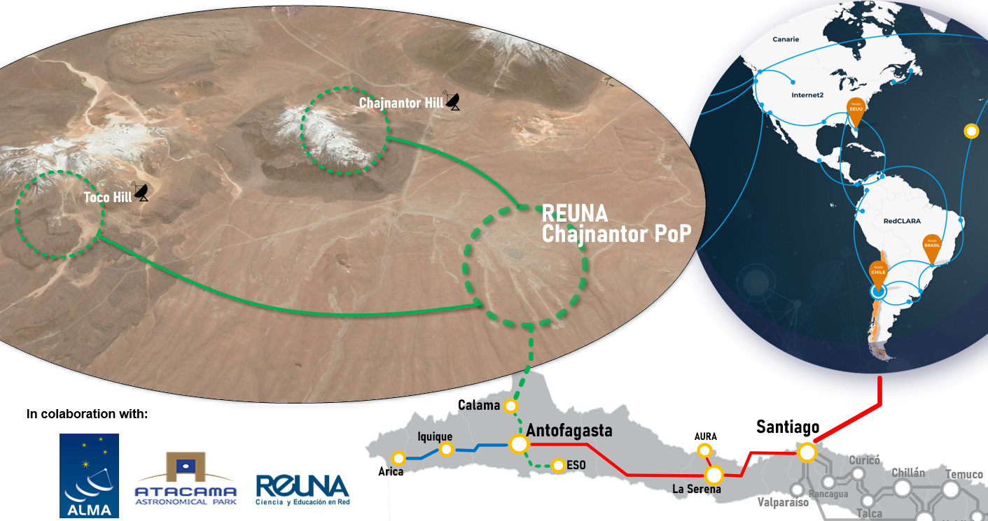
A collaborative physical connectivity
REUNA, through a collaboration agreement with ALMA, accesses a portion of the connectivity infrastructure and installs its PoP in the ALMA data center in AOS.
The telescopes, or the Park, make agreements with ALMA to achieve last-mile connectivity to connect the various hills to the REUNA PoP.
A CWDM solution is the current proposal of connectivity.
The first telescope connected is expected for first half of 2024

Slide 10
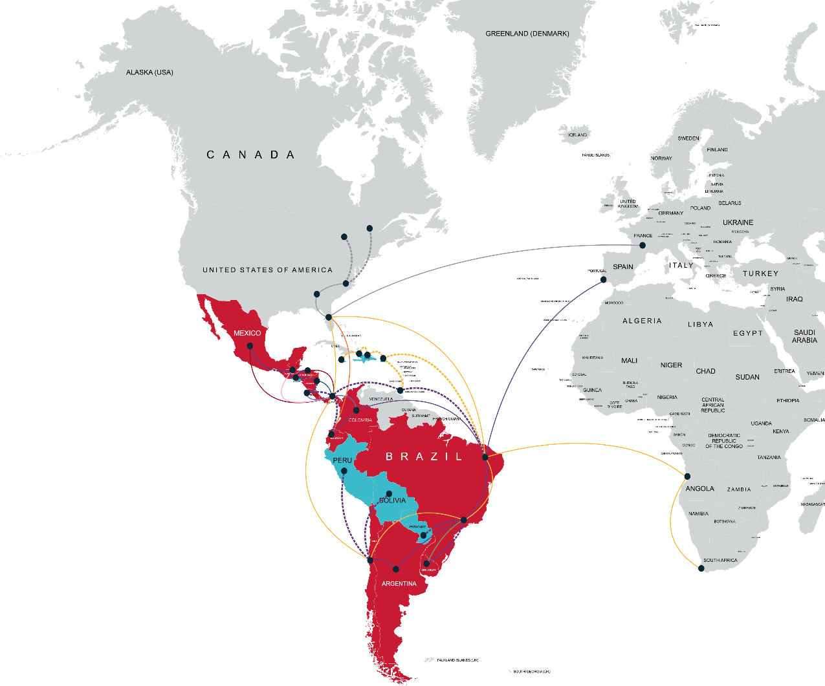
International Reach
Much of the astronomical research community is distributed around the world.
International connectivity is key for data transmission and remote management of instruments
We are founders of RedCLARA and members of BELLA.
We hope to strengthen Latin American academic connectivity through the BELLA II project, incorporating Peru, Bolivia and Paraguay through new connections.

Slide 11
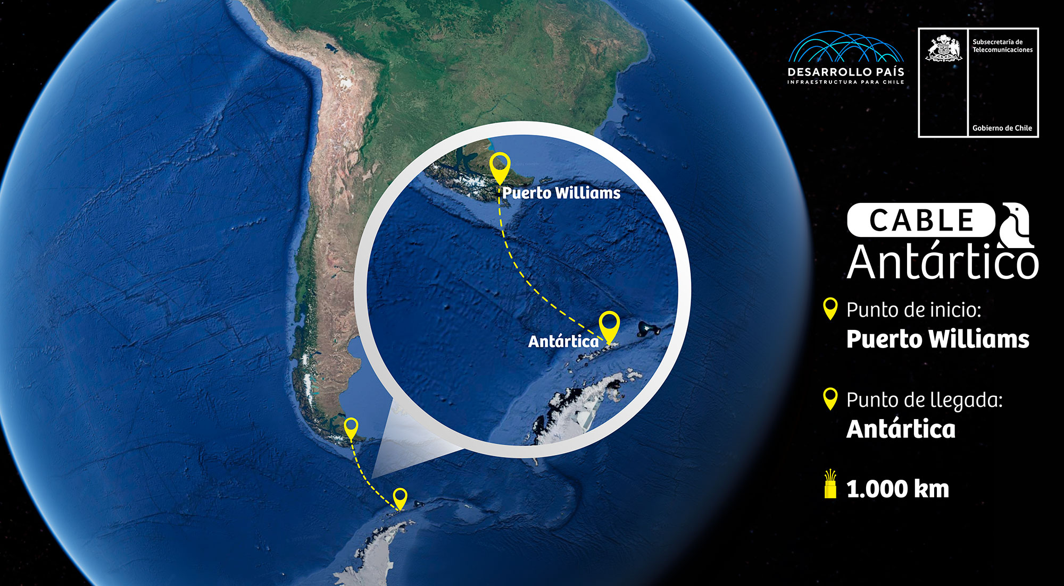
Next Challenge: Connecting Antarctica
Proyecto Conexión Antartica.
More than 20 countries use Punta Arenas as a gateway city to Antarctica
Starting Point
Arrival Point
Image Credits: Desarrollo País

Slide 12
Thank you
Any questions?
aastudillo@reuna.cl scofre@reuna.cl

