Slide 1
Path to a European Digital Educational Infrastructure
Erik Kikkenborg, NORDUnet
Gyöngyi Horváth, GÉANT

Slide 2
Education layers
Tools
& Services
Foundation
'plumbing': inter-institutional interoperability
Protocols, standards and services
enables all layers above
Platforms, procurement, ...
Notes:
Path to a European Digital Educational Infrastructure – Erik and Gyongyi
The top layer includes educational services. The universities offer these to their students. There might be merit for the NRENs to develop a platform that the universities can use to deliver these services (e.g. LMS platform). NRENs can create platforms for many such services that can bring direct value to the universities and their educational work.
In the middle layer, we have the "plumbing" required to ensure interoperability between services and systems across universities. This layer includes the protocols, standards and services ensuring data interoperability and exchange across universities. ELM, the EWP services, the Academic Digital Credentials etc, are focusing on this layer.
At the lower layer, we have the building blocks required to enable all the above layers. The EU ID Wallet, MyAcademicID, ESI, OpenID Connect VC are relevant for this layer. Currently, GÉANT is strong at the lowest layer.
The foundation layer – the network NRENs and GÉANT provides to educational institutions and eduroam. (Traditional role.)

Slide 3
Education layers
The top layer includes educational services. The universities offer these to their students. There might be merit for the NRENs to develop a platform that the universities can use to deliver these services (e.g. LMS platform). NRENs can create platforms for many such services that can bring direct value to the universities and their educational work.
In the middle layer, we have the "plumbing" required to ensure interoperability between services and systems across universities. This layer includes the protocols, standards and services ensuring data interoperability and exchange across universities. ELM, the EWP services, the Academic Digital Credentials etc, are focusing on this layer.
At the lower layer, we have the building blocks required to enable all the above layers. The EU ID Wallet, MyAcademicID, ESI, OpenID Connect VC are relevant for this layer. Currently, GÉANT is strong at the lowest layer.
The foundation layer – the network NRENs and GÉANT provides to educational institutions and eduroam. (Traditional role.)

Slide 4
Identity layer – the enabler
In order to enable safe and secure access we built on top of eduGAIN:
MyAcademicID
ESI (European Student Identifier)
Verifiable credentials
Wallets

Slide 5
‘Plumbing’ – inter-institutional interoperability
Higher education institutions are rolling out services such as:
Data exchange (student records) between universities (e.g. Erasmus+)
More active role of GÉANT and NRENs:
Protocols
Standards
Interoperability
Notes:
HEIs needs to be part of the EWP network in order to roll out Erasmus.

Slide 6
Top layer
Higher education institutions are rolling out services such as:
Learning Management Systems
Educational resources
Video conferencing
More active role of GÉANT and NRENs:
Procurement
GDPR
Technical specification for vendors

Slide 7
The educational ecosystem
Network
eduroam
Trust & Identity
MyAcademicID / ESI / Wallets
Open badges / Digital credentials
EWP APIs
ELM data exchange
DLEs / Videoconferencing / Online, Blended and remote delivery of education
E-Content / Digital assessment and testing / Learning analytics
Student Management Systems
GÉANT
NRENs
HEIs
Notes:
HEIs needs to be part of the EWP network in order to roll out Erasmus.

Slide 8
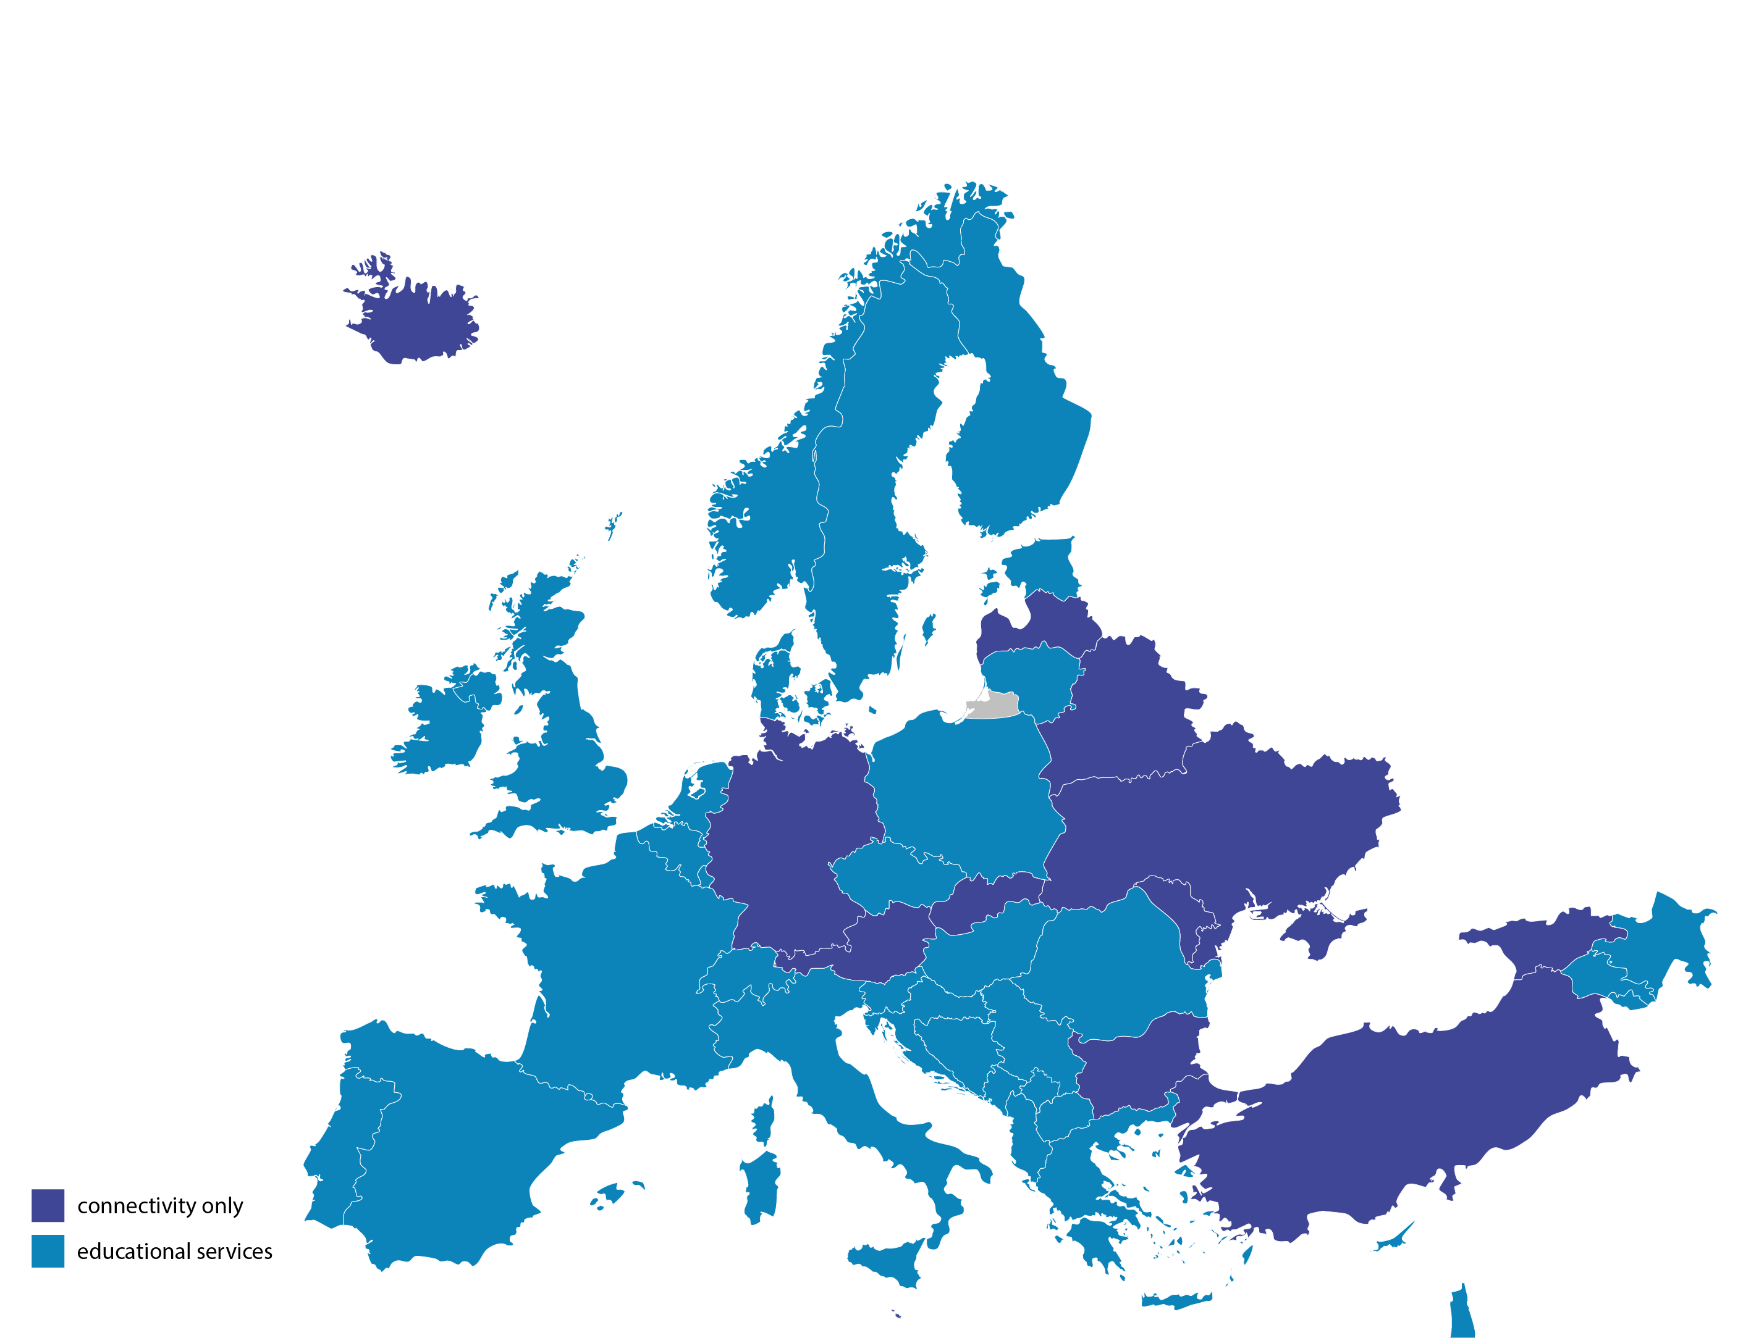
GÉANT NREN educational services

Slide 9
TF EDU surveys
2019-2023
Digital Learning Environment
Student
Management
Systems
Online, blended and remote delivery of education
Providing e-Content
Edu services =
services for teaching and learning
services for administration of education institutions
Video
Conferencing
T&I
Open badges, digital credentialling
Inhouse built tools by your NREN for digital learning
Educational
Data mining and Analytics
Learning
Analytics
Digital assessment and testing
Support for off shore students

Slide 10
Challenges for NRENs
Country situation
NRENs’ mandate varies
Business models
Legal situation
Resources
Interoperability
Individual / national developments – interoperability, standardization
Procurement
Transferability

Slide 11
Stepping up collaboration
NRENs and universities have a strong tradition of collaboration.
Europe has shown its strength in collaboration and joint agreements.
The European educational sector proved to be able to set a common agenda.
Now it’s time!

Slide 12
Thank you
Any questions?

