Slide 1
Do you see what I see?
IVRE at work
Tim Waters BICT MscBA
Tirana, Albania
7th June 2023

Slide 3
What options do you have?
To investigate how many systems are affected:
Check inventory software what server software has changed
Scan all your servers for certain binaries
Scan your webservers for changed HTTP-headers
How to construct a timeline?

Slide 4
IVRE to the rescue
Why the bottle?
IVRE means ‘drunk’ in French

Slide 5
IVRE to the rescue
Solution might be the IVRE recon framework
Can import masscan/nmap/zeek/bro data to create a fingerprint of the network at one point in time
When run daily, can be used to ‘go back in time’ and see changes throughout the network
In previous scenario, you could go back and see when the HTTP-header of a server changed. Can thus be used to track down patient zero ( the one where the HTTP-header changed first).

Slide 6
Deep dive IVRE
Filter shortcuts
Create/edit comments on Wiki
Host + scan description
Filters
Port status
Top values

Slide 7
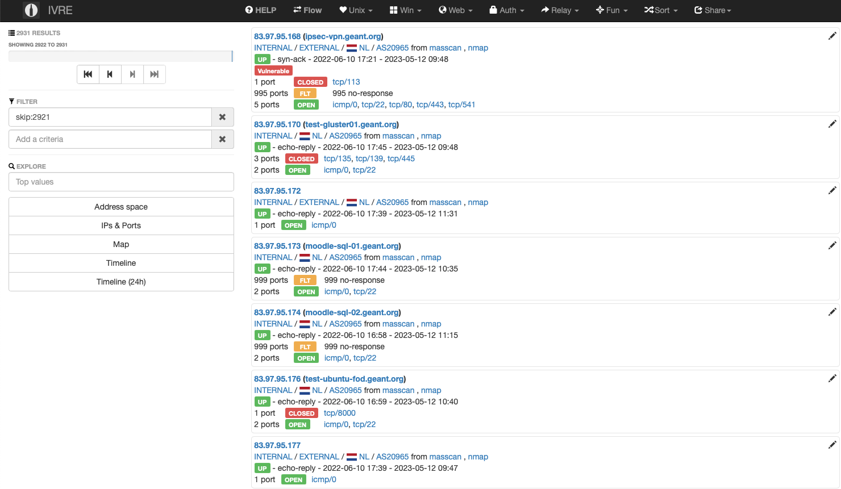
Deep dive IVRE
IP/DNS
Category / Country / AS
Scan sources that contributed
Port status

Slide 8
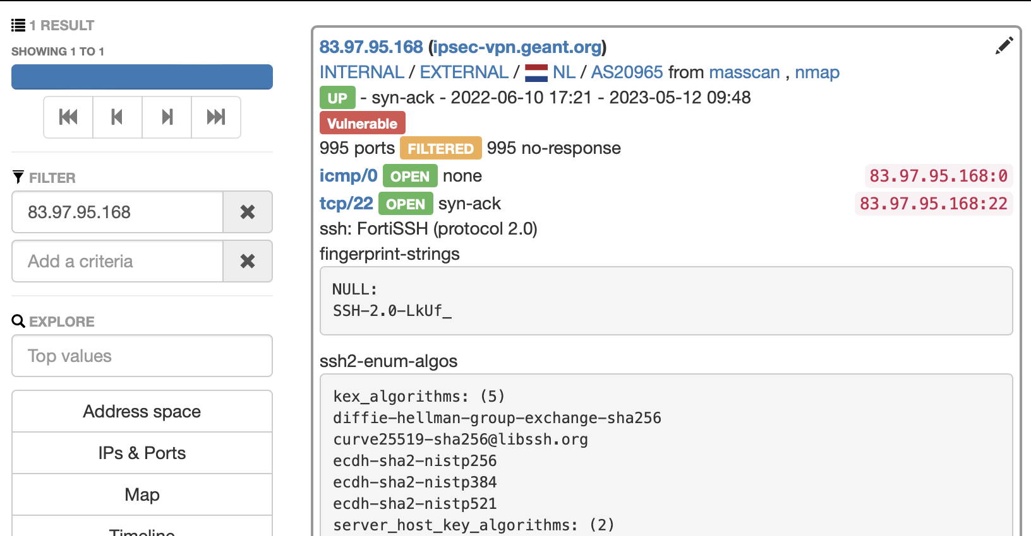
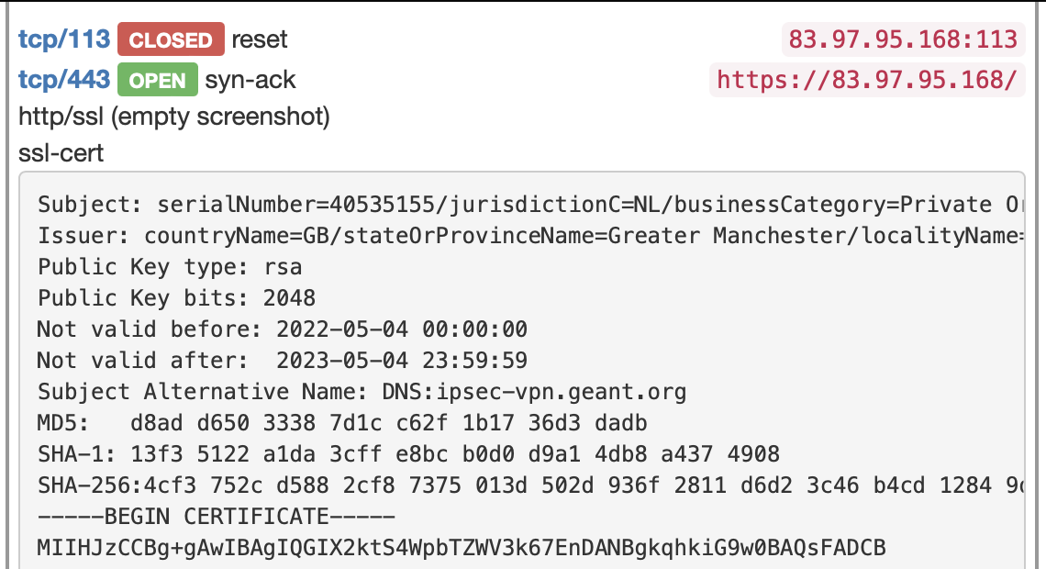
Deep dive IVRE

Slide 9
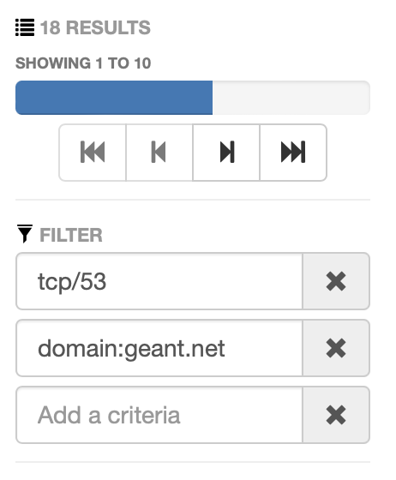
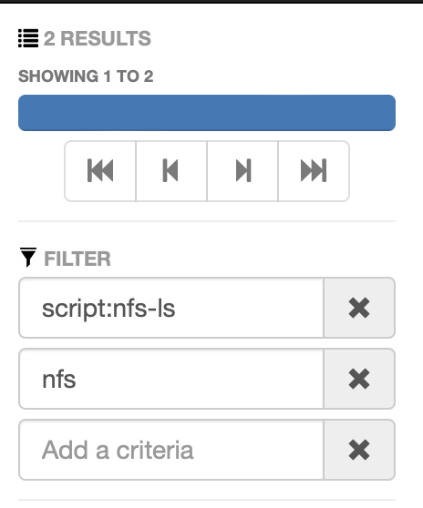
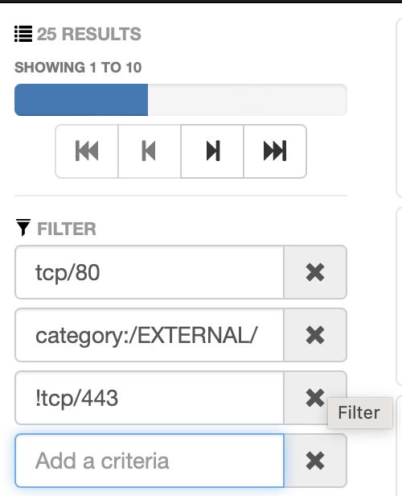
Deep dive IVRE - filtering
Find dns servers in an particular domain
Find servers with open NFS exports
Find internet facing websites with port 80 open but not 443/SSL

Slide 10
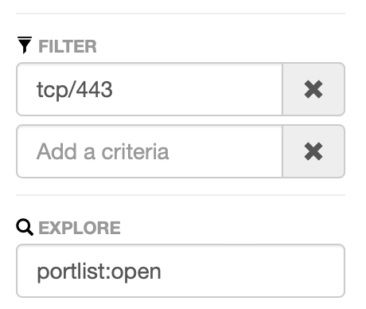
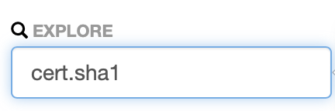
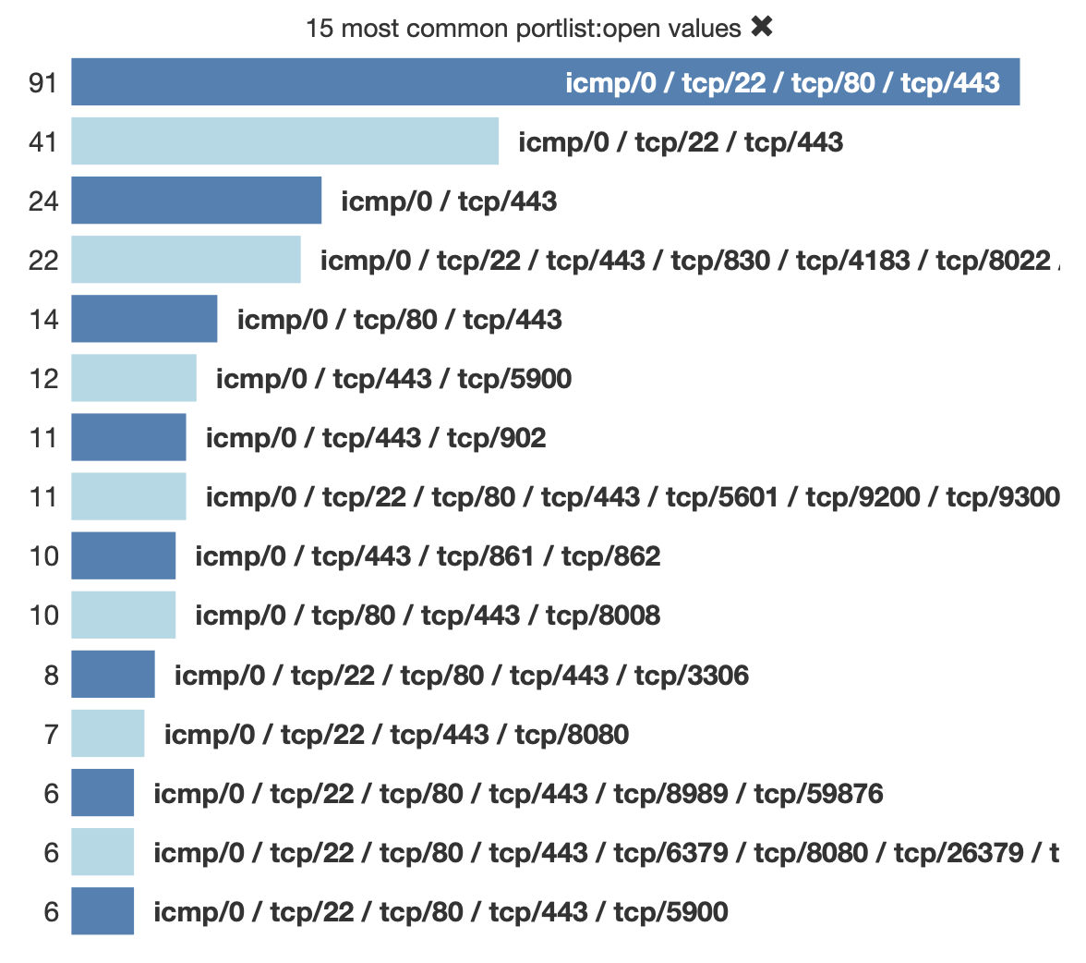
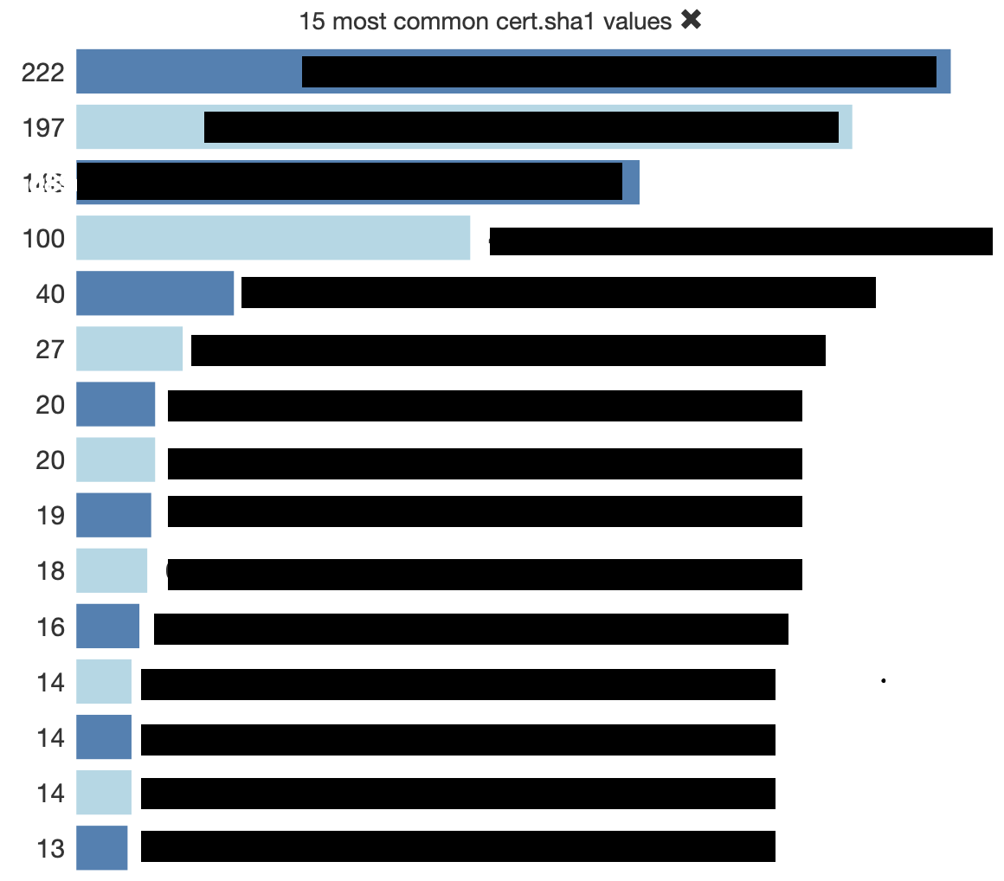
Deep dive IVRE – filtering + aggregation

Slide 11
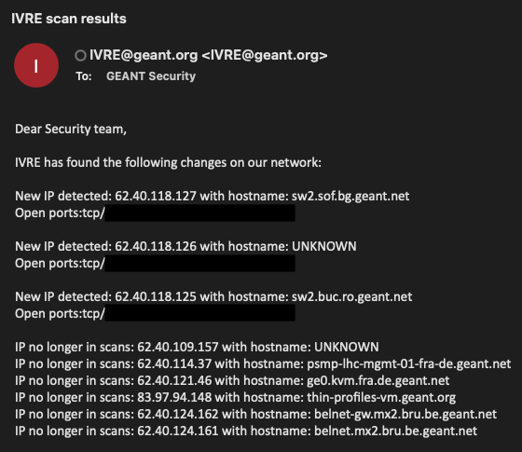
GÉANT specific implementation
Newly added IP’s in a specified timeframe

Slide 12
GÉANT specific implementation
Newly opened up ports on a host in a specified timeframe

Slide 13
Other useful use cases
From an incident response perspective:
Did a port open up or close?
T1601 – Modify / patch / downgrade system image
T1095 – Non-application Layer Protocol
T1571 – Non-Standard Port
Did the service fingerprint / HTTP headers change?
T1601 – Modify / patch / downgrade system image
Notes:
Numbers are reference to the MiTRE ATT&CK framework

Slide 14
Other useful use cases
From a (security) compliancy perspective
Find unmanaged machines / IoT-devices that run outdated software
Find software that should not be running
6881-6889 (bittorrent), 1194 (OpenVPN)
Find (the number of) wildcard certificates used within the network
Find websites that do not do a hard redirect from port 80 to 443

Slide 15
What did we (internally) find at GÉANT using IVRE?
Several services that came up with vulnerabilities
NFS shares that could be read/write for everyone
VNC (remote desktop) tools without authentication
Structural problems
Servers using expired certificates
Wildcard certificates that are being used to widely

Slide 16
Feature / road map
Scan both from inside and outside
Be notified when new ports are opened up to the internet
Integration with commercial vulnerability scanner ( new hosts are added and scanned automatically)
Adding vulnerability scanning data ( Nuclei )
Further development and automation of use cases

Slide 17
Thank you
Any questions?
tim.waters@geant.org

