Slide 1
ACTIVE AND HEALTHY AGEING AT A SAFE-HOME
Michał Kosiedowski
Poznań Supercomputing and Networking Center
TNC 2023, Tirana

Slide 2
Agenda
The ageing challenge
Technology – how can it help?
Technology – will it help?

Slide 3
THE AGEING CHALLENGE

Slide 4
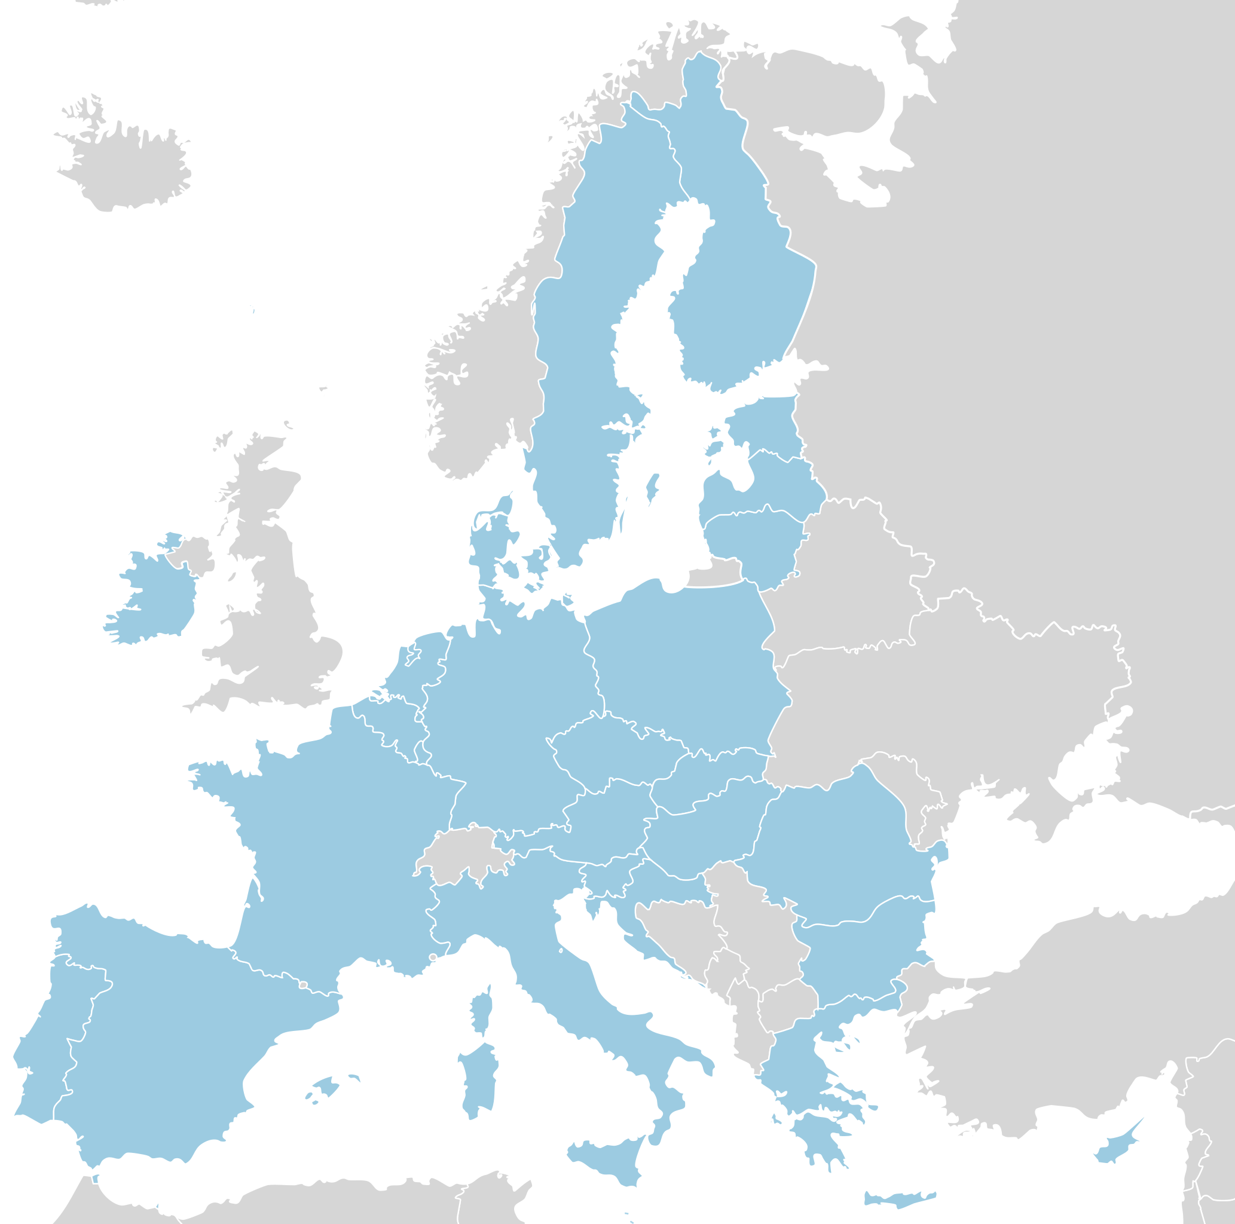
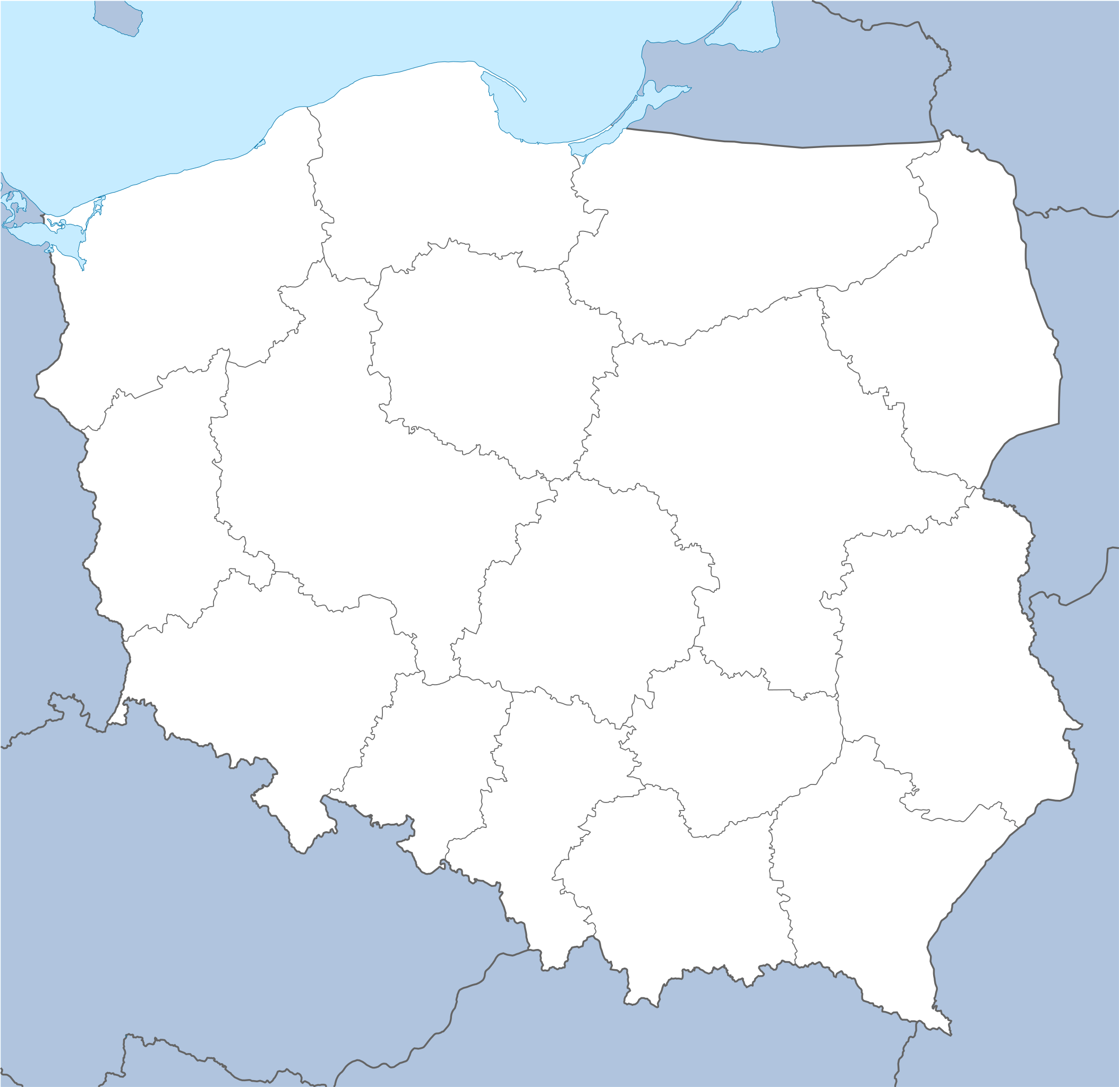
We are getting older
Every 3rd citizen will be aged 65+ in 2060 (Eurostat)
40.4% of population will be aged 60+ in 2050 & 9.6% will be aged 80+ (Główny Urząd Statystyczny)

Slide 5
Ageing-related challenges for social policy and welfare systems
Loneliness
Growing care needs
Dementia
Digital exclusion
Transition into retirement
Providing information and advise
Quality of living in care homes

Slide 6
Europe vs. the ageing challenge: technology
+ other international and national initiatives
Large(r) scale solutions: framework programmes
2005
FP6
2007
FP7
2014
H2020
2023
Horizon Europe
2008
AAL
2014
AAL2
2023
THCS
Specialized AAL services and applications: Ambient Assisted Living programmes

Slide 7
TECHNOLOGIES SUPPORTING ACTIVE AND HEALTHY AGEING

Slide 8
Involvement of PSNC in solving the ageing challenge
COORDINATOR
COORDINATOR
COORDINATOR

Slide 9
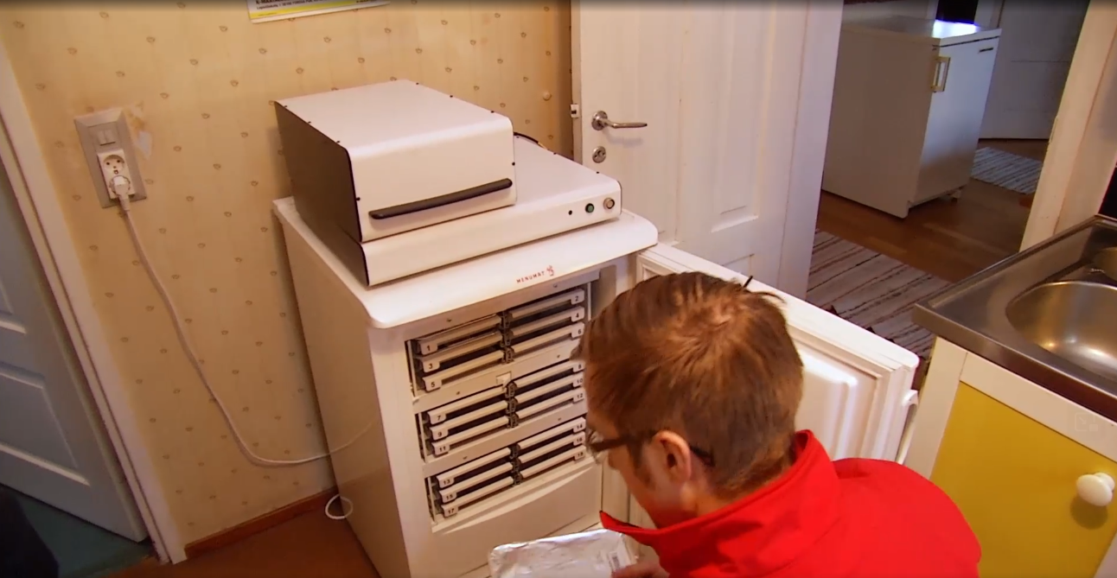
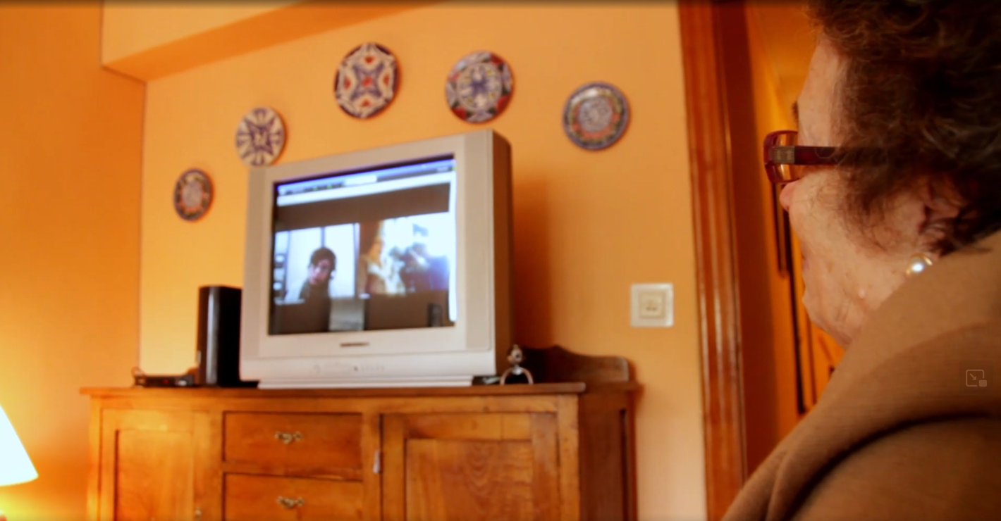
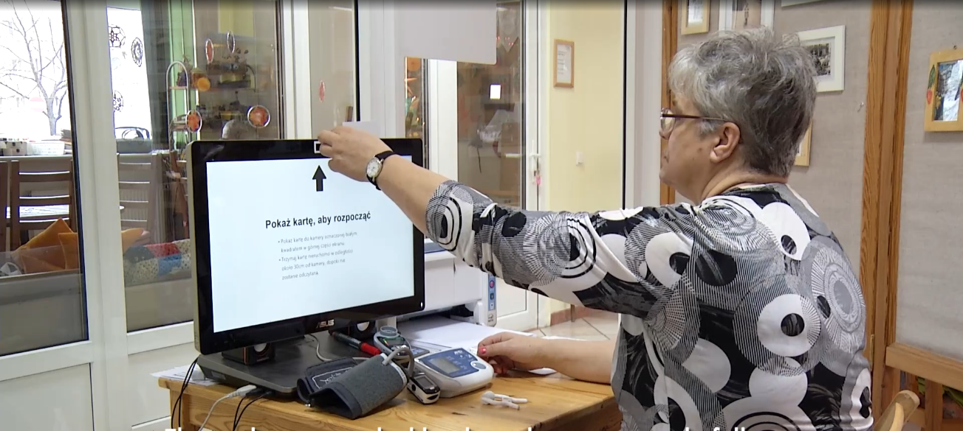
Historical technological solutions

Slide 10
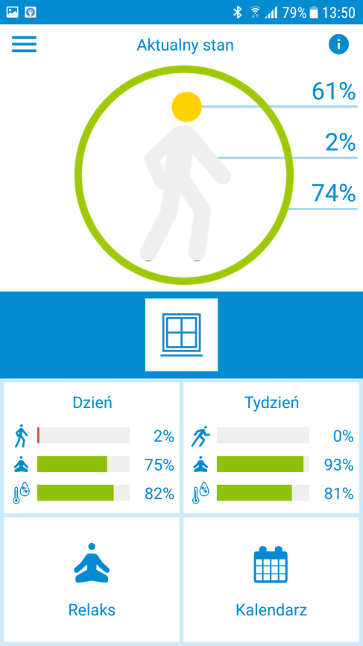
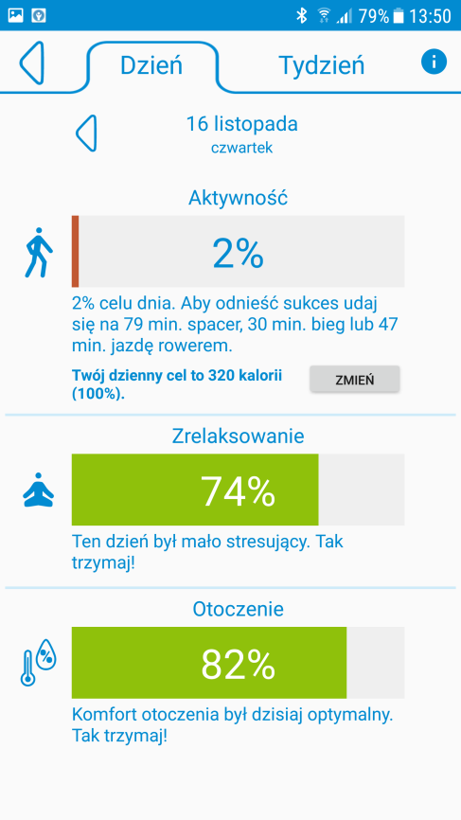
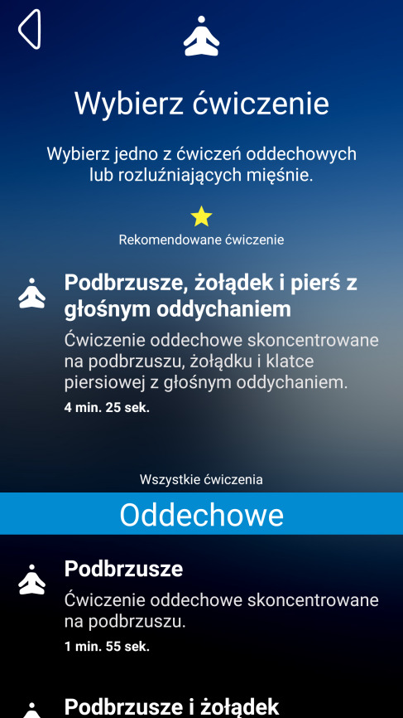

Slide 11
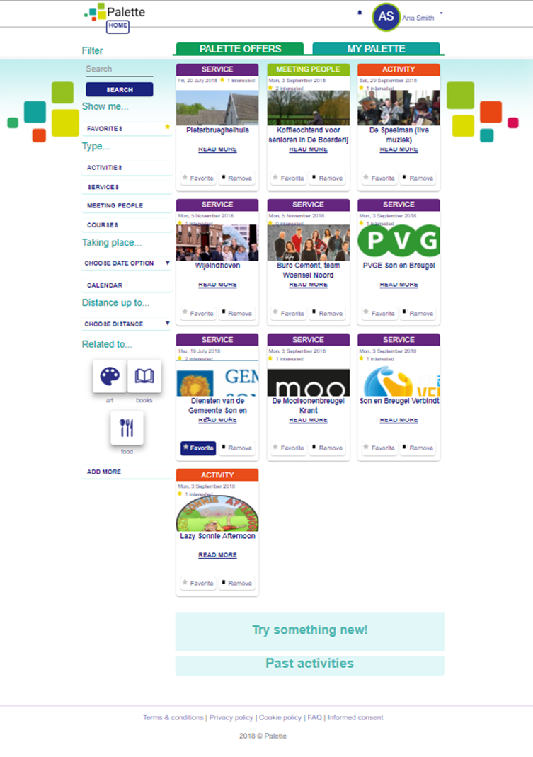
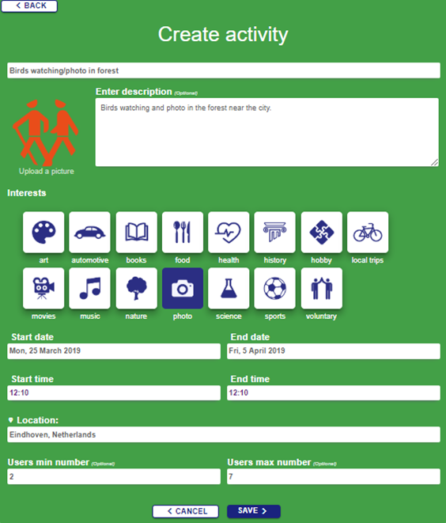

Slide 12
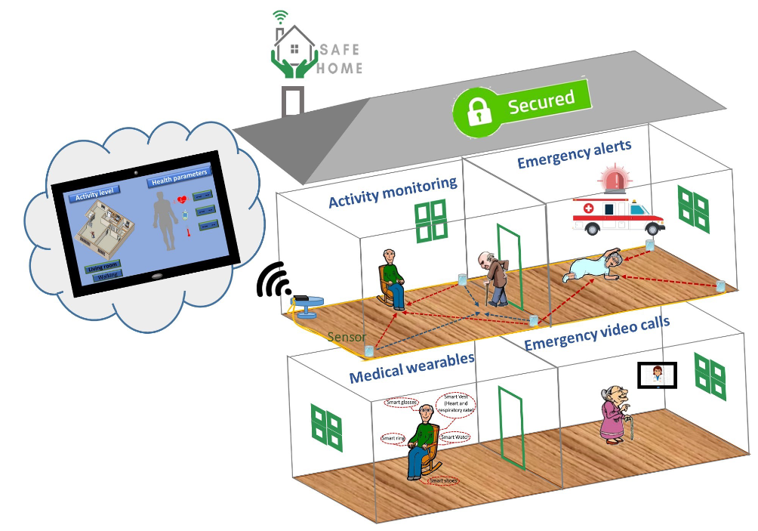
Security-Aware Fog-based Efficient Home Monitoring for Elders

Slide 13
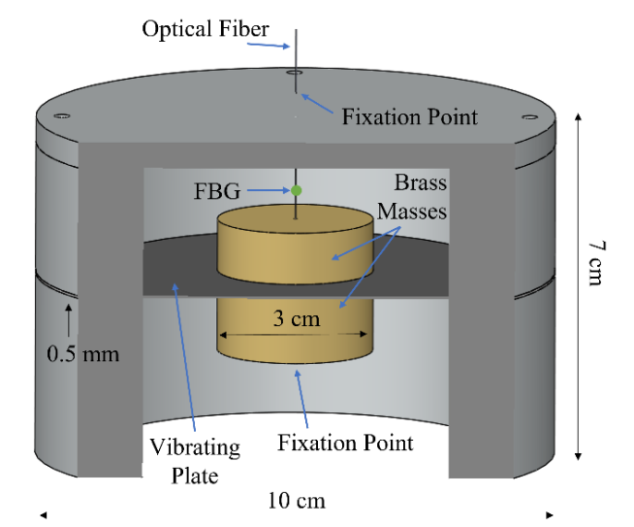
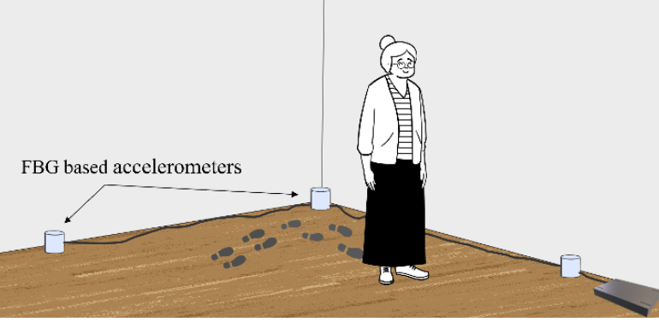
Tracking of location and walking, fall detection

Slide 14
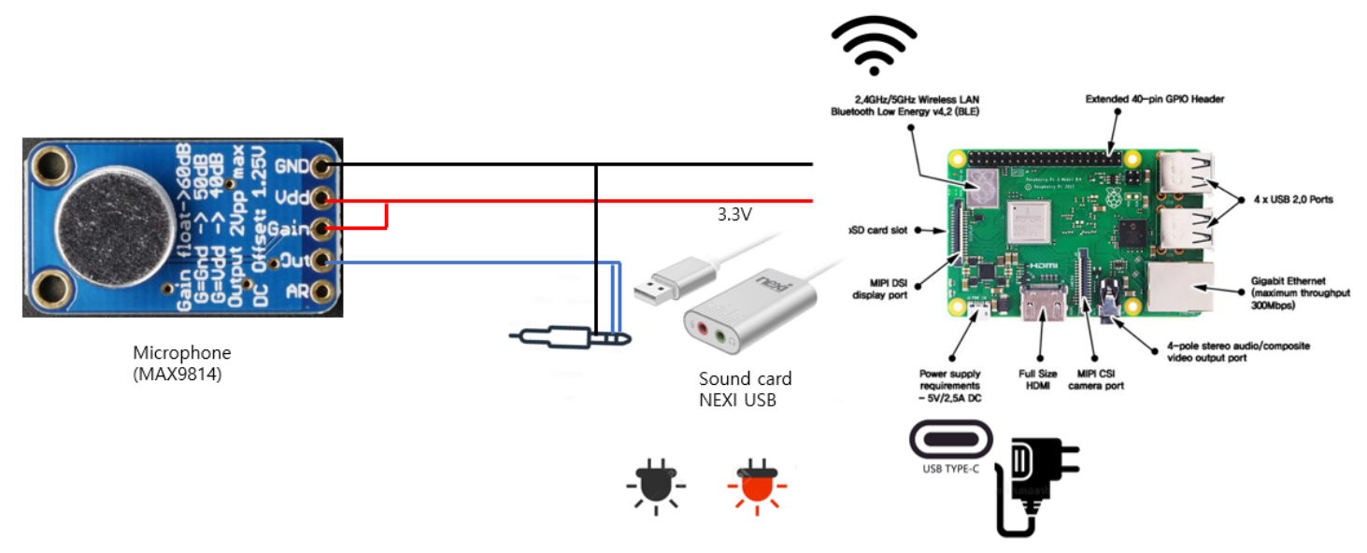
Sound-based event detection

Slide 15
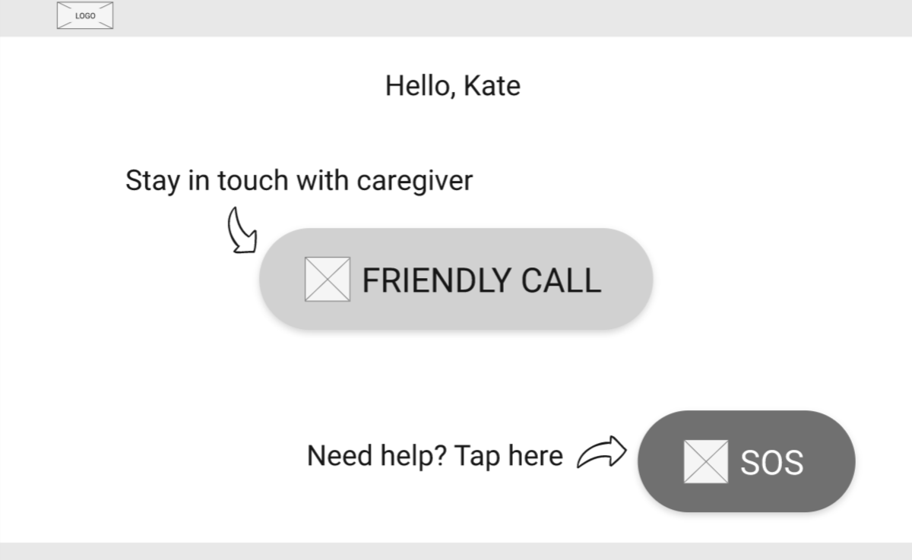
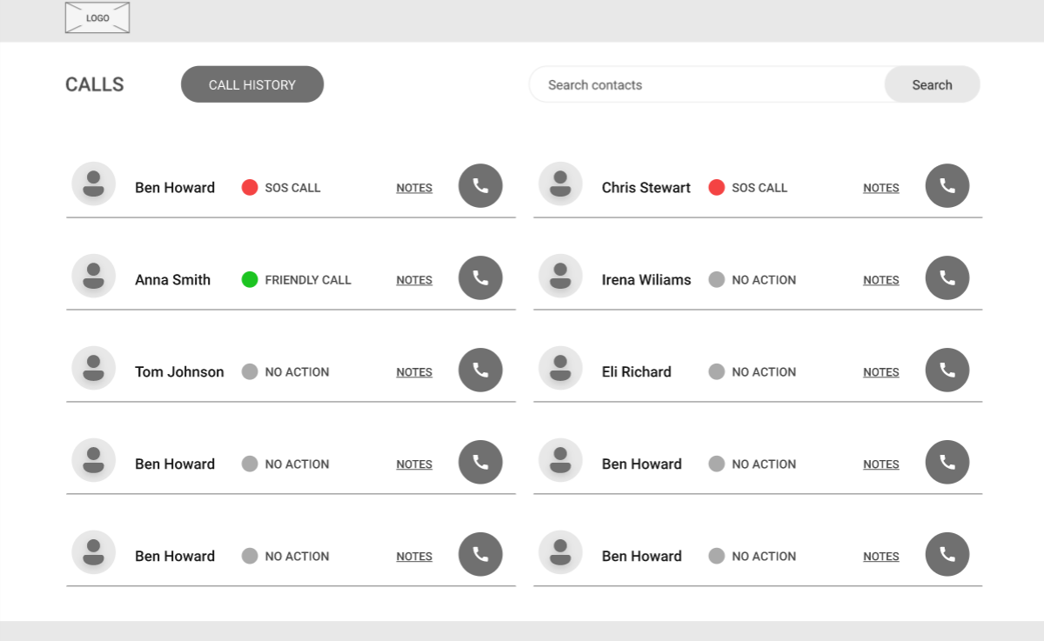
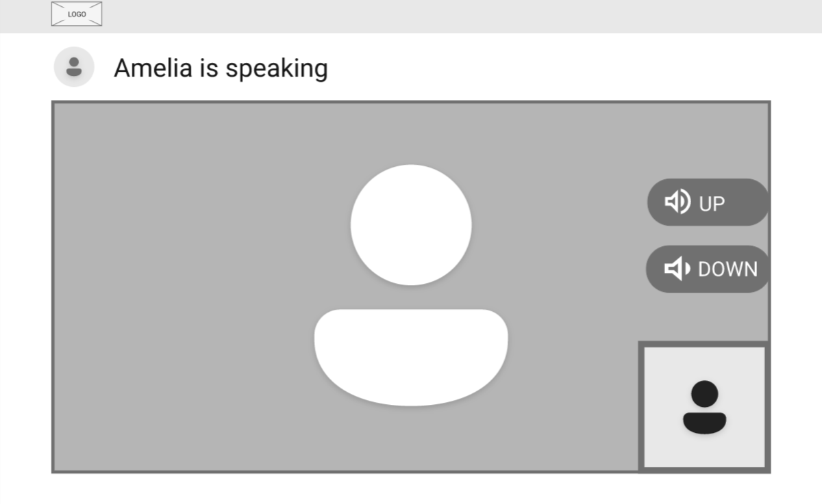
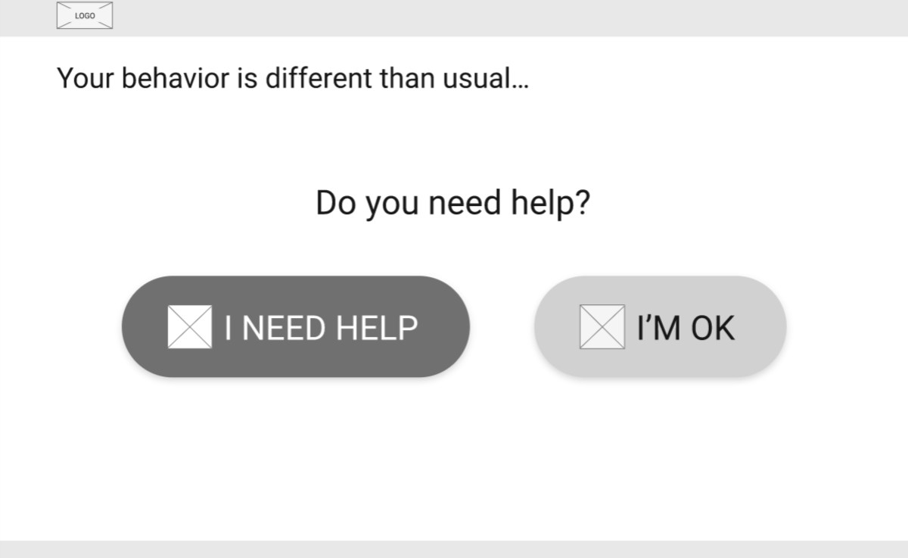
Emergency video calls

Slide 16
FUTURE OF ACTIVE AND HEALTHY AGEING TECHNOLOGY

Slide 17
Funding development of innovative AAL products – has it been successful?
A significant number of new products and services has been developed and proposed
Market success is not so great though

Slide 18
Little (silver) market success – the reasons
Technology cost: older adults cannot afford it
The social welfare system in Europe is primarilly public!

Slide 19
Flexibility of the (integrated) service offer
integrated solution that can support older adults in managing their health as they age
personalizable environment in which all key aspects of older adult’s health can be addressed with specialized AAL services and applications
smart selection of services adequate to the current needs of the end user, ranging from assisting them in preventing diseases, detecting symptoms of increased risk of health deterioration up to the management of life with chronic diseases

Slide 21
Who is the customer?

Slide 22
THANK YOU FOR YOUR ATTENTION

