Slide 1
A QKD Network Including Coexistence of Quantum and Classical Signals
Experimental demonstration on the Paduan QKD network
Giulio Foletto (UniPD), Matteo Colantonio (GARR)
TNC23
08/06/2023
This work is partially funded by the Quantum Secure Networks Partnership (QSNP)

Slide 2
Introduction to QKD and Quantum Networks
Matteo Colantonio – matteo.colantonio@garr.it
Notes:
In the second part of the presentation we will show some of our experimental results and discuss the details of our particular implementation of the quantum key distribution network that we are building in Padova.

Slide 3
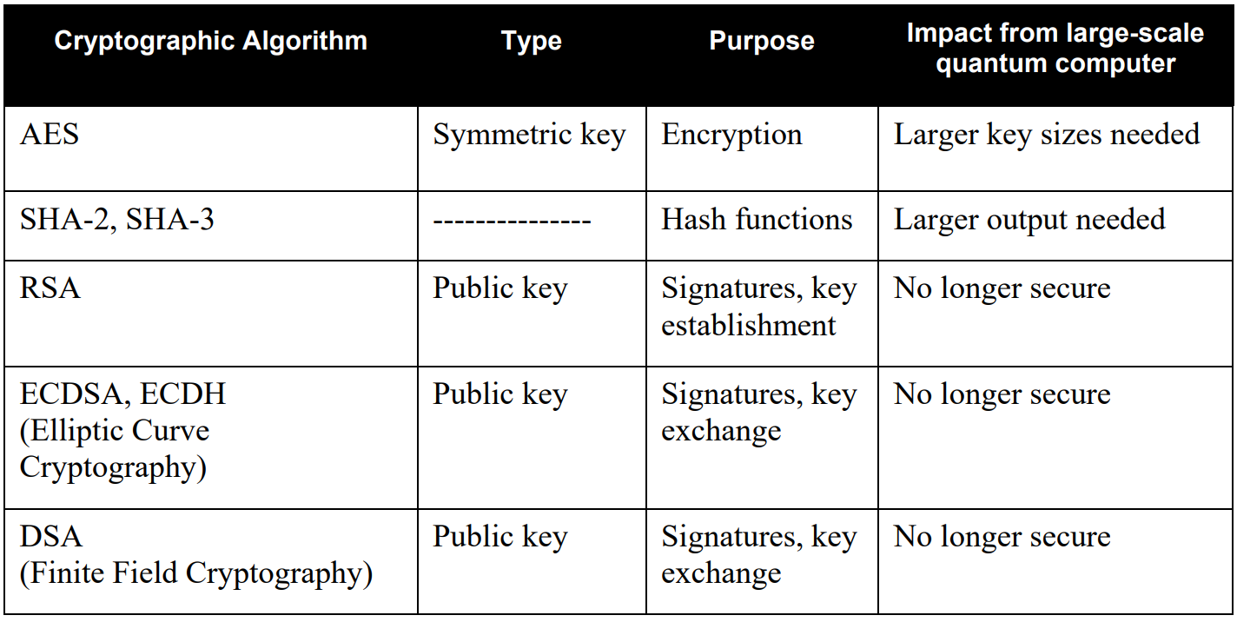
The Impact of Quantum Computers
“This [large-scale quantum computer] would seriously compromise the confidentiality and integrity of digital communications on the Internet and elsewhere.”
NIST.IR.8105
Notes:
Key points:
The quantum computer can in principle break commonly used cryptographic algorithms (especially public-key ones)
Their security relies on assumption on the computational power of adversaries (and maybe these assumptions could be already broken now).

Slide 4
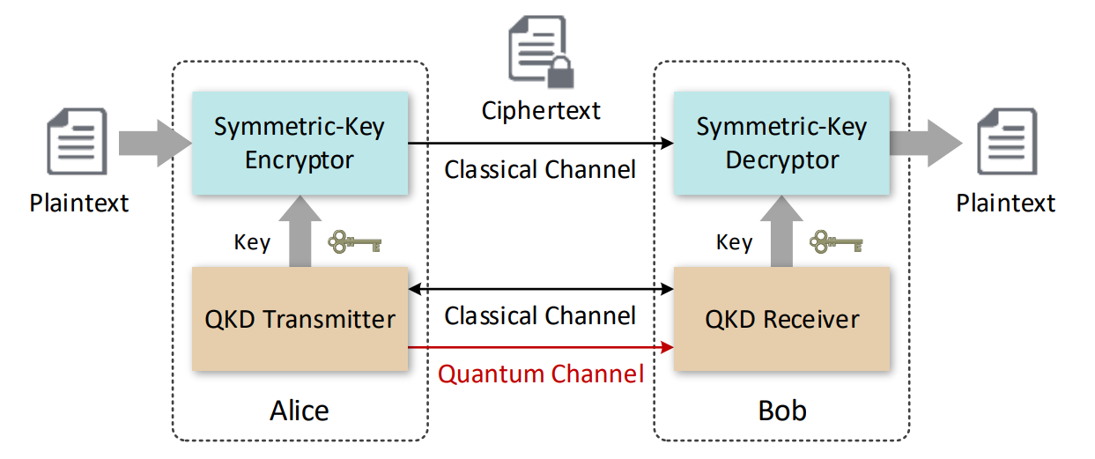
How to Keep Communications Safe
Algorithm | Application
CRYSTALS-KYBER | Public-key Encryption
CRYSTALS-DILITHIUM | Digital Signature
FALCON | Digital Signature
SPHINCS+ | Digital Signature
Post-Quantum Cryptography
NIST selected one public-key encryption algorithm
Might be vulnerable to future algorithms
Quantum Key Distribution
Unconditional security
Composable with unconditionally secure authentication or encryption algorithms
Future-proof
Notes:
Important points about QKD
Underline that it is a key exchange method
It is based not on algorithms but on the physical principles underlying the key exchange
Because of this, it offers unconditional security based on physical laws
Unconditional in this context means that it does not require assumption on the computational or mathematical power of an adversary
It does not offer encryption on its own, but can be combined with unconditionally secure classical encryption algorithms (vernam cypher) or authentication schemes (wegnam-carter)
This creates an unconditionally secure cryptography pipeline that is robust against future developments in technology or algorithm

Slide 5
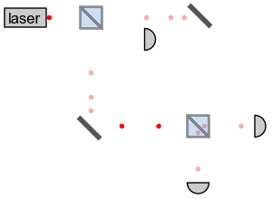
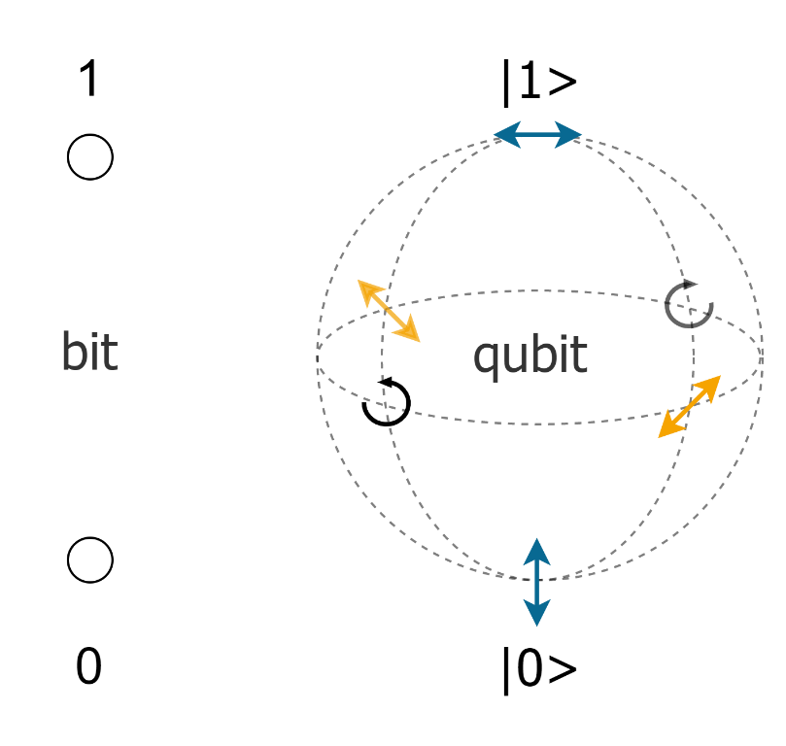
QKD Basics
Qubit
State of a 2-level quantum system (e.g. photon polarization)
Two orthogonal states $\left|\left.H\right\rangle ,\right|\left.V\right\rangle$ form a basis
Superposition state$α\left|\left.H\right\rangle +β\right|\left.V\right\rangle$(e.g. diagonal or circular polarization)
No-go theorems and principles
Superposition principle
Measuring a qubit changes its state (“collapse”)
No-cloning theorem
By user:Geek3 - Own work, CC BY 3.0, https://commons.wikimedia.org/w/index.php?curid=42554812
Notes:
The security of QKD is based on the core tenets of quantum theory, like:
The superposition principle, for which every state can be viewed as a superposition of others
The collapse principle, for which (in general) any quantum measurement changes the quantum state of the system it is applied to
The no-cloning theorem, for which an unknown quantum state cannot be reliably copied.
These mean that if a key is encoded in quantum system, every attempt to read it or copy it is detected.
For this to work, the encoding must use true quantum systems, and not (for example) ensembles of many copies of the same system.
The description of the simplest possible quantum system is the qubit, which is at the basis of many QKD protocols. This is the state of a two-level system, like for example photon polarization. Two orthogonal polarizations, like H and V, form a basis, and all the other states are superpositions of them.

Slide 6
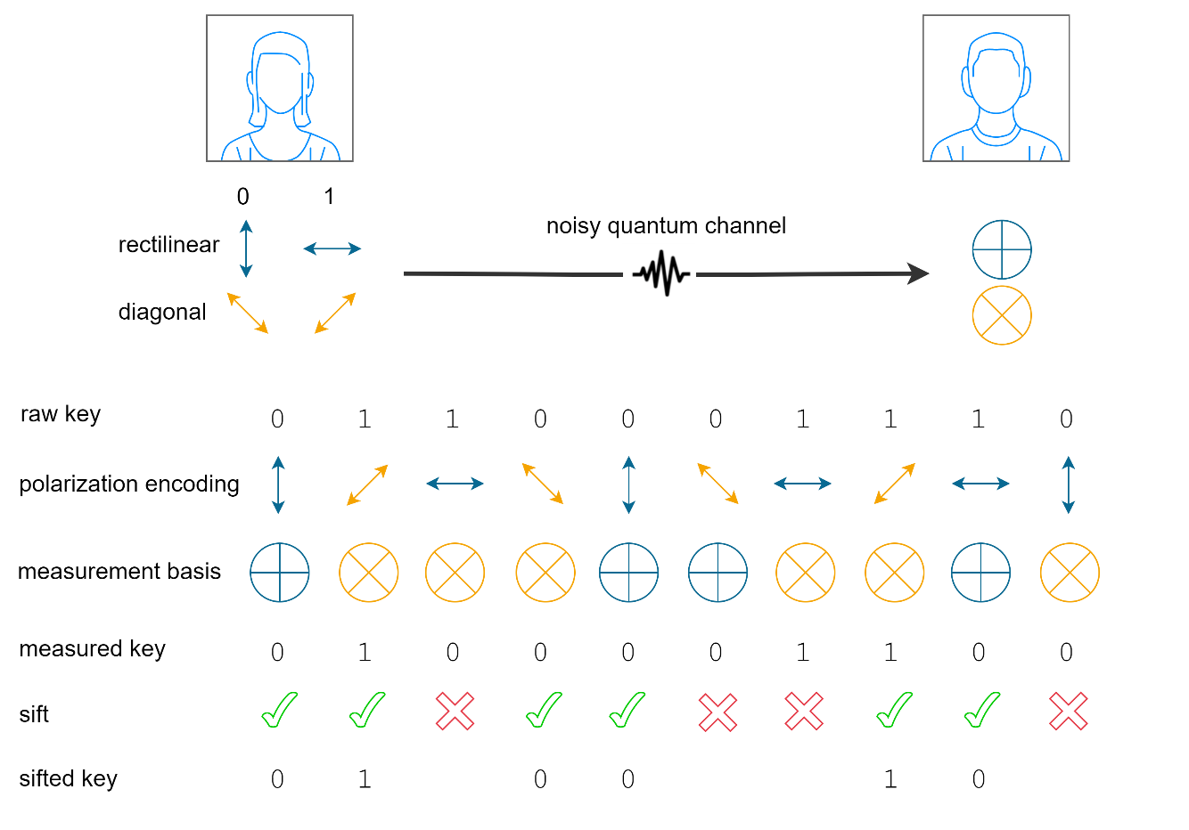
BB84 Protocol
Quantum transmission
Qubit preparation
Qubit measurement
Classical post-processing
Sifting
Parameter estimation
Error correction
Privacy amplification
Notes:
BB84 is the oldest and arguably the simplest QKD protocol. It is based on qubits and we will explain it using the language of polarization (although other degrees of freedom can be used)
Explanation
Alice randomly chooses one of two measurement bases (e.g. Rectilinear and diagonal) and selects one of the two states in such bases depending on the key bit she wants to encode
She prepares a single photon in the selected polarization state and sends it to Bob over the insecure quantum channel
Bob receives the photon and measures its polarization in one of the two bases, selected at random
After this is repeated many times to encode a long key, the quantum part is over and the classical post-processing can begin
Alice and Bob discard all the instances in which they selected different bases
They estimate the error rate (QBER) by publicly exchanging a small portion of the key
They reconcile their repective keys with classical error correction algorithms
They eliminate the eavesdropped information (related to errors) by shortening the key with a procedure called privacy amplification. The amount by which the key is shortened depends on the QBER

Slide 7
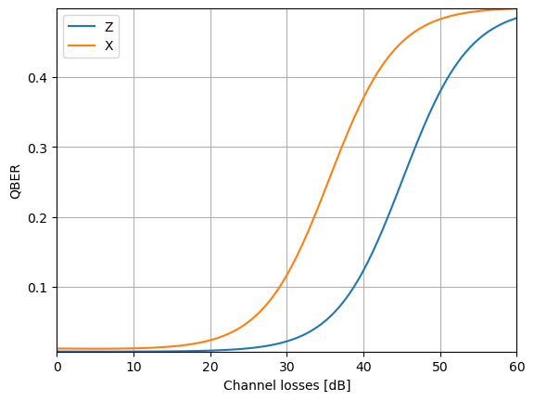
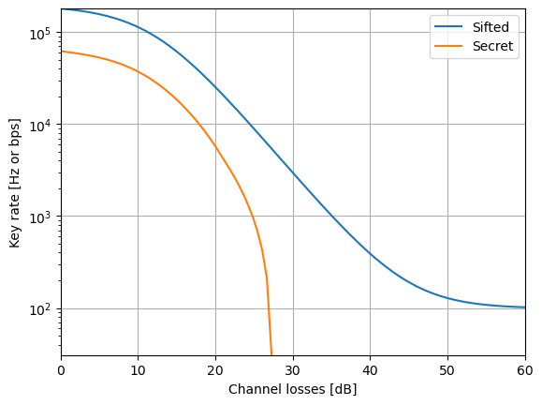
QKD Performance Indicators
Quantum bit error rate
Sifted and secret key rate
Example of the generic behavior of key performance indicators
Notes:
Here, we can see effect of losses on the relevant performance indicators of QKD, namely the QBER and the secret key rate (we also report the sifted rate for completeness). The specific numbers are arbitrary, although representative of a realistic QKD system, but the behavior of the lines is general. We can focus first on the orange line in the graph on the right, which shows the rate at which a secret key is produced. For intermediate losses, we see the characteristic trend for which the SKR decreases by a factor of 10 for every 10 dB of losses (like the sifted rate). For low losses the SKR plateaus because of the saturation of the detectors, while for high losses it drops to zero. This happens when the QBER (left graph) grows too much. This indicates that an eavesdropper might have learned part of the key, which is no longer secure.

Slide 8
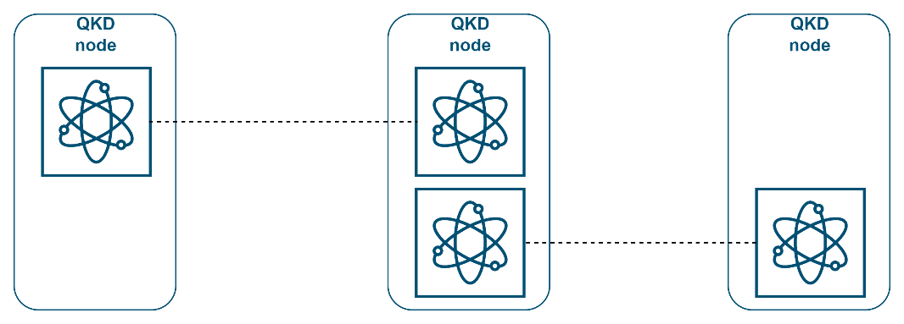
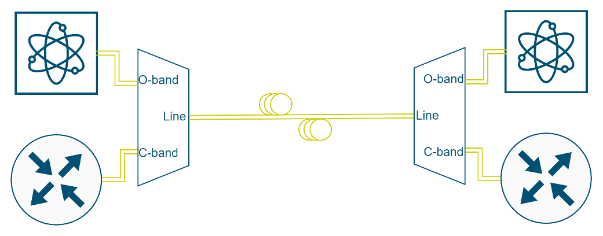
GARR and QKD
How could GARR infrastructure potentially be used to provide QKD between user sites?
What would be the implications/consequences on already deployed packet services?
How could GARR build a QKD network? Are dedicated fibres a must?
What about exchanging quantum states?
Field trials:
Access/Metro links
DWDM links
QKD networks
Bob
Alice
Metro optical fibre

Slide 9
QKD Networks
 | Optical Switching | Trusted Relay | Untrusted Relay | Quantum Repeater
Reach | - | ++ | + | ++
Scalability | - | ++ | - | +
Security | ++ | - | ++ | ++
Maturity | ++ | + | - | --
Standardization efforts by ETSI, ITU-T, ISO/IEC, IETF (Qinternet), IEEE (SDQC), CSA.
“Current Standardisation Landscape and existing Gaps in the Area of Quantum Key Distribution”, OpenQKD
Notes:
Key points:
The table shows possible ways to combine point-to-point links to form a network
Standardization efforts have been ongoing for some years and will continue

Slide 10
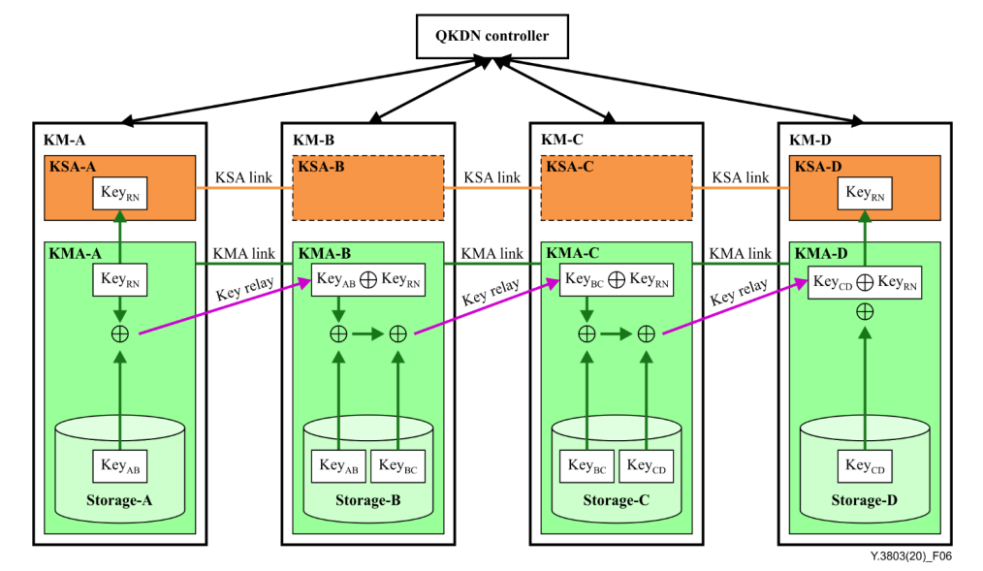
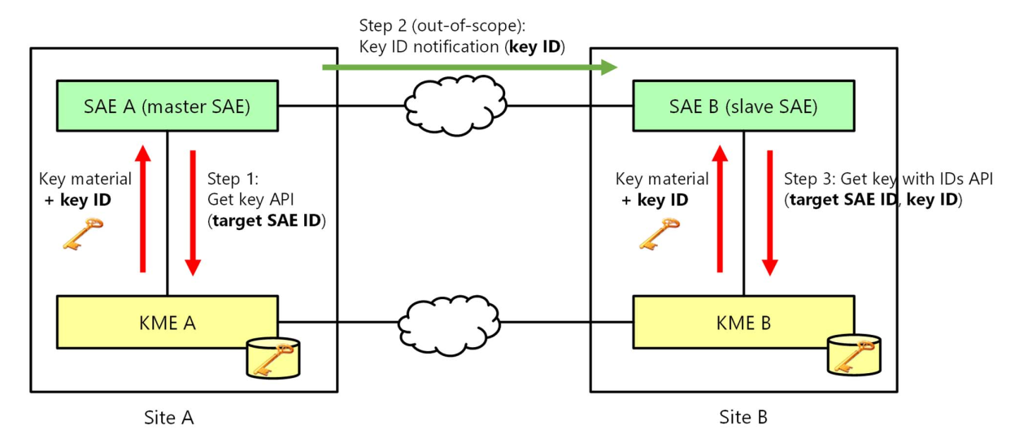
A QKD Network
Trusted Relays (e.g. ITU-T Y.3803)
Application Key Delivery (e.g. ETSI GS QKD 014)
QK users should be co-located with trusted QKD node in a safe location (e.g. Data Centres)
Notes:
For the moment, our experimentation focuses on a QKD network based on trusted relays, placed in sites belonging to University of Padova or collaborating institutions, and connected with an underground fiber network. We stress that key users should be co-located with QKD devices, because QKD only protects the channel between the devices themselves.

Slide 11
Experiment and Field Trial
Giulio Foletto – foletto@dei.unipd.it
Notes:
In the second part of the presentation we will show some of our experimental results and discuss the details of our particular implementation of the quantum key distribution network that we are building in Padova.

Slide 12
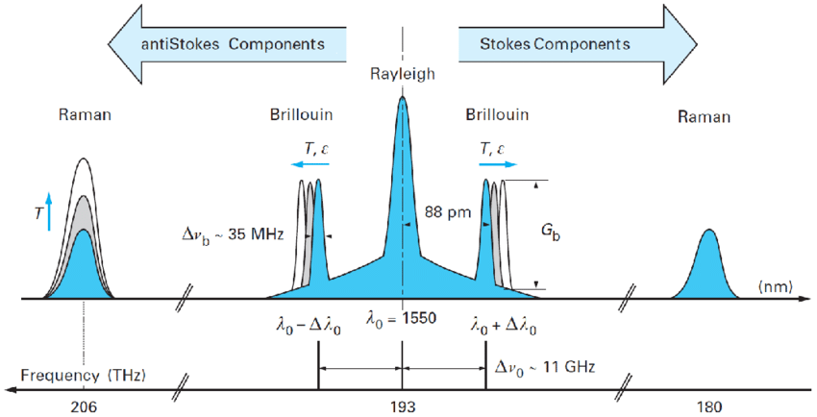
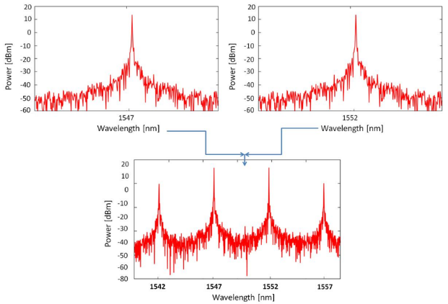
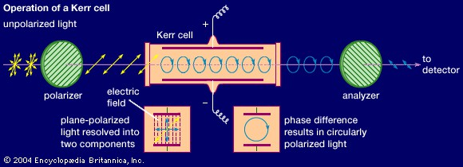
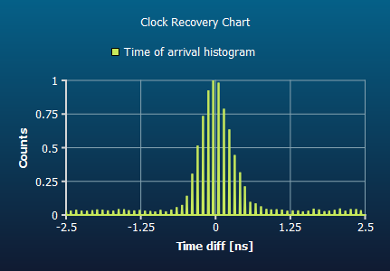
Multiplexing Quantum and Classical Signals
Sources of noise
Direct cross-talk
SRS
FWM
Others (ASE, XPM…)
Mitigations
Wavelength filtering
Time filtering
Attenuation
Notes:
When deploying QKD on an existing fiber network, unless dark fibers can be used, one must try to multiplex quantum and classical signals. This is more complicated than in the classical case because the quantum signal is much weaker than the classical one, and even a small portion of the latter might cause unberable noise.
Key points:
Direct cross-talk is caused by classical light being directly detected due to the imperfect extinction of filters.
This can be mitigated with better wavelength demultiplexing (even cascaded filters).
In SRS and FWM, light is converted to different wavelengths, and wl filtering can help only if reduces the bandwidth.
FWM is relevant relevant only for some specific wavelengths and fibers, so the main culprit is SRS
Other sources that should be mentioned are the ASE noise from EDFAs, which must be bypassed and filtered, and cross-phase modulation, which has been studied but is considered negligible for most QKD schemes.
When wl filtering is not enough other strategies like time filtering or attenuation of the classical signal can be of help

Slide 13
State of the Art - Field Trials Muxing QKD and Classical Signals
Quantum band (wavelength) | Classical band | Number of classical channels | Classical signal launch power | Multiplexed data bandwidth | Achievable distance | Maximum secret-key rate | QKD type
C-band (1550 nm) | L-band | 1 | -33.3 dBm | N/A | 97 km | 820 bps | DV
C-band (1547.72 nm) | C-band | 4 | –10 dBm | 40 Gbps | 26 km | 160 kbps | DV
C-band (1550.12 nm) | L-band | 3 | Tunable | 1 Gbps | 2.08 km | 10 kbps | CV
O-band (1310 nm) | C-band | 20 | 21 dBm | 3.6 Tbps | 66 km | 5.1 kbps | DV
C-band (1550 nm) | C-band | 2 | Tunable | 200 Gbps | 10.6 km | 2.58 Mbps | DV
C-band (1550 nm) | C-band | 17 | N/A | N/A | 3.9 km | 70 kbps | CV
C-band (1551.7 nm) | C-band | 4 | Tunable | 400 Gbps | 1.9 km | 1.28 kbps | DV
O-band (1310 nm) | C-band | 5 | Tunable | 500 Gbps | 14.2 km | 1.95 kbps | DV
Y. Cao, Y. Zhao, Q. Wang, J. Zhang, S. X. Ng and L. Hanzo, "The Evolution of Quantum Key Distribution Networks: On the Road to the Qinternet," in IEEE Communications Surveys & Tutorials, vol. 24, no. 2, pp. 839-894, Second quarter 2022, doi: 10.1109/COMST.2022.3144219.
Notes:
Despite all these difficulties, multiplexing has been done many times, with many different techniques and with varying performance.

Slide 14
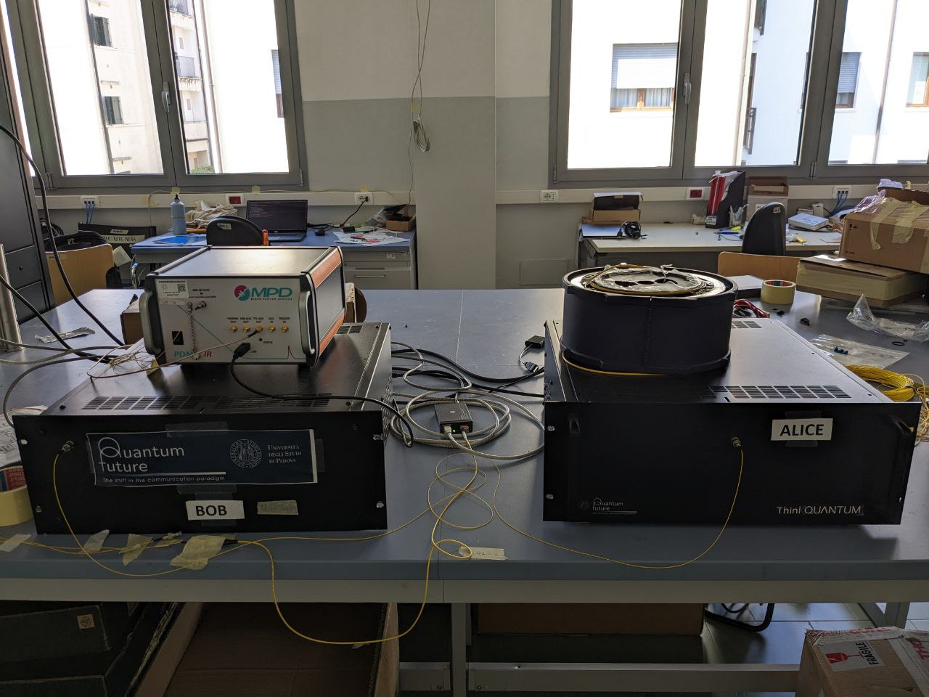
QKD Devices
Portable and compact in size
Telecom wavelength
BB84 protocol
One-decoy state method
Photon polarization
Patented iPognac polarization encoder
Time-multiplexing scheme at the receiver to use only one single photon detector
Notes:
Let’s now talk of our devices. These prototypes, developed at the quantum optics laboratory of the department of information engineering by PhD students and postdocs, come from a long series of previous iterations and shrunk from towers of electronic components and optical assemblies occupying half a table to portable and compact 4U rack devices.
They operate in the telecom C or O bands and mostly contain commercial off the shelf elements. They implement the BB84 protocol with the one-decoy-state method. This is a technicality, but an important one, because it allows QKD to operate with weak laser pulses rather than actual single photons.
Interestingly they encode the key in the degree of freedom of polarization, which is not the most typical choice for fiber implementations because fibers are birefringent, but it has worked very well in all of our tests on underground deployed fibers.
From the technical point of view we notice that these devices operate at a repetition rate of 50 MHz, use the iPognac polarization encoder and a time multiplexing scheme at the receiver. Let’s briefly go through these.

Slide 15
The iPognac
M. Avesani et al., «Stable, low-error, and calibration-free polarization encoder for free-space quantum communication», Opt. Lett. 45, 4706, 2020
Notes:
IPognac is a portmanteau for polarization and Sagnac, and I think the I stands for intrinsically stable. Two orthogonal polarization components are split and travel in opposite directions in the unbalanced Sagnac loop so that their phase can be modulated separately (because of the different delays). Depending on the modulation, the output polarization can be one of the four states required by the protocol and the polarization reference is stable due to the free space part at the beginning of the scheme.

Slide 16
Time multiplexing at the receiver
Notes:
The time multiplexing setup at the receiver is a simple network of beam splitters, polarization beam splitters and delays that allows to convert a polarization measurement into a time one. Basically the four polarization components arrive at different times and it is this time that allows to distinguish them. This means that only one single photon detector is necessary, which can reduce performance but dramatically reduces costs and size.

Slide 17
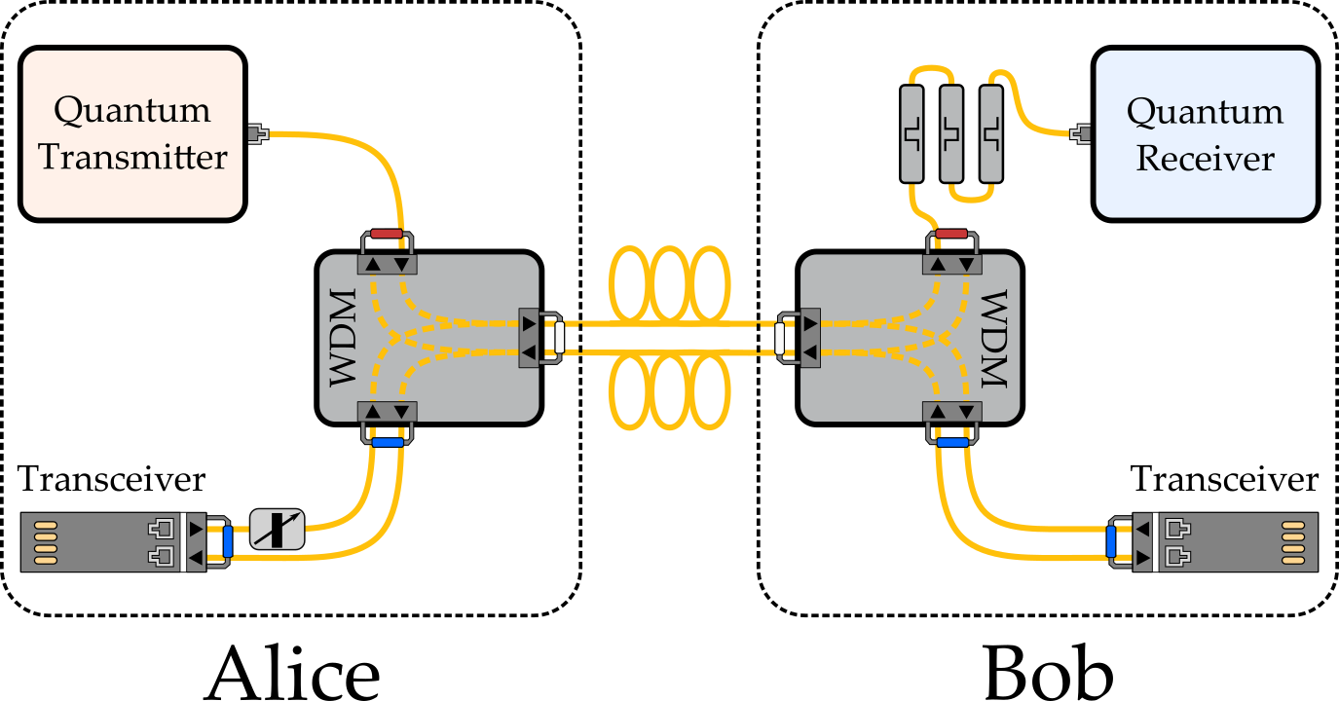
Wavelength multiplexing with classical signals
Notes:
In the test we want to focus on today the quantum light coming from the transmitter is multiplexed with classical light from standard WDM transceivers. This happens with passive filter components and in a duplex configuration due to the characteristics of our link. We choose to have the quantum light co-propagate with the classical one in the same direction because we have measured that at the tested distance the Raman scattering is less detrimental with this choice.

Slide 18
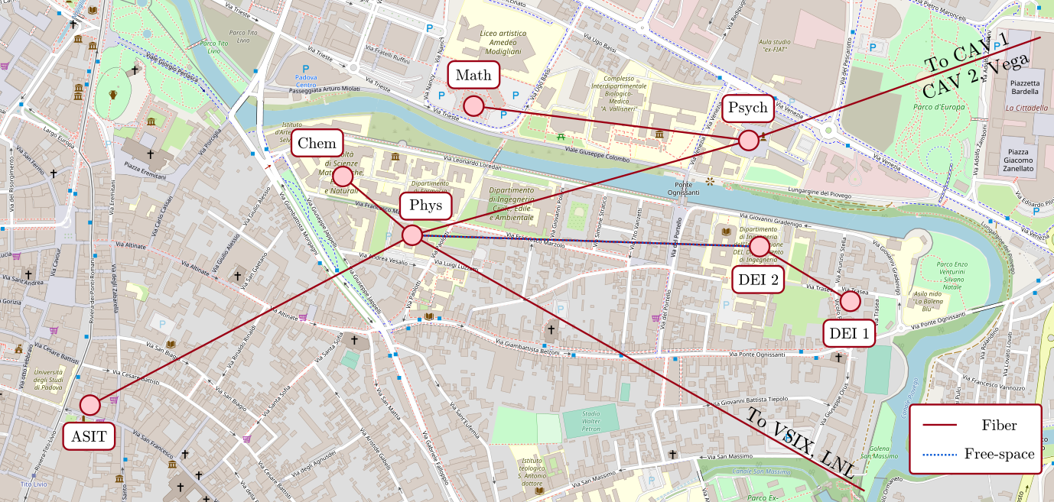
The Paduan QKD Network
Notes:
The test happened on the embryonic Paduan QKD network, which can include up to 12 different nodes some of which are in the vicinity of our laboratory and some stretch to the metropolitan area of Venice. We have tested all nodes, but we don't have 12 devices so the network is never entirely active at the same time. We have tested all point-to-point links and some star configurations involving 3 users. As an aside, the network can also include a free space link between the physics and engineering department.

Slide 19
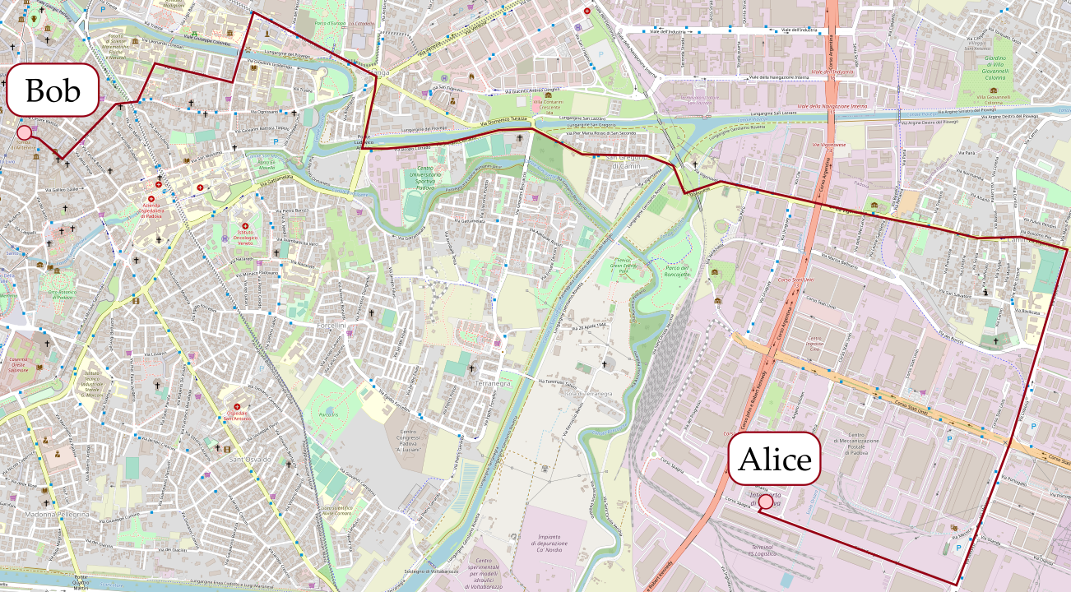
The Paduan QKD Network
~13 km G.652
Notes:
Our particular test employs a 13 kilometer link between the VSIX facility and the ICT center (ASIT) of the university. This is a duplex fiber link provided by GARR.

Slide 20
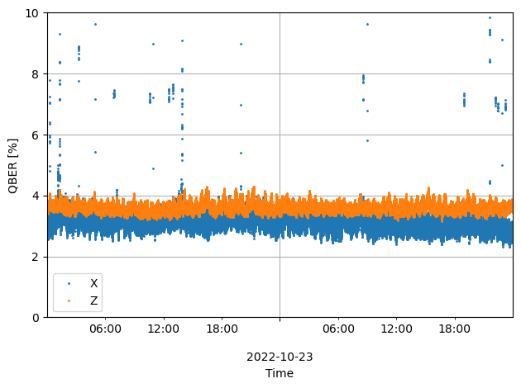
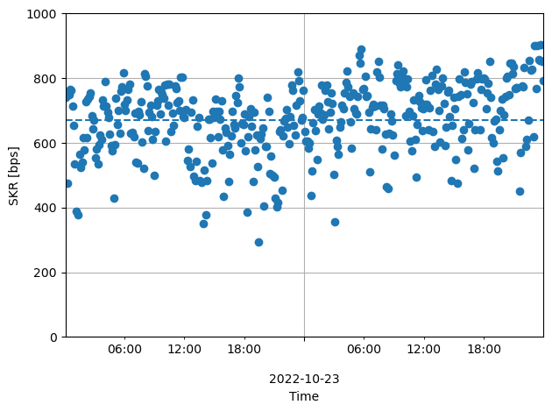
Results: Quantum C-band + Classical O-band
Classical signal: 10GBASE-LR transceivers $P_{min}^{rx}=−14.4 dBm$
10Gbps error-free $P_{}^{rx} =−14.0 dBm$
Notes:
We tested QKD in two different configurations, one in which the quantum light was in the C band and the classical in the O band, and another with the swapped settings. We show here two example 48-hours runs, in which (for both configurations) the QBER was around 4% and the classical communication happened error-free at 10Gbps. In the first case we achieved around 670 bps and in the second around 420.

Slide 21
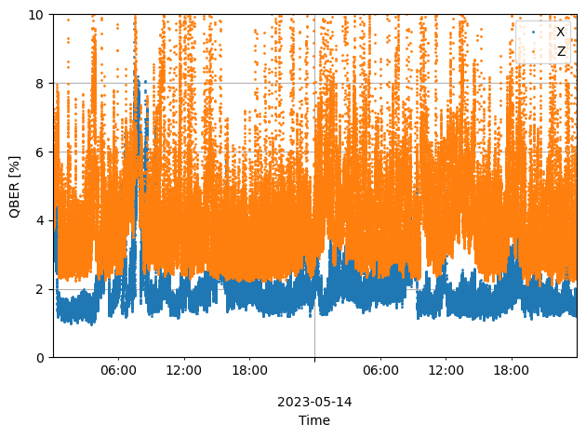
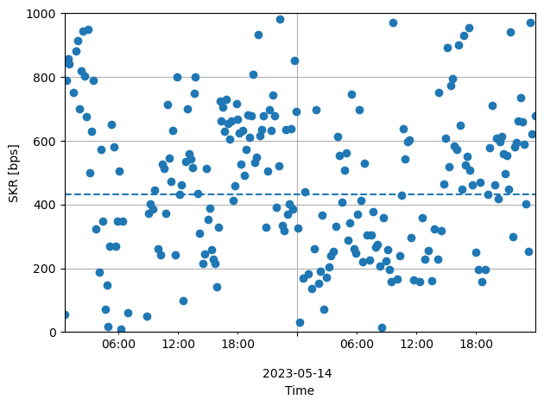
Results: Quantum O-band + Classical C-band
Classical signal: 10GBASE-Z transceivers $P_{min}^{rx}=−24 dBm$
10Gbps error-free $P_{}^{rx} =−14.7 dBm$
Notes:
However, this lesser performance is mostly due to our O band transmitter being less precise in modulating the states, which also justifies the higher QBER fluctuations. In both cases we had to attenuate the classical light to around -14 dBm of received power, which is much more acceptable in the second configuration, where the power threshold is much lower. In the second configuration we had less noise and more margin to attenuate more.

Slide 22
Conclusions
QKD is a promising technology to provide unconditional security
It protects only the channel between the QKD devices
QKs must be securely delivered to the end application (co-located devices)
Practical challenges still remain
To realize QKD links co-propagating with classical data with grey optics:
Often necessary to attenuate classical signal
Transceivers with low sensitivity required
Still less expensive to use ZR@10km than dedicated fiber
More advanced (time and wavelength) multiplexing can be investigated, also with DWDM
Notes:
During this presentation, we hope to have shown that QKD is a promising technology to provide unconditional security. We stress that this security extends only to the channel between the devices, which mostly means that QKD users must be co-located with such devices. Practical challenges still remain, one of which is the coexistence of quantum and classical signals on the same fiber. It is often necessary to attenuate the classical light and transceivers with low sensitivity are required. Despite these difficulties, it might be cheaper to just use transceivers optimized for longer distances than to use a dedicated fiber. Finally, more advanced filtering techniques can be investigated, to reduce this need for attenuation.

Slide 23
Thank you
Any questions?
Giulio Foletto – foletto@dei.unipd.it
Matteo Colantonio – matteo.colantonio@garr.it
This work is partially funded by the Quantum Secure Networks Partnership (QSNP)

Slide 24
Backup slides

Slide 25
Power of SRS contribution
$$P_{fw}=P_{out}⋅L⋅Δλ⋅ρ(λ)$$
$$P_{bw}=P_{out}⋅\frac{\sinh\left(αL\right)}{α}⋅Δλ⋅ρ(λ)$$
P. Eraerds et al 2010 New J. Phys. 12 063027

