Slide 1
First proof of concept for Long Distance QKD across the GÉANT Network
D. Vicinanza (GÉANT), M. Pittaluga (Toshiba Europe Ltd.), G. Roberts (GÉANT), P. Rydlichowski (PSNC)

Slide 2
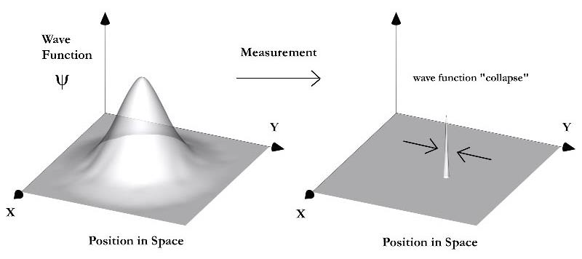
Wave function and quantum measurement
Quantum states are best described using probability waveforms
Attributes of a quantum objects ( e.g. position) are described by the Schrodinger wave function
Under the Copenhagen interpretation the act of measuring a quantum object causes the wave function to ‘collapse’ resulting in a known position.
In the process information is lost, but certainty is gained

Slide 3
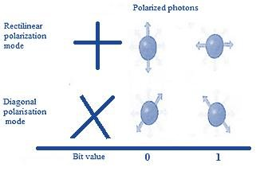
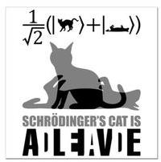
Qubits
A qubit is a basic unit of quantum information. Analogous to a ‘bit’ in classical computing
The degrees of freedom of a quantum system can be used to encode information
For example the polarization state of a photon can be used to represent 1 or 0
During transmission down the fibre, both the 1 and 0 states can be encoded in a state of superposition i.e both present at the same time. (Schrodinger's cat)
The act of observation of the photon collapses the wave function and we have a measurement.

Slide 4
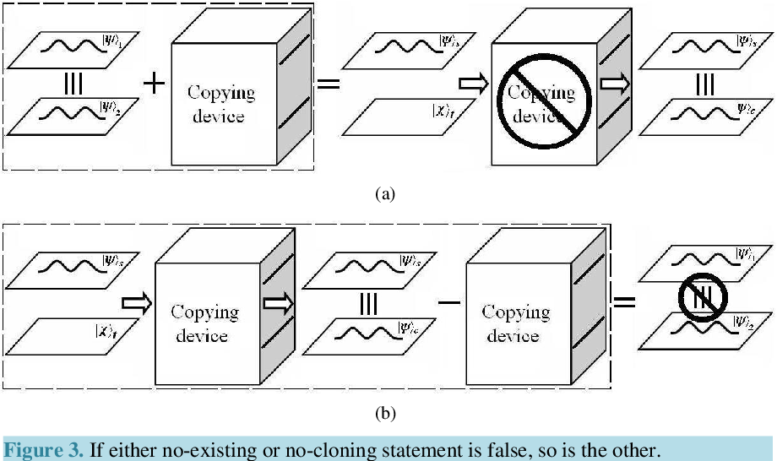
No-cloning theorem
The No-Cloning Theorem is a fundamental principle in quantum mechanics that says it is impossible to create an identical copy of an arbitrary unknown quantum state.
This is due to the fundamental behavior of quantum systems, which distinguishes them from classical systems.
If you have a quantum system in a specific state and you want to clone it, you would first need to measure its state. But when you do this, the state collapses to one of the possible states, and all the information about the superposition of states is lost. So you can't create a copy of the original superposition.

Slide 5
Quantum Key Distribution (QKD)
QKD is a secure method of generating and sharing cryptographic keys for symmetric encryption based on the principles of quantum mechanics.
QKD relies on the fundamental properties of quantum mechanics, such as the superposition and the no-cloning theorem, to ensure the security of the key distribution process.
Cryptographic keys are generated by encoding quantum information
such as the polarization of photons, into quantum states.
These states are then transmitted over a communication channel.
Any attempt to intercept quantum states would disrupt the transmission and be detectable
–> Information theoretic guaranteed confidentiality
Notes:
By detecting any eavesdropping attempts and exchanging the necessary information, QKD allows two parties to establish a shared secret key that can be used for secure communication, guaranteeing the confidentiality and integrity of their messages.

Slide 6
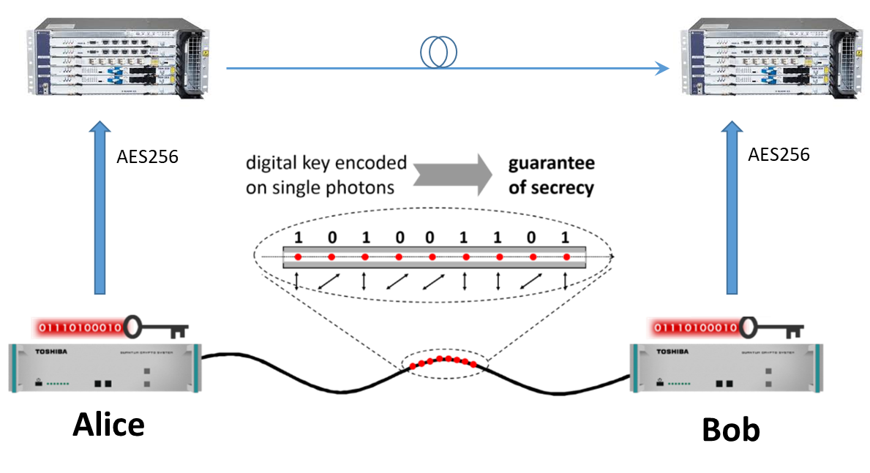
Single photon QKD
Keys are distributed between Alice and Bob using a quantum channel.
A quantum key protocol such as BB84 is used for key transmission.
Data for transmission is encrypted using AES.
This allows a large volume of data to be sent with one short key that can be refreshed rapidly.

Slide 7
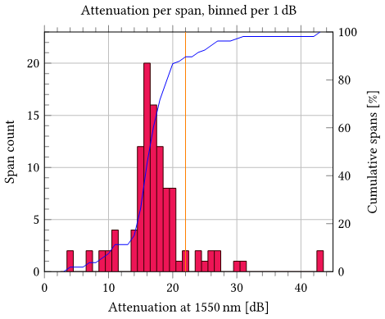
QKD in the GEANT network
Why is traditional QKD difficult to implement in the GEANT network?
GEANT network spans are typically 300km to 900km in length.
The median span has 16dB of attenuation
Single photon solutions will require around 6 trusted nodes on each link.
To make QKD scale the number of trusted nodes needs to be reduced.
Ideally we would like to eliminate trusted nodes
Trusted nodes are a potential security risk.
No quantum security
Difficult to certify as secure

Slide 8
Limitations of traditional QKD and TF-QKD
Limitations:
Traditional single photon solutions such as BB84 have a typical span length of less than 100km. This is due to the scattering of photons in the fibre.
Intermediate nodes require trusting intermediate nodes
Number of secure bits delivered by a point-to-point QKD link is fundamentally limited to 1.44η, the Secret Key Capacity (SKC) of the channel, with η being the channel transmission probability
Solution:
Twin-Field (TF) QKD protocol
Scaling the key rate proportionally to the square root of η, surpassing the PLOB bound and extending the range of QKD.
Experimental laboratory implementations of TF-QKD have been demonstrated over up to 1000 km of fibre
TF-QKD across GEANT network will demonstrate the technology over operational telecommunication infrastructure and extend the range of practical QKD
Notes:
QKD enables distant users to establish a secret key by sending photons through a communication line, but the scattering of photons limits key rate and transmission range.
The PLOB bound, a theorem, sets a limit of 1.44η on the number of secure bits delivered by a point-to-point QKD link, with η as the channel transmission probability.
The Twin-Field (TF) QKD protocol offers a solution by scaling the key rate proportionally to the square root of η, surpassing the PLOB bound and extending the range of QKD.
Experimental implementations of TF-QKD demonstrate the first proof-of-principle demonstration, exceeding the PLOB bound over highly attenuated channels, and achieving long-distance communication over 600 km of fibre length.

Slide 9
The European landmark
The vision:
Establish a European-wide quantum communication infrastructure (euroQCI).
24 countries already signed the Declaration and have agreed to work towards the development of a QCI across Europe.
Europe’s quantum industry has also expressed its strong support for a QCI for Europe
Representatives of 24 major European companies that manufacture quantum technology products and systems.
Strategic research agenda:
The Quantum Flagship agenda is to develop a Europe-wide quantum network
that complements and expands the current digital infrastructure,
and lays the foundations for a quantum internet.

Slide 10
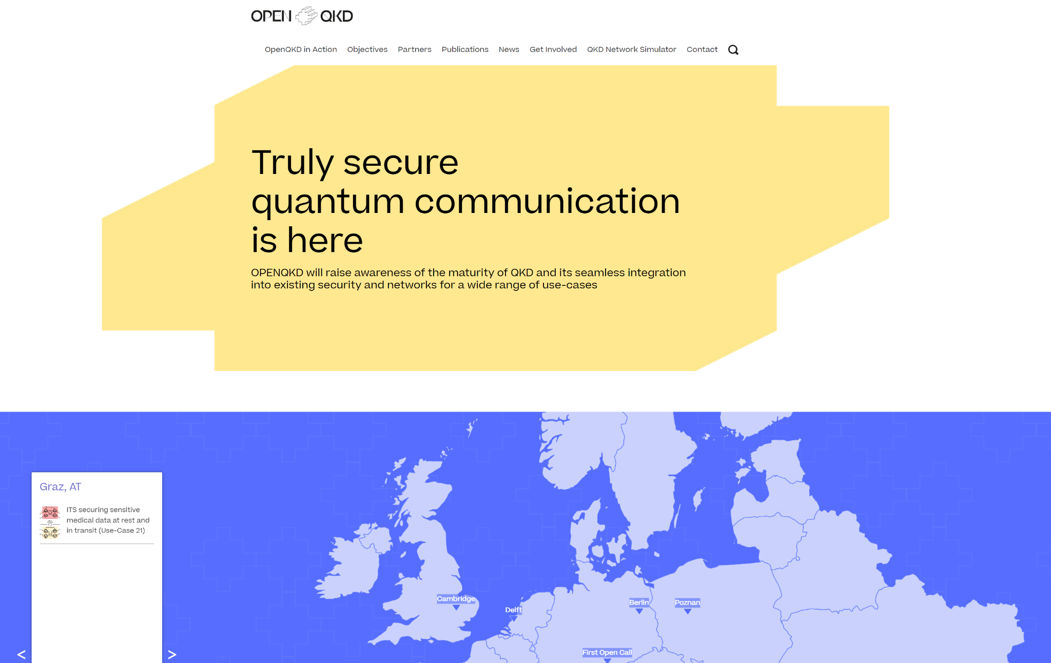
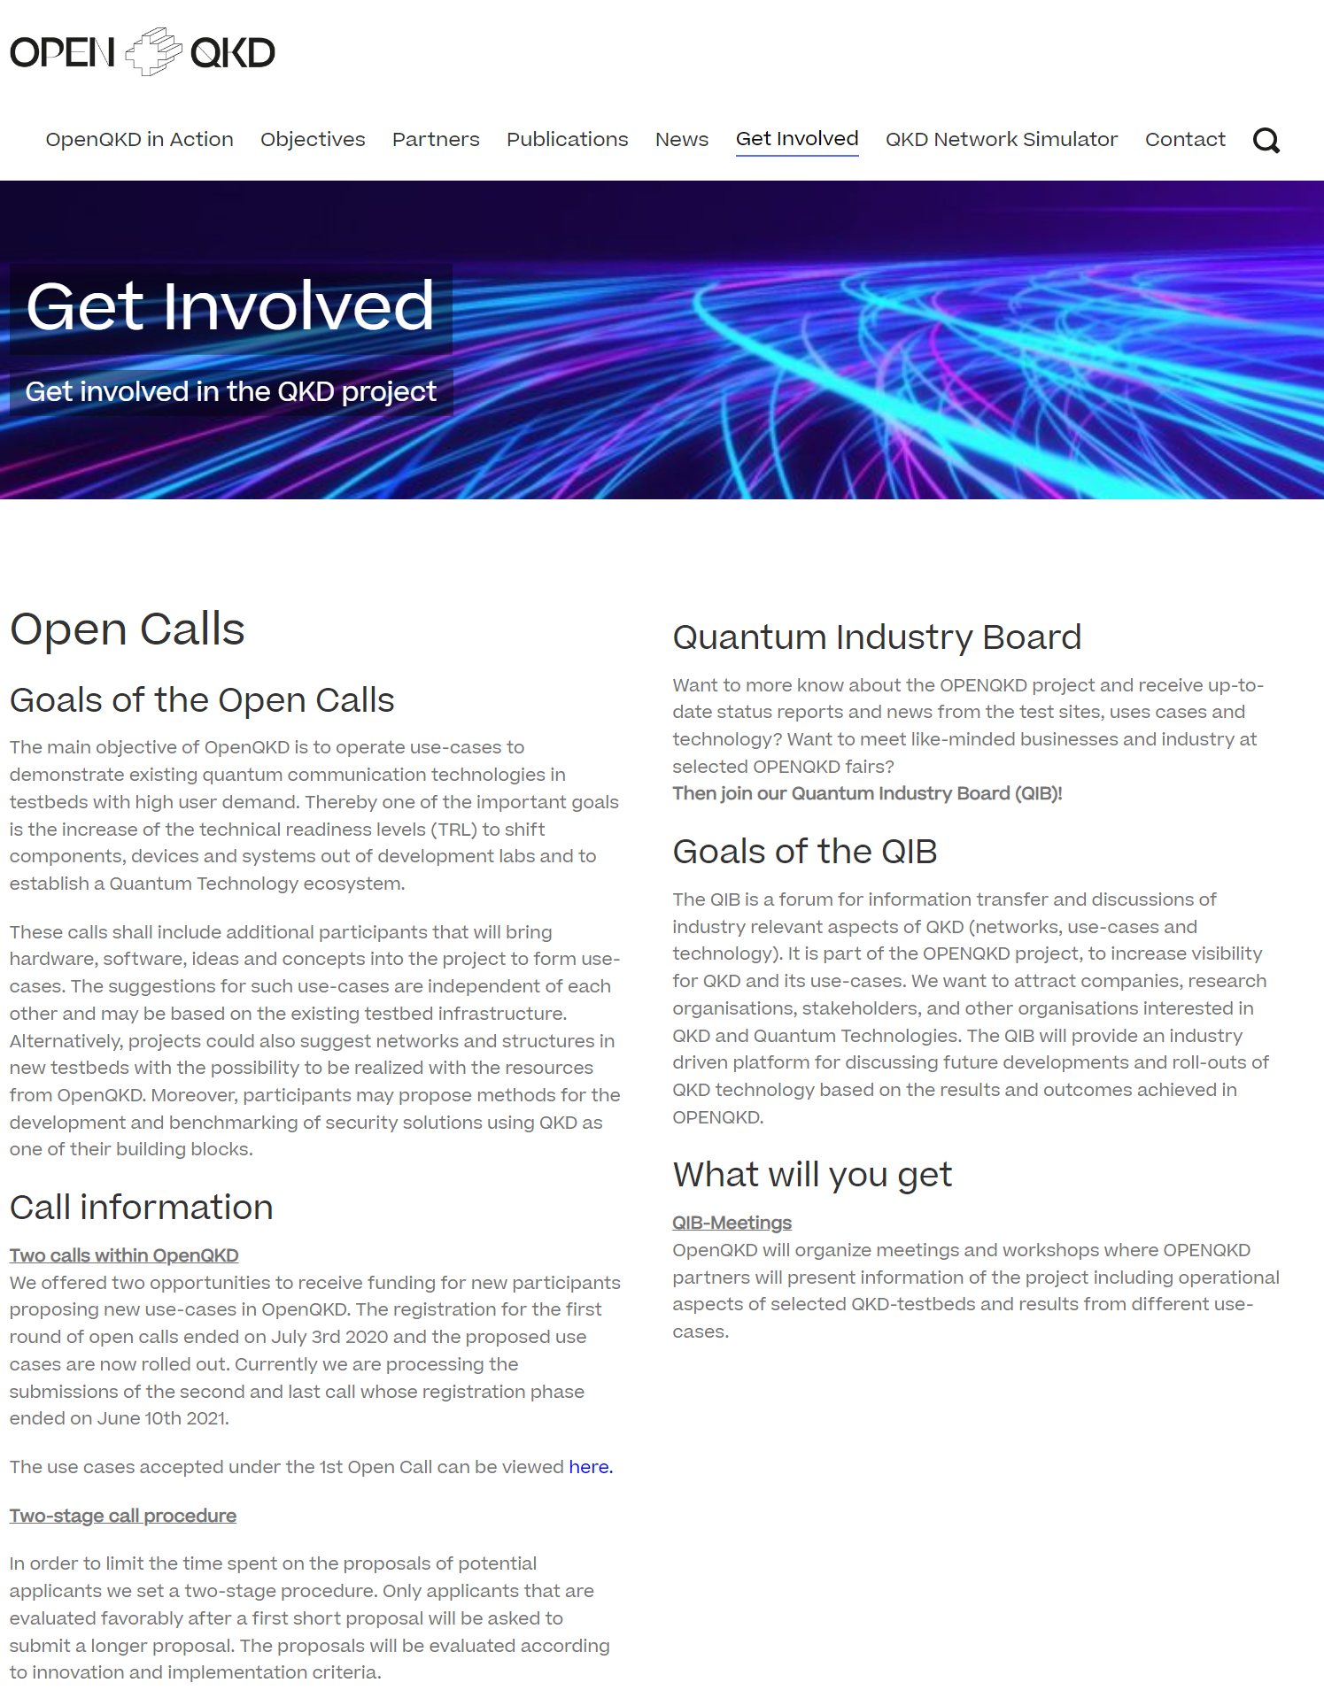
OPENQKD Open Calls
OPENQKD project focused on establishing European scale QKD testbeds and various types of use cases.
Pilot project for EuroQCI
In total over 40 use cases.
Initial list of use cases from project partners was significantly extended through two round of use cases in 2020 and in 2021.
TOSHIBA GEANT use case was special as no funds from the OPENQKD project coordinator was requested and it was treated as collaboration between the project and GEANT.

Slide 11
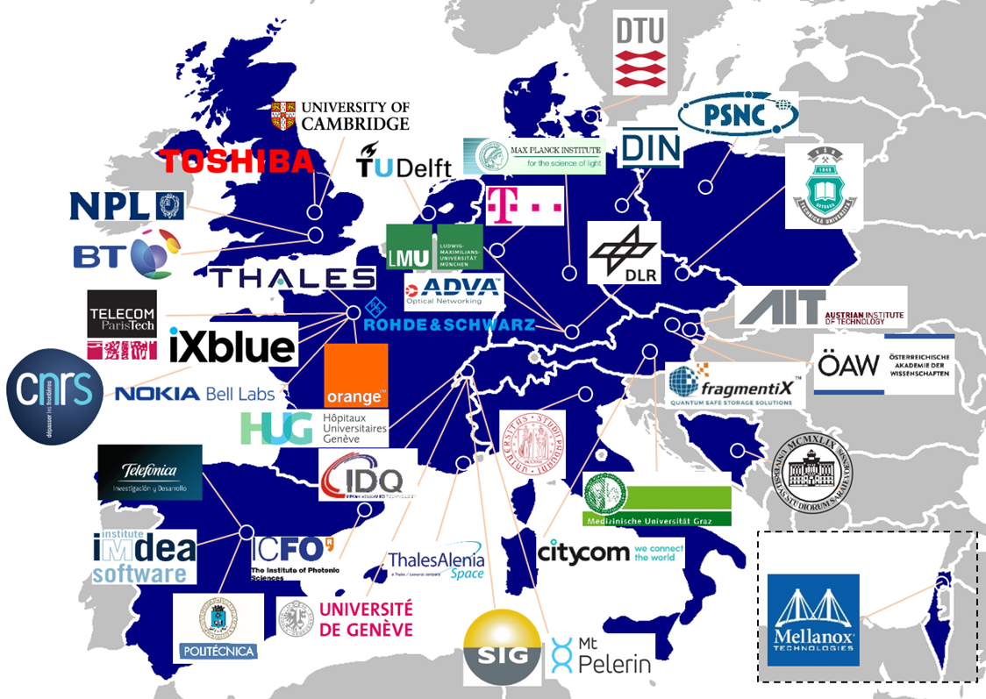
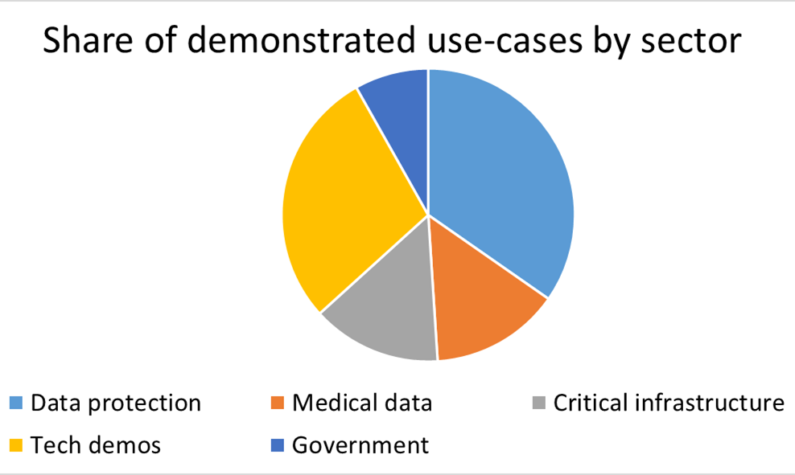
OPENQKD Open Calls
Open Calls allowed to extend the range of different use cases and partners in the project.
Results from Open Calls will be published and help in the EuroQCI activities.
Achieved excellent geographical and thematic diversity from both industry and research stakeholders
Scientific innovation: multicore, cross-country links
High-performance deployment capabilities crucial asset for wider adoption of QKD technology
Valuable input from technical point of view: key management service, network integration, stability, deployment configurations

Slide 12
The GÉANT-Toshiba Open Call
Achieve quantum key distribution over 200+ km of real-world fibre.
First commercially available product suitable for GÉANT backbone links.
Pilot on the GEANT fibre network from Q4 2021 to Q2 2023.
First step towards establishing a QKD network
Making quantum-secure communication possible.
Implementing untrusted node network
Increasing distance of practical QKD
Costs:
GEANT: international dark-fibre
Toshiba/OpenQKD: QKD equipment.

Slide 13
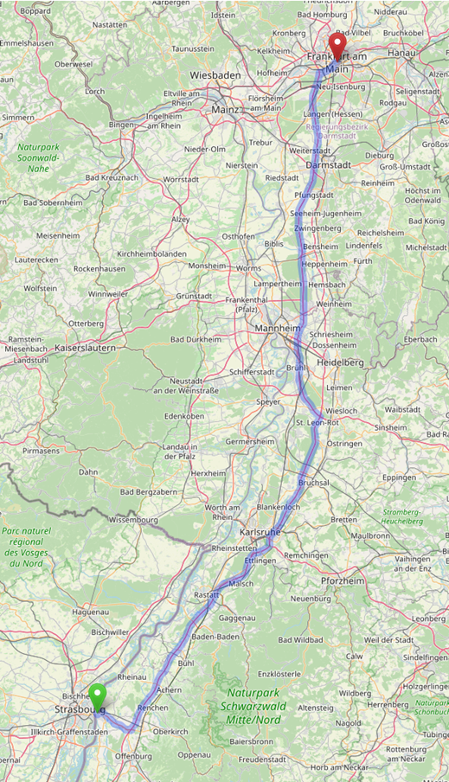
Long-haul QKD proof-of-concept
Proof of concept uses GEANT fibre from Frankfurt to Kehl
G655 fibre total distance is > 200 km and > 50 dB
Intermediate site in Kirchfeld, Germany

Slide 14
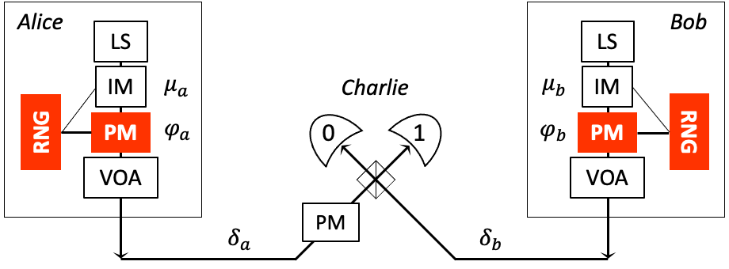
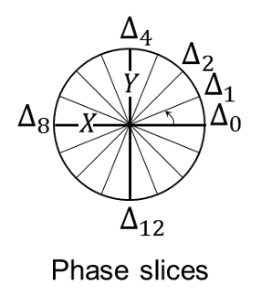
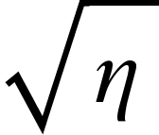
The Twin-Feld (TF) QKD protocol
phase locking
Encoding: information encoded in the phase of the optical fields
Type of interference: 1st order interference (optical field interference)
Detection: Single photon detection
Secret Key Rate (SKR) ∝
Untrusted node: Removes detectors side channels, detection made by an untrusted relay

Slide 15
Experimental schematic
Three node architecture with untrusted central node
Aiding optical signals multiplexed over service fibres
Protocol running on installed optical fibres
Single photon detections at the central node
Dual-band phase stabilisation technique to support protocol execution
Continuously running feedbacks to align all relevant degrees of freedom for optimal single photon interference

Slide 16
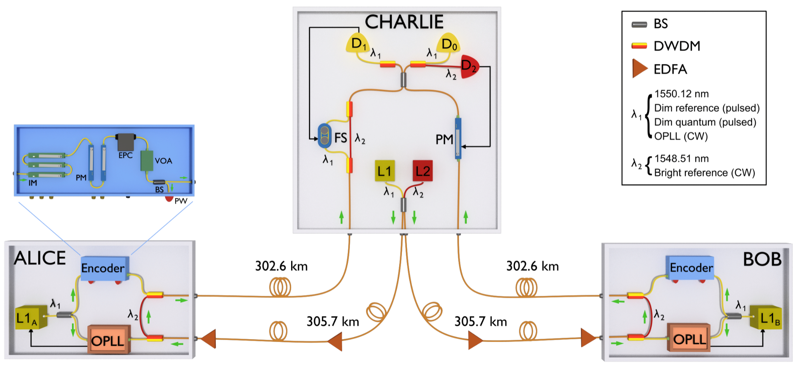
Reference functional diagram for quantum layer
Diagram of 2021 Toshiba TF-QKD lab experiment over 600 km
Single photon detection
Slow feedback
Encoder box
Fast feedback
Frequency dissemination

Slide 17
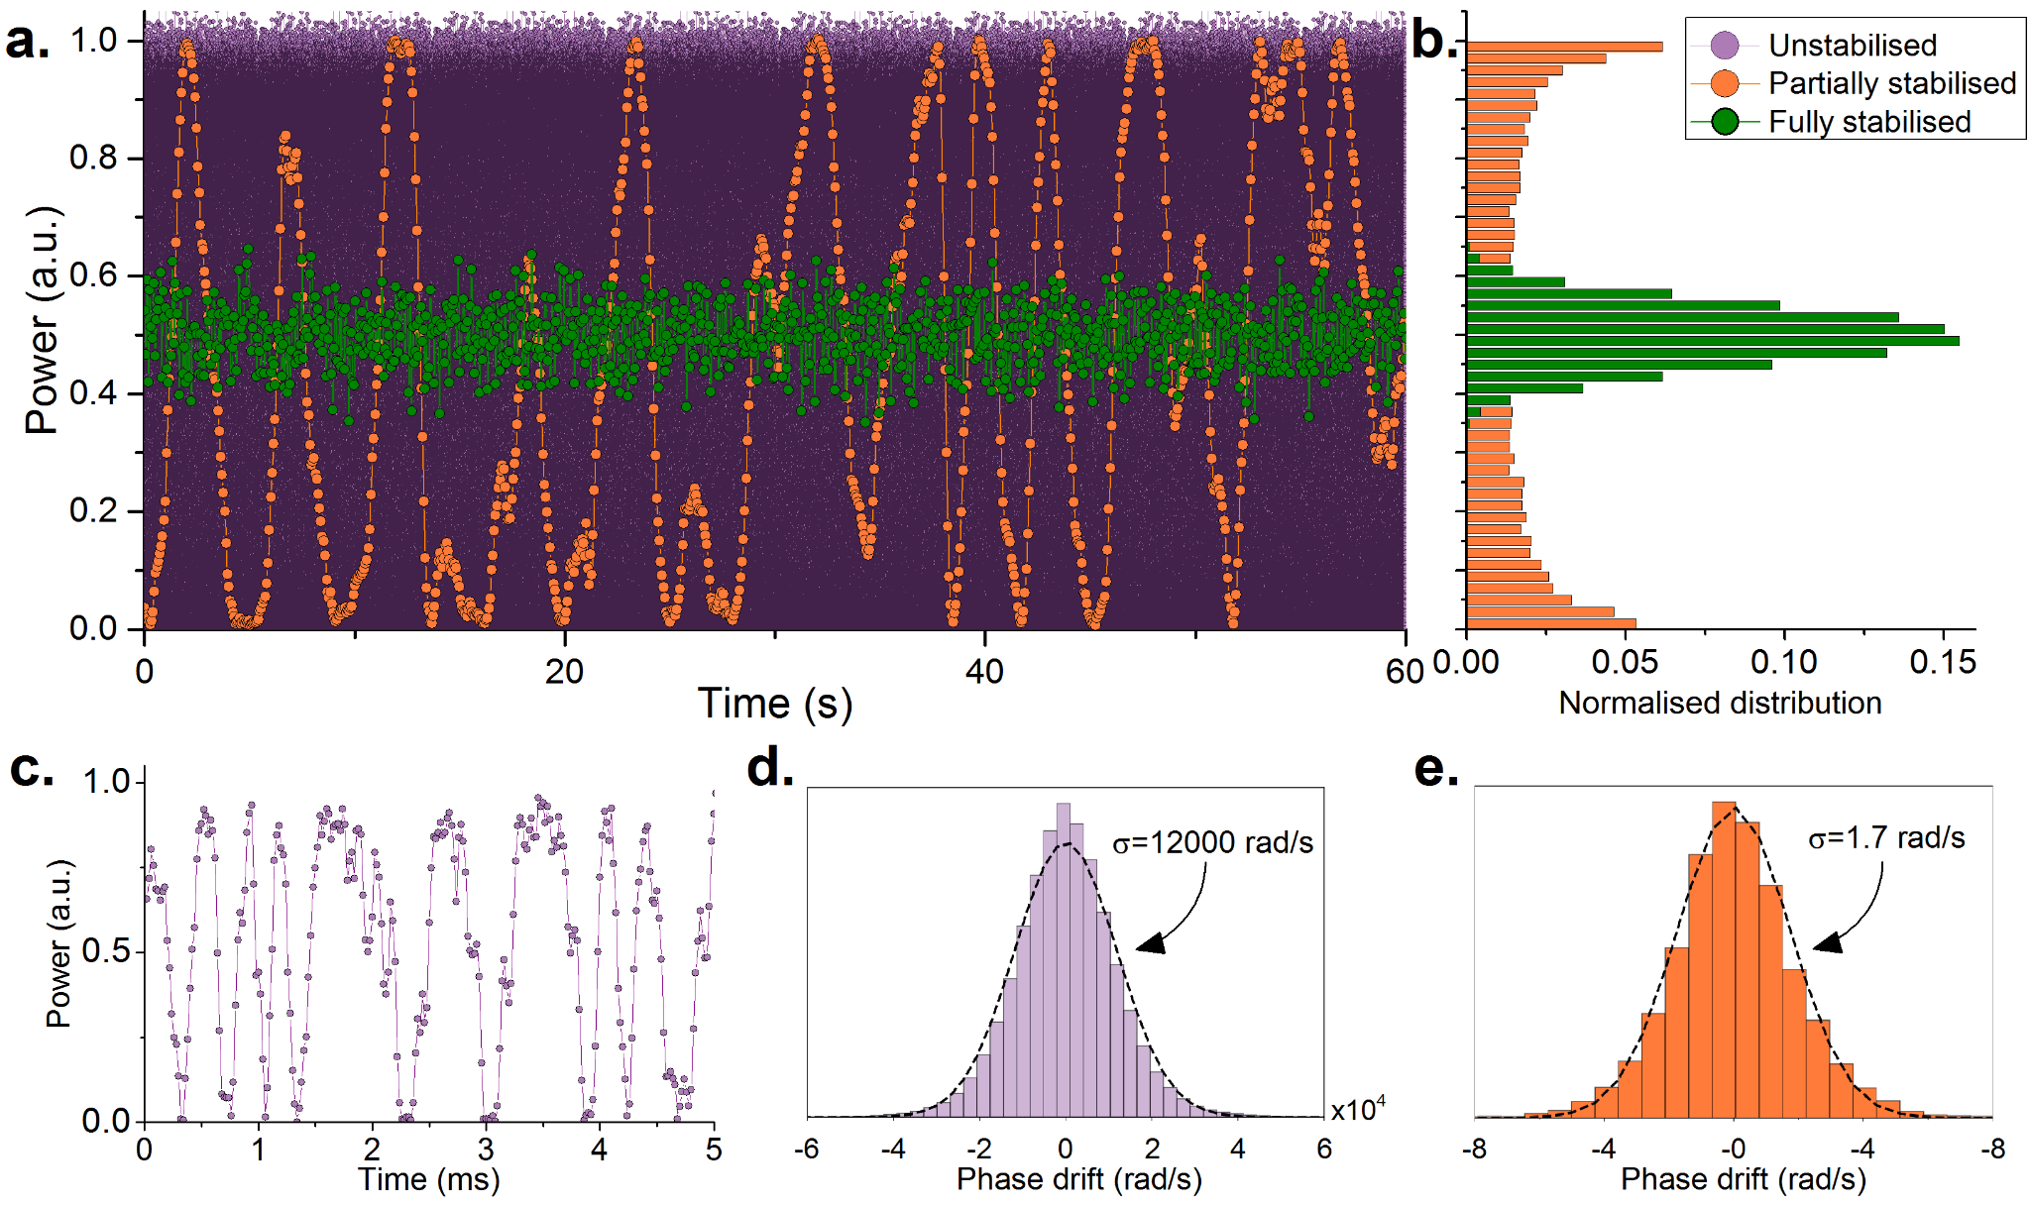
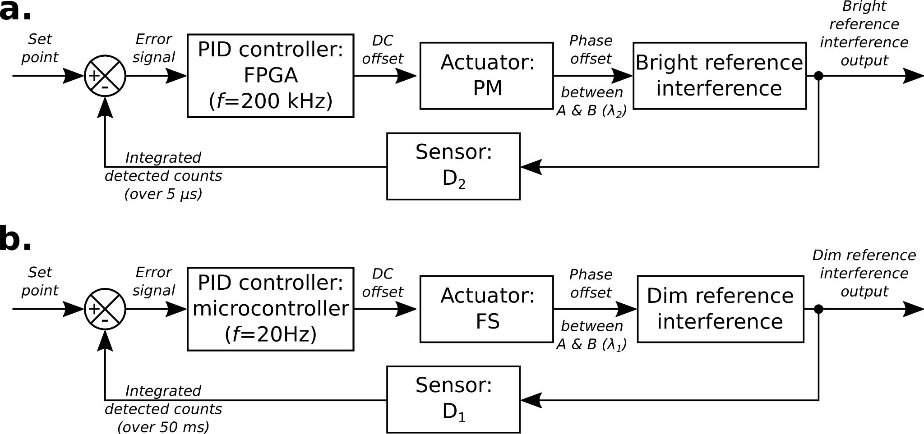
Dual-band phase stabilisation
Complete optical phase stabilisation is required for successful protocol execution
Phase drift introduced by hundred km of optical fibers is in the order of ~10 rad/ms
Dual-band phase stabilisation reduces the optical noise introduced by the reference optical signal
Dual-band phase stabilisation allows full stabilisation of the optical channel
Block diagram of phase feedbacks:

Slide 18
Conclusions
Ground-breaking demonstration of quantum key distribution on long-haul transmission services.
Bringing together the GEANT dark fibre and transmission network with the next generation of QKD equipment under development by Toshiba
The OPENQKD funded advances aim to work extend the range of QKD of real-world fibre.
GEANT & Toshiba working on the first commercially available solution for GÉANT backbone links.
Data communication would be done on the parallel fibre pair carrying up to 1 Terabit of data
Measurements starting next month (July 2023)

Slide 19
Thank you
Any questions?

