Slide 1
Who will join us at TNC 2028?
Fabio Farina, Consortium GARR
TNC23, Tirana - Albania
8 June 2023

Slide 2
Outline, to quit a different kind of shortage
Why is it so difficult to find and retain young talent?
A new approach: the GARR Academy
What we learned, dos and don'ts to replicate and extend the Academy
What lies ahead, with some proposals

Slide 3
Getting new collaborators for future challenges
From where
EU and US need ~500/700k ICT experts
Competition with large corporations
EU Higher education paths to overcome national/regional factors
Keep them involved in a long-term strategy for NRENs?
ICT keeps renewing, 3-5 years window
Experts age >35 years
Notes:
Space, Time

Slide 4
Many new careers, but networking is hidden
Notes:
Network is implicit, are we still relevant

Slide 5
GARR traditional recruitment process is no longer enough
Skilled, smart colleagues in recent years, but finding them was HARD
Problems
Slow selection speed
Turnover, newcomers age, needed skills
Full remote vs back to the office
Awareness about GARR
Mitigations
Recruitment agencies
Team building, conflict management trainings, smart-working
GARR values and uniqueness
Focus on the topic – Automation
Junior candidates, strong orientation to lifelong learning
Focus on the trainers – young GARR staffs to “reduce the distance” to learners and maximize their expertise
Notes:
needle in the haystack

Slide 6
The GARR Academy
Goal – Select and train young talents as DevOps Engineers
Syllabus – defined by GARR, teachers from the staff
Number of trainees – no more than 10-12
Duration – 120 hours (15 days)
STEM bachelor degrees, high school diploma, post-high school technical education
Less than 3 years since graduation
Notes:
Purpose: Targeted selection and training of young talent to be trained and hired
Requirements for participation: possession of a bachelor's degree in technical and scientific disciplines not more than three years old or a high school or ITS diploma in technical and scientific subjects
No more than three years passed since graduation
Professional figure to be trained: DevOps Engineer
Number of trainees: max 12 chosen by GARR through selection
Training path entirely defined by GARR
Duration120 hours(15 days) total of which 8 hours mandatory safety training and 8 hours cross training

Slide 7
Why the GARR Academy
Observe the participants throughout the training
Technical, learning and reasoning skills
Soft skills – problem solving, public speaking, team working
Hire the most deserving students, operational by Day0
Developing a sense of belonging to GARR mission
Reduce the factors that could bring to resignations

Slide 8
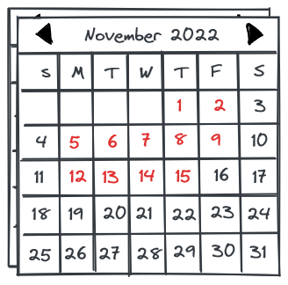
Academy preparation
Autumn 2022
Sept. 12 – Oct. 3 → Call for candidates, social media campaign
Oct. 17 – Nov. 15 → Academy, overlap with GARR Workshop (26-18 Oct.)
The location – GARR headquarter in Rome
Train the trainers by the GARR Learning team – knowledge transfer, class management

Slide 9
The topics
Week 1
GARR vision, values and mission
Linux, Python, data formats (YAML), documentation and versioning (Git, GitLab)
Ansible – base and intermediate level
Week 2
Soft skills – delegation, problem solving, communication, negotiation
Cloud-native architectures – Docker, Kubernetes, Telemetry & Alerting, CI/CD
DevOps – Agile software engineering and the GARR methodology
Many hands-on activities and finally, Hackathon on small, real use cases
Week 3
Notes:
Collaborative docs and code versioning
Hands-

Slide 10
Preparing the class roll call
Attitudinal interviews
15 admitted to technical interview
Selection on CVs
32 candidates
50 Applicants
10 winners
Physics and Computer Science B.Sc., some freshmen
~22yo (19yo high school graduate, 27yo astrophysicist)
From many Italian regions, but just one woman
1 drop-out due to logistical problems

Slide 11
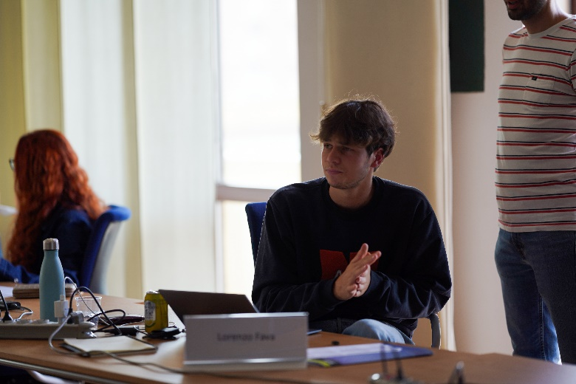
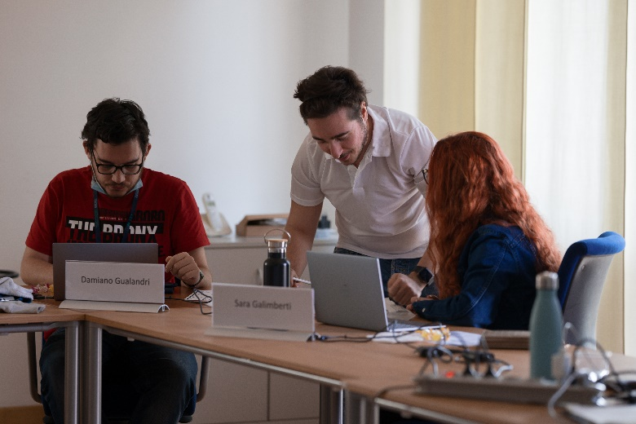
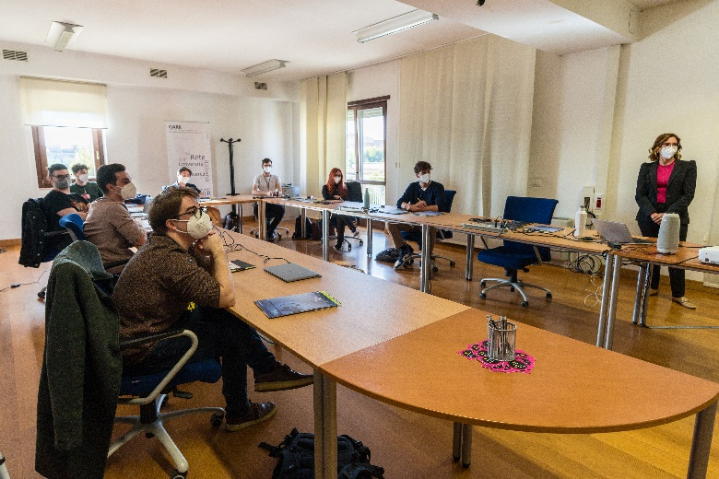
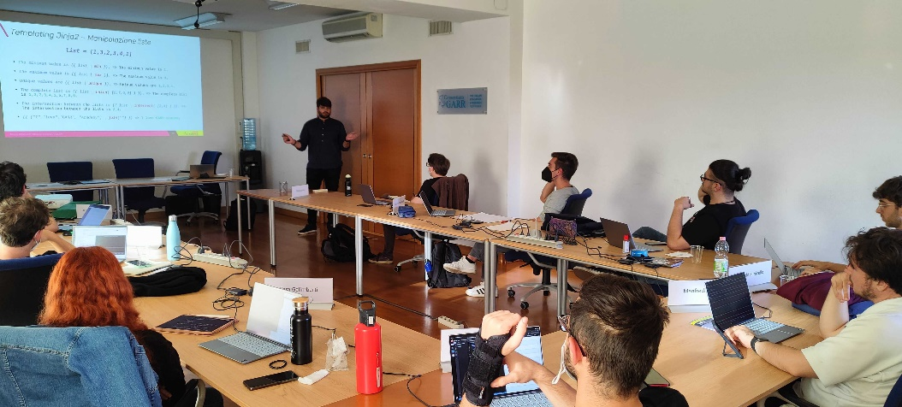
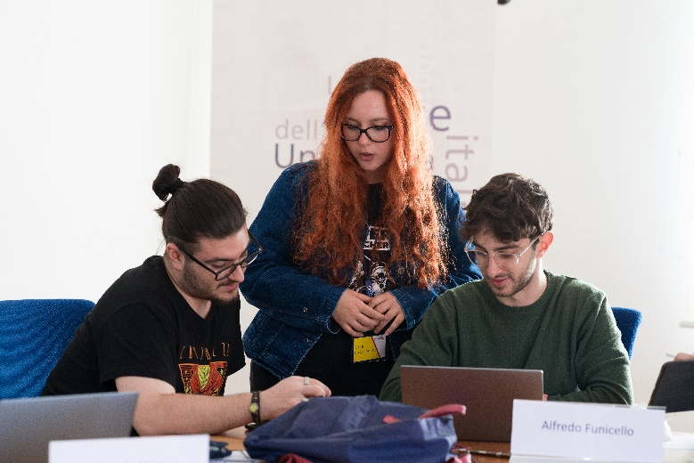
Showtime!
Notes:
Photos of GARR Workshop
Involvement in one of the GARR Community's yearly key events
Being confronted with the topics we really deal with, making contact with GARR users and understand GARR Community

Slide 12
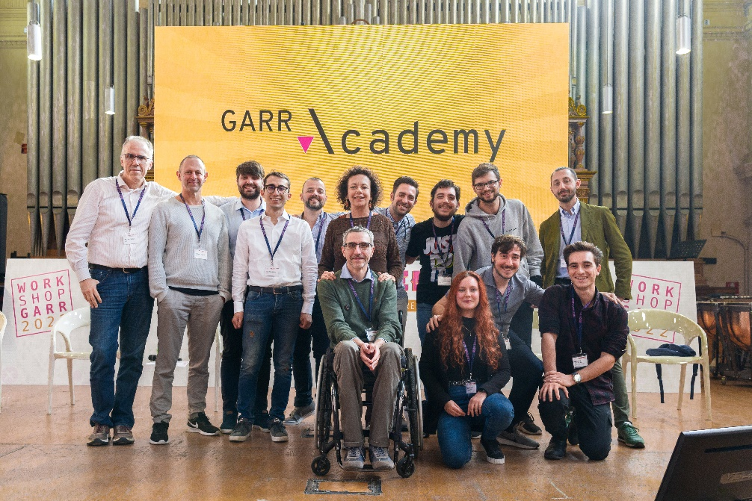
Follow-up to the Academy
Fixed-term employment for 5 Academy graduates, 4 now are permanent positions
What we learned about 20-year-olds
Digital natives way of learning
Internationalization, work-life balance
Relevance of their contribution
Continuous learning and curiosity
Notes:
YOLO

Slide 13
Evolution, adoption and wider horizons
Repeatable? YES, upcoming edition for all GARR technical roles
Agile methods, NetOps/DevOps for NOC, CERT, and other teams
Exportable to other NRENs?
Narrow set of topics that your experts are very confident about
Hands-on trainings
Social media coverage was a booster
Can we imagine a Joint Academy involving more NRENs?
Like PhD schools, HPC exchange programs, CERN summer and technical students

Slide 14
Conclusions
Cause analysis of difficulties in finding and retaining new employees
GARR Academy
4 new DevOps to work on the next GARR network
Internal expertise available to train new resources
More Academy editions
Academies as tool for other NRENs, and maybe in Collaborations
The no-so-trivial becoming knowledge diffusers → planning is the key to success

Slide 15
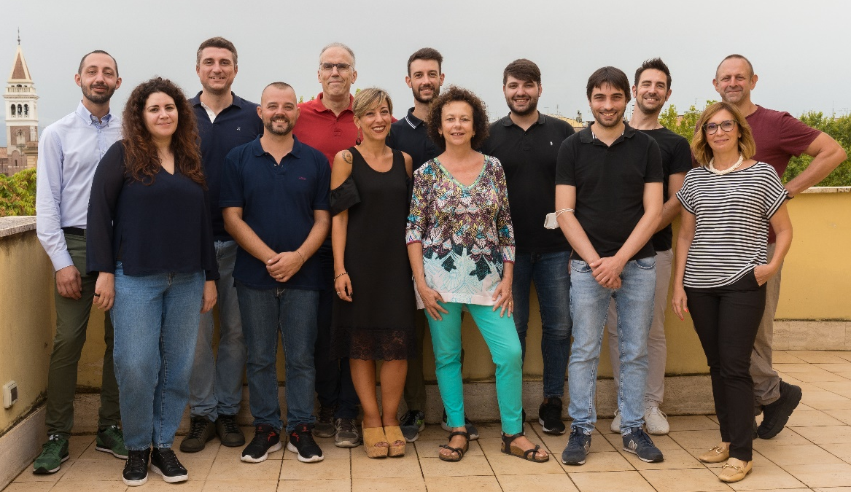
No one is an island
Thanks to all the contributors
Patrizia Landi
Ilaria Pezzetta
Eleonora Napolitano
Pasquale Mandato
Vincenzo Caracciolo
Marco Malavolti
Mario Di Lorenzo
Gianni Marzulli
Marco Lorini
Francesco Lombardo
Stefano Giardino
Giovanni Cesaroni
Giancarlo Viola

Slide 16
Thank you
Any questions?
fabio.farina@garr.it

