Slide 1
Gamified Awareness
The impressive results of a new approach​
Rodrigo Facio
RNP – Rede Nacional de Ensino e Pesquisa / Brazil
06/08/2023

Slide 2
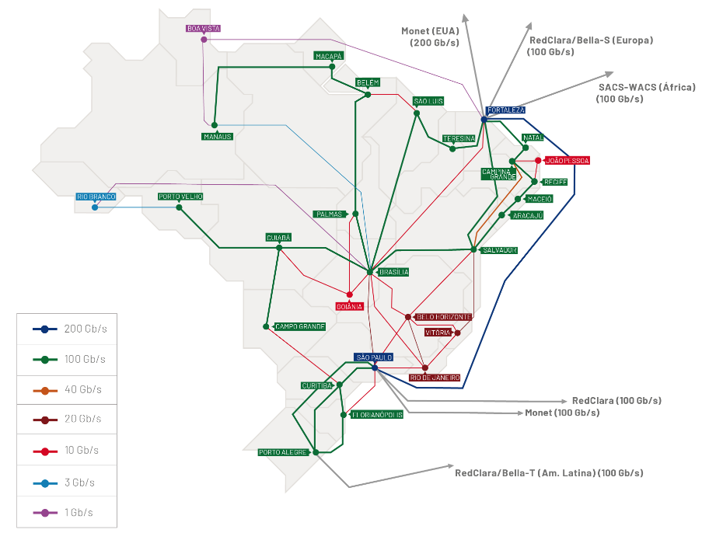
RNP Consulting Services​
Security and Privacy Services Catalog
​
15 consulting services​
Any institution member of RNP​
There are costs for the institution

Slide 3
Why Security and Privacy
Awareness Campaigns?

Slide 4
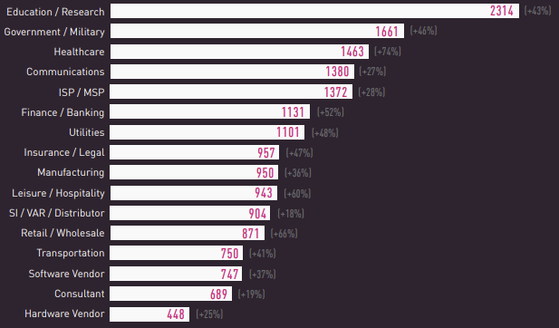
Why Security and Privacy Awareness Campaigns?
Global Average of weekly attacks per organization by Industry in 2022 [% of change from 2021]
2023 Cyber Security Report – Check Point​
https://resources.checkpoint.com/report/2023-check-point-cyber-security-report

Slide 5
Traditional
Awareness Campaigns

Slide 6
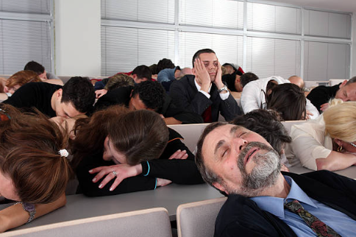
Traditional Awareness Campaigns
Usually a lecture in an auditorium with a lot of people
Technical documents, many rules and duties for users
During the campaign users lose interest and don’t apply the knowledge in their routine
Too hard to measure

Slide 7
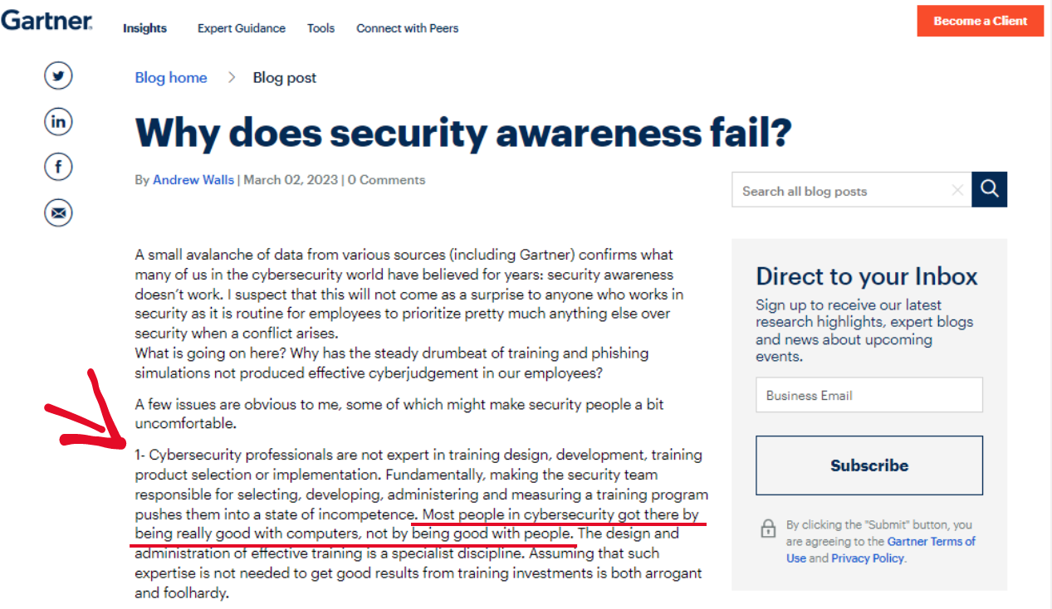
Traditional Awareness Campaigns
Notes:
That gives us a importante tip...

Slide 8
How can we change it?
How can we engage users?​
How are we going to make sure that users don't give up in the middle of the journey?
​What can we do to improve users interaction?
​How can we measure the results?​

Slide 9
Gamification
Strategies

Slide 10
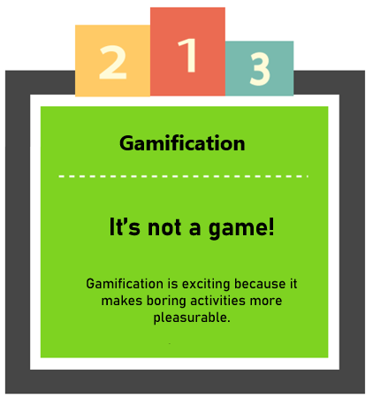
Gamification Strategies
Gamification is the use of game mechanics and experience design to digitally engage and motivate people to achieve their goals…
Gartner Glossary
https://www.gartner.com/en/marketing/glossary/gamification

Slide 11
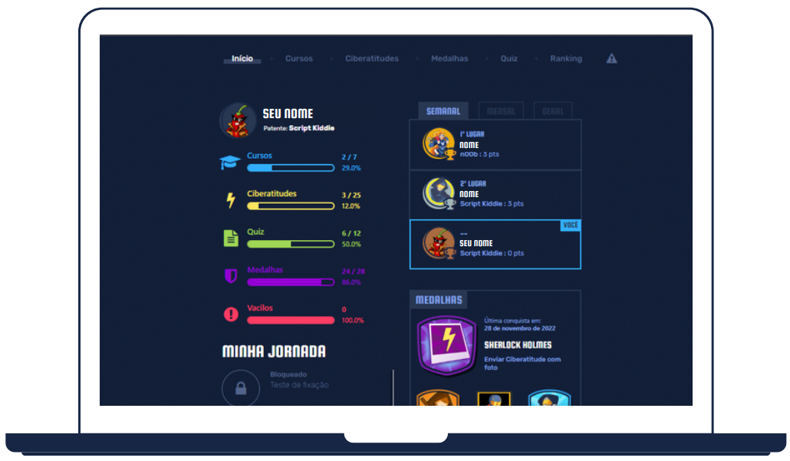
Gamification Strategies
Healthy competition between users
Boost users engagement and interaction to do activities
For all completed tasks, they get points and will receive awards

Slide 12
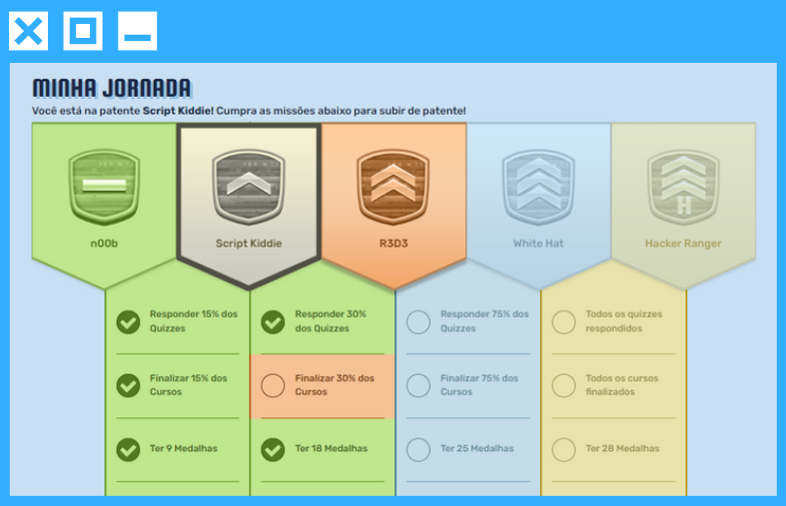
Gamification Strategies
User Journey
E.g. Rank based journey, and users can be promoted like in a military career
Users can monitor their own progress, and focus on doing tasks to improve their performance!

Slide 13
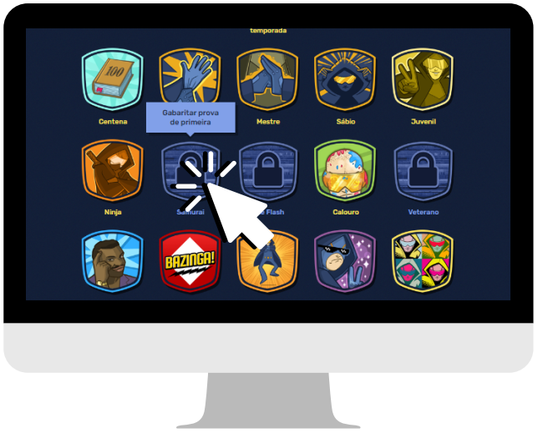
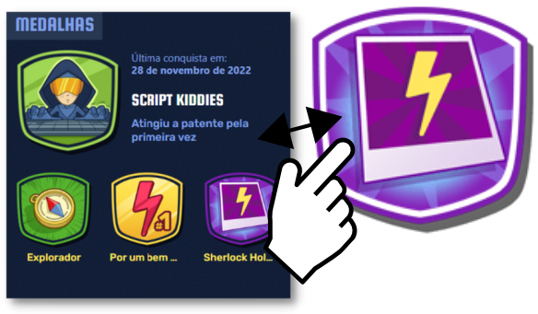
Gamification Strategies
Short Missions

Slide 14
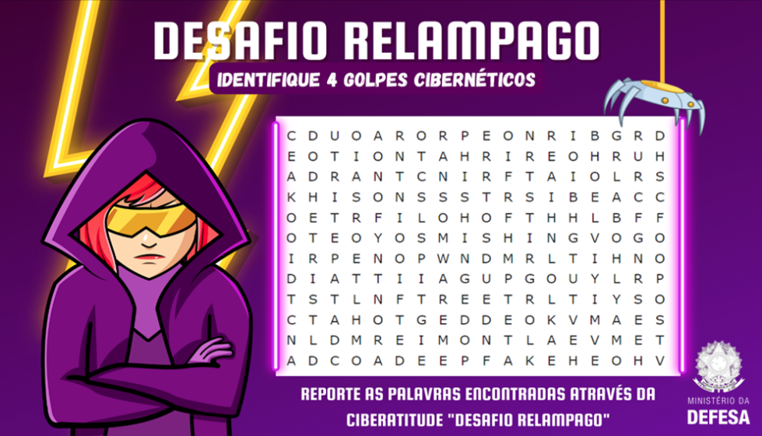
Gamification Strategies
Mini Challenges
Notes:
Word hunt
to find 3 errors about desk clean policy (yellow)...

Slide 15
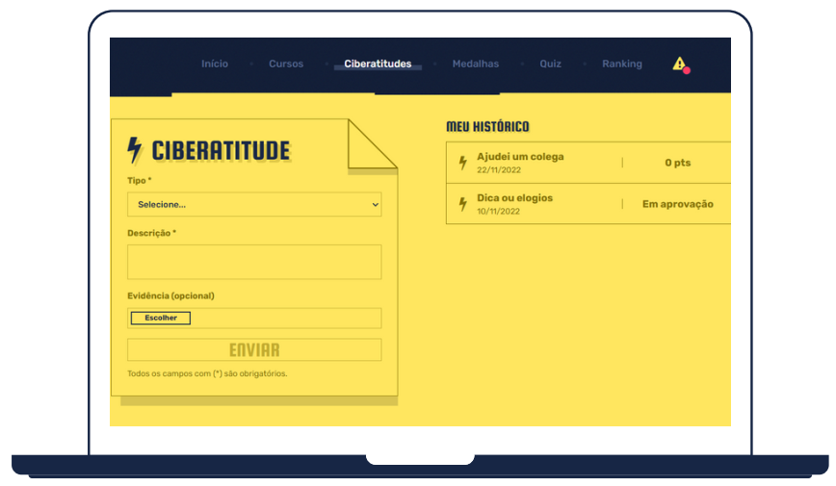
Gamification Strategies
Cyber Attitudes
Users can report good attitudes
Report a security risk
Share knowledge
Give feedback about the campaign

Slide 16
Gamification Strategies
Awards

Slide 17
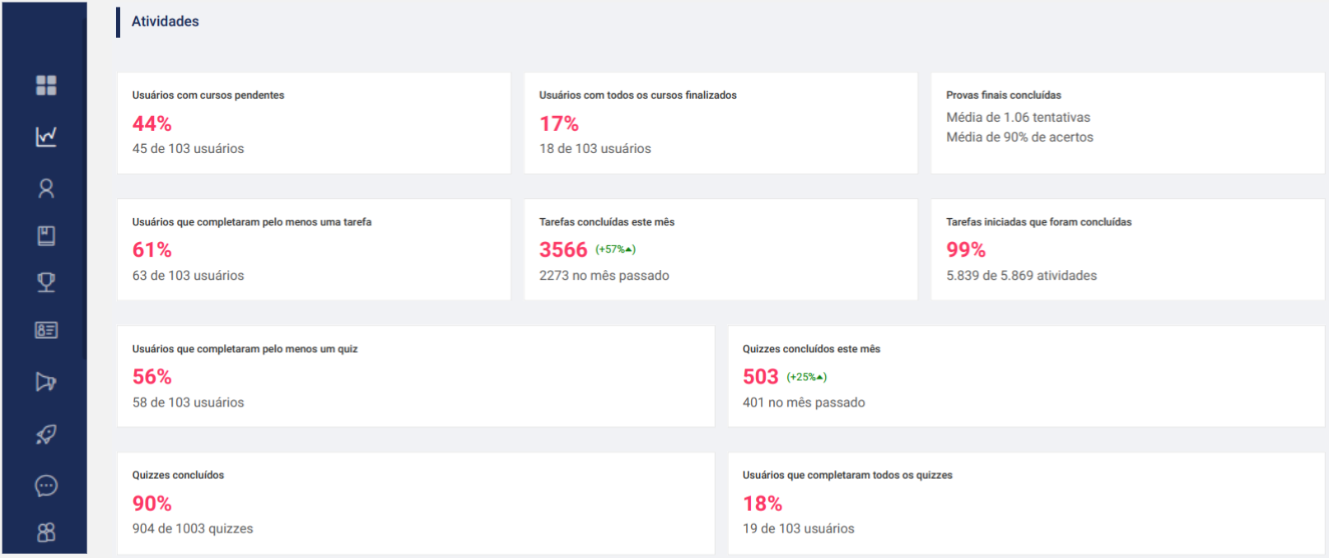
Gamification Strategies
Admin Monitoring

Slide 18
RNP Campaigns and
Results

Slide 19
RNP Campaigns and Results
SaaS platform developed in gamification format
Many features to promote users engagement
Good security and privacy contents
Admin Panel to monitor our campaign
Awards for top users

Slide 20
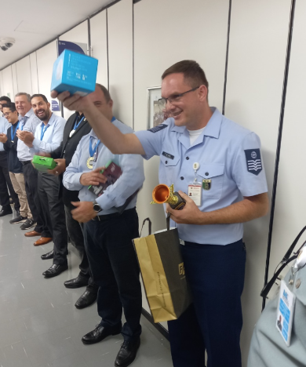
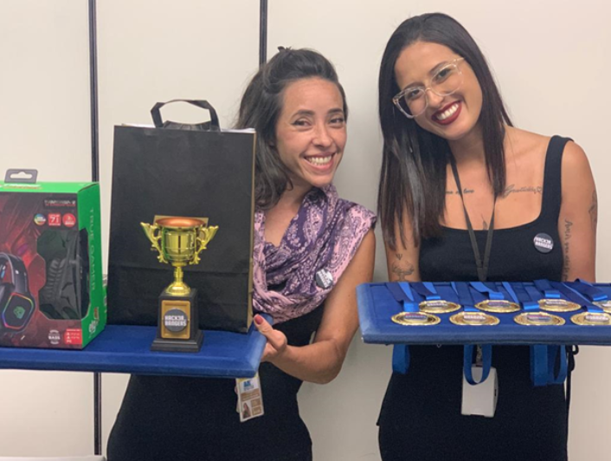
RNP Campaigns and Results
Prizes
Trophy and Medals
Amazon Alexas
Headset Gamer
Mouse Gamer

Slide 21
RNP Campaigns and Results
Security and Privacy Awareness Plan
Wave 1
Wave 2
…
Wave N
Notes:
12 month

Slide 22
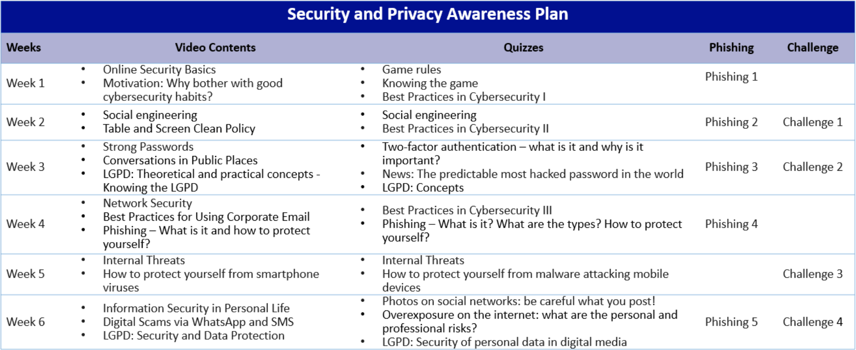
RNP Campaigns and Results
E.g. Campaign Waves
Notes:
6 week

Slide 23
RNP Campaigns and Results
228 Total users
40 Courses
40 Quizzes
11 Weeks
02 Campaigns Waves
3466 Medals

Slide 24
RNP Campaigns and Results
542 Security risks

Slide 25
RNP Campaigns and Results
E.g. Reported risks
1
“The youtube web site is easily bypassed if you add a ".%" at the end of the address, and many users are doing this...”
2
“Today I saw a person who had been fired log in with their expired credential. However, according to the Internal Security Bulletin, they should no longer have access to the network.”
translated from PT-BR

Slide 26
RNP Campaigns and Results
570x Shared knowledge

Slide 27
RNP Campaigns and Results
E.g. Shared knowledge
1
"I reported to the user responsible for the sector that sensitive data was incorrectly stored. Thus ensuring best practices from data collection to information disposal."
2
"Today when I was about to use the printer, I noticed it was logged in to the previous user account. I reported to him that it is important to click on the logout tab to avoid this problem. Because someone with bad intentions might do something on his behalf.”
translated from PT-BR

Slide 28
RNP Campaigns and Results
578 Feedbacks from
the campaign

Slide 29
RNP Campaigns and Results
E.g. of feedbacks from the campaign
1
“The game is providing healthy competition among users, and expanding information security knowledge and mindset. Congratulations!!!”
2
“Today in a conversation with a friend, I had the true happiness of discussing ISO 27001 with great confidence, thanks to the knowledge acquired in the game…”
translated from PT-BR

Slide 30
Thank you
Any questions?
rodrigo.facio at rnp.br

