Slide 1
Establishment of Identity Federations in Africa: Challenges and Opportunities
…OR…”WHY DO WE LIKE SO MUCH WHAT WE DO ?”
Alex Mwotil / UbuntuNet Alliance Mario Reale / GÉANT
June 8, 2023 - TNC23 Tirana, Albania

Slide 2
Establishing Identity Federations in Africa: A hands-on perspective
I. BEFORE WE STARTED
II. OUR DAILY WORK IN THE AC3 PROJECT
III. GETTING EVERYONE ONBOARD !
IV. ARE WE THERE YET ? (OF COURSE NOT)
V. CHALLENGES AND IDEAS FOR THE FUTURE
Notes:
PRESENTED BY: MARIO

Slide 3
BEFORE WE STARTED
Notes:
PRESENTED BY: MARIO

Slide 4
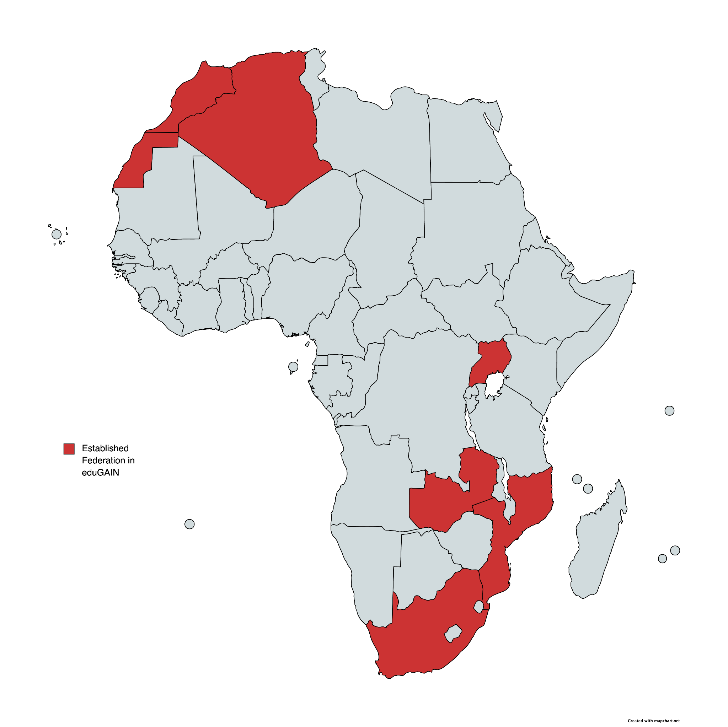
Before AfricaConnect3 started
2019
Four years ago,
six federations from Africa were in operation/eduGAIN:
South Africa, Morocco, Uganda, Algeria, Mozambique, Zambia
On Nov 16, 2019,
The AfricaConnect3 project started
Notes:
PRESENTED BY: MARIO

Slide 5
OUR DAILY WORK IN THE AC3 PROJECT
Notes:
PRESENTED BY: MARIO

Slide 6
The AfricaConnect3 project
Start date: 16 November 2019
Duration: 48 months
Funds: European Union Grant Contract DCI-PANAF/2019/411-583/584/585/585
Budget: 37.5M EUR (80% EU funding, 30M EUR)
Funding for connectivity, equipment and cloud: 23.2M EUR It builds on the success of its predecessor projects, AfricaConnect and AfricaConnect2, in supporting the creation, development and use of advanced connectivity and services for R&E communities in Africa
www.africaconnect3.net
Notes:
PRESENTED BY: MARIO

Slide 7
AC3 Objectives and Outputs
Enhance human capital development in Africa.
Unlock the potential of education and research through increased access of African R&E institutions to digital infrastructures and technologies.
Output 1: Access to affordable and adequate e-infrastructures is increased
Output 2: Dedicated R&E services and applications are developed
Output 3: Adequate human resource capacity and expertise is built
Output 4: Digital transformation in research and education is raised
www.africaconnect3.net
Notes:
PRESENTED BY: MARIO

Slide 8
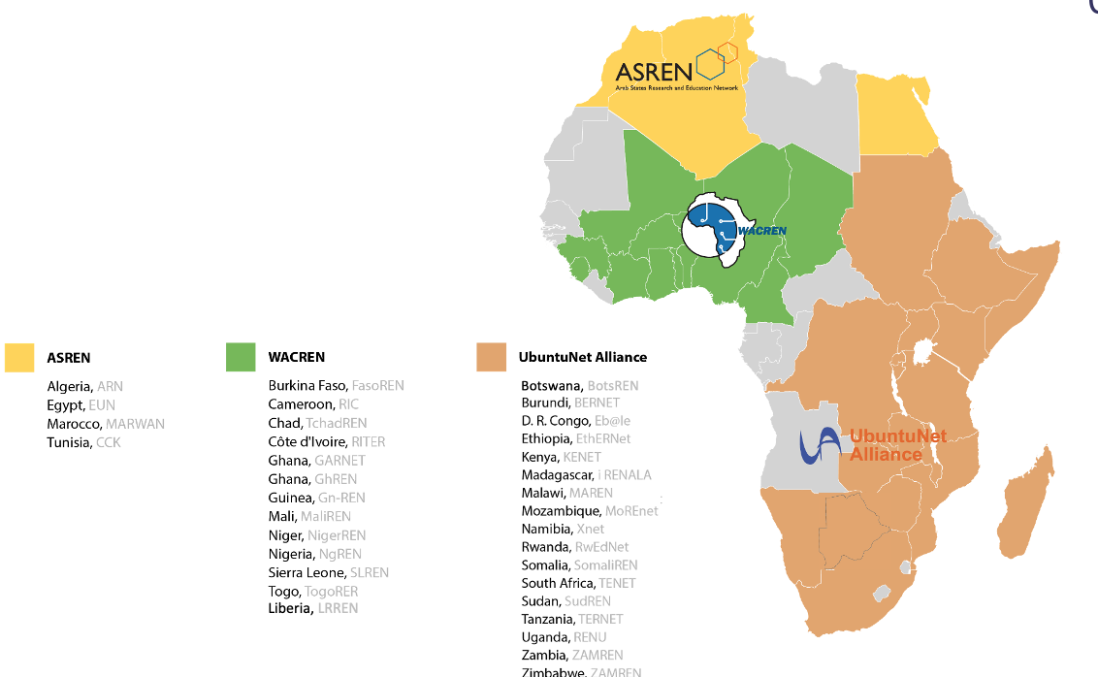
National Research and Education Networks in Africa
AfricaConnect (2011-2015) – E&S Africa
AfricaConnect2 (2015-2021) – pan-African
AfricaConnect3 (2019-2024) – pan-African
Since AfricaConnect started in 2011, 22 out of 38 African NRENs are connected to their regional network
africaconnect3.net
www.africaconnect3.net
‹#›
Notes:
PRESENTED BY: MARIO

Slide 9
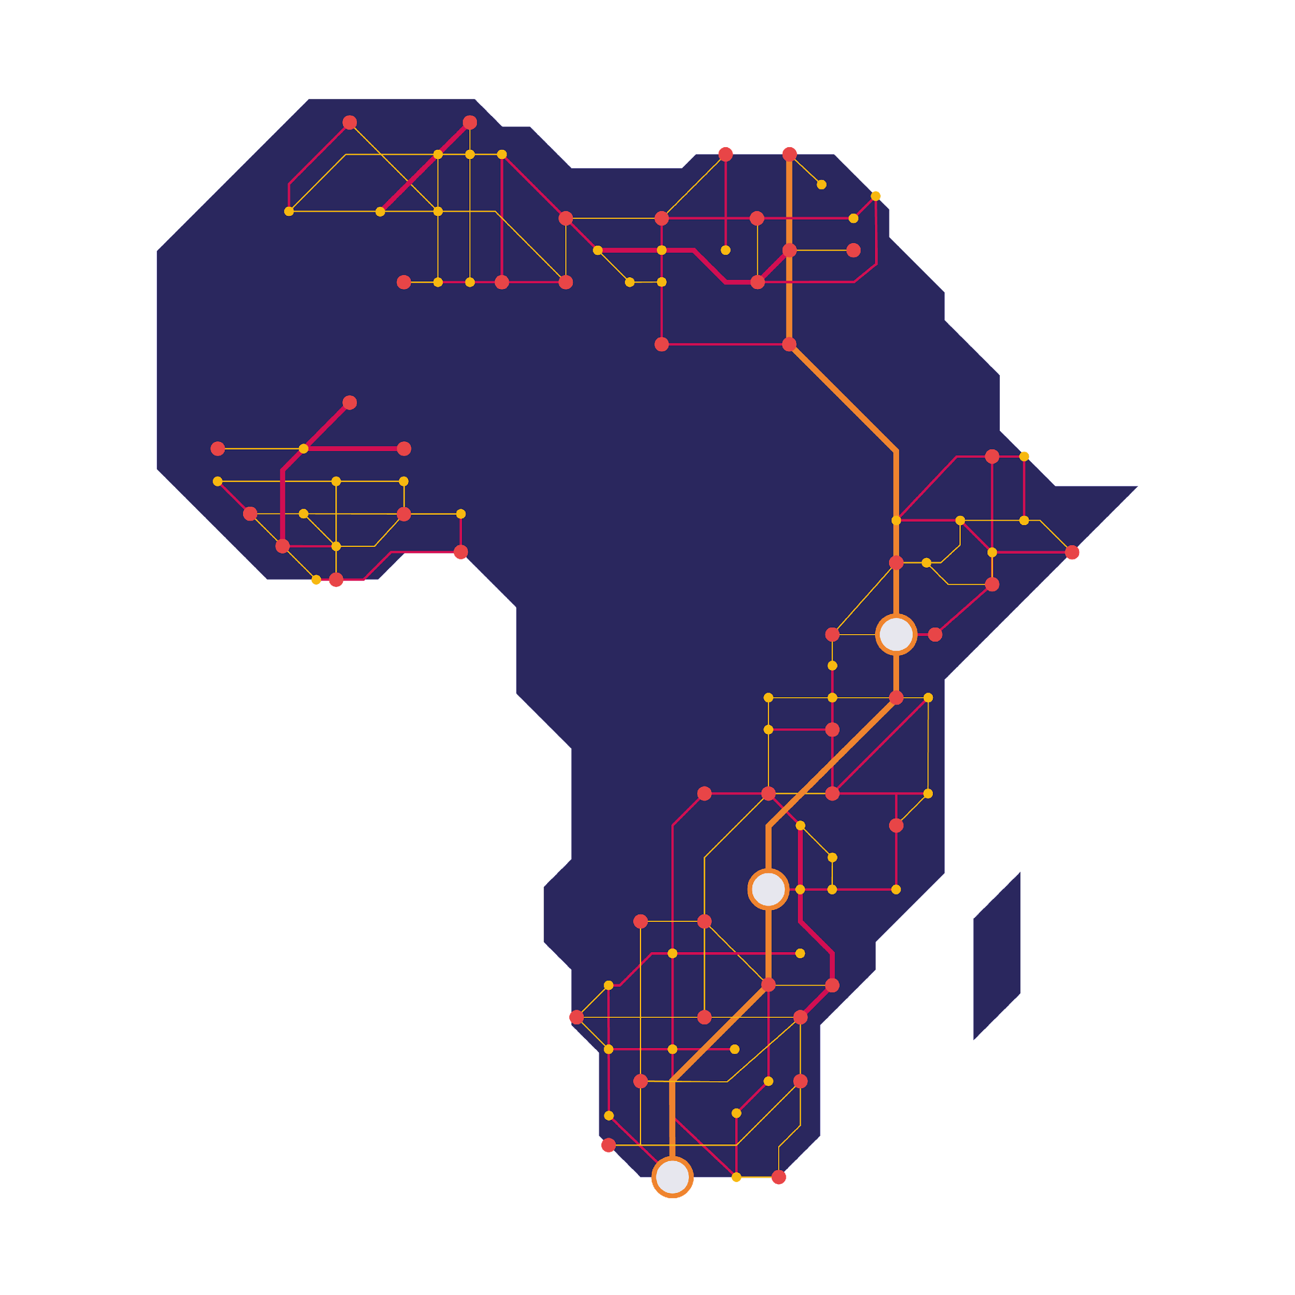
AC3 Work Package 2: Developing R&E Services
Service outreach to science communities
Deployment of R&E applications and access to repositories
Trust and Identity
Proactive Cybersecurity for NRENs and their Digital Assets
Federated Identity Management for Libraries
WP2: Development of R&E Services and Applications
WP2.1 Services Outreach and Deployment Support
WP2.2 Trust and Identity Services, eduGAIN, eduroam,..
WP2.3 Proactive Cybersecurity for NRENs and their Digital Assets
WP2.4 Federated Identity Management for Libraries
www.africaconnect3.net
Notes:
PRESENTED BY: MARIO

Slide 10
What National Identity Federations are
National Identity Federations are organisations managing Service Providers and Identities Providers (entities) within a country, acting as a trusted third party among them
Their main goal is to provide users with web Single Sign On
They are collections of organisations that agree to interoperate under a certain rule set for the benefit of their users
They are based on common, agreed standards, best practices, and policies, to build the required trust across institutions
Notes:
PRESENTED BY: ALEX [Visualize]
to enable their users to use their set of unique home credentials while accessing services provided by other institutions in the nation, and, through eduGAIN, worldwide

Slide 11
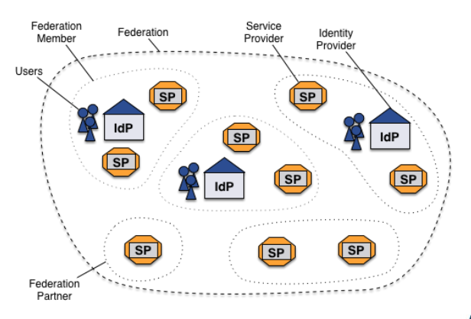
The main tasks of an Identity Federation
Participating Entities register their metadata into the Federation
The Federation validates and aggregates all the entities metadata creating the federation feed
The Federation feed is signed with the Federation key and distributed through an MDS (Metadata Distribution System)
Notes:
PRESENTED BY: ALEX

Slide 12
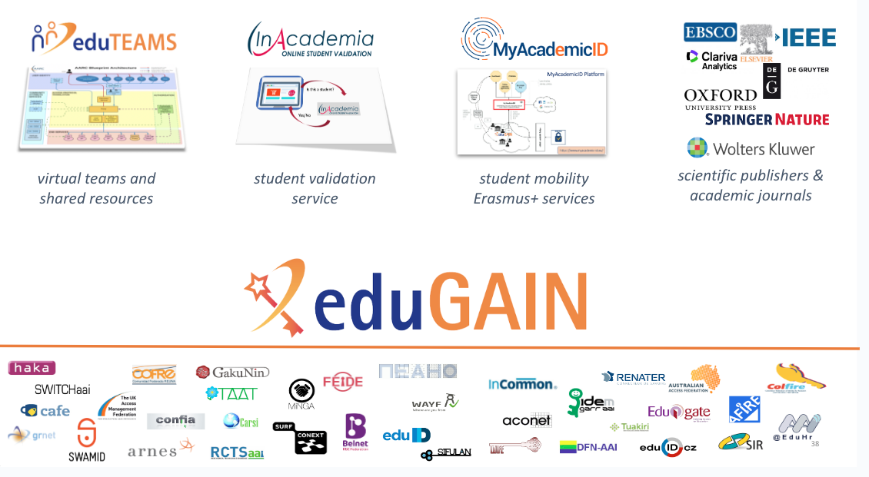
Why are Identity Federations fundamental for R&E ?
Notes:
PRESENTED BY: ALEX

Slide 13
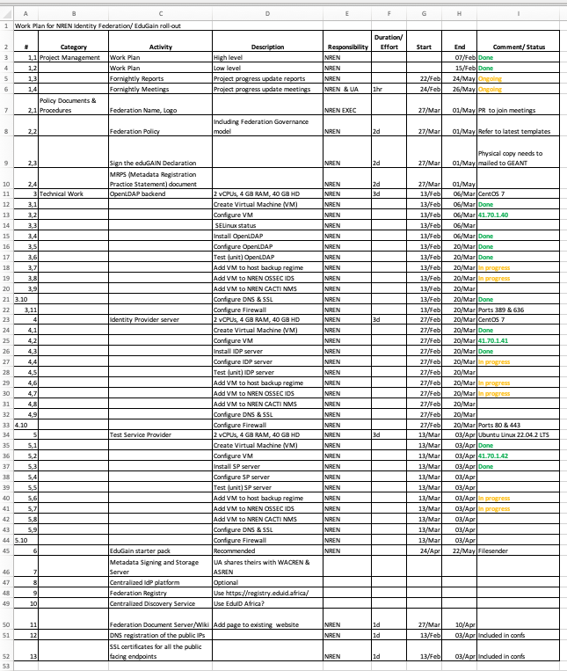
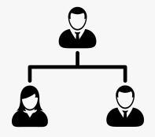
We jointly track with the NREN team the very first steps
Reach out to the NREN team
Start planned calls and slack support
Organise support sessions online
Escalate to community experts
Community orientation, who is who and documentation
We use a simple spreadsheet to track the progress
Notes:
PRESENTED BY: MARIO
We start by reaching out to the NREN team and provide them with the initial context, information, goals, orientation when needed
We usually meet on a weekly or biweekly basis with the NREN team
Use SLACK chat to provide support on a daily basis when needed
Sometimes carry out joint debugging/support sessions from remote
Point the NREN team to all available documentation on the tools and the best practices (HowTos, REFEDS, tools documentation)
Escalate to additional community experts/developers when needed, organising joint NREN sessions with them

Slide 14
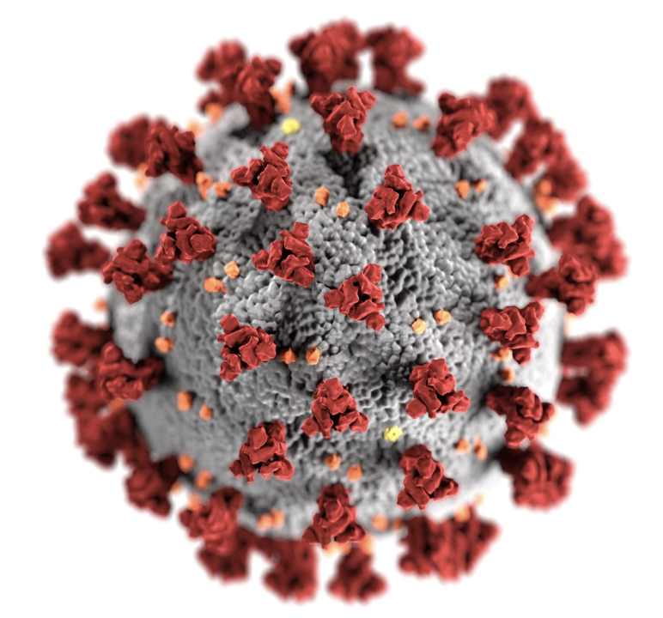
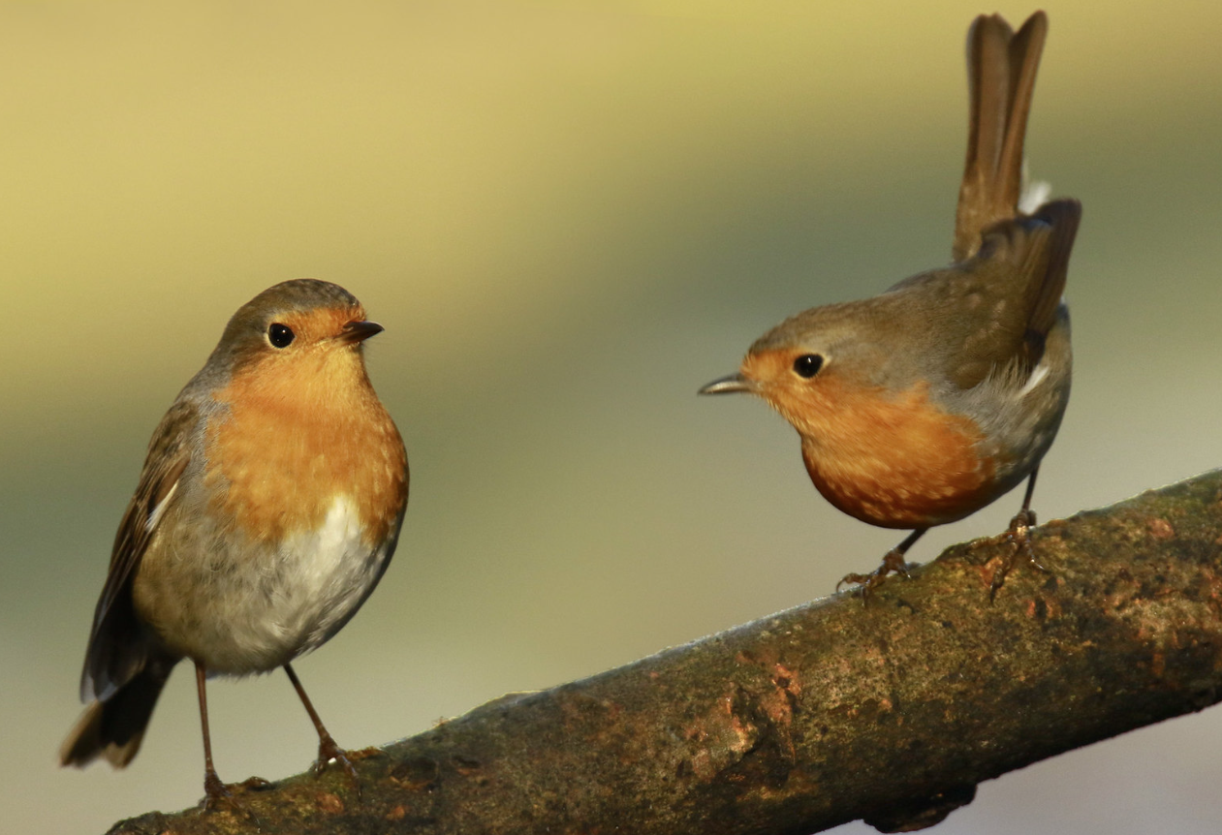
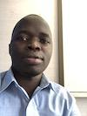
Alex,Mario
So….in 2020 Alex and Mario met… virtually….. to work for AC3 ..and in 2021….2022….
I don’t know, Let me check out of the window. None is outside, only birds.
How is it there ? Can you go outside ?
Do you need to wear a face mask ?
Nice memories from 2020…!
but.…Internet was not in lock down :-) ….
Notes:
PRESENTED BY: ALEX AND MARIO

Slide 15
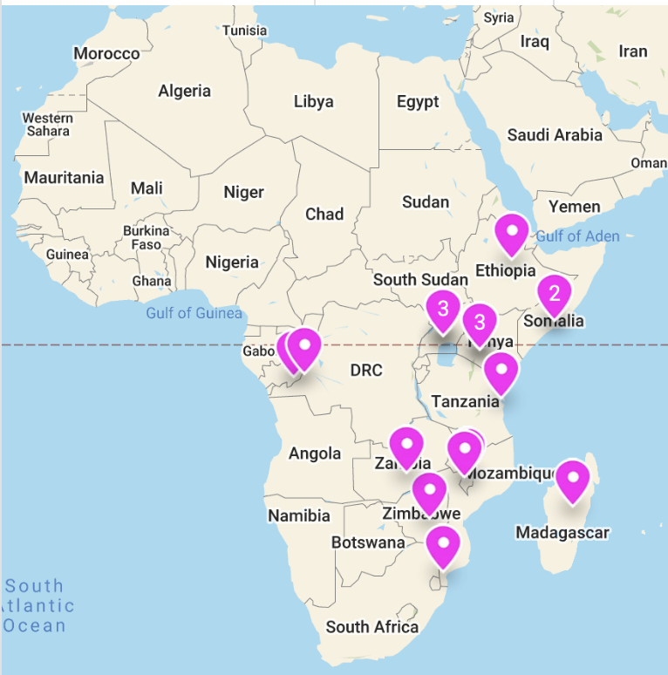
Training for Federation Operators in the Ubuntunet region (South-East Africa) September 2021
We organised - jointly with the GÉANT eduGAIN training team - an online Training for Federation Operators for the UbuntuNet Alliance region, in September 2021
Training IT infrastructure provided by GÉANT IT
Attended by 33 trainees from 14 countries
The AC3-GÉANT Ubuntunet FedOps training Sept 1 to October 3 2021
Country | # trainees | Country | # trainees
BOTSWANA | 3 | MOZAMBIQUE | 2
BURUNDI | 1 | RWANDA | 3
DRC | 2 | SOMALIA | 2
ETHIOPIA | 2 | TANZANIA | 4
KENYA | 3 | UGANDA | 4
MADAGASCAR | 1 | ZAMBIA | 2
MALAWI | 2 | ZIMBABWE | 2
Notes:
PRESENTED BY: MARIO

Slide 16
Training for Federation Operators in the Ubuntunet region (South-East Africa) Training program structure
https://wiki.geant.org/display/eduGAIN/Training+Materials
Notes:
PRESENTED BY: MARIO

Slide 17
GETTING EVERYONE ON BOARD !
Notes:
PRESENTED BY: ALEX

Slide 18
What is eduID.Africa ?
As the three RRENs in Africa (ASREN, UbuntuNet Alliance and WACREN)
We had identity federation needs:
Our operational requirements & services
Catch-all needs in Africa
Support template
→ eduID.africa
Notes:
PRESENTED BY: ALEX
eduID.africa is the Trust and Identity collaboration framework established in the context of AfricaConnect3 by the three Regional Research and Education Networks of Africa:
Arab States Research and Education Network (ASREN)
Ubuntunet Alliance for Research and Education Networking
West and Central African Research and Education Network (WACREN)
It is an established Identity Federation inside the worldwide eduGAIN interfederation service

Slide 19
What is eduID.Africa ?
eduID.africa is an established Identity Federation inside the worldwide eduGAIN interfederation service
Governance of the eduID.africa is delegated to the three RRENs in Africa
A continental workspace for users, services and institutions
Ease introduction of new services for users
A framework for collaboration on education identity services between the regional research and education networks (RRENs)
A catch-all Federation for countries that have not established identity federations.
Notes:
PRESENTED BY: ALEX
eduID.africa is the Trust and Identity collaboration framework established in the context of AfricaConnect3 by the three Regional Research and Education Networks of Africa:
Arab States Research and Education Network (ASREN)
Ubuntunet Alliance for Research and Education Networking
West and Central African Research and Education Network (WACREN)
It is an established Identity Federation inside the worldwide eduGAIN interfederation service

Slide 20
Why setting up an African catch-all federation ?
Many countries in Africa are still green field regions
It is difficult for many to understand the real benefits of Identity Federations without any infrastructure, or any IdP or SP in place
A catch-all federation is there for all those countries who do not yet have their own federation, to experience the benefits of federated identity management
Notes:
PRESENTED BY: ALEX
Many african countries are still green field regions with respect to federated Identity Management, Identity Federations, WebSSO and related technologies
It is difficult for many to understand the real benefits of Identity Federations without any infrastructure, or any IdP or SP in place
A catch-all federation is there for all those countries who do not yet have their own federation, to experience the benefits of federated identity management, gain hands-on experience, promoting federations towards decision-makers, thus helping pushing towards the establishment of the national identity federation

Slide 21
Joining eduID.africa
Who can join eduID.Africa ?
The three RRENs are defacto members of eduID.africa
Institutions formally registered in Africa - Collaborations
No national identity federation
R&E related Services and/or Identity Providers:
willing to promote the adoption of Federated Identity Management (FIM) in Africa
who would benefit institutions in Africa through eduGAIN and generally FIM
Notes:
PRESENTED BY: ALEX
Main goals of the eduID.Africa
Facilitate and simplify introduction of shared services across the federation
Fastrack the rollout of identity federations in Africa
Provide guidelines/best practices to constituent countries in establishing national federations
Onboard institutions within the region and without a national federation in order to support collaboration
Who can join eduID.Africa ?
Institutions formally registered in Africa and looking forward to collaborations within and/or outside Africa using federated identities
Research and Education (R&E) related Services and/or Identity Providers willing to promote the adoption of Federated Identity Management (FIM) in Africa
with the purpose of promoting identity federations and eduGAIN in the continent
Services and/or identity providers who would benefit to join eduGAIN and FIM, and do not have a corresponding national identity federations

Slide 22
Currently ongoing work in our AC3 task
We are planning/organising forthcoming trainings for federation operators
in close collaboration with colleagues with established federations in Africa and GÉANT eduGAIN Training Team
We’re further planning ahead for the on-going activities with Tanzania, Ethiopia, Malawi, Mozambique, Ghana and Togo.
Cote d’Ivoire , Benin and Burkina Faso are also in the pipeline.
Notes:
PRESENTED BY: ALEX

Slide 23
ARE WE THERE YET ? (OF COURSE NOT)
Notes:
PRESENTED BY: MARIO

Slide 24
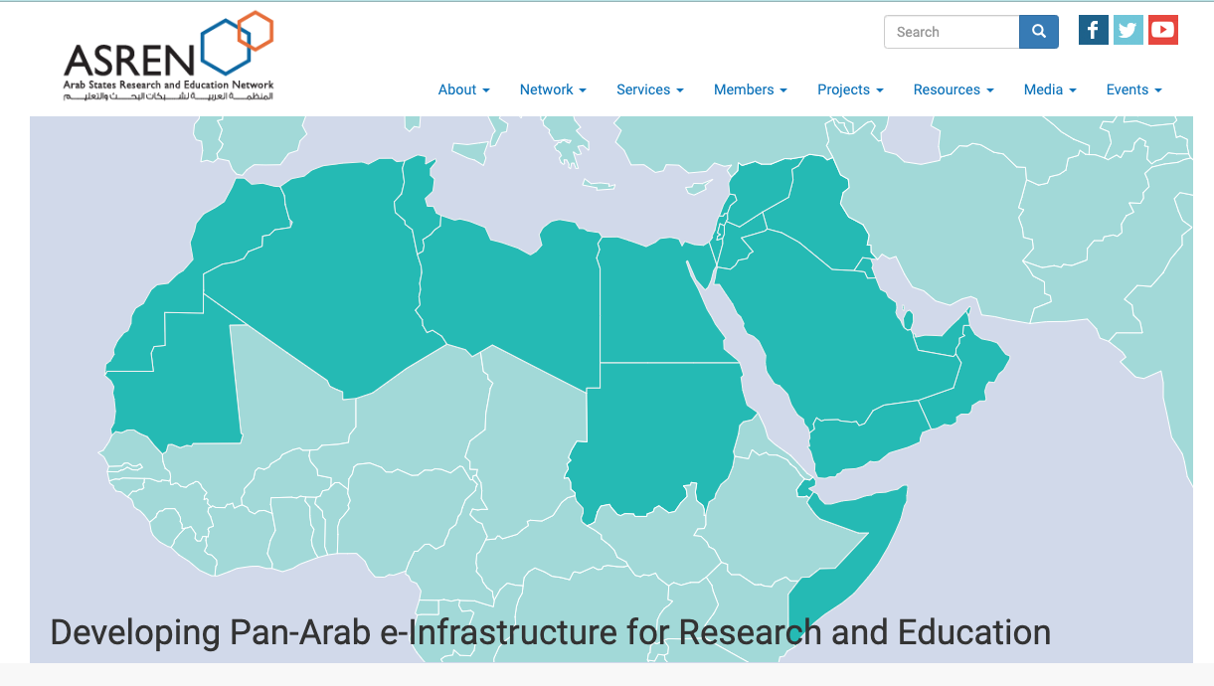
What did AC3 achieve, overall, about Identity Federations ?
AC3 Ubuntunet provided training for the region and direct assistance to set up the national federation to the NRENs of the following countries:
Somalia, Ethiopia, Kenya
AC3 set up the eduID.Africa African Catch-all federation
And got it included in the worldwide eduGAIN interfering service
AC3 WACREN team set up the Nigerian Identity federation and is currently working with Togo, Ghana, - and we are about to start with Burkina Faso, Côte d’Ivoire, Benin The eduID identity federation platform has been provided
AC3 ASREN team has set up the iFARE federation, to promote federations and eduGAIN within the Arab region ( https://asrenorg.net/?q=content/asren-ifare )
A successful FedOps training was provided in 2020, In collaboration with the GÉANT GN4-3 project eduGAIN training team
Notes:
PRESENTED BY: MARIO

Slide 25
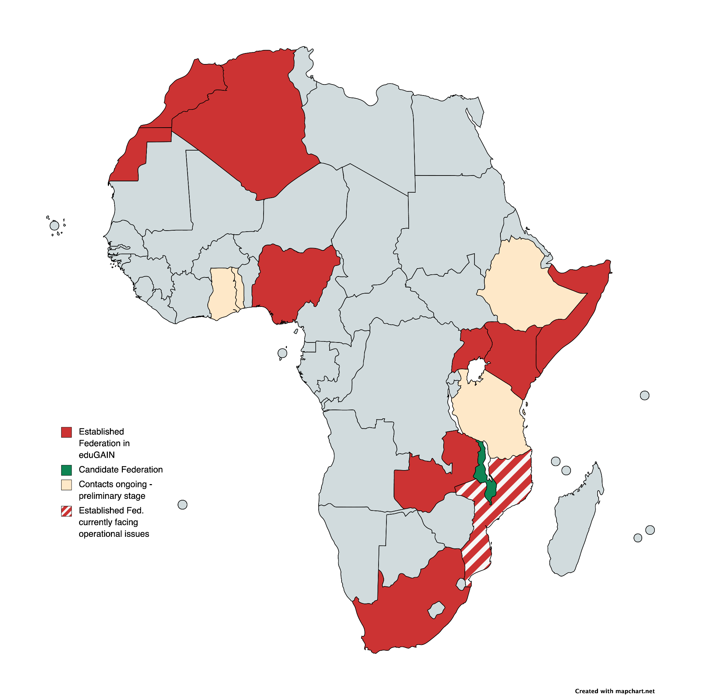
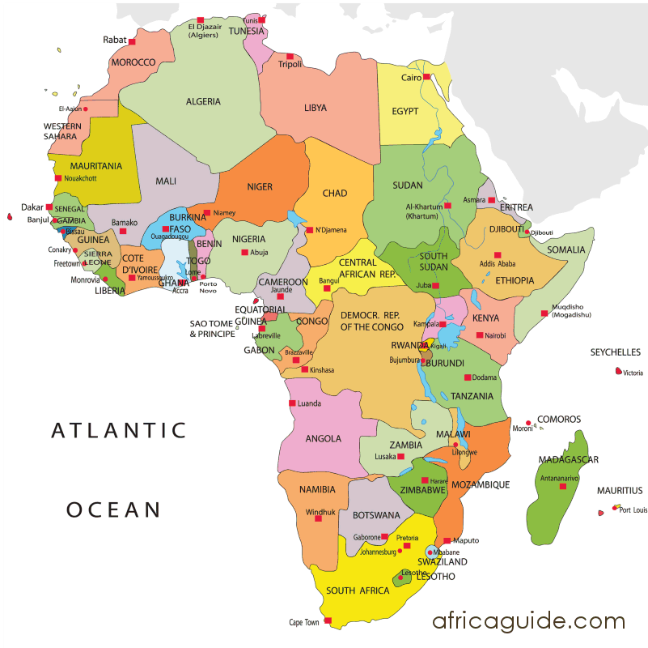
Identity Federations in Africa in 2023
2023
Morocco
Algeria
Togo
Nigeria
Ethiopia
Ghana
Somalia
Uganda
Kenya
4 years ago
Tanzania
Malawi
Zambia
Mozambique
South Africa
Notes:
PRESENTED BY: MARIO

Slide 26
eduGAIN in Africa
AfricaConnect3 Started Nov 2019
South Africa SAFIRE
Algeria ARNaai
Morocco
eduIDM.ma
Uganda RIF
Mozambique CAFmoz
Zambia FIDERN
Nigeria
eduID.ng
Kenya RAFIKI
eduID.Africa
Somalia SIF
2017
2017
2018
2018
2018
2018
2021
2022
2022
2023
African entities in eduGAIN (June 2022):
Total of 19 African SPs in eduGAIN
Total of 53 African IdPs in eduGAIN
Total of 7 National Identity Federations in eduGAIN
Africa entities in eduGAIN (June 2023):
Total of 32 African SPs in eduGAIN +68%
Total of 61 African IdPs in eduGAIN +15%
Total of 10 National Identity Federations in eduGAIN +42%
Notes:
PRESENTED BY: MARIO

Slide 27
CHALLENGES AND IDEAS FOR THE FUTURE
Notes:
PRESENTED BY: ALEX

Slide 28
Challenges in our task
Manpower and Human Resources retention
Generally speaking: pandemics do not help :-)
Online-only trainings more challenging than in-person ones
Linguistic barriers in 'diverse' Africa
English, Arabic, Portuguese, French
Welcome!
Thanks but NO THANKS !
Notes:
PRESENTED BY: ALEX
For emerging NRENs, usually equipped with small teams on Trust & Identity services, if one staff member in a team leaves, this is often easily 30%, 50% or 100% of the available manpower
Generally speaking: pandemics do not help :-)
But nevertheless we provided a complete, successful training during COVID-19
Online it takes a bit of extra time to get everyone onboard, focus, get attention
Linguistic barriers
In some countries, Portuguese and French would be totally beneficial, but there is general lack of training materials and trainers in those languages

Slide 29
Future
Collaborations with initiatives aimed at adoption and use of FIM:
BonafID
PROFERE
R4L
iFIRExMAN
Work on the next FedOps training
Enhance and ensure sustainability of the tools:
Jagger
Containers/Kubernetes
Notes:
PRESENTED BY: ALEX
Collaborations with initiatives aimed at the same goals (e.g. iFARE4xMAN)
Work on the next Identity Federations/Federation Operators training
Enhance the level of support and the effectiveness of the tools we use to provide help to emerging NRENs:
Need to clarify about the sustainability and long term plans for JAGGER
Using an approach based on Containers / Kubernetes to ease the deployment of services and make them highly available
Federation as a Service (FaaS) aims at becoming a full fledged, deployable solution (Docker based) to implement required federation services
We should try and help there, and push for adoption once ready
eduID.Africa will also be playing a key role for boosting collaboration around relevant initiatives as BonafID, PROFERE, R4L

Slide 30
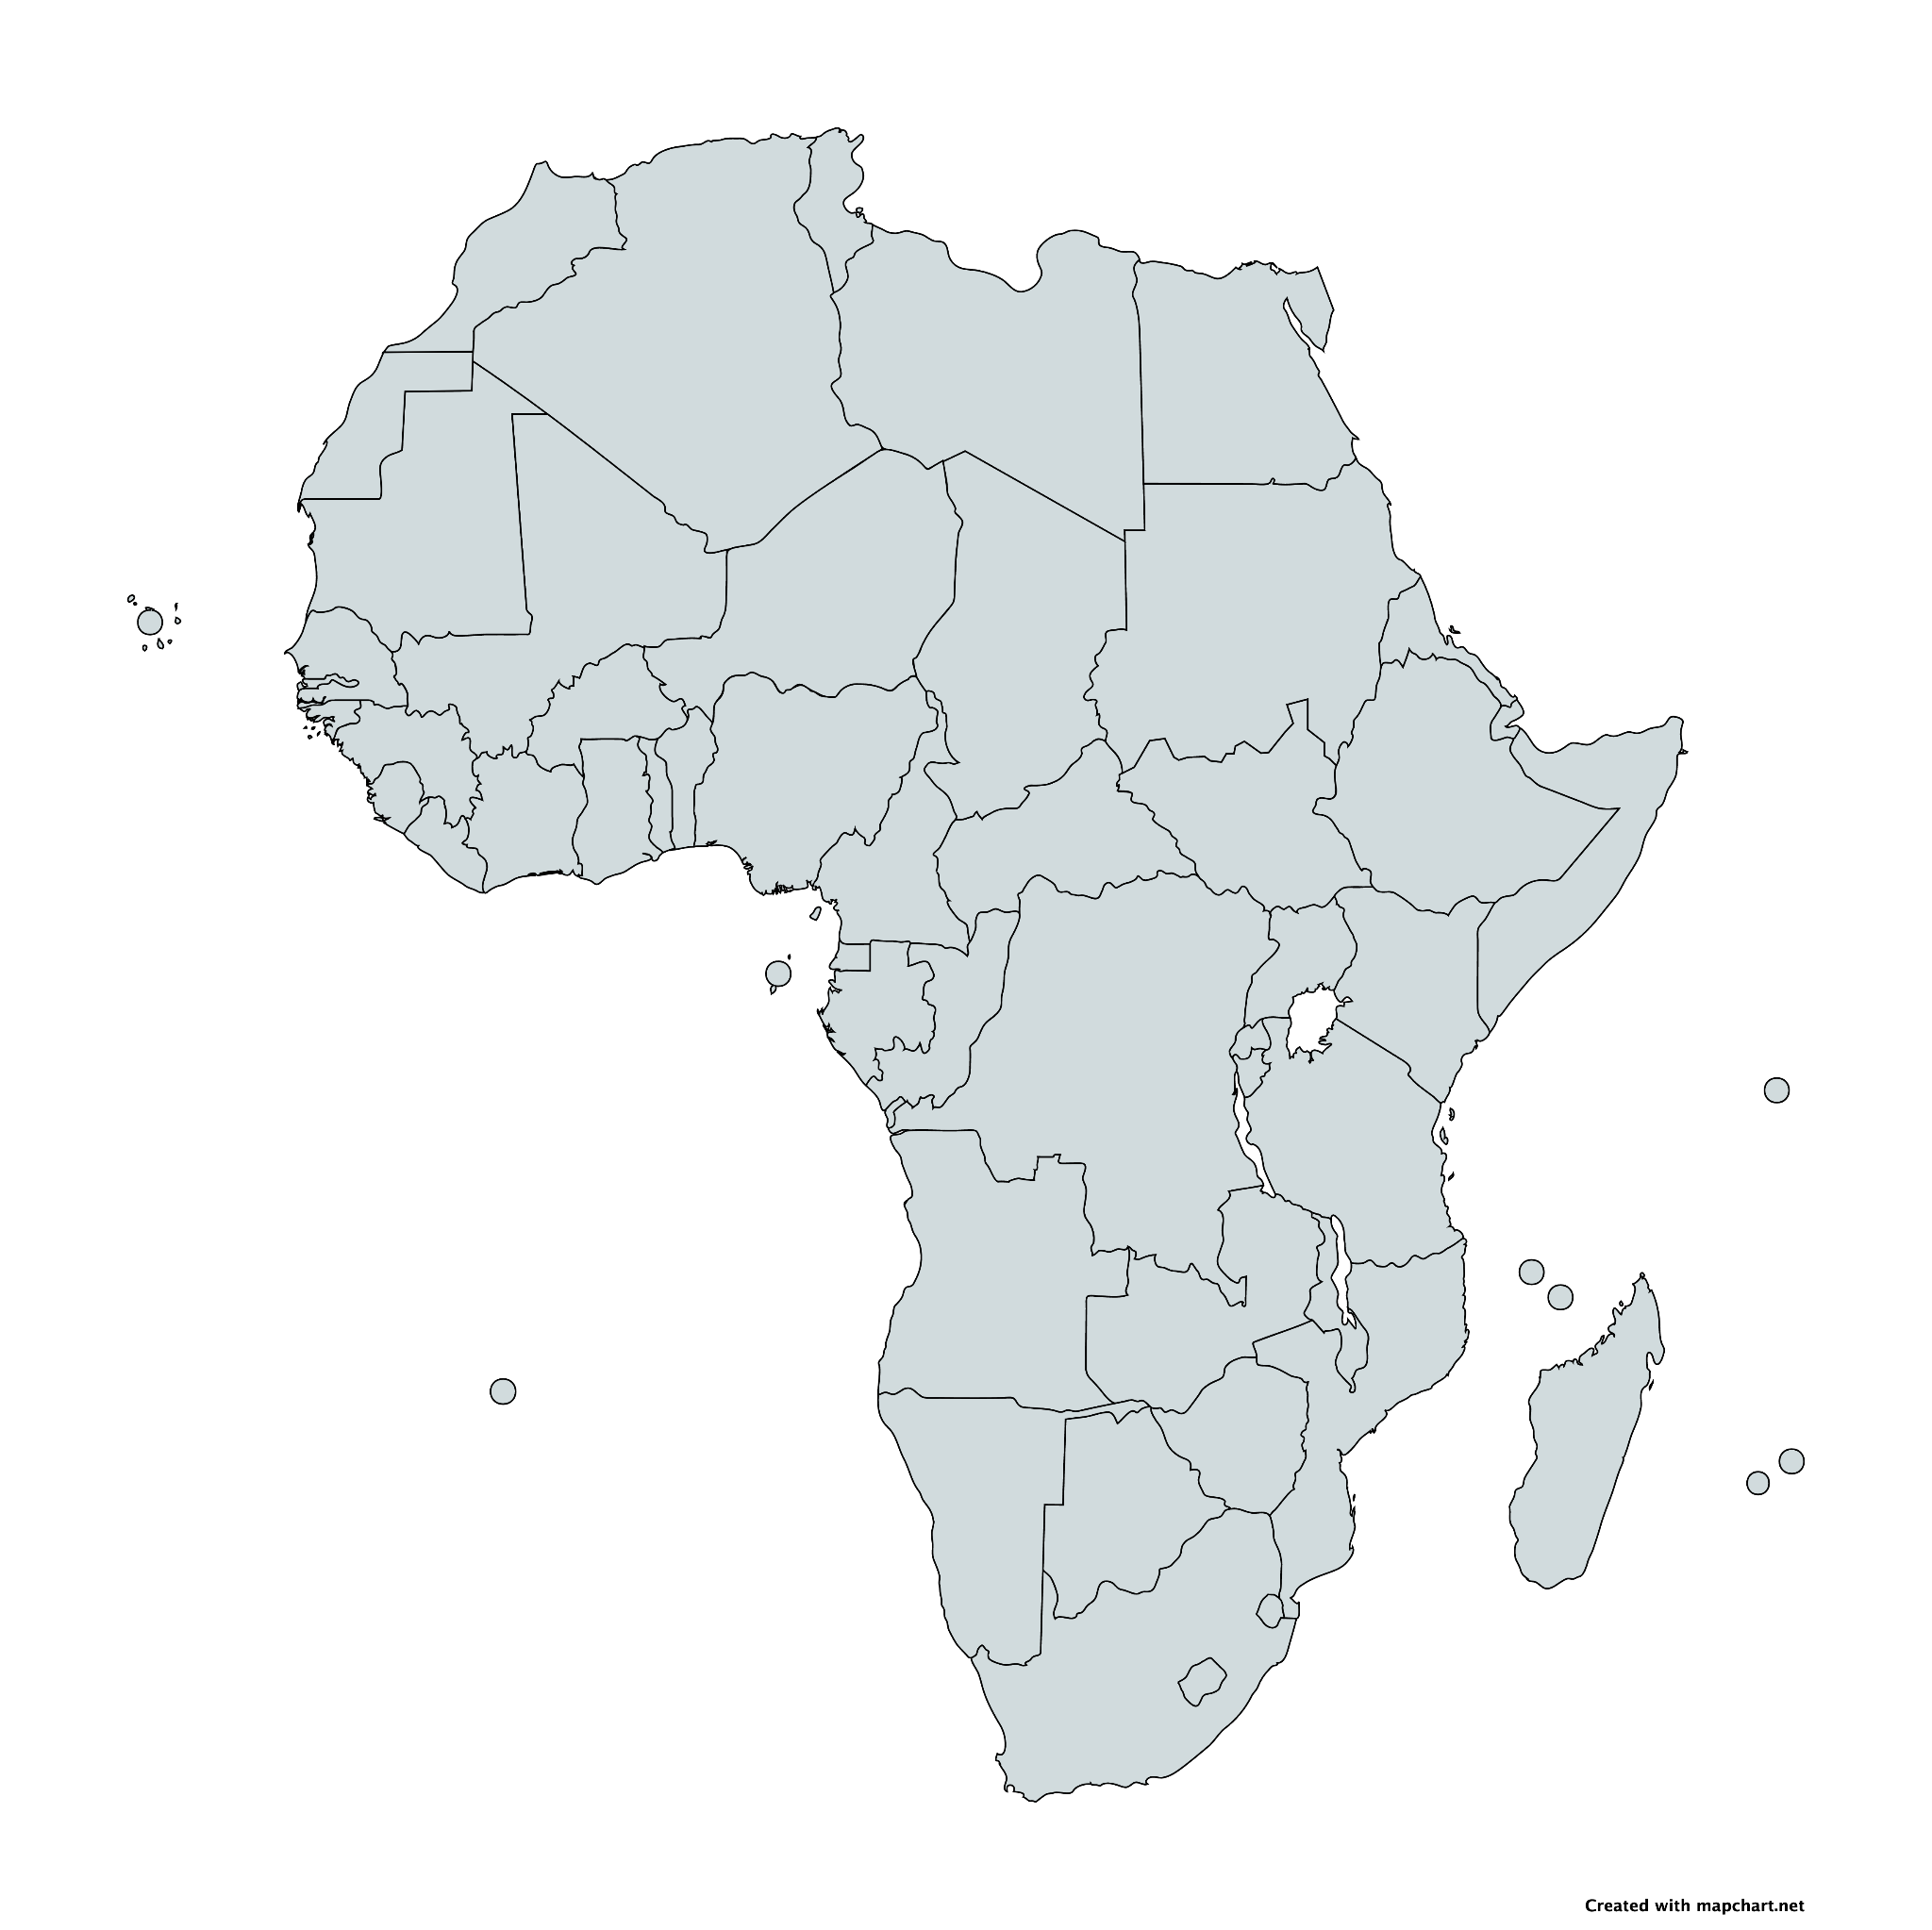
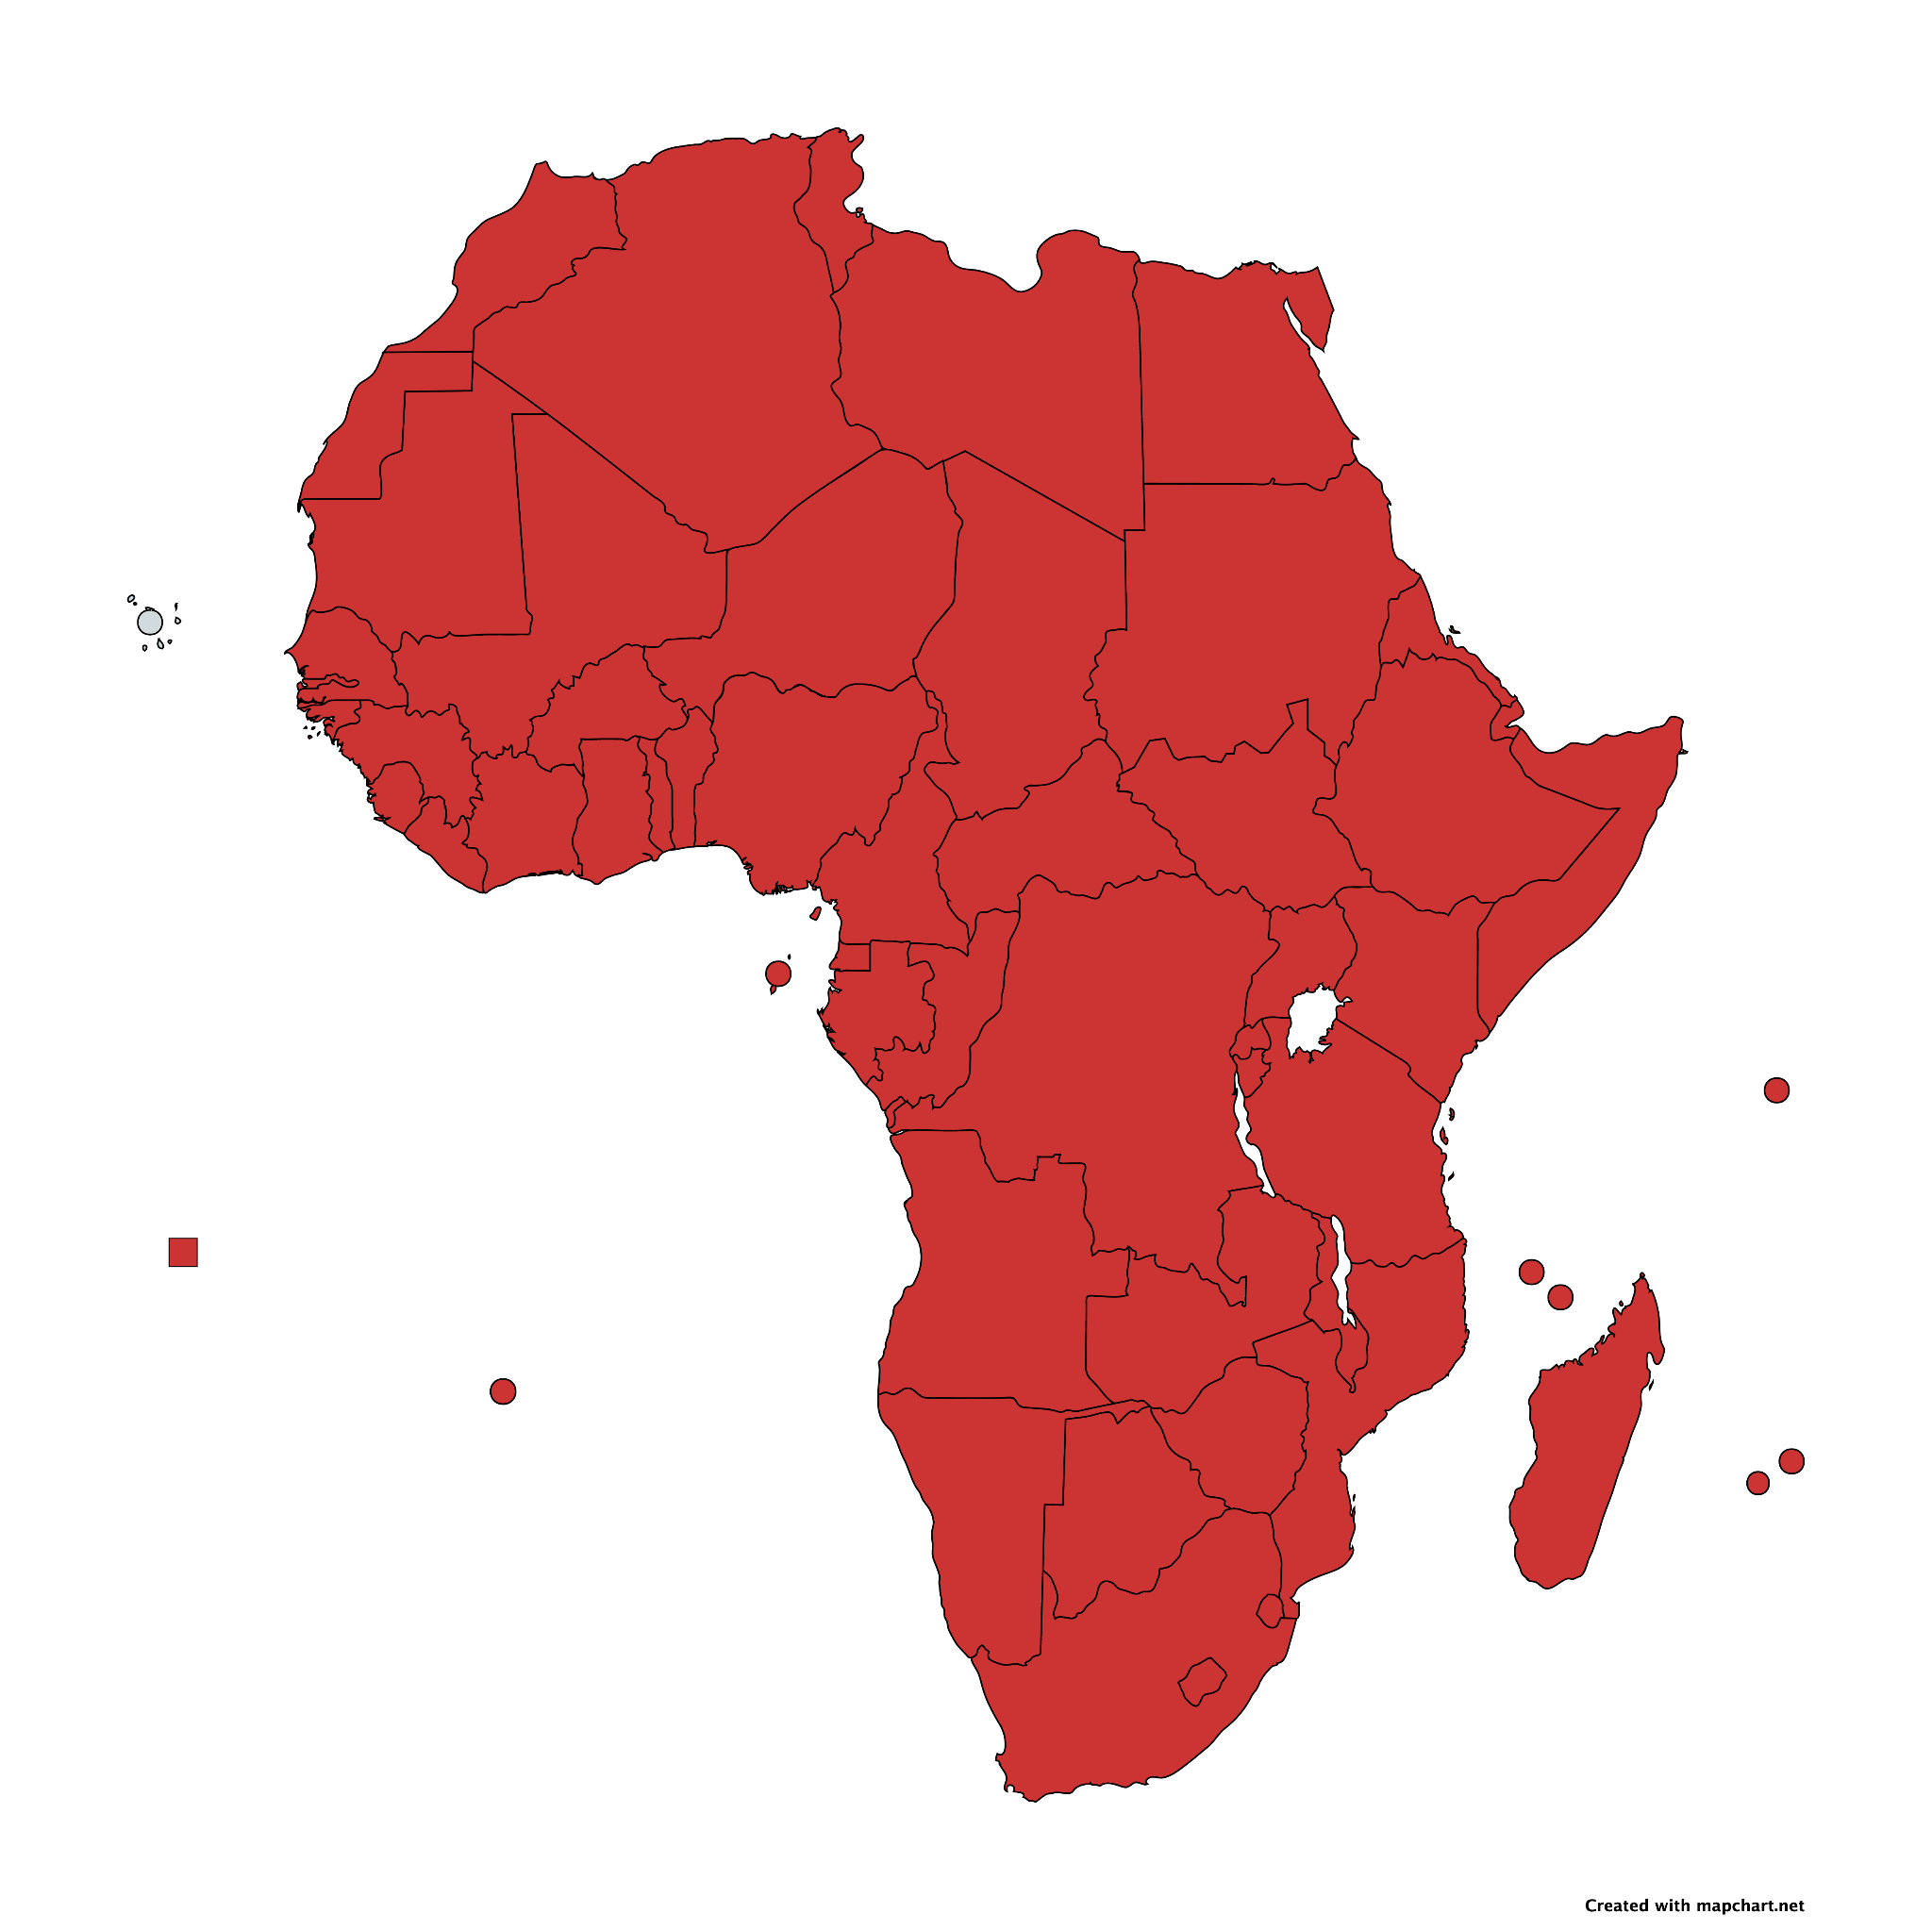
So is it clear now, why we like what we do ?
It is exciting and rewarding helping the community to take the first steps in the world of Identity Federations
Wonderful to see the progress and the community response !
There is a lot to do, still, and the next months/years to come will be at least as interesting and exciting as the past ones
Notes:
PRESENTED BY: ALEX

Slide 31
Thank you
Any questions?
@AC3_News
AC3-Community
africaconnect3.net
Alex Mwotil alex.mwotil@ubuntunet.net Mario Reale mario.reale@geant.org
Notes:
PRESENTED BY: ALEX

