Slide 1
Future sustainable access to commercial services through EOSC
an opportunity for the GÉANT community!
Jan Meijer, Sikt – Norwegian Agency for Shared Services in Education and Research
TNC 2023, 8 June 2023
Notes:
Want to present a concept, have a serious discussion
A story about the lessons learned through our collective efforts of engaging with commercial cloud solutions since 2013 and the opportunity it created for us
My creds:
Sikt – EOSC member, I’m delegate to the GA
EOSC-A co-chair financial sustainability
Participated in OCRE and EOSC-Future INFRA-EOSC projects in last 4 years, Geant cloud effort since 2016

Slide 2
1. About European Open Science Cloud
2. Access to commercial services
3. GÉANT’s capability
4. Our opportunity
Notes:
Story developed during 10 years of projects
This is what I’m trying to get the Geant community in on: rather than retreating on their own turf now EOSC-INFRA funding for activities around “providing access to commercial services through EOSC” has run out, I want to convince them to actively engage and take responsibility for that part of EOSC. Because who else will do that, not at the scale we can do this.
Potential benefit: rather than letting all institutions be eaten alive by steadily bigger commercial actors, organize our collective buying power and get good deals & relevant influence there where we wish to use commercial services.

Slide 3
€95.5 billion 2021-2027
€100+ billion 2021
1M researchers – 5000 organisations – 40+ countries
research data
Findable, Accessible, Interoperable, Reusable
Notes:
To start, I promised that at the very least you’d leave with a slightly better understanding of EOSC, so here’s an attempt to simplify something rather complicated in about 5 minutes and 4 slides.
What is EOSC and why should you care? Lets take a step back. The EU27 invest more than 100 billion in 2022 in public sector research.
KEY POINT: the rationale behind EOSC, and why we should care
And because research builds on past research, we’d like to keep the research data around. FAIR is a concept that came about because of that desire, to do this systematically. And that again triggered the open science agenda, the notion that public funding should lead to open results, which would greatly benefit society
Both public sector and HE: FAIR data
HE timeline 2021-2027
Hypothesis: data reuse enables answers to big questions
HE Europe 95.5 billion (https://research-and-innovation.ec.europa.eu/funding/funding-opportunities/funding-programmes-and-open-calls/horizon-europe_en)
Gross domestic expenditure on R&D (GERD) stood at €328 billion in the EU in 2021 (https://ec.europa.eu/eurostat/statistics-explained/index.php?title=R%26D_expenditure&oldid=551418)

Slide 4
EOSC
Data Federation
Data Governance Act Data Act
Open Science policy
FAIR data
commercial research
5.000 data producers
data
consumer
data producer
5.000 data
consumers
data space X
1M researchers – 5.000 organisations - 40 countries
data space Y
business
operational
technical
legal
Health data space
governance
Notes:
KEY POINT: rationale of EOSC, in terms that come closer to home: data federation. That’s the key component
Not only generic data legislation are changing.
Thematic regulations Health data space, new regulation
And that needs to be supported by services, most are envisioned to come from within the community but…
access to commercial services is also required (check nordunet slides + symposium slides)

Slide 5
European Open Science Cloud
sharing FAIR data without friction, at scale
because research = data
> €100.000.000.000 / year

Slide 6
So?
European Research Area
voluntary policy actions 2022 - 2024
Action 1
“Enable the open sharing of knowledge and the re-use of research outputs, including through the development of the European Open Science Cloud (EOSC)”
25/27
tri-partite process:
post 2027
governance & financing
EC €500M
2021-2027
Notes:
2021-2027
KEY MESSAGE: this is stuff that matters at highest policy levels, and it won’t go away. But that’s good!
Policy support at EC and member state level. Example, Council of Europe (the people that can commit member states to policies)
The implication: this is stuff that matters, and it won’t go away
25/27 MS and 3 Acs have committed to supporting ERA action #1,including EOSC
Don’t say: Over 20 have committed to others: research careers, research assessment
https://research-and-innovation.ec.europa.eu/system/files/2021-11/ec_rtd_era-policy-agenda-2021.pdf
Overview. In the Council of the EU, informally also known as the Council, government ministers from each EU country meet to discuss, amend and adopt laws, and coordinate policies. The ministers have the authority to commit their governments to the actions agreed on in the meetings.
Support from highest level -> complicated landscape but it’s moving to somewhare
High level policies are set, but landscape is complicated. Lets see if we can simplify it a bit.
A key tool to implement the Open Science agenda
That will enable a web of FAIR data
X countries signed up to ERA action 1
€500 million EC investment
According to European values and priorities
For our purposes: a research data & services commons that WILL become quite real, if not called EOSC then called something else

Slide 7
1 million researchers
5000+ institutions
40+ countries
public sector
+ associated
countries
delivery channels to researchers
institutions, research infrastructures, eInfrastructures, NRENs
EOSC Data Federation
EOSC Exchange
european marketplace
digital research services
public
sector
Notes:
EOSC data federation needs services to do something with that data or to produce data.
Many services come from within the community. Now typically organised on national level, but within European research infrastructures already organised pan-European as well. Hope to establish a good mechanism for cross-border service delivery, which would offer a great opportunity for the Geant communty, but that’s another story at another time. Talk to me in the break ☺
KEY POINT: the rationale behind EOSC, and why we should care
Both public sector and HE: FAIR data
HE timeline 2021-2027
Hypothesis: data reuse enables answers to big questions
HE Europe 95.5 billion (https://research-and-innovation.ec.europa.eu/funding/funding-opportunities/funding-programmes-and-open-calls/horizon-europe_en)
Gross domestic expenditure on R&D (GERD) stood at €328 billion in the EU in 2021 (https://ec.europa.eu/eurostat/statistics-explained/index.php?title=R%26D_expenditure&oldid=551418)

Slide 8
1 million researchers
5000+ institutions
40+ countries
public sector
+ associated
countries
commercial digital services
delivery channels to researchers
institutions, research infrastructures, eInfrastructures
EOSC Data Federation
EOSC Exchange
gating process:
public
procurement
public
sector
commercial services
Notes:
EOSC data federation needs services to do something with that data or to produce data.
Many services come from within the community. Now typically organised on national level, but within European research infrastructures already organised pan-European as well. Hope to establish a good mechanism for cross-border service delivery, which would offer a great opportunity for the Geant communty, but that’s another story at another time. Talk to me in the break ☺
Commercial services:
Endless market of services
Commodity – specialised – pre-commercial
Law says: they require a special gating process before they can actually be used by the public sector researcher: the dreaded 2Ps; Public Procurement.
and that should be the entry requirement for EOSC portfolio of commercial services, otherwise what is the added value; as demonstrated in GN4-2
- The other question is whether you’d let each institution and project do their own process, or whether you sort this collectively
KEY POINT: the rationale behind EOSC, and why we should care
Both public sector and HE: FAIR data
HE timeline 2021-2027
Hypothesis: data reuse enables answers to big questions
HE Europe 95.5 billion (https://research-and-innovation.ec.europa.eu/funding/funding-opportunities/funding-programmes-and-open-calls/horizon-europe_en)
Gross domestic expenditure on R&D (GERD) stood at €328 billion in the EU in 2021 (https://ec.europa.eu/eurostat/statistics-explained/index.php?title=R%26D_expenditure&oldid=551418)

Slide 9
Collective approach to commercial services?
<stuff>as-a-Service – same for you & me
do together what is hard to do alone
do once what 1000s need to do

Slide 10
collective portfolio procurement compliant agreements commercial services
INSTITUTION
Check EOSC portfolio
good to go - good conditions
RESEARCHER
Check EOSC portfolio
good to go – good conditions
Integrated
Collective power
INTERMEDIARY AGGREGATORS
need commercial service?
no-complexity access through us
Good T&Cs
Digital Sovereignty
Notes:
Once demand has been aggregated, it can also be directed to other places
Once demand has been aggregated, our collective voice to the suppliers is stronger. Remember Mathlab’s annoying pricing? Want discounts? Want integration with community-specific infrastructure and data?

Slide 11
EOSC is big: 1000s institutions, 1 million researchers
Assess demand and requirements, at scale?
What type of procurement vehicle to use?
Central Purchasing Body for joint procurement on behalf of 5000+ institutions
Legislative compatibility EU + Associated Countries
How to get the services to the researchers who need them?
Financing of process
each service area:
1-2 years
€ 1 million/year
Who?
Assess demand
Aggregate demand
Procure
Deliver Contracts
Notes:
Need to assess demand, pick right type of procurement vehicle, procure for a mixture of legislative environments, have delivery channels in place for timely access (i.e. useless if it takes new contracts 4 years to percolate through to the all end users), and financing of process and consumption
Which services to procure?
How to assess demand and requirements, at scale?
What type of procurement vehicle to use?
Framework agreements
Dynamic purchasing system: more flexibility, harder to scale
Pre-commercial procurements, stimulate new service development
Central Procurement Bureau for joint procurement on behalf of 5000+ institutions
Procuring for EU + Associated Countries
How to get the services to the researchers who need them?
Channel to the user, channel to the bill-paying customer
Financing
Assess & aggregate demand, procure, deliver contrats, repeat
Process needs to be financed, preferably sustainably, by an actor that has a cost-sharing model
Service consumption by researchers: self-financed (bill), pre-paid ?

Slide 12
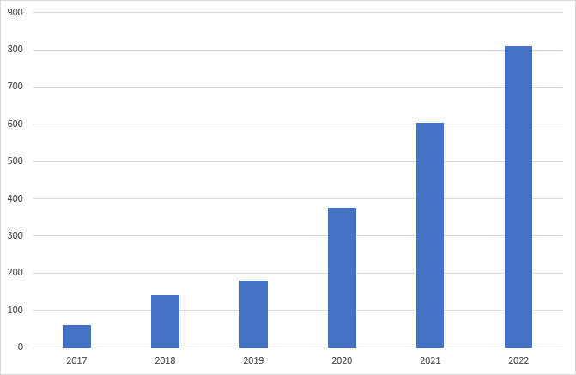
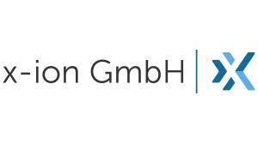
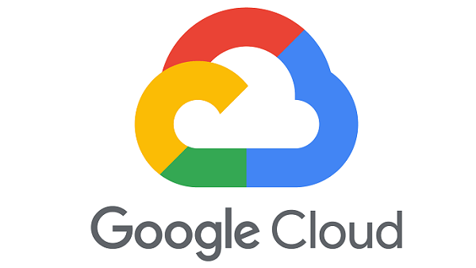
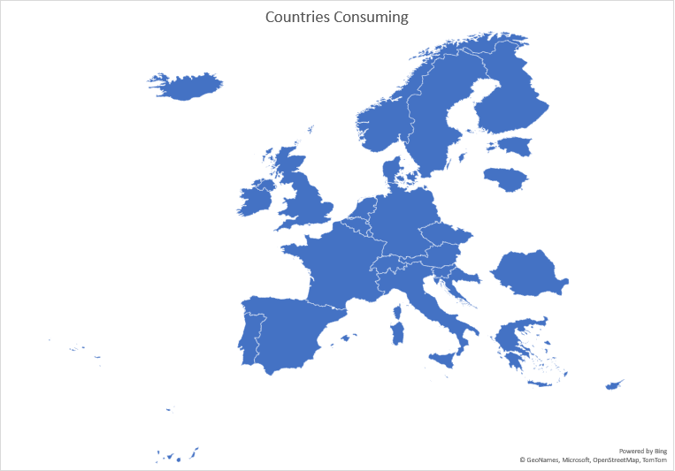
GEANT capability built 2013-2023
2020 IAAS+ FW (gen2)
GN3+
GN4
GN4
OCRE
EOSC-Ftr
GN5
Notes:
GEANT has built its capability over the past 10 years
- Joint IaaS procurement – 26 platforms
Slide with table of aggregated revenue going through FWs, and countries consuming

Slide 13
2019 – 2022 working research adoption funding IaaS & Earth Observation services
22
Countries represented
All OECD disciplines
120
Project proposals
Notes:
30 projects

Slide 14
Modelling of Drug Deposition with Realistic Dosages in Patient-Specific Lung Airways
Agile Response To High performance computing needs for Undergraduate Research
Quantifying war damage in Ukraine based on EO data (impact to global food production)
Stimulate practical application of forestry impact results by industry
High Availability OpenStack Cloud IaaS platform
Slide courtesy Dave Heyns

Slide 15
EOSC-Future project - April 2020 – September 2023
Demand assessment
Delivery channels
Buying data
Service sustainability – EOSC Association TF sustainable financing
Aggregator | Solution | Platform
GWDG Germany | AWS Trusted Research Environment | AWS
Portugese national computing infrastructure | Commodity Google Cloud | Google
SURF | European Environment for Scientific Software Installation | Microsoft
University of Sussex Applied Language Modelling Facility | Hate Classifier service | Oracle
Vienna Scientific Cluster | OpenScienceLabs for HPC | Google
Notes:
Survey – meh
More labour-intensive approach through NRENs – tsja
Whom do you ask?
Not solved yet
Delivery channels: include projects (pictures?)
5 projects awarded, aggregators making services available. Fewer aggregators than

Slide 16
2028: EOSC exists as an infrastructure
1 million researchers
5000+ institutions 40+ countries
delivery channels:
institutions, research infrastructures, eInfrastructures
Network, T&I
EOSC Exchange
Data Federation
Access to commercial services?
commercial services
Notes:
EOSC data federation needs services to do something with that data or to produce data.
Many services come from within the community. Now typically organised on national level, but within European research infrastructures already organised pan-European as well. Hope to establish a good mechanism for cross-border service delivery, which would offer a great opportunity for the Geant communty, but that’s another story at another time. Talk to me in the break ☺
Commercial services:
Endless market of services
Commodity – specialised – pre-commercial
Law says: they require a special gating process before they can actually be used by the public sector researcher: the dreaded 2Ps; Public Procurement.
and that should be the entry requirement for EOSC portfolio of commercial services, otherwise what is the added value; as demonstrated in GN4-2
- The other question is whether you’d let each institution and project do their own process, or whether you sort this collectively
KEY POINT: the rationale behind EOSC, and why we should care
Both public sector and HE: FAIR data
HE timeline 2021-2027
Hypothesis: data reuse enables answers to big questions
HE Europe 95.5 billion (https://research-and-innovation.ec.europa.eu/funding/funding-opportunities/funding-programmes-and-open-calls/horizon-europe_en)
Gross domestic expenditure on R&D (GERD) stood at €328 billion in the EU in 2021 (https://ec.europa.eu/eurostat/statistics-explained/index.php?title=R%26D_expenditure&oldid=551418)

Slide 17
Opportunity & choice!
Who else?
1 million researchers
5000+ institutions
40+ countries
Enhances our capability
GÉANT (engine for) procurement-compliant agreements
Uniquely positioned
EOSC
Portfolio procurement compliant agreements
Practical value to EOSC
2028
Opportunity!
make strategic objective
stake claim
Act!
Questions? jan.meijer@sikt.no
Notes:
Want to remember
Geant is only one that has been doing that
Is opportunity to expand beyond infra-cloud
Very similar to AAI, which is a success story for Geant, maybe new AAI success!
So, what do we do now?
We’ve built a capability and we have mechanisms to make it a financially sustainable one, either through project funding or cost sharing. There’s a good hook for joint procurement in the EOSC future, but the project funding for the time being is gone.
It was a nice experience, the EOSC projects we’ve done through OCRE and EOSC-Future. Now the funding is gone and we retreat in the Geant bubble.
Another option is to explicitly contribute this to EOSC. The sustainability rests in the notion that a wide community with self-interest needs to keep the engine going, and uses that existing capability to contribute to EOSC’s portfolioo of procurement-compliant agreements
We enlargen the reach of an activity we already care deeply about, and get better engaged with the research world
We deliver tangible value to EOSC
We’re the only ones who can do this
Alternatively, we don’t do this, and an additional capability needs to be built up in EOSC
Portfolio of contracts with commercial services in proposal for sustainable EOSC
Collective process to advance collective requirements
Do together that which is hard to do alone
Do once what otherwise has to be done 1000s of times
Geant community has expertise, channel to user, and trust
We can deliver tangible value to researchers, to building up EOSC as a research data & services commons, thanks to our long-term legal ties to deliver network, T&I and security
We are uniquely positioned to organise one conversation with suppliers of services
Do we accept the opportunity, we should tell “them” about it
And work on the demand assessment
We are currently doing iteration 3 of IaaS+, but no other servivces
If the conversation is not done jointly, it will be thousands of individual conversations or non-R&E specific deals and many benefits of EOSC will be lost
If we don’t do it, no-one else will

