Slide 1
Sustainable software development at NRENs
The example of the economics of eduVPN
Tangui Coulouarn, DeiC
Rogier Spoor, SURF
8 June 2023

Slide 2
What we hear sometimes…
Commercial software: liability for vendor
Commercial software: comes with support
Commercials: have much more budget
Commercials: have better coders
USA companies pay engineers up to $ 350 per hour (project manager $ 200)
Commercials: strong marketing campaigns
Commercial software is (often) easy to use
Managers won’t get fired when buying the no. 1 commercial product
What are WE doing in the software engineering business?

Slide 3
Why software engineering at NRENs
Specifically tailored for our NREN community needs/requests;
Keeps the commercials alert;
Jointly developing/maintaining software is cheaper;
In our environment it requires:
Skilled coders “tied” to the project
Have skilled engineers to install/deploy/maintain the software
We are a community and the community improves the product -> FOSS facilitates

Slide 4
Questions
Is there a point to do FOSS at NRENs?
How do you fund this?
How do you govern this?
Does one model fit all?
Can you be transparent about your costs?

Slide 5
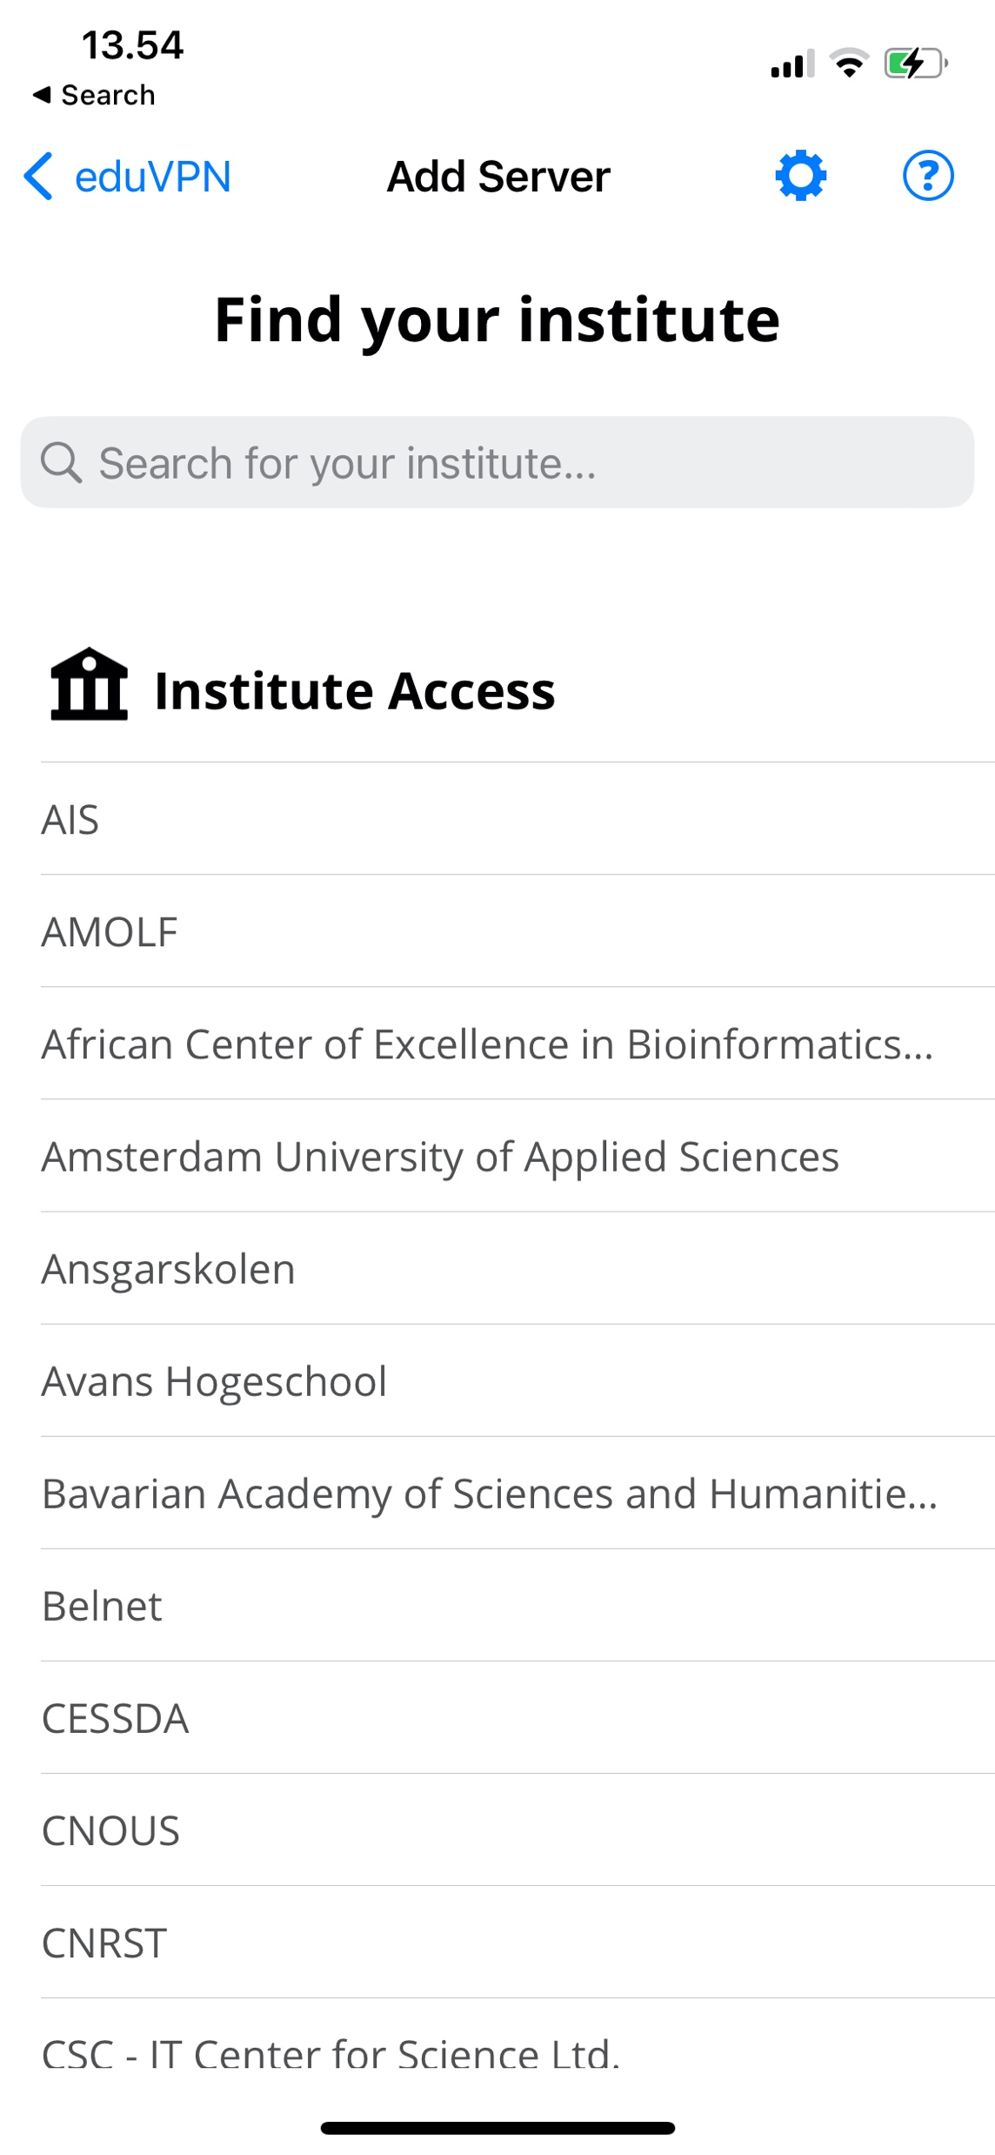
What is eduVPN?
VPN software package with
server side components
client apps for Linux, Windows, iOS/macOS and Android
Supports WireGuard and OpenVPN
Integrates well with identity management systems at universities (SAML, LDAP, RADIUS, client certificates, etc.)
Granular profiles + possibility to provision managed devices
Scales from raspberry pi to multi-node deployments
See https://docs.eduvpn.org/server/v3/ for full feature list

Slide 6
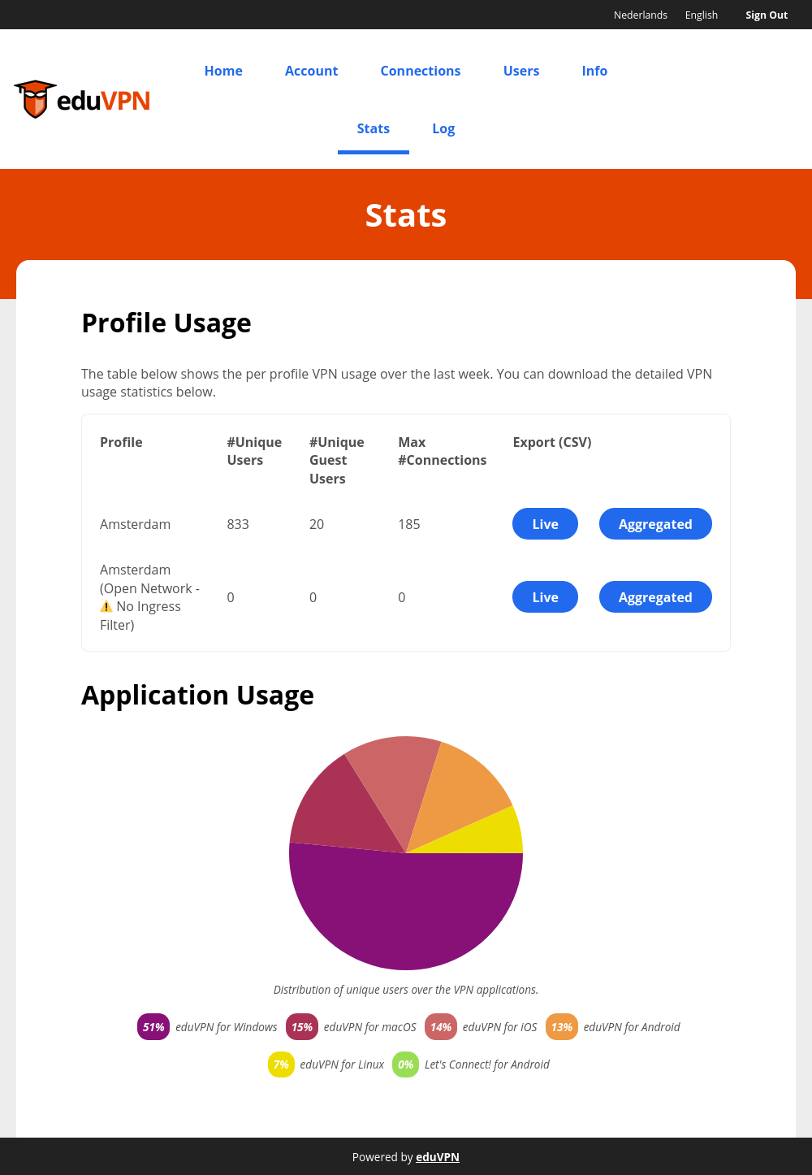
What is eduVPN? (2)
Used in production by more than 128 universities in 28 countries (+ 17 NREN deployments)
Also used outside R&E as “Let’s Connect!” (+ collaboration with govroam).
Software Governance via The Commons Conservancy foundation
Service governance via GÉANT
2 main models of deployment: run-by-university or managed by NREN

Slide 7
On every continent

Slide 8
What does it cost
Let’s start with the costs for a commercial VPN solution at a Danish University
11000 students and 6000 staff
Requirements/features:
1000 concurrent users;
Hardware with 10Gbps interfaces;
Differentiated access to services according to type of user, equipment used.
Cost in 2019: 100 kEUR for hardware + 35 kEUR in licenses for 3 years
Supplement for extra licences paid when COVID19 to be able to serve more users
Cheap extra license renewal in 2022 for 3 years (10kEUR)
UX is not impressive: username and password + microsoft second factor
Maintained by the IT department
Includes hardware but not network costs, maintenance, power, etc.

Slide 9
What does it cost
Costs at university marginal if stand-alone instance: installation costs, price of a VM/bare metal server
Typical price: set-up of one VM charged 1200 EUR, 600 EUR per extra server
Price per trimester for 2 core, 2GB RAM, 100 GB HDD: 300 EUR
Costs for university when eduVPN is a hosted service:
Depending on university size: in range 937 - 1377 euro per month
Maintenance costs (0.1 FTE)

Slide 10
Budget aspects – eduVPN core team work
(technical) Project/Product management
UX (partly funded as NGI project)
Server code maintenance
Governance
Innovation
Community engagement
Costs:
Lead architect & coder:1 FTE (cost shared by DeiC/GÉANT)
Other costs: 2 FTE (cost shared by SURF/DeiC/GÉANT/Renater)

Slide 11
Budget aspects - audits
Audits, roughly 30 kEUR a year.
2022, server-side audits (Cure53); eduVPN-common audit (ROS)
2021, macOS/iOS codebase
2020, PHP-SAML-SP (Cure53)
More Changes -> More Audits
When understand software components -> understand risks -> hire and guide the right auditor -> saves money

Slide 12
Budget aspects - details
Contributions from students (14 students since 2016)
Nearly “free” (sponsored by SURF)
Costs of the client software
Initially thought 5-10kEUR to create a client, 30kEUR more realistic
Hire external developers on contract base
Minimal 10% of initial costs for bare minimal maintenance
Testing costs (done by core team currently)
Are working on common (shared) client code in 2023

Slide 13
Budget aspects – contributors
Initial product development phase funded by SURF
Innovation funded via Vietsch Foundation and NORDUnet
NGI project: D4S collaboration on UX
No subscription model like FileSender
Biggest contributor: GÉANT project (see next slide)
eduVPN is usable outside NREN community -> got funding via RIPE, NCTV, SIDN fund

Slide 14
Budget aspects – GÉANT project since 2018
For GN4-3 - eduVPN team claimed around 73 PMs. The available budget was around 84 PMs. - around 500 kEUR was spent
Cost per year: 2019: 128 kEUR 2020: 115 kEUR 2021: 102 kEUR 2022: 145 kEUR (up to October 2022)
Includes manpower, external audits, traveling, as well as external developers
100% direct costs, not overheads shared between DeiC, SURF, Sikt, Renater and GÉANT org

Slide 15
Costs: summary
3 FTEs
30 kEUR per year in audits
120 kEUR per year in client developments
Communication, marketing, etc.

Slide 16
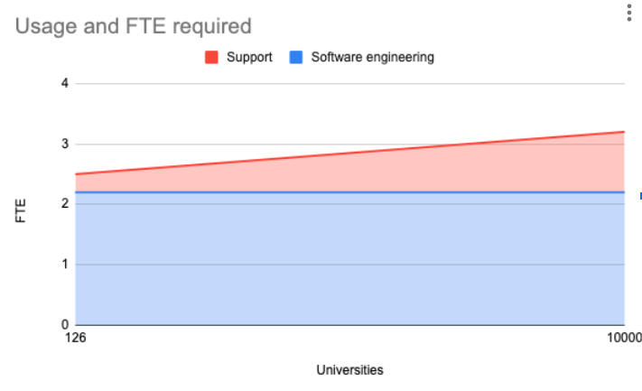
Costs & scaling

Slide 17
Budget aspects - Long term
Need a sustainable model without GN Projects in the long term
Issue with delivery model: direct contact with universities
Not equipped to do support for Let’s Connect!, GovVPN and other use outside of the R&E community

Slide 18
Community
Software governance via The Commons Conservancy -> by NREN people but with an autonomy
Service governance supported by GÉANT
Everything is open-source and published via Codeberg (and Github)
Workshop & presentations
Training
Support email

Slide 19
The Commons Conservancy
Commons Conservancy is an 'organisation hypervisor' that can spawn and support virtual open source foundations
Each Programme runs independently from all the others, in perfect isolation
Each Programme determines its own operating environment (such as bylaws) with templates provided, and has own infrastructure (website etc.)
Templates to manage the legal stuff + support for the financial stuff

Slide 20
The Commons Conservancy (2)
Protects us from project cycles
Easier long term collaboration
Allows us to explore other directions

Slide 21
Quality Assurance
Get good coders (don’t hire a random coder!)
Treat software as something living that needs attention
Be in control which components are used
Less code is better
Simplify architecture
Importance of testing (unit tests, overall tests)
Interesting: automated GUI testing per client didn’t help
We recoded clients (even a few times) because of QA issues
User experience: server and clients should be up2date

Slide 22
Conclusions
We can do FOSS collectively
Have different funding sources
Spread the risks
Plant the seed (kickstarting)
There is no universal spreading model

Slide 23
Thank you
Any questions?
eduvpn-support@lists.geant.org

