Slide 1
Greece in the Cloud
A collaborative journey towards hybrid Cloud Services
Panos Louridas (GRNET) &
Monique Pellinkhof (GÉANT)
”Mostly Cloudy”
6th of June 2023
Notes:
Panos Louridas Director of Research and Development at GRNET
Monique Pellinkhof is the Procurement Specialist for Cloud Services at GÉANT

Slide 2
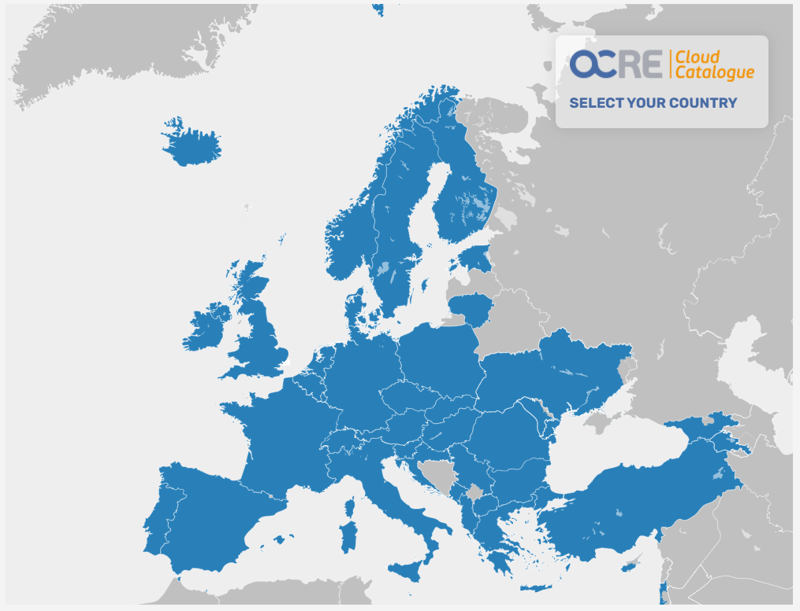




Community Cloud
CAPEX
Self-hosting
Commercial Cloud
OPEX
Partnerships
Procurement
Framework
Notes:
Current approaches to provisioning cloud resources and services include: Infrastructure as a Service (IaaS), Platform-as-a-Service (PaaS), Software as a Service (SaaS), as well as hybrid approaches that involve blending procurement of capabilities across multiple deployment models, purchasing access to some capabilities from Commercial Cloud service providers while creating other capabilities themselves through Private or Community cloud deployments
In addition to self-hosted and Community Cloud services, some researchers are also making use of Commercial Cloud services, buying access to cloud technologies and capabilities provided by for-profit businesses. The commercial cloud market has grown dramatically over the last decade, stratifying significantly as a small group of front-runner cloud service providers have claimed an overwhelming majority of market share.
- Consider sustainable/innovative/compliance approaches to cloud procurement, including international partnerships- Removal of “artificial” CAPEX/OPEX distinction in DRI funding.

Slide 3


GRNET Overview
> 150 universities, research centers, hospitals, cultural centers
> 15,000 schools
Nx10 Gbps dark fiber backbone
Access 1 || 10 Gbps per institution
International connectivity through GÉANT network multiple 10 Gbps
535 TFlops HPC Tier–1 centre, member of PRACE
6 Data Centres (NDC, 3x Ministry of Education, Louros, Heraklion), hosting:
  134 racks
  2000+ servers
  3 PB disk storage
  5 PB tape

Slide 4





^{Indicative Services gov.gr}
^{Single Digital Portal}
^{@gov.gr}
^{Gov.gr wallet}
^{Formal Declaration}
^{Authorization Form}
Digital Signature of Private Contracts
^{Naming of Minors (registry)}
^{EU Digital COVID Certificate}
^{Covid Free GR mobile app}
COVID-19 self-tests declaration
Certificates about positive or negative COVID-19 test
Platform edupass.gov.gr gr for issuing a COVID-19 student card for all public schools and academic entities
Issuance of citizens’ movement official forms during the COVID-19 pandemic
University admission exams: information about the results by SMS
Digital graduation diplomas for graduates of high schools, lyceums and vocational lyceums
Direct service to citizens and businesses
in their daily transactions with the public sector
^{> 1,500}
^{>8,000,000}
^{> 650,000,000}
^{> 800,000,000}
^{DIGITAL}
^{SERVICES}
^{CITIZENS}
^{AUTHS}
^{CALLS}
^{WEB SERVICES}
4

Slide 5
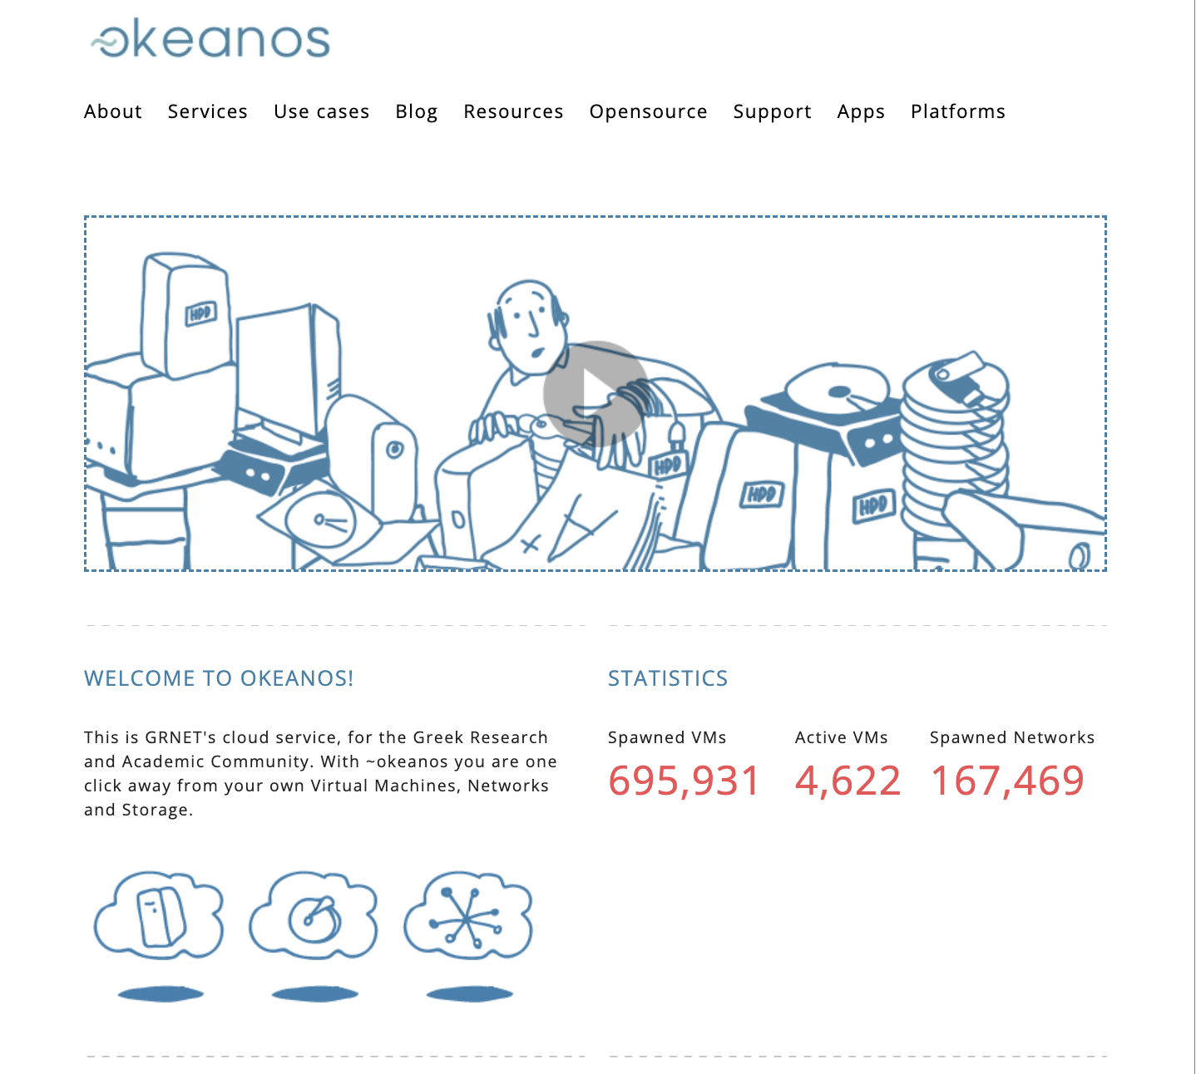
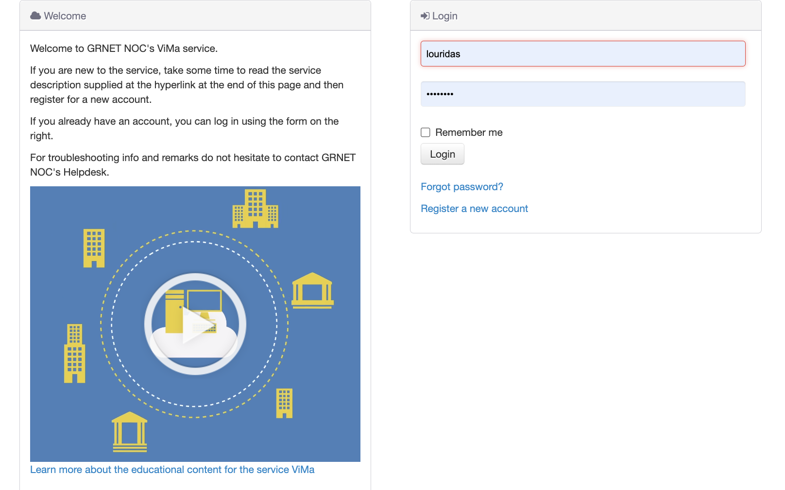
GRNET Cloud
ViMA

Slide 6




GRNET – Winds of Change
Public sector has access to public cloud services (Microsoft Azure)
Lots of universities, research labs, etc. already using public cloud services (AWS, Google):
  Existing know-how
  Existing budget earmarked in EU projects etc.
Explosion in use of ML / AI, which require special hardware for non-toy uses.

Slide 7




GRNET / OCRE - Now
11/2022: GRNET signed agreement in OCRE with AWS / Rackspace
03/2023: Official announcement in information day for the Greek Research and Academic Community.
Currently working with AWS ProServe + Rackspace for the creation of solution to:
  Monitor approved budget + consumption per project
  Aggregate approved budget + consumption per institution
  Enforcing budgetary limits on projects + dashboard for the cloud delivery team
  ETA: 06/2023

Slide 8

GRNET Future - Hybrid
Committed to maintaining and extending our data centres (new one in the works).
Extend the public cloud service provision considerably (x6-fold in the near future).
Public cloud provision via budget allocated to projects that are accepted:
  Work with solution architects to ensure most cost-efficient solution.
  Ensure that using public cloud is really more suitable than using GRNET’s own cloud resources.
GRNET cloud resources will be available:
  gov.gr services are and will continue to be hosted on GRNET premises.
  GRNET cloud allocates resources, not budgets, and allocation is for volume of resources and time - different model than budget-based provision in public clouds.

Slide 9

NEW: Re-procurement of the IaaS+ Cloud Framework
Supply
Demand
Compliance
Best value on Commercial Cloud
Inventory -Strategize
Evaluate - Select
Award - Contract
GN5-1
NRENS
Jan.–Mar. 2023
Establish procurement task force
Mar.–Nov. 2023
Determine procurement strategy
Dec. 2023
ITT ready
Jan. 2024
Launch the procurement
Dec. 2024
OCRE II in place
Notes:
To procure in understanding and serving the needs of the wide user base across multiple disciplinees for excellent science and research by delivering a broad range of excisting and innovative new cloud services.
To prfocure new IaaS_+ framework to meet these needs. - TBC

Slide 10
Thank you
Any questions?
louridas@grnet.gr | monique.pellinkhof@geant.org

