Slide 1
QKD in the GÉANT Network
Is it Possible?
Karel van Klink
Tirana, Albania
6/6/2023

Slide 2
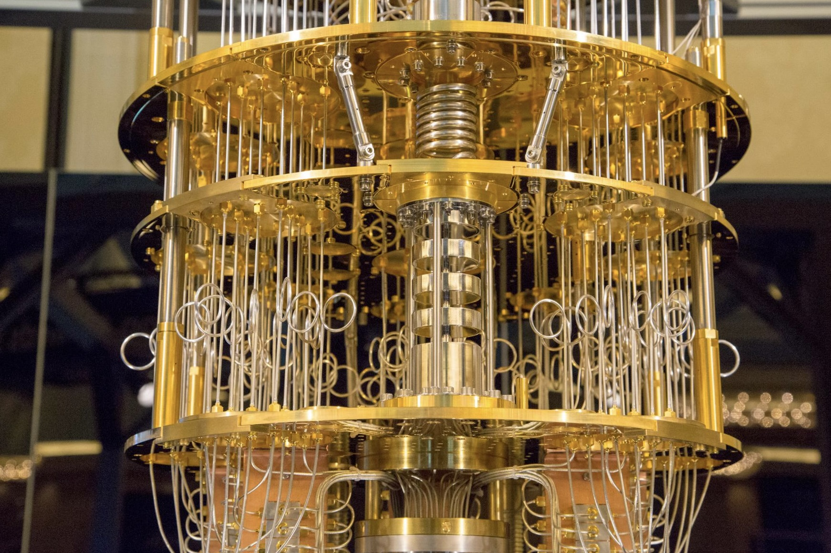
Quantum Secure Cryptography

Slide 3
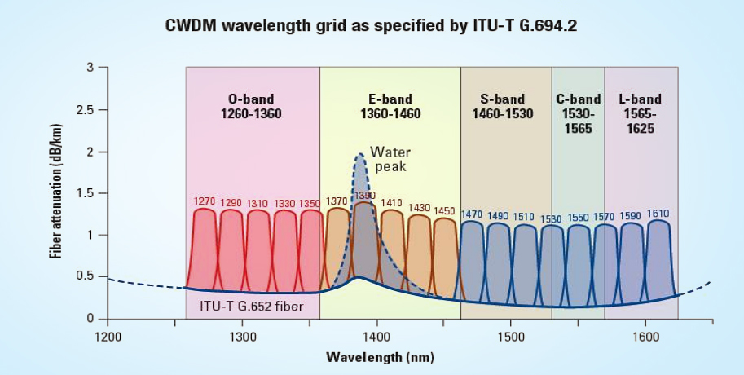
Optical Spectrum Bands

Slide 4
Optical Spectrum Bands

Slide 5
Experimental Setup

Slide 6
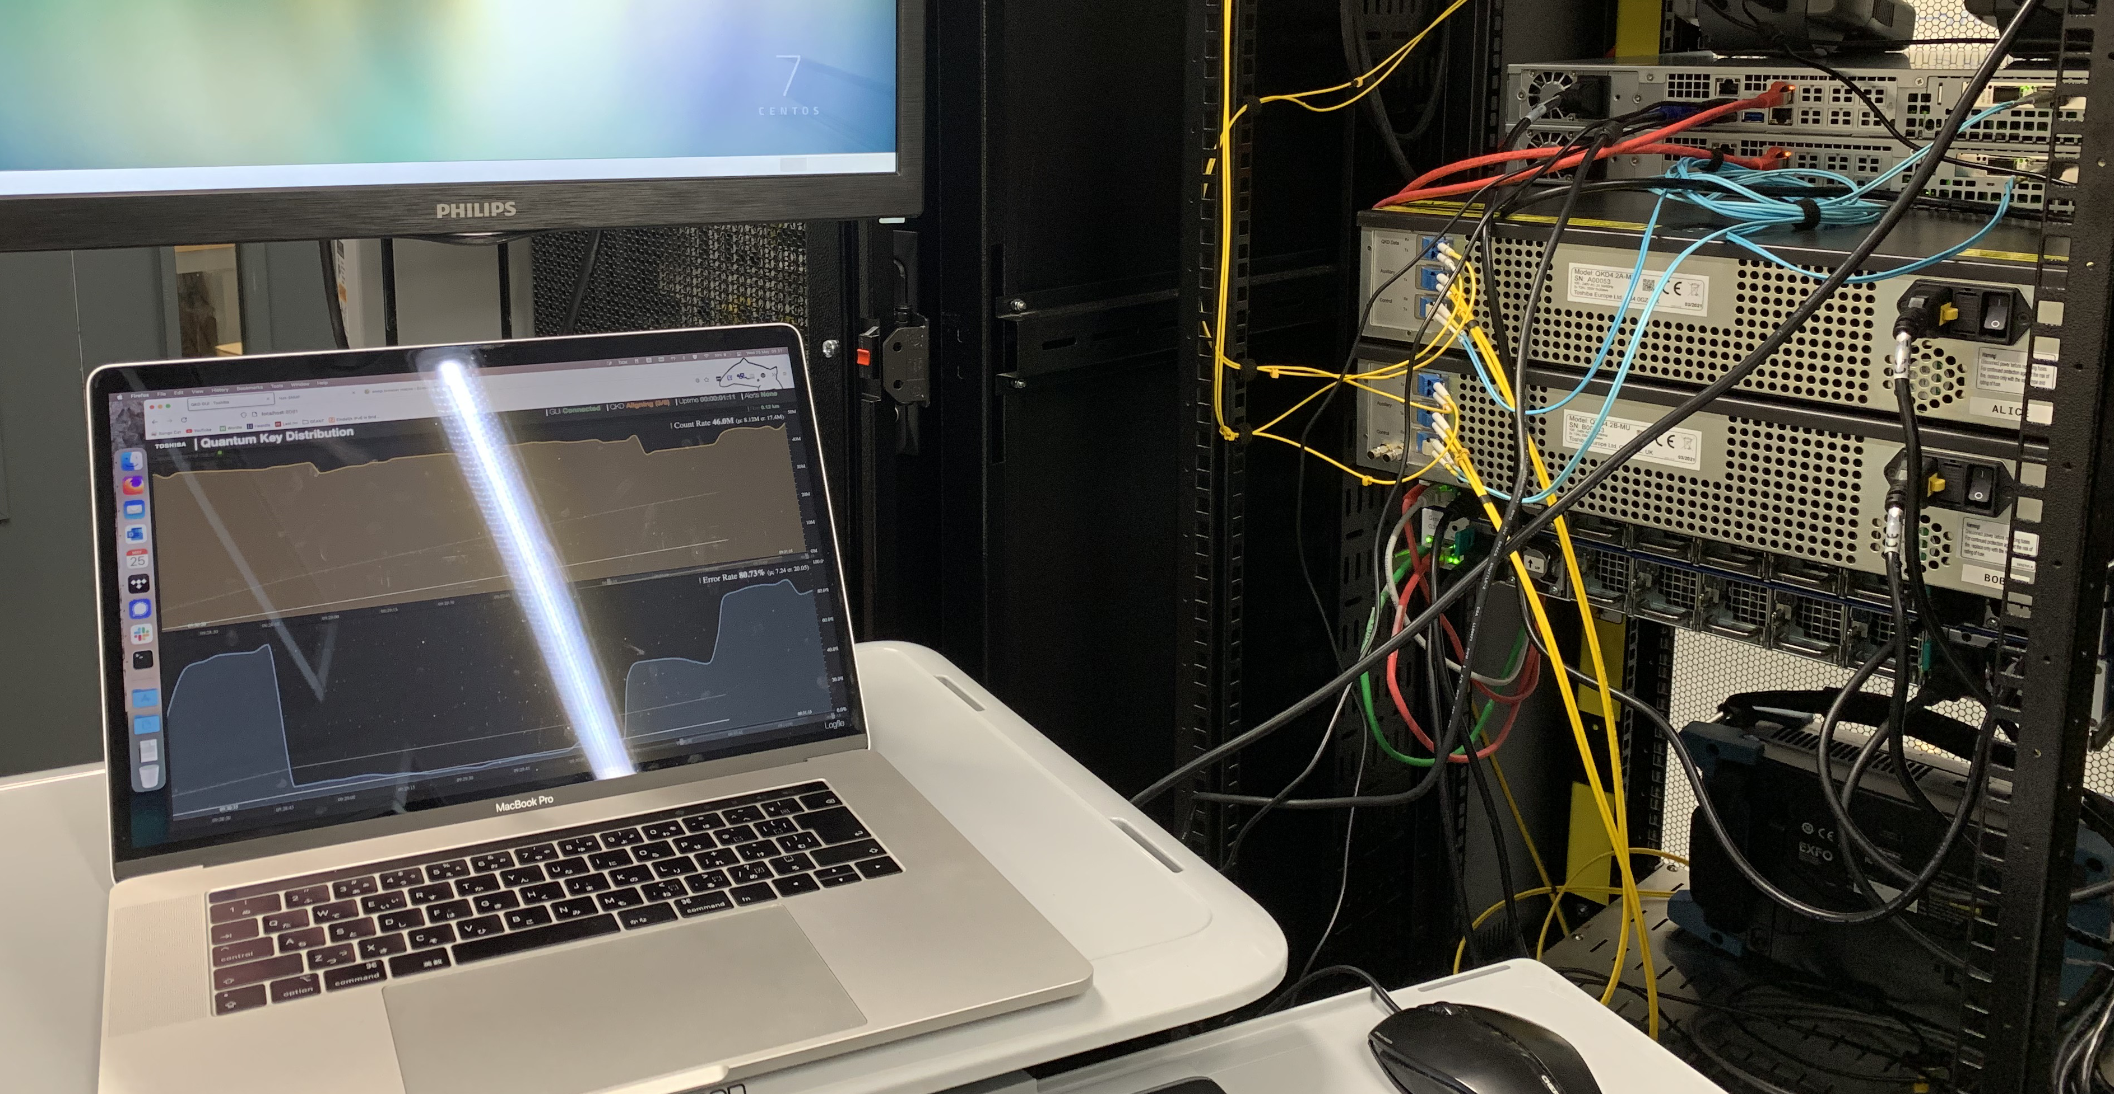
Setup in the Lab

Slide 7
Experimental Results

Slide 8
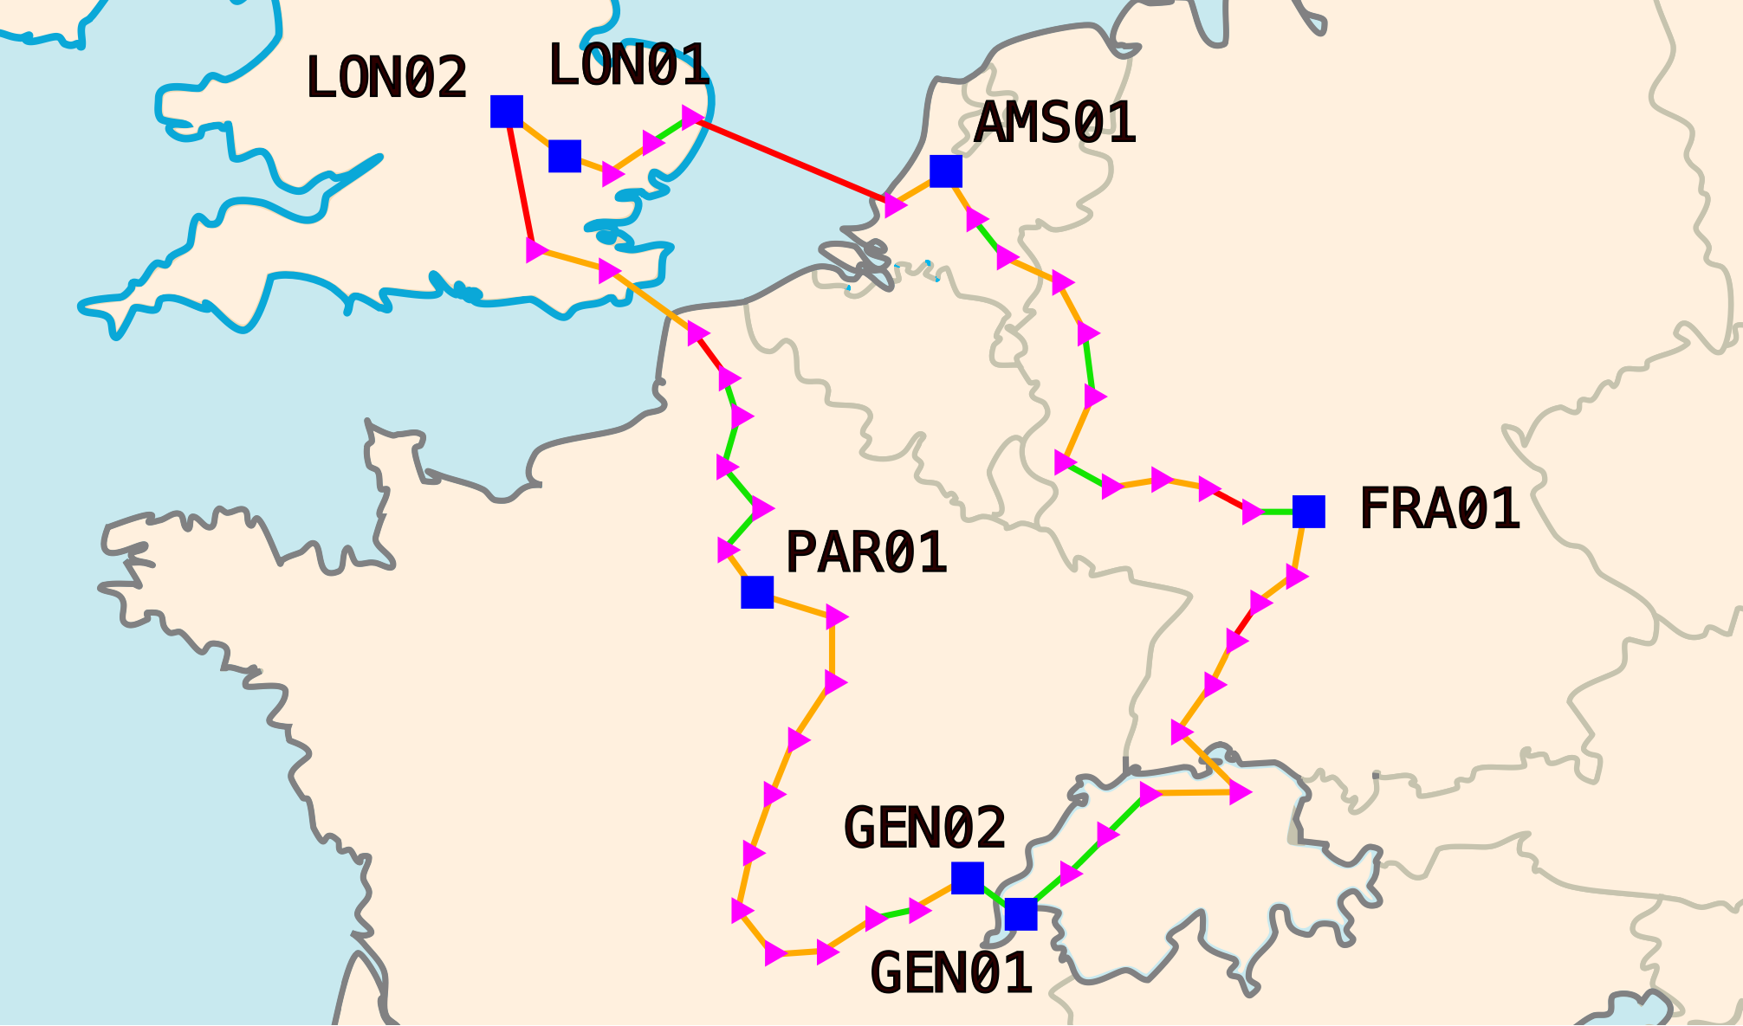
Potential Deployment of QKD
Multiplexing possible
Dark fibre required
Alternative solutions

Slide 9
Thank you
karel.vanklink@geant.org
https://purl.utwente.nl/essays/93637

