Slide 1
Open API garnering Trust & Collab
among NRENs
Saket Agrahari
Tirana TNC23
8- June 2023

Slide 2
We wrote the specs for the system…

Slide 3
We don’t know what it’s doing in production

Slide 4
OPEN API
Notes:
Open API with solution

Slide 5
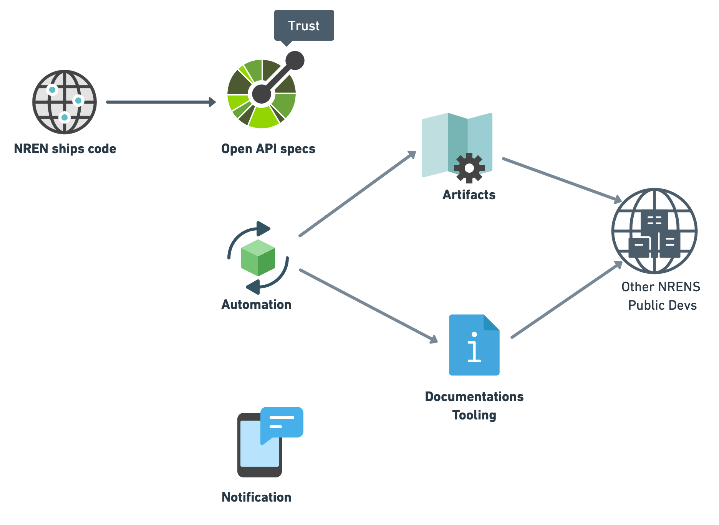

Slide 7
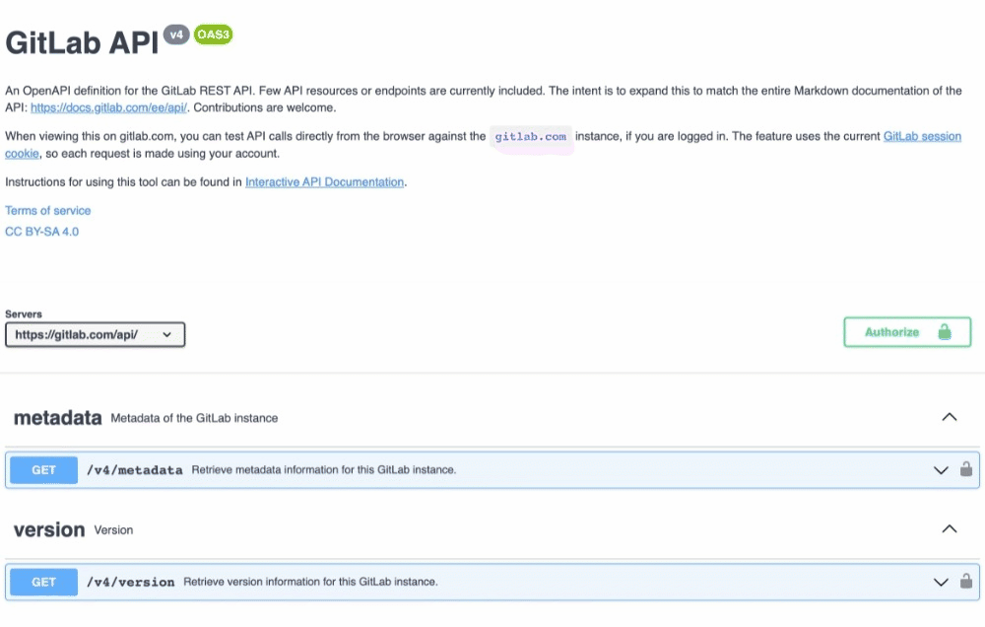

Slide 8
Open API
Spec Definition
Define request parameter, response and operations
Spec
GET https://api.geant.org/v2/surf/federated-user/567
Frontend
GET http://geant-prototype-federated.glitch.me/567
Controller Logic
Validate params, prepare v1.1 request
API v1.1 Backend
GET http://api.geant.org/v1.1/federated-user/ids.json
[567]
“data”:[{
“id”: “567”
“username”: “jhone.doe”
“nren”: “surf-net”
}]
API v2 Renderer

Slide 9
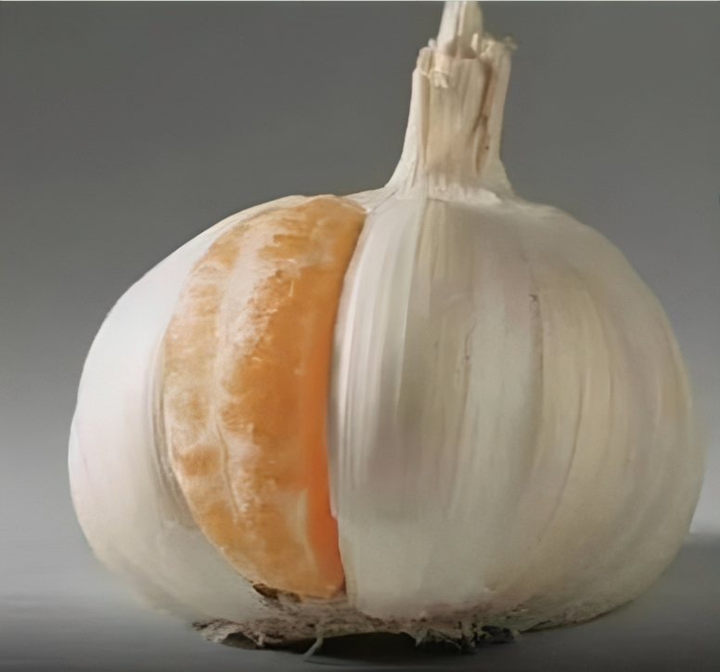
How do I know what is right fit for me?

Slide 10
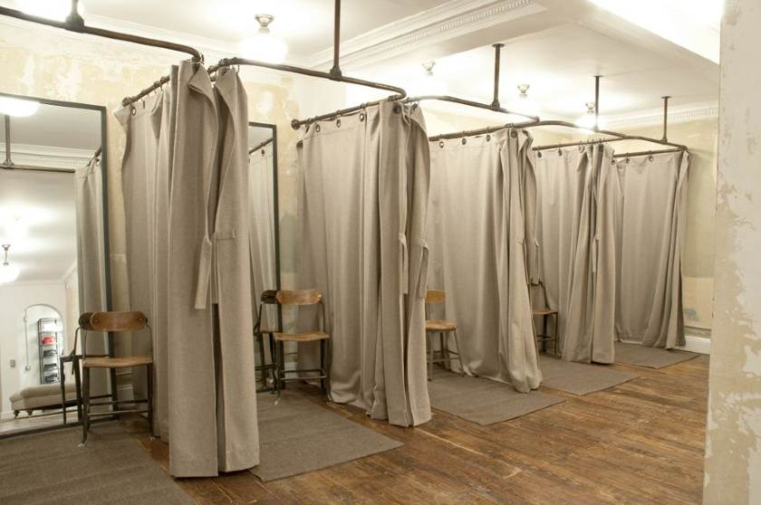

Slide 11
0
0
lines of code
to use v2
lines of code
to update

Slide 12
Thank you
Any questions?
saket.agrahari@geant.org

