Slide 1

Deploying a Pilot Spectrum Connection Service over GARR/GÉANT
Lessons Learned
Gloria Vuagnin - GARR
TNC23 – Lightning talk
Tirana, June 7th 2023

Slide 2
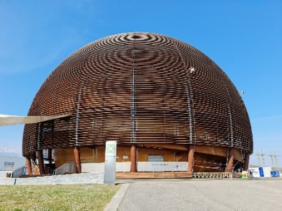
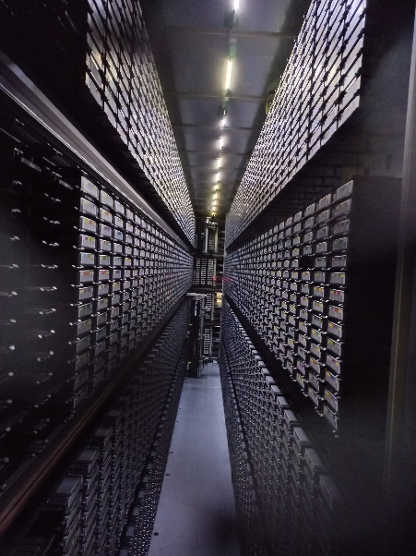


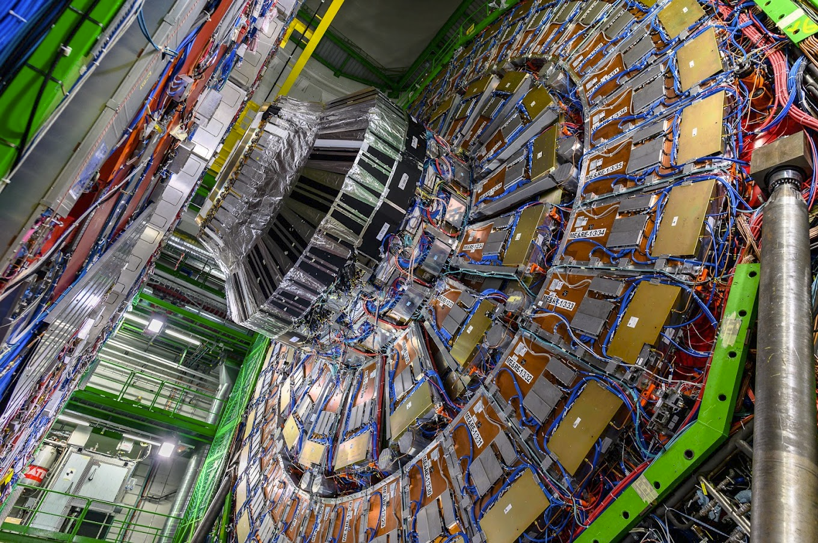
Ultra-high capacity connection
High Energy Physics Tier0
1.6 Tbp/s
‘‘LHC requirements for Run4 (2029) […] Larger Tier1s are supposed to get connected to CERN and to their Tier2s at 1 Tbps.’’
Martelli Edoardo, “Networks for High Energy Physics: LHCOPN and LHCONE”, AmRP Working Group Meeting (11 Oct 2022)
HEP
Italian
Tier1

Slide 3








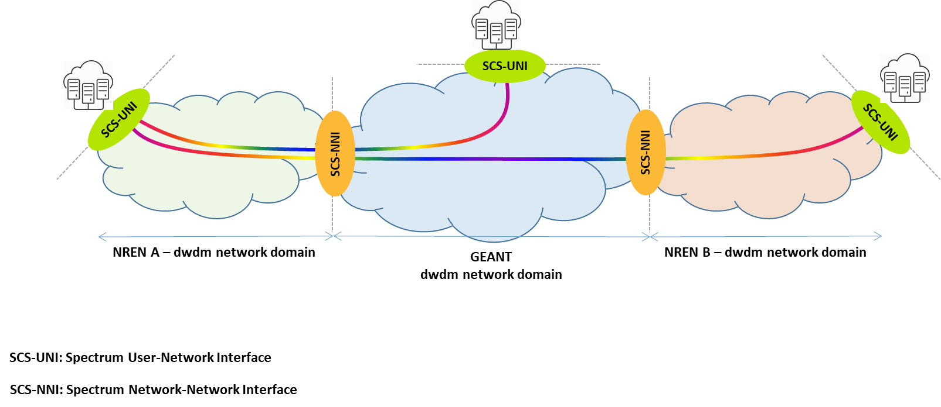
Spectrum connection service (SCS)
WP7-T2 of GN4-3
SCS Users (huge capacity consumers) own the coherent transponder or
transceiver
SCS Providers own and operate their Open Line System giving access to an empty slice (e.g 100-400GHz) of their available spectrum (the extended C-band has 4.8THz of spectrum)
Spectrum THz
191.3
192.1
196.1
Extended
C-Band
Traditional C-Band
User-to-Network Interface (SCS-UNI) defines the boundaries between users and providers (e.g. a LC port on a patch panel).
Network-to-Network Interface (UNI-NNI) defines the demarcation point between providers (e.g. a patch cord between ROADMs).

Slide 4
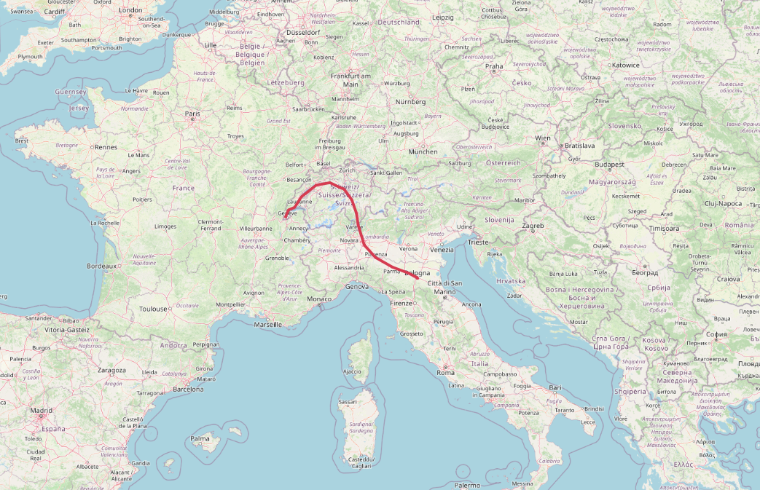


CERN-CNAF/INFN datacenter interconnection
Pilot of the Spectrum Connection Service (SCS)
GARR and GÉANT optical network have a partially disaggregated architecture
Co-located PoP in Milan
Use of DCI/Transponders boxes @ end-points
Pure optical connection that uses an empty slice of the optical spectrum available on GÉANT and GARR fibre infrastructure
Demarcation Point between GÉANT and GARR in Milan PoP
~ 1000 km

Slide 5
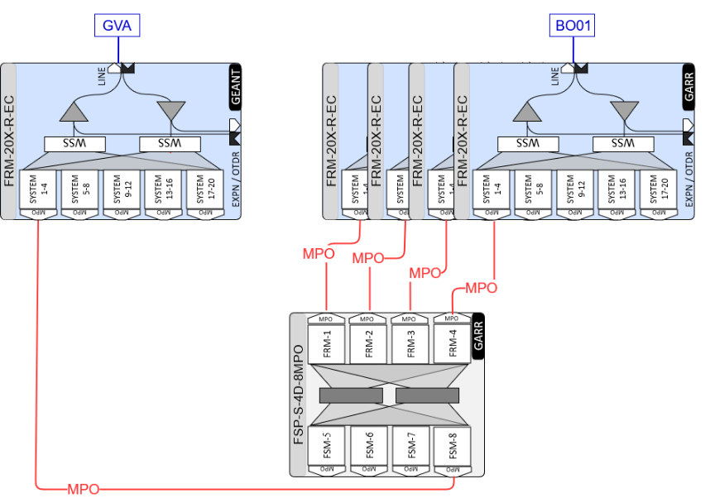
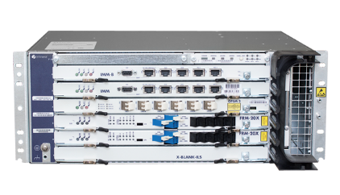
The multi-domain open line system
Add/Drop
Geneva
PoP
Bologna
PoP
Add/Drop
ROADM
ROADM
GARR OLS
GÉANT OLS
8 x AMP
Infinera FlexILS
3 x AMP
GÉANT-GARR NNI
GÉANT and GARR PoPs in Milan are 10m apart
Route&Select ROADM: Pravicy and spectrum policing and shilding

Slide 6
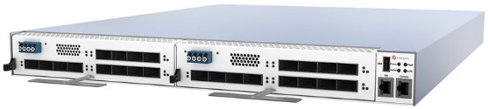
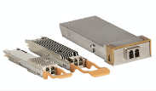
User-Network Interfaces
Infinera G30 - CHM2T
100-600Gbps wavelength
4x100/1x400 GbE clients
1.6Tbps on 4 carriers each of them:
DP-16QAM- 400Gbps
100GHz
27% SD FEC
69Gbaud
CERN – GÉANT UNI
in Geneva
CNAF – GARR UNI
in Bologna
Privacy is guarantee by a dedicated power splitter/combiner add/drop card in Geneva,
by a add/drop optical switch card in Bologna

Slide 7
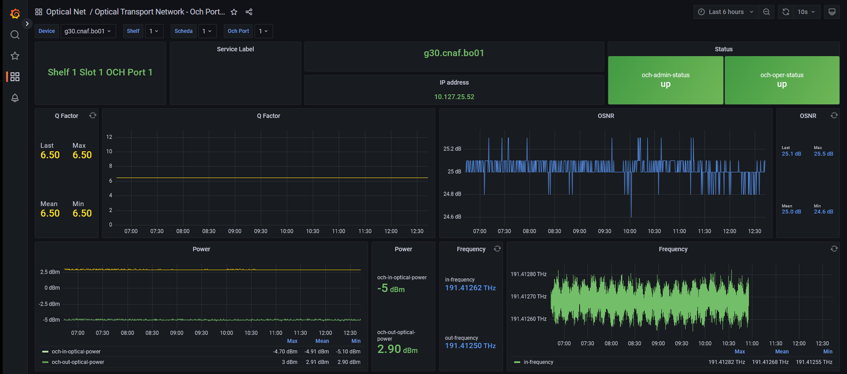
Telemetry data from G30 through gRPC

Slide 8
The SCS pilot is successfully showing its great potential. Be tuned to the upcoming GÉANT SCS service launch
Thank you
Any questions? Please, send me an e-mail
gloria.vuagnin@garr.it

