Slide 1
A new ingredient
to
federated cookies
Notes:
Hi there! My name is Zacharias and I'm here to speak</p> <p>with you about what to do when something disruptive is coming your way, but first lets talk cookies

Slide 2
?
Notes:
recipe courtesy of fiften spatulas . com</p> <p>what do you get if you mix :</p> <p>egg whites</p> <p>sugar</p> <p>butter</p> <p>vanilla extract</p> <p>almond extract</p> <p>water</p> <p>flour

Slide 3
FORTUNE COOKIE!
Notes:
FORTUNE COOKIE!

Slide 4
Cookies for everyone!
Notes:
I make a cookie you can have it too!

Slide 5
THIRD PARTY COOKIE!
Notes:
THIRD PARTY COOKIE!

Slide 6
Problem?
Notes:
Cookies, and the many other technologies we use for good</p> <p>have a lot of applications - tracking

Slide 7
European Union
Notes:
European Union is saying online tracking is bad,</p> <p>and tracking unbeknownst to the person is THE unthinkable.

Slide 8
Not only EU
(but mostly EU)
Notes:
To be fair</p> <p>a lot of legislative bodies say online tracking is bad.</p> <p>But really EU has played a huge part in setting demands saying browsers need to stop unwanted tracking.

Slide 9
Law
Notes:
So regulations are put in place. And the companies behind the browsers react,</p> <p>they are the Googles and Apples - Microsofts and Mozillas of the world, and they want to be able to say they are complying.

Slide 10
Anti-tracking efforts
Notes:
So they each experiment in ways to comply without breaking their own technologies or business models or stuff they depend on. The stuff they know.

Slide 11
Eureka!
Notes:
And they work something out, and it works with their business model without breaking their technology too much. EUREKA! More on that in a moment.

Slide 12
Standards!
Notes:
But what if I'm using a different browser than you to read baking recipies - how do we make sure it works across platforms? We use standards, aside from meaning our tech can work on either platform - if done right, it has the added benefit of saying you comply through a shared response to a regulation.</p> <p>Standards are often set inside W3C - the standard setting body of the Internet. But what goes into a standard, what use cases does it account for?</p> <p>Its participants and the knowledge they share.

Slide 13
Federated Credential Management
FedCM
Notes:
Federated credential management is a working group within W3C. There are several groups related to anti-tracking efforts. This specific sub-group is focused on making authentication work in a world after the anti-tracking efforts have been implemented.

Slide 14
Research and Education Federations
REFEDS
Notes:
We joined FedCM and other W3C-groups because authentication protocols strongly resemble the privacy threat called &quot;bounce tracking&quot;. Other privacy and anti-tracking efforts also affect various elements of the higher ed technical infrastructure, such as the cookie. We work together with the browser vendors to explain the impact their solutions have on federated identity systems, but most importantly help them test it with our use cases and report back how it could be better!

Slide 15
Something
in the way
Notes:
Now, whats the new ingredient I was teasing before? The current iteration for FedCM suggests the browser is gonna ask for..

Slide 16
User Consent
User Consent
User Consent
User Consent
User Consent
User Consent
Notes:
User Consent!</p> <p>to save and use a first party cookie on every level, at every proxy along the way.</p> <p>If you or someone you know can think of why this would be a sub-optimal idea, join us!

Slide 17
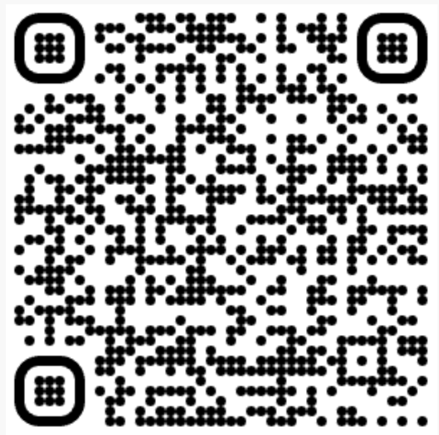
REFEDS.org

