Slide 1
Collaboration Innovation Networking
John Dyer, The Vietsch Foundation
Tuesday 6th June 2023

Slide 2
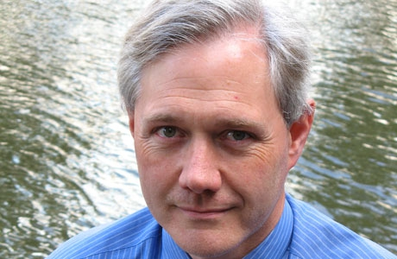
ANDREW CORMACK

Slide 3
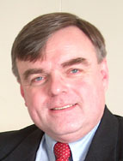

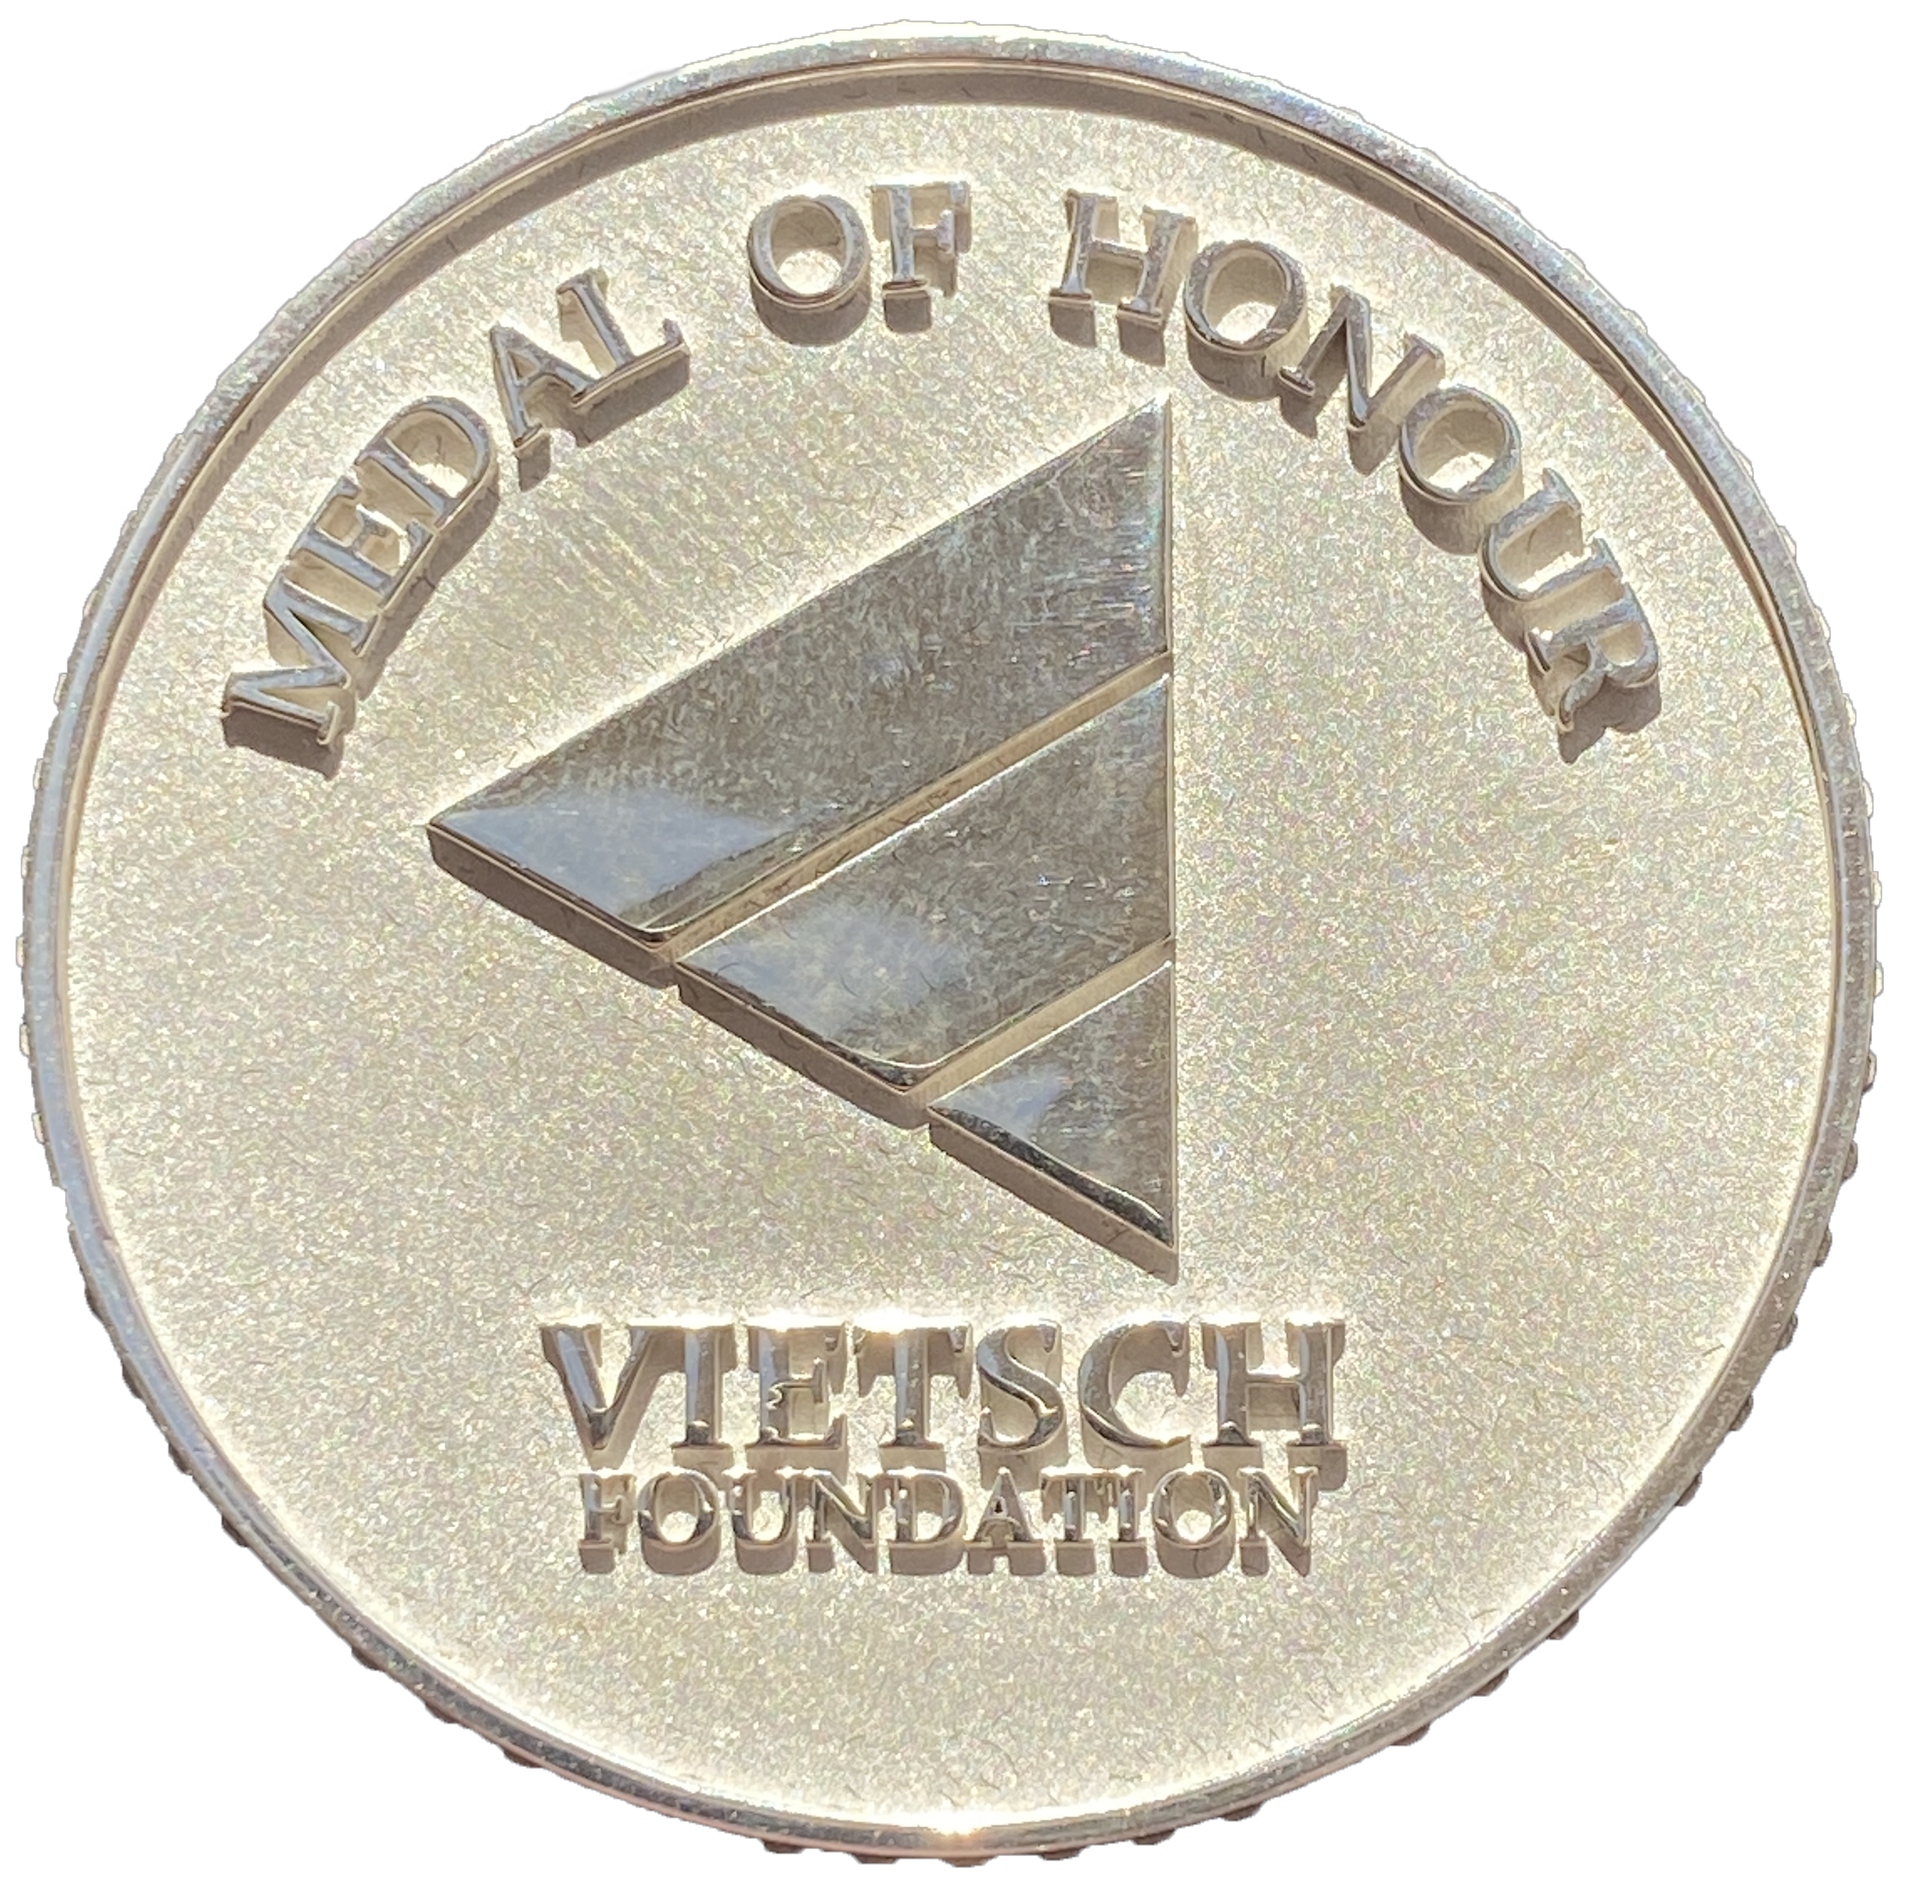
The Vietsch Foundation
Created 2014 in memory Karel Vietsch
Vietsch Foundation Mission
  Annual Medal of Honour
  Small projects, initiatives, pilots . . . . .
    Demonstrate innovation and lasting value
    Focus: Research and Education Networking

Slide 4
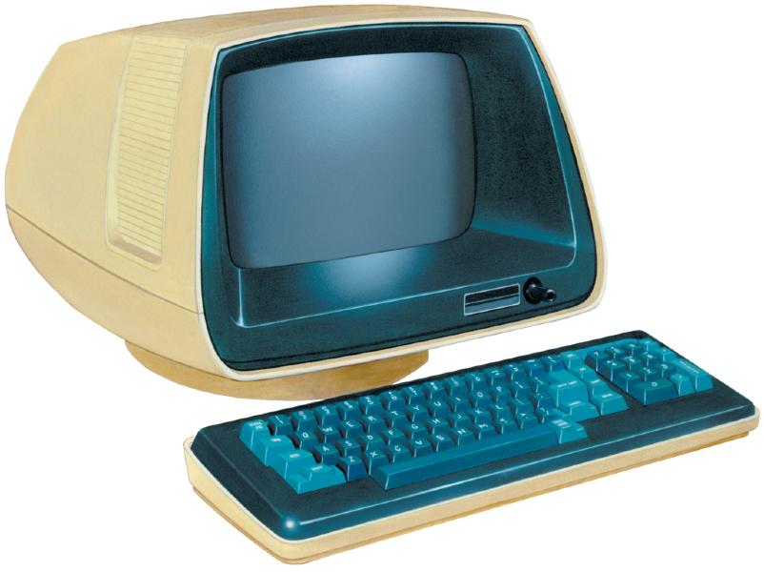

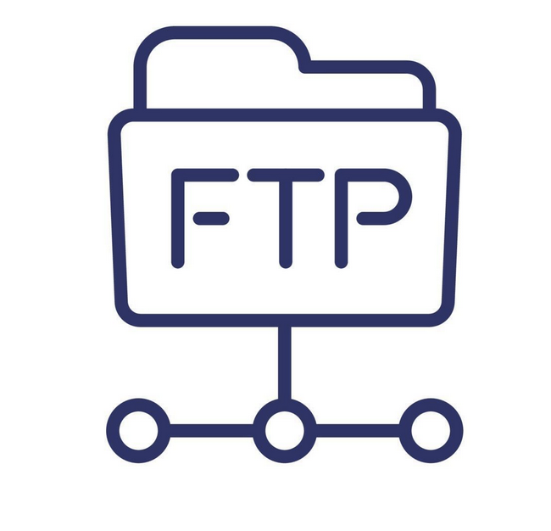


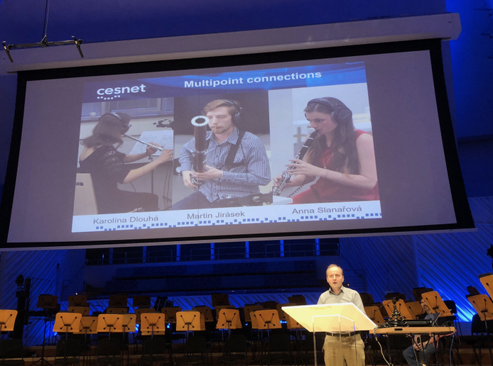

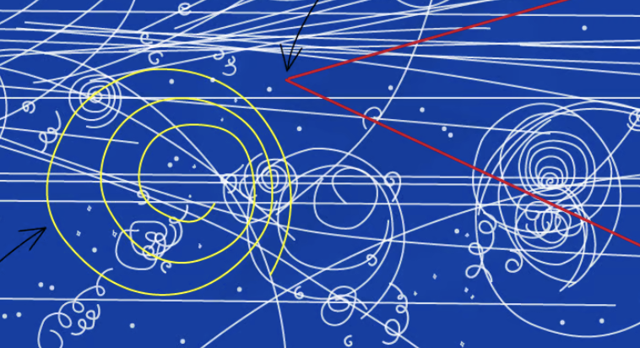


Innovation (how the Internet got to here)
Concept of IP & TCP
Emergence of NRENs
Connectivity, limited services
Emergence of New Technology & Services
JTMP

Slide 5

Funding of Big Projects
European Framework Programmes
Big Science, Advanced Services & Applications
Strong Oversight
  Detailed Reporting
  Milestones, Deliverables
  KPIs
  Reviews
Significant overhead

Slide 6

Funding of Big Projects
Small Innovative Projects
European Framework Programmes
Big Science, Advanced Services & Applications
Strong Oversight
  Detailed Reporting
  Milestones, Deliverables
  KPIs
  Reviews
Significant overhead
Proof of Concept
Develop ideas
Pilot Projects
Lightweight Admin

Slide 7
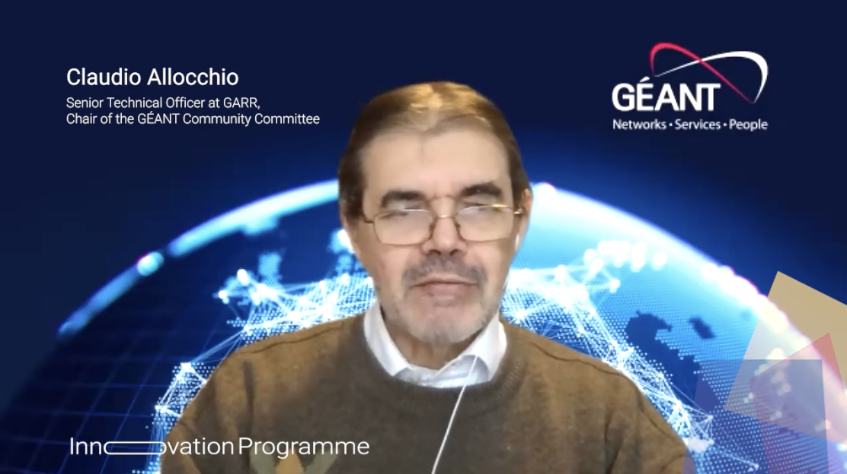
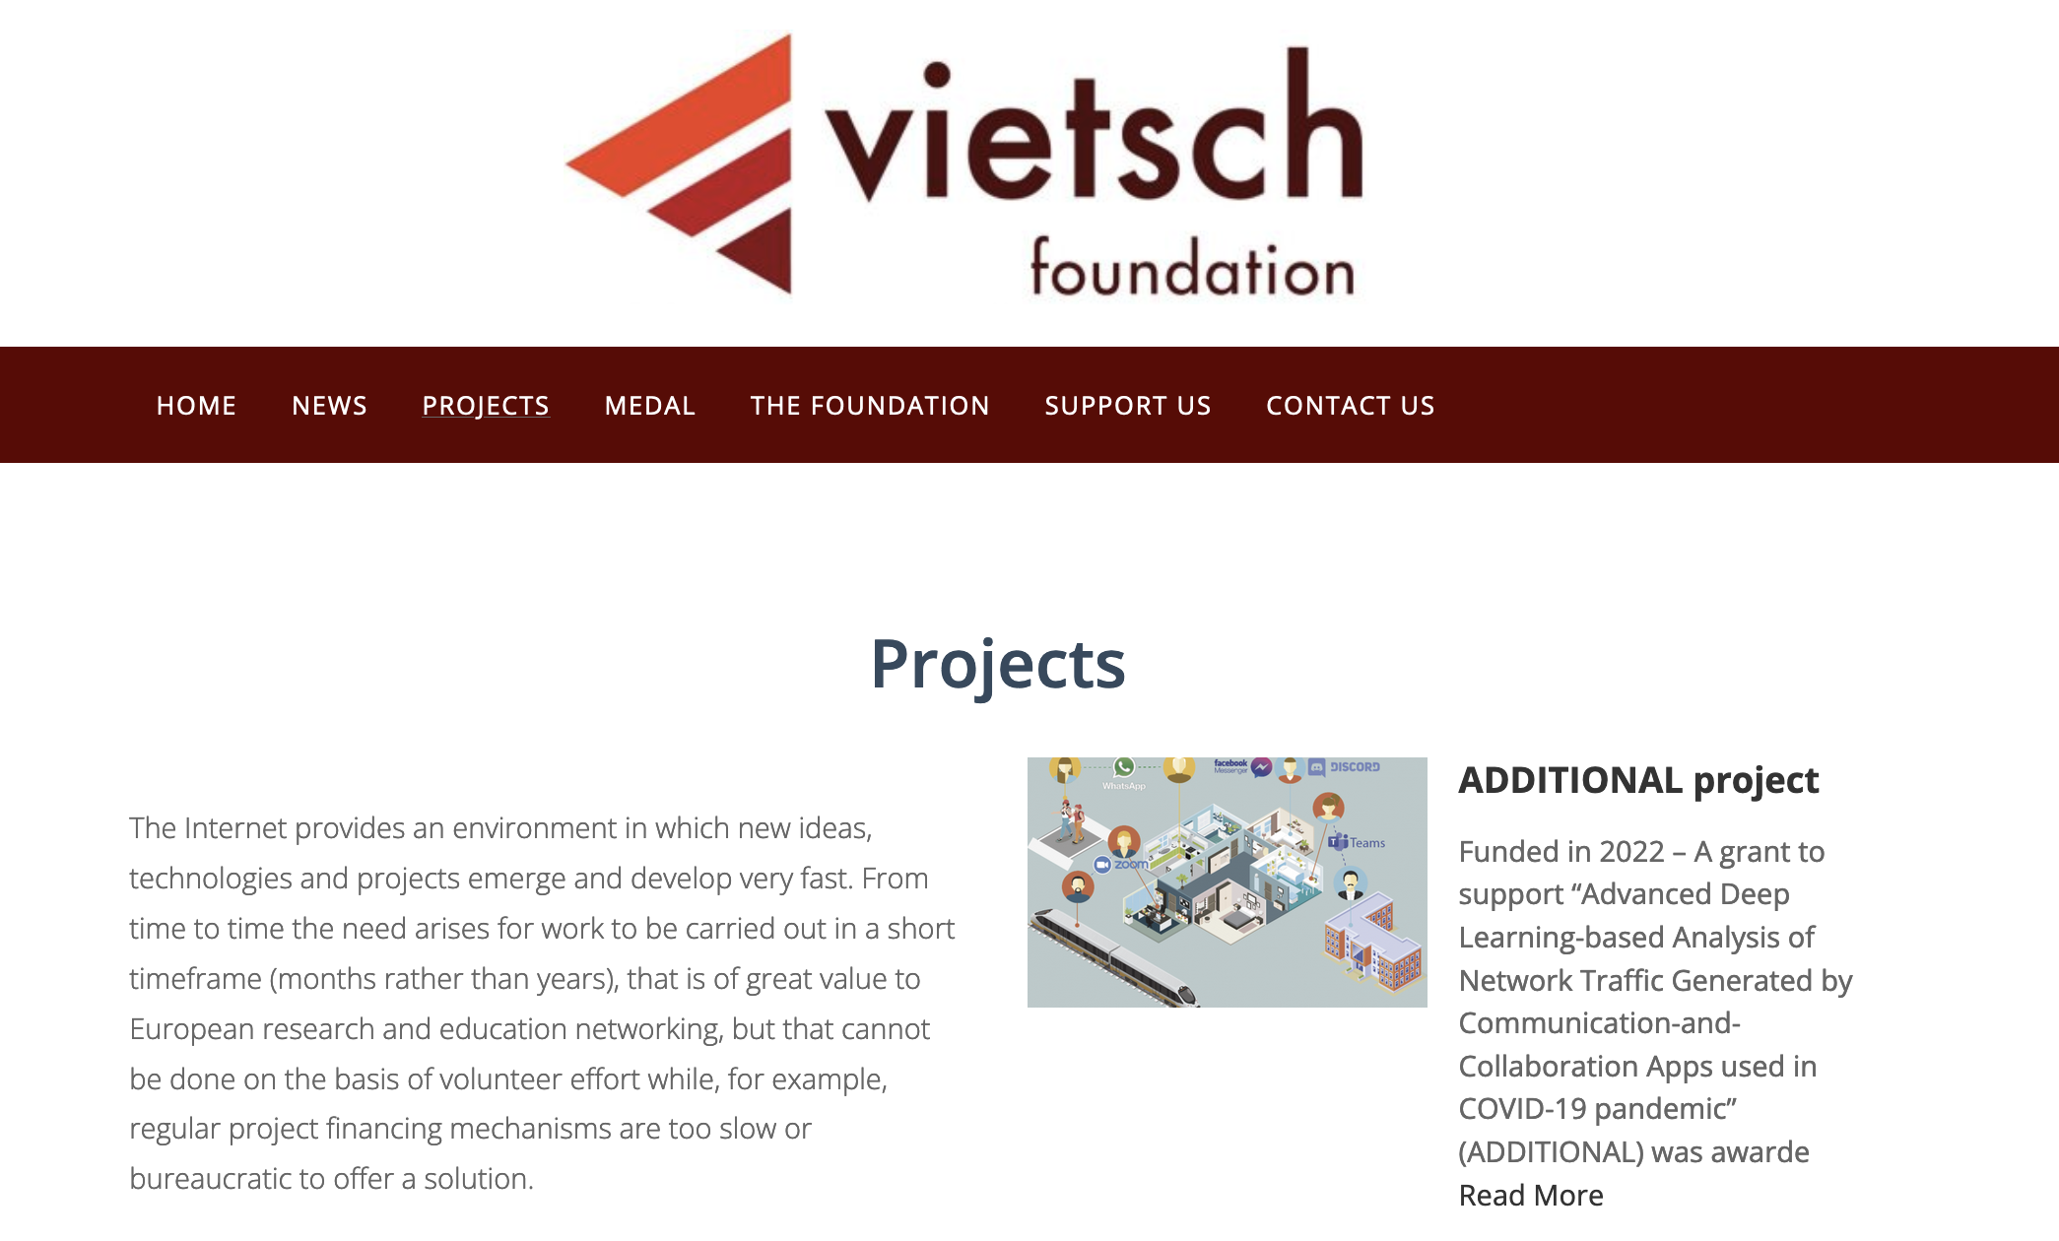
Supporting Smaller INNOVATIVE IDEAS
GÉANT Innovation Programme
10 projects in 2022
Vietsch Foundation works collaboratively with GIP
Vietsch Foundation
Continuously Open Project Call

Slide 8
Vietsch Foundation Grant Selection Criteria
Innovative technologies or services
Original studies and reports
Assistance in the preparation of bids to other funding bodies
Project duration small lasting few months
Few tens of thousand euros
Co-funding encouraged
SUBMIT
www.vietsch-foundation.org/projects
contact@vietsch-foundation.org

Slide 9


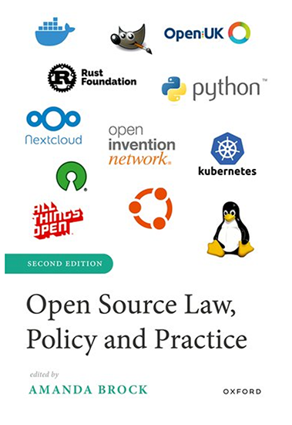
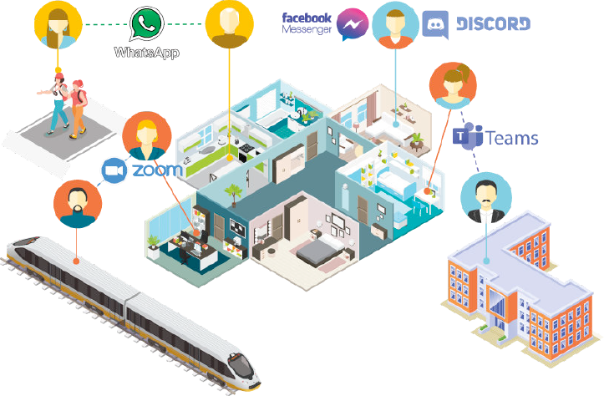
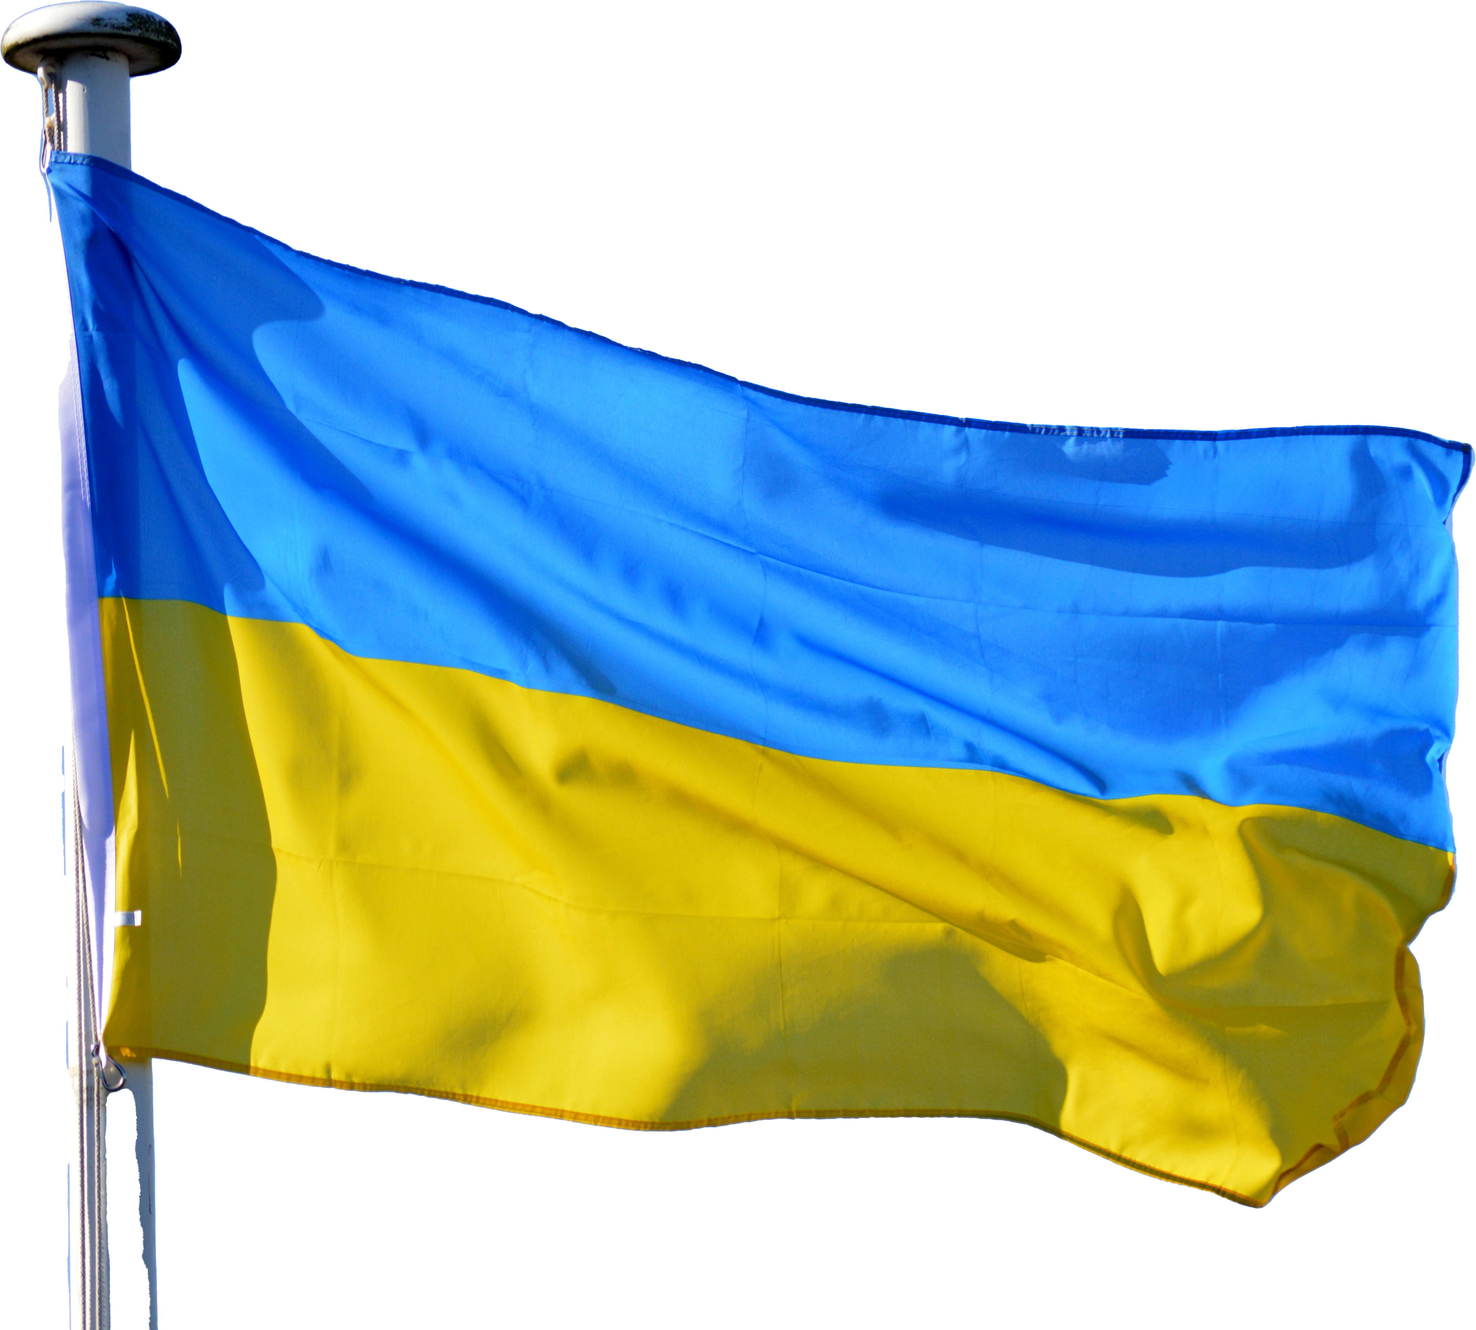

Recent Projects
Science Checker
Novel AI system & database to verify scientific claims
eduDNS
Dynamic DNS
Deployment of Cloud Services
Open Source Law Policy
& Practice
Open Access to OUP Book
ADDITIONAL
Uses Deep Learning for analysis of traffic from collaborative applications
Community Support for URAN, UKRAINE
MARLIN
Reliable authentication for booking remote physical resources

Slide 10
Thank you
www.vietsch-foundation.org

