Slide 1
Automating Incident Communication with AI
Optimize your enterprise communication responses on incident scenarios
Fernando Justino
Senior IT Analyst – Cloud Computing
RNP - Rede Nacional de Ensino e Pesquisa
Notes:
Hi, my name is Fernando Justino, and today we going to talk about Automating Incident Communication with AI
How can Artificial Intelligence improve IT incident communication for organizations that utilize ITSM standards?

Slide 2
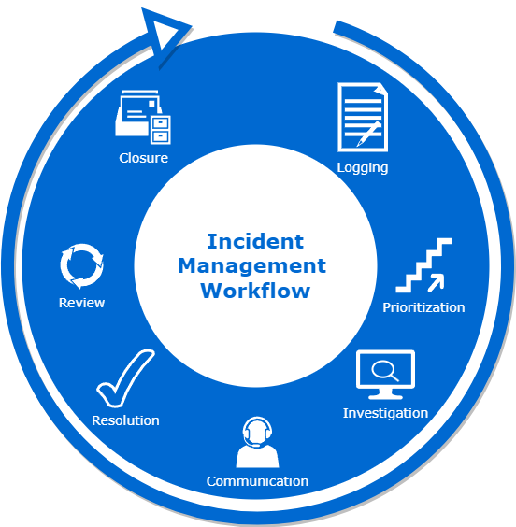
What are IT incident communications?
“IT incident” refers to any event that disrupts or deviates from the normal functioning of an IT service.
“Incident communications” are the practices and processes involved in effectively and timely communicating information about IT incidents to stakeholders.
Notes:
“IT incident” refers to any event that disrupts something that is not normal
“Incident communication” is the practice to keep informed customers or stakeholders
There's a stark difference between what you see during an IT incident and what your customers experience. For you, it might start with an alert from the monitoring tool and end with an email about the fix. But for your customers, it could start with panic and end in a loss of trust. That's why you need a solid incident communication plan to ensure incidents are handled smoothly.
Mean ITSM

Slide 3
Benefits of using AI in IT incident communication:
Improved agility and accuracy in incident communication.
Reduced response and resolution time for incidents.
Increased efficiency and effectiveness in IT incident management.
Team can focus on problem resolution.
Keeping customers informed about the situation during the incident.
Enhanced user and customer satisfaction.
Flexibility and adaptability: Unlike fixed templates, AI-powered incident communication can adapt to different incident types, complexities, and stakeholder preferences.
Notes:
Say
Reduced response and resolution time
Team can focus on problem resolution
Keeping customers informed
Unlike fixed templates, can adapt to different incident types, complexities, and stakeholder preferences
Personalization: AI allows for personalized incident communication by analyzing the specific details of each incident and tailoring the communication accordingly. This ensures that stakeholders receive relevant and accurate information, improving their understanding and response to the incident.

Slide 4
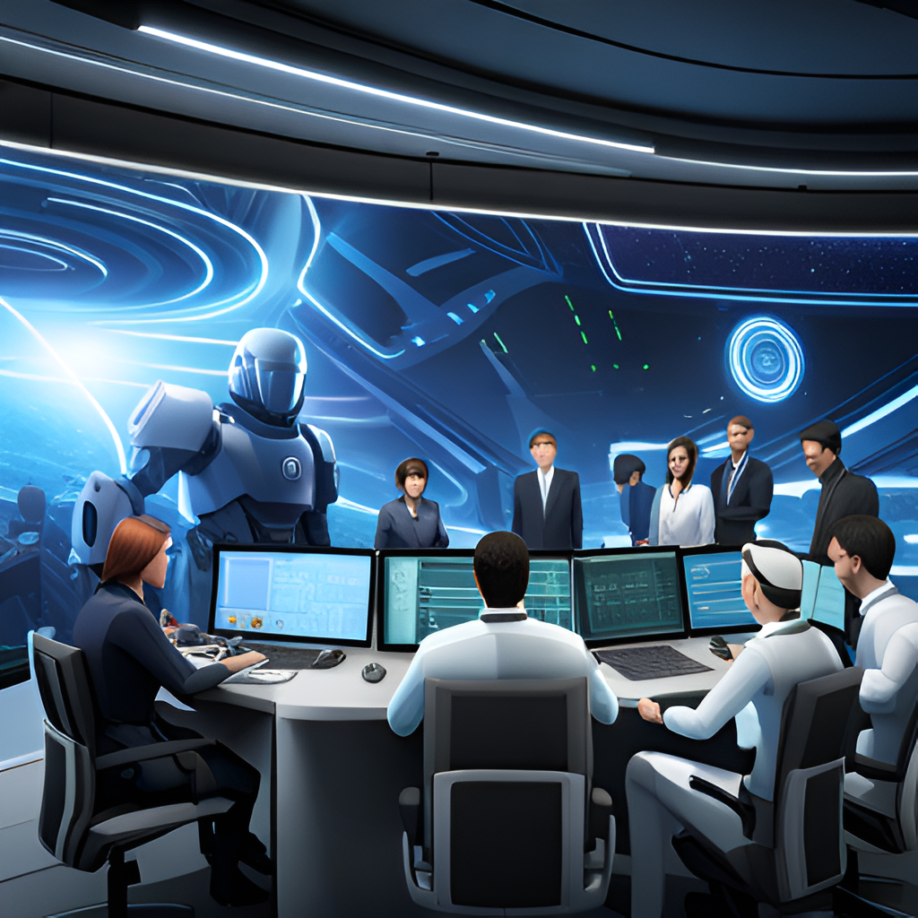
Challenges and limitations of AI in IT incident communication:
Need for training and expertise to develop and implement AI solutions.
Possibility of biases and errors in AI algorithms that can impact incident communication.
Dependence on high-quality data to enhance AI solutions.
Final text review by humans is still necessary.
AI solutions are still in the experimental phase.
Handling sensitive data with care.
Notes:
Say
Possibility of biases and errors in algorithms
Final text review by humans
AI solutions are still in the experimental

Slide 5
Composing an incident communication:
Tags can be extracted from any incident management tool.
Examples:
[Title]: Indicates the start of the title of the communication.
[Description]: Signals the beginning of the incident description section.
[Status]: Identifies the current status of the incident.
[Estimated Resolution Time]: Marks the estimated time for incident resolution.
[Affected Services]: Indicates the list of services impacted by the incident.
[Actions Taken]: Signals the start of the description of actions already taken to resolve the incident.
[Recommended Actions for Users]: Highlights specific instructions or recommendations for users.
[Contact Information]: Identifies the section with contact details for obtaining further information.
[Future Updates]: Signals the section that provides information on future updates related to the incident.
[Appreciation]: Marks the final expression of appreciation to users for their understanding and patience.
Notes:
Tags can be extracted from any incident management tool you use
Examples of tags extracted
Rich tags mean rich communication, its primordial to make a good communication
Communication templates are one of the most helpful tools during an incident. In the heat of a service outage, the response team is under a lot of pressure, and every second counts. Sitting down on a blank page to figure out how to update customers is a lot harder than it seems. We recommend using some boilerplate language to get started.
Be sure to update the placeholder sections before posting. And don’t be afraid to add, edit, or delete pieces of these copies to make them yours.

Slide 6
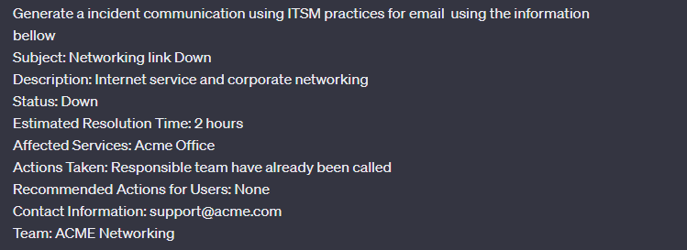
Training AI to generate effective communications:
How to prepare the request for the AI. Examples of announcements:
Notes:
Now we have the tags, so we can do like this example
This is an example of how to prompt a request for the AI
Read

Slide 7
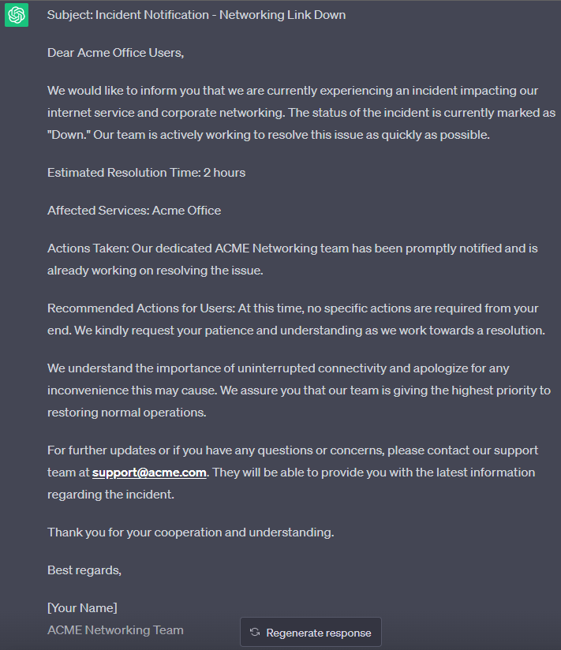
Example of a communication generated by AI:
Customized communications according to the customer's profile (executive/technical).
Communications can be personalized based on the communication channel used, E-mail, SMS, Chat and WhatsApp.
Real-time updated communications.
Notes:
Based on the tags, you can compose different types of communication
And provide a regular updates during the incident based on tags changing

Slide 8
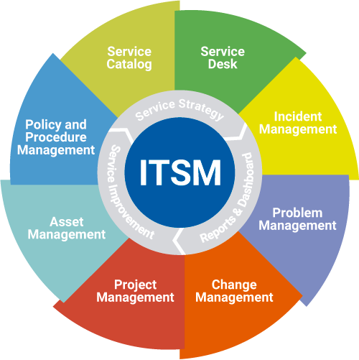
Conclusion:
Investing in AI solutions to enhance communication and management of IT incidents.
Ensuring transparency and agility.
Improving credibility, service quality, and customer satisfaction.
Enhancing incident communication is just the first step, as in the future, AI could be used throughout the entire incident management process, including decision-making.
ChatGPT with Opsgenie API Integration examples:
https://pipedream.com/apps/openai/integrations/opsgenie
Notes:
Investing in AI solutions could be important to manage IT incidents
They ensure transparency and agility
Improve credibility, service quality, and customer satisfaction
incident communication with AI just the first step, but in the future could be used in all incident process, including decision-making
Intelligent Escalation and Routing: AI can automate the triaging and routing of incidents to the appropriate teams or individuals. By intelligently analyzing incident details and historical data, AI can ensure that incidents are directed to the right experts, accelerating resolution times and improving overall efficiency.
Continuous Improvement: AI systems can learn from past incidents and feedback, continuously improving their communication capabilities. They can identify patterns, refine responses, and adapt to evolving incident scenarios, enhancing the quality and effectiveness of future communications.
Enhanced User Experience: AI-powered incident communication can provide a seamless and interactive user experience. Chatbots or virtual assistants can engage with stakeholders in natural language conversations, providing instant responses and guidance. This results in a more user-friendly and efficient communication process.
By leveraging AI in incident communication, organizations can benefit from personalized, real-time, and context-aware communication. This leads to improved stakeholder engagement, faster incident resolution, and overall enhanced incident management capabilities.
It's important for organizations to be aware of these challenges and limitations and develop strategies to address them. By carefully considering the limitations and augmenting AI with human involvement, organizations can effectively leverage AI in IT incident communication while mitigating potential risks.

Slide 9
Thank You !
fernando.justino@rnp.br

