Slide 1
Standing on the shoulders of Argus
By Ilona Podliashanyk (Norwegian NREN Sikt)

Slide 3
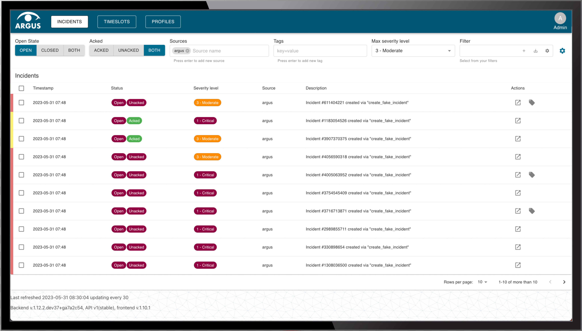

Slide 4
More about Argus
Visit us at TNC23: all-things Argus at the NORDUnet stand
Contact us: argus@lists.geant.org
Read more: https://network.geant.org/argus/

