Slide 1
It’s people!
Why we need an interdisciplinary approach to cyber security
Fabio Greiner at TNC 2023, Tirana
Notes:
Hello. My name is Fabio and I work at SWITCH, the Swiss NREN.
I am doing Security Awareness and today I want to talk to you about why Security Awareness needs an interdisciplinary approach.
(For that I will take you into the findings of my master's thesis, in which I studied the collaboration between security awareness and internal communication professionals.)
-> What is security awareness and why do we do it?

Slide 2
82%
Notes:
What is security awareness and why do we do it?
According to the Verizon DBIR, in 2022 82% of all data breaches involved a human element. To bring this number down, it's our job and mission to raise awareness about information security and enable people to develope secure habits in their day to day work life - for example by doing training or running security awareness campaigns.
But before I go into any details - let me tell you a story.

Slide 3




















Notes:
Imagine your leg is hurting for quite some time now. So, you decide to go to an Orthopaedist.
The Orthopaedist looks at your leg, does some examination and tells you, (CLICK) you got a Meralgia Paresthetica. Against that he tells you to do some exercies and mumbles sth that it also might be neccesary to do a corticosteroid injection or even surgery. He writes everything down for you on a piece of paper - in a handwriting you'll be never able to read - and sends you on your way.

Slide 4




















Notes:
Imagine your leg is hurting for quite some time now. So, you decide to go to an Orthopaedist.
The Orthopaedist looks at your leg, does some examination and tells you, (CLICK) you got a Meralgia Paresthetica. Against that he tells you to do some exercies and mumbles sth that it also might be neccesary to do a corticosteroid injection or even surgery. He writes everything down for you on a piece of paper - in a handwriting you'll be never able to read - and sends you on your way.
--> You're frustrated, because you waited for this appointment for three months.

Slide 5
Notes:
You're frustrated, because you waited for this appointment for three months.
But then, luckily, (CLICK) you remember, you know a really good physio therapist.

Slide 6

Notes:
You're frustrated, because you waited for this appointment for three months.
But then, luckily, you remember, you know a really good physio therapist.

Slide 7















Notes:
You go to your physio therapist and she shows you some exercises you can easily do at home and two weeks later the pain is gone.
--> Now, what do we learn from that story?

Slide 8
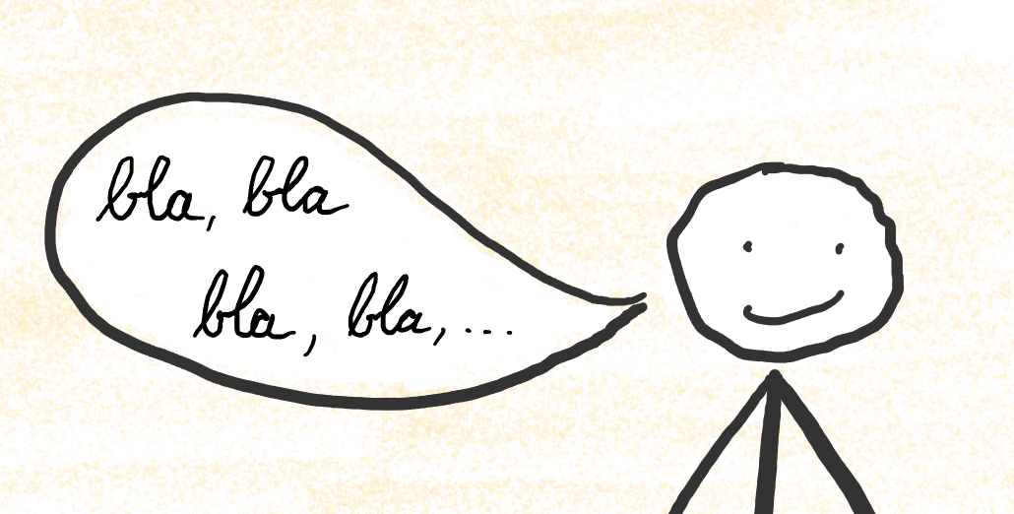
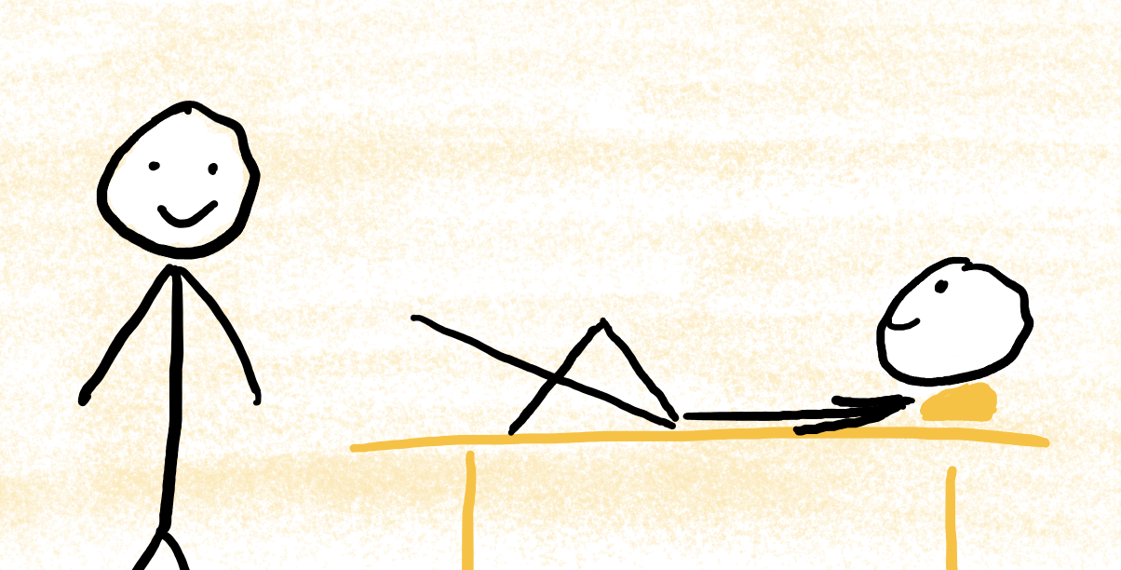


Notes:
Now, what do we learn from that story?
(CLICK) Obviously, it's not one of the Orthopaedist's skills, to talk to his patients in a way that they understand what he means.
Maybe he should get some training for that - but in the end it will not be his most important expertise. It is important that he has a deep knowledge about the human anatomy to diagnose your problems.
(CLICK) But it's the physio therapist's expertise, and their job, to show you your training exercises and accompany you through your process of recovery.
--> But what does this mean for our topic today?

Slide 9
 | Security Professionals
Communications | ❌
Notes:
* But what does that mean for our topic?
* Well: Communication is not a skill that is typically associated with security people. And - doesn't matter if skilled or not - it also - should not be their primary job. Why?
* Because there are people in our organisations who are paid and trained for exactly that: (CLICK) doing internal communications.

Slide 10
 | Security Professionals | Internal Communications
Communications | ❌ | ✅
Notes:
* But what does that mean for our topic?
* Well: Communication is not a skill that is typically associated with security people. And - doesn't matter if skilled or not - it also - should not be their primary job. Why?
* Because there are people in our organisations who are paid and trained for exactly that: (CLICK) doing internal communications. * So it would be interesting to see, how these to field collaborate, wouldn't it?
--> In my master thesis, I studied th e collaboration between sec aw and int comms

Slide 11
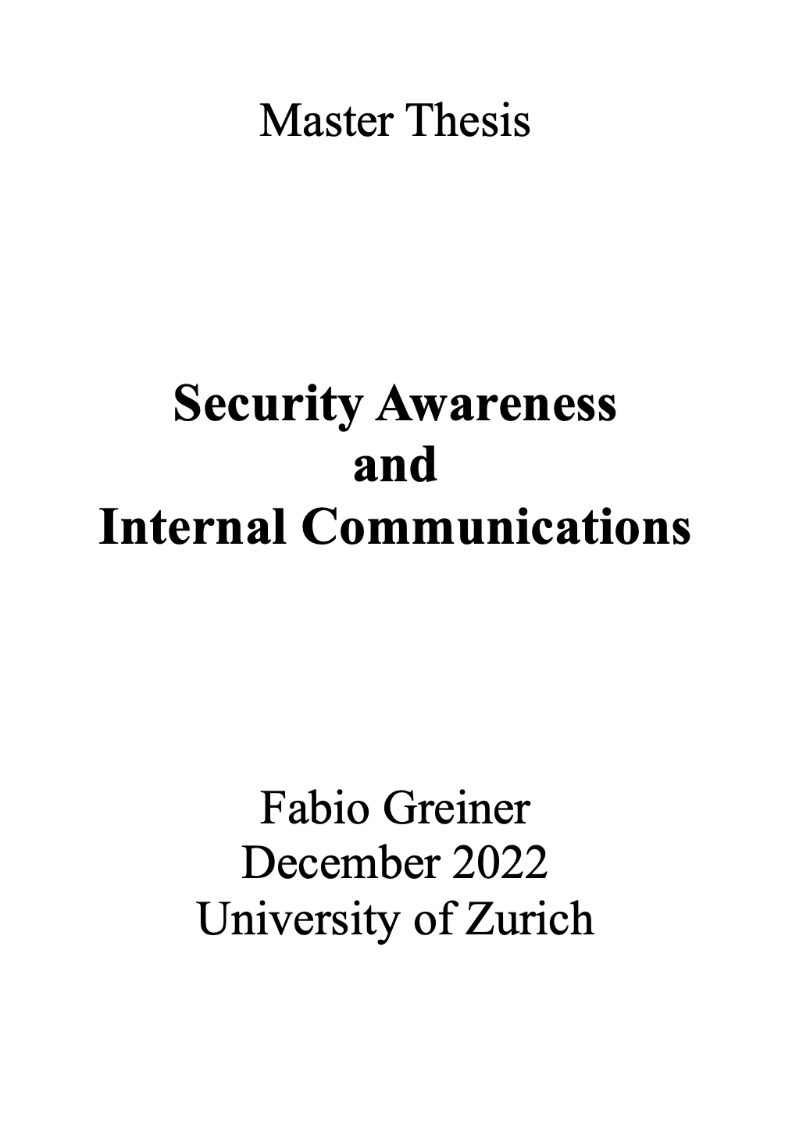

Notes:
In my master thesis I studied the collaboration between Security Awareness and Internal Communications.
Remember Security Awareness? They were the ones with the traings and the campaigns.
My goal was to find out, what are the benefits from that collaboration and where there is more potential.
So I spent a lot of time talking to professionals from both fields in different organisations to find out, how they benefit from their collaboration.

Slide 12
FINDINGS
Findings
Findings
Benefits: Security Awareness
Internal communications help simplify content
Internal communications have overview over communication activities

Slide 13
FINDINGS
Findings
Findings
Benefits: Internal Communication
Can get a lot out of security topics
Security awareness offers great insight in organisation

Slide 14
FINDINGS
Findings
Findings
Summary
When working together with internal communications…
… many benefits
… nothing to be afraid of

Slide 15
Notes:
So, to all the security people in here: Let's not be like that Orthopaedist, who doesn't appreciate the work of the physio therapist.
Let's take our security topics and go to our communications people - they will be happy to help!
Together we can raise the awareness of the users, increase the resillience of our organisations - and make that big number a little bit smaller.
Thank you!

Slide 16
 | Security Professionals | Internal Communications
Communications | ❌ | ✅
Notes:
* But what does that mean for our topic?
* Well: Communication is not a skill that is typically associated with security people. And - doesn't matter if skilled or not - it also - should not be their primary job. Why?
* Because there are people in our organisations who are paid and trained for exactly that: (CLICK) doing internal communications. * So it would be interesting to see, how these to field collaborate, wouldn't it?
--> In my master thesis, I studied th e collaboration between sec aw and int comms

Slide 17
82%
Notes:
So, to all the security people in here: Let's not be like that Orthopaedist, who doesn't appreciate the work of the physio therapist.
Let's take our security topics and go to our communications people - they will be happy to help!
Together we can raise the awareness of the users, increase the resillience of our organisations - and make that big number a little bit smaller.
Thank you!

Slide 18
Thank you!
Contact:
fabio.greiner@switch.ch
Notes:
So, to all the security people in here: Let's not be like that Orthopaedist, who doesn't appreciate the work of the physio therapist.
Let's take our security topics and go to our communications people - they will be happy to help!
Together we can raise the awareness of the users, increase the resillience of our organisations - and make that big number a little bit smaller.
Thank you!

