Slide 1
APK FALCON
Empowering User’s Privacy
Javier Crespo Guerrero – University of Valladolid (Spain)

Slide 2
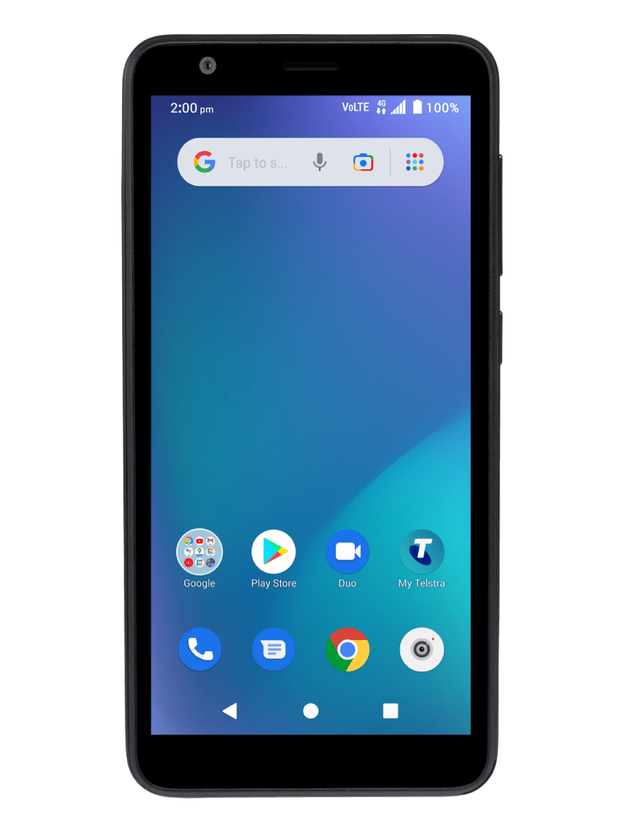
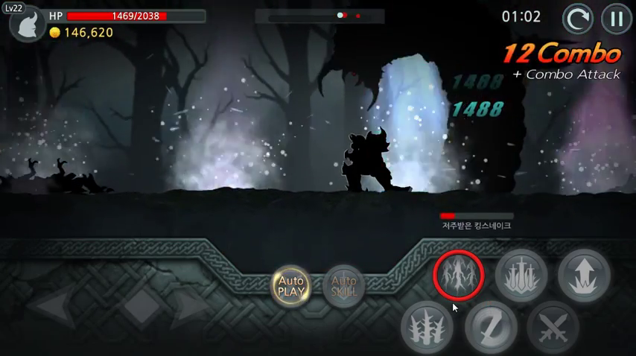
Allow Epic Sword to take pictures and record video?
Allow Deny

Slide 3
Allow Face Beautify to make and manage pone calls?
Allow Deny

Slide 4
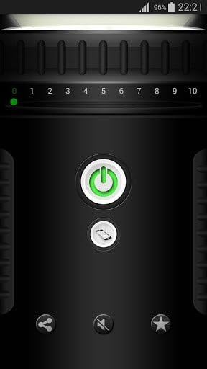
Allow Flashlight to Access this device’s location?
Allow Deny

Slide 5
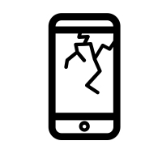
…mess with your phone?
Allow Deny
Allow APP to…
Allow Deny
…sell your personal data?
Allow Deny
…take photos at any time?
Allow Deny

Slide 6
1 in 3
apps want to use your camera

Slide 7
Can we trust our apps?

Slide 8
Take control
of your privacy
(Manage permissions in an active way)

Slide 9
Any solution?

Slide 10
Too technical
Can’t compare
…

Slide 11
Easy-to-use website
Overall privacy score
APK Falcon
Assist in decision-making

Slide 12
How can you benefit?
Privacy - conscious users
Small businesses & developers
Casual users
Simple & graphical report
Detailed & exportable report
Upload your own apps!
I want a flashlight that’s not interested in my location!
I can use the scores in my studies…
Does our app comply with privacy standards?

Slide 13
APK Falcon
… ¿is it respecting privacy?
Search
Download
Report
+ Privacy guaranteed by design!

Slide 14
APK Falcon
simple + open + transparent

Slide 15
THANK YOU!
Javier Crespo Guerrero - javier.crespo.guerrero@estudiantes.uva.es

