Slide 1
Vietsch Foundation
Medal of Honour Award 2023
6 June 2023

Slide 2
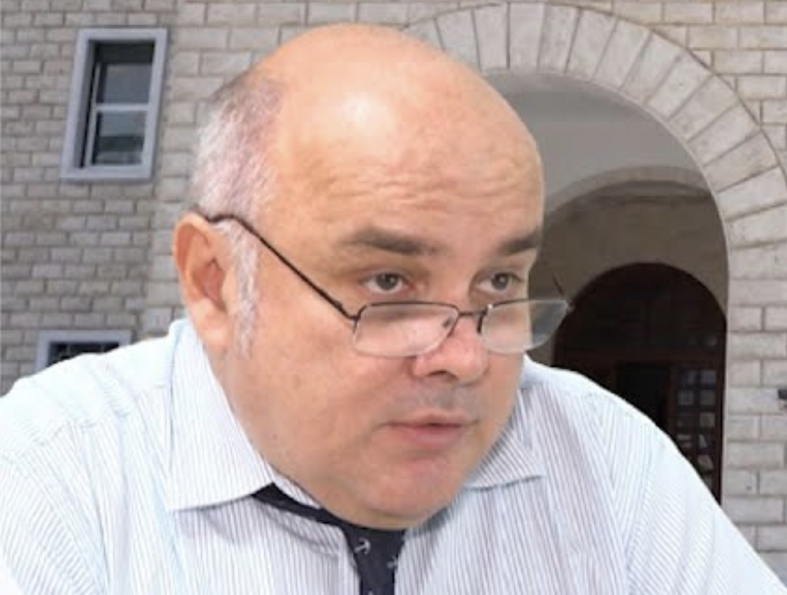
Dr. Arjan Xhela
Founder of RASH

