Slide 1
Community Support for URAN
John Dyer, Vietsch Foundation
TIRANA
8 June 2023

Slide 2
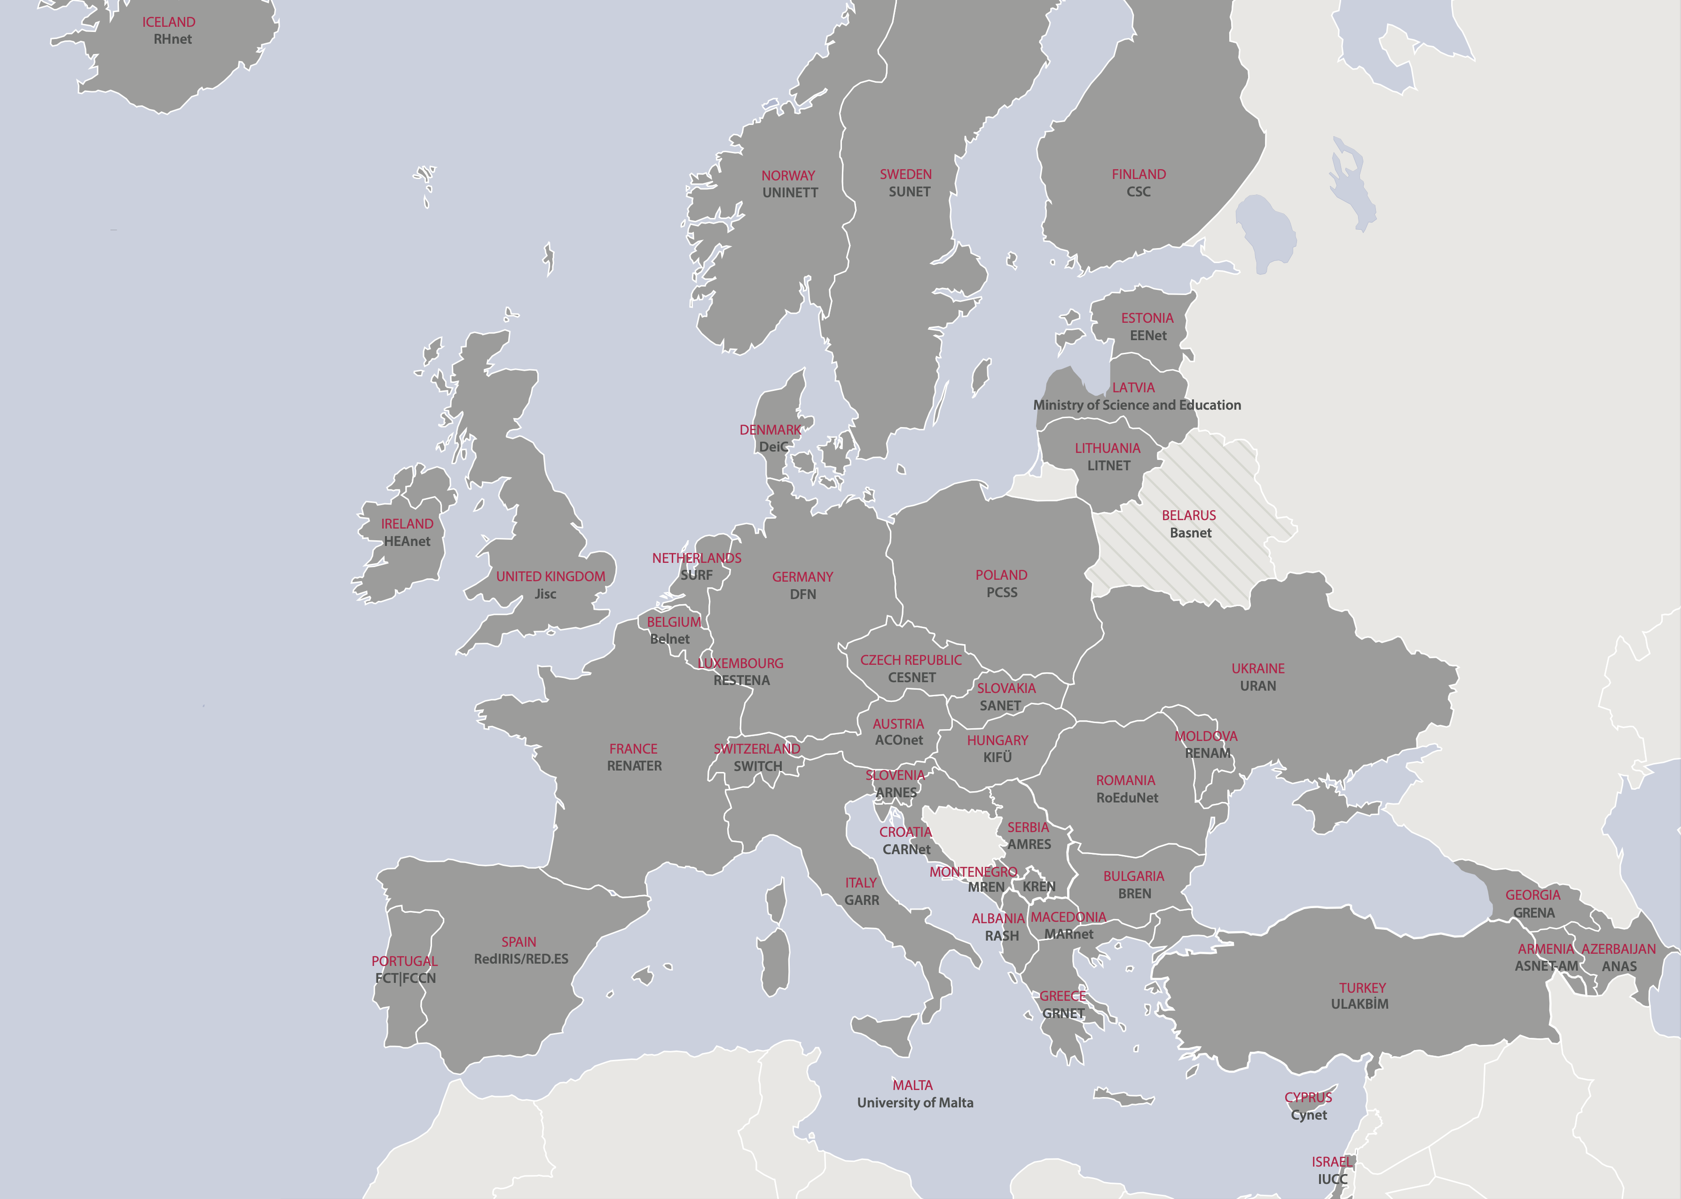

Slide 3
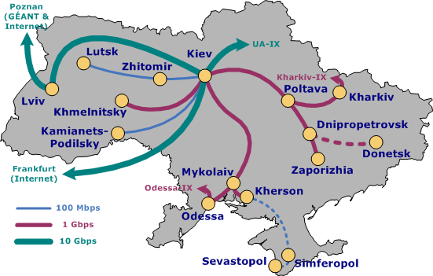
UKRAINIAN RESEARCH & ACADEMIC NETWORK
National Technical University of Ukraine
“Igor Sikorsky Kyiv Polytechnic Institute”
URAN established 1997
ATTACK of UKRAINE - 24 February 2022
URAN Network repeatedly damaged by fierce fighting
Issues
Safety of Team including relocation
Provision of Reliable Electrical Power
Destruction of Network Infrastructure & Connectivity
Funding Operational & Living Costs

Slide 4
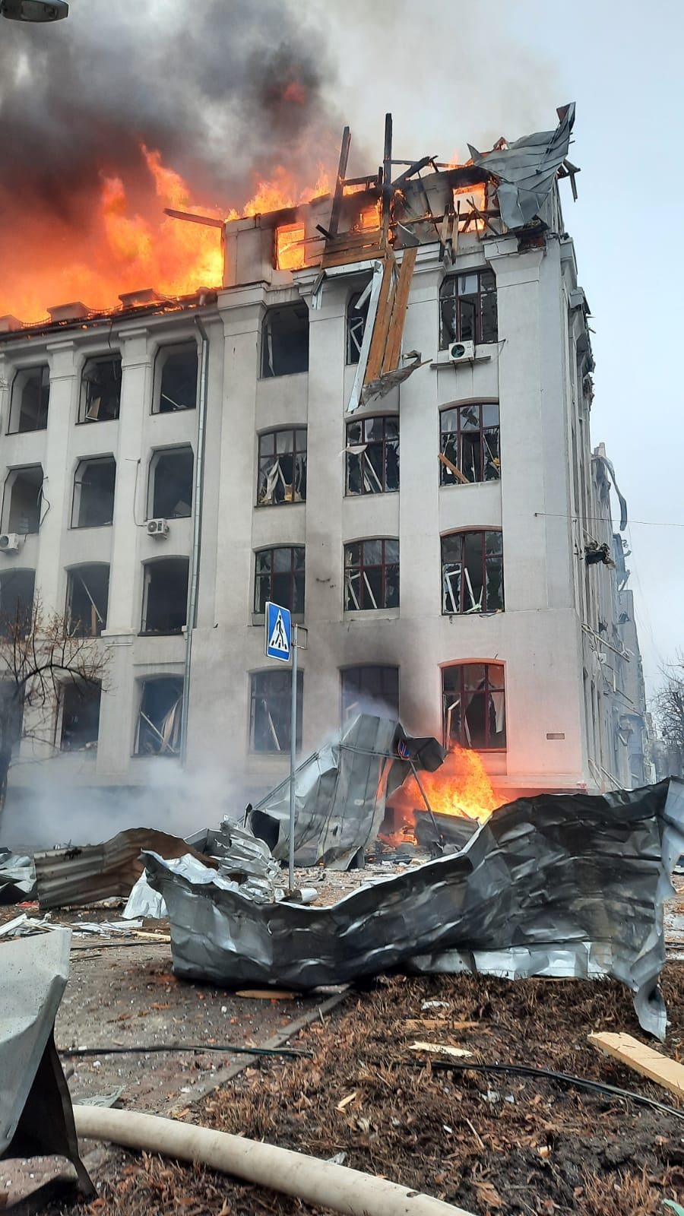
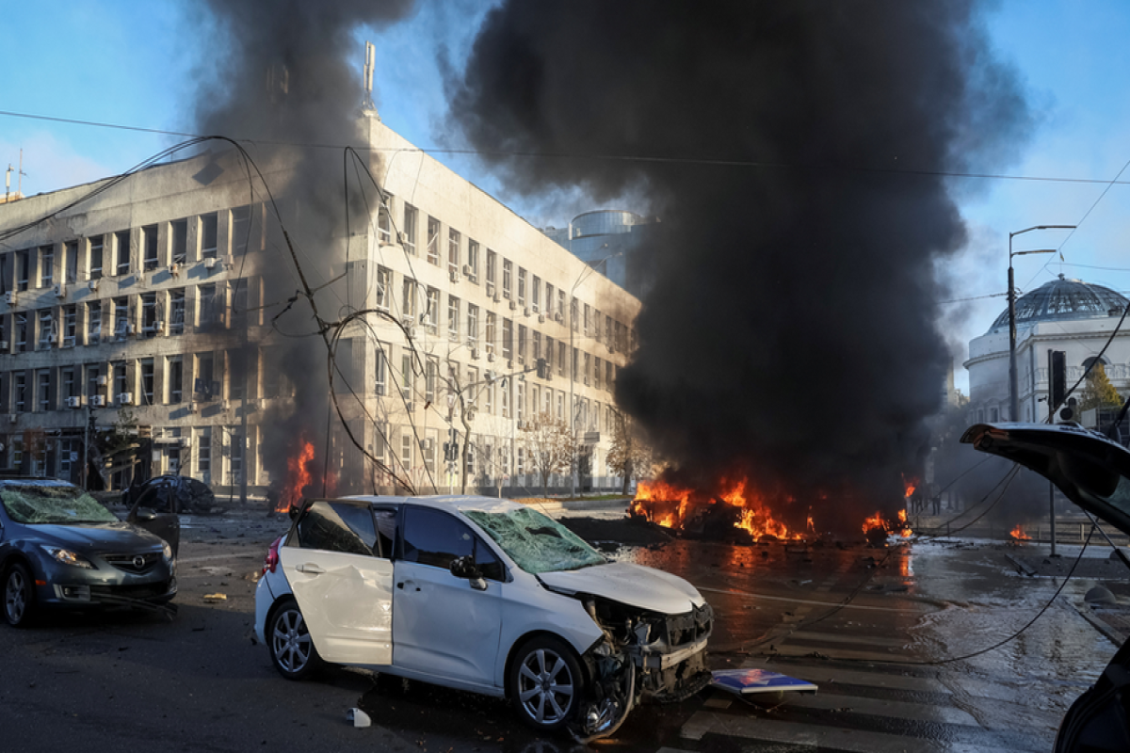
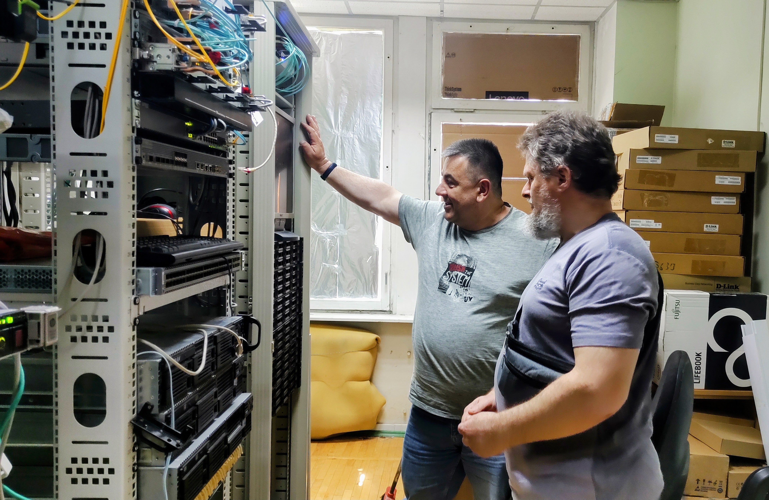
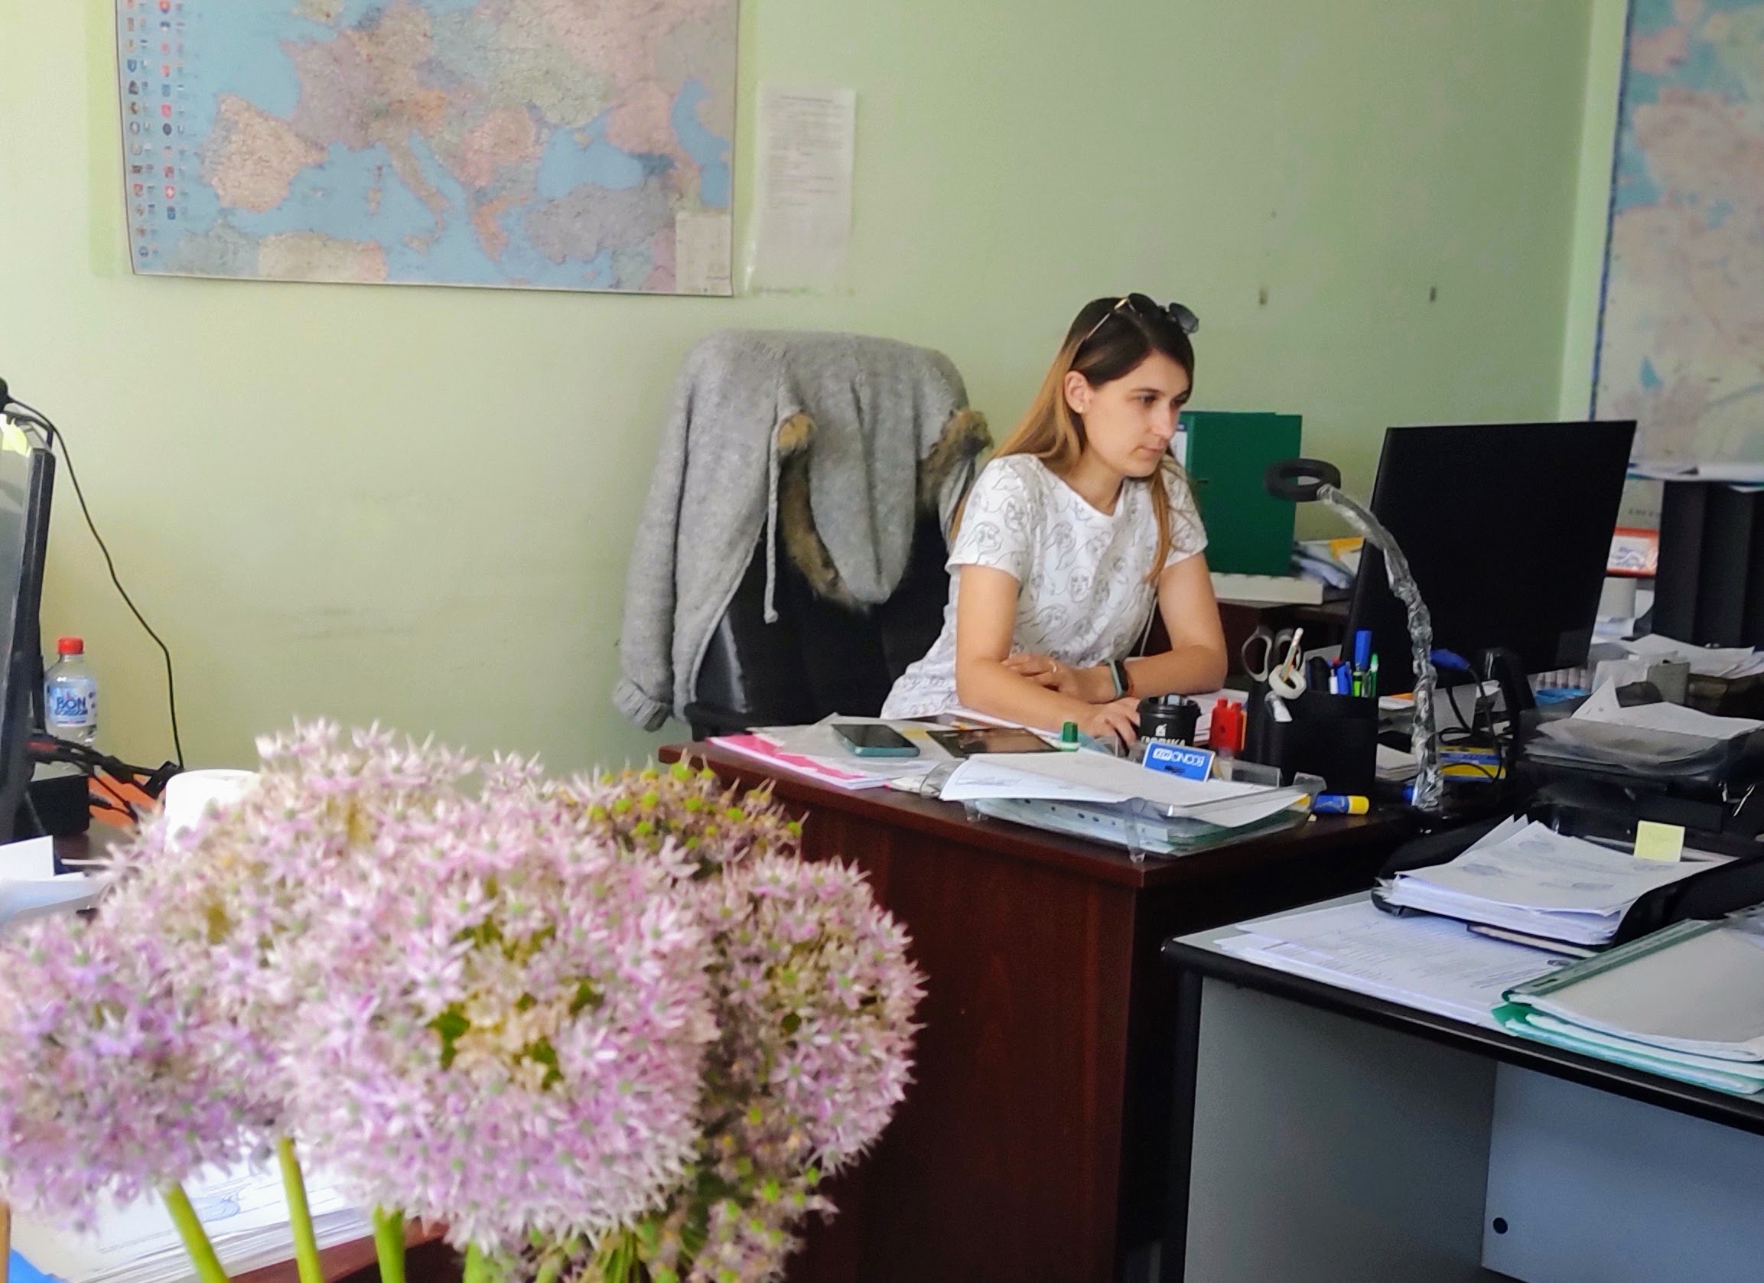
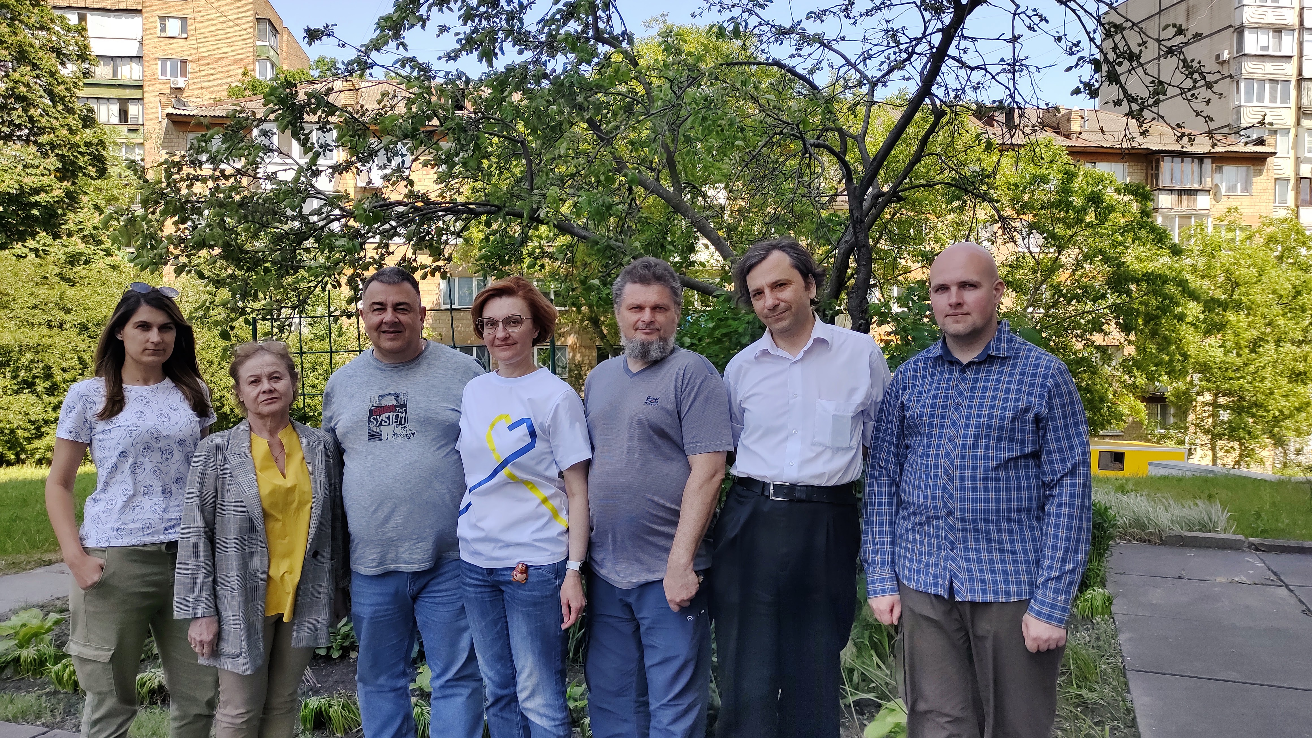
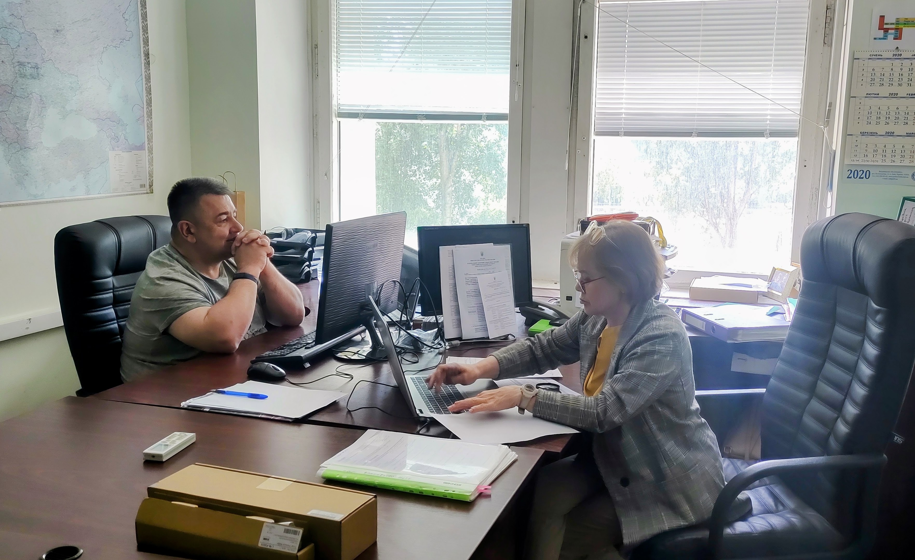
One year under fire

Slide 5
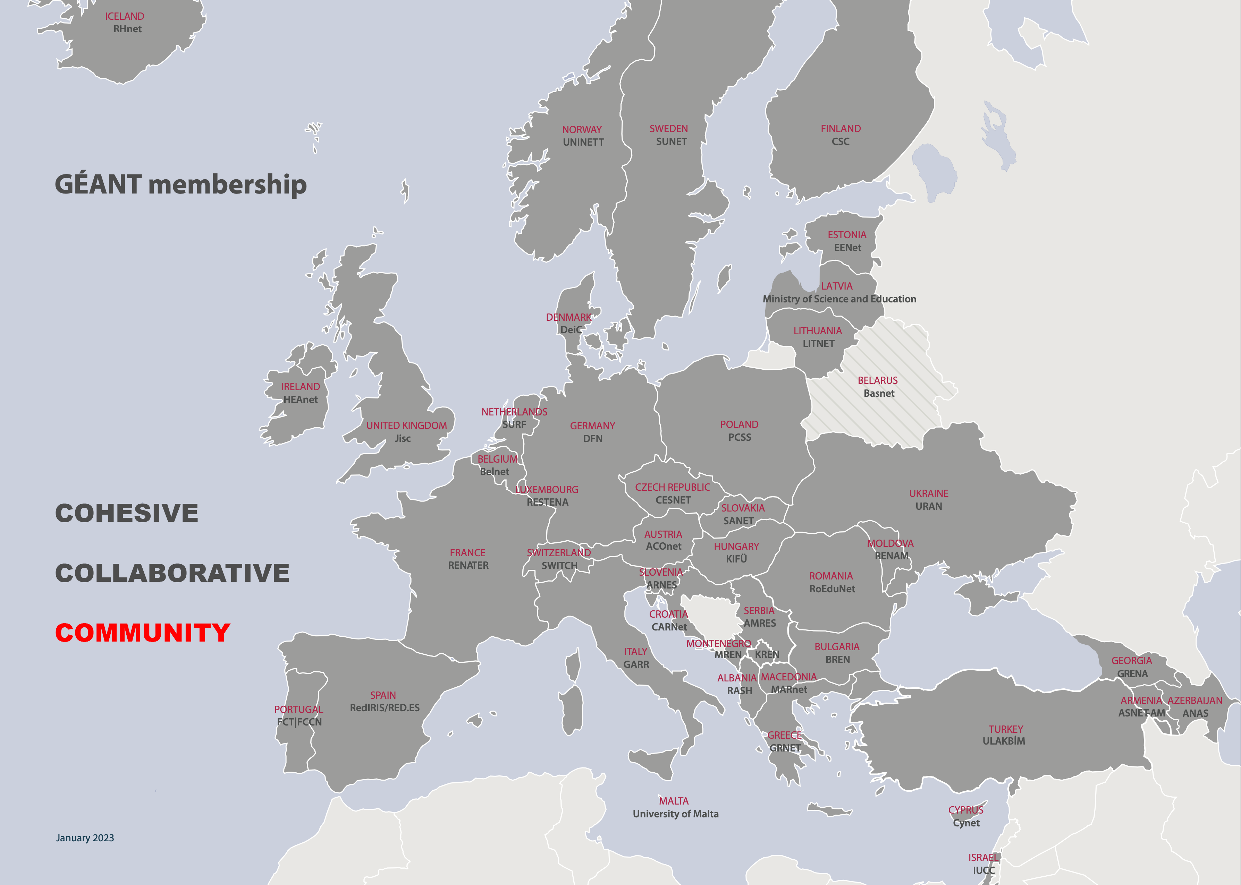
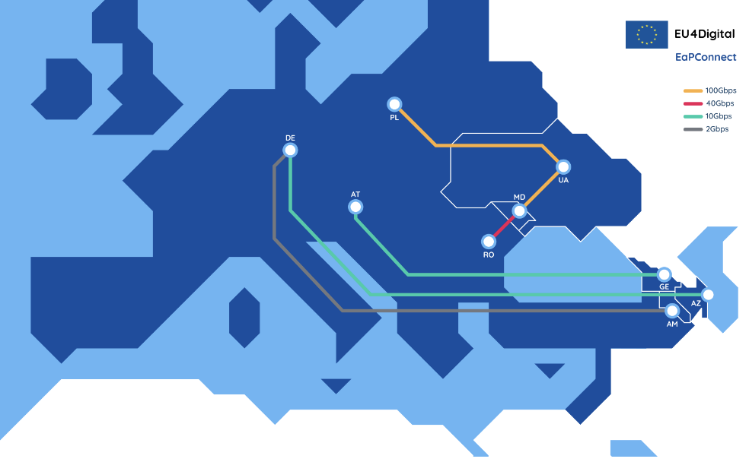
Community SOLIDARITY
NRENs
EaPConnect
EU4Digital project
Digital Infrastructure
Eastern Partnership

Slide 6
Donations
2022 10 donations totaling €80k+
2023 6 donations totaling €69k+ (to date)
Allocation
2022 Operation Costs & Living Expenses €36k
2023 Generator €12k
Operation Costs & Living Expenses €20k

Slide 7
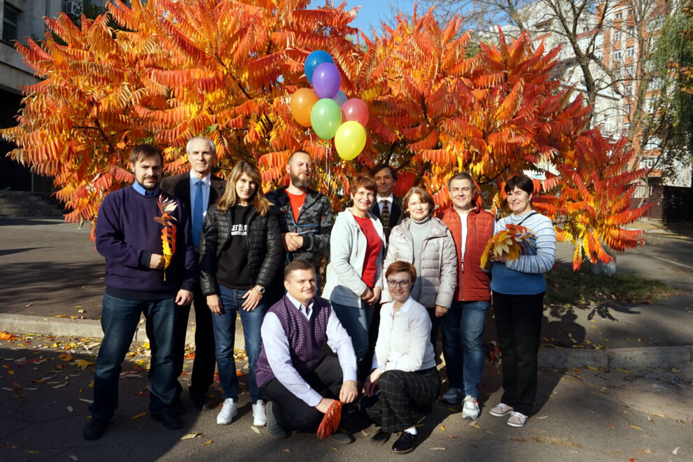
In conclusion

Slide 8
Thank you
www.uran.ua
contact@vietsch-foundation.org

